Slide 1

The Pentagon Papers: The Most Important EMS Trauma Literature of 2024-2025
Christopher B. Colwell, MD, FACEP
Department of Emergency Medicine
San Francisco General Hospital and Trauma Center
UCSF School of Medicine

Slide 2

5 Topics
Trauma resuscitation
ACLS in trauma
Prehospital vital signs
Management of traumatic pneumothorax
Cervical collars

Slide 3
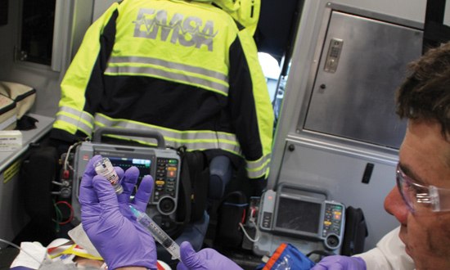
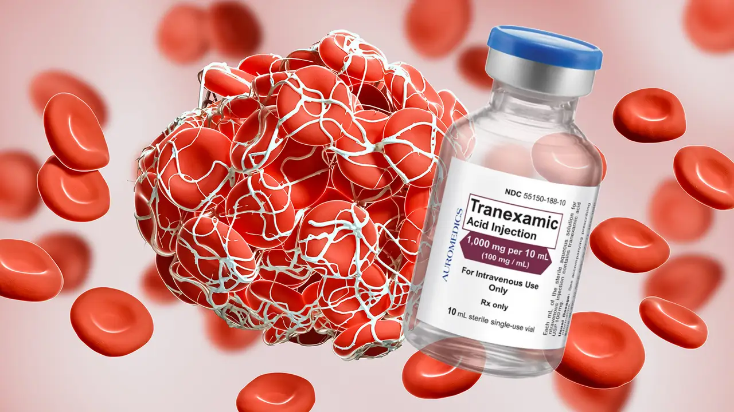
Prehospital TXA
Prehospital tranexamic acid is associated with a survival benefit without an increase in complications: Results of two harmonized randomized clinical trials
  Mazzei et al
    J Trauma Acute Care Surg, 2024
  Secondary analysis of harmonized data from 2 clinical trials
  1744 patients

Slide 4
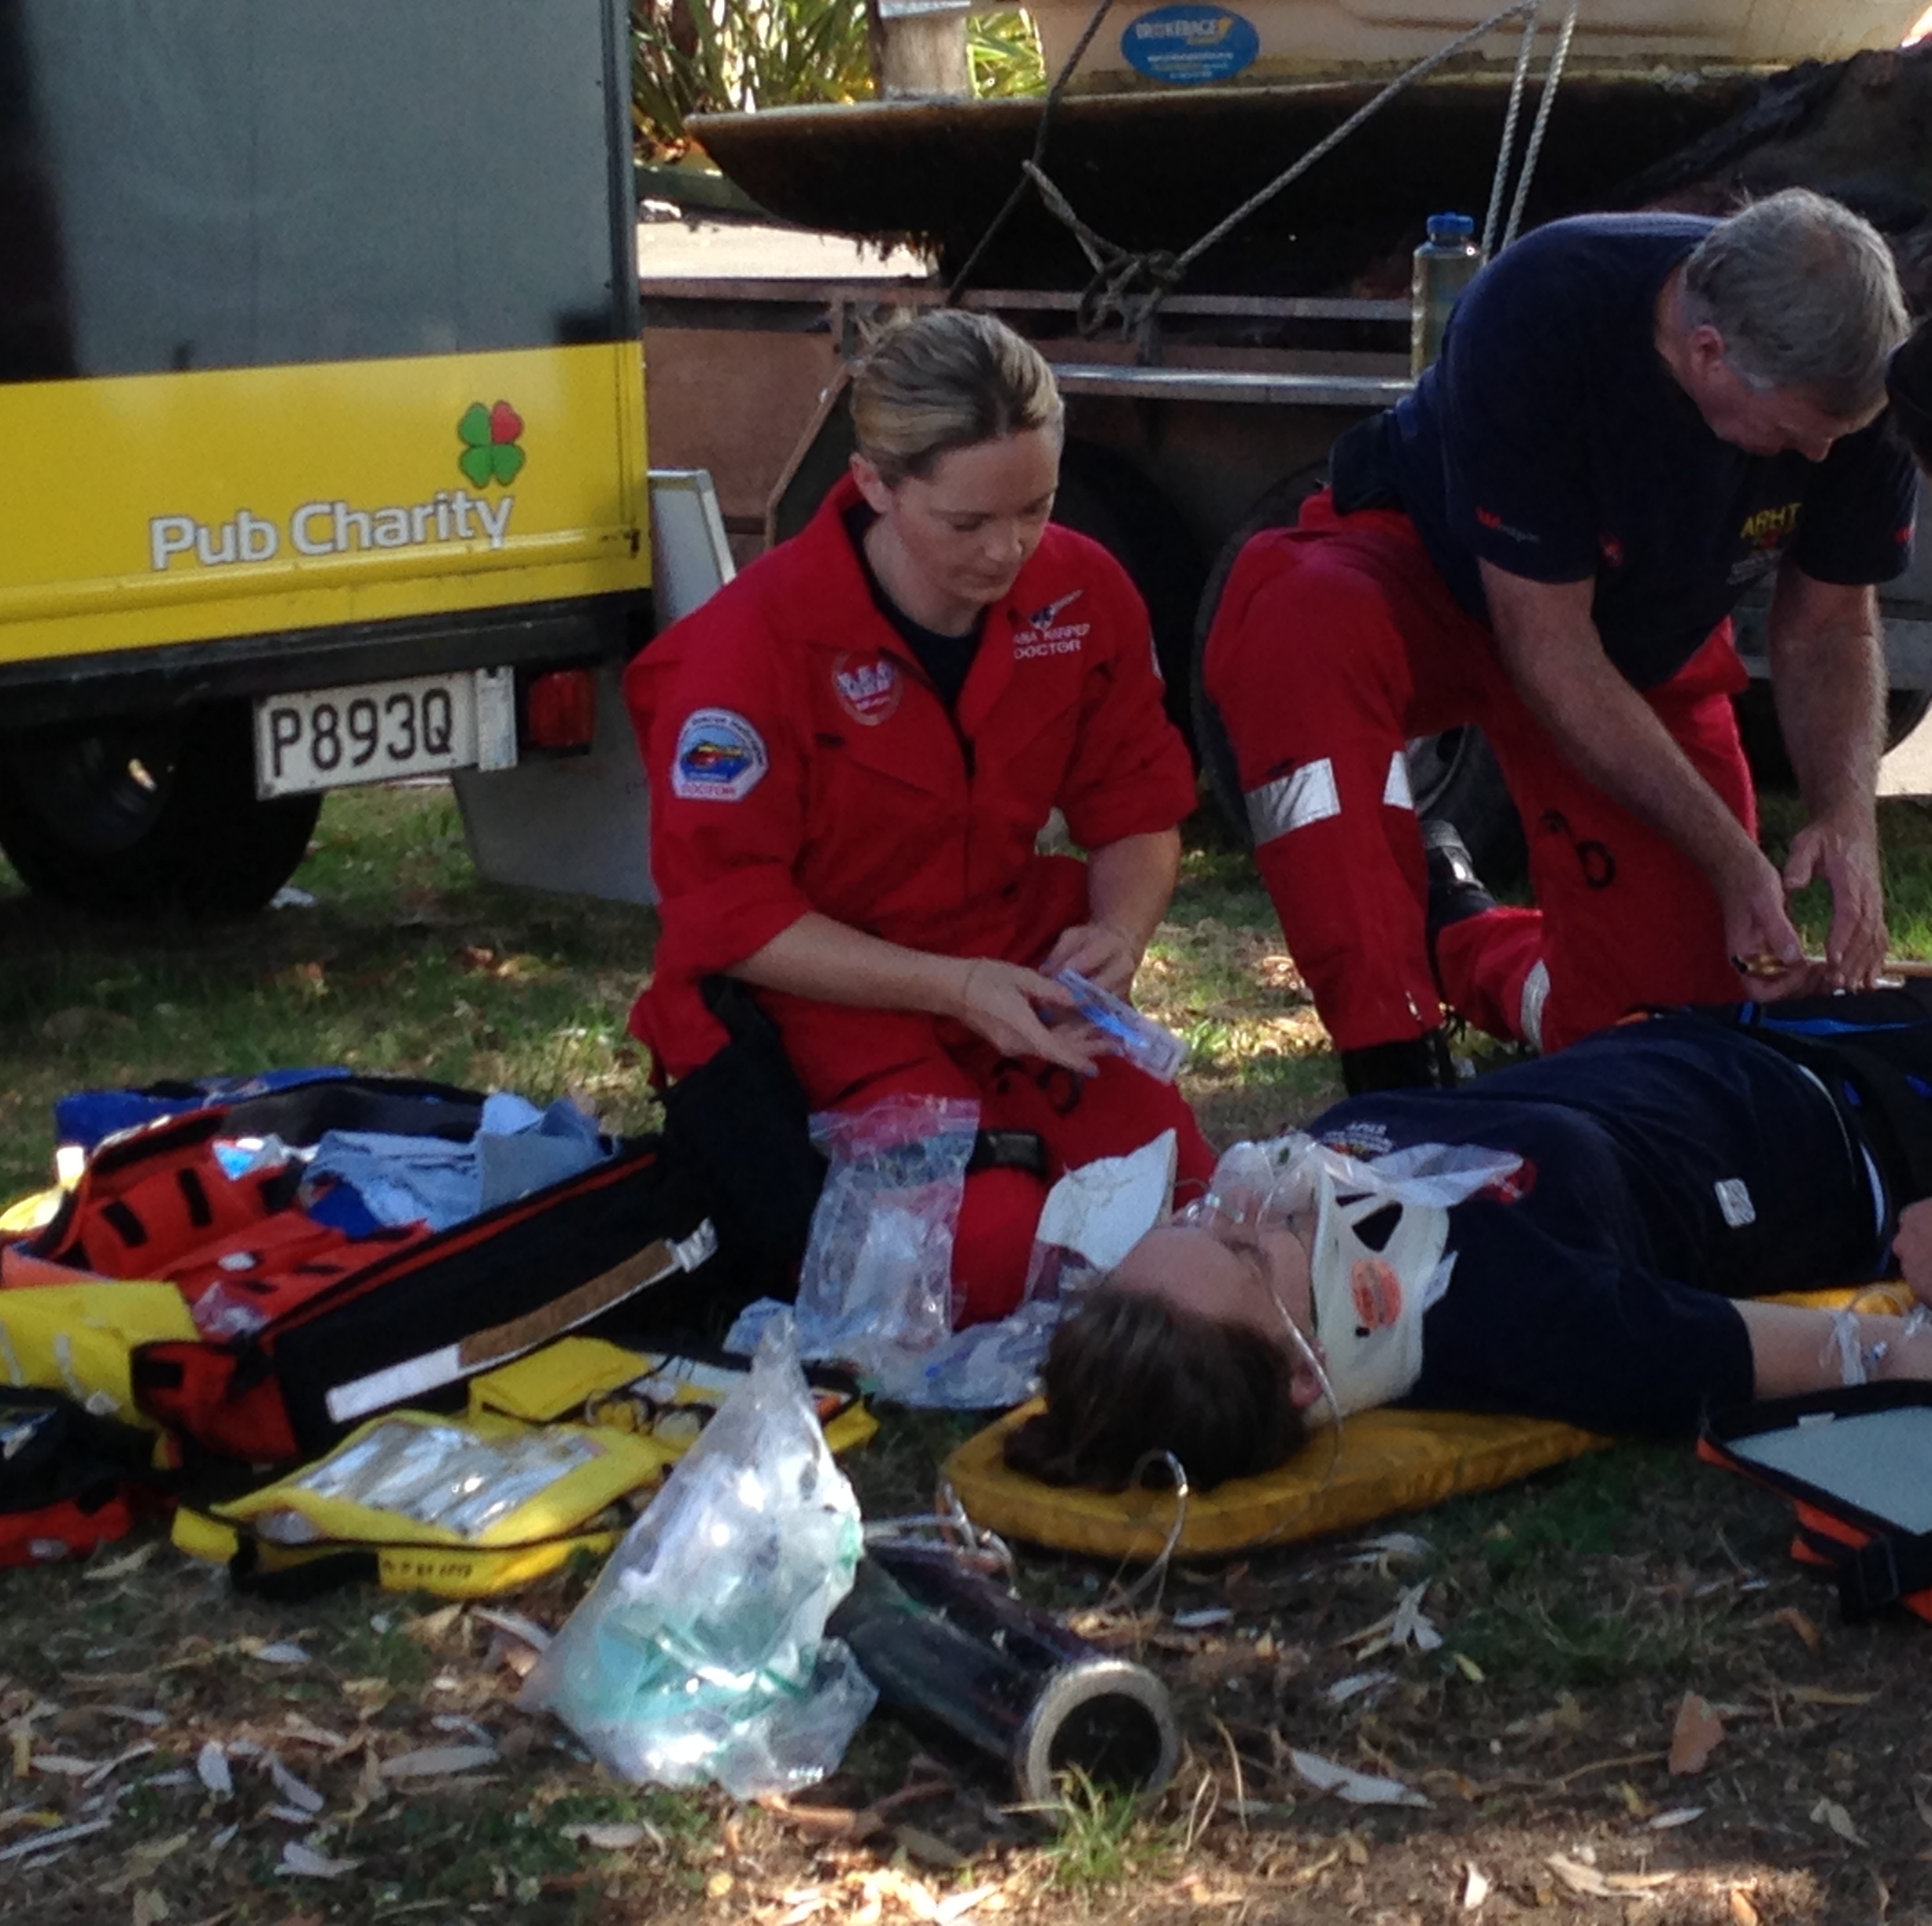
Prehospital TXA
Significant 28-day survival benefit
No increase in adverse events
Dose-response relationship demonstrated that increasing the dose of prehospital TXA resulted in an incremental reduction in 28-day mortality

Slide 5
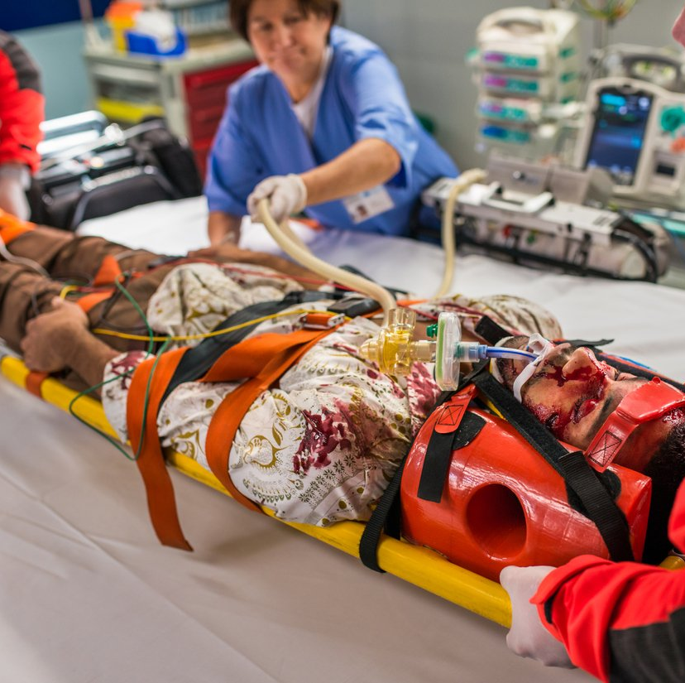
Prehospital TXA
TXA for Traumatic Injury: A Systematic Review
  Fouche et al
    Ann Emerg Med, 2024
  All randomized controlled trials to date
  7 studies
    3 prehospital
  2 biggest findings
    Weak evidence in head injury
    Strong evidence for prehospital administration
      OR of death 0.78
      NNT - 33
Notes:
Very well done meta-analysis. Very weak evidence for use in TBI. Strong evidence for prehospital use with an Odds Ratio (OR) of death vs. placebo of 0.78, resulting in a number needed to treat (NNT) of 33.

Slide 6
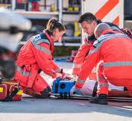
Trauma Induced Coagulopathy
Trauma-induced coagulopathy: What you need to know
  Buzzard, Schreiber
    J Trauma Acute Care Surg, 2024
Preventing TIC begins in the prehospital phase
  Early hemorrhage control
  Prevention of hypothermia
  Thoughtful fluid resuscitation
  Blood product resuscitation
  TXA

Slide 7
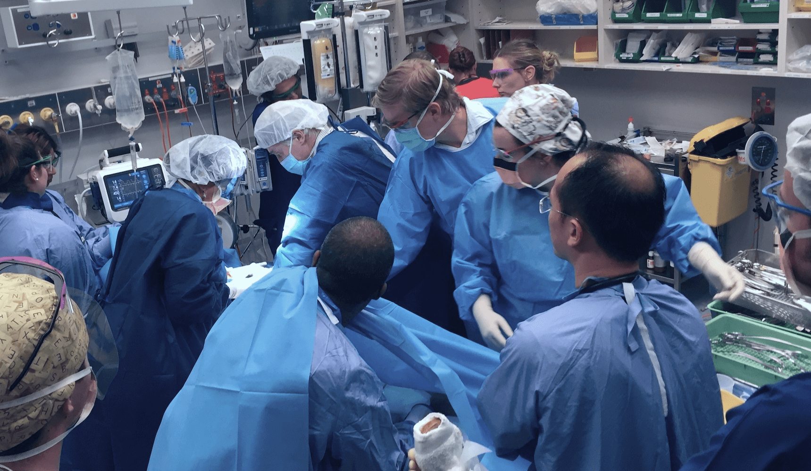
xABC Trauma Resuscitation
Impact of prehospital exsanguinating airway-breathing-circulation resuscitation sequence on patients with severe hemorrhage
  Ritondale et al
    J Amer Coll Surg, 2024
  Single year prospective analysis
    93 patients
  Overall mortality was lower in the xABC group
    13% versus 47%
    Prehospital circulation-first prioritization decreased in-hospital mortality
  Resuscitate, and you may not have to intubate
Notes:
The x signifies priority of addressing exsanguinating hemorrhage before other interventions. Circulation first means control of hemorrhage and restoration of circulating blood volume takes priority. Their pre-hospital advanced resuscitative care (ARC) bundle includes 2 units PRBC, 2 grams CaCl, and 2 grams TXA.

Slide 8
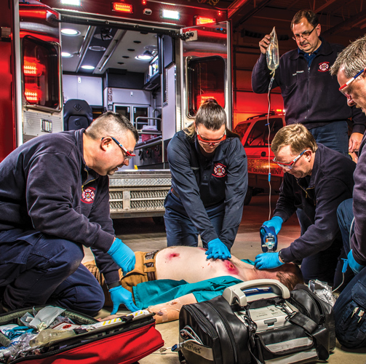
CPR in Trauma Patients?
Effect of cardiopulmonary resuscitation on perfusion in a porcine model of severe hemorrhagic shock
  Greiffenstein et al
    J Trauma Acute Care Surg, 2025
  CPR did not improve end-organ oxygenation/perfusion but did diminish skin perfusion
    Corroborates existing literature on the potential detrimental effects of CPR in patients suffering from hemorrhagic shock

Slide 9
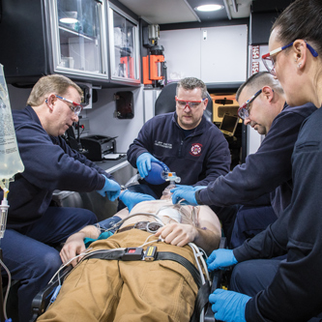
Epinephrine in Trauma Patients?
Epinephrine in prehospital traumatic cardiac arrest – Life saving or false hope?
  Witt et al
    Prehosp Emerg Care, 2025
  Multicenter, retrospective, cohort study
  1631 patients
  Epinephrine was not associated with improved survival and was associated with inferior outcomes
Notes:
In multiple sub analyses, epinephrine was associated with inferior outcomes.

Slide 10
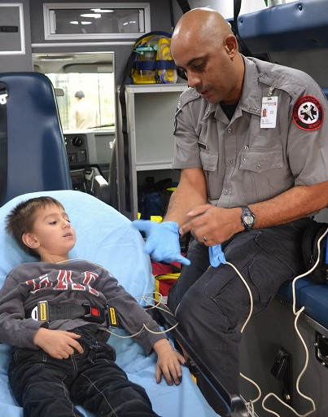
Prehospital Vital Signs Matter!
Prehospital and emergency department vital sign abnormalities among injured children
  Ramgopal et al
    Prehosp Emerg Care, 2025
  Multiagency/multicenter retrospective study
    Over 10 years
    21,298 patients
  Combined use of prehospital and ED vital signs improved predictive value

Slide 11

Prehospital Vital Signs
Out-of-hospital circulatory measures to identify patients with serious injury: A systematic review.
  Newgard et al
    Acad Emerg Med, 2020
Many seriously injured trauma patients have normal circulatory measures
  Poor sensitivity
Abnormal circulatory measures are highly specific for identifying patients with serious injuries
Notes:
Looked at 114 articles and looked at SBP, HR, Shock index, lactate, base deficit and HR variability

Slide 12
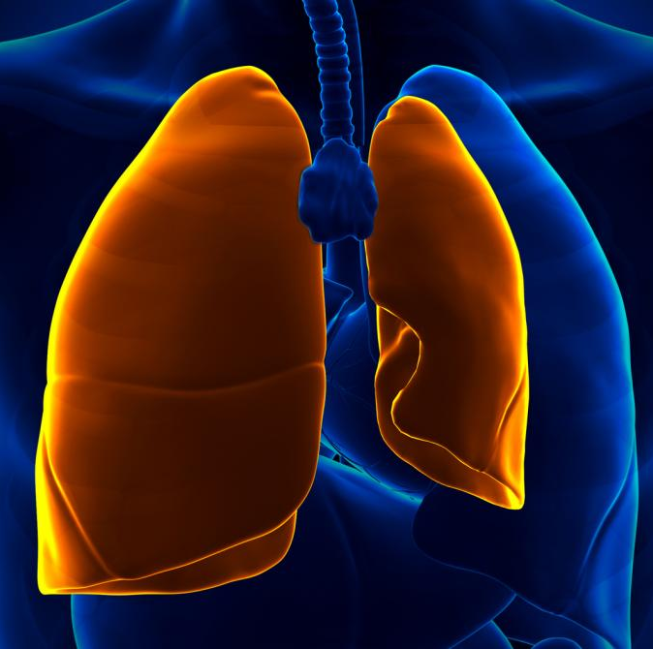
Traumatic Pneumothorax
Prehospital trauma compendium: Traumatic pneumothorax care: Position statement and resource document of NAEMSP
  Lyng at al
    Prehosp Emerg Care 2024
  42% of NT did not have a PTX
  30-92% of NT do not enter the pleural space
  NT > ST or TT
  There is no one superior location
  NT not needed for
    TOHCA
    Flight
Notes:
December, 2024. NT = Needle thoracostomy. ST = simple (finger) thoracostomy. TT = tube thoracostomy.

Slide 13
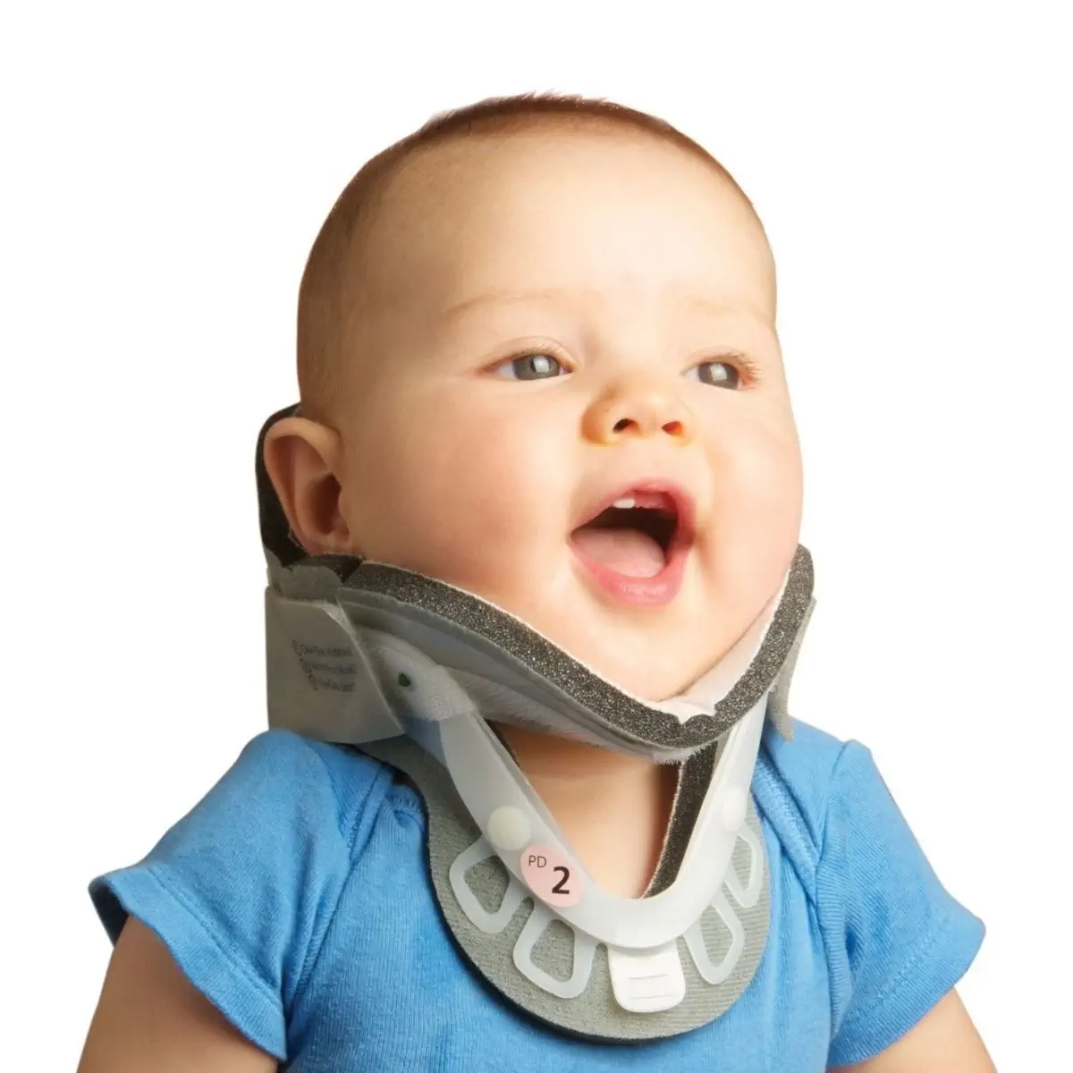
Cervical Collars
Prevalence and indications for applying prehospital spinal motion restriction in children at risk for cervical spine injury
  Ward et al
    Prehosp Emerg Care, 2025
  Planned secondary analysis of the PECARN database
  7721 patients

Slide 14
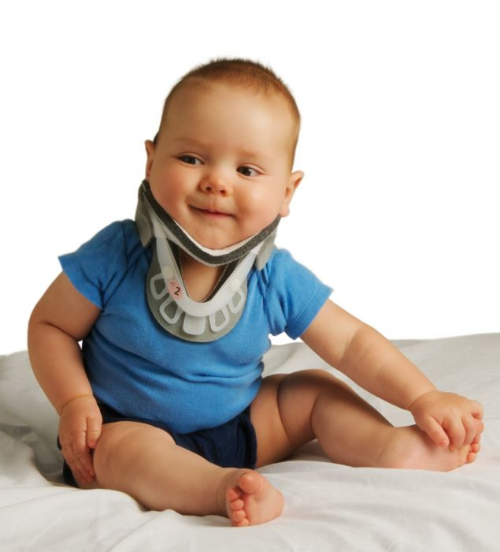
Cervical Collars
Conclusions:
  Many had SMR place, very few had injuries
  Factors associated with SMR placement included patient demographics, mechanism of injury, history, and examination findings not in the PECARN CSI clinical prediction rule
  Given the established harms with current SMR practices, more consistency is needed

Slide 15
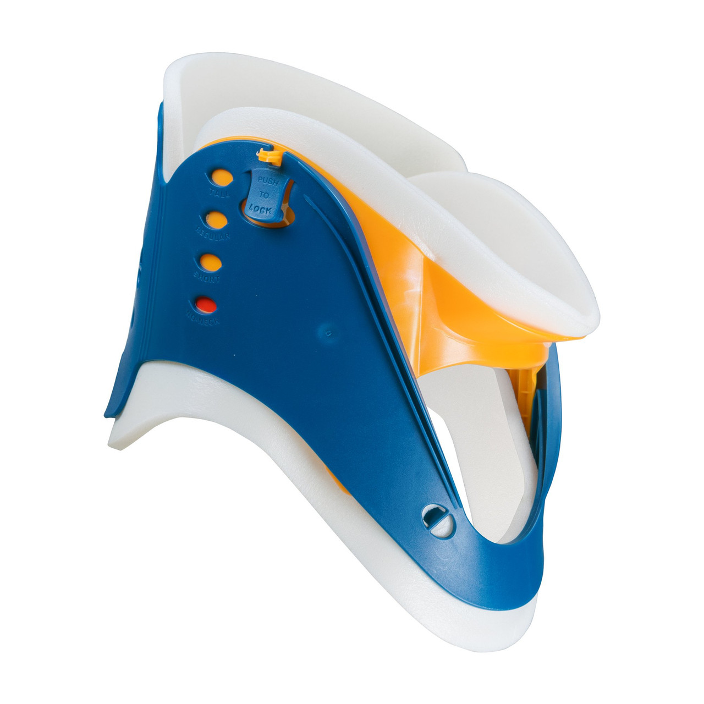
Cervical Collars
Application of cervical spine motion restriction to injured children in the prehospital setting
  Ramgopal et al
    Am J Emerg Med, 2025
Prehospital use of spinal precautions by emergency medical services in children and adolescents
  Phillips et al
    Emerg Med Austral, 2025

Slide 16
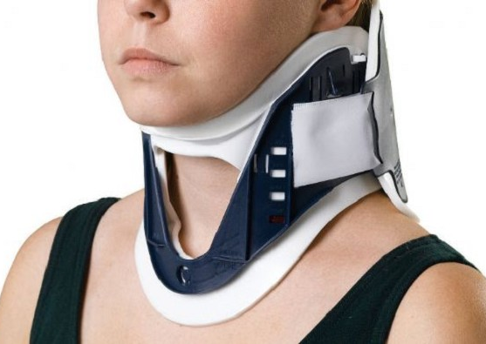
Spinal Motion Restriction
Cervical spine motion restriction after blunt trauma
  The Brass Tacks: Concise reviews of published evidence
  Serigano, Riscinti
    Acad Emerg Med, 2021
  Cochrane systematic review searched for trials studying the effects of spinal immobilization
    No studies of sufficient quality were found

Slide 17
Cervical Collars
No studies of sufficient quality were found

Slide 18
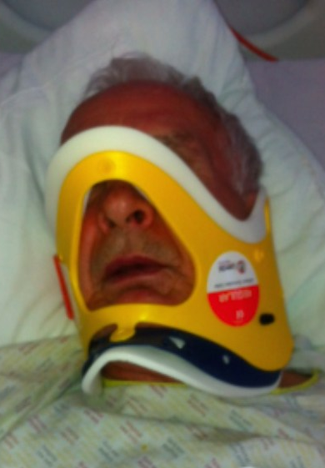
Cervical Collars
Known harm
  Increased radiation
  Increased intracranial pressure
    May be worse with elevated ICP
  Complicates airway management
  Increased risk of aspiration
  Concealed wounds
  Patient discomfort/agitation
No proven benefit

Slide 19
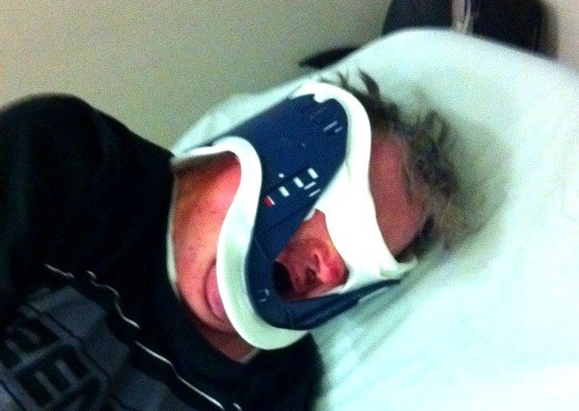
Cervical Collars
Known harm
No proven benefit

Slide 20

Five Take Homes
Prevention of TIC starts in the prehospital setting
  TXA early
    Best by EMS
    Consider 2 grams
  Circulation first in trauma resuscitation
ACLS is unproven in trauma patients
  May cause harm
We need to do chest decompression better
Prehospital vital signs matter
Ditch the C-collar whenever you can

Slide 21
Thank You!
Christopher.Colwell@ucsf.edu

