Slide 1
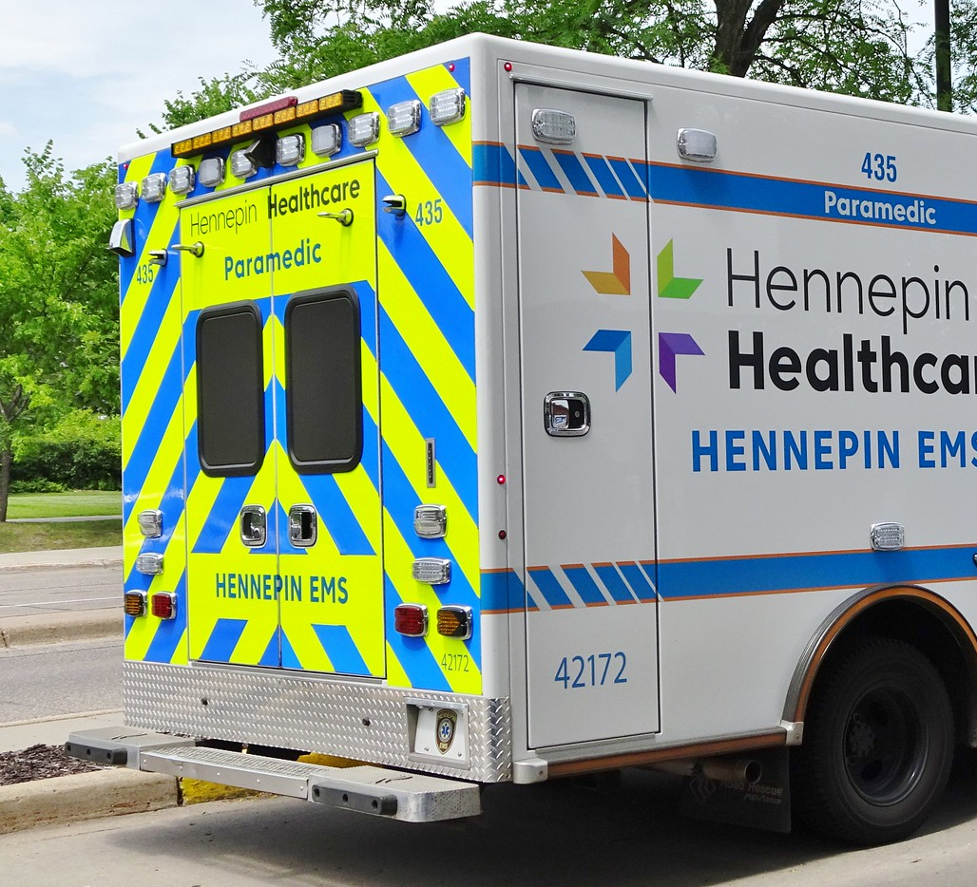

No Longer Pharming Things Out
Nick Simpson, MD FACEP FAEMS

Slide 2
No financial disclosures

Slide 3
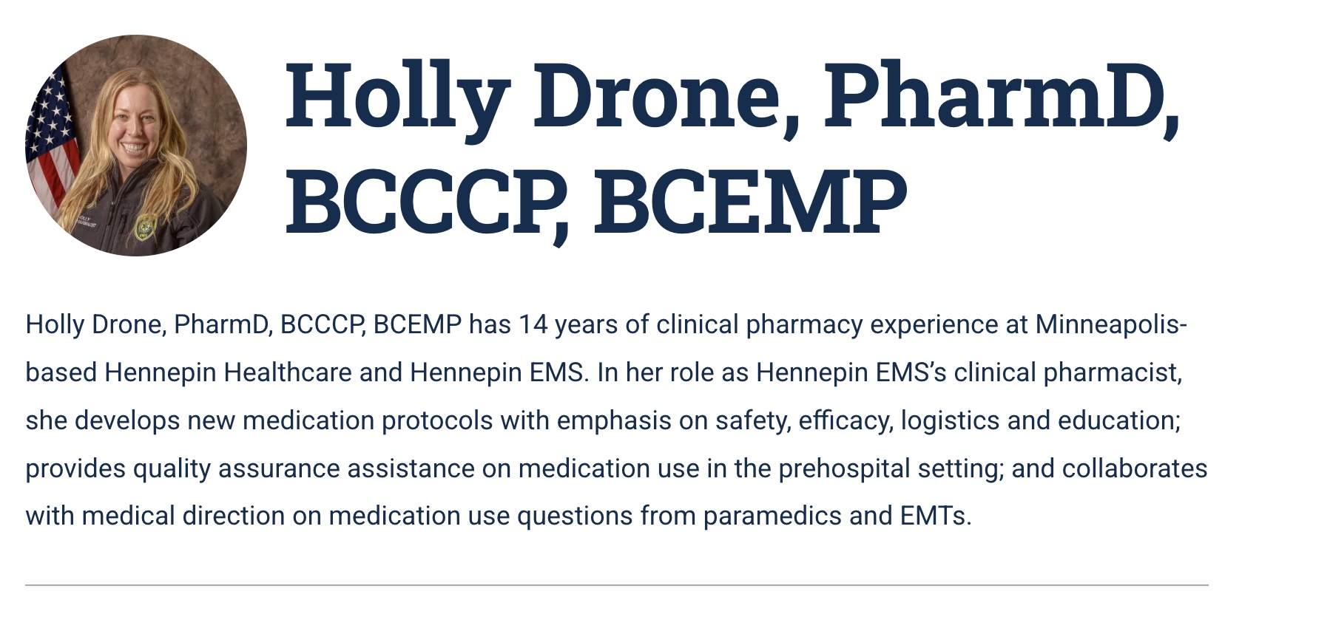

Slide 4
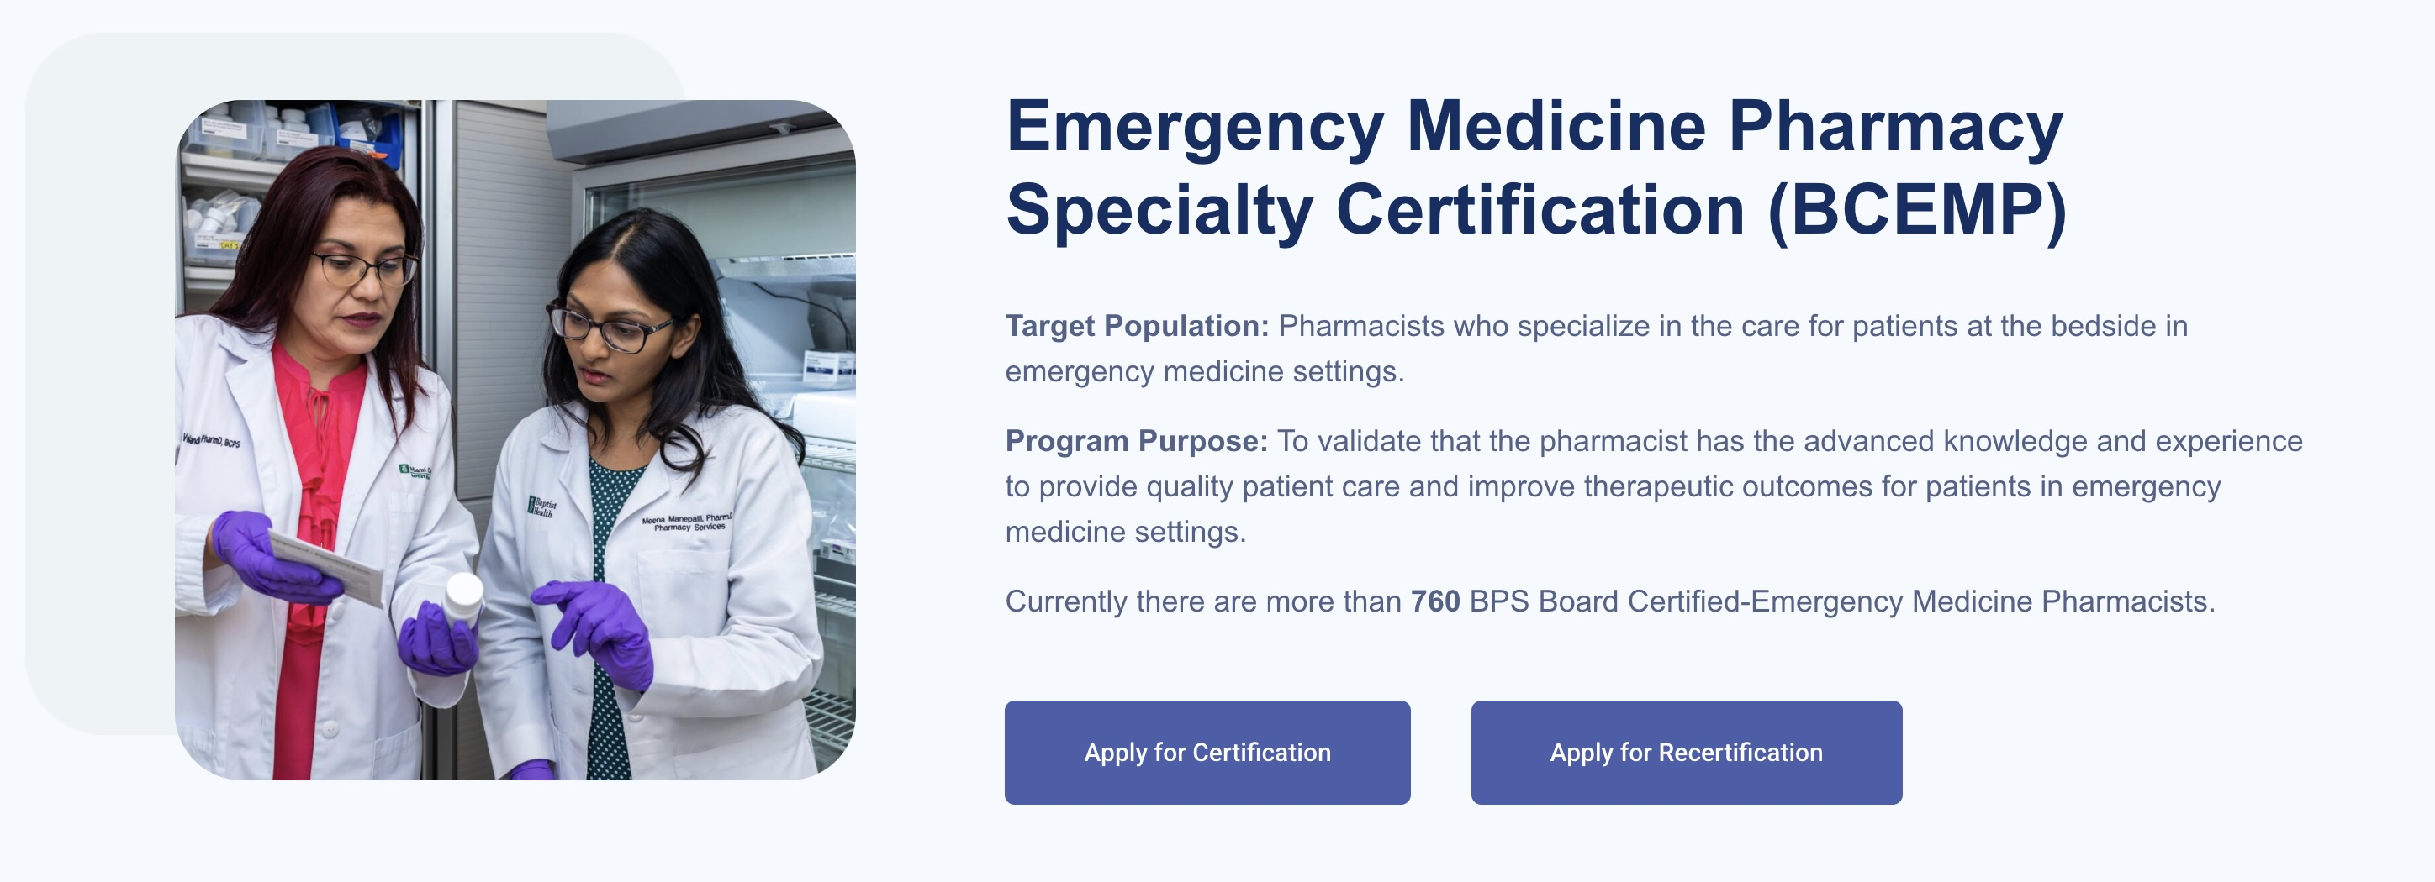
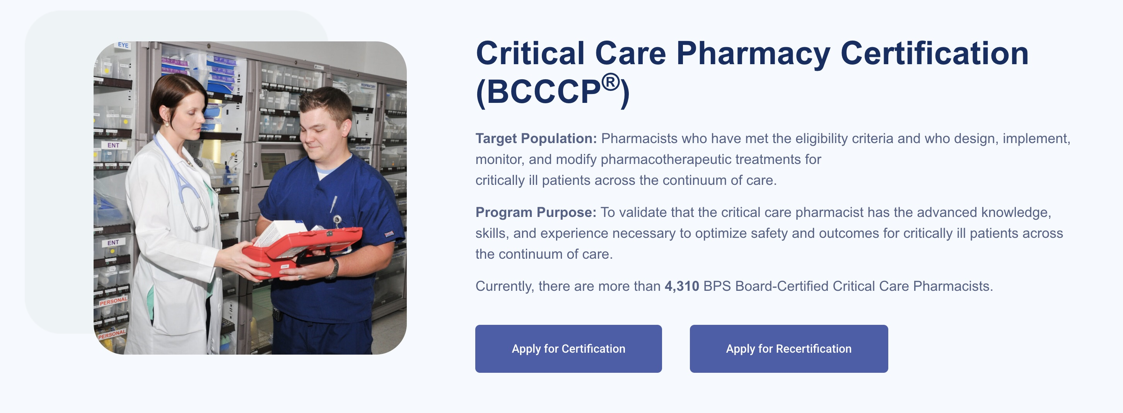

Slide 5
What could a clinical pharmacist add to an EMS service?

Slide 6
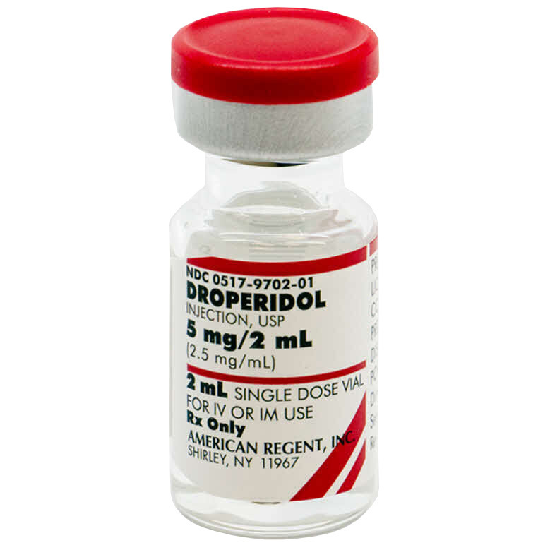
Clinical PharmD add MEDs
Medical Direction Team
Experience, i.e. field work
Data

Slide 7

Medical Direction Integration
Input into the clinical discussions
Protocol reviews and updates
Increased efficiency for consideration
Special populations, dosing, and special situations
Shortage mitigation
Omnicell management

Slide 8
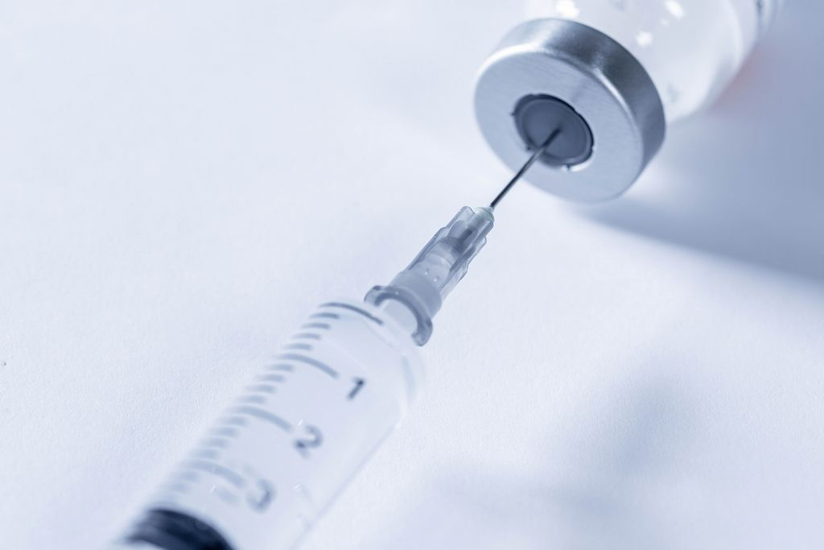
Experience / Field Work
Not the same to hear about it, need to live it to understand it
Fully trained to go out into the field
Bedside care in the ED, the back of the ambulance, the living room, etc.
This Photo by Unknown Author is licensed under CC BY

Slide 9
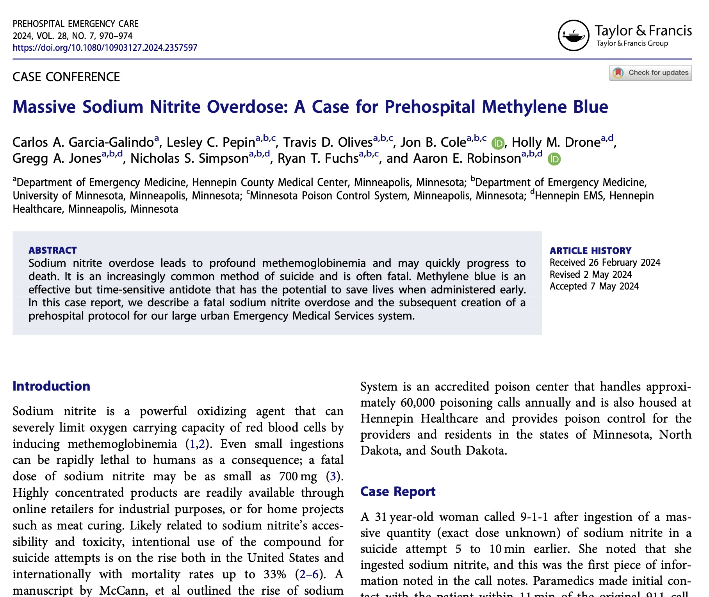
Data
Medication changes, additions, removal
Resource/Tool updates (e.g. Handtevy, reference sheets, etc.)
Evaluation of the service

Slide 10
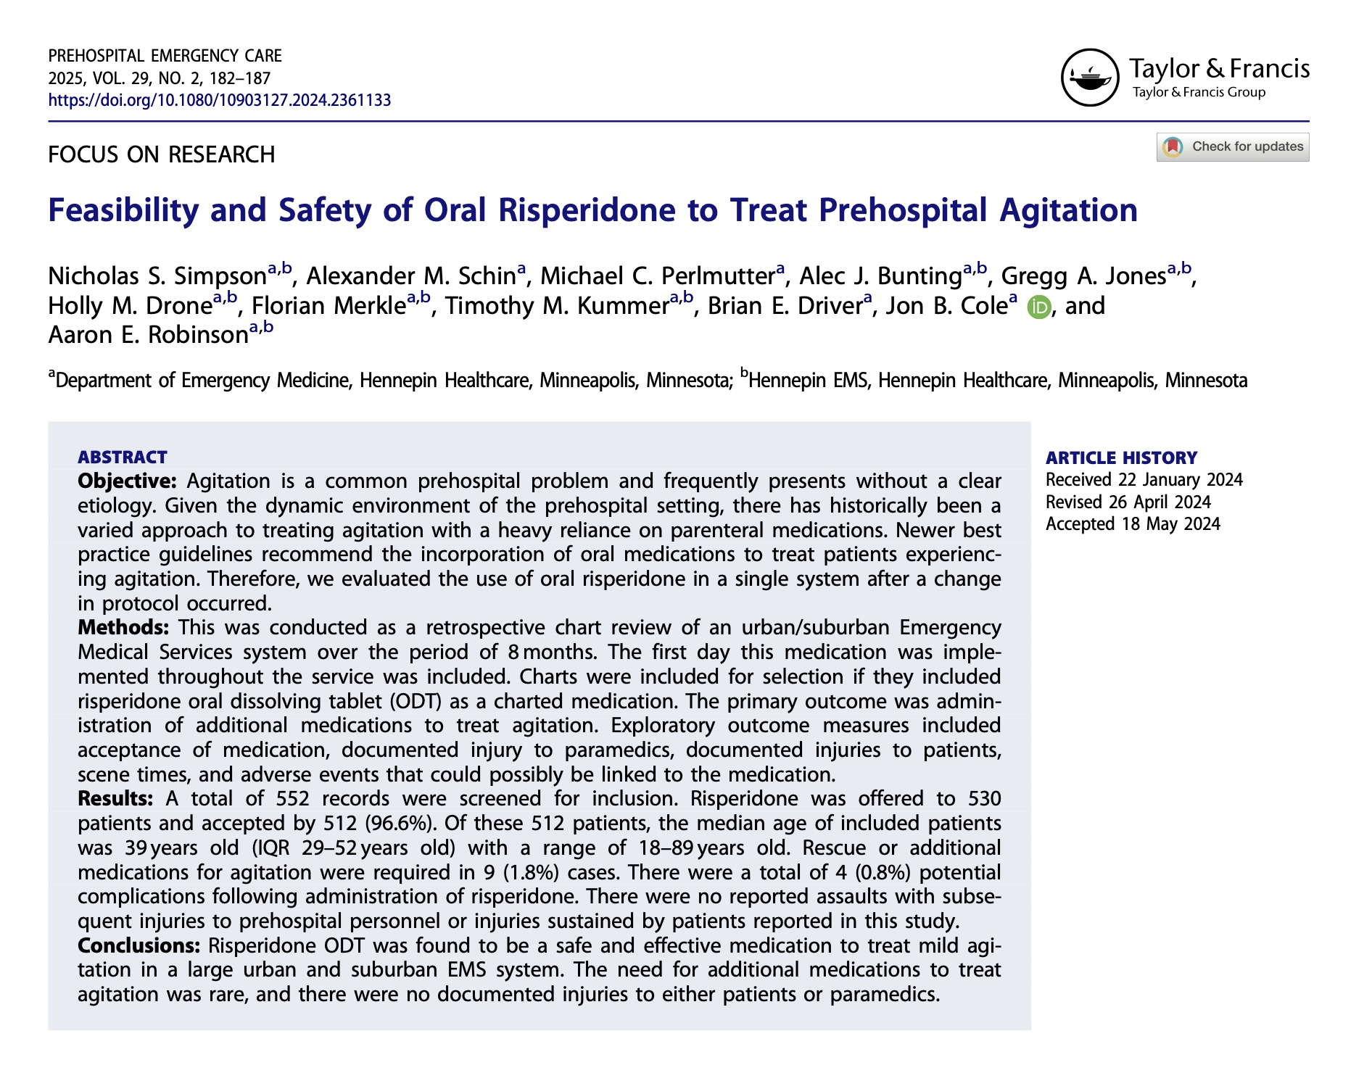

Slide 11
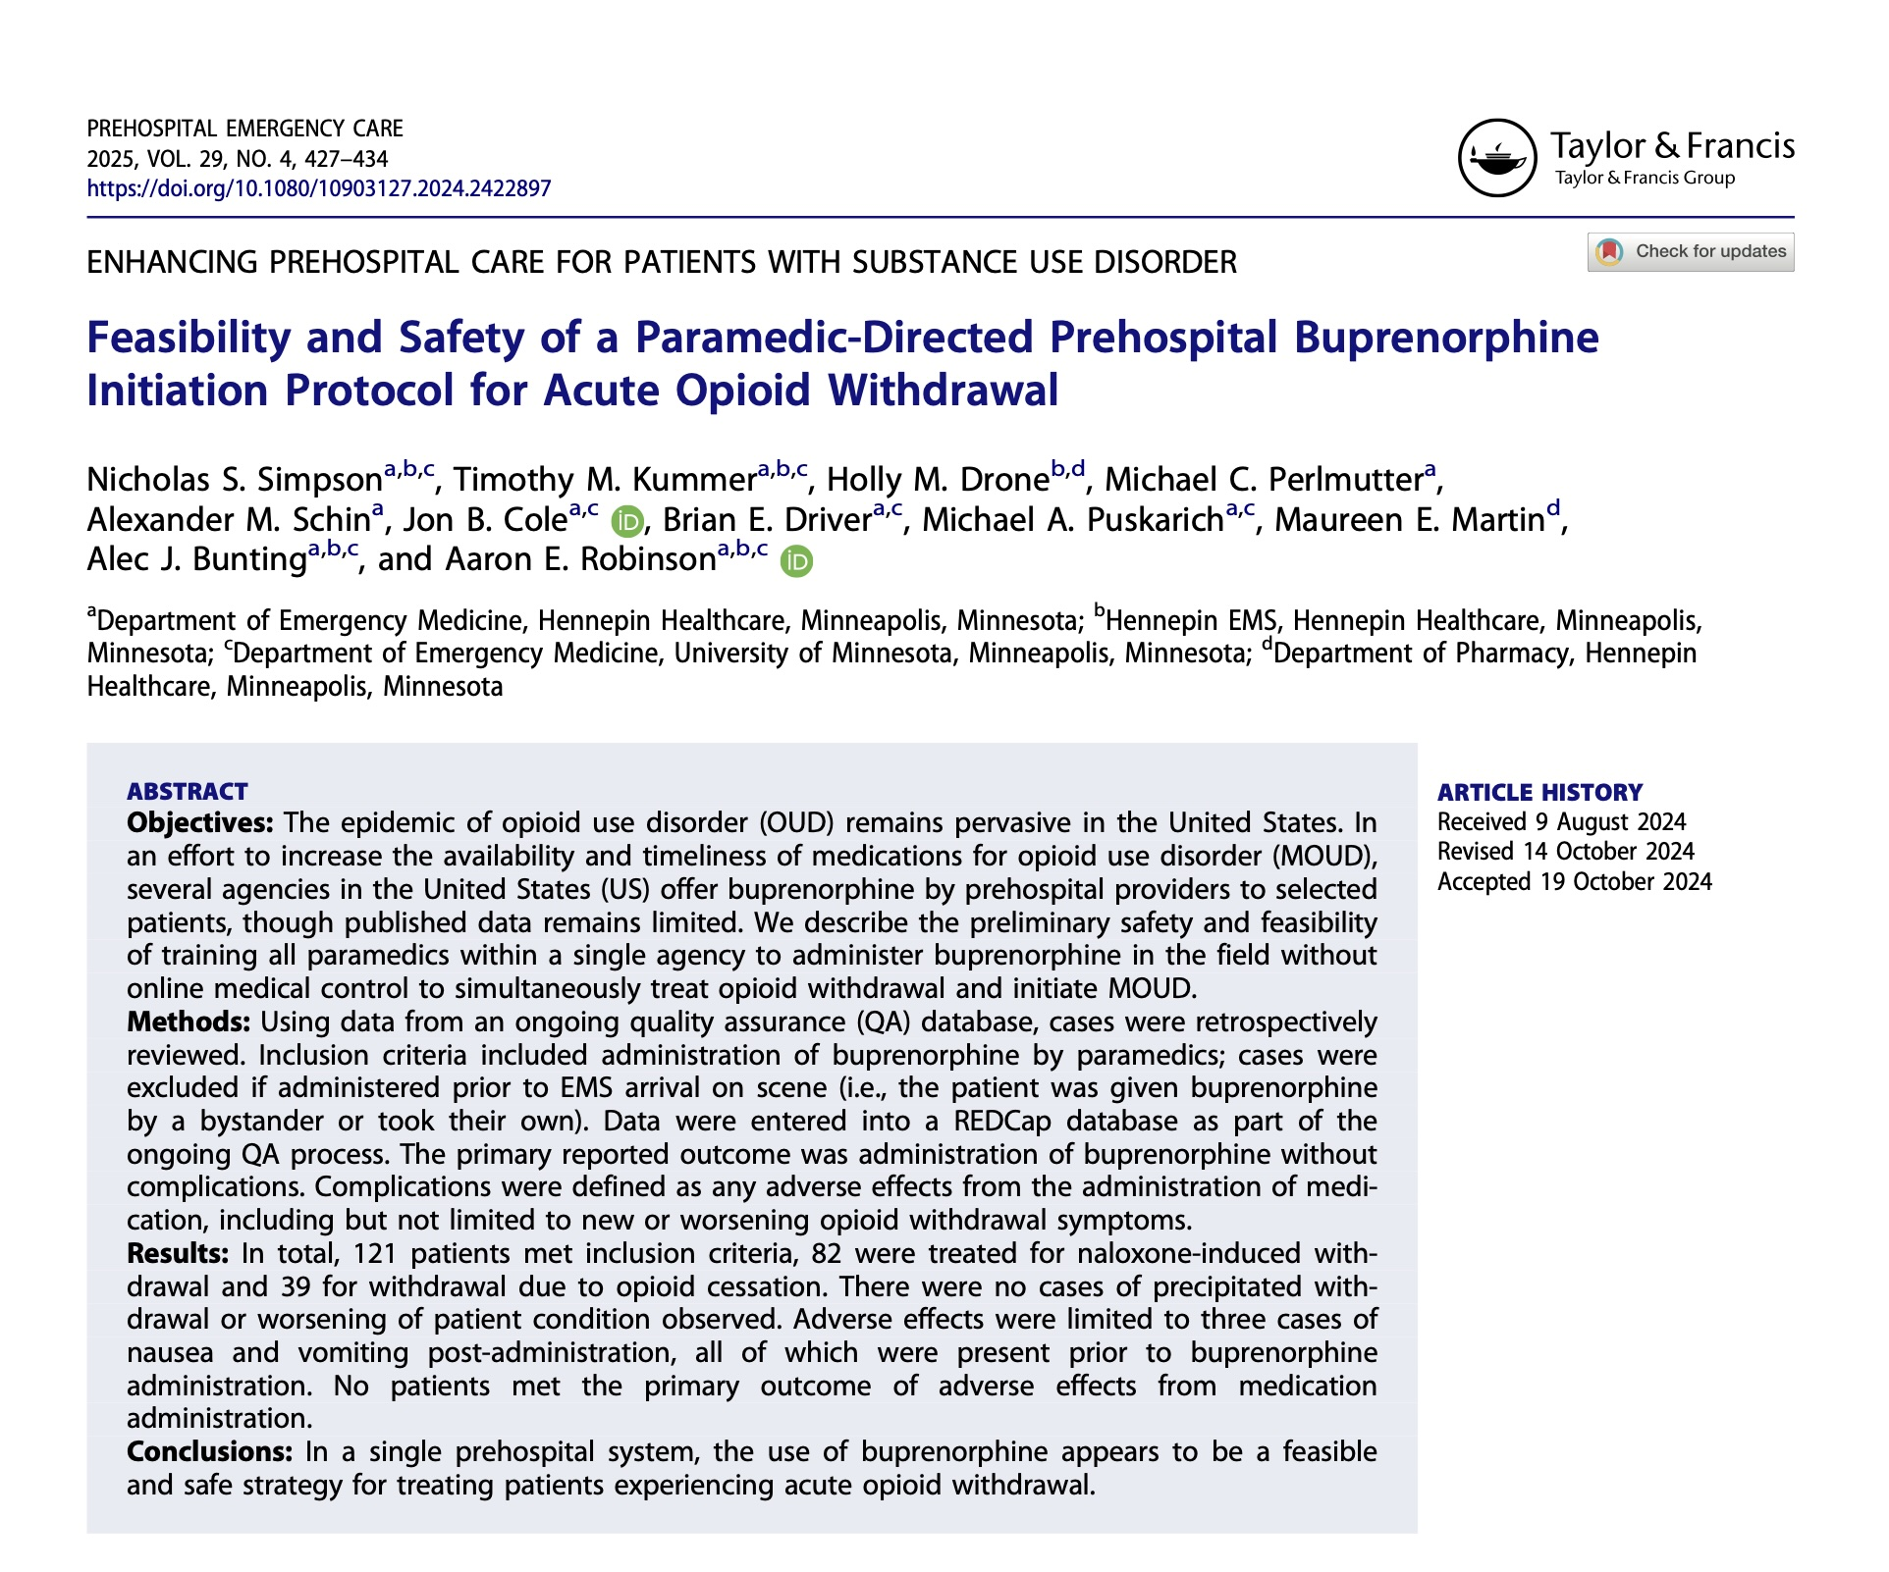

Slide 12
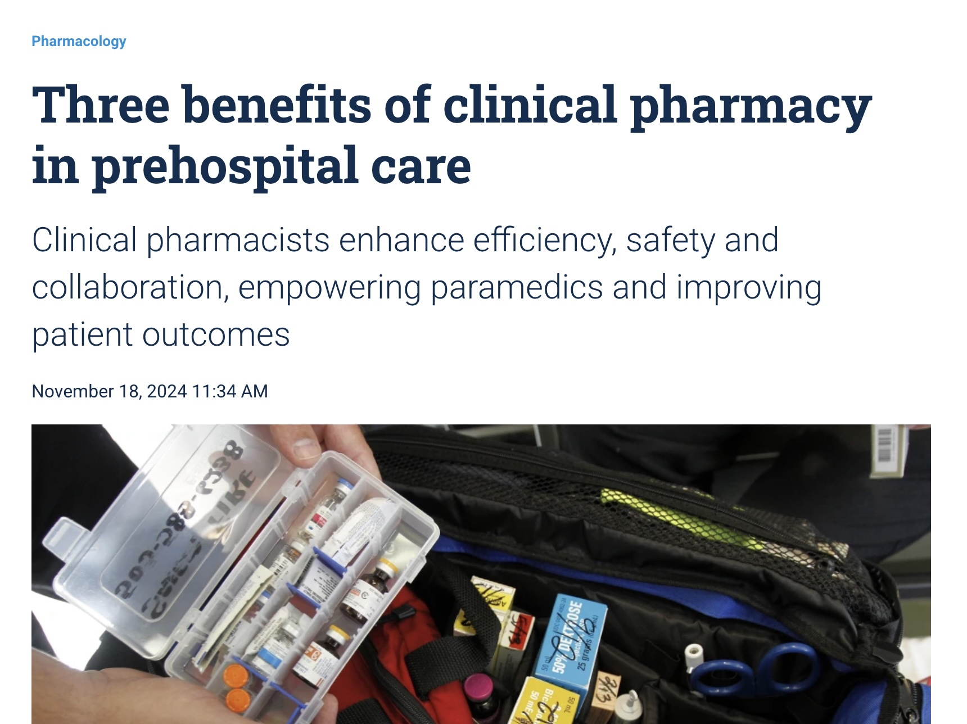

Slide 13
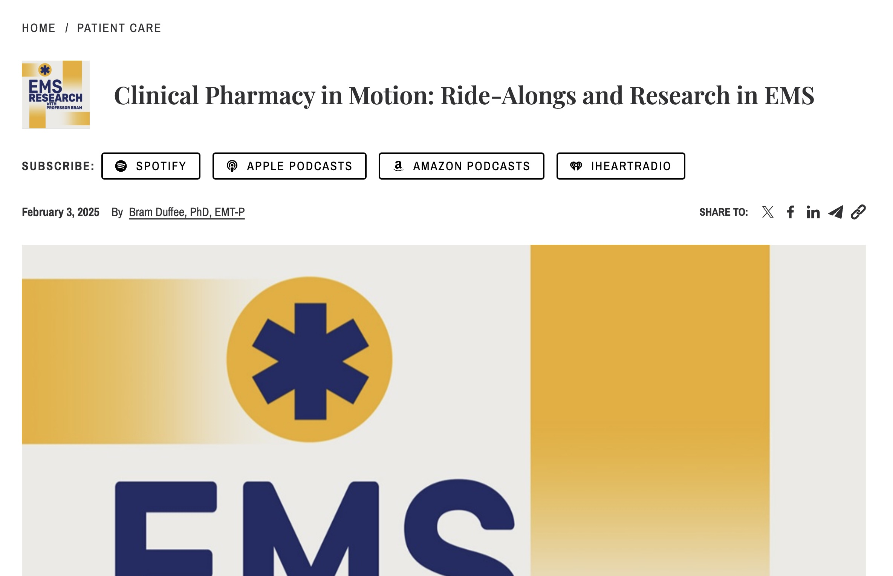

Slide 14
What could a clinical pharmacist add to an EMS service?

Slide 15
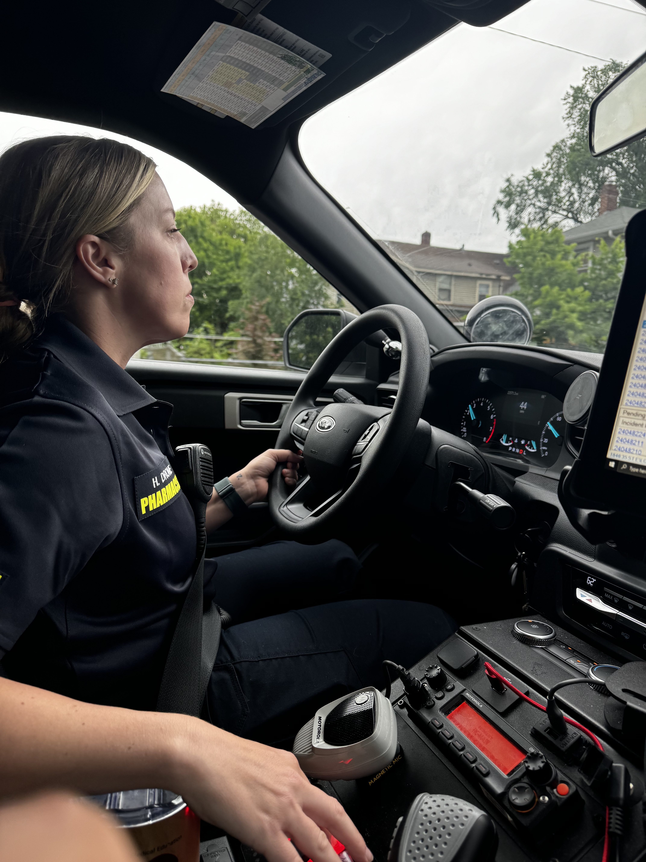
Clinical PharmD add MEDs
Medical Direction Team
Experience, i.e. field work
Data

Slide 16
Nick.Simpson@hcmed.org

