Slide 1



PREHOSPITAL SEPSIS: BUGS, DRUGS and SLUGS
Randy S. Katz, DO, MBA, FACEP
District Medical Director emergency services
Memorial Healthcare system city of Hollywood fire rescue

Slide 2
EMS ENCOUNTERS
Severe sepsis/shock at a rate of 3.3 per 100 patients
  MI - 2.3 per 100
  Stroke - 2.2 per 100
30-60% of all severe sepsis admissions arrive via EMS
Most cases of sepsis start before admission
→ PREHOSPITAL KEY TIME
EMS Clinical practice and Systems Oversight, 3rd

Slide 3
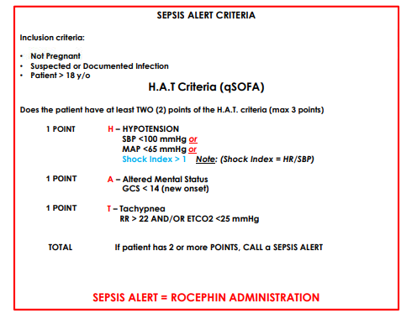
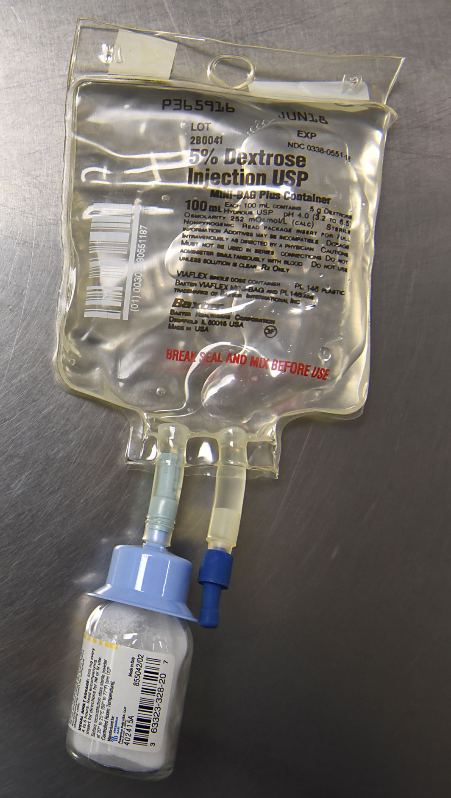
SEPSIS PROTOCOL – APRIL 2024
ANTIBIOGRAM

Slide 4

SIRS vs QSOFA

Slide 5
DATA – 3 PATIENT POPULATIONS
RECEIVED PREHOSPITAL CEFTRIAXONE (183) – APRIL 2024-2025
CONTROL GROUP (217) – APRIL 2023 – 2024
ED DIAGNOSIS OF SEPSIS

Slide 6
HAT CRITERIA MET FOR ADMINISTRATION
HYPOTENSION – 58%
ALTERED MENTAL STATUS – 79%
TACHYPNEA – 97%
SEPSIS ALERT INDICATED → 96% (2 OR MORE CRITERIA)

Slide 7
ANALYSIS
183 Total Patients
LOST TO FOLLOW UP - 4
NOT GIVEN – 11
HOME NURSE - 1
DUE TO ALLERGY – 4
DUE TO LACK OF IV ACCESS - 4
MISSED OPPORTUNITY – 2 (IMPROVEMENT, TRAUMA/SEIZURE)
COMPLICATIONS
ALLERGIC REACTIONS - 0
IV DISLODGMENT - 1

Slide 8
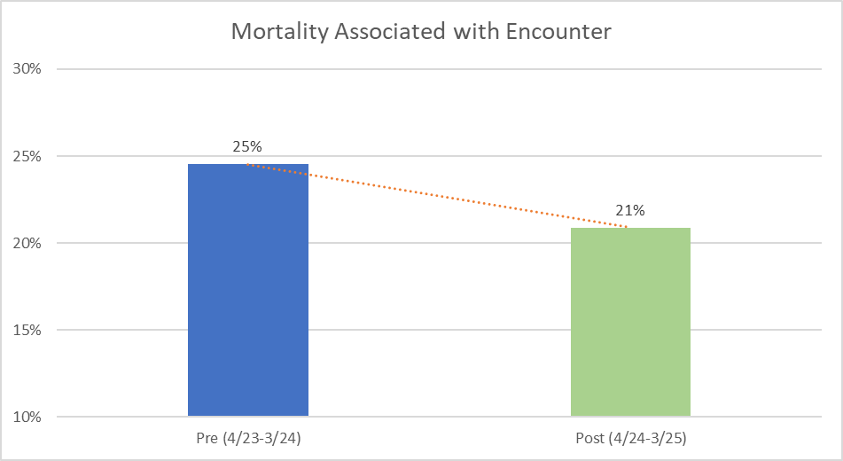
IN-HOSPITAL MORTALITY
Pre/Post Comparison | Mortality Associated with Encounter
Pre (4/23-3/24) | 25%
Post (4/24-3/25) | 21%

Slide 9
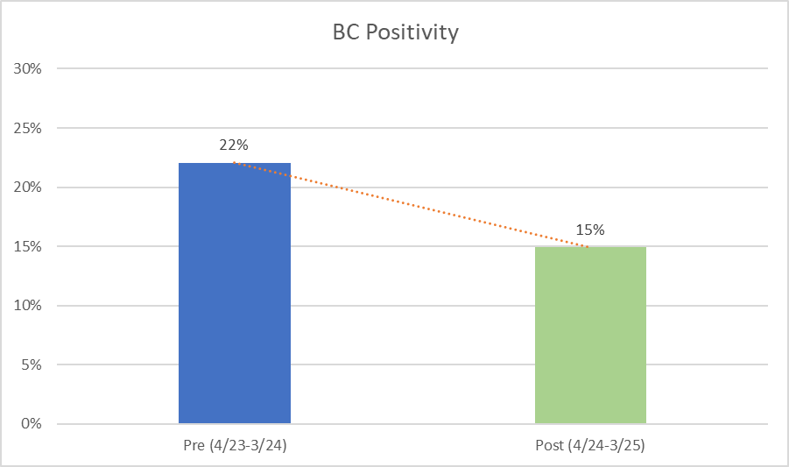
BLOOD CULTURE YIELD
Pre/Post Comparison | BC Positivity | Contamination
Pre (4/23-3/24) | 22% | 8%
Post (4/24-3/25) | 15% | 4%

Slide 10
ED METRICS
Pre/Post Comparison | Arrival to BC (minutes) | Arrival to Lactic (minutes) | Arrival to SOS (minutes) | Arrival to ABX | LOS
Pre (4/23-3/24) | 64 | 53 | 42 | 115 | 10
Post (4/24-3/25) | 45 | 39 | 37 | 113 | 8

Slide 11

THANK YOU
Randy S. Katz, DO, MBA, FACEP
Rkatz@mhs.net

Slide 12
Eagles 2025
Paramedic Initiated Treatment of
Sepsis Targeting Out-of-hospital Patients
The PITSTOP Trial
Sheldon Cheskes, MD CCFP(EM) FCFP DRCPSC
Medical Director, Sunnybrook Centre for Prehospital Medicine
Professor, Division of Emergency Medicine, University of Toronto
Scientist, Li Ka Shing Knowledge Institute, St. Michael’s Hospital
Affiliate Scientist, Sunnybrook Research Institute
Co-Principal Investigator, Toronto Site, Canadian Resuscitation Outcomes Consortium

Slide 13

Prehospital Antibiotics: PHANTASi
Lancet Respir Med 2017
N=2672 patients; 10 EMS, 34 destination hospitals
(Netherlands)
  Age ≥18
  Suspected infection
  Temperature >38.0°C or <36°C
  One other SIRS (HR >90bpm or RR >20/min)
Notes:
Phantasi trial, conducted across Netherlands. Importantly, they enrolled a relatively healthy patient population (e.g. only 1 SIRS plus fever).

Slide 14


The PITSTOP Trial
Paramedic Initiated Treatment of Sepsis Targeting Out-of-hospital Patients

Slide 15
Primary Research Question
Does earlier treatment of sepsis by paramedics improve survival?
  antibiotics vs placebo
  standard IV fluids vs aggressive fluid resuscitation

Slide 16
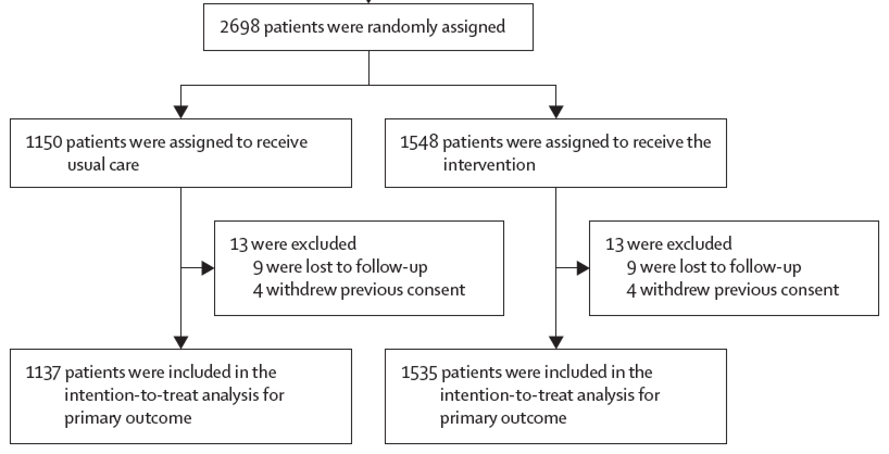
Prehospital Antibiotics: PHANTASi
One blood culture sample
2g IV ceftriaxone
Lancet Respir Med 2017
Notes:
Phantasi trial, conducted across Netherlands. Importantly, they enrolled a relatively healthy patient population (e.g. only 1 SIRS plus fever).

Slide 17
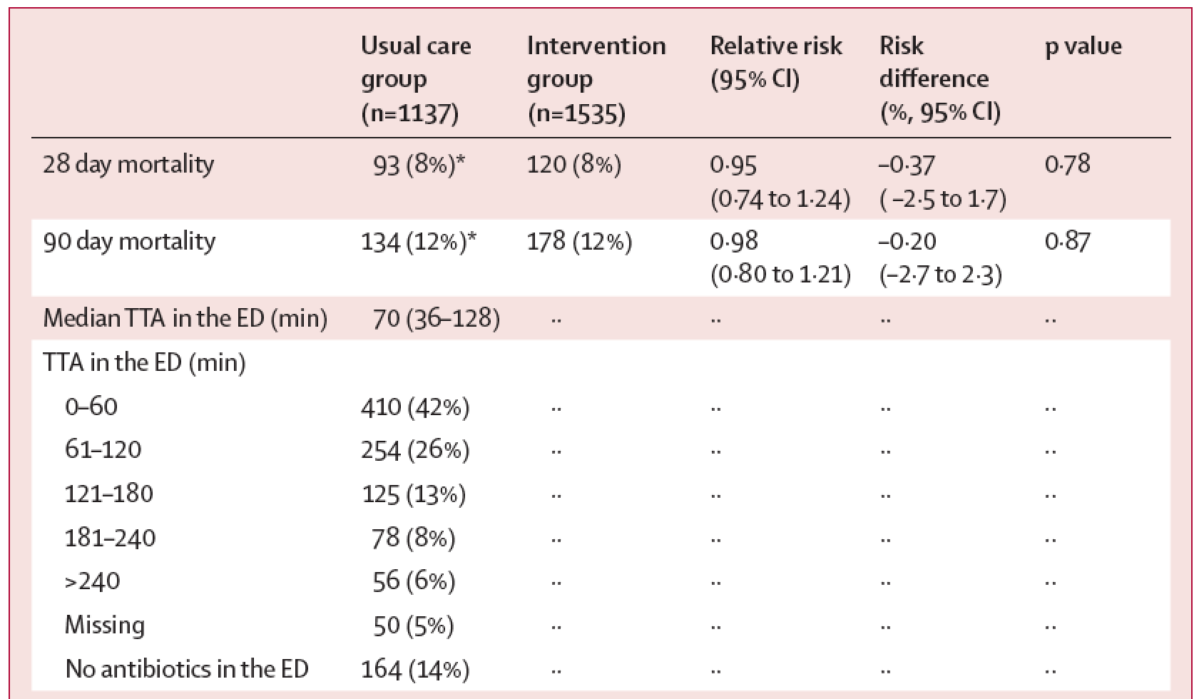
Prehospital Antibiotics: PHANTASi
Lancet Respir Med 2017
Notes:
Phantasi trial, conducted across Netherlands. Importantly, they enrolled a relatively healthy patient population (e.g. only 1 SIRS plus fever).

Slide 18
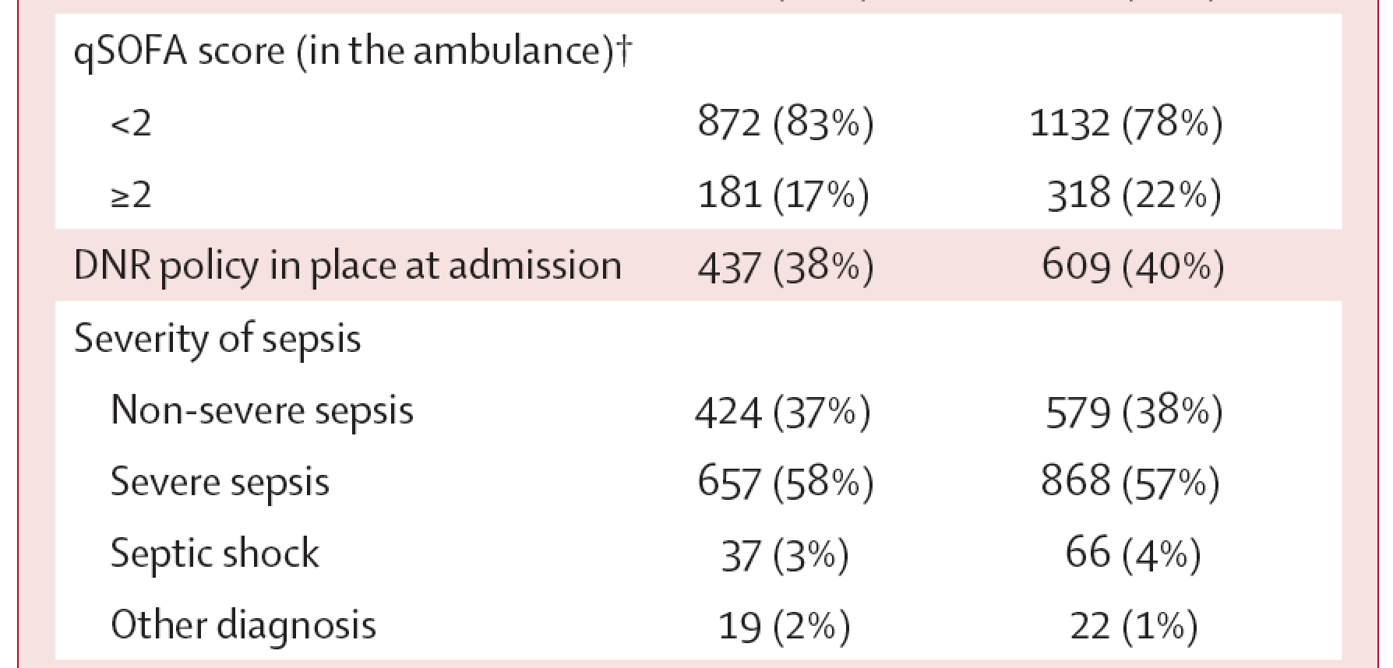
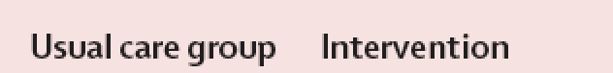
Prehospital Antibiotics: PHANTASi
Lancet Respir Med 2017
Notes:
Phantasi trial, conducted across Netherlands. Importantly, they enrolled a relatively healthy patient population (e.g. only 1 SIRS plus fever).

Slide 19
Prehospital Antibiotics: PHANTASi
Lancet Respir Med 2017
Notes:
Phantasi trial, conducted across Netherlands. Importantly, they enrolled a relatively healthy patient population (e.g. only 1 SIRS plus fever).

Slide 20
Inclusion Criteria
(Sepsis: all must be present)
Paramedic Suspects Possible Infection
    Pneumonia, urinary tract infection, abdominal sepsis, meningitis, cellulitis, septic arthritis, etc.
Presence of Fever
Temperature ≥38.0°C or measured by patient/surrogate within previous 24 hours
Presence of Hypotension
SBP<100mmHg at any time during call
Notes:
Note that the fever can now be measured by patient or surrogate in previous 24 hours; also any (not just initial) SBP <100 can qualify

Slide 21
Factorial RCT: 2x2 Randomization
Placebo IM
vs
Ceftriaxone 1g IM
Aggressive IV fluids
vs
Standard IV fluids
1:
All
Paramedics
2:
Paramedics with IV Autonomous Certification
Notes:
These are my disclosures

Slide 22
IV Fluid Resuscitation ‘Aggressive’ vs ‘Standard’
IV Aggressive
  2 litres 0.9% NaCl regardless of subsequent SBP
  (unless signs of overload)
IV Standard
  0.9% NaCl only if SBP<90 to maximum of 2L
Notes:
Teaching point is that the fluids administered in the IV standard group follows the current medical directive for IV NaCL fluid bolus administration.

Slide 23
Outcomes
Primary Outcome: Mortality at hospital discharge
Secondary Outcomes
  Use of life support treatments during first 24 hours
  Healthcare use (hospital/ICU admission, discharge destination)
  Fluids, antibiotics administered during first 24 hours
  Microbiology (first 24 hours)
Safety Outcomes
  Pulmonary edema (prehospital/in ED), resistant microorganisms, no sepsis diagnosed in ED, anaphylaxis
Notes:
These are my disclosures

Slide 24
Sample Size
Hospital mortality of suspected sepsis with SBP<90 ranges from 17% to 23%
Seeking plausible reduction of 5% (ARR)
80% power, 2-sided testing at significance 5%
Need between 780 and 1020 patients per group
Target = 2040 patients
Notes:
These are my disclosures

Slide 25
Process Measures
Antibiotics
911 call to PITSTOP study IP: mean 47 min (SD 32)
911 call to in-hospital antibiotics: mean 301 min (SD 261)
Difference: 254 minutes (4.2 hours)
IV Fluids Allocation
23% ineligible (no IV)
Expected to increase
Fluid Administration
Aggressive: 1474 ml (SD 605)
Standard: 452 ml (SD 424)
* Based on first interim analysis
Notes:
These are my disclosures

Slide 26
Culture Results
Preliminary Results
318 patients
Patient-level Summary
Any positive culture: 162/318 = 51%
Positive blood culture: 101/318 = 32%
Any resistant blood culture: 39/318 = 12%
  CNST 10, 3 enterococcus, 3 fungal, ~20 ESBL/pseudomonas
Culture Result Summary
250 positive cultures from 162 patients
109/250 (44%) blood cultures
98/250 (39%) urine cultures
Remainder wound/tissue, very few sputum (n=3)
Notes:
These are my disclosures

Slide 27
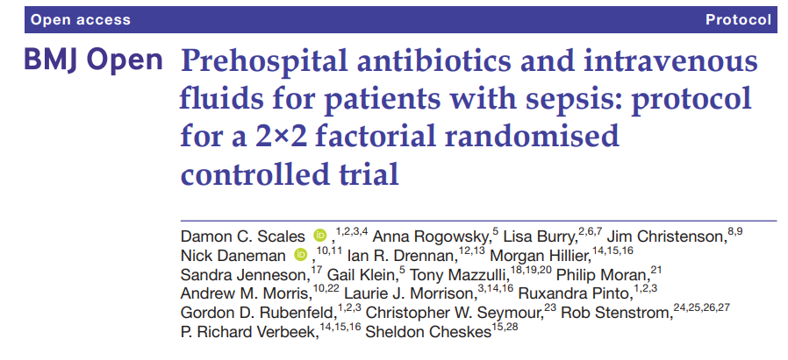
Study Protocol

Slide 28
PITSTOP Significance
Early identification and treatment of sepsis an opportunity for prehospital care
Treating patients based on WHEN they need therapy, rather than WHERE they are physically located
May lead to LIVES SAVED

Slide 29

Thank You!

Slide 30

BCFR
ABX for SEPSIS Update
Dr. Aldo Manresa
and
Orlando J. Dominguez, Jr.
Assistant Chief of EMS Opereations
June 6th, 2025
Medical Care Committee

Slide 31
Rocephin Administration
Septic Shock
  SEPSIS ALERT CRITERIA
    Temperature > 38° C (100.4° F) OR < 36° C (96.8° F) AND one of the following:
    Decreased level of consciousness
    Hypotension, SBP < 90 mmHg
    EtCO₂ ≤ 25 mmHg
    Respiratory Rate > 20 breaths/min
    Heart Rate > 90 beats/min

Slide 32
Cases Reviewed Post Rocephin
May 1, 2024 – May 1, 2025
Total cases reviewed: 92
Sepsis: | 49 | 53.26%
Respiratory: | 32 | 34.48%
UTI: | 20 | 21.74%
Renal: | 15 | 16.30%
Cellulitis: | 1 | 1.09%
Transfer to 2nd Hospital: | 3 | 3.26%
Discharge to Hospice: | 8 | 8.70%
Discharge to SNF: | 12 | 13.04%
Discharge to Home: | 32 | 34.78%
Discharge with HHA: | 10 | 10.87%
Deceased: | 8 | 8.70%

