Slide 1
Hennepin EMS
With Bupe in the Loop

Slide 2
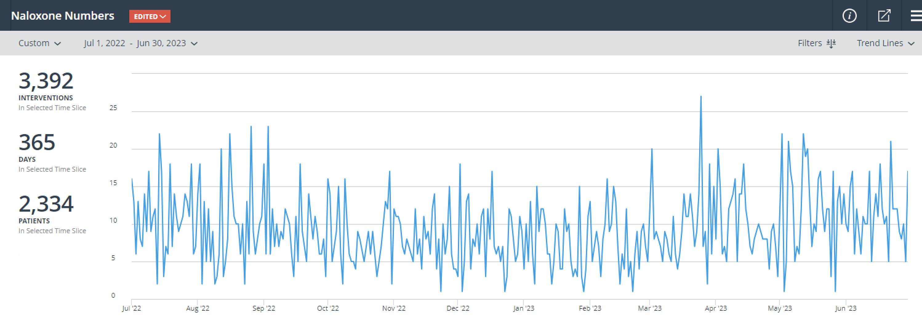

Slide 3
Who We Are
Our Reach
14 communities
266 square miles
1.5 million resident/visitor population
Deephaven | Eden Prairie | Excelsior | Greenwood | Golden Valley
Hopkins | Minneapolis | Minnetonka | Richfield | Shorewood
St. Anthony | St. Louis Park | Tonka Bay | Woodland

Slide 4
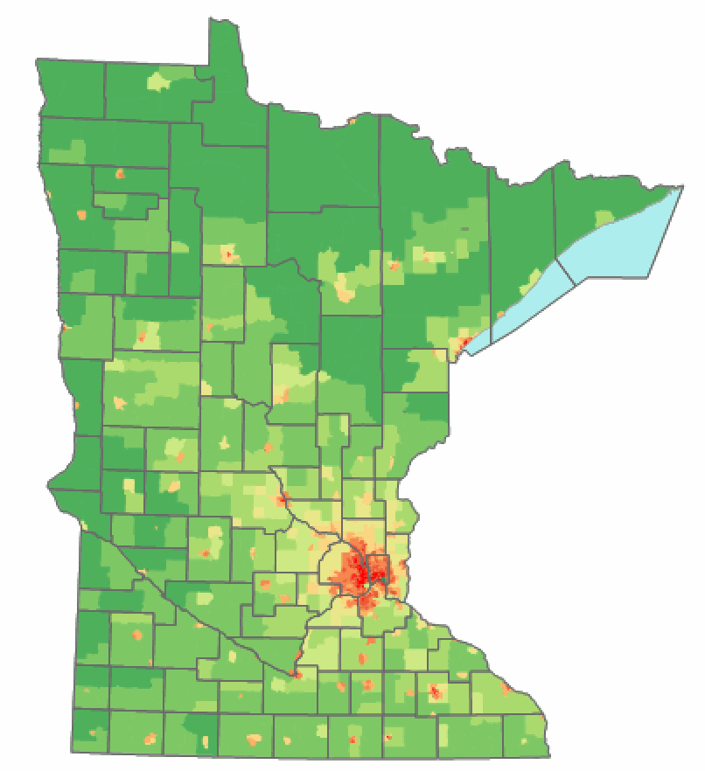
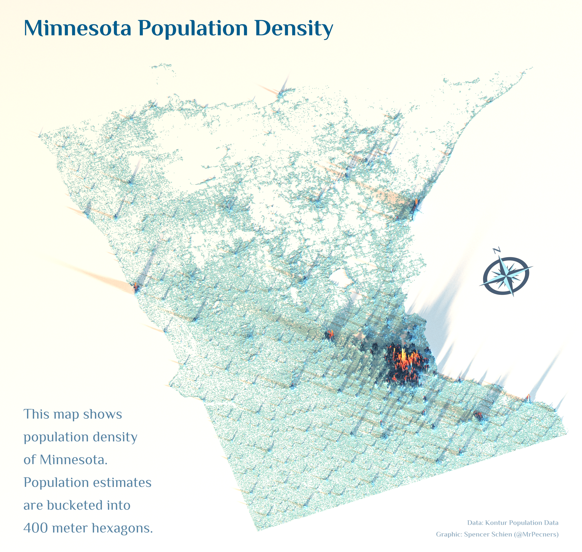

Slide 7
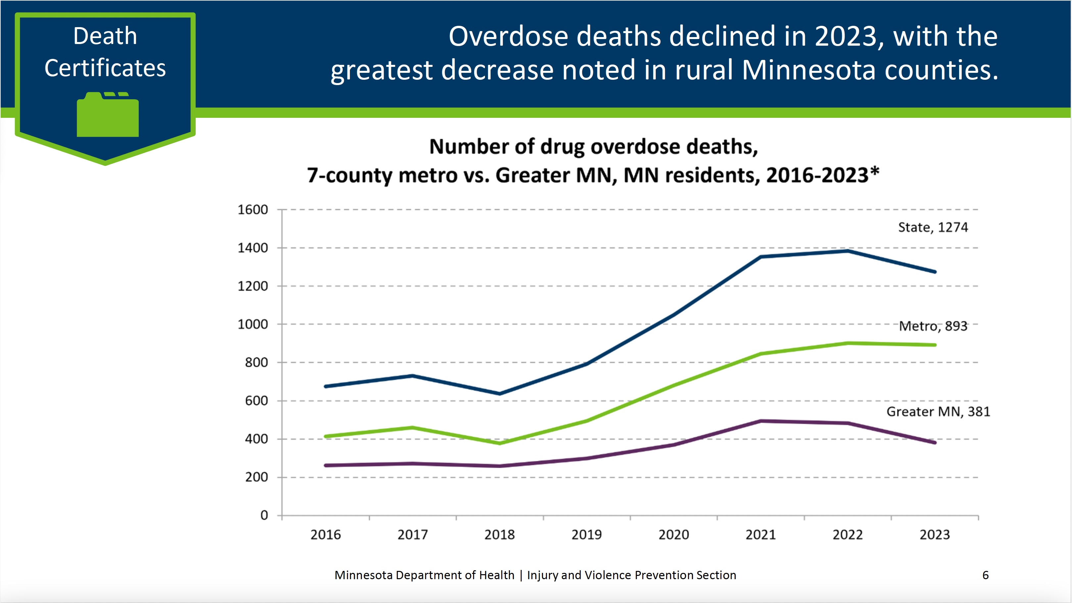

Slide 8
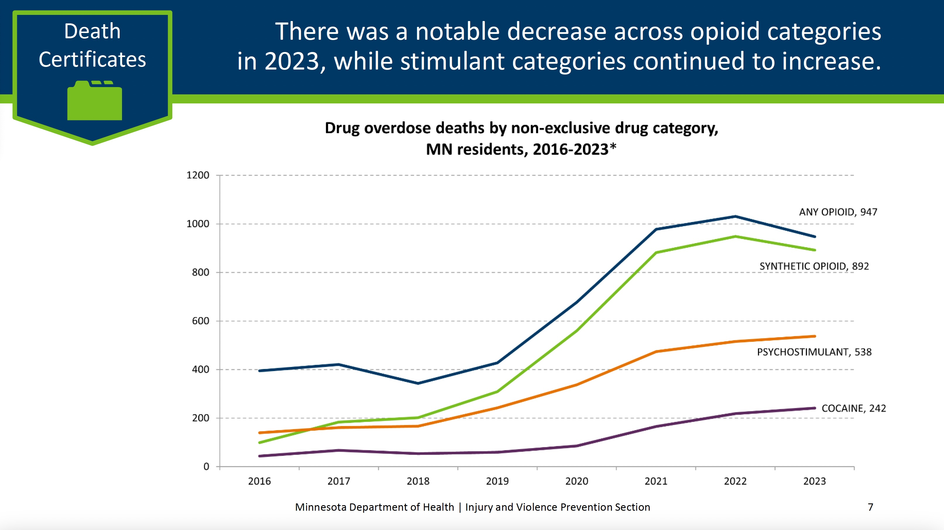

Slide 9

Fall 2022…

Slide 10
Decision to Implement Prehospital Buprenorphine
Education began Spring 2023

Slide 11
Keys to Implementation
Cost effective
Training realistic (mandatory initial training was under an hour)
Goes on every truck, just another medication

Slide 12
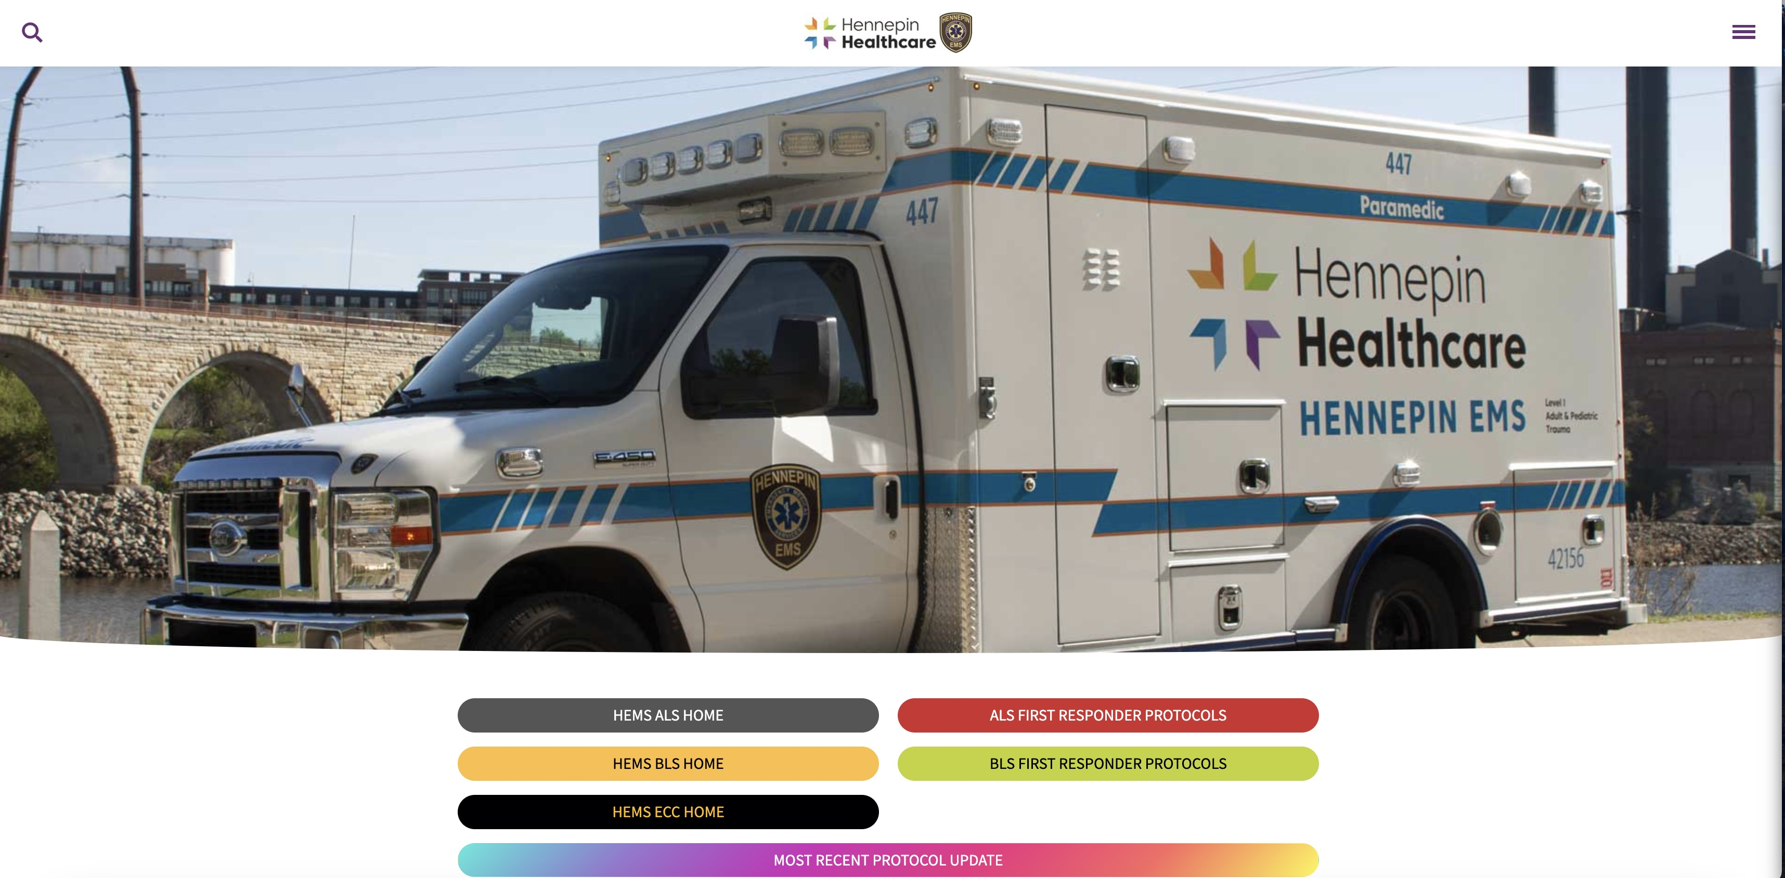

Slide 13
The First Year…

Slide 14
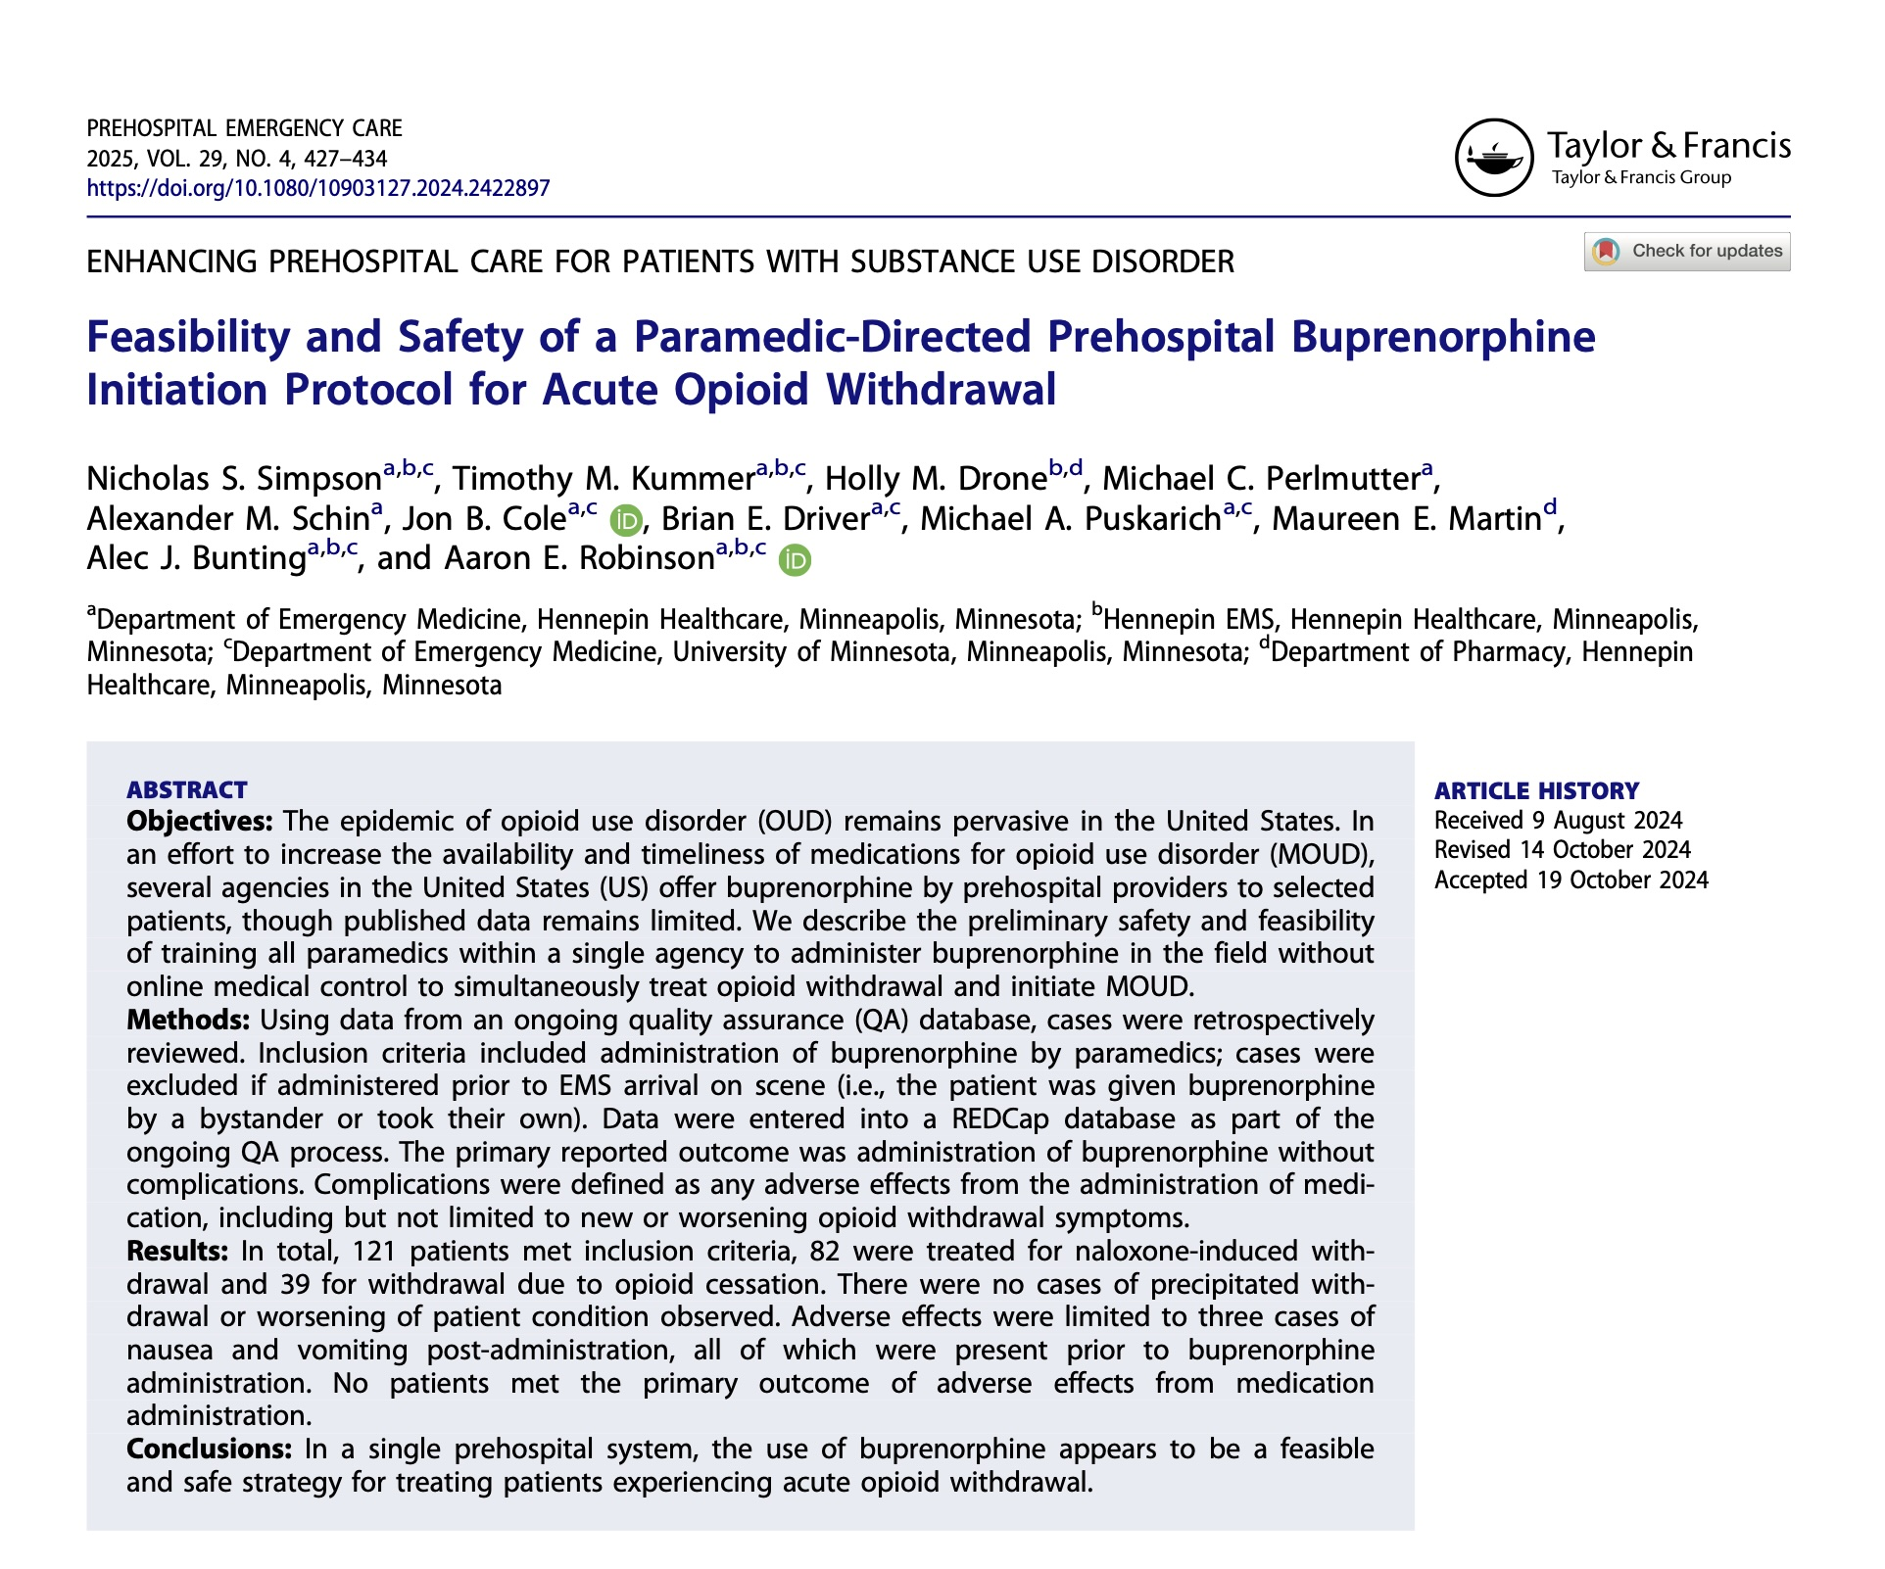

Slide 15
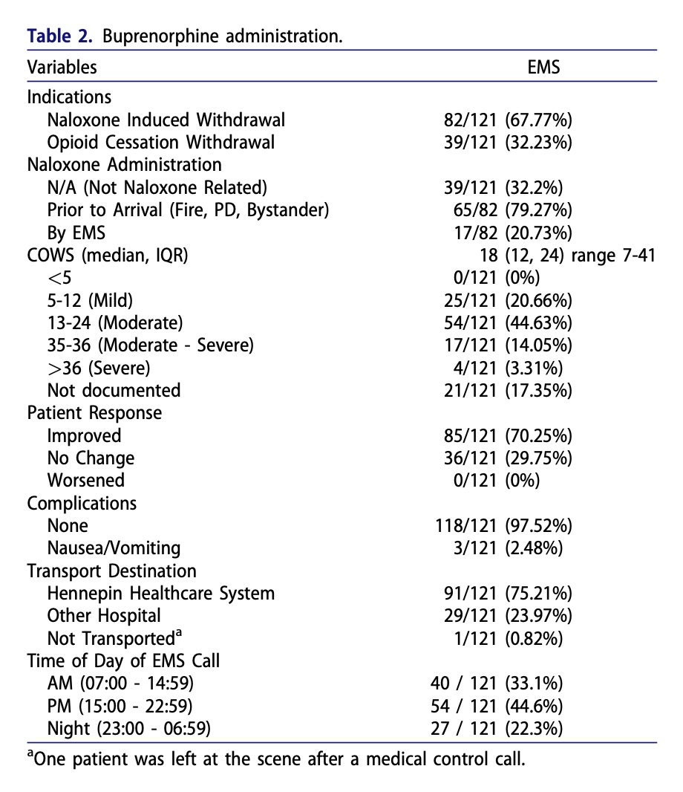

Slide 16
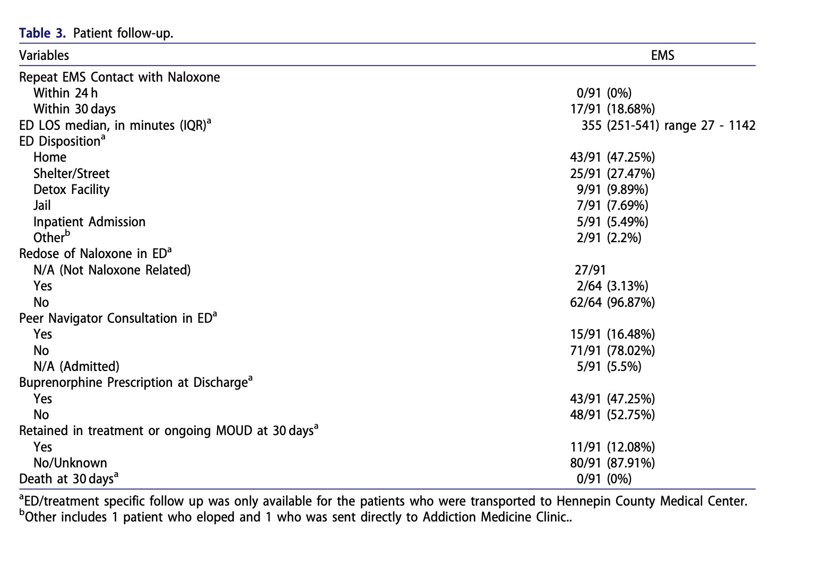

Slide 17
Beyond The First Year…

Slide 18

33% of Paramedics giving at least one dose of buprenorphine
51 doses to 49 patients in just 4 months this past summer/early fall
Administration to at least 7 documented races
Over 200 total administrations since program initiation in June 2023
*19 patients with (known) engagement in treatment or ongoing buprenorphine prescriptions within 30 days after EMS administration
Average overall COWS score 17 (prior to admin)
Usage statistics

Slide 19

 | Camden NJ N=292 | Contra Costa CA N=100 | Hennepin MN N=157
Dates | 8/1/2020 – 5/1/2024 | 10/9/2020 – 10/11/2023 | 6/16/2023 -11/12/2024
Mean Age (range) | 43.7 (19-72) | 36.4 (17-82) | 36 (18-81)
Sex # (%) Male Female Missing | 219 (75.0) 73 (25.0) --- | 65 (65.0) 34 (34.0) 1 (1.0) | 95 (61.0) 61 (39.0) ---
Race/Ethnicity # (%) White Black Asian Multirace Other Hispanic | 134 (46.0) 117 (40.0) 1 (0.3) --- 14 (8.0) 28 (16.1) | 51 (51.0) 25 (25.0) 9 (9.0) 5 (5.0) 9 (9.0) 89 (89.0) | 51 (33.0) 42 (27.0) --- --- 17 (10.0) American Indian 6 (4.0)
Presentation Overdose Withdrawal | 292 (100) --- | 33 (33.0) 67 (67.0) | 102 (65.0) 55 (35.0)
COWS Score Mean (range) | 10.2 (2-30) | 16.1 (3-45) | 17 (5-37)
BUP Dispensed – Mode # (%) Initial Dose Total Dose | 16mg 172 (99) 16mg 144 (83) | 16mg 87 (87) 16mg 69 (69) | 16mg 157 (100) 16mg 157 (100)
Transport to ED | 161 (55.0) | 99 (99.0) | 155 (99.0)
Follow-up Attended F/U Apt In treatment 30-day | 51 (21.3) 59 (20.0) | --- 33 (33.0) | --- 20 (13.0)

Slide 20

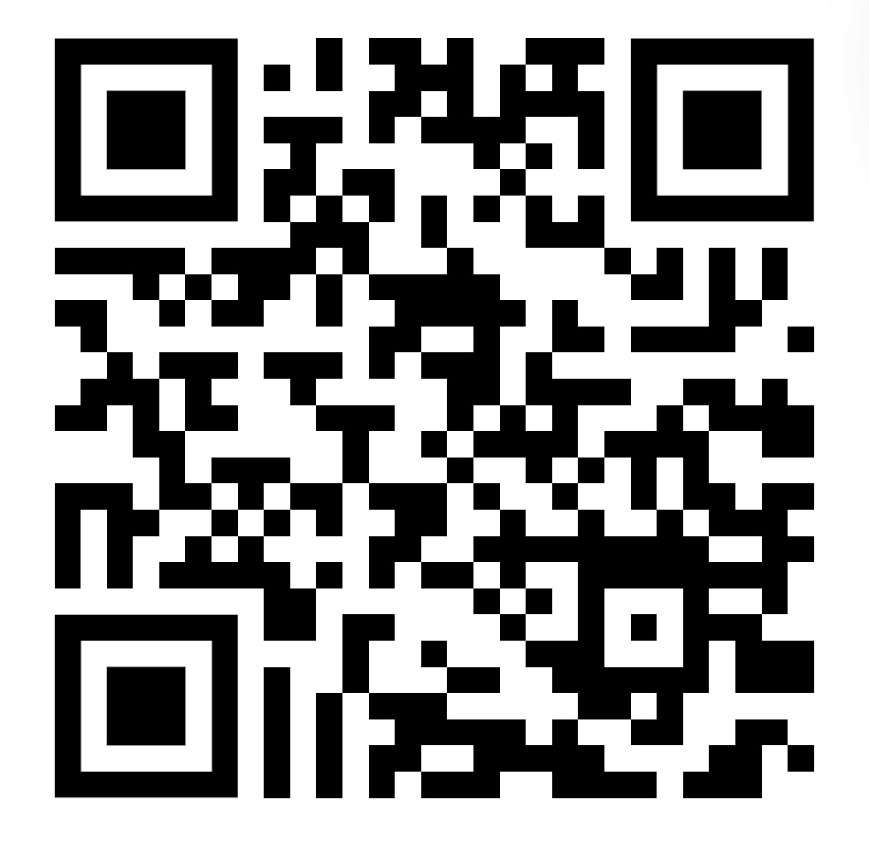
Link to access Hennepin EMS Protocols

Slide 21
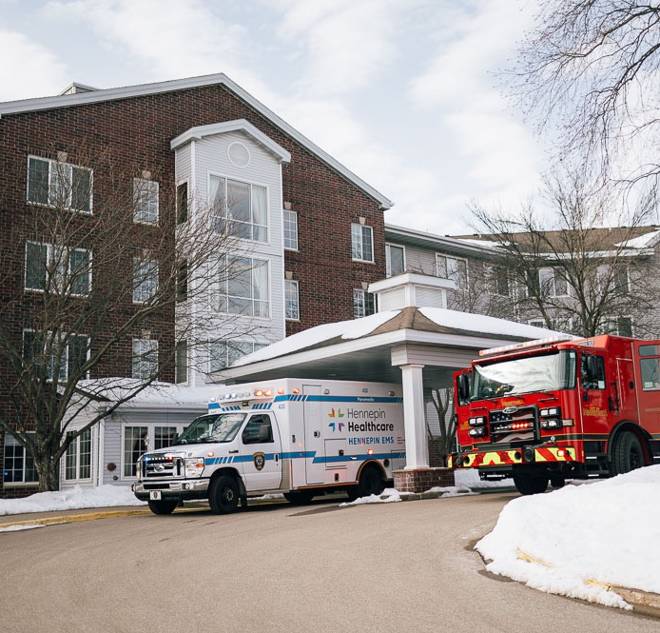
Harm Reduction and Outreach
Other OUD Efforts
Every ambulance carries and distributes free Naloxone leave-behind kits
Every ambulance carries and distributes free Fentanyl Test strips
Partnership with Peer Recovery Services (currently mostly occurring in the HCMC ED)
Growing partnerships with the MN Department of Health
We’ve put all our EMTs and EMT/EMDs through the Buprenorphine training to ensure awareness

Slide 22



Questions
/hennepinems
Hennepin EMS
@hennepinems
HENNEPINEMS.ORG

