Slide 1

Newark NJ Overdose Response Team

Slide 2
Question
Does adding internal EMS social support staff improve follow-up?

Slide 3
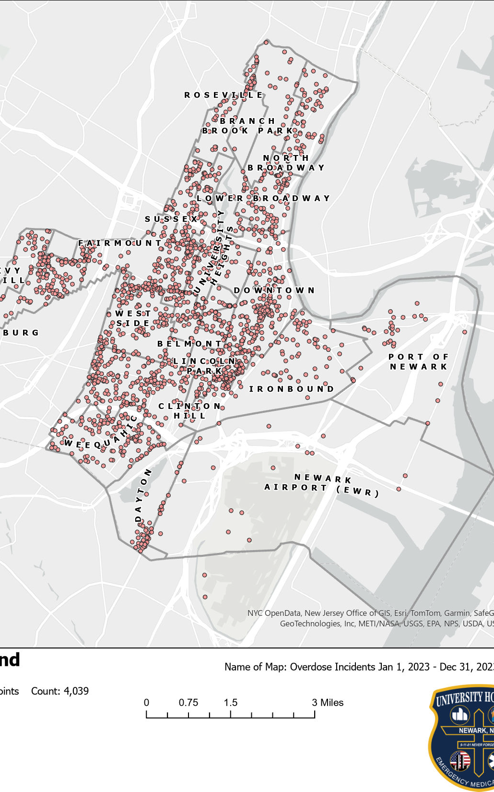
Overdose Mapping: Jan1, 2023, to
Dec 31, 2023

Slide 4
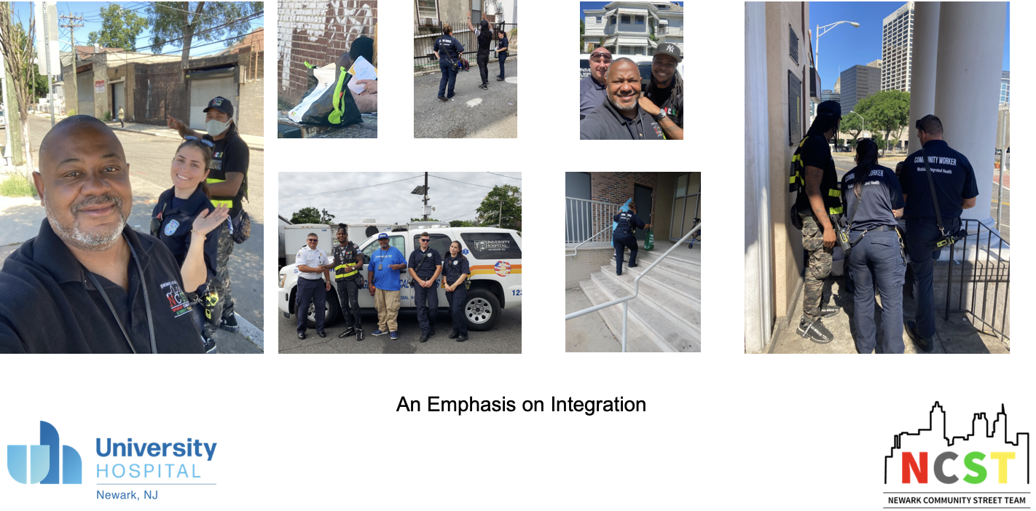
Notes:
Introduce the Overdose Response Team and its importance in creating a comprehensive response to OUD.

Slide 5
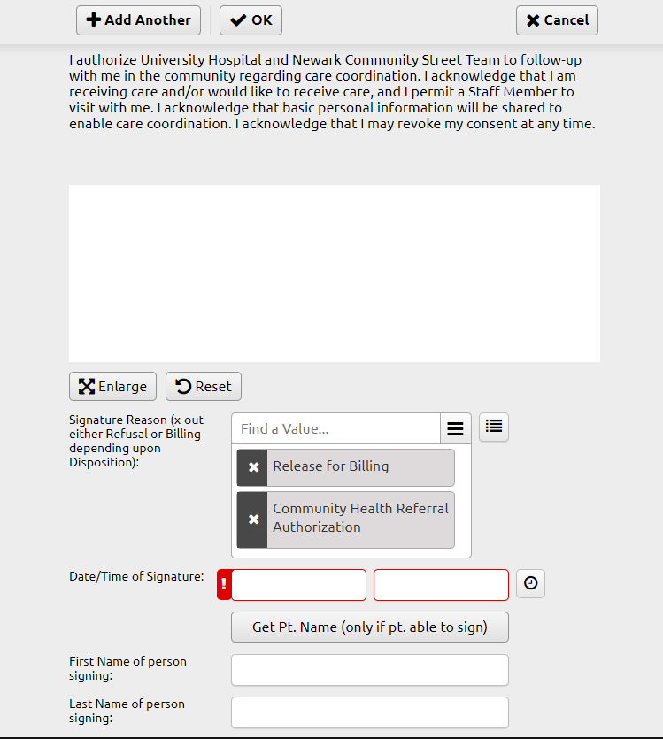
How to Refer Patients?
Old system of manual referrals
  Essentially never happened
  Hope the ED takes care of it
New System integrated to the EPCR

Slide 6
Too Many Steps
EMS Encounter / Referral
Appointment with Agency
Appointment with Outpatient Provider
Outside Social Services Agency Makes Contact
MIH Encounter

Slide 7
EMS Encounter / Referral
Appointment with Outpatient Provider
EMS Navigator

Slide 8
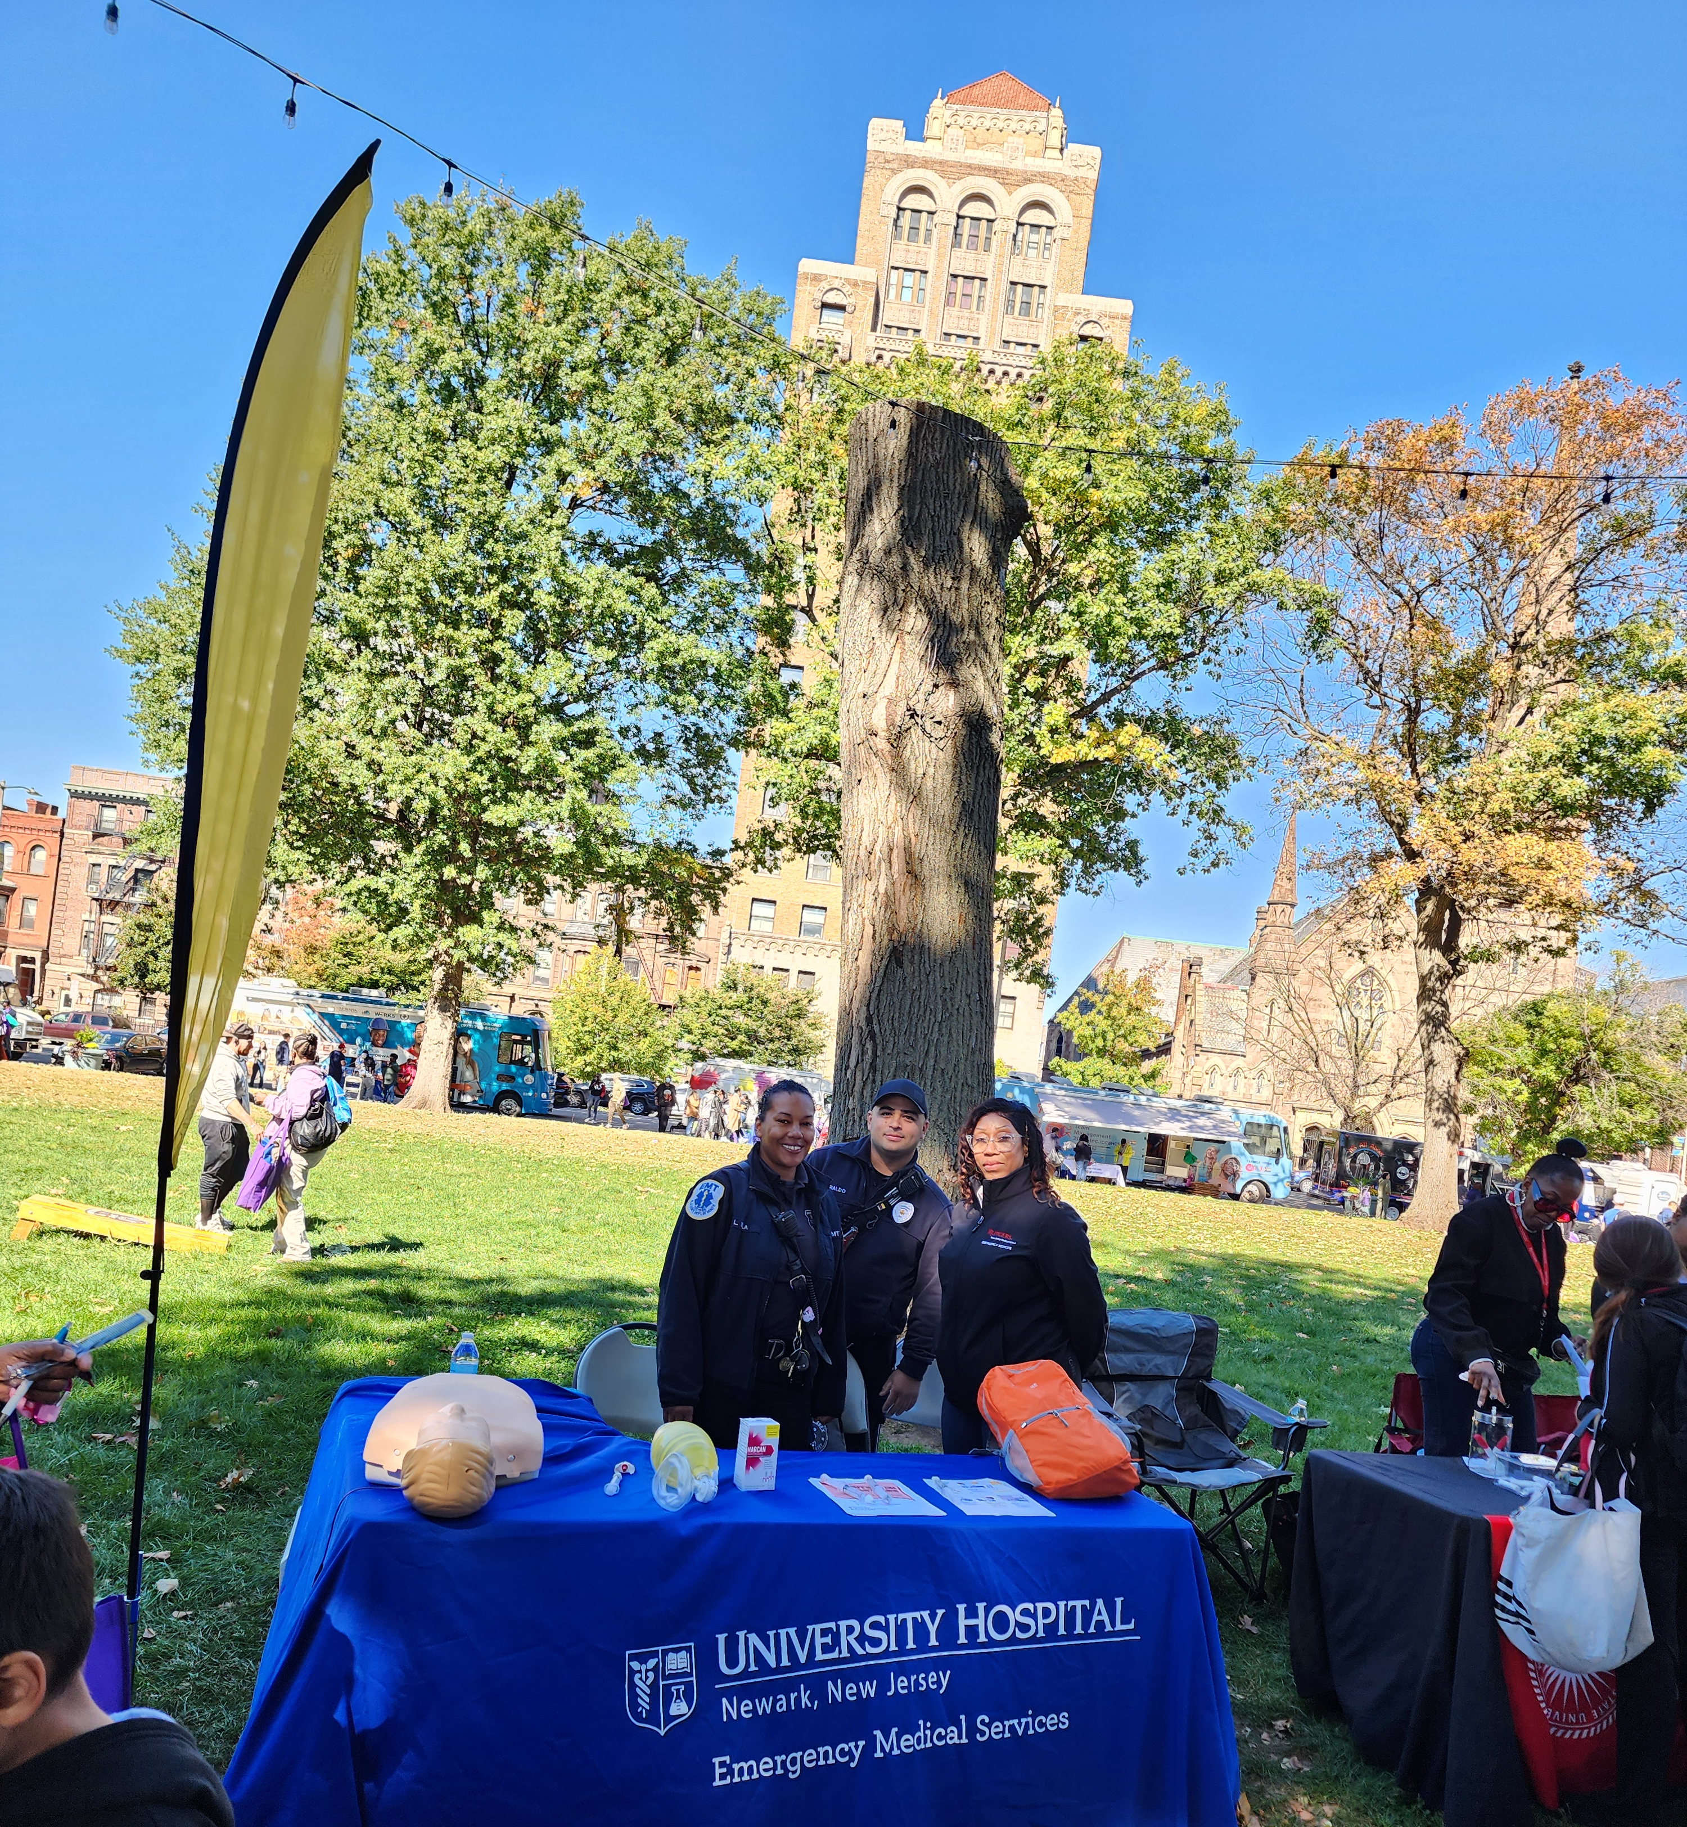
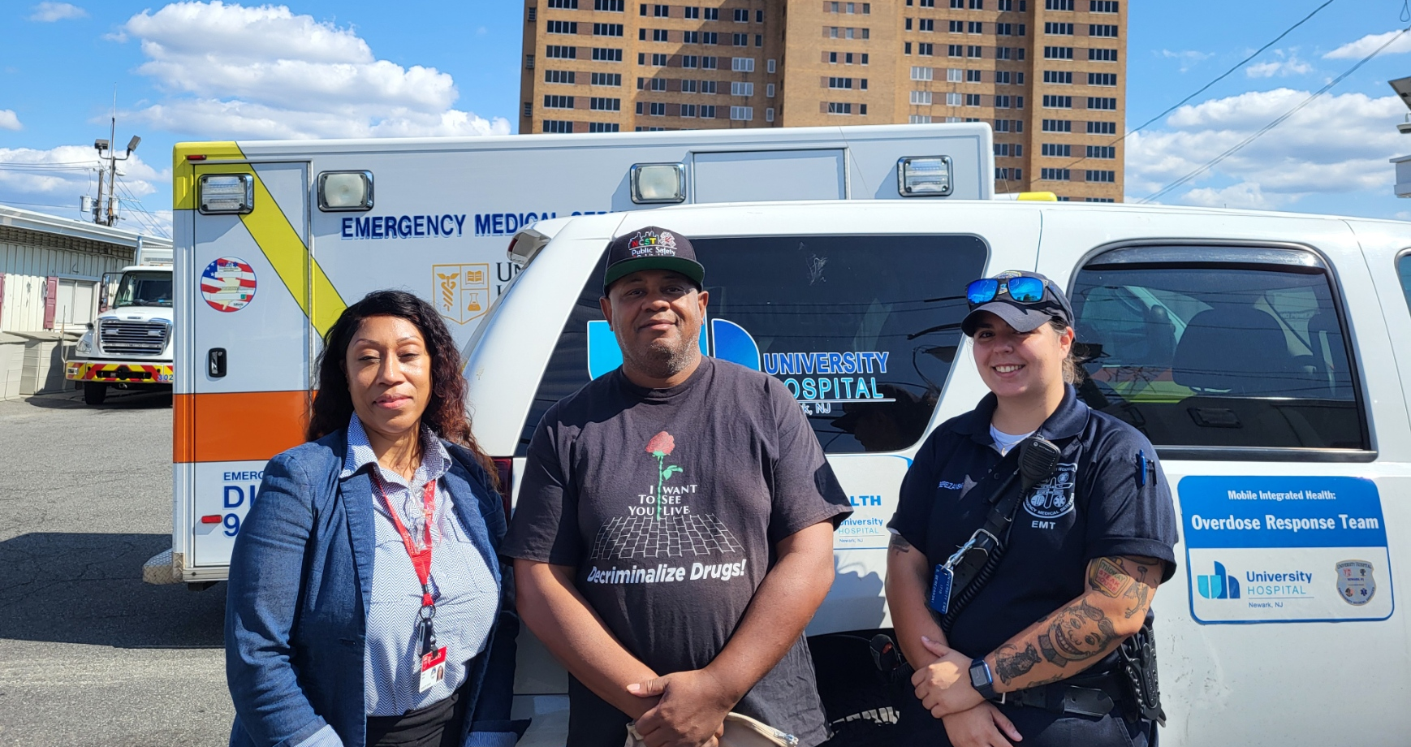
EMS CARE Navigator
EMS Navigator:
  314 Referred to NCST
  104 Referred to Essex County (QRT)
  10 Referred to Blessed ministries for Employment
  253 Call to relatives of participants
  107 Follow-up visits in the community
  14 Bus tickets for participants
  16 participants placed in long term care
  53 Participants placed in Addiction Services
Notes:
MANDY E. SPROW first EMS Care Navigator in the State! She is a compassionate, resourceful, and service focused coordinator and social case worker dedicated to providing resources and pathways for disadvantaged families and individuals.

Slide 9
EMS APN
Rides with our ORT and has clinic hours
Self referral pathway
Opens the door to injectable therapy

Slide 10
EMS Encounter / Self Referral
EMS / Addiction Medicine NP

Slide 11
UHEMS Opioid Plan
Opioid Response Team (Navigator, Community Paramedic, APN)
  Can transport to walk-in clinic
Simplified referral pathway after hours
All ALS units carrying buprenorphine
All units with leave behind naloxone and harm reduction supplies
Weekly education to Newark PD and community groups
Patient referrals by the team are on track to double this year

