Slide 1

This Ain’t Your Father’s Excipient!
From Xylazine to Medetomidine --- What’s the Fentanyl Additive Du Jour?
C. Crawford Mechem, MD
EMS Medical Director
Philadelphia Fire Department
Department of Emergency Medicine
University of Pennsylvania School of Medicine

Slide 2

Four Questions
What is medetomidine
What are manifestations of medetomidine overdose and withdrawal?
How are these treated?
Why has it appeared in Philly’s street drugs?

Slide 3
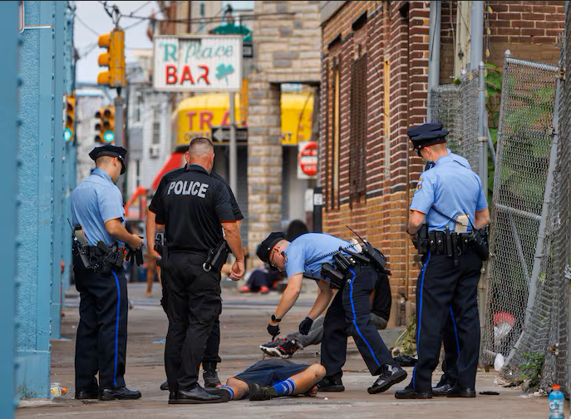
Philly’s Ever Changing Drugs Potpourri
First there was heroin, then fentanyl, then xylazine (“tranq”) in fentanyl
In April 2024 saw a cluster of opioid ODs that just didn’t seem right
  No response to naloxone
  Severe CNS depression, bradycardia
Medetomidine had arrived

Slide 4
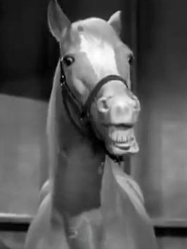
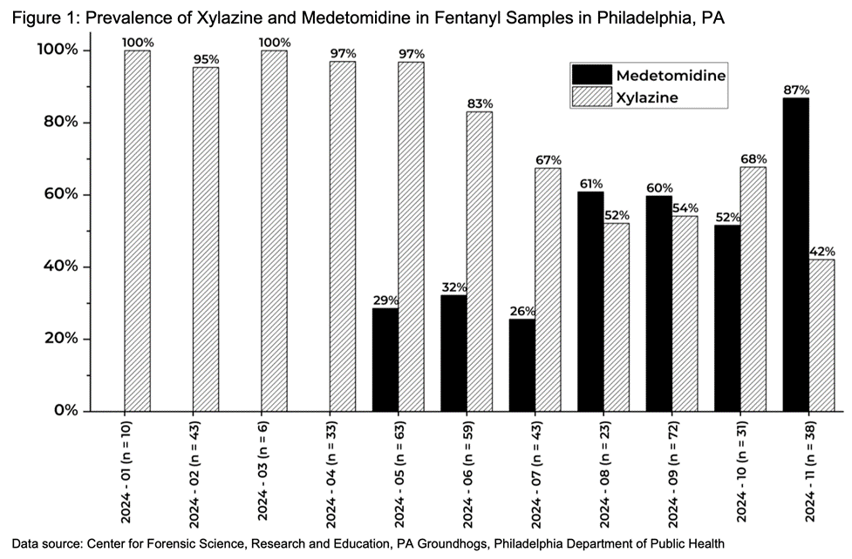
Medetomidine
Veterinary sedative & analgesic
Central α-2 adrenergic agonist
  Like xylazine and clonidine
Related to dexmedetomidine
  Used in ICU/OR for sedation
Now a more common fentanyl adulterant than xylazine
Jan
May 2024
Nov

Slide 5
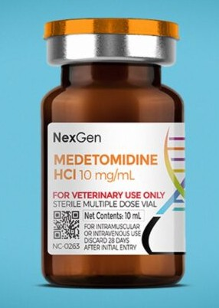
Clinical Effects
Called “Rhino tranq”
100-200x more potent than xylazine
CNS and respiratory depression
Hypotension
Persistent bradycardia (20-50 bpm)
Longer duration than xylazine and fentanyl

Slide 6

Treatment
Based on 160 hospitalized pts during April 2024 cluster
Naloxone administration
  No effect on medetomidine but fentanyl almost always present
Supportive care
Atropine and pressors generally not needed
Hypotension & bradycardia resolved with fluids and time

Slide 7
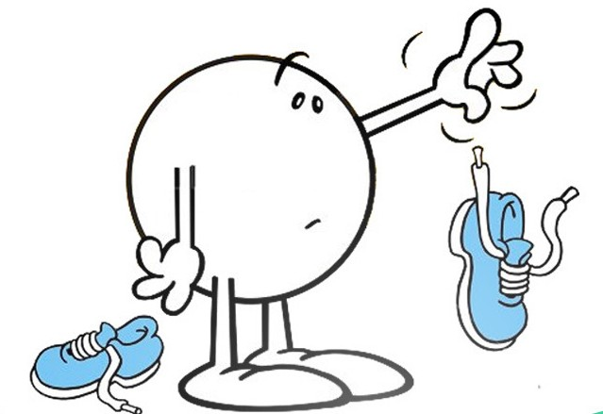
The Other Shoe Drops
Sept 2024 - Jan 2025, 165 pts hospitalized with opioid withdrawal with severe autonomic signs
Profound hypertension, tachycardia
Nausea, vomiting, diarrhea, agitation, tremors
91% required ICU, 24% required intubation
Similar to dexmedetomidine withdrawal seen in ICUs
Medetomidine withdrawal syndrome
MMWR Morb Mortal Wkly Rep. 2025 May 1;74(15):266-268.

Slide 8
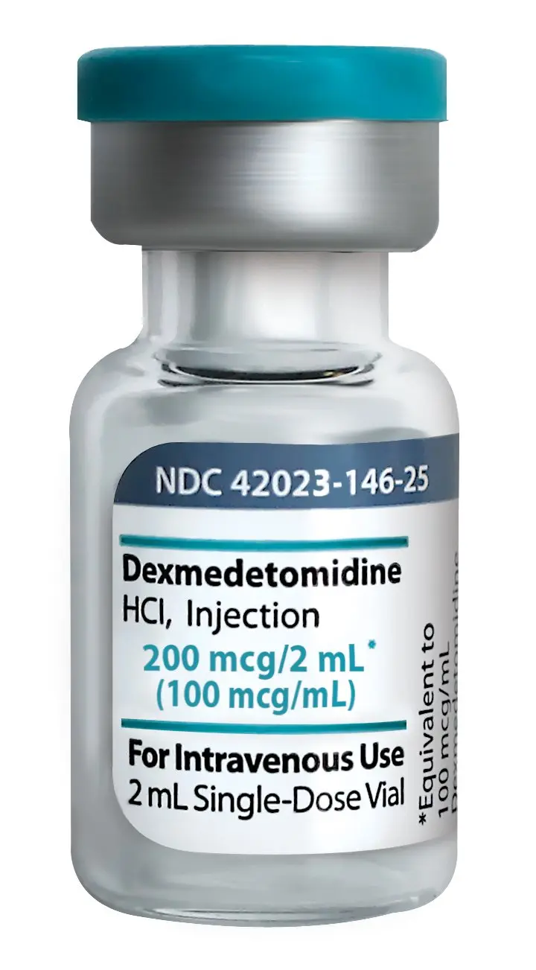

Management – What Works?
Treat coexisting opioid and xylazine withdrawal, but expect to use much higher doses
Opioids, sedatives, ketamine, anti-emetics, droperidol, etc…
Antihypertensives
α-2 agonists, starting with clonidine but transition early to dexmedetomidine (83% response rate)
penncamp.org/medetomidine/

Slide 9
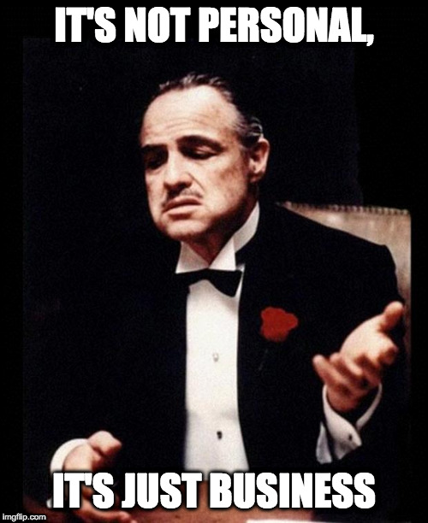
Why Add Medetomidine?
Xylazine less available due to new regulations
Medetomidine is cheap and not tightly regulated
Enhances and prolongs fentanyl’s sedation and euphoria, so better high
Not believed to cause wounds like xylazine
Good xylazine replacement, good business move

Slide 10

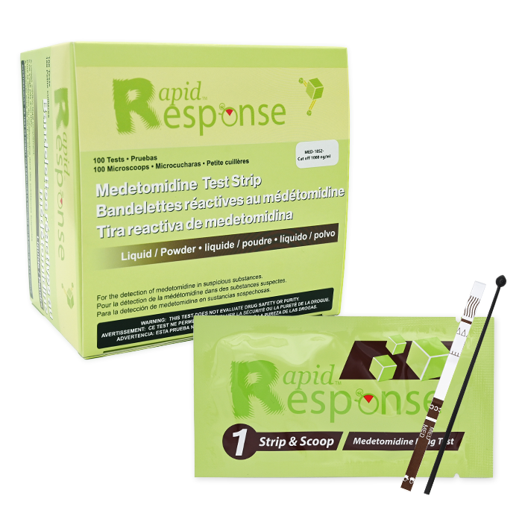
Closing Thoughts
Medetomidine is here to stay, for now
Causes profound CNS, respiratory, and CV depression
No antidote. Treatment supportive
Withdrawal produces severe autonomic hyperactivity
Low threshold to treat this with dexmedetomidine
Already talk of making it a controlled substance
Test strips already available

