Slide 1

Pin-Pointing Your Pupils:
Value of Public-Facing Data and Community Education in the Opioid Crisis
Ben Weston, MD, MPH, FAEMS

Slide 2



What are key elements to understand the state of the opioid epidemic?

Slide 3





Slide 4
How can data be leveraged to improve population health?

Slide 5
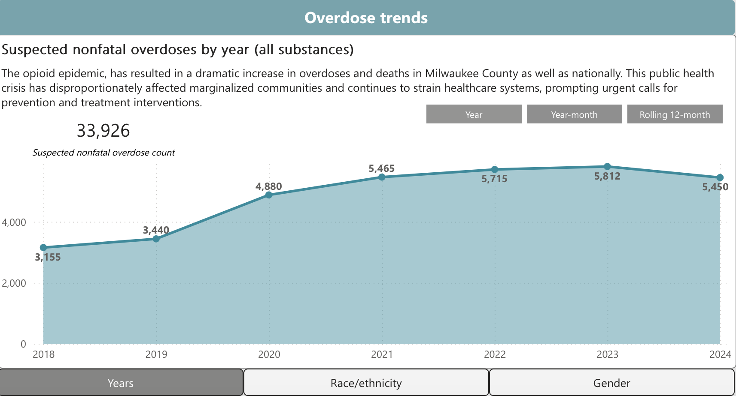
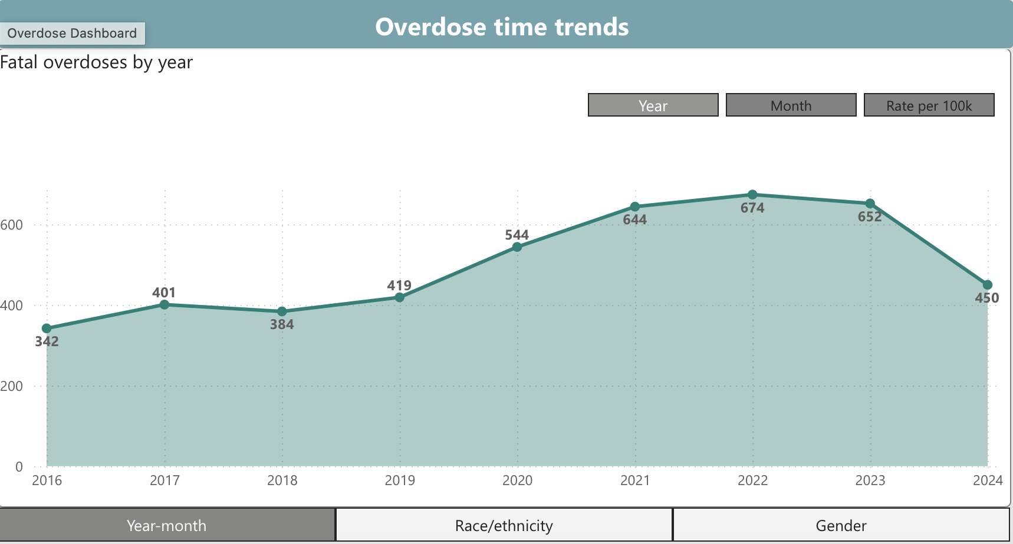


Slide 6
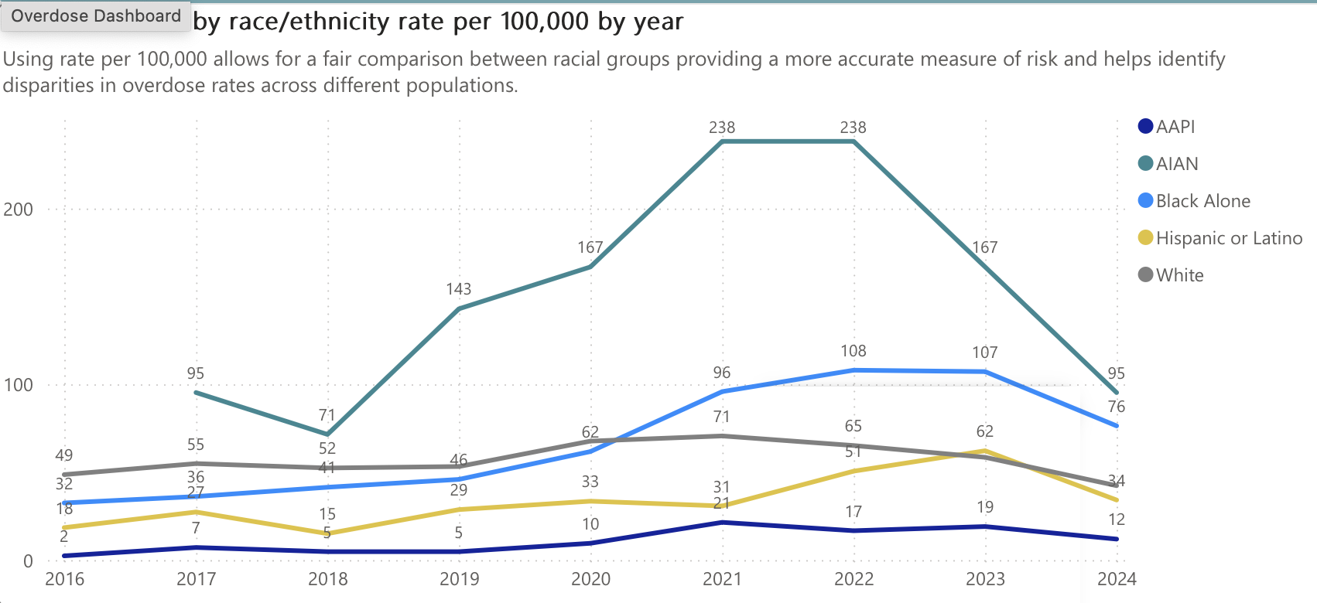

Slide 7
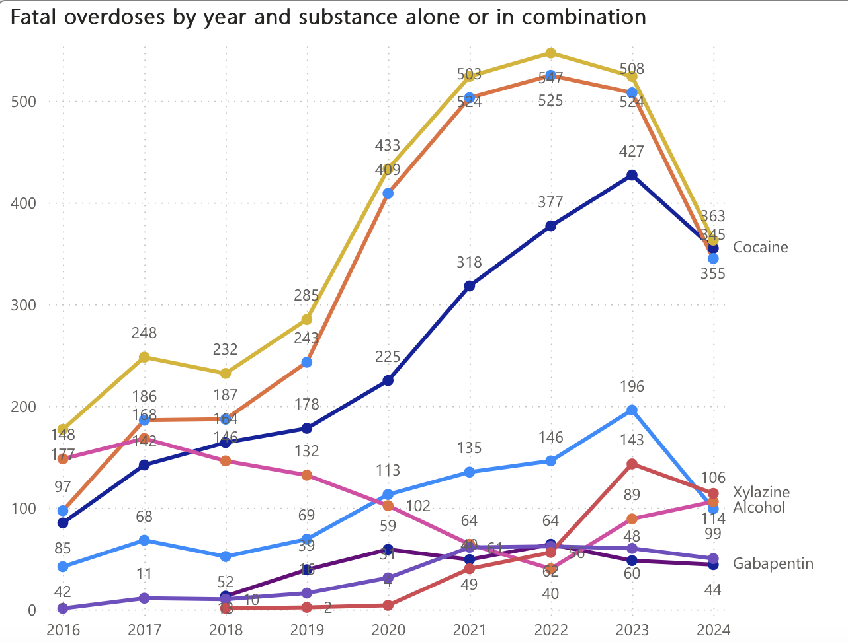

Slide 8
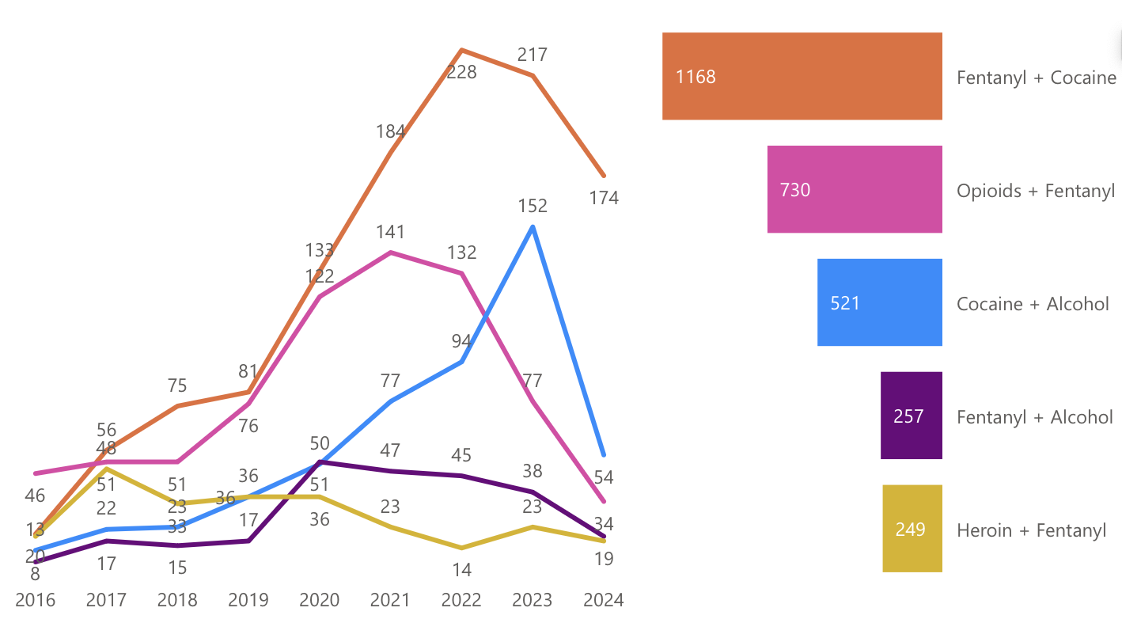

Slide 9
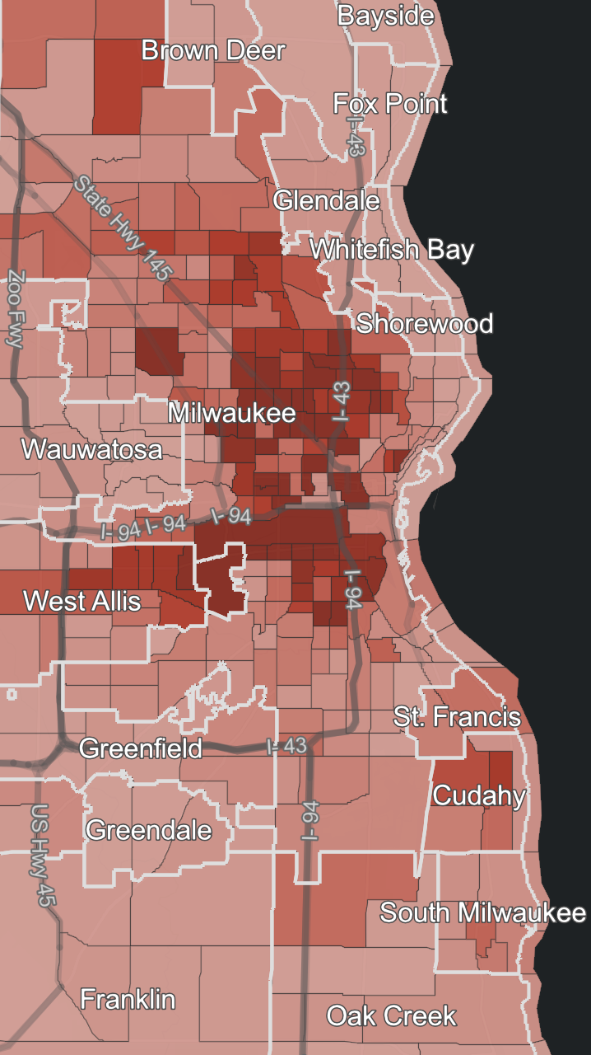

Slide 11
What is the value of public facing data?

Slide 12
Thank You
beweston@mcw.edu
@BenWWeston

