Slide 1
Leveraging DEA Drug Take Back Day
Robert Lowe MD FACEP FAEMS
Columbus (OH) Division of Fire

Slide 2
How can we leverage DEA drug take back day to increase Community Outreach?
Goal is to get as many ”touches” as possible

Slide 3
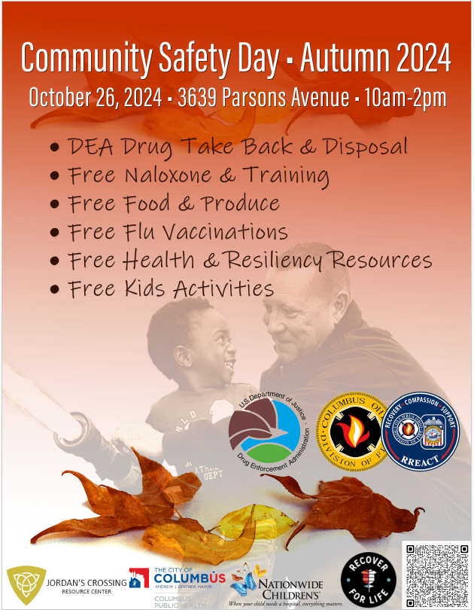

Slide 4
What resources have been well received or utilized in our experience?

Slide 5
Community Safety Day
Food Grocery Bags to 310 Families
161 Narcan Kits
125 Gun Locks
54.18 lbs of prescription medications were collected
39 Flu Vaccinations
Children’s bike helmets
Legal Aid Consults
300 grab bags - Franklin County Public Health (Water bottles, sunglasses, flashlights, hand sanitizer)

Slide 6
How do you manage the volume of Attendees?

Slide 7
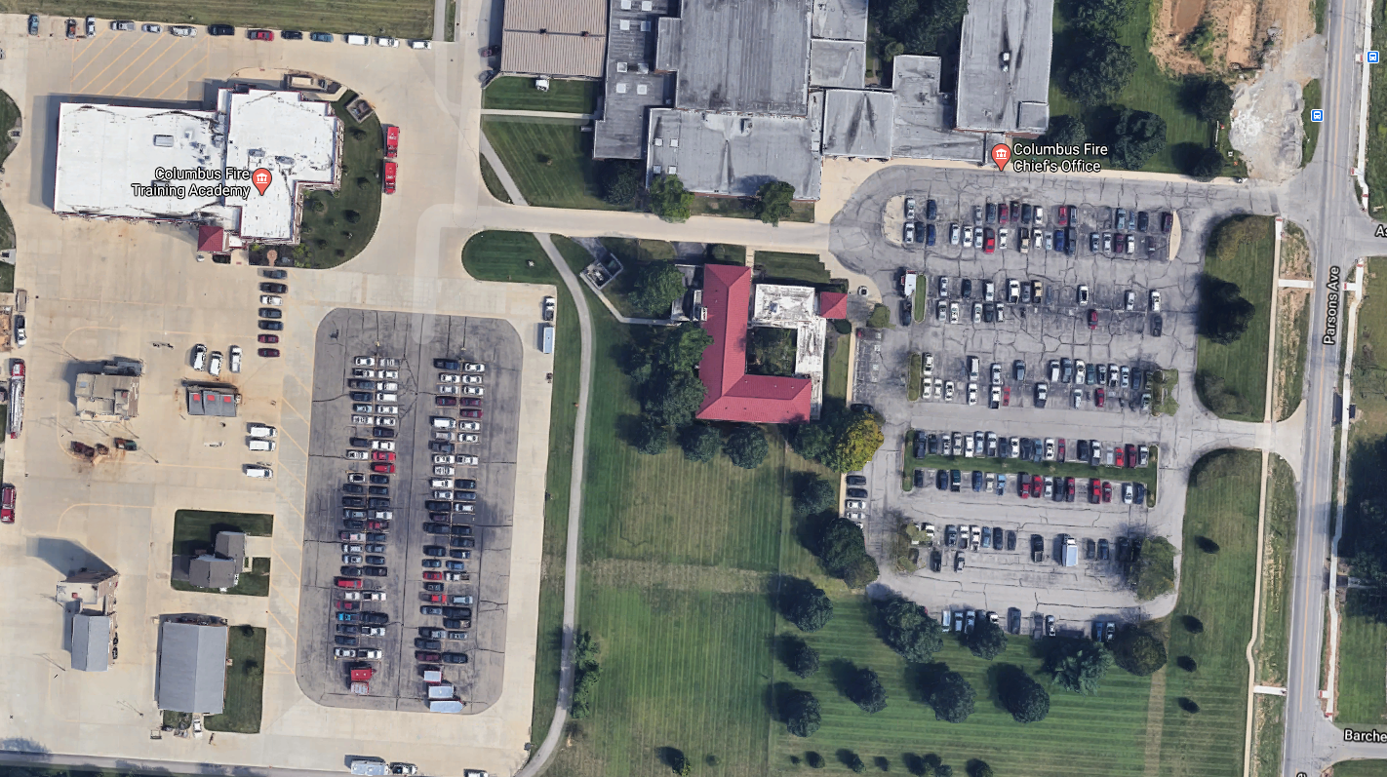
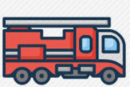
FOOD
DEA
Enter
Narcan, CPH, Care, FCPH, Linden
FPB
Event Parking
Exit
Cadet corner; Fire Engine, CPR & Bleeding control, Therapy dogs, Bike helmets, Gun locks, COSI, Recruitment CFD & CPD
Volunteer Parking
Upper Arlington
Testing

