Slide 1
Blood and Transfusion Discussion
Info and Thursday Dress Rehearsal

Slide 2
Randi Schafer
State of Current Blood

Slide 3

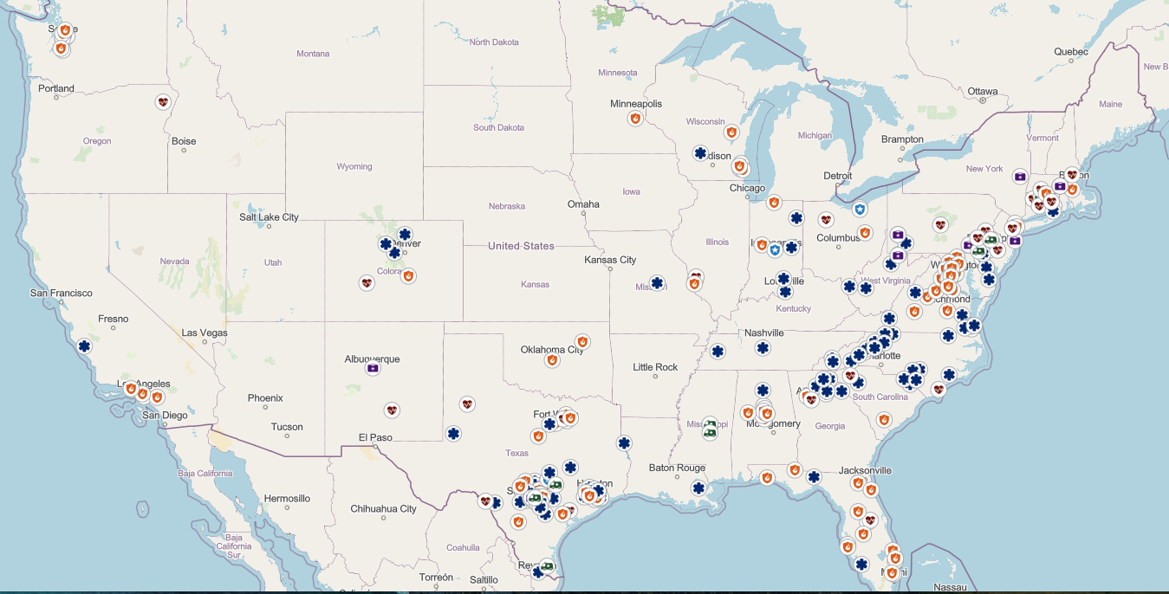
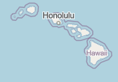
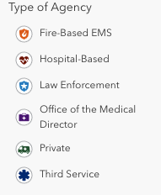

Ground EMS Prehospital Blood Transfusion Programs as of May 2025
Source: https://prehospitaltransfusion.org/blood-program-interactive-map/

Slide 4
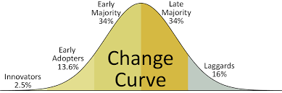
Top Issues
Scope of Practice
What if we can’t get LTOWB?
Education, Training, Standardization
Economics and Advocacy

Slide 5
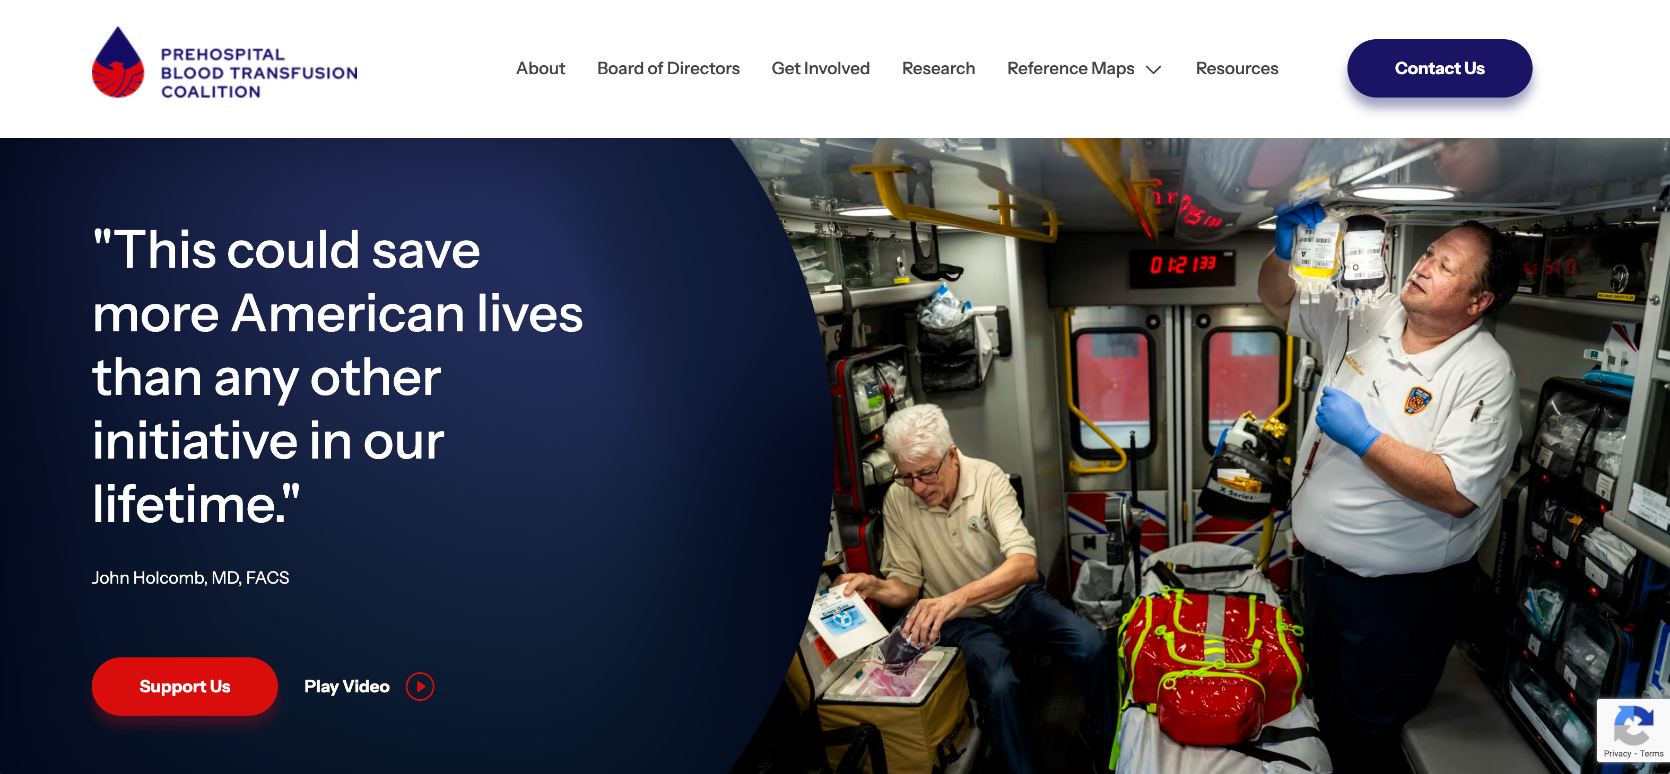

Prehospital Blood Transfusion Coalition
Collaboration / Facilitation / Resources
  Non-regulatory / no standards development
Open to all interested stakeholders
  EMS agencies
  Individuals
  Regulators
  Federal partners (ex-officio)
  Industry partners
Agnostic to:
  Blood components
  Causes of hemorrhagic shock
  Patient condition and age
www.prehospitaltransfusion.org

Slide 6
Dr. Paul Pepe
Disparities and Future Trends

Slide 7
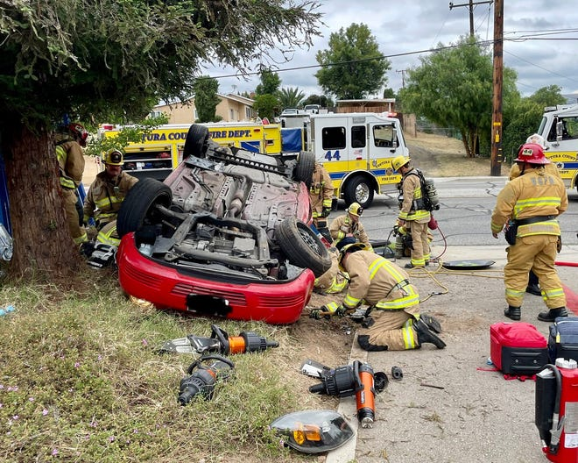
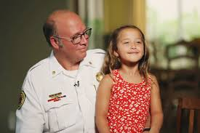
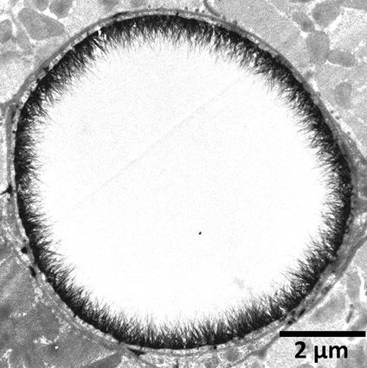
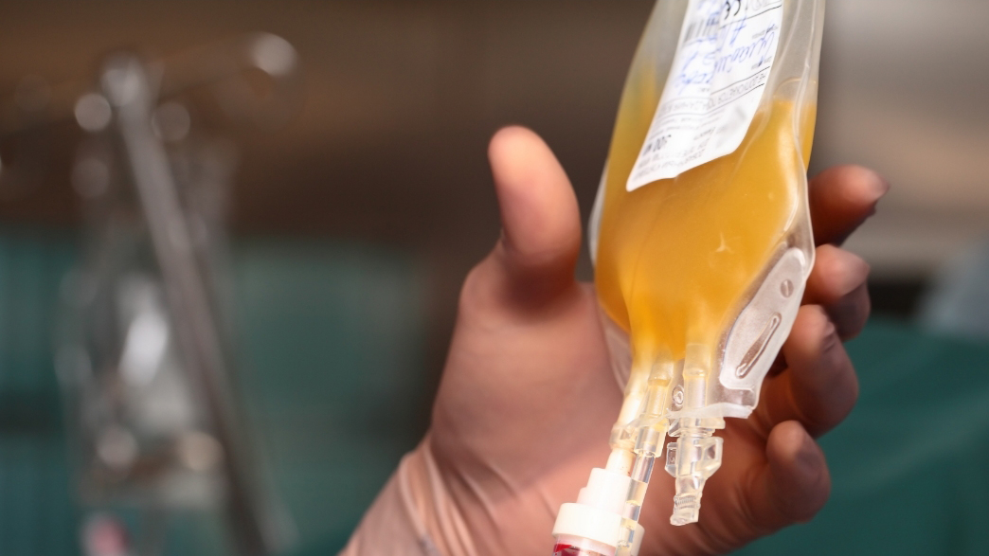
Disparities, Unclarities and the New Verities in the World of EMS Transfusions
What is Likely to Evolve with Prehospital Blood Product Administration?
Paul E. Pepe, MD, MPH, FAEMS, MCCM, MACP, FACEP, FCCP, FRCP
Adjunct Professor of Management, Policy & Community Health
University of Texas Health Sciences Center, Houston, USA
and
Public Safety/EMS Medical Director,
Dallas County (Texas), USA
\

Slide 8
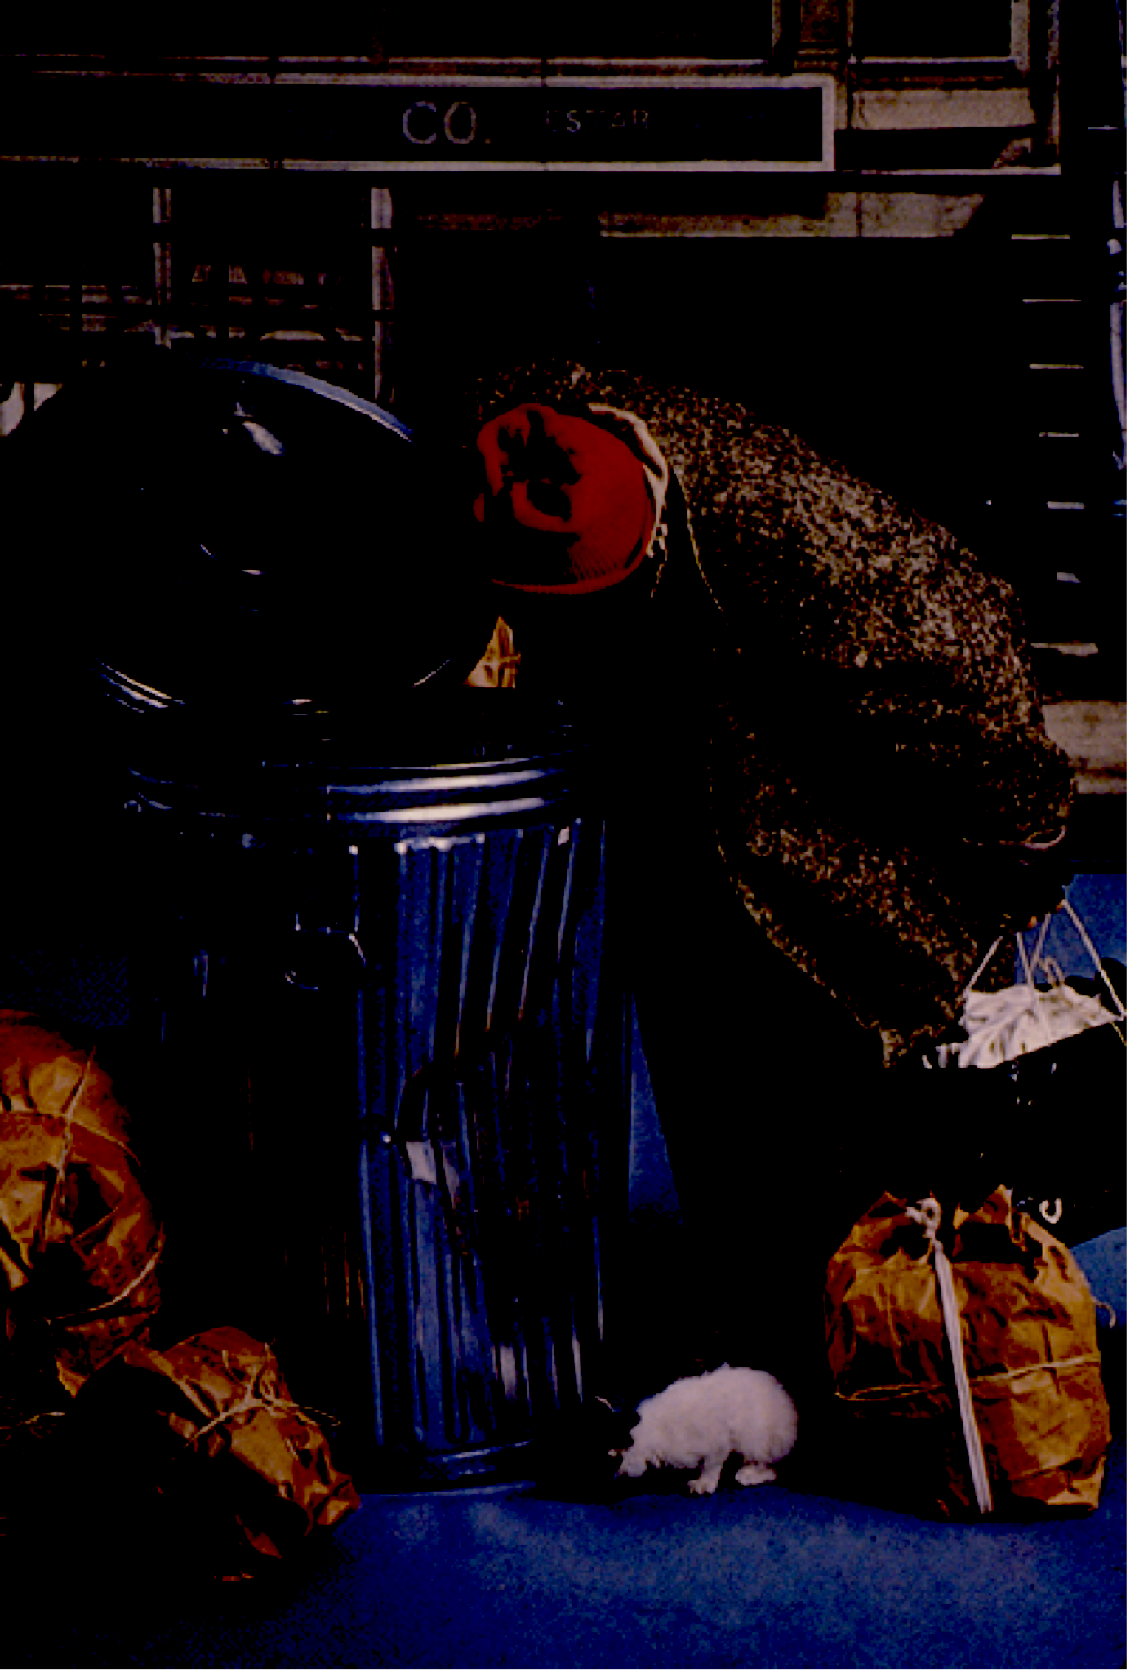
Program Committee Gets Assistance Finding Today’s Speaker ...

Slide 9
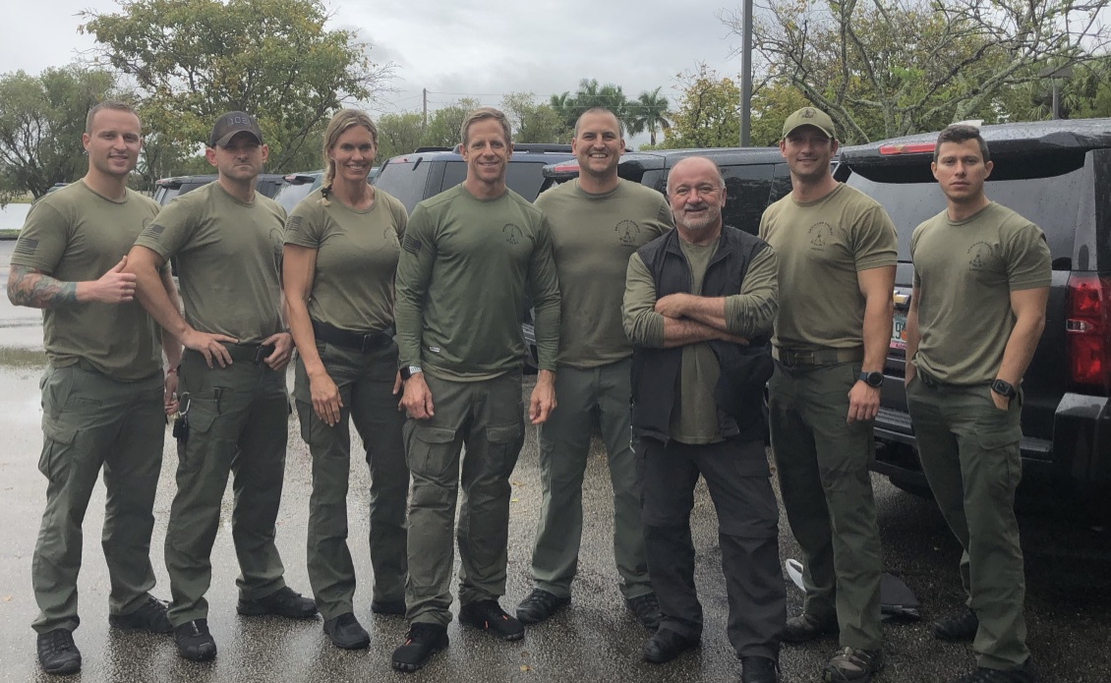
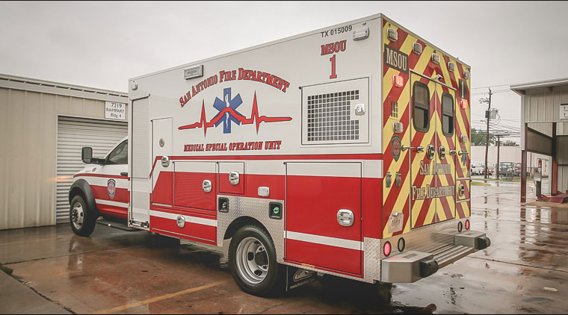
Giving Blood in the Field…

Slide 10
But What’s the Latest?

Slide 11
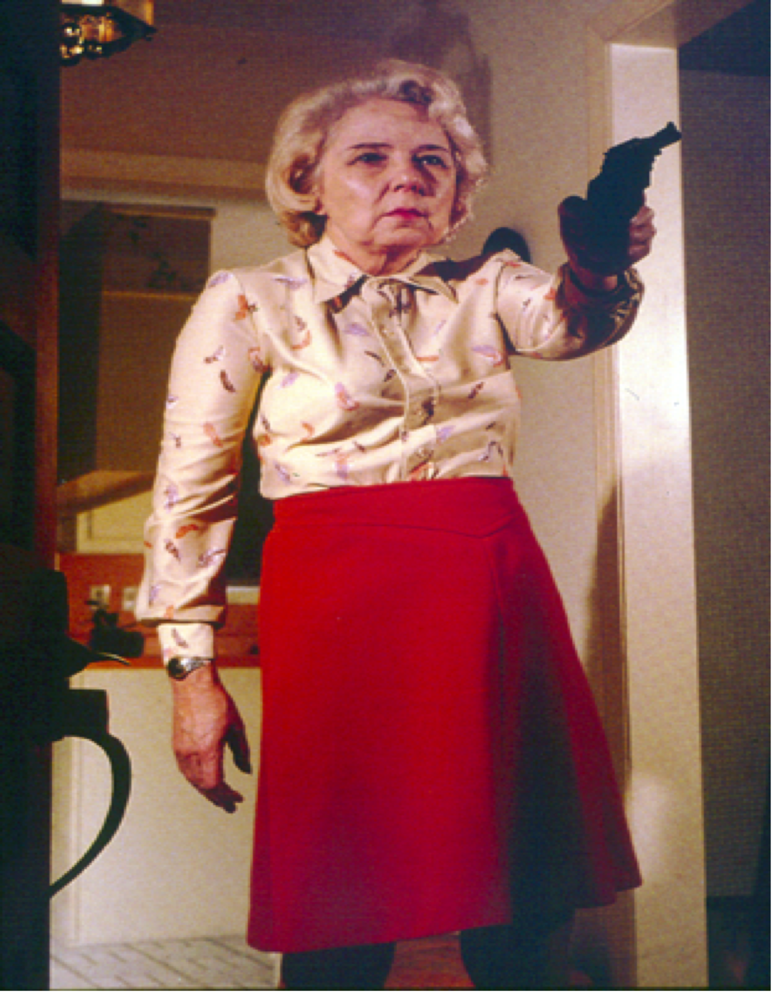
Not Just Trauma …

Slide 12


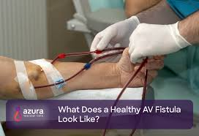

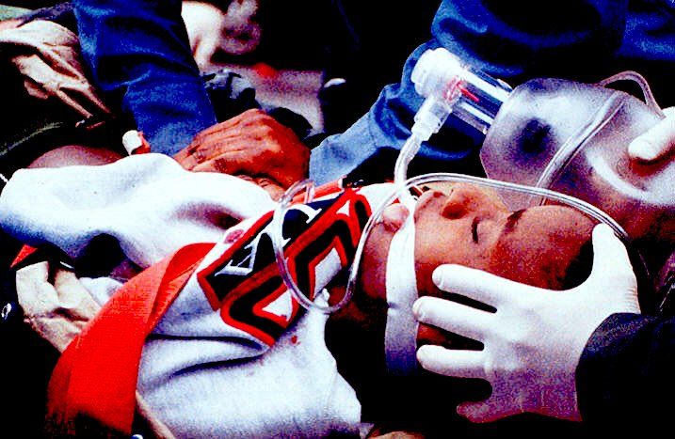
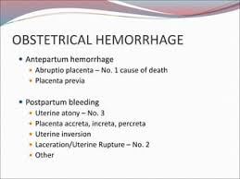
X

Slide 14
But ….

Slide 15
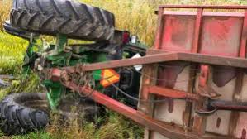
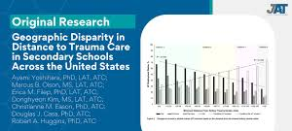
Disparities and Limitations

Slide 16
Not Only That …

Slide 17
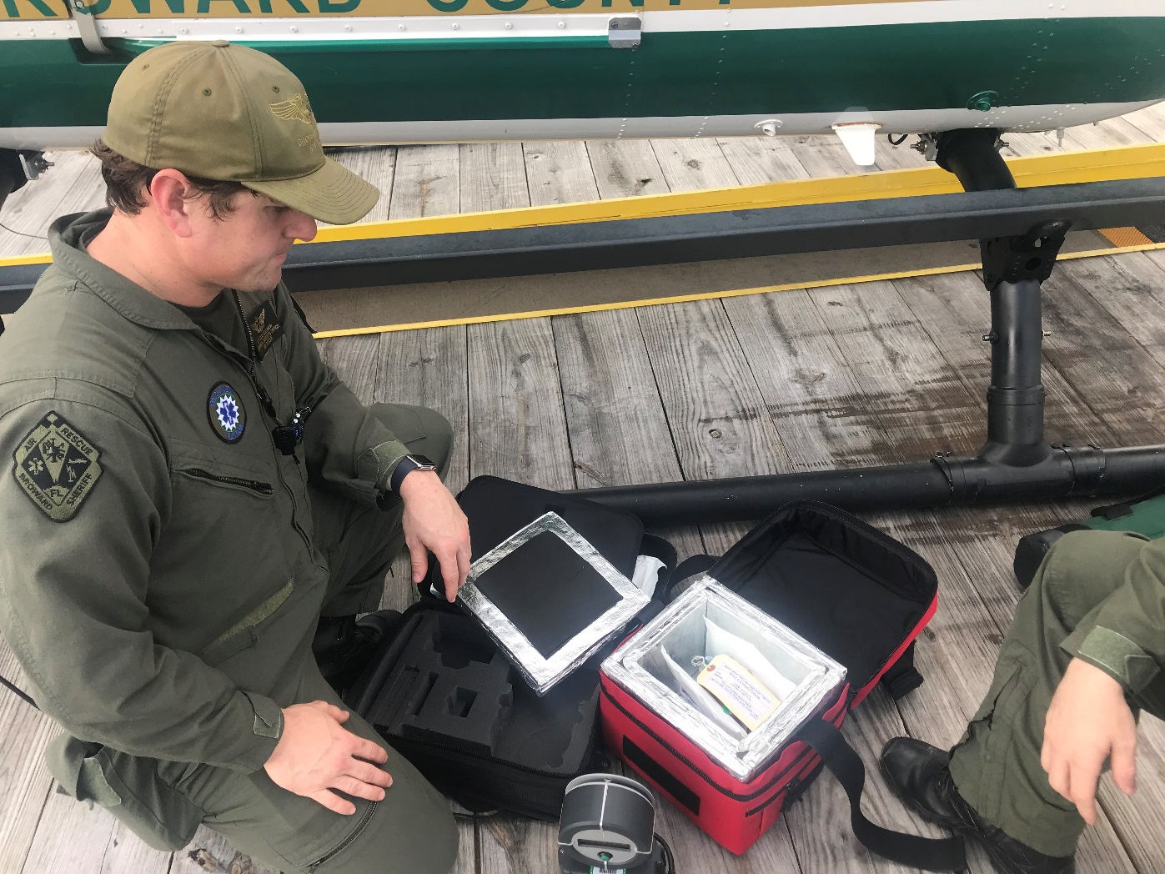
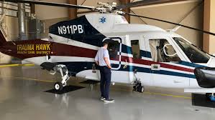
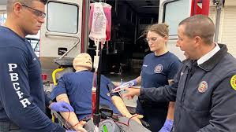
Not On Every Ambulance …

Slide 18
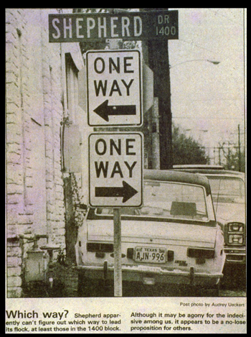

Slide 19

Protect the Glycocalyx !

Slide 20
Scand J Trauma Resusc Emerg Med. 2016; 24: 48
Published online 2016 Apr 12. doi: 10.1186/s13049-016-0239-y
PMCID: PMC4828893
PMID: 27068016
The endothelial glycocalyx and its disruption, protection and regeneration: a narrative review
Ulf Schött, Cristina Solomon, Dietmar Fries, and Peter Bentzer

Slide 21
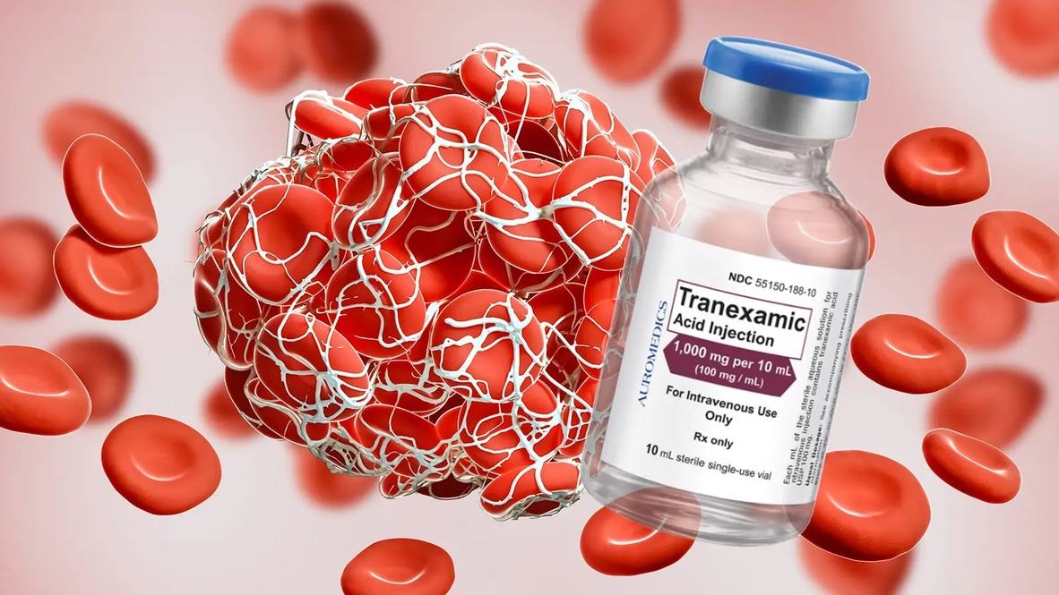
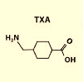
TXA and Plasma

Slide 22
TXA
Head
Injury
New NIH ROC Study….

Slide 23
TXA for TBI
ROC TXA Study….

Slide 24
ROC TXA for TBI JAMA
But, Examining Those with CT-Confirmed Intracranial Hemorrhage – the Target Group…
16% mortality with 2 grams upfront
vs. 27% with 1g+1g infusion vs. 26% Placebo
Increased Risk of Seizures but good outcomes
and no other increase in complications = safe

Slide 25
For Bleeding Deaths – Early TXA Treatment is Better
RR (99% CI)
≤ 1 hour
0.68 (0.54–0.86)
>1 to ≤ 3 hours
0.79 (0.60–1.04)
>3 hours
1.44 (1.04–1.99)
0.85 (0.76–0.96)
.7
.8
.9
1
1.1
1.2
1.3
1.4
1.5
BETTER OUTCOME
WORSE OUTCOME
p=0.000008

Slide 26
TXA and Plasma

Slide 27
Hematology Am Soc Hematol Educ Program. 2013;2013:656-9.
doi: 10.1182/asheducation-2013.1.656.
Optimal trauma resuscitation with plasma as the primary resuscitative fluid: the surgeon's perspective.
Holcomb JB¹, Pati S.
Abstract
Over the past century, blood banking and transfusion practices have moved from whole blood therapy to components. In trauma patients, the shift to component therapy was achieved without clinically validating which patients needed which blood products. Over the past 4 decades, this lack of clinical validation has led to uncertainty on how to optimally use blood products and has likely resulted in both overuse and underuse in injured patients. However, recent data from both US military operations and civilian trauma centers have shown a survival advantage with a balanced transfusion ratio of RBCs, plasma, and platelets. This has been extended to include the prehospital arena, where thawed plasma, RBCs, and antifibrinolytics are becoming more widely used. The Texas Trauma Institute in Houston has followed this progression by putting RBCs and thawed plasma in the emergency department and liquid plasma and RBCs on helicopters, transfusing platelets earlier, and using thromboelastogram-guided approaches. These changes have not only resulted in improved outcomes, but have also decreased inflammatory complications, operations, and overall use of blood products. In addition, studies have shown that resuscitating with plasma (instead of crystalloid) repairs the

Slide 28
I’m Paul Pepe…
... and I Approved this Message

Slide 29
Punt to Dr Holcomb…

Slide 30


Ditch the Saltwater:
Plasma is the Next Revolution in TBI Management
Peter Antevy, MD
Medical Director

Slide 31
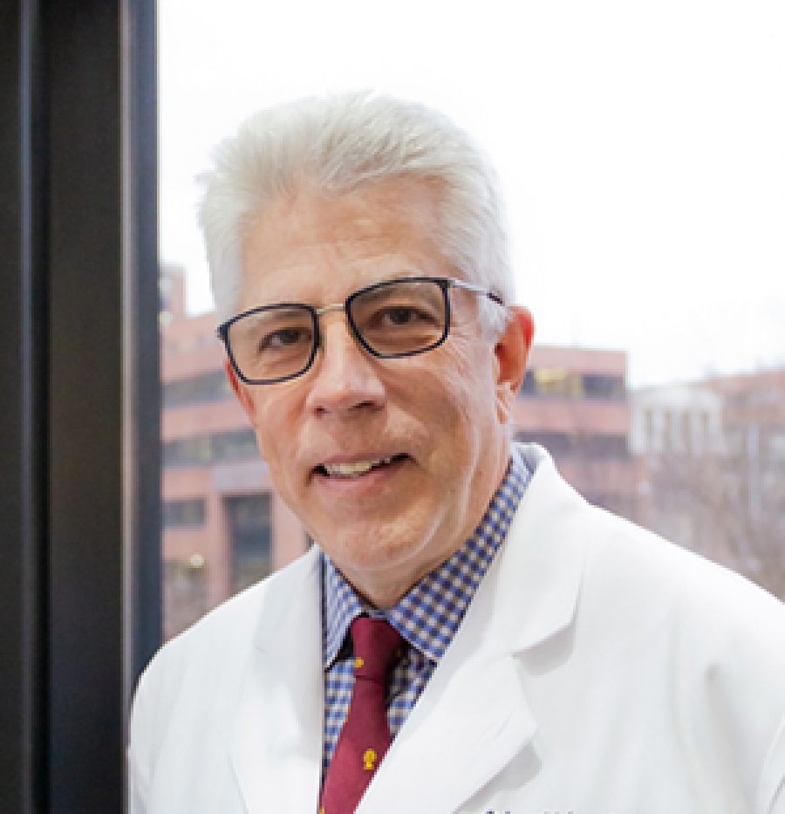
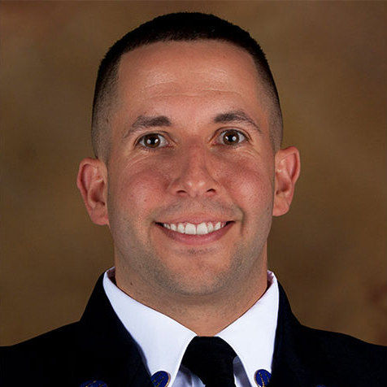

Slide 32
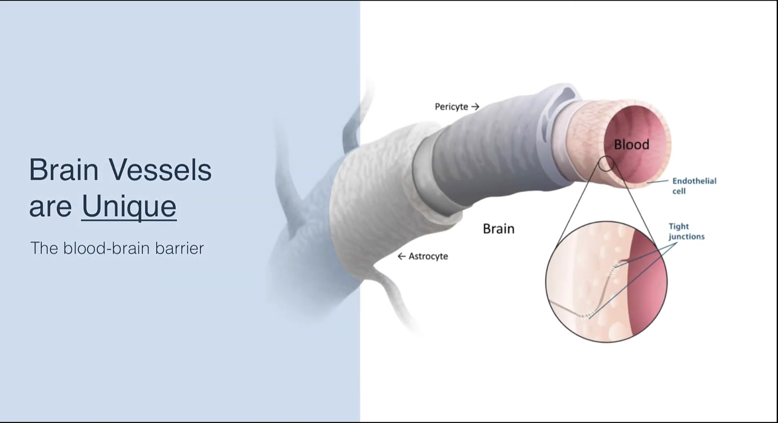

Slide 33
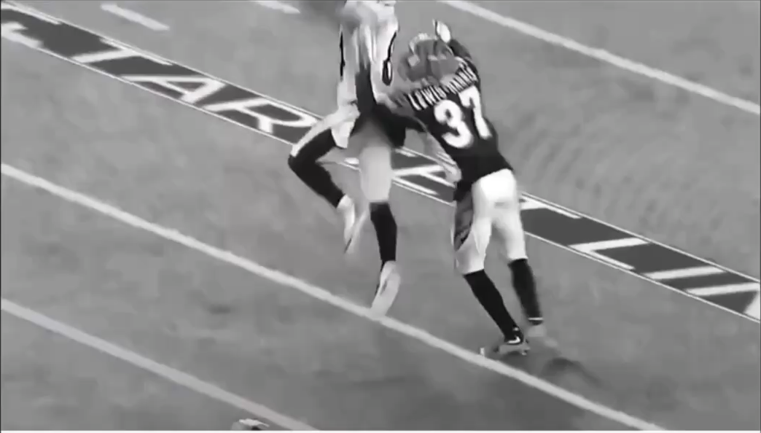

Slide 34
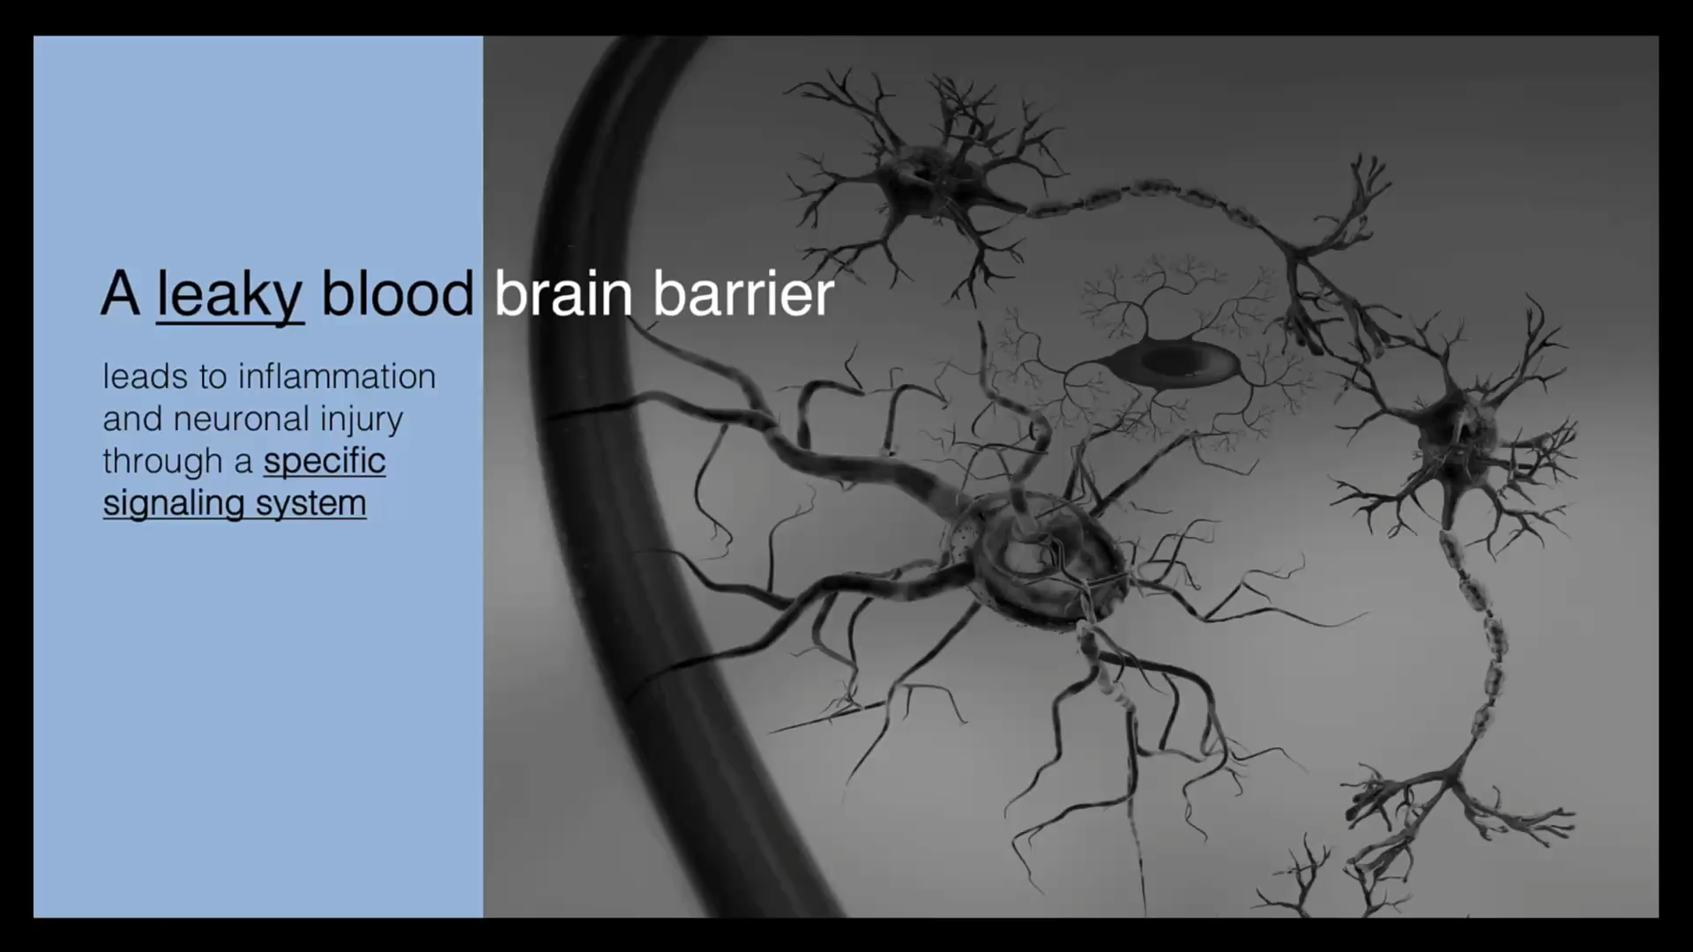

Slide 35
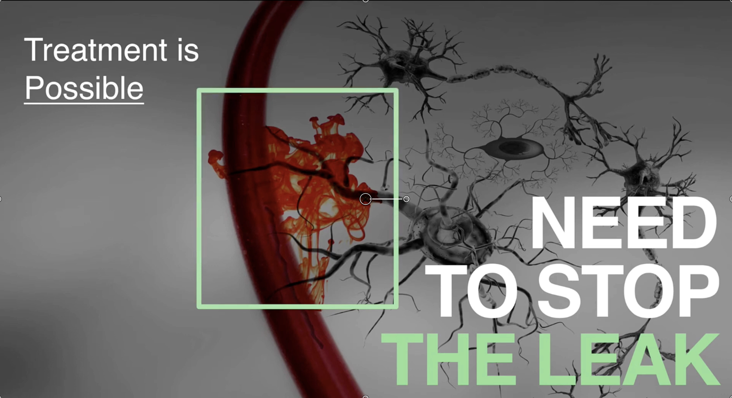

Slide 36
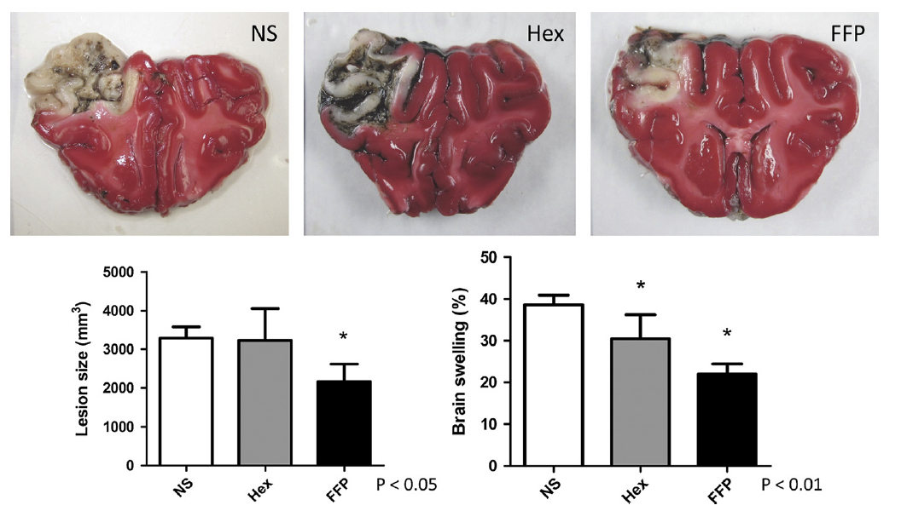
TBI : Large Animal Model

Slide 37
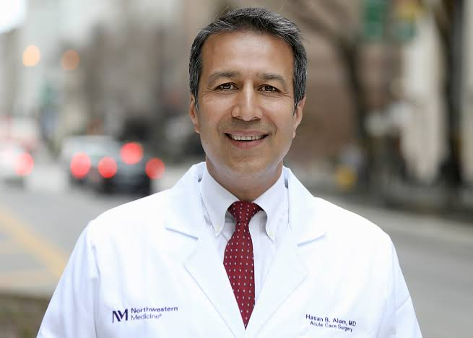
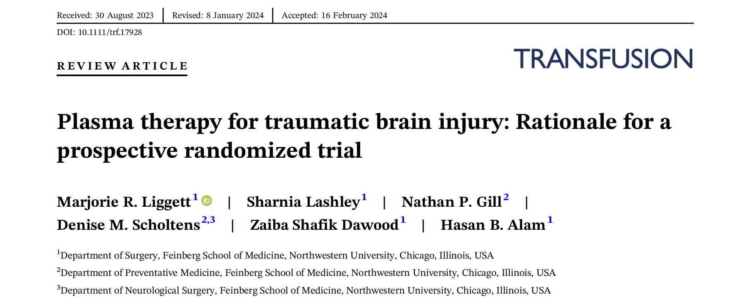
A Multicenter RCT Has Begun

Slide 38
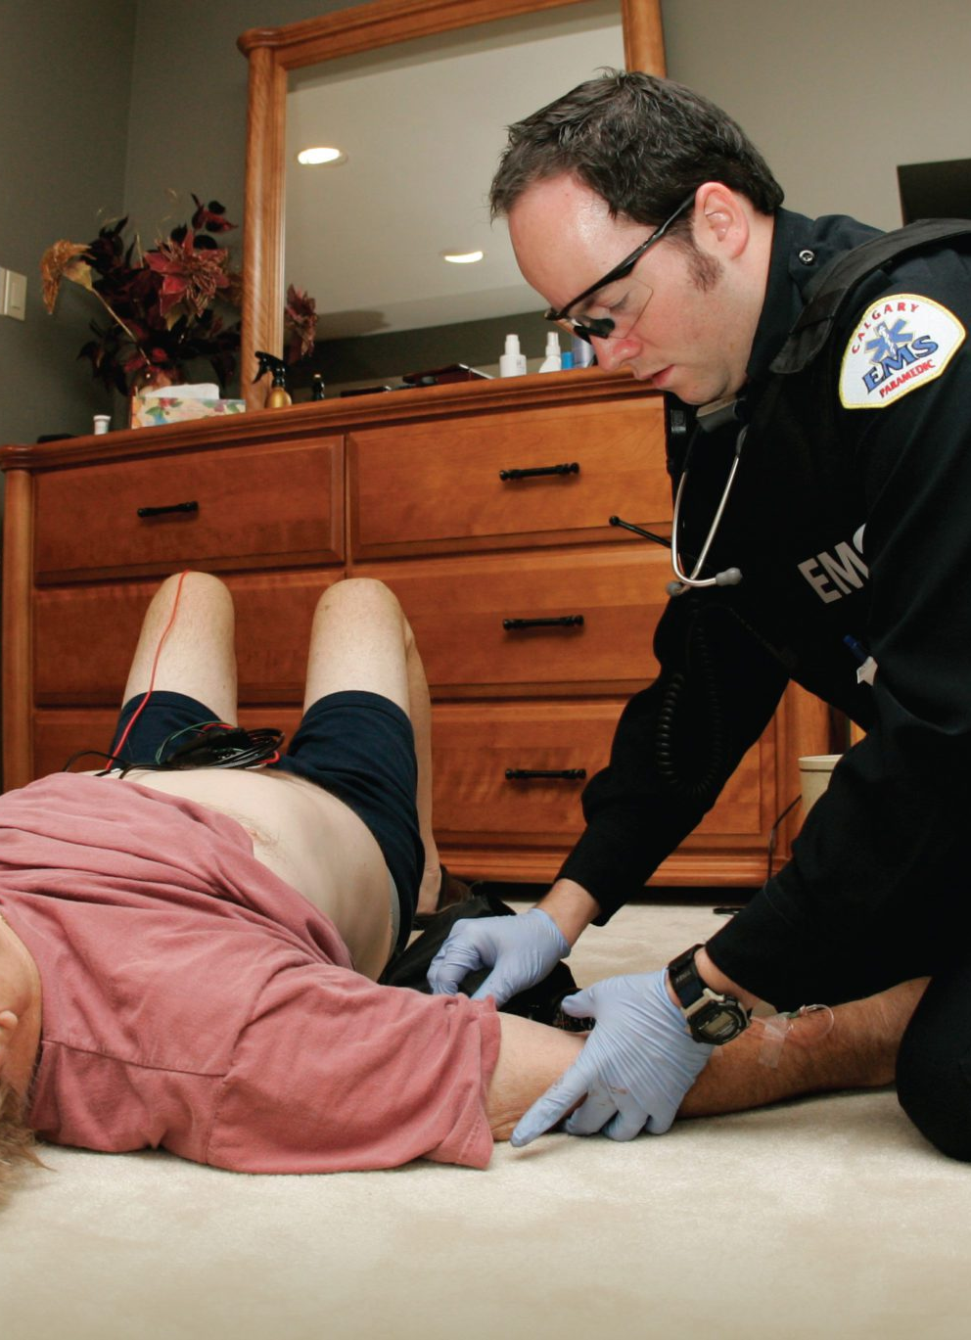
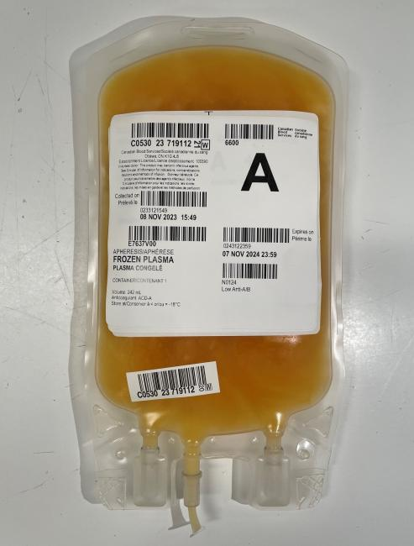
Plasma: The Next Frontier
TBI
Trauma
Sepsis
Burns
ACE-i induced Angioedema
Warfarin Reversal

Slide 39
Eric Bank
Plasma Uses

Slide 40
Dr. Don Jenkins
Calcium in Hemorrhage States

Slide 41
Medication Adjuncts in Rapid Emergency Transfusion
Don Jenkins, MD
Collaboration Kristi Hargrove, PharmD & Daniel Giddings, PharmD

Slide 42
Background
Calcium plays an important role in trauma resuscitation
Hypocalcemia exacerbates trauma induced coagulopathy
Standardized calcium replacement protocols have been associated with lower incidence of hypocalcemia in massive transfusion
Laing ML. J Trauma Nurs. 2023; 30 (5): 290-295.
Shandaliy Y. Am J Health-Syst Pharm. 2024; 81 (4): S160-S165.

Slide 43
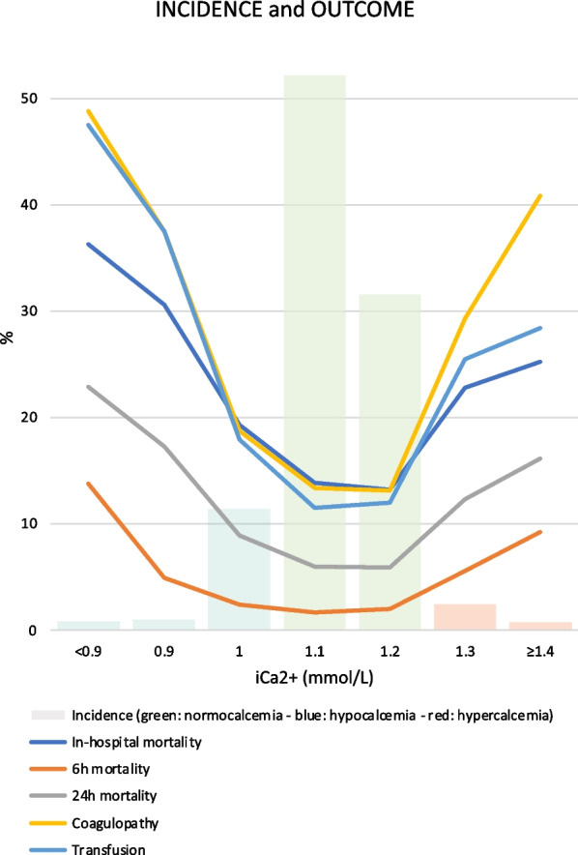
Background
Hypo- and hypercalcemia on presentation both linked to worse outcomes
Optimal calcium repletion strategy is not known
  Elemental Ca per unit?
  Citrate/calcium ratio?
Conflicting evidence to the optimal repletion strategy in ongoing emergency transfusion
Helsloot D. Crit Care. 2023;27(1):267
Robinson A. Am J Emerg Med. 2023;70:96-100
Wade DJ. J Surg Res. 2024;303:788-794.
Helsloot D. Crit Care. 2024;28(1):222.
Chanthima P. Anesth Analg. 2021;132(6):1684-1691.

Slide 44
Goals and target patients for UH guideline
All adult trauma patients receiving rapid emergent transfusion
Condense available data + guidelines into concise recommendations
  Calcium
  Monitoring
Consider logistics and resuscitation priorities
  IV access available, medication administration times and safety

Slide 45
Calcium repletion recommendations
Initial repletion – lab driven
Transfusion-based repletion
Follow-up doses
  iCal 1.0-1.2 = 1g CaCl
  iCal < 1 or no timely measurement = 2g CaCl
  1g CaCl every 3-4 units (whole blood or component therapy)
  Additional 1-2g CaCl based on repeat point of care iCal at attending discretion

Slide 46
Administration and monitoring
Calcium chloride preferred
  If calcium gluconate utilized, higher doses required
Administer calcium chloride diluted in 100 mL NS over 10 minutes
Central line or large bore peripheral IV may be used
Continuous telemetry and blood pressure monitoring
Repeat point of care blood gas at attending discretion or upon transition of care
  HOLD empiric calcium if iCal > 1.8 at any point
Obtain TEG for further coagulopathy management
  Administer TXA if not completed prehospital
  Consider further TXA or other adjuncts based on TEG and clinical picture

Slide 47
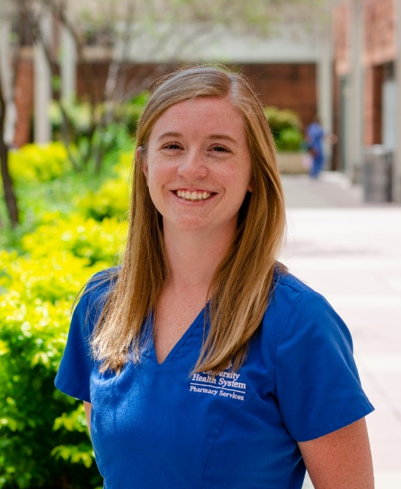
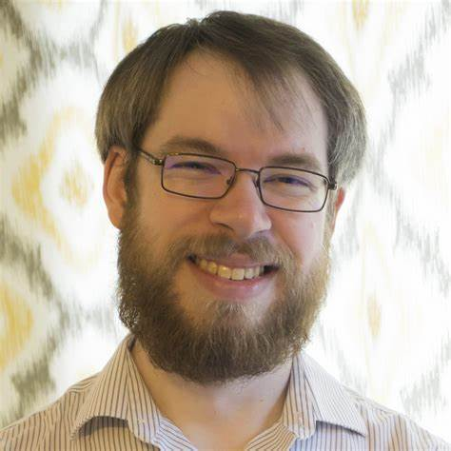
Acknowledgements
Kristi Hargrove, PharmD, BCEMP
Clinical Specialist Emergency Medicine University Health
kristi.Hargrove@uhtx.com
Daniel Giddings, PharmD, BCEMP
Clinical Specialist Emergency Medicine University Health
daniel.Giddings@uhtx.com

Slide 48
Et Al
Walking Blood Bank

Slide 49
A few facts about South Texas Regional Advisory Committee on Trauma
13 helicopters
Del Rio to Eagle Pass….La Grange to Marble Falls
8 San Antonio Fire Department Medical Officers rigs
17 other Emergency Medical Services ambulances
20+ units per day donated by BIA donors
1 January 2020 = 4767
30 September 2020 = 7821
3054 new donors in 9 months….over 300 new donors/month
Routinely over 125 units LTOWB on hand in the system every day
LTOWB used instead of components during platelet shortage

Slide 50
MCI Initiative
ASPR TRACIE from 5 Nov 17 Sutherland Springs MCI (Assistant Secretary for Preparedness and Response, Technical Resources, Assistance Center, and Information Exchange)
  Recommendation: take resources from urban to remote setting including people and blood
South Texas Blood and Tissue Center
  30 units LTO+WB inventory
  Dispatch EMS to STBTC to pick up 20 pack of whole blood and drive to scene/rural hospital or rendezvous with HEMS to fly it there

Slide 51
Since El Paso Shooting
Contingency plan established to supply blood in real time to hospitals in Texas for MCI events
Approximately 30 units, taken from multiple locations, will be flown along with 6-8 personnel who can communicate needs back to STRAC
Aircraft notification to take off ~30 minutes

Slide 52
Real World Example
Father’s Day 2018
Big Wells
  14 person MCI rollover Motor Vehicle Crash
    4 Dead on Scene
  At least 9 Helicopter EMS agencies responded
3 patients received Low Titer O+ Whole Blood on scene/transport: 1 died (33%)
First MCI event known where prehospital whole blood was used for resuscitation

Slide 53
Walking Blood Bank Plan
  MCI activated
  Immediately assess regional blood inventory
  If number of casualties is greater than predicted need initiate WBB
  Notify an appropriate number of Brothers in Arms donors
  Needs to be scalable response
  Donors report to their usual donor location
  Plan for four donors per patient; notify 8 donors in hopes 4 will show up

Slide 54
What next?
Screen donors (these are regular donors tested 4 times/year)
If screening questions indicate safe donor, initiate donation
Blood will be delivered, by current need assessed by Medical Operations Center, to appropriate place (scene, hospital, etc)
Blood will be warm from the donor and not yet tested
Transfusion commences
Retrospective testing of the donor unit and tracking of recipient for treatment of any transfusion transmissible disease

Slide 55
Lt Holly O’Byrne
Dr. Vitberg
ArcGIS

Slide 56
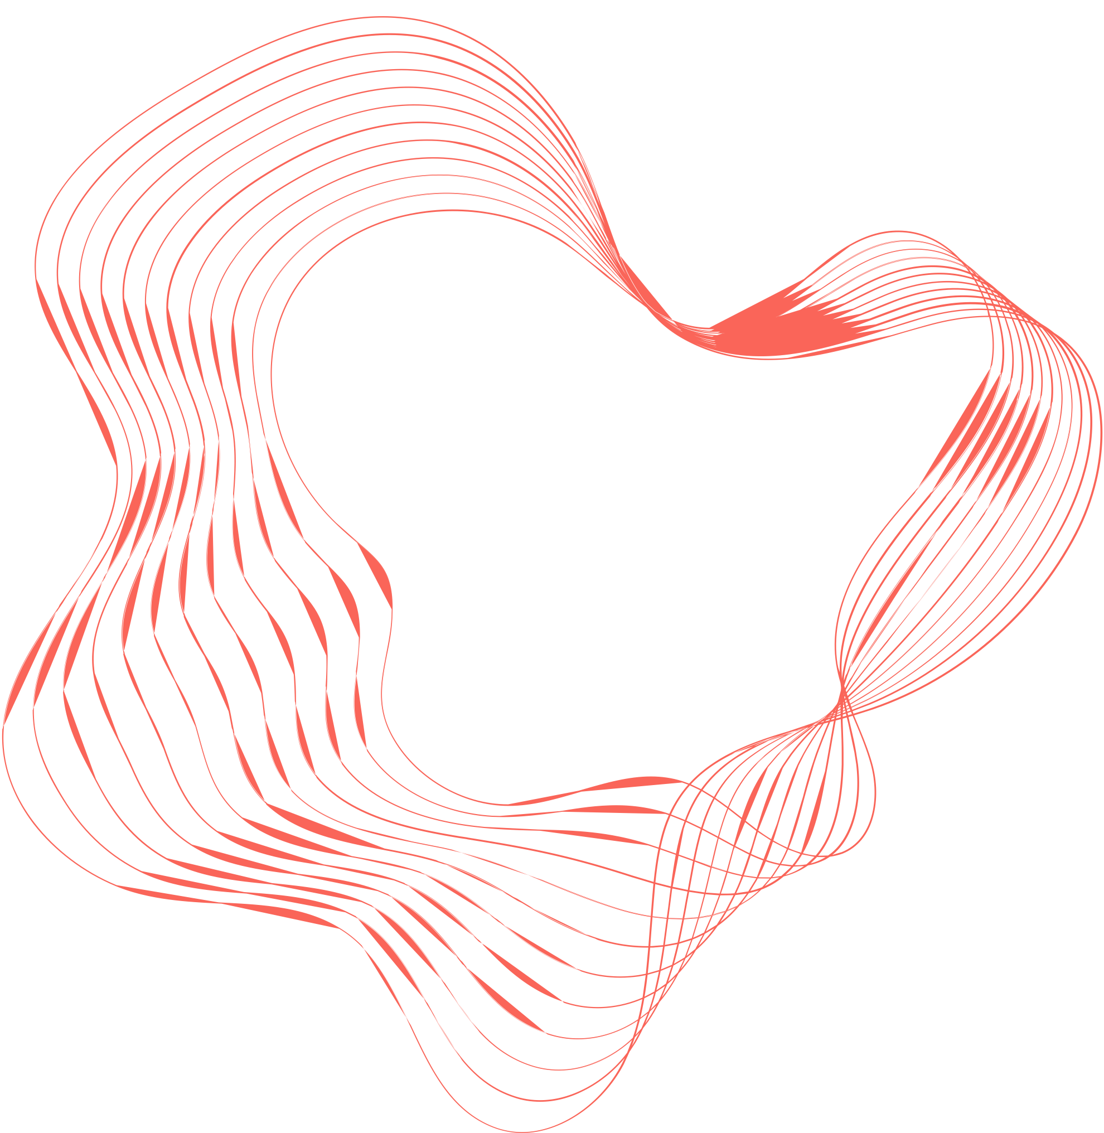

DC Fire and EMS LTOWB
4/10/2024 – 6/9/2025
Variable | Data
Median Age | 33
Male | 79.1%
Black/African American | 86.3%
Penetrating Trauma | 76.0%
Blunt Trauma | 4.8%
Medical | 19.2%
TCA before/after contact | 52
Total Mortality | 15.1%
Mortality excluding TCA | 3.7%
Dispatch to Blood Admin | 22:55
Transport Time | 12:58
Scene Time | 13:04
Administration Data
Total Patients | 295
Total Units | 316
Patients >1 Unit | 18
Unit per hour | 1 unit every 32.2 hours
Calcium Administration | 91.4%
TXA Administration | 93.4%
Vital Sign | Pre Admin | Post Admin | Change
Systolic BP | 79 | 114 | 𝚫 +35
Heart Rate | 104 | 96 | 𝚫 -8
ETCO2 | 24 | 29 | 𝚫 +5
Shock Index | 1.40 | 0.89 | 𝚫 -0.51
*Median times for all incidents

Slide 57
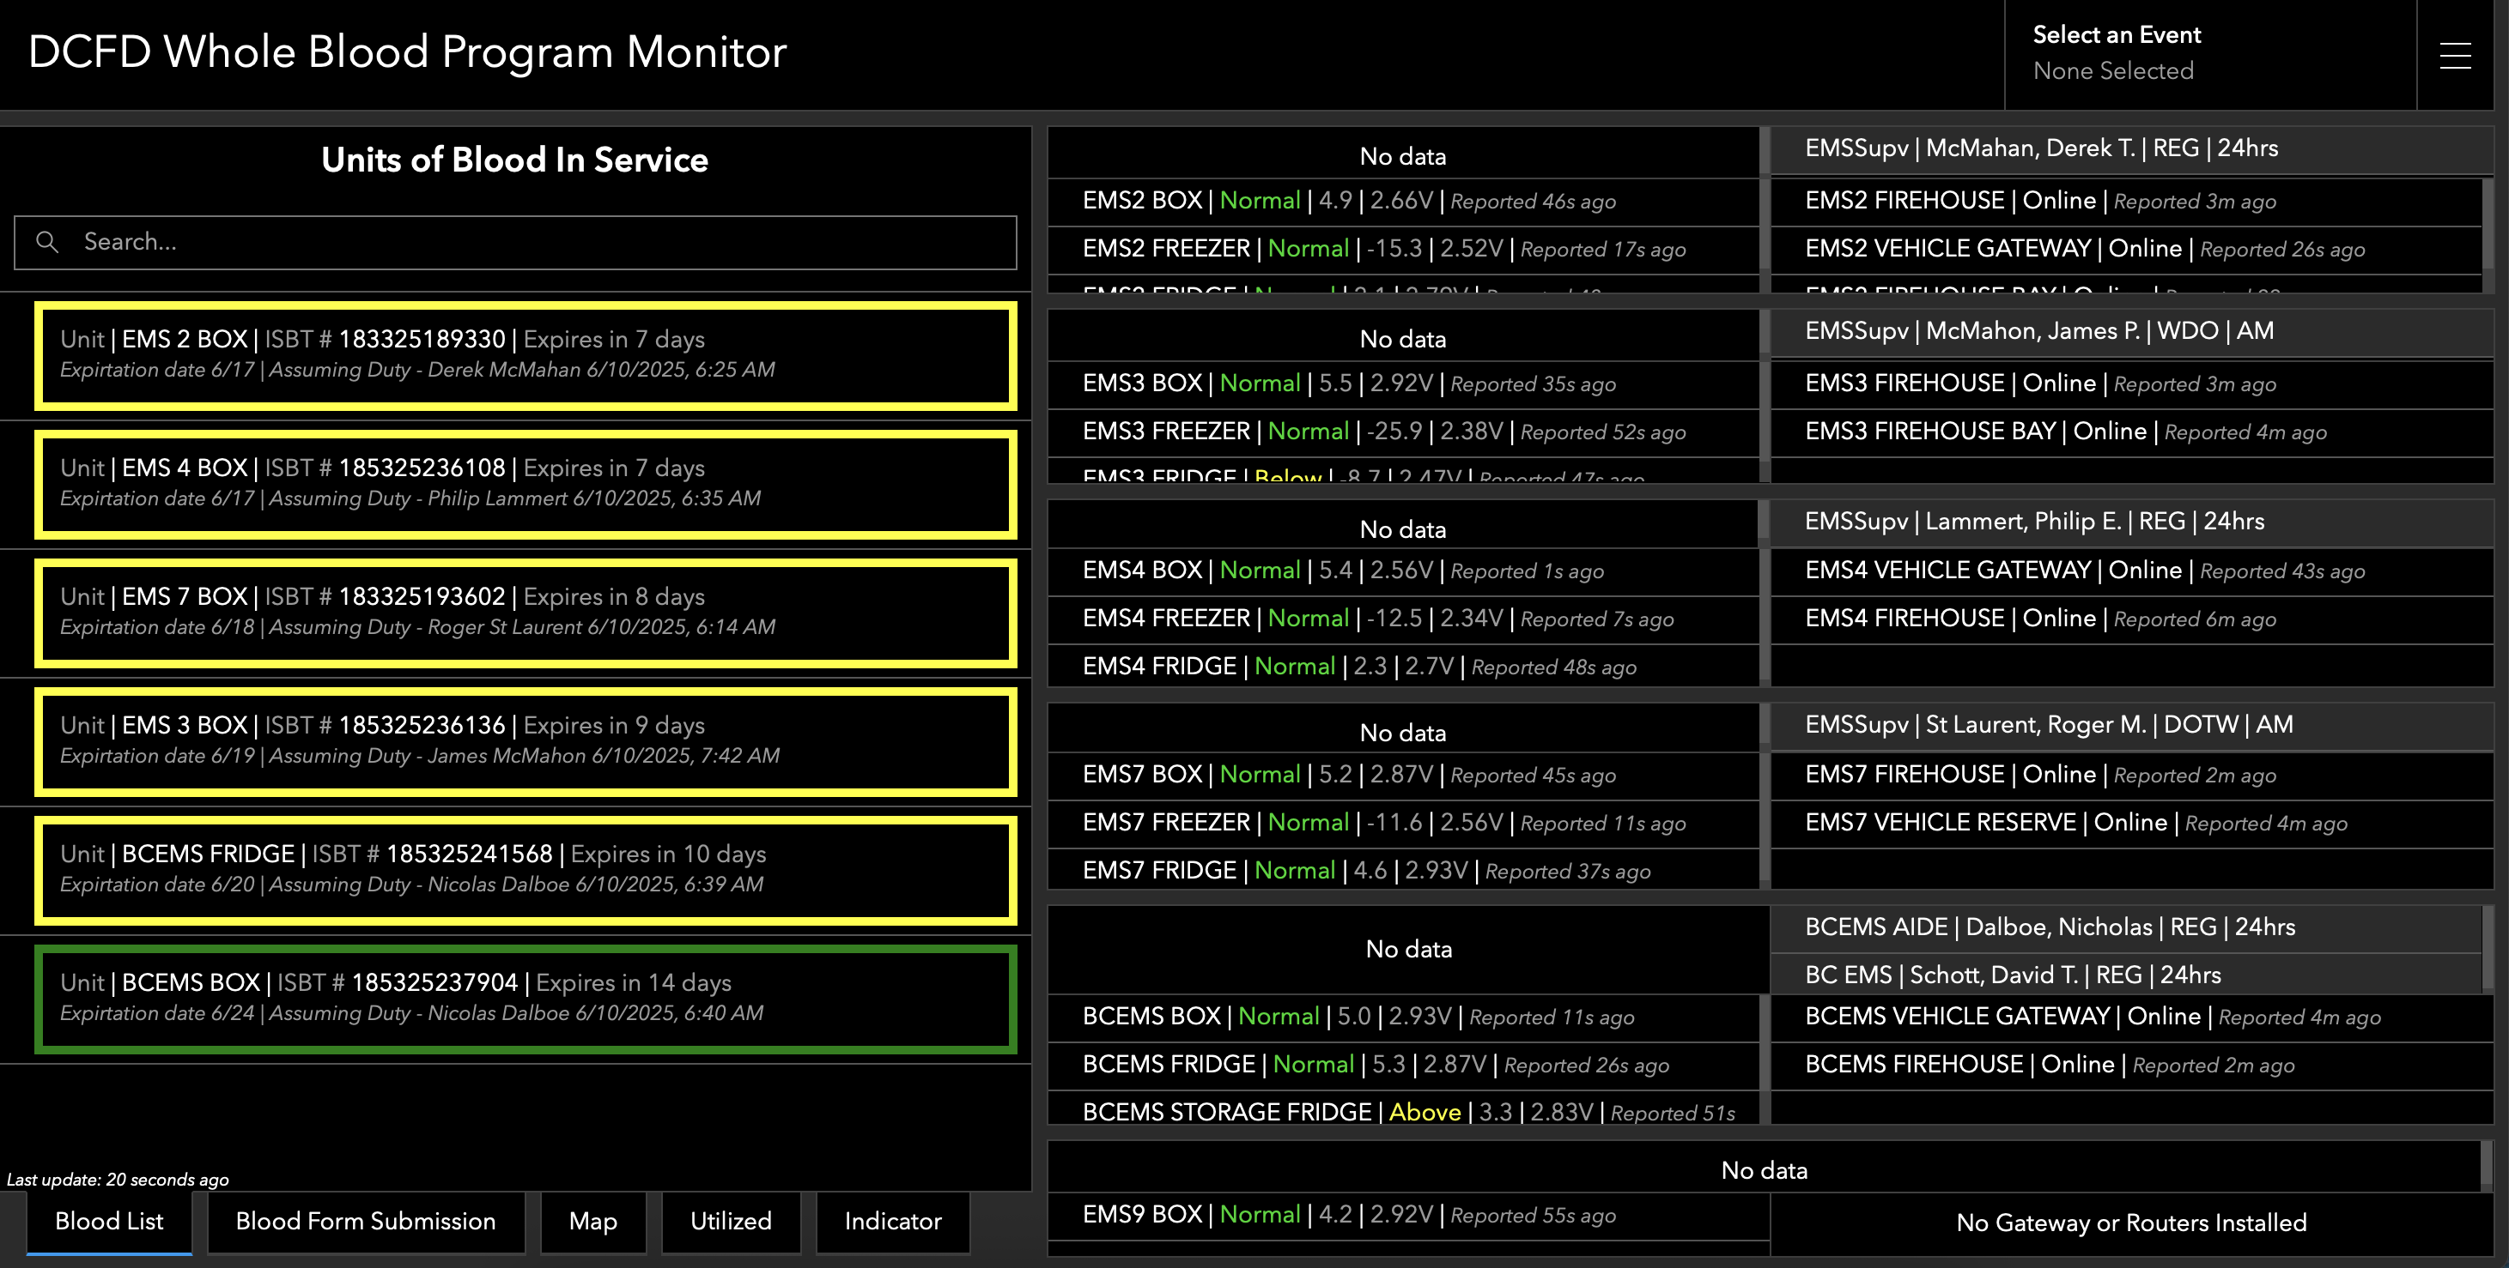

Slide 58
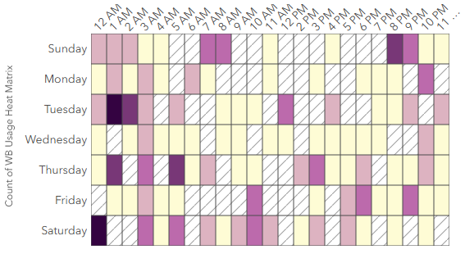
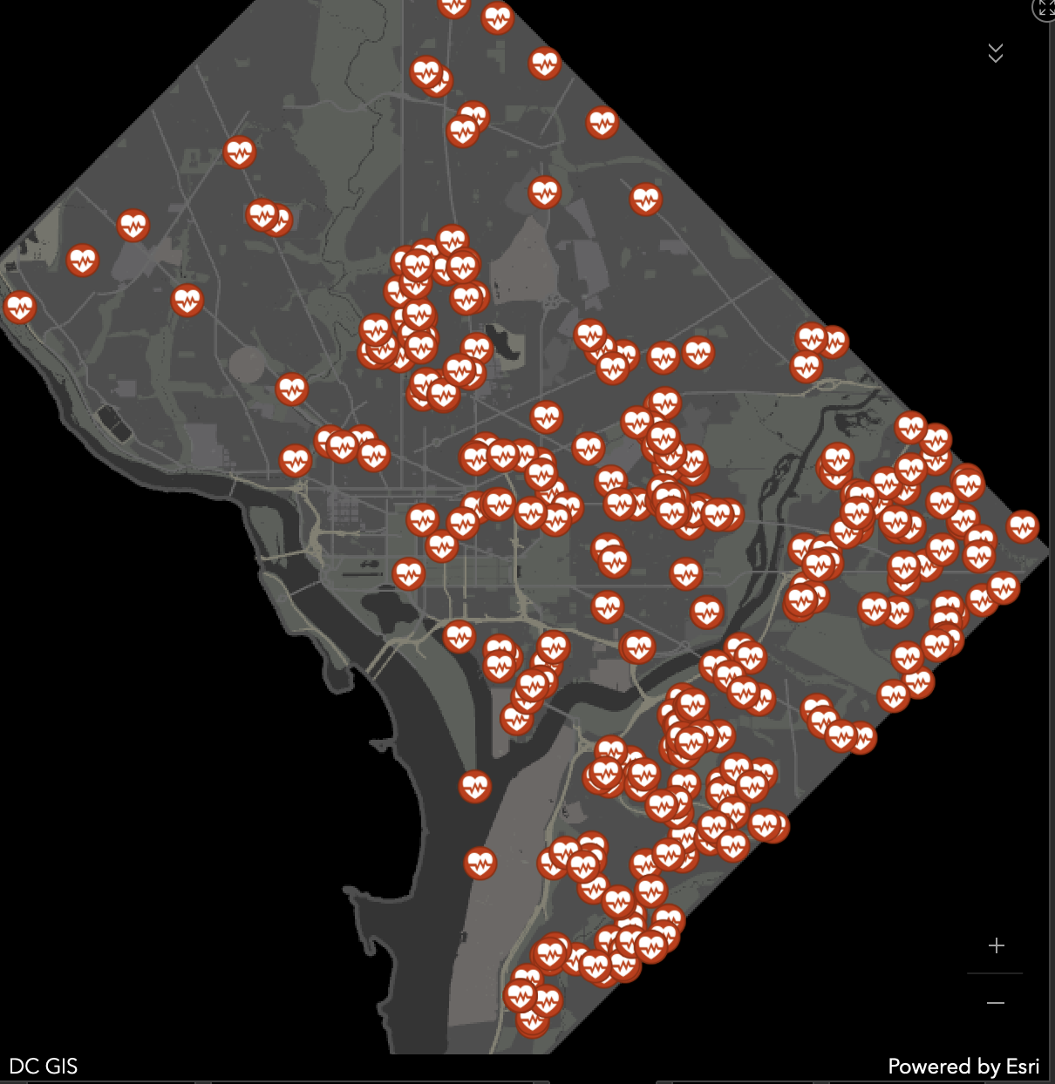
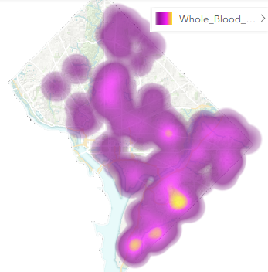
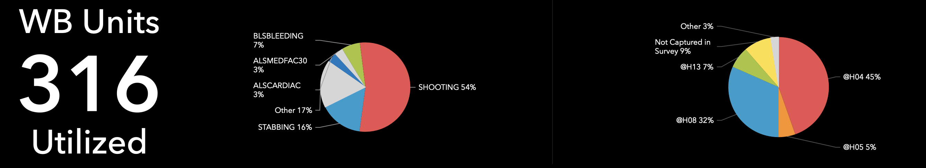

Slide 59
Dr. Paul Banerjee
Pedi TBI

Slide 60
Dr. Rob Lowe
IM TXA

Slide 61
IM TXA
Robert Lowe MD FACEP FAEMS
Columbus (OH) Division of Fire

Slide 62
Why consider IM TXA when 2 IV protocols (TECC, TCCC) already exist?
What is the clinical evidence supporting IM administration?
What is the operational Advantage of IM TXA?

Slide 63
Why consider IM TXA when 2 IV protocols (TECC, TCCC) already exist?
Average IV in EMS is 2.5 minutes
TECC: 10 minutes infusion
TCCC: slow IV push (5-10 minutes - common definition)
IM likely 10 - 12.5 min faster on average
Prehospital intravenous line placement: A prospective study. Jones, Stephen E et al. Annals of Emergency Medicine, Volume 18, Issue 3, 244 – 246.

Slide 64
What is the clinical evidence for IM TXA?
Trauma INTACT - United Kingdom
  11 minutes to achieve blood serum concentration equivalent to 1 gram IV (of 10 mg/L).
  IM TXA rapidly absorbed even in the presence of hemorrhagic shock and elevated blood lactate
  NHS paramedics now administer IM TXA
  CRASH-4 trial IM TXA for TBI - head bleeds

Slide 65
What is the operational advantage of IM TXA? The Columbus Fire Experience
4 Adult L1/L2 Trauma Centers and 3 Adult L3 Centers
917,000 223 sq. miles
furthest from a trauma center
Went live in Dec 2024
Trauma dashboard of scene times

Slide 66
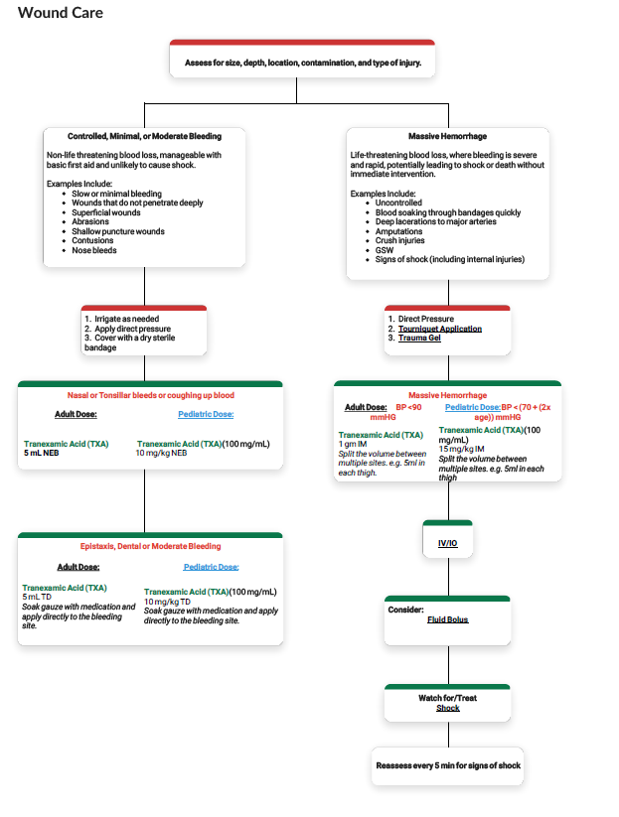

Slide 67
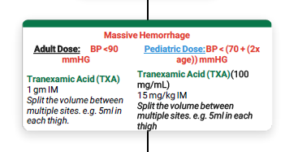

Slide 68
Dr. James Roach
Broward County

Slide 69

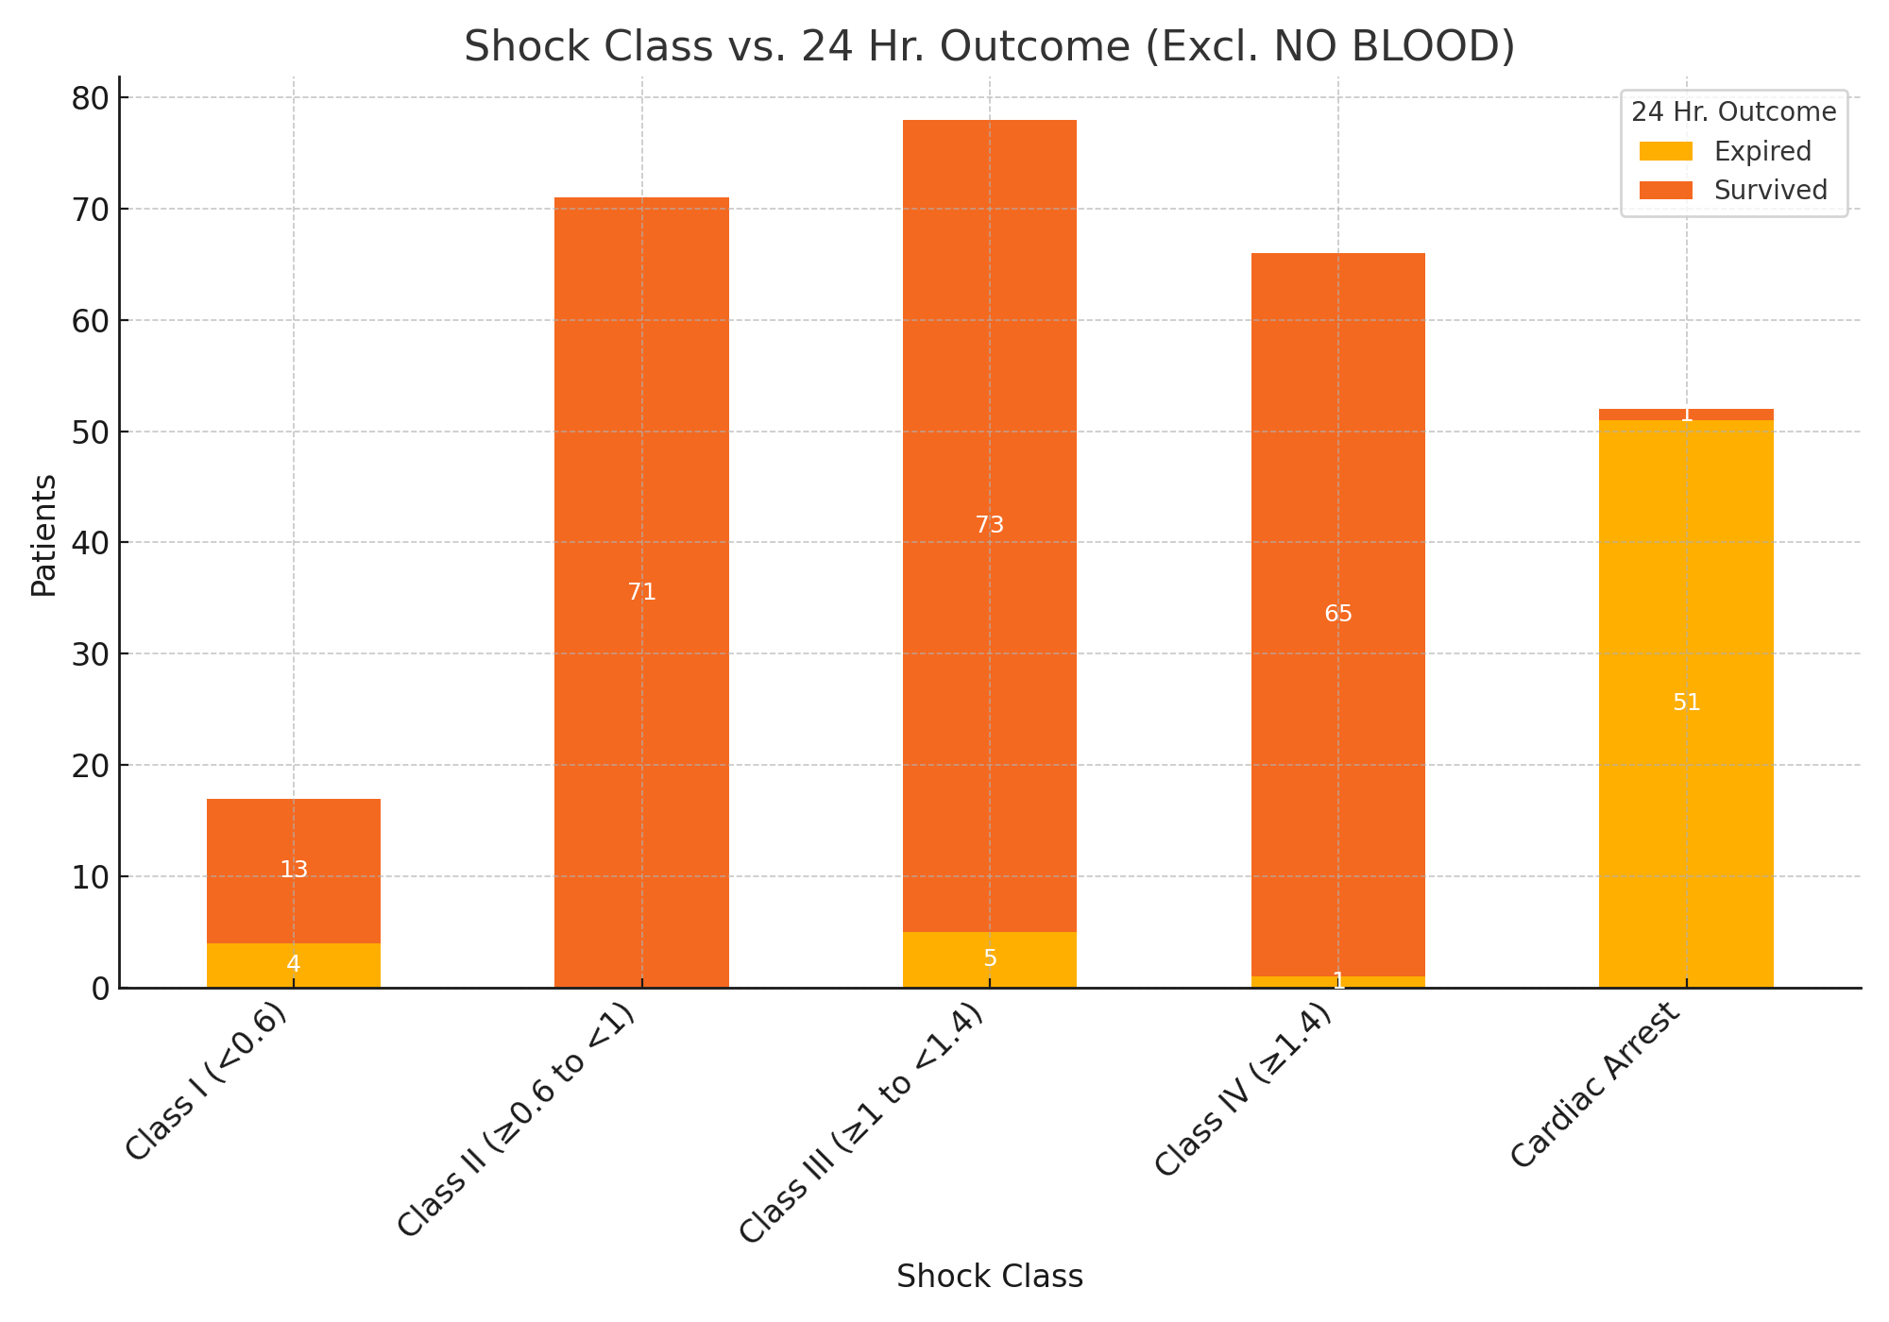
Shock Class vs. 24 Hr. Outcome
Notes:
These are patients that got blood. The 17 class I patients, most common call type was MVA. Tib/fib fractures secondary to removal of dash from the patients entrapped legs. Training was done after CQI and training was rolled out.

Slide 70
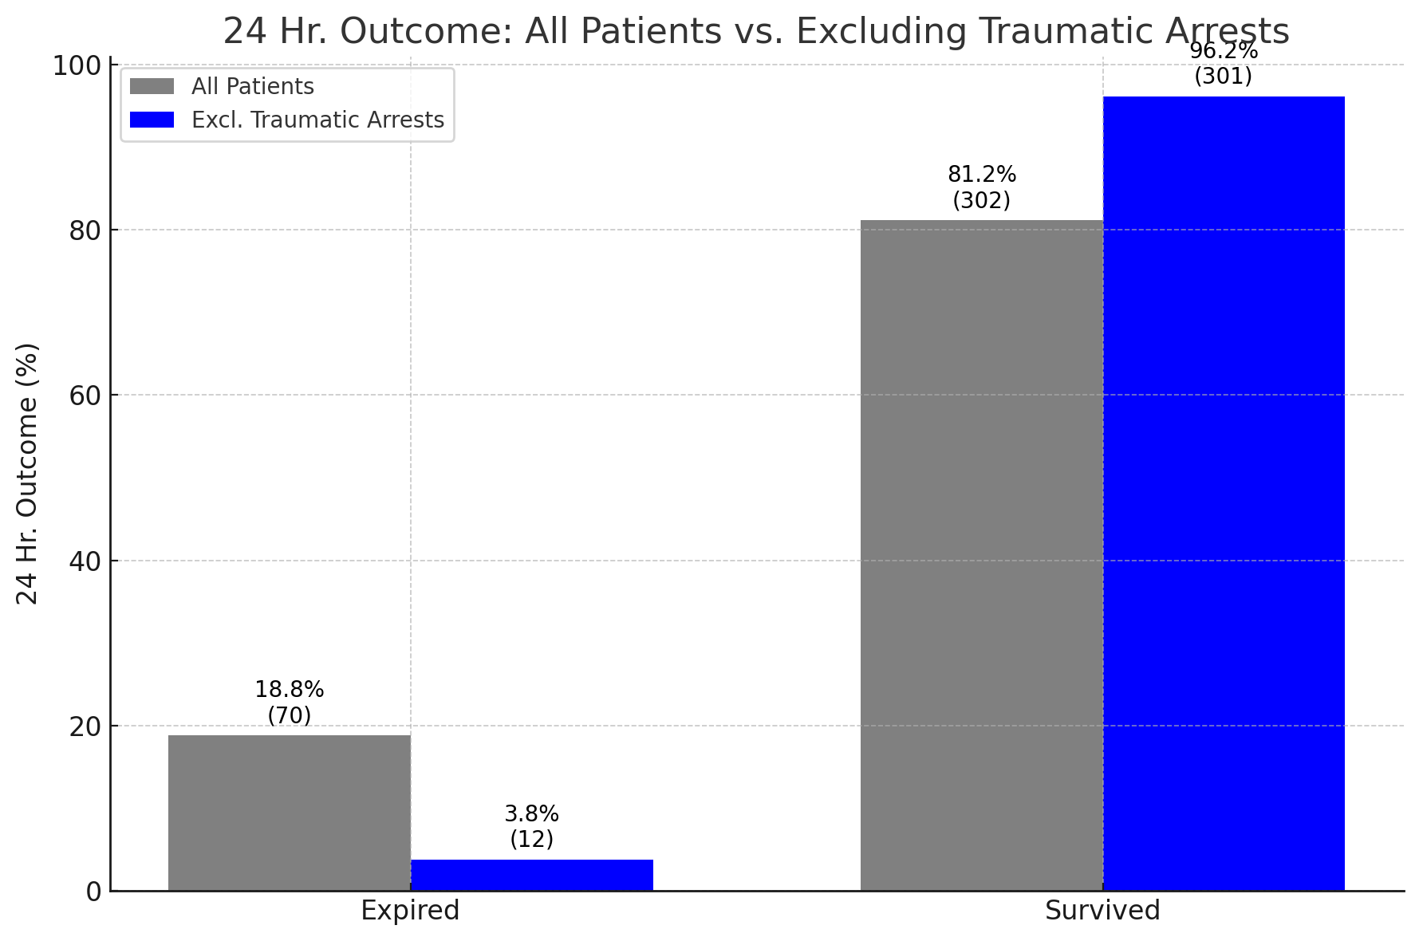
Analysis of 24-Hour Survival Excluding Traumatic Arrests
Out of the 59 Traumatic arrests
Only 1 survived
58 Died

Slide 71
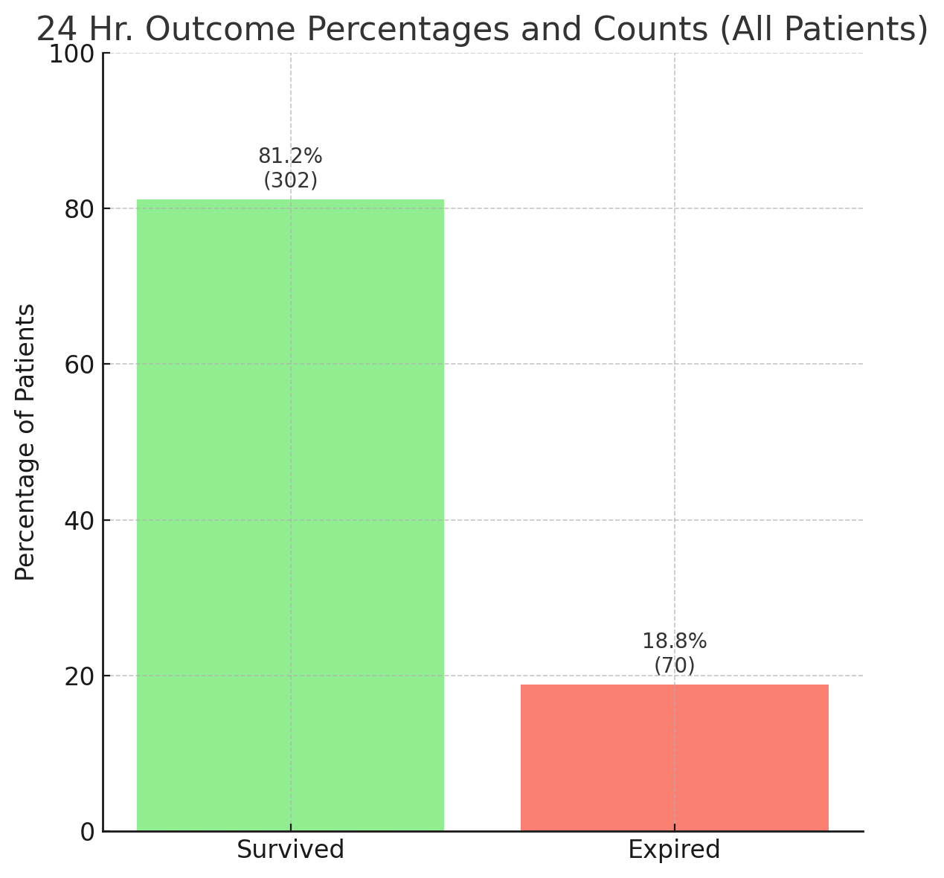
TXA and Whole Blood 24 Hr. Outcome
2021- Current (372)

Slide 72
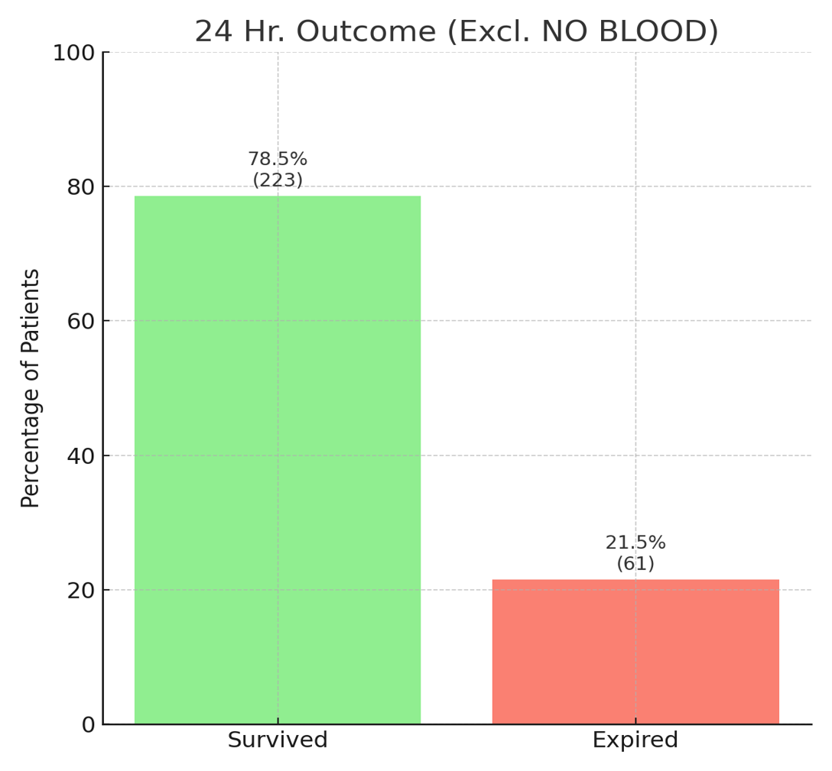
Whole Blood Only 24 Hr. Outcome
2021- Current (284)
Patients that received Whole blood only had a 2.7 percent decrease in 24 hr. Survivability
Notes:
Talk about

Slide 73

24-Hour Survival Trends by Year
📈 24-hour survival improved from ~70% in 2021 to ~87% in 2025
Notes:
Talk about

Slide 74
A Strategic Response to U.S. IV Fluid Shortages
Terence Valenzuela MD MPH
A proposal to address recurrent IV fluid shortages using decentralized, on-site manufacturing.

Slide 75

The Triggering Event: Hurricane Helene and the Baxter Crisis
2018: Hurricane Helene disrupted Baxter’s North Cove IV fluid facility in North Carolina.
Facility accounted for up to 60% of national IV bag production.
Resulted in severe national shortages of sterile IV fluids.

Slide 76
Immediate Consequences: Healthcare System Disruption
Elective surgeries cancelled, dialysis sessions shortened, and fluid use rationed.
Hospitals lacked buffer due to just-in-time inventory systems.
Exposed vulnerability of centralized production models.

Slide 77
Causes of Fluid and Medication Shortages
Natural disasters (e.g., Maria, Helene).
Low margins and regulatory burden deter manufacturing.
Overreliance on centralized production and long-distance transport.
No built-in redundancy or buffer capacity.

Slide 78

Caspian IV Fluid System: The Alternative
Portable, automated system developed by DEKA Research and Development Corp.
Uses local water to produce FDA-grade sterile IV fluids on-site.
Minimal human intervention; compact and resilient in disasters.
Output: 500 one-liter IV bags/day per unit.

Slide 79


Slide 80
Advantages and Regional Deployment Plan
Eliminates single points of failure in production.
On-demand availability in emergencies and remote settings.
Scalable: ~1,100 units could meet national demand.
Five regional hubs: LA/Seattle, New Orleans, Chicago, Tucson, NYC.

Slide 81
Next Steps
Technical validation and FDA pathway development.
Cost modeling and operational logistics.
Pilot site deployment via FEMA, HHS, VA, and public-private partnerships.

Slide 82
Discussion and Questions
ET AL

Slide 83
Discussion and Questions
ET AL

