Slide 1


Wheelin’ and Dealin’ with Leg-Reelin’:
How Should EMS Manage the Accelerating # of Persons Requiring Wheelchairs?
C. Crawford Mechem, MD
EMS Medical Director
Philadelphia Fire Department
Department of Emergency Medicine
University of Pennsylvania School of Medicine

Slide 2

Three Questions
How has xylazine impacted the number of wheelchair-dependent patients in Philadelphia?
Are there consequences from not transporting patients’ wheelchairs with them to the hospital?
How has the PFD accommodated the increasing number of wheelchair-dependent patients?

Slide 3

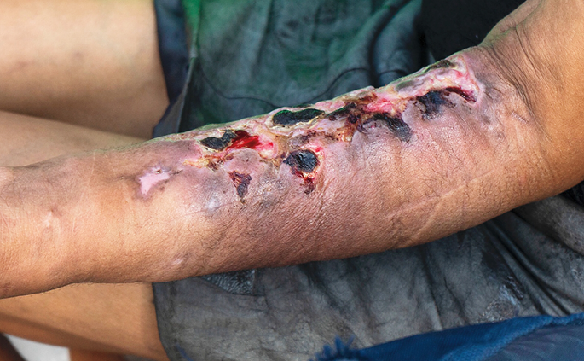
The Challenge
Philly’s drug crisis continues
  Fentanyl plus ____________
In early 2024, xylazine found in 99% of fentanyl samples
Causes severe wounds
Management complicated by inconsistent care, ongoing drug use, housing instability

Slide 4
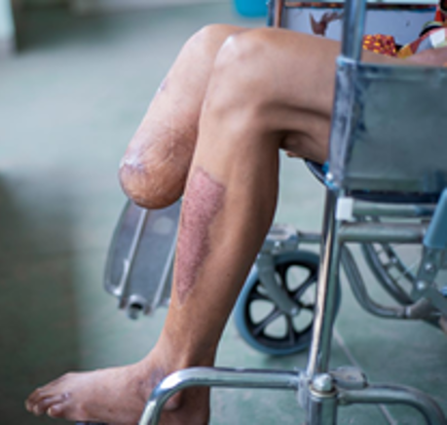
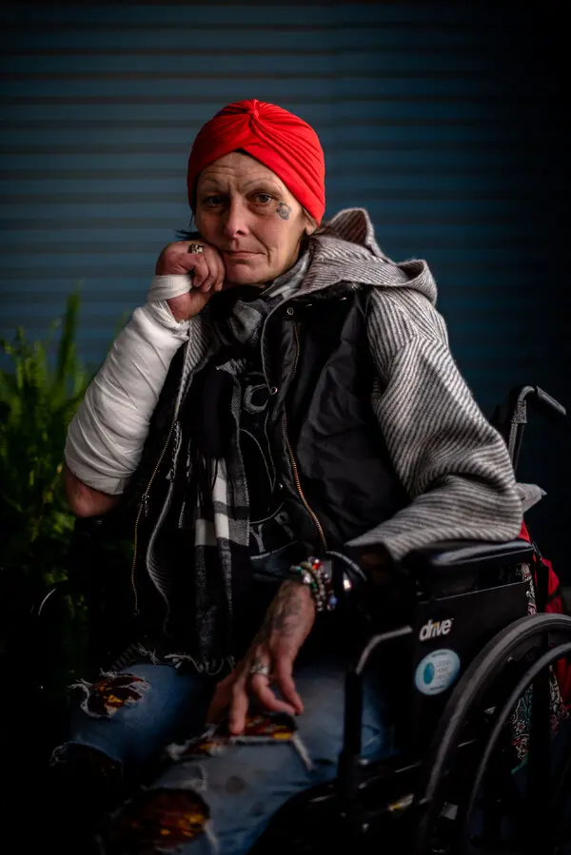

The Challenge
At times surgeons recommend amputation over ongoing wound care
PFD transporting more patients with lower extremity wounds and amputations who are:
  Wheelchair-dependent
  Still drug-dependent
  Unhoused
Receiving complaints from hospitals if wheelchairs not brought with pts

Slide 5

The Issues
Hospital Perspective
  Hospitals attempt to replace wheelchairs
  Cost not always covered by insurance
  Some pts placed in Observation pending resolution
  Hospital assumes cost of wheelchair or hospital stay
  Mobility devices (wheelchairs) fall under ADA
EMS Perspective
  Transporting wheelchair with pt not always feasible
  Little room in ambulance, can interfere with pt care
  Wheelchairs often heavily soiled

Slide 6
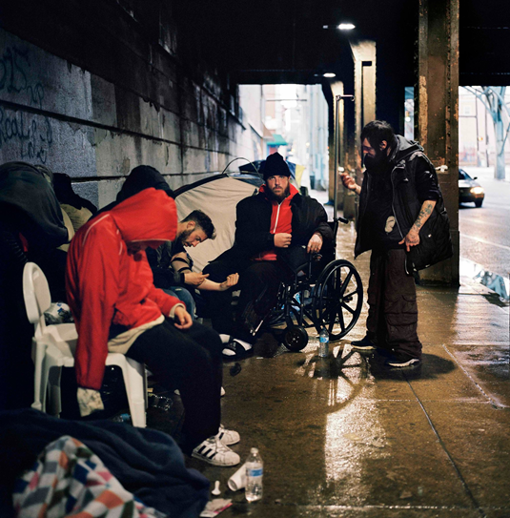
A Solution?
New PFD policy on transportation of patient mobility devices (wheelchairs)
To ensure patient safety and ADA compliance, EMS will transport wheelchair with patient when possible provided:
  Transport will not compromise vehicle operation or impact patient care
  Wheelchair can be covered to protect staff from body fluids

Slide 7

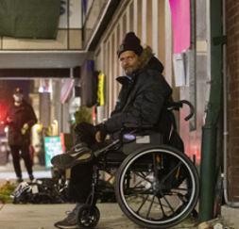
How It Works
If wheelchair cannot be safely transported or transport would interfere with patient care…
  Is left at scene
  Crew contacts Fire Communications Center (FCC) with location
  FCC contacts Mobile Integrated Healthcare
  MIH goes to incident scene and transports wheelchair (assuming it’s still there) to ED
    Wheelchairs get stolen

Slide 8

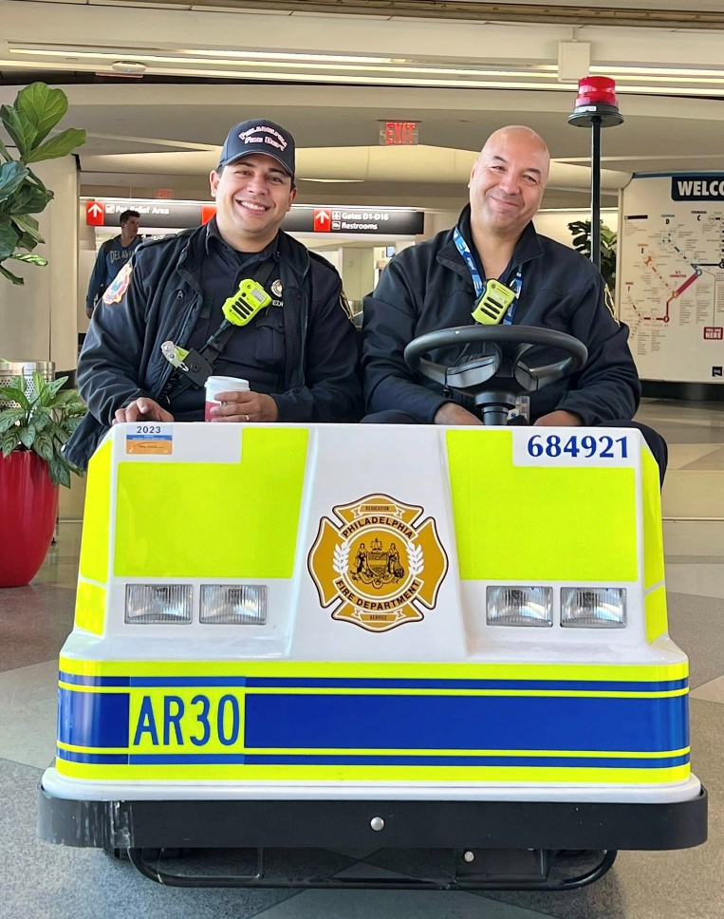
Mobile Integrated HealthCare
Operates several Alternative Response Units
  Opioids, behavioral health, maternal heath, PIA
Has wheelchair accessible van
Traditionally only staffed during day
Now 24/7 to recover patients’ wheelchairs
From April 29-June 3, 54 transported
Another way MIH can meet our pts’ needs

