Slide 1

Early Naloxone in Non-Shockable Cardiac Arrest
Jonathan Jui MD, MPH
Credits : Josh Lupton MD

Slide 2
Naloxone and Cardiac Arrest - Guidelines
AHA Focused Updates – 2023
  “There are no studies demonstrating improvement in patient outcomes from administration of naloxone during cardiac arrest. Provision of CPR should be the focus of initial care. Naloxone can be administered along with standard care if it does not delay components of high-quality CPR.”
AHA Scientific Statement on Opioid-Associated OHCA – 2021
  “naloxone does not have a likely benefit in patients with confirmed CA who are receiving standard resuscitation, including assisted ventilation, and there are some reasons to suspect that this practice may cause harm by increasing cerebral metabolic demand at a time of hypoxemia and acidosis.”
Lavonas et al., 2023
Dezfulian et al., 2023

Slide 3
Objectives
Trends in overdose deaths and opioid-associated out-of-hospital cardiac arrest (OHCA)
The pathway from opioid overdose to cardiac arrest
Mechanisms by which naloxone could benefit OHCA patients
Results of our Portland observational study

Slide 4
Out-of-Hospital Cardiac Arrest
Incidence: 55 per 100,000 person-years worldwide¹
  In the United States: 78 per 100,000 person-years²
Etiology: 7% due to overdose per EMS in the U.S. in 2023²
Initial Rhythm: 83% non-shockable in the U.S. in 2023²
Survival: 10% overall and 18% overdose etiology²
  Non-Shockable Survival: Asystole 2% | PEA 11% | unknown 16%
Yan et al., 2020
CARES 2023 Annual Report
Notes:
1 - https://ccforum.biomedcentral.com/articles/10.1186/s13054-020-2773-2
2 - https://mycares.net/sitepages/uploads/2024/2023_flipbook/index.html?page=6

Slide 5
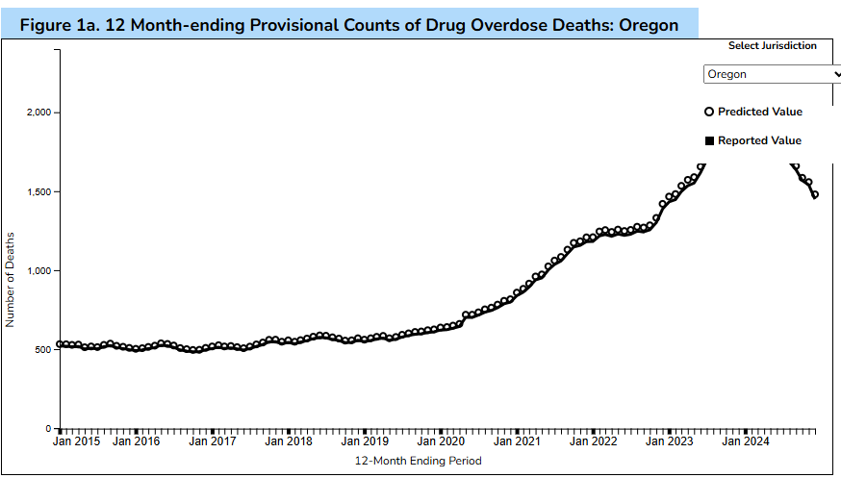
Overdose Deaths Oregon
2015-2024 July
CDC National Center for Health Statistics
Notes:
https://www.cdc.gov/nchs/nvss/vsrr/drug-overdose-data.htm

Slide 6
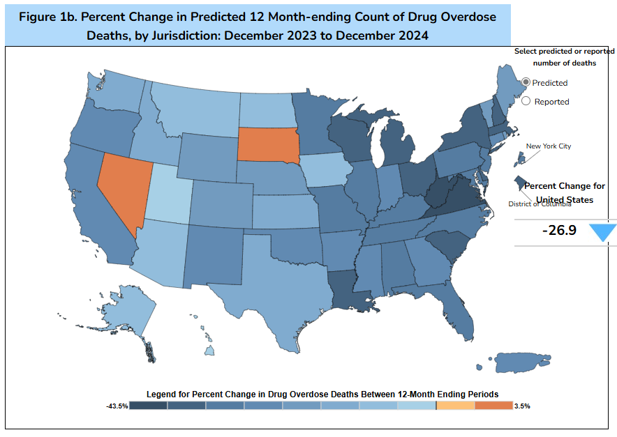
Percent Change in Overdose Deaths
December 2023 to December 2024

Slide 7
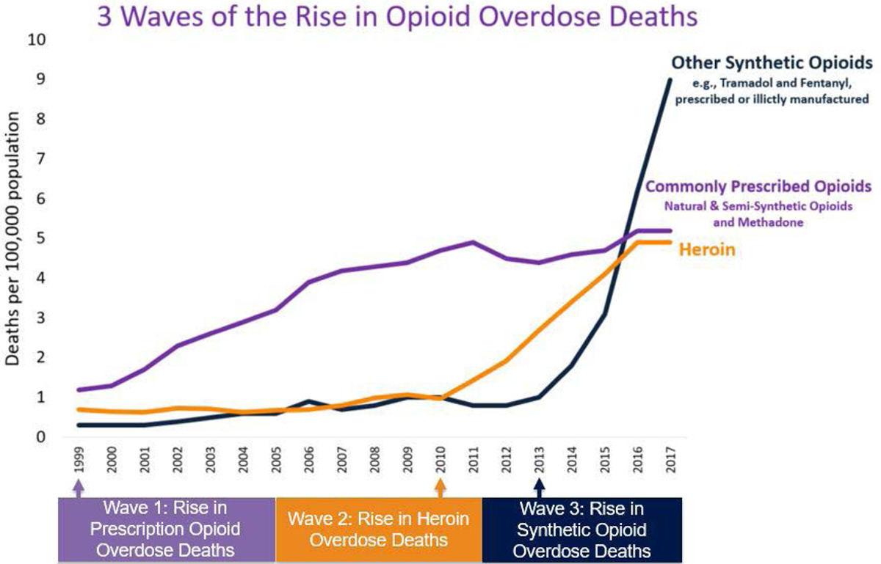
Overdose Deaths
Dezfulian et al., 2021
Notes:
Dezfulian C, Orkin AM, Maron BA, Elmer J, Girotra S, Gladwin MT, Merchant RM, Panchal AR, Perman SM, Starks MA, van Diepen S, Lavonas EJ; American Heart Association Council on Cardiopulmonary, Critical Care, Perioperative and Resuscitation; Council on Arteriosclerosis, Thrombosis and Vascular Biology; Council on Cardiovascular and Stroke Nursing; Council on Quality of Care and Outcomes Research; and Council on Clinical Cardiology. Opioid-Associated Out-of-Hospital Cardiac Arrest: Distinctive Clinical Features and Implications for Health Care and Public Responses: A Scientific Statement From the American Heart Association. Circulation. 2021 Apr 20;143(16):e836-e870. doi: 10.1161/CIR.0000000000000958. Epub 2021 Mar 8. PMID: 33682423.

Slide 8
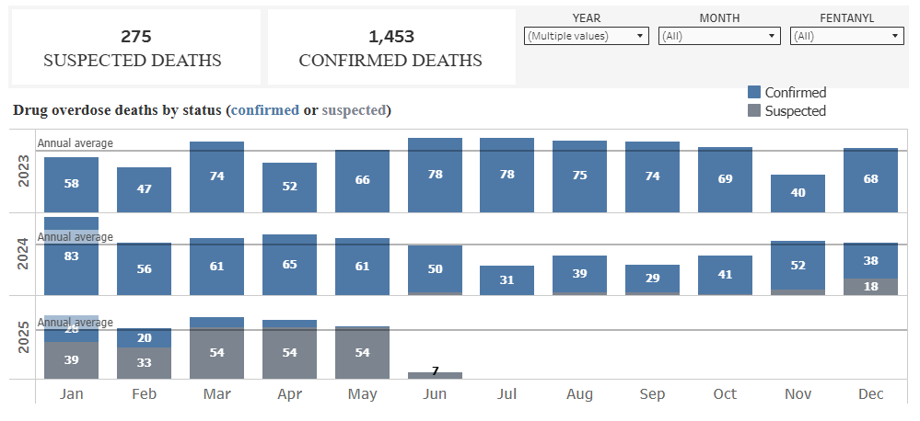
Multnomah County Overdose Deaths
2023-2025

Slide 9
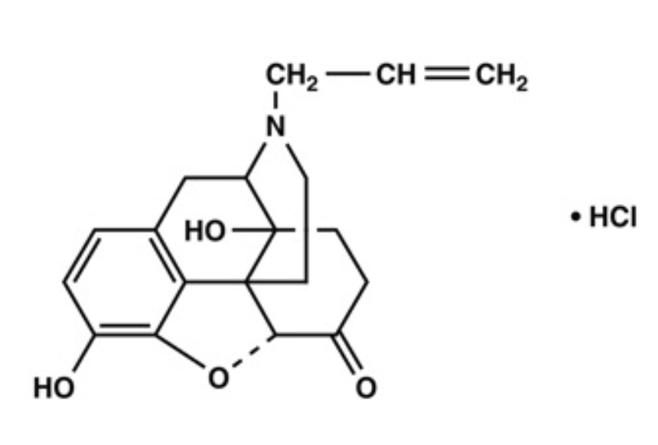
Naloxone
”Naloxone is an opioid antagonist”
“naloxone has no effect on someone who does not have opioids in their system”
NIH National Institute on Drug Abuse

Slide 10
Opioid Receptors
Receptor | Site of Action | Effects | Agonist | Antagonist
Mu | Systemic | Analgesia, euphoria, constipation, respiratory depression | DAMGO, morphine, fentanyl, endomorphins, beta-endorphin | CTOP, naloxone
Delta | Systemic | Analgesia, convulsions, anxiolysis | DPDPE, SNC 80, enkephalins, deltorphin, beta-endorphin | Naltrindole; ICI 174,864; naloxone
Kappa | Systemic | Analgesia, diuresis, dysphoria | U-69593; U50,488; bremazocine; dynorphin | Norbinaltorphimine, naloxone
Stein, 2016
Notes:
https://www.annualreviews.org/docserver/fulltext/med/67/1/annurev-med-062613-093100.pdf?expires=1727385142&id=id&accname=ar-229737&checksum=5BD2419DF67FFDFAD7079AB70D8490CB

Slide 11
Naloxone and Cardiac Arrest
How might naloxone improve outcomes from OA-OHCA and/or OHCA from any cause?

Slide 12

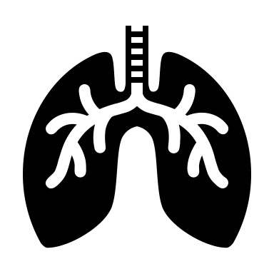




Opioid-Associated OHCA Mechanism
Opioid Use
Respiratory Depression
Loss of Consciousness
Bradycardia
Cardiac Arrest

Slide 13
What is cardiac arrest?
Lay Public: “Is the patient conscious?” and “Are they breathing normally?”
  No-No-Go
Professionals: Loss of consciousness in the absence of palpable pulses?
  Manual palpation?
  Ultrasound/Doppler?
  Arterial Line?

Slide 14
Opioid-Associated OHCA Mechanism
Opioid Use
Respiratory Depression
Loss of Consciousness
Bradycardia
Cardiac Arrest
Not conscious.
Not breathing normally.
Cardiac arrest?

Slide 15
How accurate in manual pulse detection?
54 patients and 213 pulse checks with a femoral arterial line
40% sensitivity at detecting a pulse (vs. arterial line) in the ED
  47% if SBP ≥60 mmHg
  52% if SBP ≥80 mmHg
  62% if SBP ≥ 100 mmHg
Cohen et al., 2022
Notes:
Cohen AL, Li T, Becker LB, Owens C, Singh N, Gold A, Nelson MJ, Jafari D, Haddad G, Nello AV, Rolston DM; Northwell Health Biostatistics Unit. Femoral artery Doppler ultrasound is more accurate than manual palpation for pulse detection in cardiac arrest. Resuscitation. 2022 Apr;173:156-165. doi: 10.1016/j.resuscitation.2022.01.030. Epub 2022 Feb 4. PMID: 35131404.

Slide 16
Opioid-Associated OHCA Mechanism
Opioid Use
Respiratory Depression
Loss of Consciousness
Bradycardia
Cardiac Arrest
Systolic Blood Pressure
120
90
60
0
SBP (mmHg)
Time

Slide 17
Opioid-Associated OHCA Mechanism
Opioid Use
Respiratory Depression
Loss of Consciousness
Bradycardia
Cardiac Arrest
Potential for naloxone to prevent death from OA-OHCA
100%
75%
50%
0%
100
75
50
0
% in “cardiac arrest”
Pseudo-PEA?
Time

Slide 18
Background Summary
Opioid-associated OHCA is a rising problem
Naloxone’s theoretical activity in OHCA survival
  Reversing “pseudo-PEA” (OA-OHCA in pseudo-PEA)
  Hemodynamic support (all OHCA)
  Neuroprotection (all OHCA)
  Other mechanisms…

Slide 19
Naloxone's action:
  Restores respiratory drive
  Hemodynamic benefit:
    reversal of bradycardia
    reversal of hypotension
  Return of Spontaneous Circulation (ROSC).

Slide 20
Naloxone : CNS Protective Effects
Inhibition of Microglia Activation:
Inhibition of HSP60-TLR4-NF-$\kappa$B Signaling Pathway:
Reduced Inflammatory Cytokines:
Modulation of Excitotoxicity:
Direct Neuronal Protection:
improving cell viability and reducing apoptosis.

Slide 21
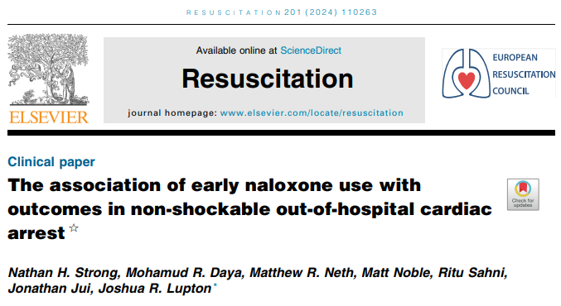

Slide 22
Our Objective
To evaluate if, in adult OHCA patients with non-shockable initial rhythms, there is an association between early naloxone use and patient outcomes.

Slide 23
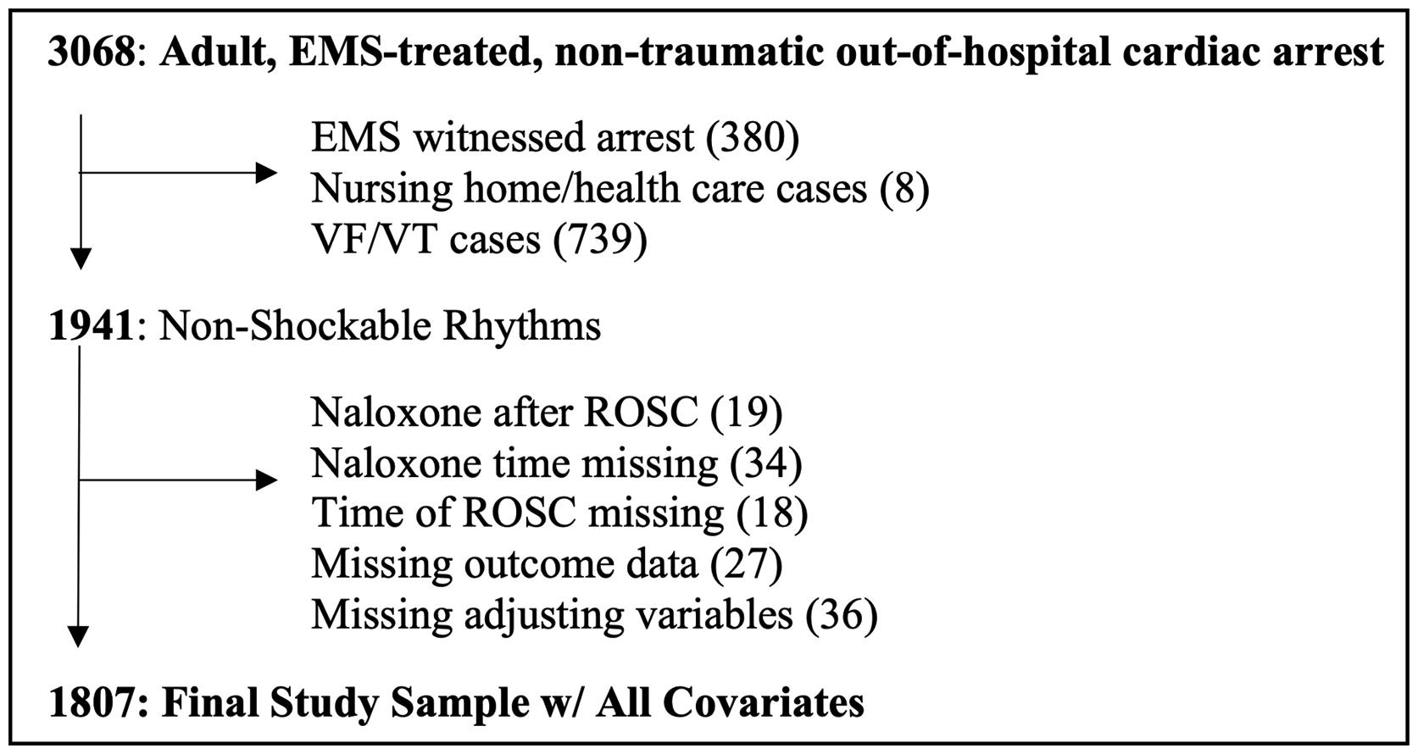
Study design, setting, and population

Slide 24
Exposure (naloxone)
Early Naloxone
Before intravenous or intraosseous access attempted
  IN/IM naloxone
  Inclusive of law enforcement administered naloxone
  Not inclusive/unknown regarding bystander naloxone
Control Group
- No naloxone prior to IV/IO attempt, regardless if given later
Notes:
Our registry has the date/time and route/dose of naloxone (initial and subsequent doses)

Slide 25
Outcomes
Return of Spontaneous Circulation (ROSC at any time)
Pulses at Hospital arrival (ROSC at ED arrival)
Survival Outcomes
  Hospital Admission
  Hospital Discharge
Good Neurologic Outcome
  Cerebral Performance Category Score at Discharge 2 or less

Slide 26
Statistical Analysis
Mixed effects logistic regression analyses
  Adjusting for: age, sex, arrest location, witness status, bystander CPR, time from 911 call to EMS arrival, initial EMS rhythm
Subgroups
  By rhythm
  By presumed etiology subsets
Sensitivity
  Propensity score matching

Slide 27
Characteristics
 | No Naloxone Before IV/IO Access (control) | Naloxone Before IV/IO Access (exposure)
 | (n=1,750) | (n=57)
Route of initial (1st) EMS naloxone dose
IO (intraosseous) | 170 (75.2%) | 0 (0.0%)
IV (intravenous) | 46 (20.4%) | 0 (0.0%)
IN (intranasal) | 2 (0.9%) | 22 (39.3%)
IM (intramuscular) | 8 (3.5%) | 34 (60.7%)
Naloxone Given at Any Time | 241 (13.8%) | 57 (100.0%)
Naloxone Initial dose (mg) | 2 (2-2) | 2 (2-2)
Law Enforcement Total Dose (mg) |  | 4 (3-6)
Total Epinephrine Doses (doses of 1 mg each) | 4 (3-6) | 4 (3-5)

Slide 28
Unadjusted Outcomes
 | No Naloxone Before IV/IO Access (control) | Naloxone Before IV/IO Access (exposure) | p-value
 | (N=1,750) | (N=57)
ROSC at Any Time | 553 (31.6%) | 24 (42.1%) | 0.112
Pulses at ED Arrival | 378 (21.6%) | 20 (35.1%) | 0.022
Survival to Admission | 393 (22.5%) | 26 (45.6%) | <0.001
Survival to Discharge | 58 (3.3%) | 8 (14.0%) | <0.001
Good Neurologic Outcome | 50 (2.9%) | 7 (12.3%) | 0.002

Slide 29
Primary Analyses

Slide 30
Propensity Matched Outcomes
 | No Naloxone Before IV/IO Access (control) | Naloxone Before IV/IO Access (exposure) | p-value
 | (n=54) | (n=54)
ROSC at Any Time | 16 (29.6%) | 22 (40.7%) | 0.227
Pulses at ED Arrival | 13 (24.1%) | 18 (33.3%) | 0.288
Survival to Admission | 17 (31.5%) | 24 (44.4%) | 0.165
Survival to Discharge | 1 (1.9%) | 7 (13.0%) | 0.027
Good Neurologic Outcome | 1 (1.9%) | 7 (13.0%) | 0.027

Slide 31
Comparisons
Quinn et al., 2024 (JEM)
Dillon et al., 2024 (JAMA Open)
Summary: No difference in naloxone vs. no naloxone in matched cases of all-comers with OHCA
Limitations: Unable to adjust for bystander CPR; did not match on witness status
Naloxone group survival: 5%
Summary: Naloxone associated with survival to discharge in OA-OHCA and non-OA-OHCA.
Limitations: Selection bias, timing of naloxone unknown, CARES data limitations
Naloxone group survival: 16%
CARES 2023 Overdose survival: 18% | Our Study (non-VF/VT only) Naloxone group Survival: 12-13%

Slide 32
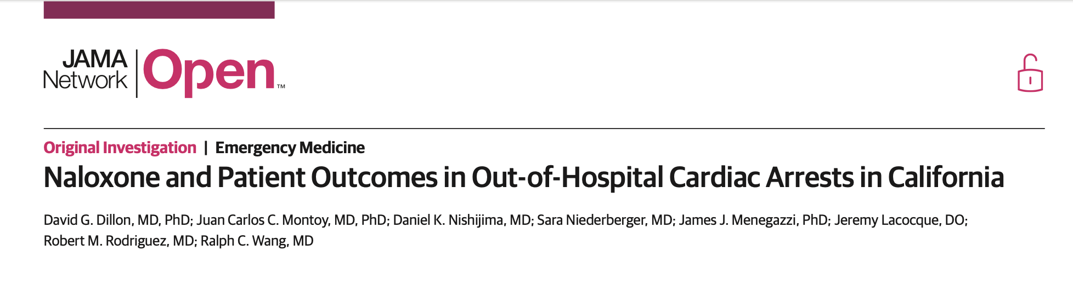

Slide 33
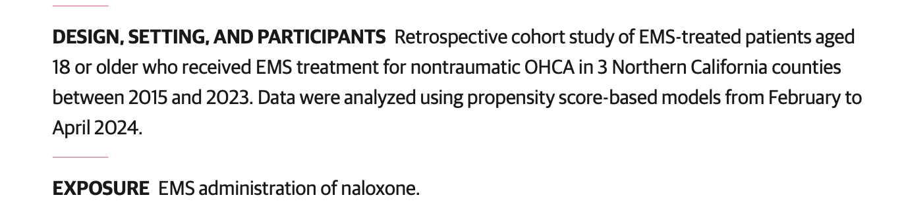

Slide 34
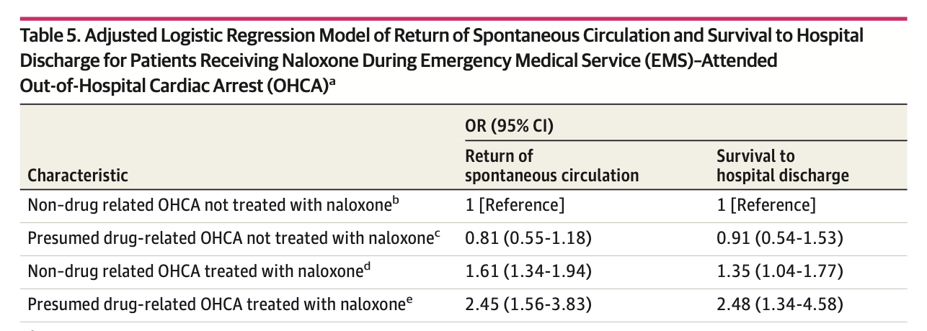

Slide 35
Conclusions
In this retrospective cohort of patients with OHCA,EMS-administered naloxone was associated with clinically significant improvements in ROSC and survival to hospital discharge.

Slide 36
The END

