Slide 1
Hennepin EMS
Prehospital Ultrasound Program

Slide 2
No financial disclosures

Slide 3


Slide 4
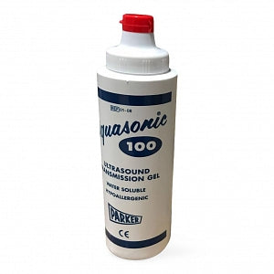
What’s the key to US success?
GEL
G – having the right Groundrules
E – having constant image Evaluation
L – Layering ultrasound full into the practice of prehospital care

Slide 5
Groundrules
Practice in your patients who are not critical, when appropriate
Save your images, submit the worksheets (so you can get feedback)
You can always upgrade acuity based on clinical concerns and concerning ultrasound findings
You can never downgrade acuity (or sign a patient) based on normal ultrasound findings

Slide 6
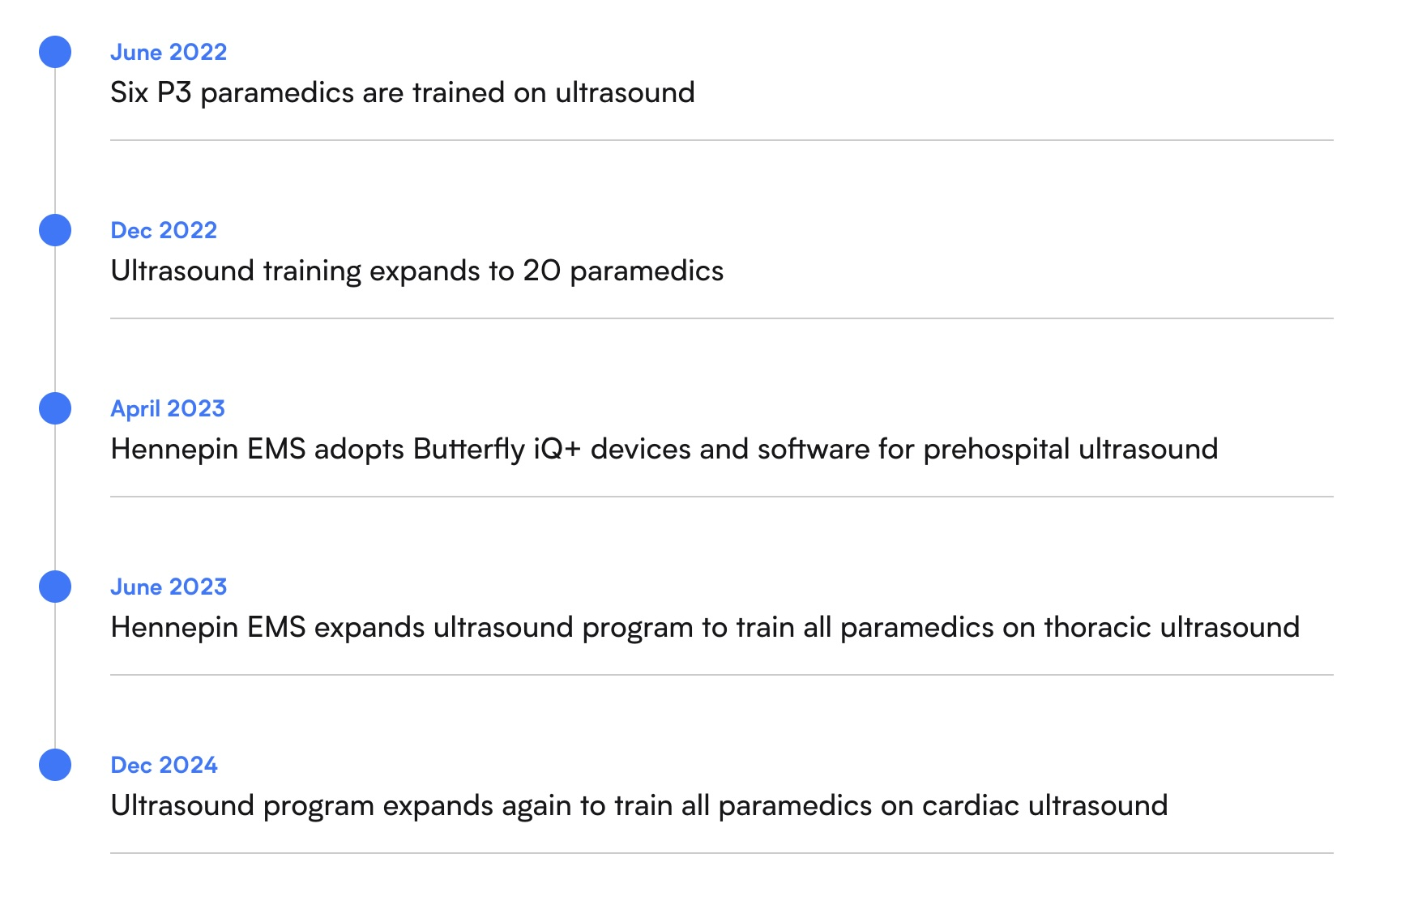

Slide 7
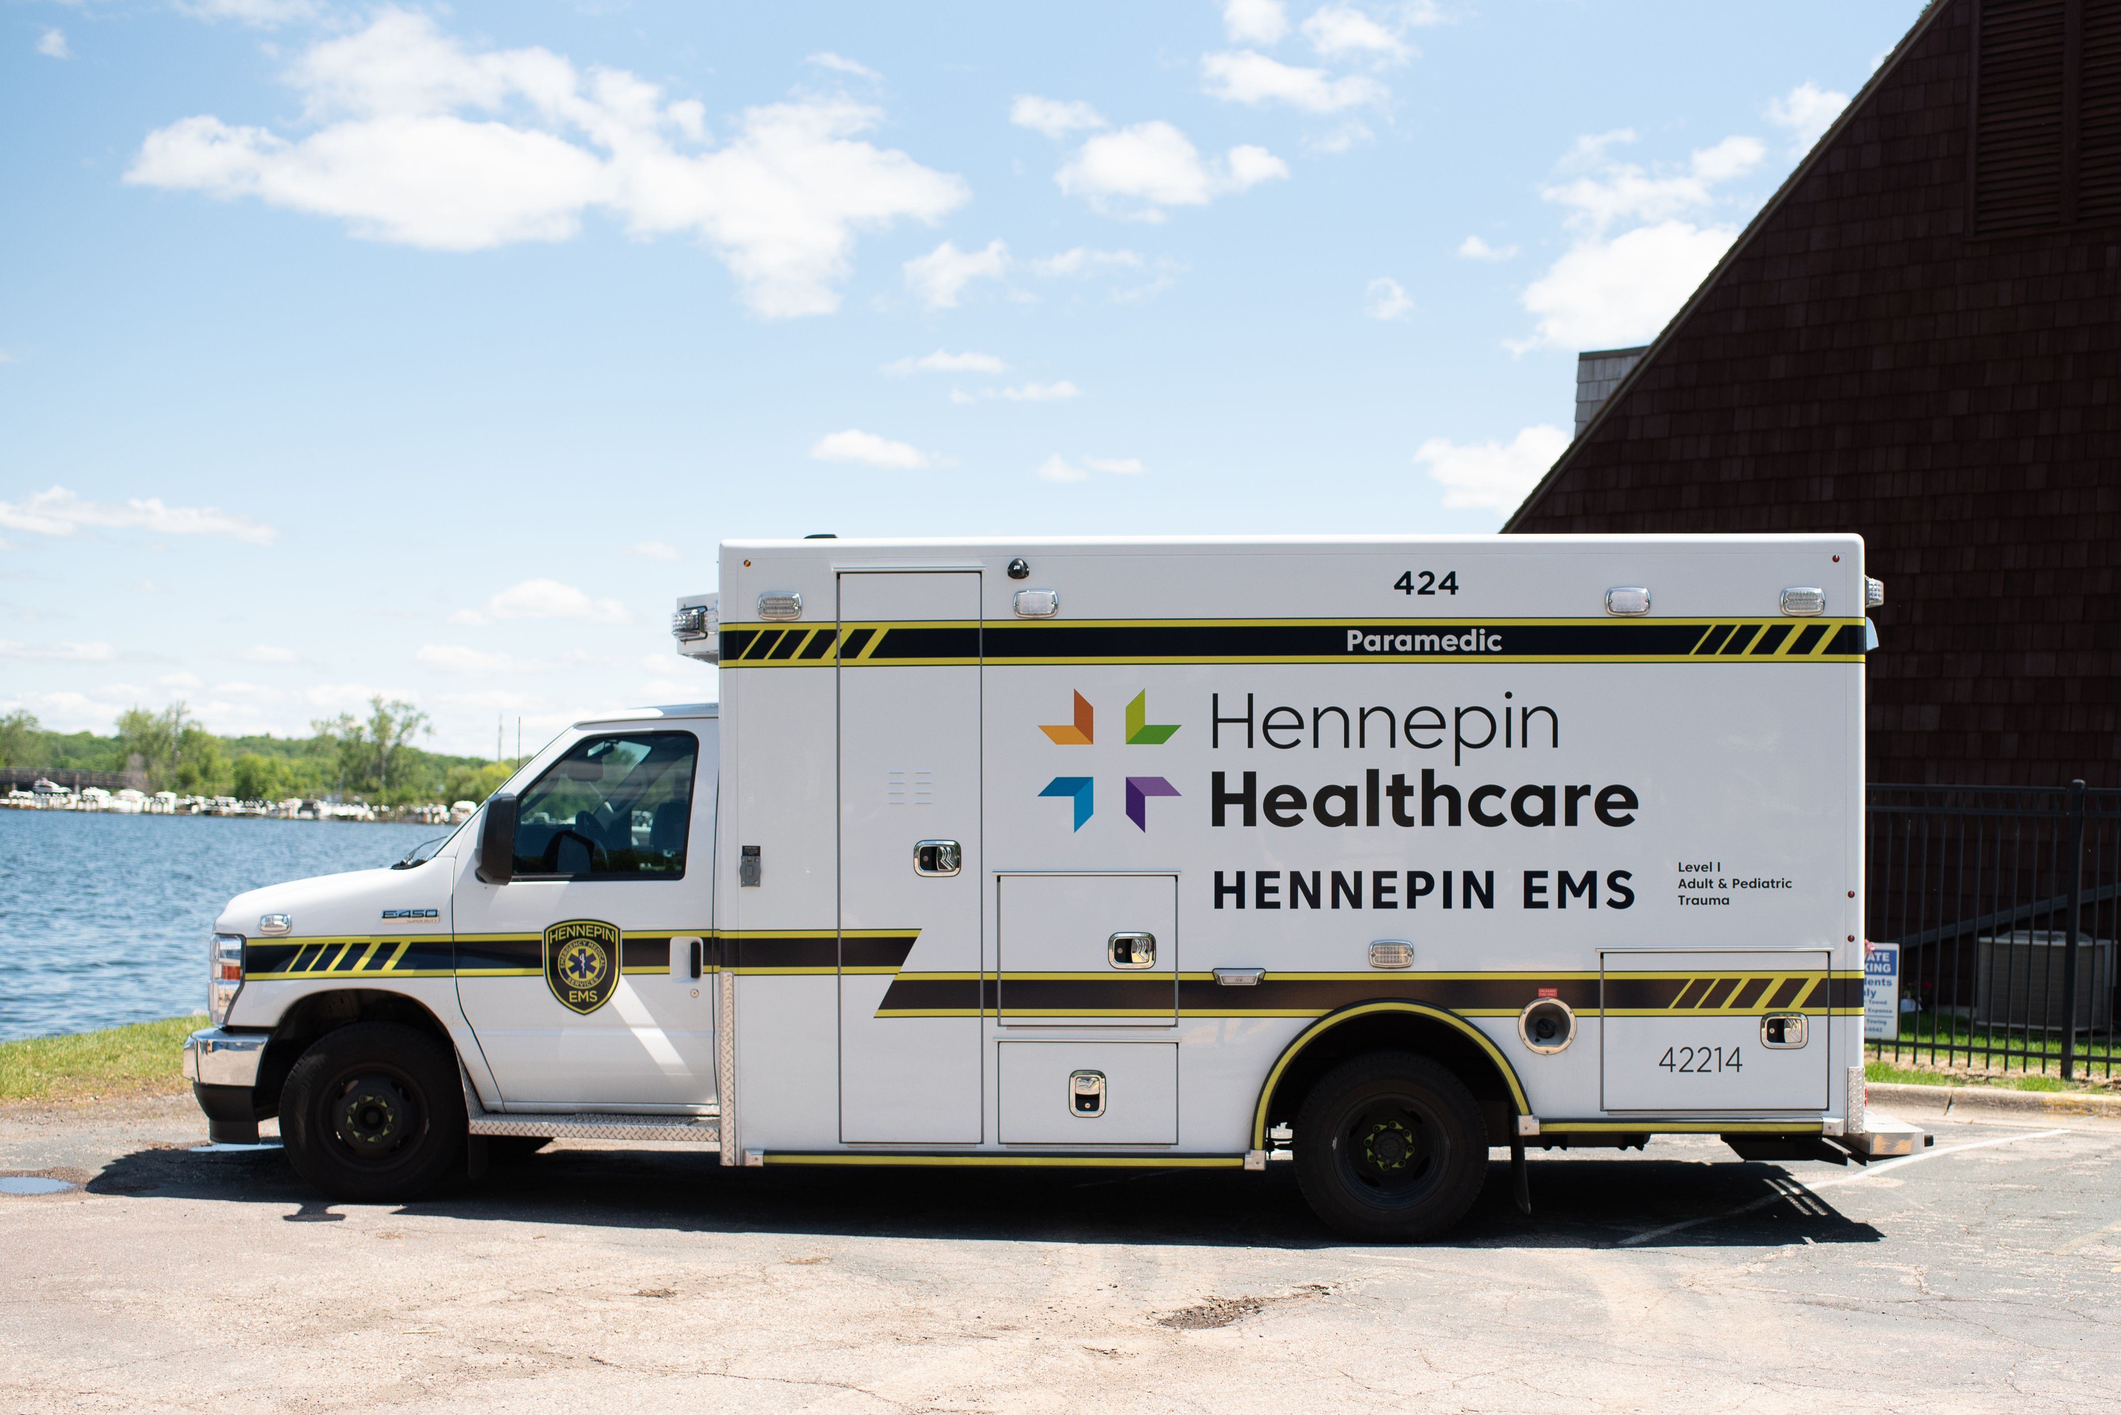
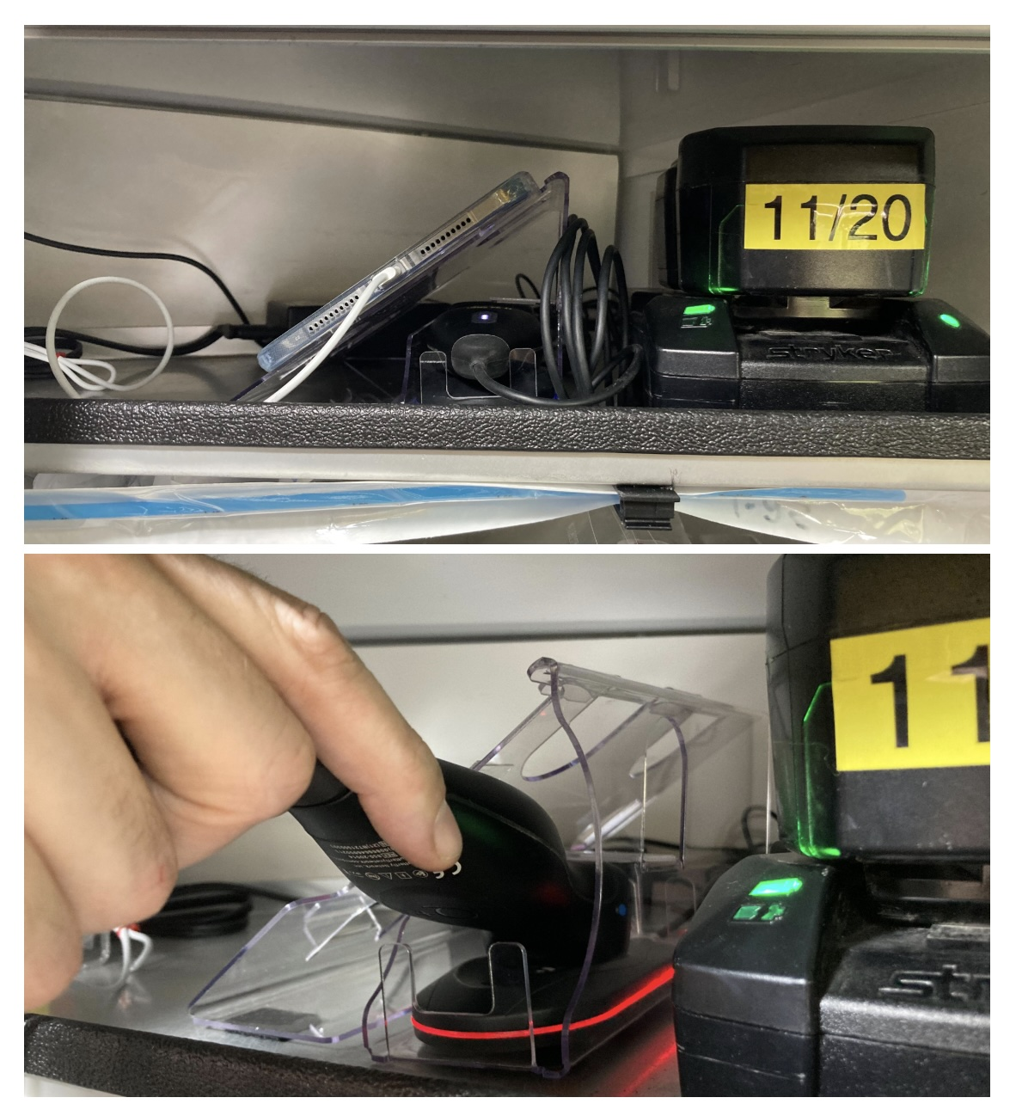

Slide 8
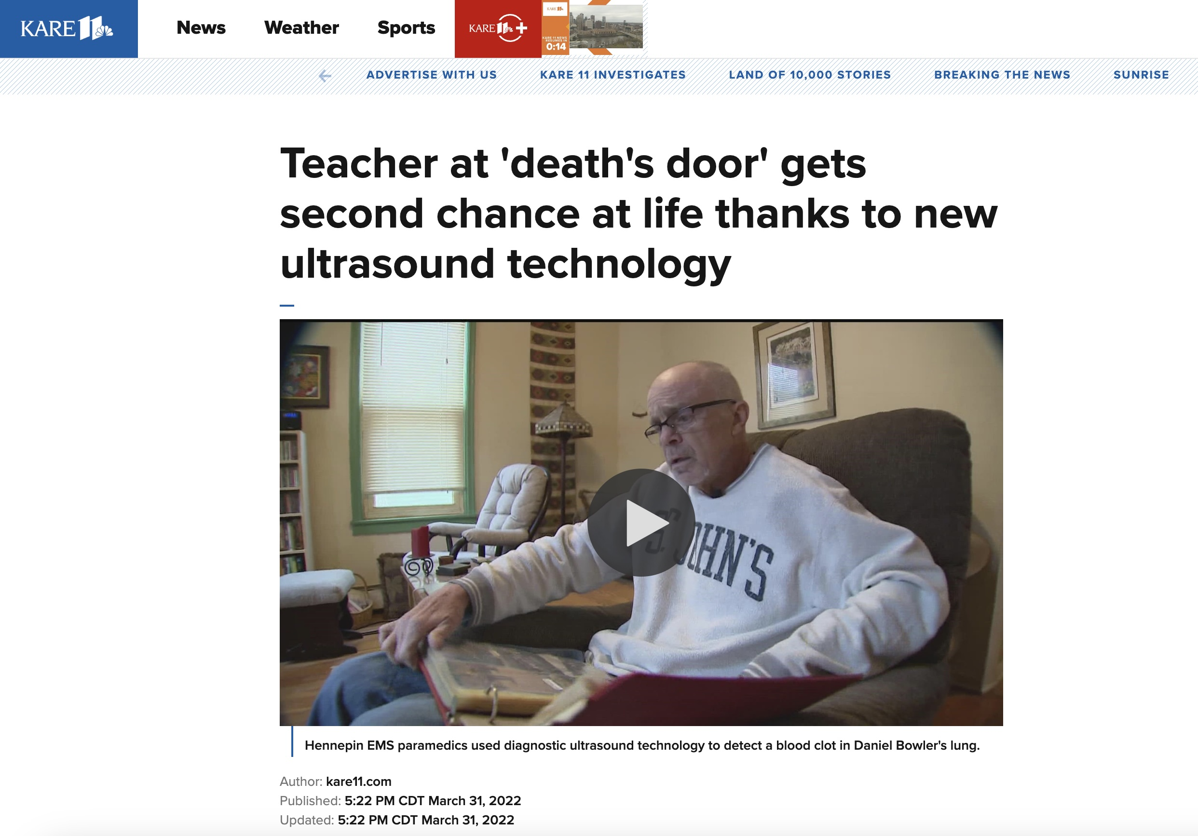

Slide 9
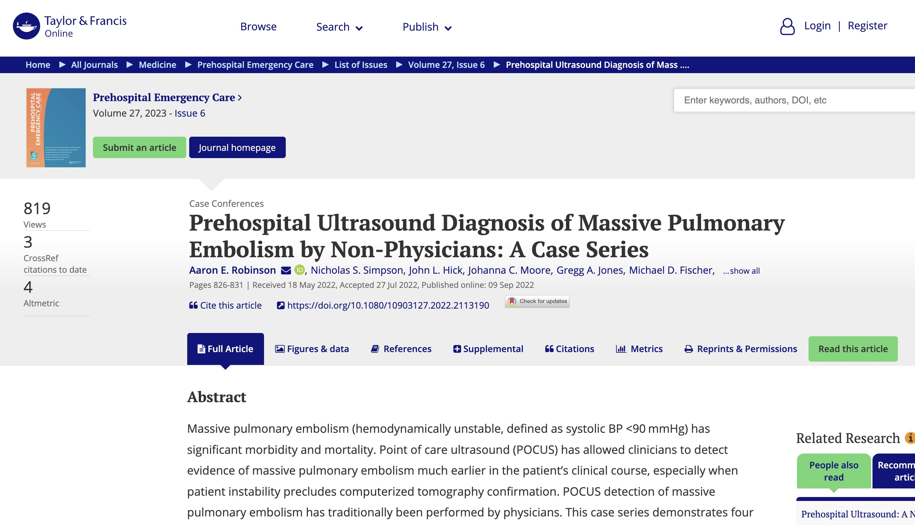

Slide 10
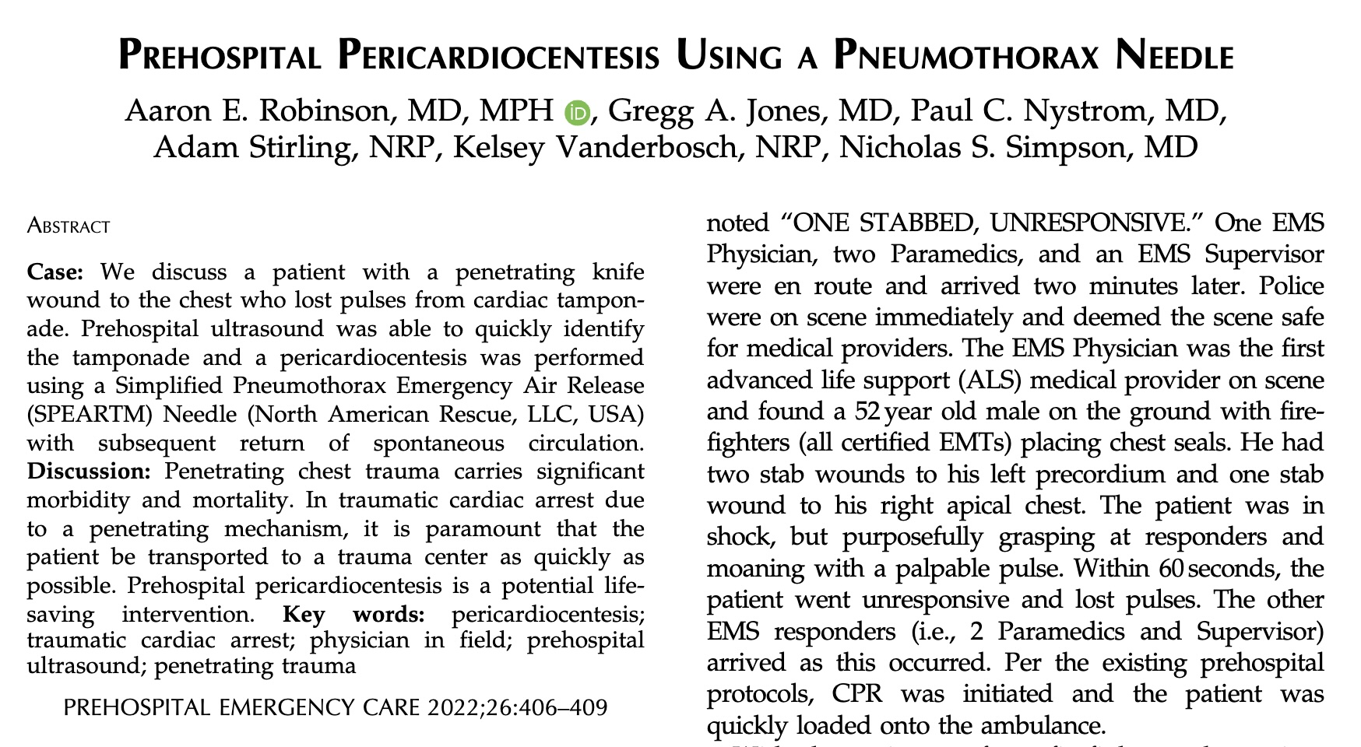

Slide 11
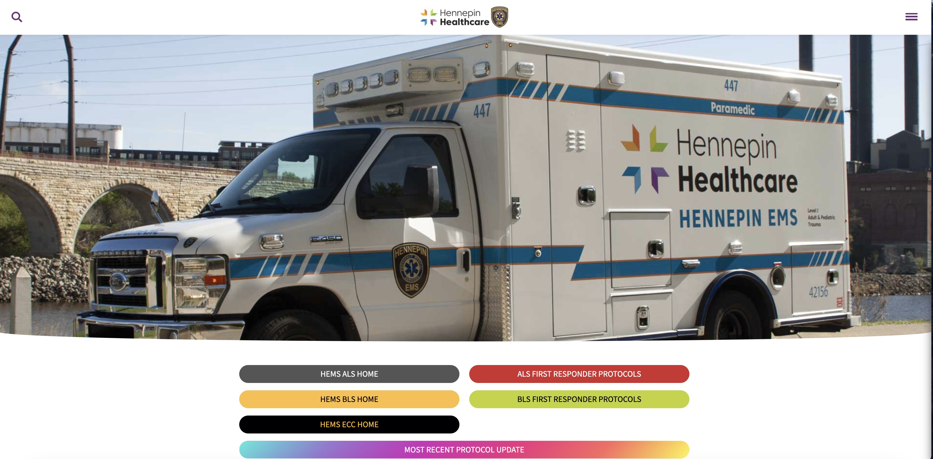

Slide 12
Do the crews use it?
Exams that all paramedics are trained to do:
Thoracic/Lung – 4,698
Cardiac (Sub-Xi, P-long)– 3,153
Exams only P3’s do:
FAST – 769
OB – 145
DVT – 12
Vascular Access – 677
Aorta
Total – 6,652

Slide 13
So what?
About 10% of the time, the cardiac/lung exams will lead to a significant change in management
Numerous cases of saves that would not have been possible without the US (e.g. PE, AAA, low amniotic fluid)
Allows increased safety with certain medications (e.g. push dose NTG)
Additional way to confirm proper ETT depth

Slide 14
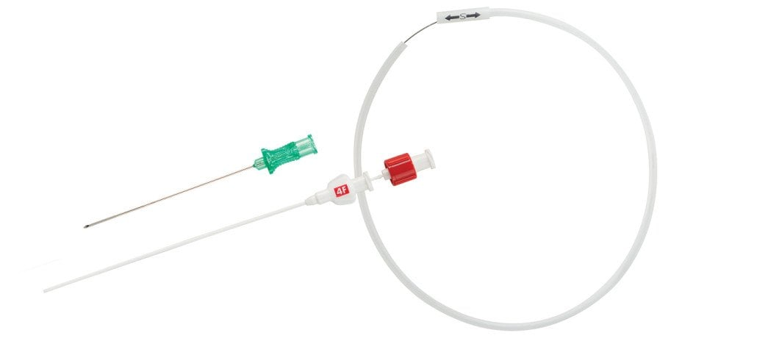
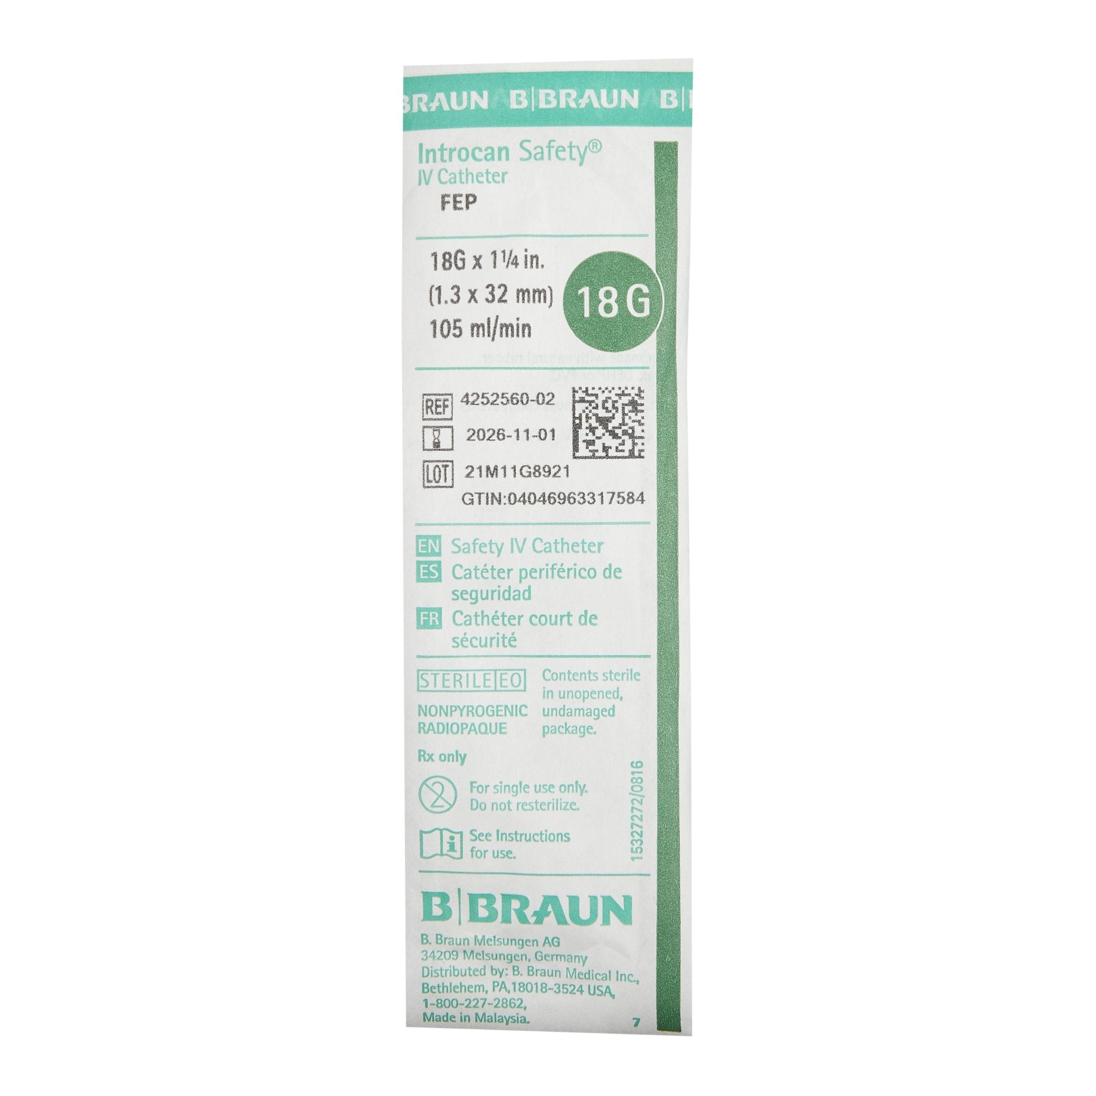
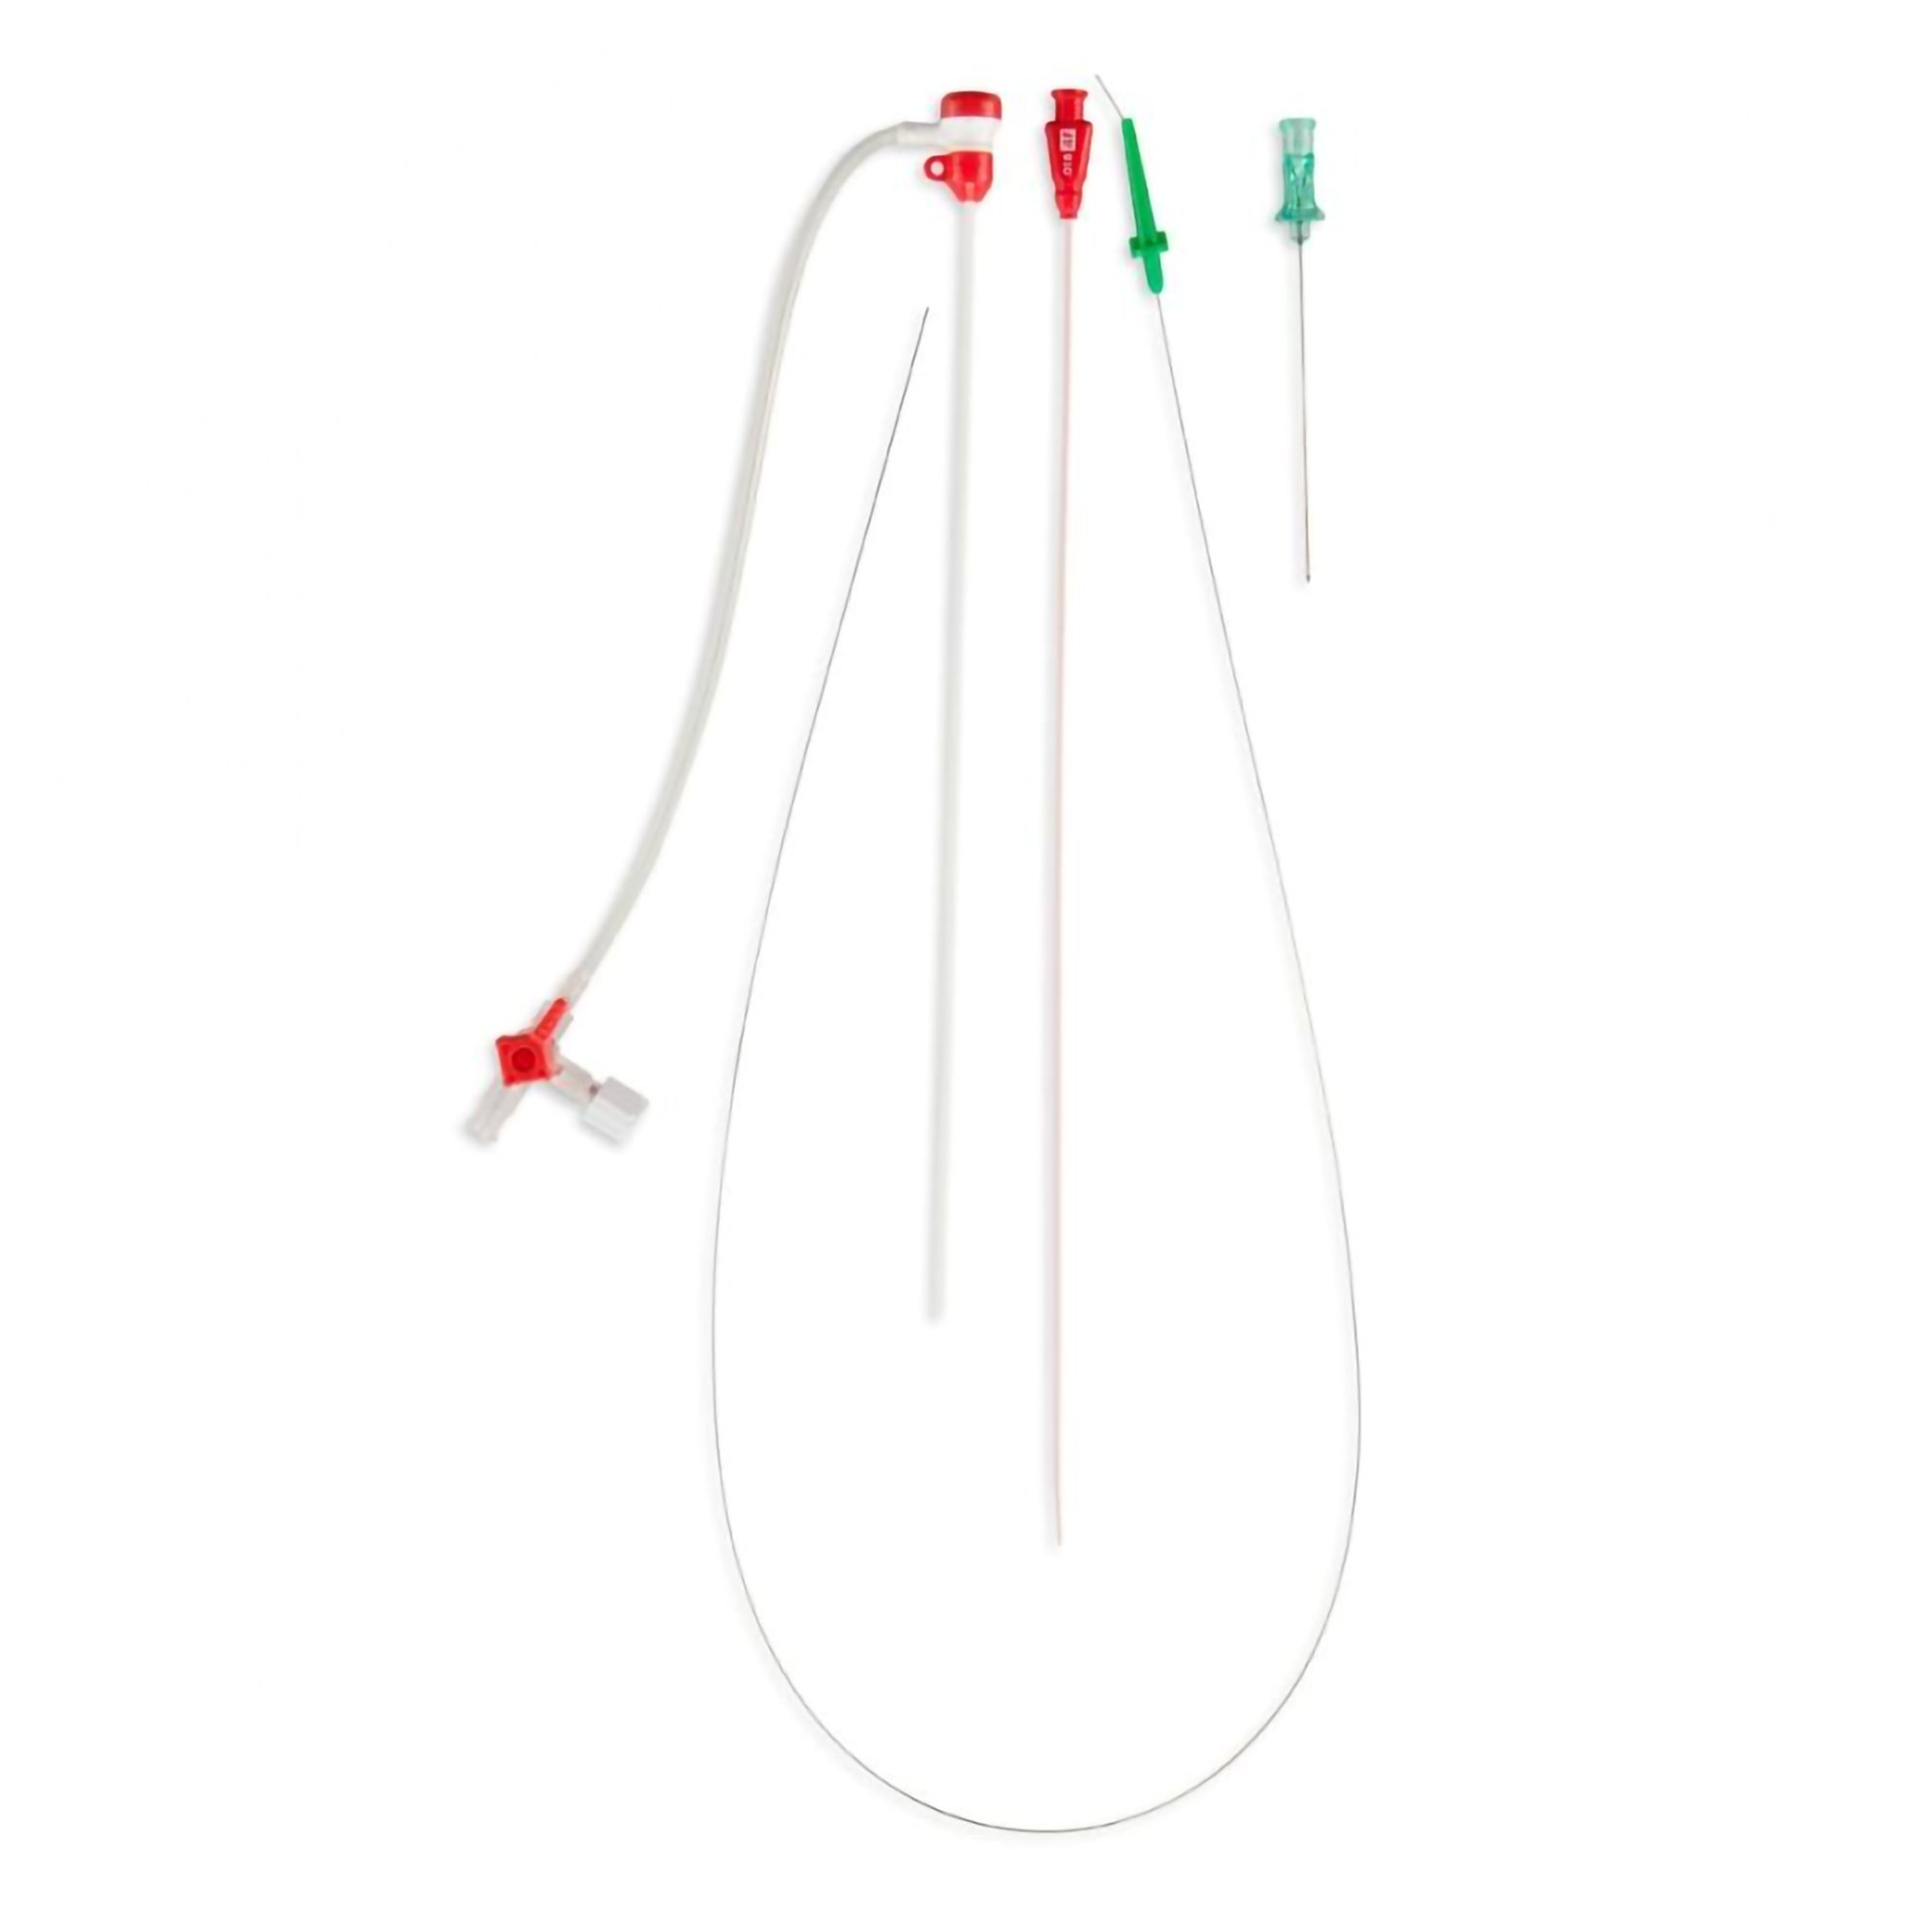
Vascular Access
S-MAK A-line
Mostly IV Access
Prelude Catheter

Slide 15
Vascular Access Rollout
Initially in our P3 Group – smaller logistical hurdle to give to a small number of paramedics
This summer, working on logistics to stock these on every ambulance and plan to train all paramedics in the fall educational period.
Plan to go-live, service wide this fall

Slide 16
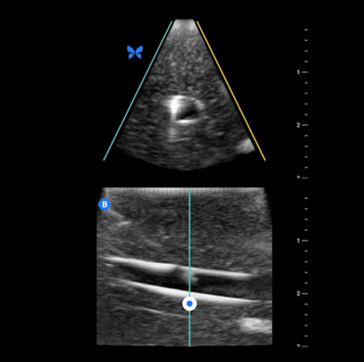

Slide 17



Link to access Hennepin EMS Protocols
Link to Butterfly / Hennepin EMS Case Study

Slide 18
What’s the key to US success?
GEL
G – having the right Groundrules
E – having constant image Evaluation
L – Layering ultrasound full into the practice of prehospital care

Slide 19



Questions
/hennepinems
Hennepin EMS
@hennepinems
HENNEPINEMS.ORG

Slide 20

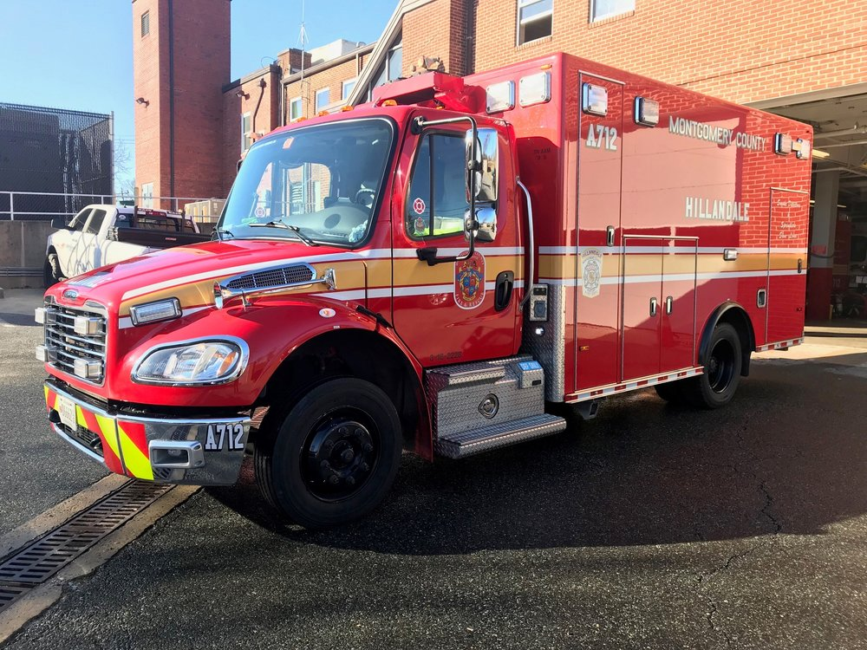
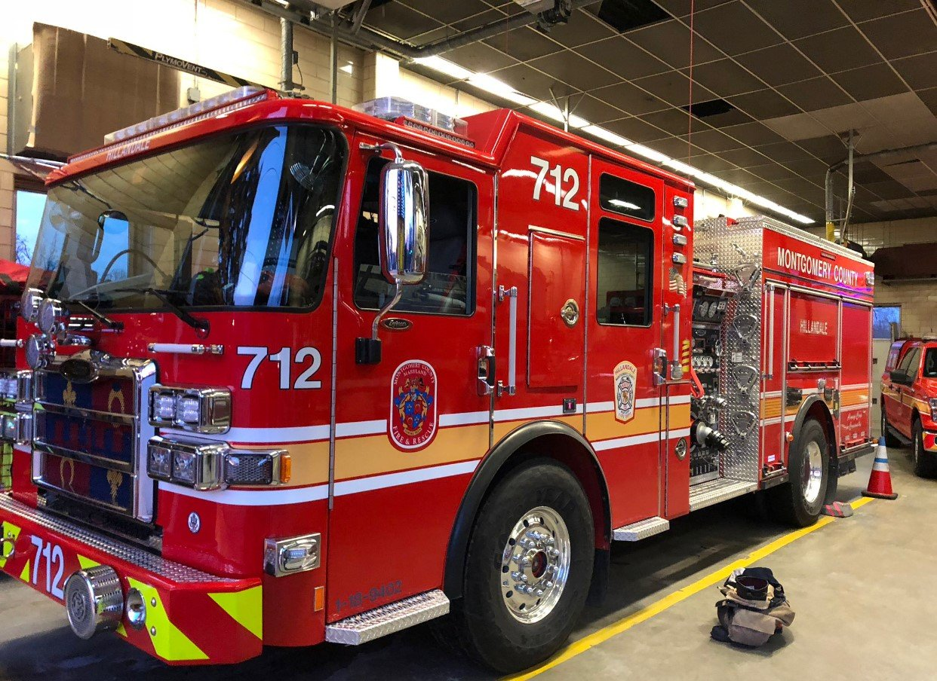
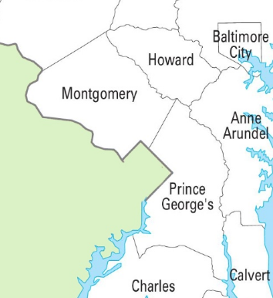
Hocus Pocus… ♪
Starting slow in Ultrasound on the go

Slide 21

“Hocus, POCUS… Let’s Focus” ♫
Inaugural EMS Ultrasound program that highlights a binary choice to inform transportation decisions in Cardiac Arrest Care
Roger M. Stone, M.D.,M.S., FAAEM FAEMS
EMIHS Section, Montgomery County Fire & Rescue
Department of Emergency Medicine, University of Maryland SOM
with generous contributions by
Batt Chief Pete Dugan, AA, NRP
Assistant Chief Timothy Burns, MS, NRP
Assistant Chief Ben Kaufman, BS, RN, NRP
MCFRS EMIHS Section and QM Division
Eagles 2025
Notes:
So good morning everybody , and it's obviously an honor for me to be here to talk to you about our startup POCUS program.
Indeed , Dr Simpson’s presentation is the toughest of acts to follow since his clinicians have such tremendous skill in multiple areas of EMS ultrasound.
I thought it helpful in that context to compare and contrast our system which had to make a decision about a “start up program” for prehospital ultrasound and given the focused choices we made, it might be helpful for those systems that may not have started a POCUS program yet to consider our experience.

Slide 22
Questions
What applications can serve as an inaugural POCUS program in EMS?
In OHCA, could POCUS help establish futility of efforts and guide TOR decisions?
During pulse checks, could carotid blood flow be indicative of sub-clinical ROSC ➔ informs transport decisions?
To “Focus” on limited use cases and do it well, is that a sound strategy to introduce a prehospital POCUS starter program?
Notes:
So here are some of the questions we asked when we were considering what applications can serve us best if we were to have an inaugural pocus program.
By serving us best, we mean where could we make the most consequential decisions ?
Could PoC US help us establish futility of efforts to guide our TOR decisions ?
And During pulse checks could carotid blood flow serve as a surrogate for sub-clinical ROSC
Focusing on a limited set of uses that are reliable seemed our best strategy for getting started.

Slide 23
Introduction
Our EMS system generally emphasizes on scene resuscitation of OHCA until ROSC or TOR at 30 minutes: “Stop, drop and resus”
Decision making may be easier in
  Asystole
  Certain historic indications implicating futility
PEA may indicate/introduce more complexity
    State protocol relied on indirect evidence of perfusion ➔ EtCO2
    > 15 ➔ May not predict survivability after the effort to transport
Traditional Protocol: “May” invoke TOR if EtCO2 < 15
Notes:
So our system had focused heavily on bringing medicine to out of hospital cardiac arrest and we saw two major decisions in working codes :
Those centering around patients in a systole and certain other historic indications associated with futility could be best be handled with clinical decision making and literature about ideal lengths of resuscitative efforts. The state of Maryland had fallen for example on 30 minutes as its minimum time frame for workable arrests
But PEA seemed to introduce a more nuanced question because the presence of electrical complexes may herald evidence of some degree of ROSC.
For a long time the state had relied on this indirect evidence through the provision of etco 2 monitoring so did not endorse termination when readings were above 15. But does that really predict survivability after an effort to transport, or were those patients invariably being called in the ED soon after arrival?
We in Montgomery County got permission to introduce ultrasonographic evidence of flow as a substitute for the ET CO2 .

Slide 24
Dilemma (For Some)
Acquisitions of complex images by EMS clinicians are subject to
  Variable skill and interpretations, skills degradation for part-timers, etc
  False positives or negatives in Non-binary or subjective continuum of variables (ex: FAST exam)
  NON-sensitive testing that TAKES TIME, cannot be used for negative decisions
We sought a start-up program that addresses above limitations
All systems have a medical director
    Should system choose low dose high frequency use of probe & digestible education?
We are also advocates of NON-disparate services to citizens 24/7
Notes:
So we were also seeing many startup programs in Maryland apply a complex array of different use cases , primarily individually taught by local medical directors.
They were often selecting a sub cohort of clinicians for credentialing .
Especially since it would be prohibitive to equip all response units with ultrasound, and try to train some 400 medics with the full array of skills , we saw several of the following dilemmas
Variations of interpretation
skills degradation
false positives or negatives related to any of the non- binary or subjective continuum of variables such as the fast exam
and the sensitivity of testing (IE ruling conditions out )
We asked ourselves how the training Academy and my office could start with a low dose high frequency use for the probe and digestible education for a limited span of control
Finally it should be noted that an unacceptable outcome of selective credentialing cannot be a variable access to a new service or innovation in the county. We advocate for the same service to be available around the clock to everyone, and therefore a regional program where the services are dispatchable to all addresses is a must for us .
That mission is only possible through the training of EMS Duty Officers (EMSDOs) much like our Whole Blood program.

Slide 25
Clinical Guidelines
We chose PEA as primary indication for its use
Assessment: Patients rhythm at the floor of care and at 30 min
May assess carotid artery flow upon arrival of the EMS DO
    Identification of flow or Pseudo-PEA and transport decisions earlier
    Futility at the 30 minute mark
ALS Pharmacology: initiate post-ROSC care with Epi drip? (Objective)
ALS Skills: Definitive airway if not obtained earlier in code (Objective)
Specialty Destinations: CIC (Mandated)
Notes:
A perfect clinical area that would marry POCUS use with a existing area of emphasis is out of hospital cardiac arrest
referring to the introductory slide , we chose PE a as a primary indication for sonography, and specifically chose objective evidence of carotid flow as the site probe application.
As we said, we stopped drop & resuscitate appropriate candidates for a minimum of 30 minutes and so the patient rhythm during our floor of scene care and that 30 minutes becomes most relevant.

Slide 26
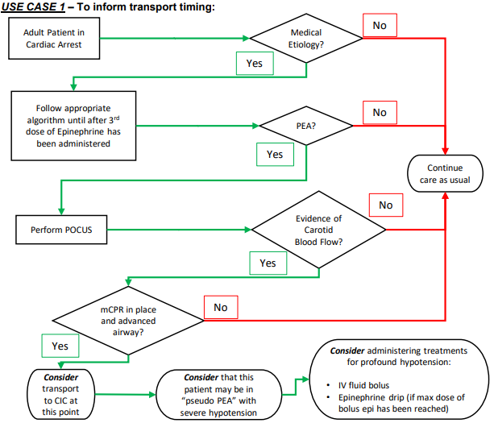
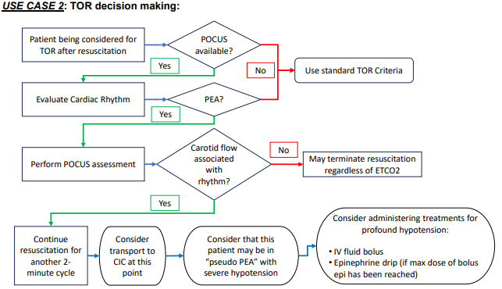
Clinical Guideline Algorithms
Notes:
This is the flow sheet associated with our clinical practice guideline.
Use case one is decisions relative to the timing of transportation after the floor of care is initiated in cardiac arrest.
Note that the variable is binary once PEA is established as a criteria for pocus use. At the third dose of EPI, a determination of the presence versus absence of carotid blood flow is established and the EMS duty officer can make subsequent decisions based on that presence. As an advanced airway is assured, and other post rusk treatments are initiated, this helps drive an informed decision
similarly in use case 2, the absence of carotid flow after the rhythm is evaluated May lead to further resuscitation through the 30th minute and in the absence of carotid flow, the state has accepted that criteria as a substitute for the end tidal CO2

Slide 27
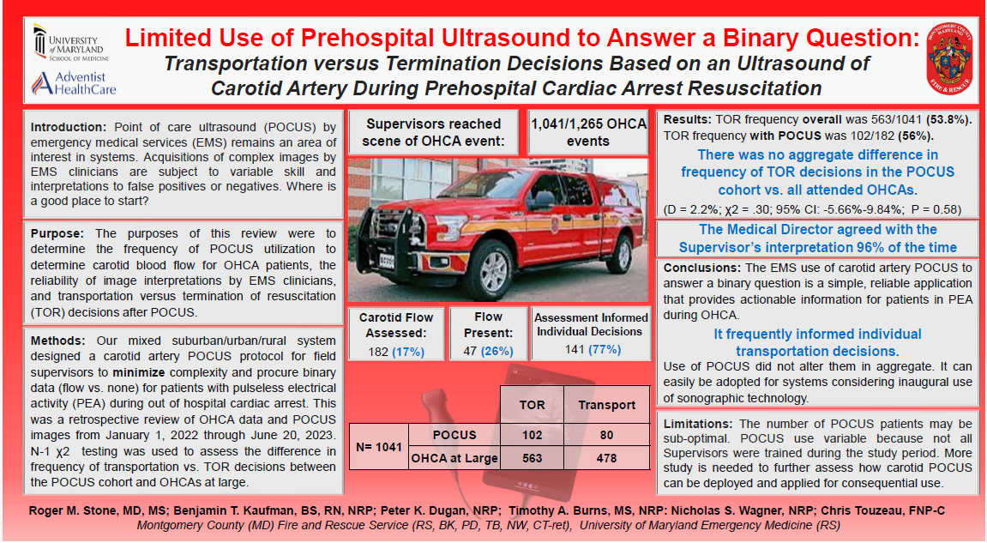
2019 Internal Study: Significant Over-dispatch
Results:
EMSDO’s reached Scene: 1,041/1,265 events
Carotid Flow assessed:182 (17%)
Flow Present: 47 (26%)
Assessment Informed Individual Decisions: 141 (77%)
TOR frequency was 563/1041 (53.8%). TOR frequency with POCUS was 102/182 (56%)
No aggregate difference in frequency of TOR decisions in POCUS cohort v. attended OHCAs
(D = 2.2%; χ2 = .30; 95% CI: -5.66%-9.84%; P = 0.58)
The Medical Director agreed with Supervisor’s interpretation 96% of the time
Notes:
This represented our first 18 months of data , which we were able to present as a poster at any NAEMSP 2024 .
what we were primarily able to show is that early on although our EMS duty officers are able to reach most cardiac events, there was a limited amount of use cases when the patients are screened for PEA.
however highlights were that once used ,
a significant Percentage of patients did have flow , and
And that the POTUS assessment informed is a visual transport decisioned the majority of times
although there was no statistically significant difference in the aggregate frequency of one decision versus the other, this seems to fine tune the specific individual decisions around who is transported is where POCUS makes the most difference
The other main finding was that the skill was easily taught, and the sonography reliably interpreted b

Slide 28
Take-Home Points
As OCHA is best managed by HPCPR, and TOR is indicated for futility of efforts ➔ We need good tools for those decisions
During pulse checks, carotid blood flow is indicative of sub-clinical ROSC, which informs downstream care
POCUS is a reliable and viable tool for use in refractory PEA
Start with an objective POCUS program answering simple (binary) questions that are actionable/consequential
“Focus” on an area and do it well; that’s how we introduced “POCUS”➔ Could that interest other starter programs?

Slide 29
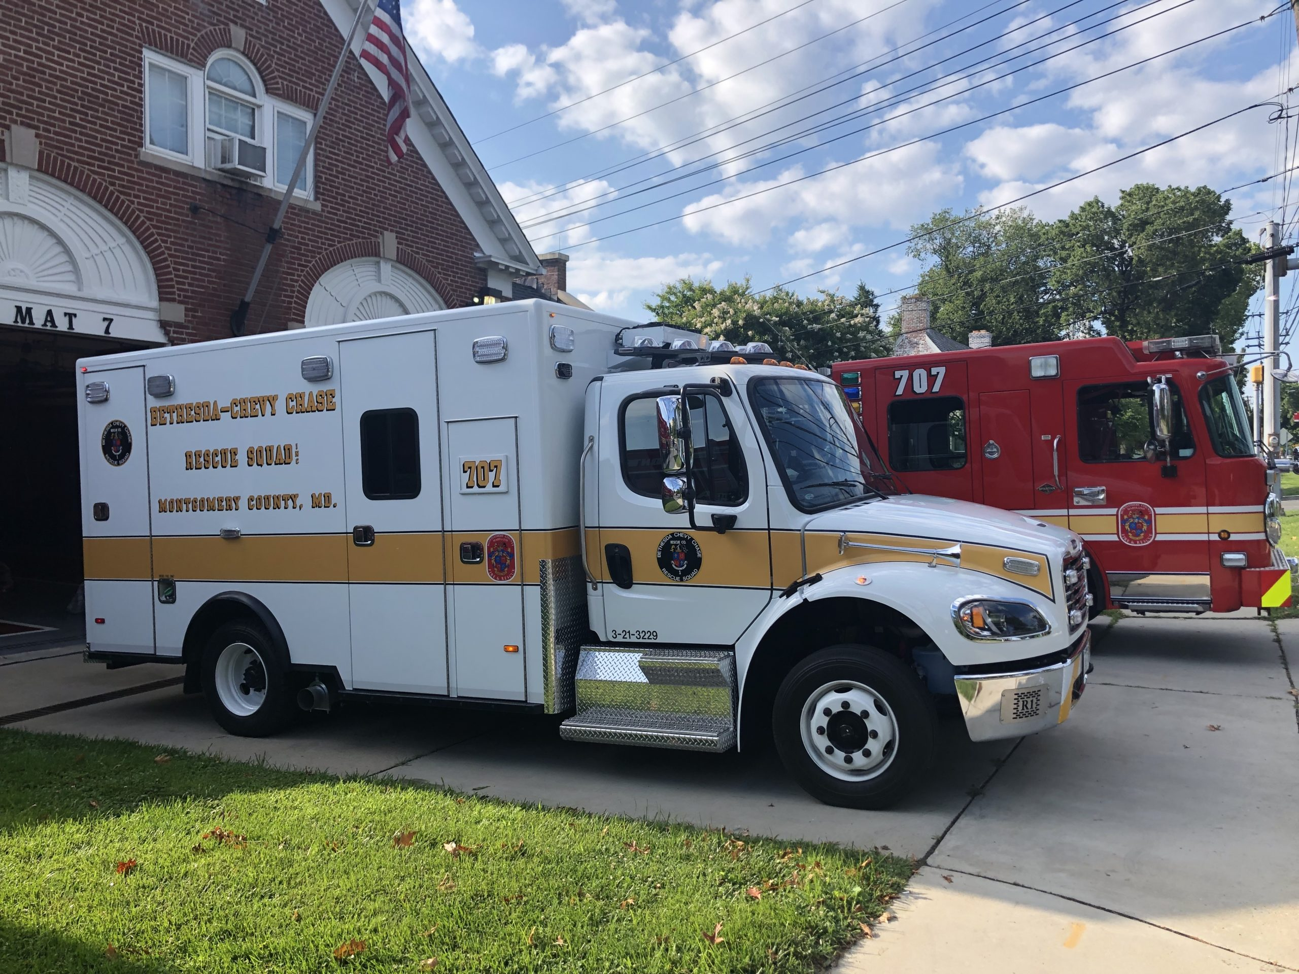
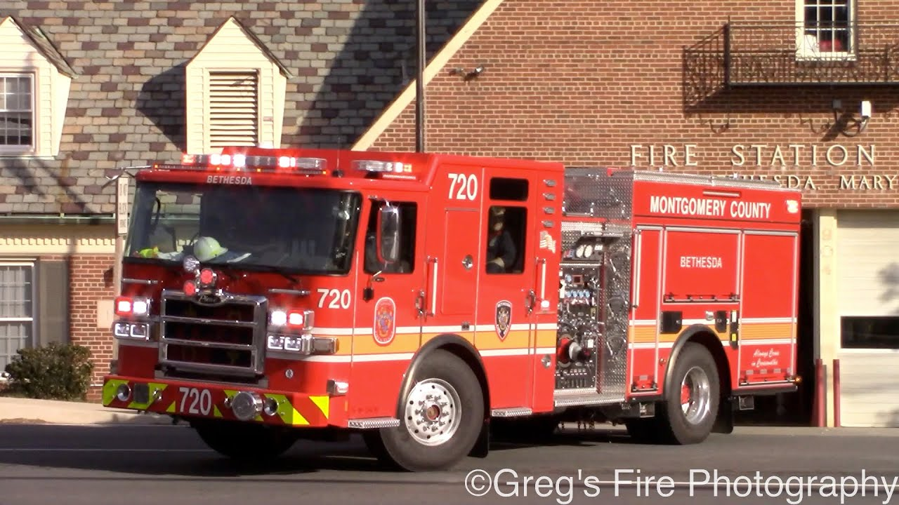
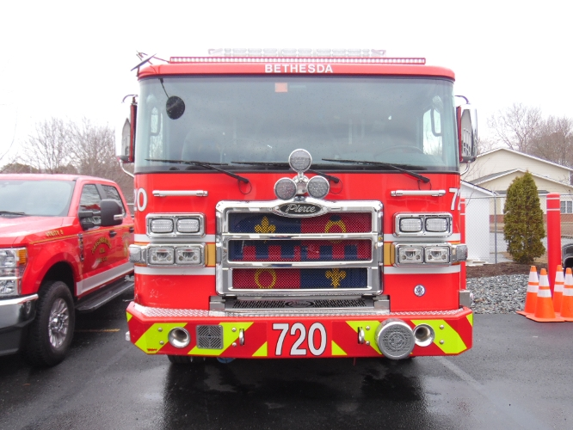
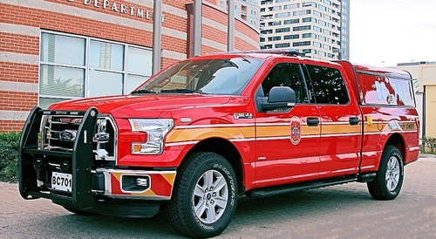
Questions?

