Slide 1
Tees-ing Out PEA and Quality CPR with TEE
Robert B Dunne, MD FACEP, FAEMS
Medical Director
Detroit Fire Department
Detroit East Medical Control Authority
Dunner@Detroitmi.gov

Slide 2
Why Are we talking about this?
How do you know your CPR is any good?
What is prehospital TEE?
What new technology is out there?

Slide 3


High-Quality CPR
Notes:
The “Crown Jewel” of Resuscitation is High Quality CPR

Slide 4
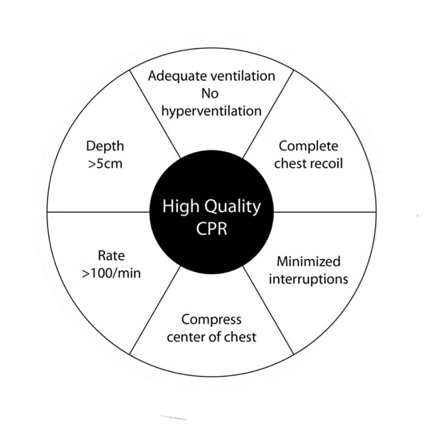
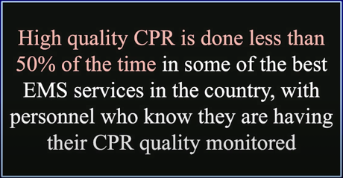
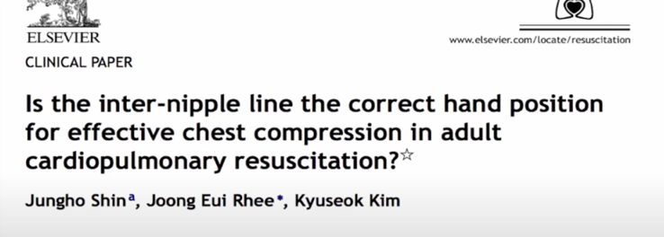

Slide 5
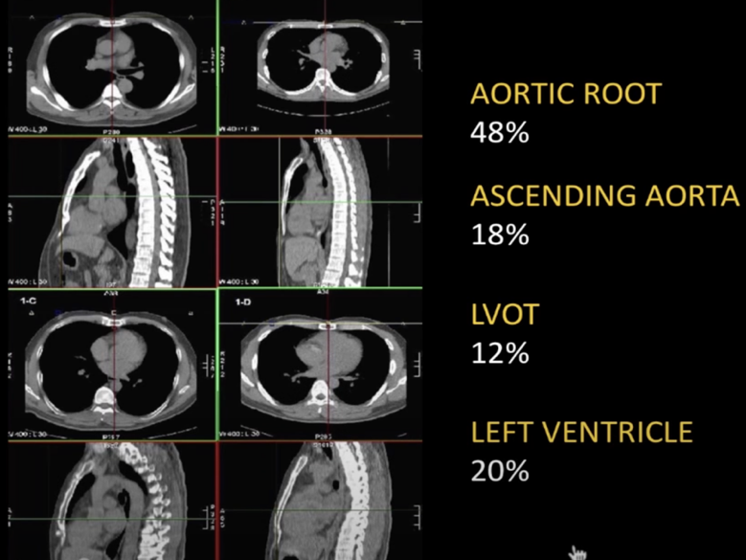
2007, CT study in South Korea, 189 patients
80% was not over the LV

Slide 6
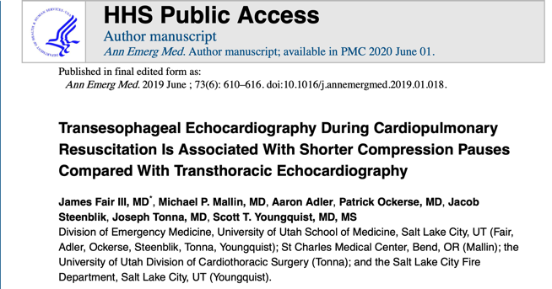
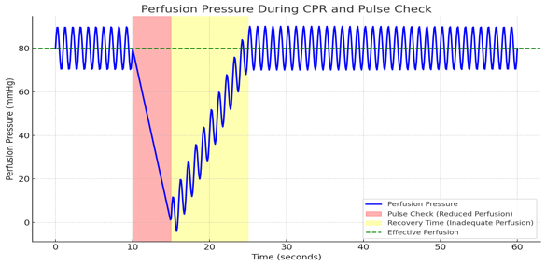
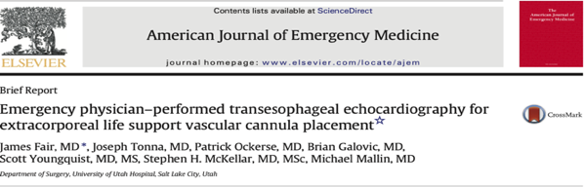
Advantages of TEE
No pesky ribs, easy view of the heart
CPR quality monitoring
Best Pulse Check. Ever!
  TTE: Mean Duration Time for Pulse Check time, 19 seconds
  TEE: Mean Duration Time for Pulse Check time, 9 seconds
  Safe for ECMO Cannulation guidance
Notes:
TTE: Mean Duration Time for Pulse Check time, 19 seconds
TEE: Mean Duration Time for Pulse Check time, 9 seconds
Safe for ECMO Cannulation guidance

Slide 7
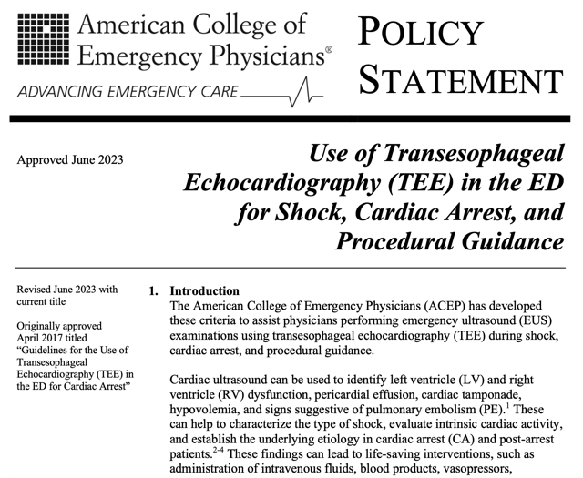

Slide 8
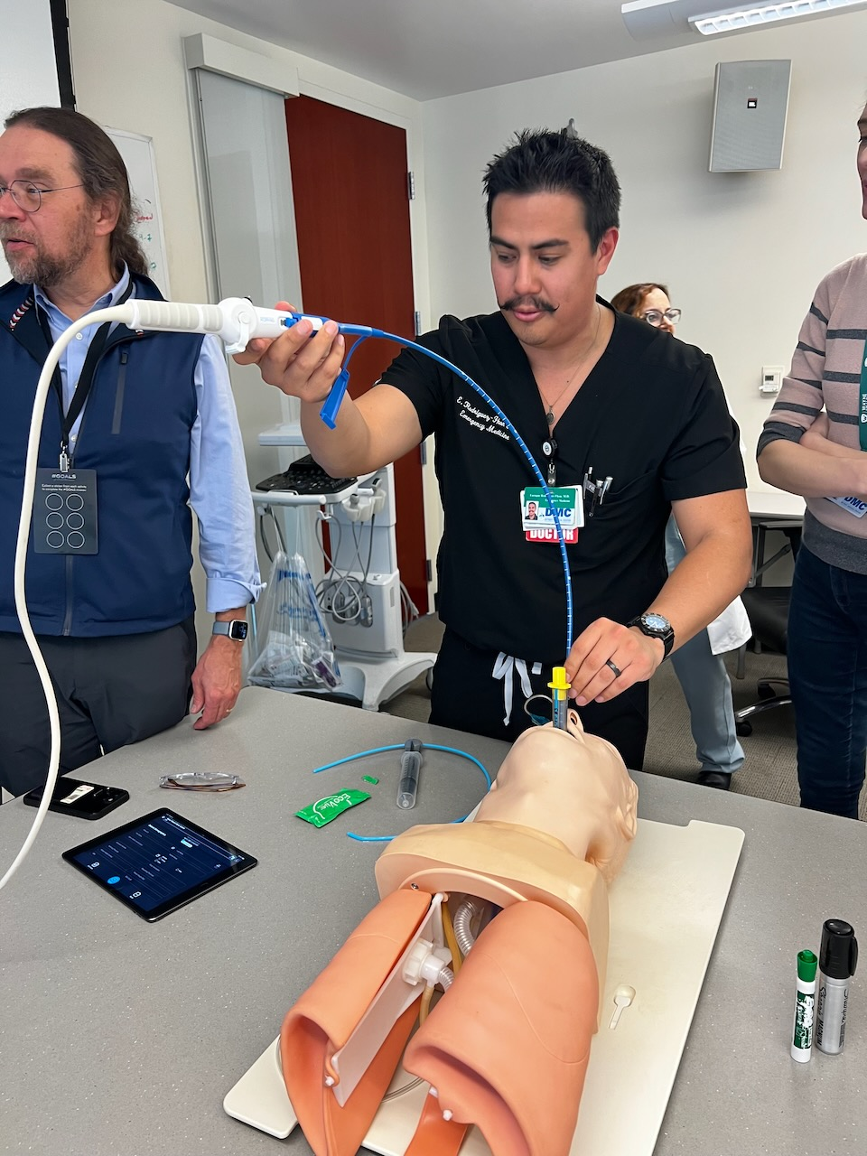
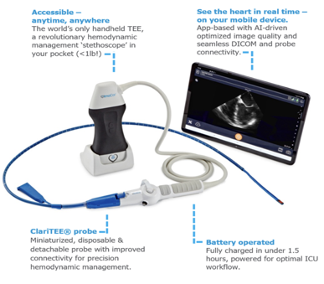
Device Choice
A disposable, mono-planar TEE probe can remain in the patient for up to 72h
Repeated measures of ventricular function and volume status, parameters needed to monitor response to therapy.
Can be used with any tablet

Slide 9
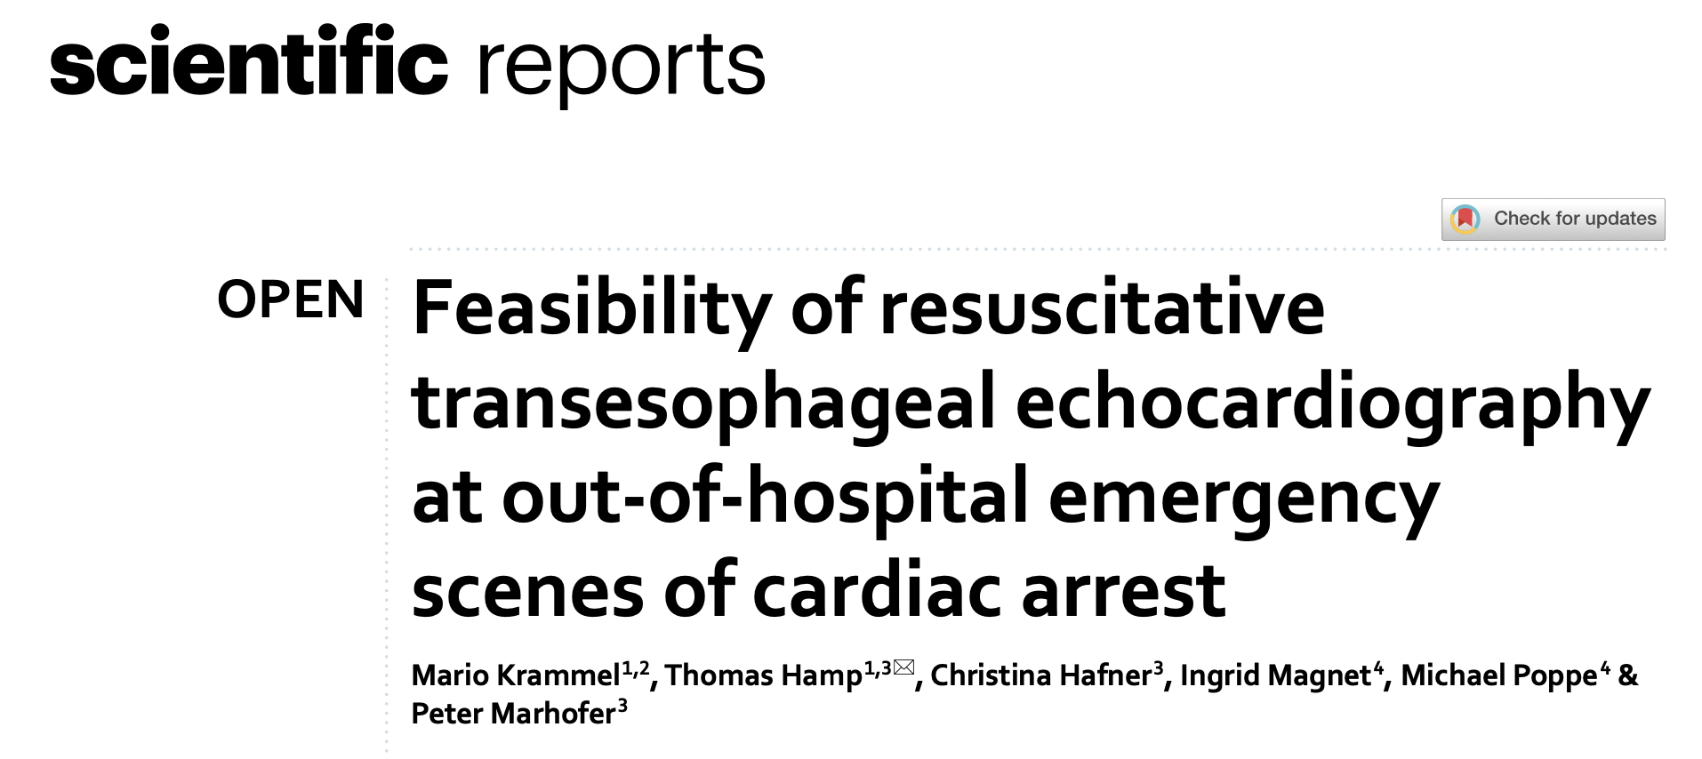

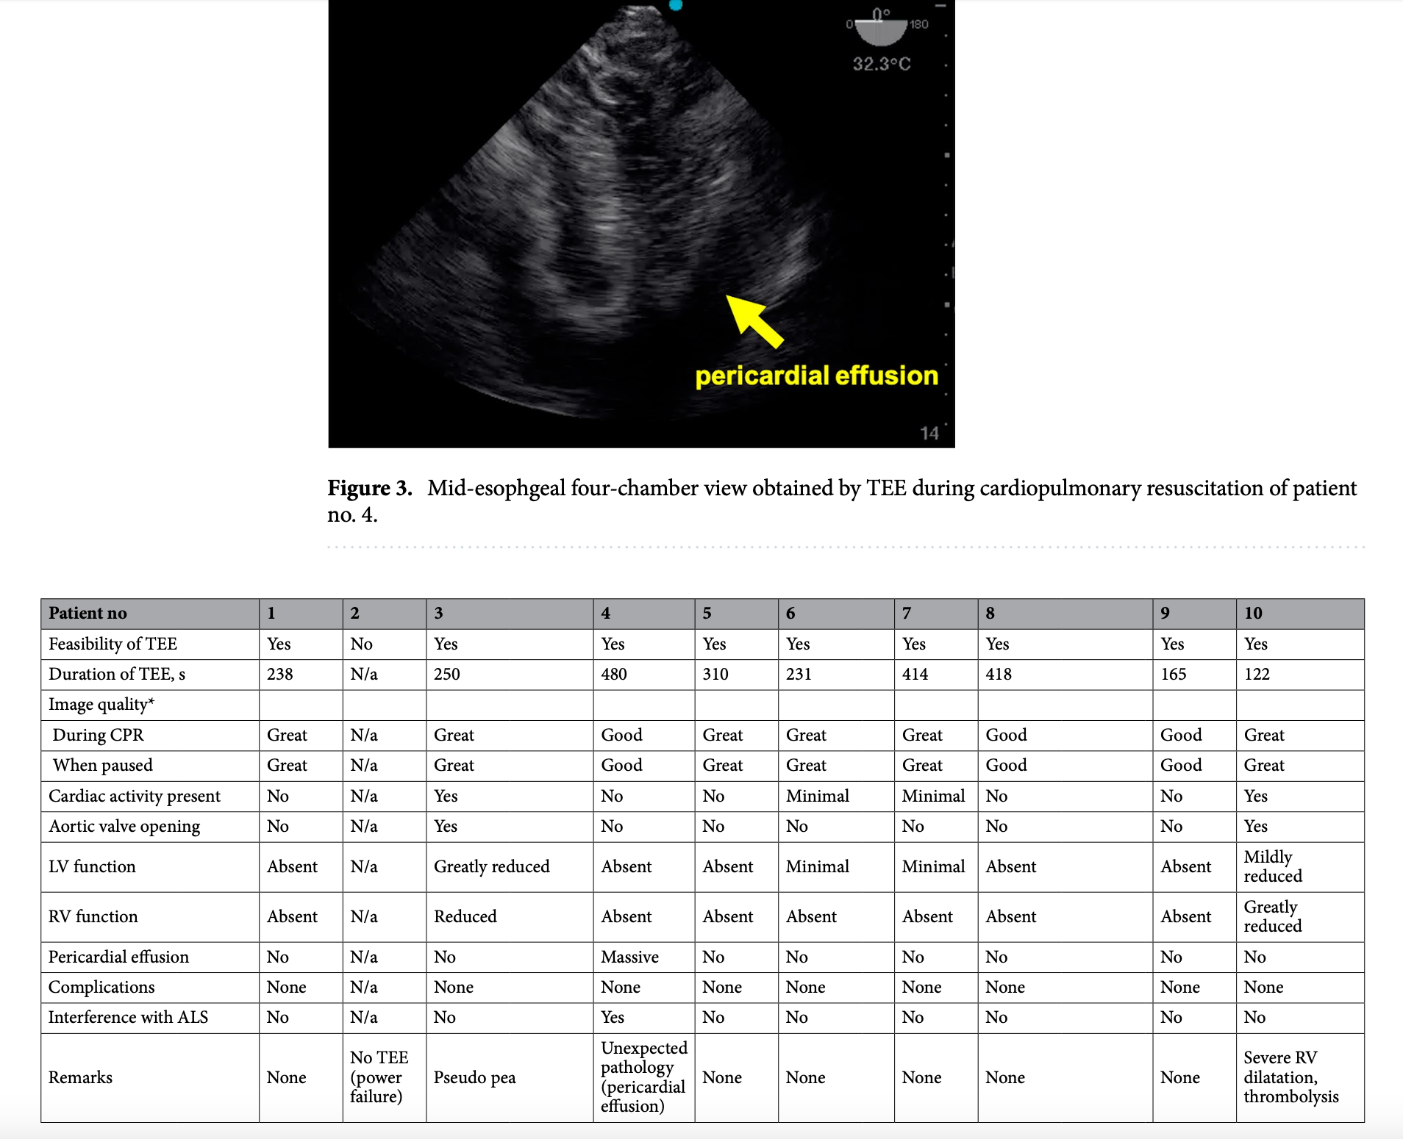

Slide 10
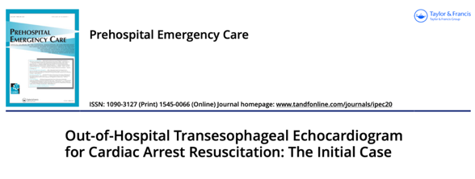
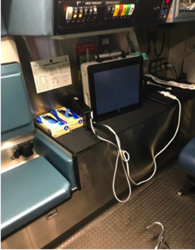
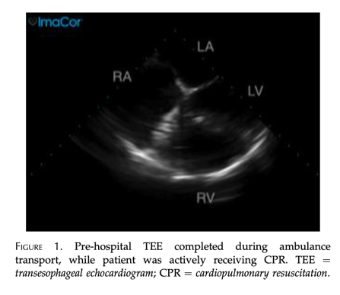

Slide 11
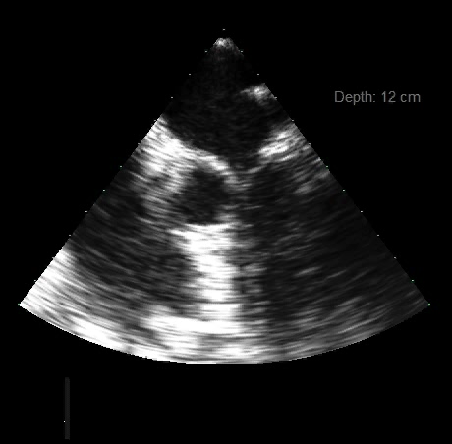
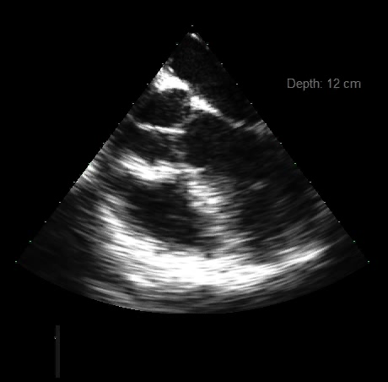
Midesophageal Five Chamber

Slide 12
References:
Skulec, R., Vojtisek, P. & Cerny, V. Correlation between end-tidal carbon dioxide and the degree of compression of heart cavities measured by transthoracic echocardiography during cardiopulmonary resuscitation for out-of-hospital cardiac arrest. Crit Care 23, 334 (2019). https://doi.org/10.1186/s13054-019-2607-2
Shin J, Rhee JE, Kim K. Is the inter-nipple line the correct hand position for effective chest compression in adult cardiopulmonary resuscitation? Resuscitation. 2007 Nov;75(2):305-10. doi: 10.1016/j.resuscitation.2007.05.003. Epub 2007 Jun 21. PMID: 17590258.
Hwang SO, Zhao PG, Choi HJ, Park KH, Cha KC, Park SM, Kim SC, Kim H, Lee KH. Compression of the left ventricular outflow tract during cardiopulmonary resuscitation. Acad Emerg Med. 2009 Oct;16(10):928-33. doi: 10.1111/j.1553-2712.2009.00497.x. Epub 2009 Sep 3. PMID: 19732038.
Teran F, Dean AJ, Centeno C, Panebianco NL, Zeidan AJ, Chan W, Abella BS. Evaluation of out-of-hospital cardiac arrest using transesophageal echocardiography in the emergency department. Resuscitation. 2019 Apr;137:140-147. doi: 10.1016/j.resuscitation.2019.02.013. Epub 2019 Feb 16. PMID: 30779977.
Riendeau Beaulac G, Teran F, Lecluyse V, Costescu A, Belliveau M, Desjardins G, Denault A. Transesophageal Echocardiography in Patients in Cardiac Arrest: The Heart and Beyond. Can J Cardiol. 2023 Apr;39(4):458-473. doi: 10.1016/j.cjca.2022.12.027. Epub 2023 Jan 6. PMID: 36621564.
Fair J, Tonna J, Ockerse P, Galovic B, Youngquist S, McKellar SH, Mallin M. Emergency physician-performed transesophageal echocardiography for extracorporeal life support vascular cannula placement. Am J Emerg Med. 2016 Aug;34(8):1637-9. doi: 10.1016/j.ajem.2016.06.038. Epub 2016 Jun 7. PMID: 27318746.
https://cpr.heart.org/-/media/CPR-Files/Resus-Science/High-Quality-CPR/CPR-Statement.pdf
Krammel, M., Hamp, T., Hafner, C. et al. Feasibility of resuscitative transesophageal echocardiography at out-of-hospital emergency scenes of cardiac arrest. Sci Rep 13, 20085 (2023). https://doi.org/10.1038/s41598-023-46684-x
Chu SE, Huang CY, Cheng CY, Chan CH, Chen HA, Chang CH, Tsai KC, Chiu KM, Ma MH, Chiang WC, Sun JT. Cardiopulmonary Resuscitation Without Aortic Valve Compression Increases the Chances of Return of Spontaneous Circulation in Out-of-Hospital Cardiac Arrest: A Prospective Observational Cohort Study. Crit Care Med. 2024 Sep 1;52(9):1367-1379. doi: 10.1097/CCM.0000000000006336. Epub 2024 May 23. PMID: 38780398.
Fair J 3rd, Mallin MP, Adler A, Ockerse P, Steenblik J, Tonna J, Youngquist ST. Transesophageal Echocardiography During Cardiopulmonary Resuscitation Is Associated With Shorter Compression Pauses Compared With Transthoracic Echocardiography. Ann Emerg Med. 2019 Jun;73(6):610-616. doi: 10.1016/j.annemergmed.2019.01.018. Epub 2019 Feb 14. PMID: 30773413; PMCID: PMC6868764.
Blanco P, Martínez Buendía C. Point-of-care ultrasound in cardiopulmonary resuscitation: a concise review. J Ultrasound. 2017 Jul 31;20(3):193-198. doi: 10.1007/s40477-017-0256-3. PMID: 28900519; PMCID: PMC5573702.
Some content and insights in this presentation were supported by OpenAI's ChatGPT.

Slide 13
Thank You

