Slide 1

Benjamin Lawner, DO, MS, EMT-P, FACEP
Associate Professor, Department of Emergency Medicine
University of Maryland School of Medicine
Medical Director, Baltimore City Fire Department
Medical Director, Maryland ExpressCare Critical Care Transport
Adjuncts, Adjuvants, Aerosols, and Abatement:
Chitosan Based Dry Powder

Slide 2
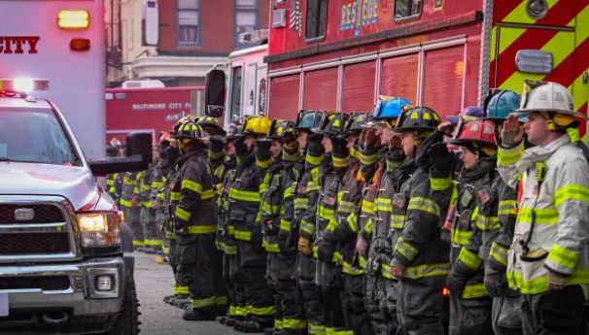
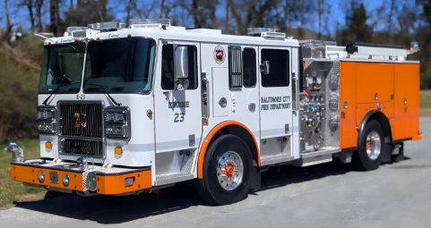
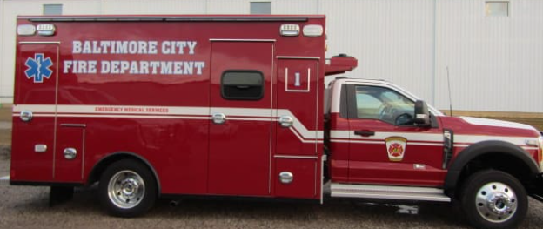
What other strategies/therapies exist to “stop the bleed” and slow the vicious cycle of traumatic hemorrhage?

Slide 3


Aerosolized Chitosan
Deploys at 80 psi
Powdered chitosan forms stabilized matrix on wound
Over the counter availability
Authorized by Maryland Medical Protocols
Trial began 03/2025

Slide 4
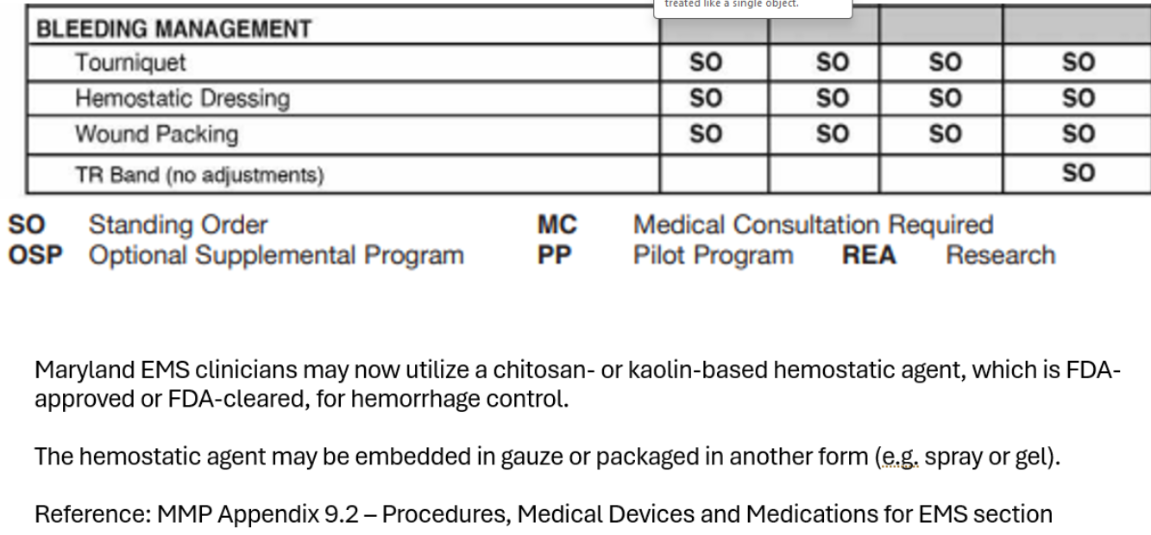
Topical Hemostatic Agents

Slide 5
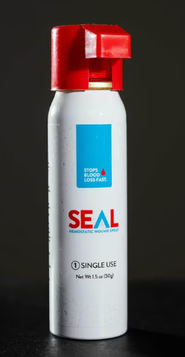
Long shelf life
Stabilized at temperature
Relatively low cost
Easily irrigated
Pilot program not applicable to pediatrics though no medical contraindication exists

Slide 6
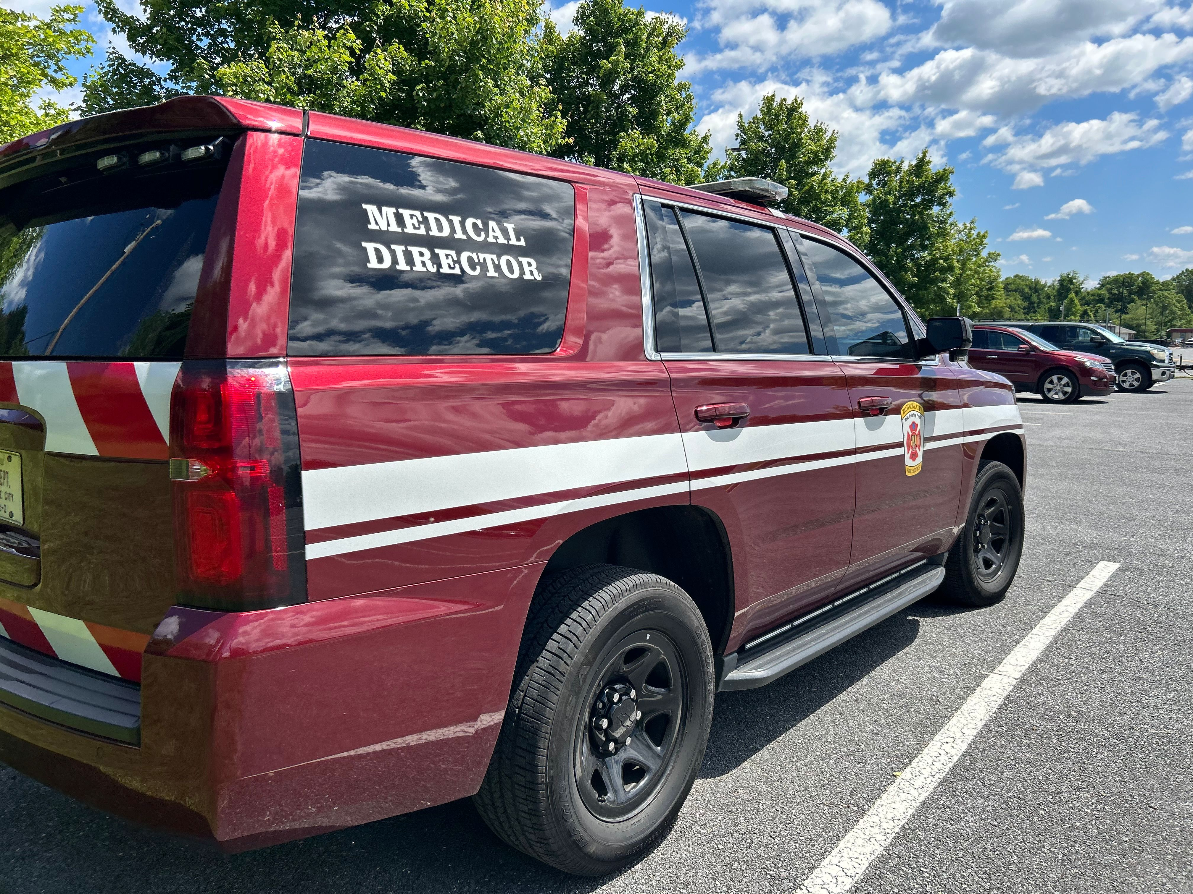
PRELIMINARY TRIAL DATA:
1 exposure, non-significant
Good hemostasis
No reported complications
Adequate hemostasis
Bleeding controlled in “minutes” with direct pressure
TAKE HOME POINTS:
Spray comes out, “cool”
Significant pressure from nozzle; recommend 6-10” from wound
Avoid deployment in closed spaces

