Slide 1

Bundling Up for PEA
Dr P.R.Banerjee
Medical Director Polk County Fire Rescue
Polk County Sheriffs Office SWAT Team
Assistant Professor of Emergency Medicine NOVA Southeastern College of Medicine

Slide 2
PEA
Pulseless electrical activity (PEA) occurs when the electrical activity generated is not sufficient to generate a heartbeat
Survival to discharge < 5%

Slide 3
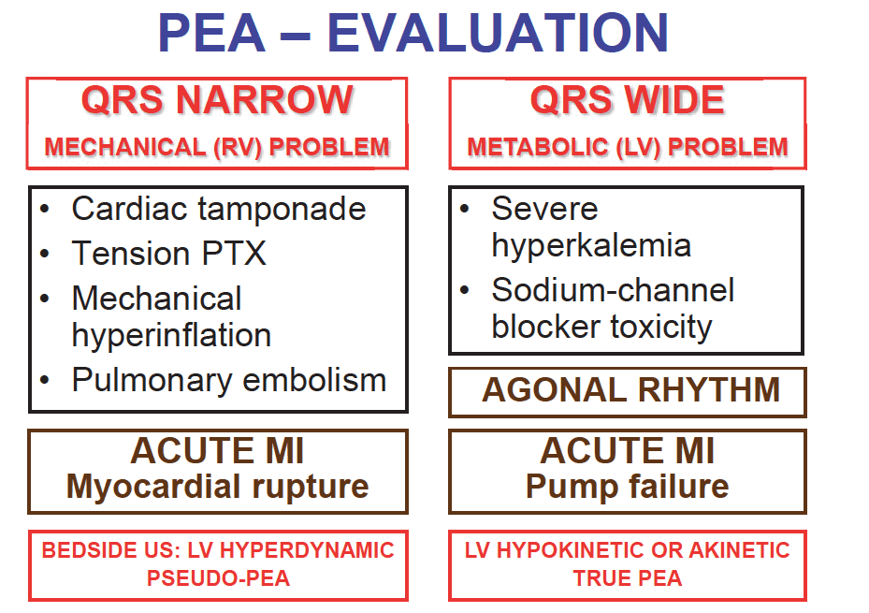
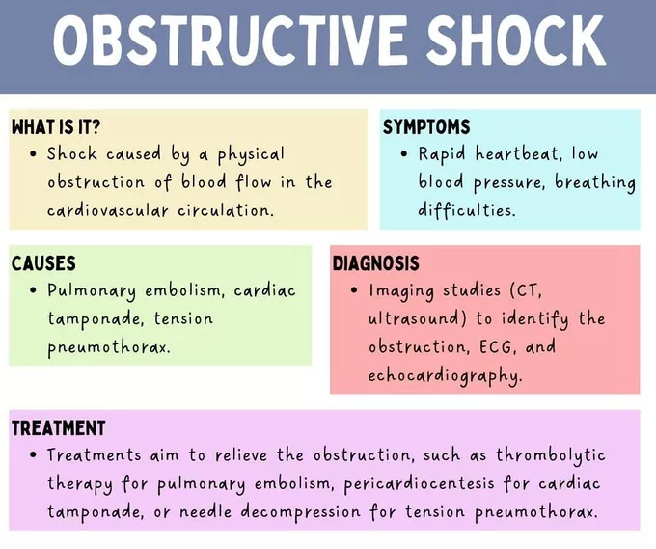

2 Main Types of PEA

Slide 4
PEA :
Narrow vs. Wide QRS
Narrow QRS
Wide QRS
QRS < 0.12 with no pulse
QRS > 0.12 with no pulse

Slide 5
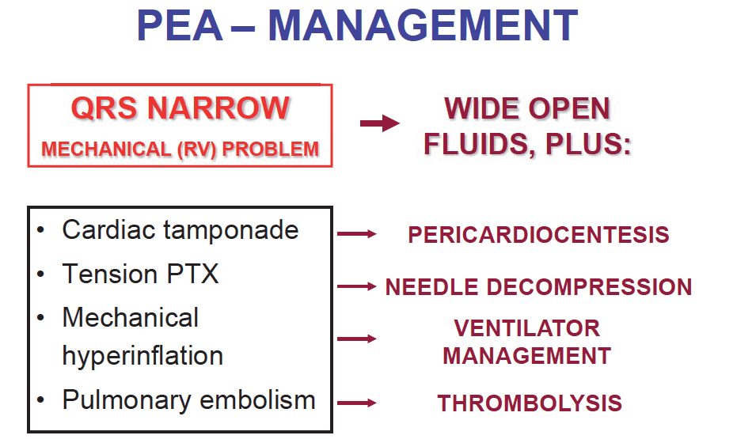
PEA Management

Slide 6
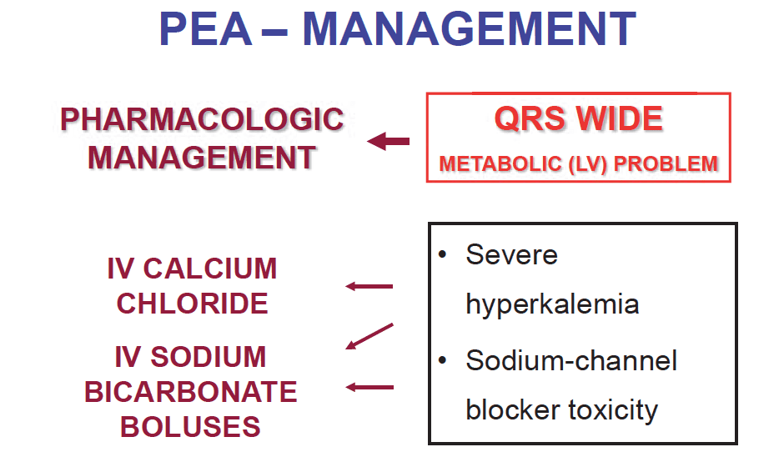
PEA Management

Slide 7

PEA : Bundle of Care
Phase 1 : Airway Phase
Immediate placement of I-Gel – NO ET intubation
Keep EtCO2 between 35-45mmHg
Narcan 2mg IV

Slide 8
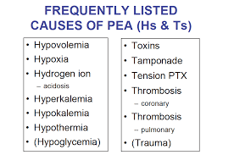
PEA : Bundle of Care
Phase 2 : Medication Phase
  1mg Epi IV
  1-amp HCO3 IV
  1-amp CaCl IV
  1-amp D10W IV
  500ml NS bolus
  Repeat Narcan 2mg IV if OD suspected
  Needle Decompression if trauma is suspected

Slide 9
Why Narcan ?
1400% increase in opioid-associated out-of-hospital cardiac arrest (OA-OHCA~20 years
Naloxone is beneficial in PEA associated with opioid overdose, by reversing neurological and respiratory depression

Slide 10
Naloxone and Patient Outcomes in Out-of-Hospital Cardiac Arrests in California
8195 patients with OHCA treated in 3 Northern California counties between 2015 - 2023
EMS management of OHCA was associated with increased ROSC and survival to hospital discharge

Slide 11


2024 PCFR Cardiac Arrest Outcomes
Total | ROSC | ROSC | Survival to Discharge
567 | 179 | 32% | 18%

Slide 12


PaulBanerjee@Polk-County.Net

