Slide 1
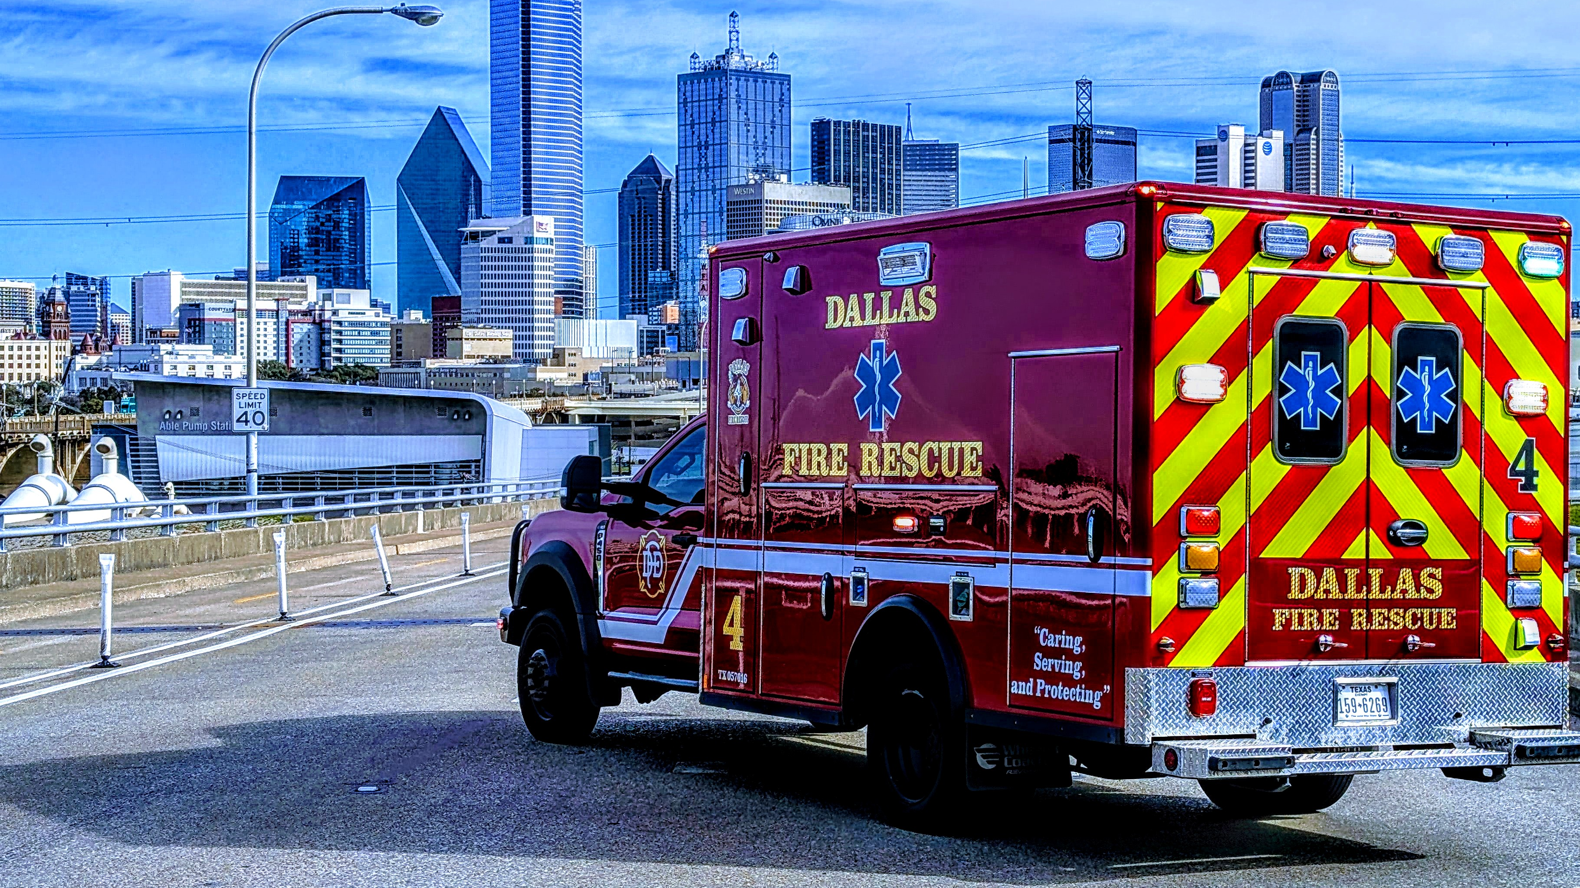


Life After Death:
The Role
of EMS in
Organ Donation
Brian Miller, MD, FACEP, FAEMS
Senior Deputy Medical Director
Dallas Fire-Rescue Department

Slide 2
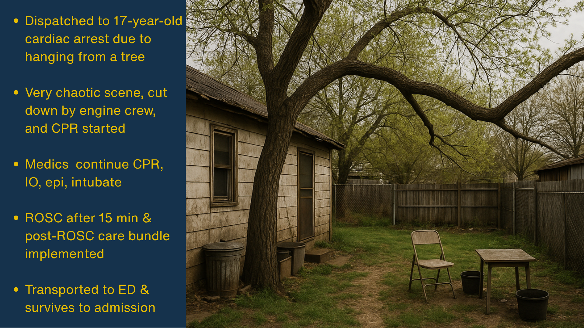

Slide 3


Slide 4
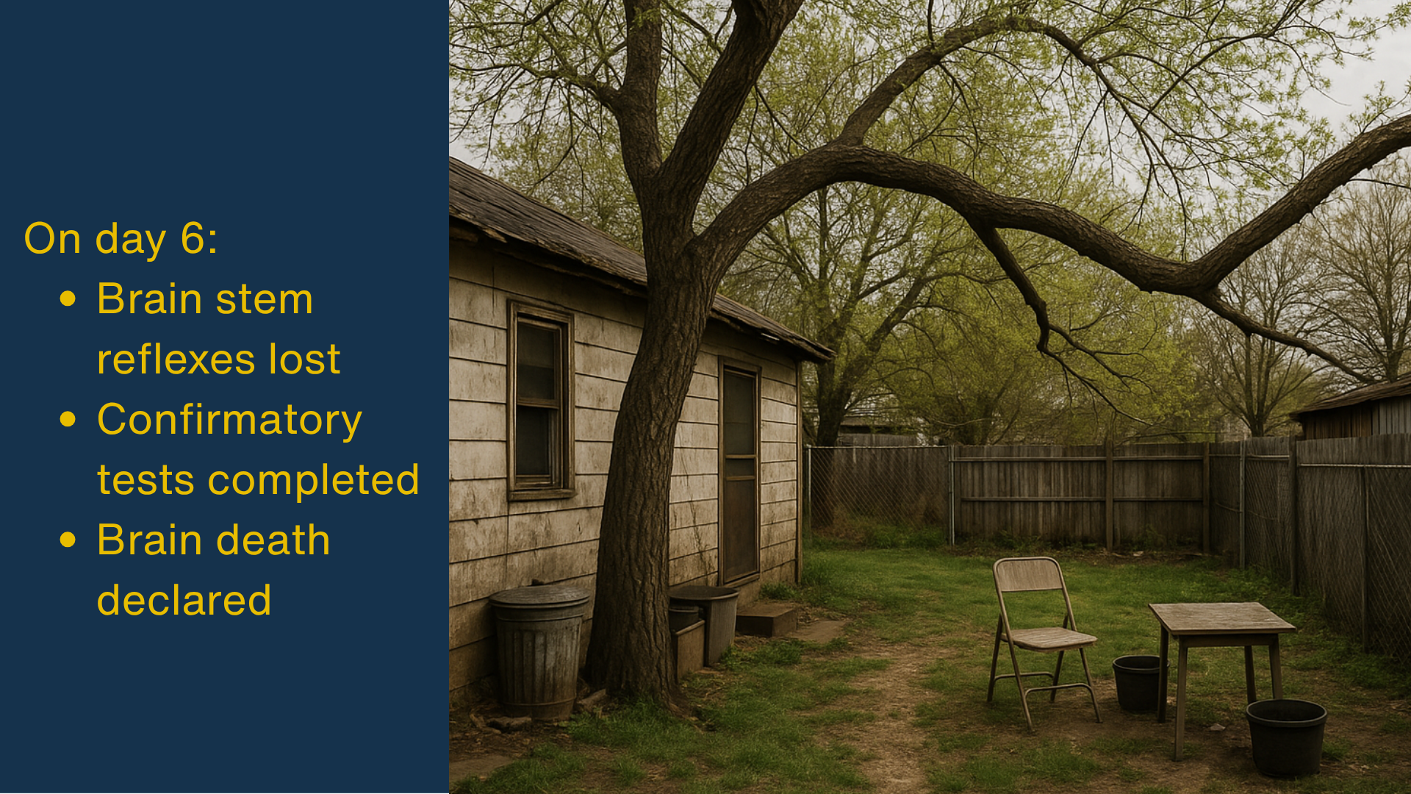

Slide 5
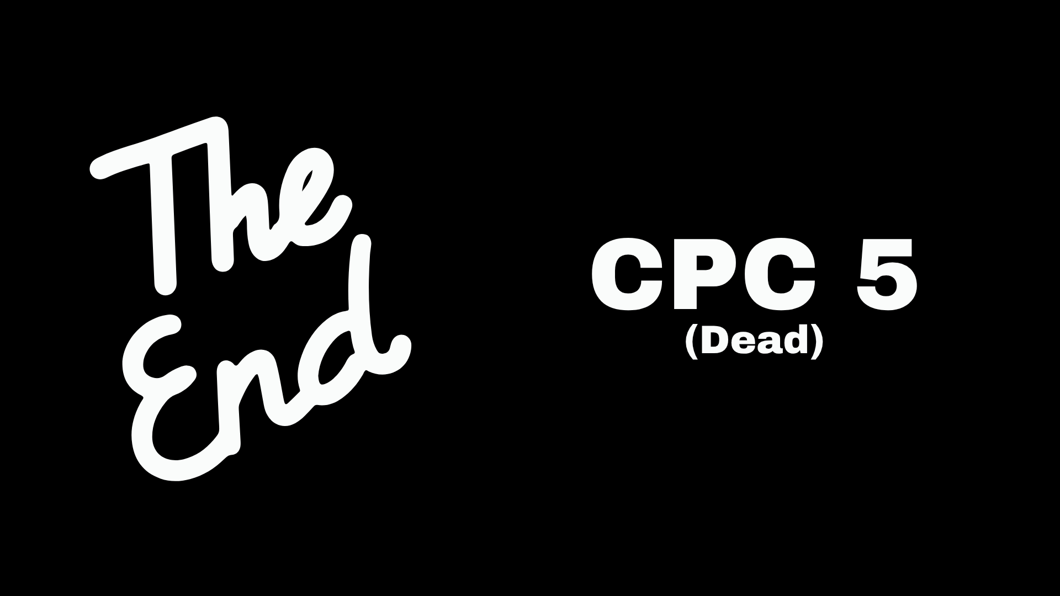

Slide 6
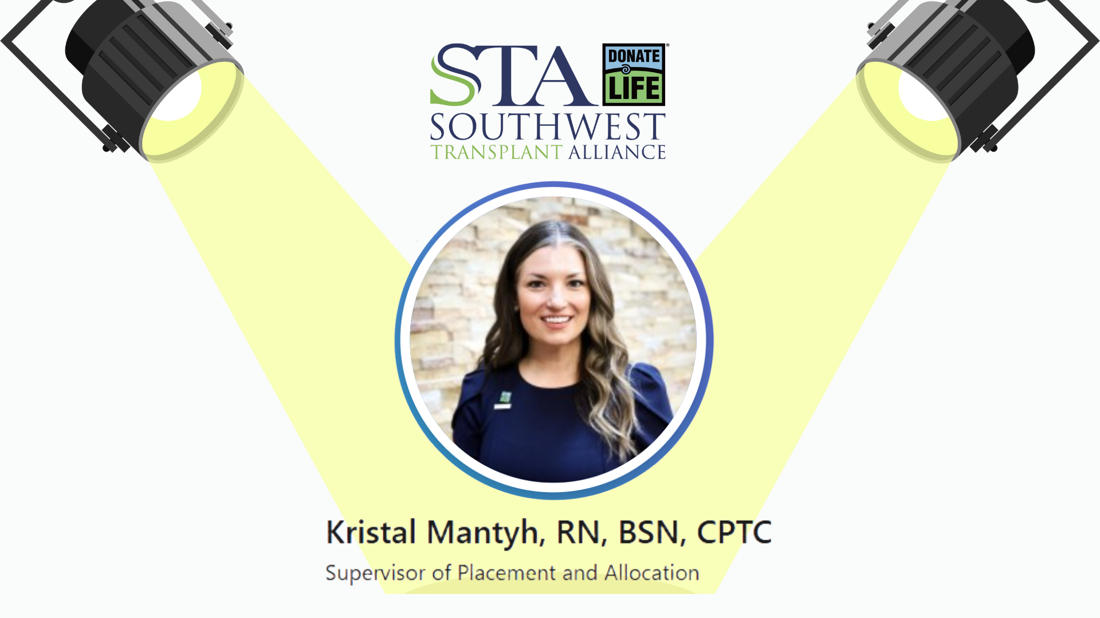

Slide 7
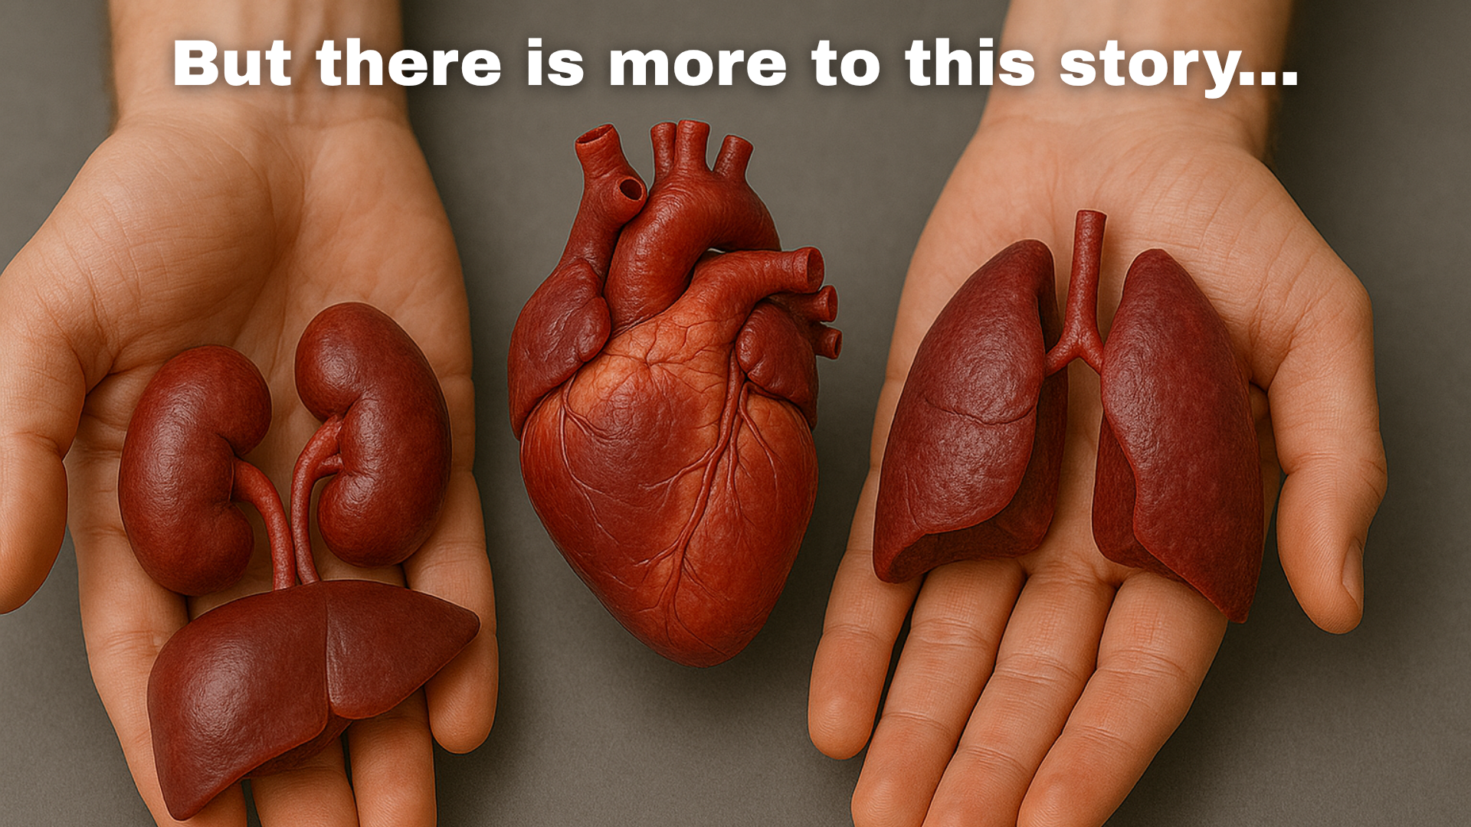

Slide 8
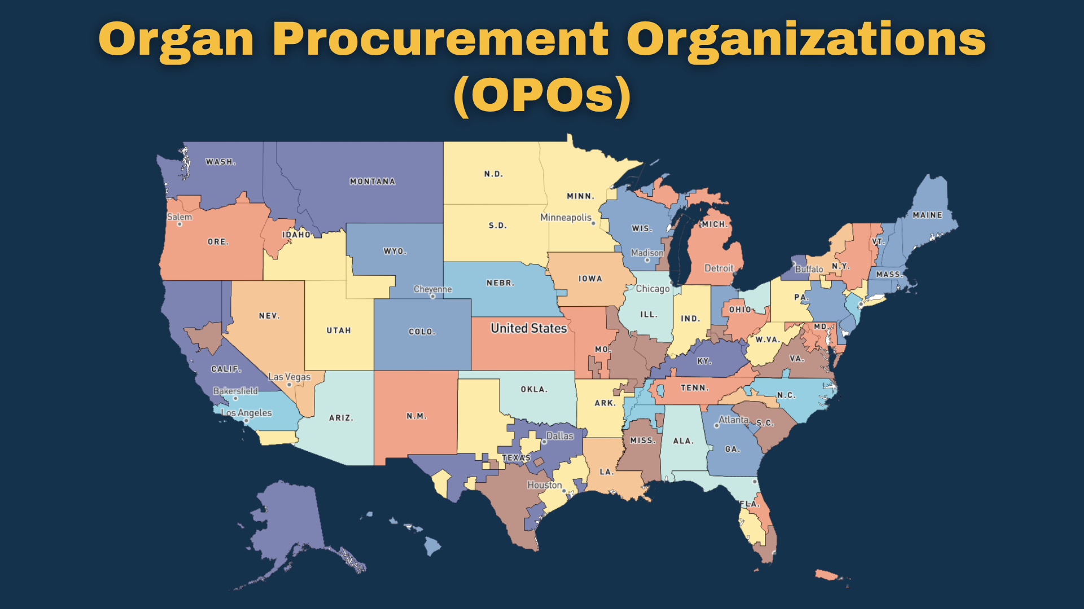

Slide 9
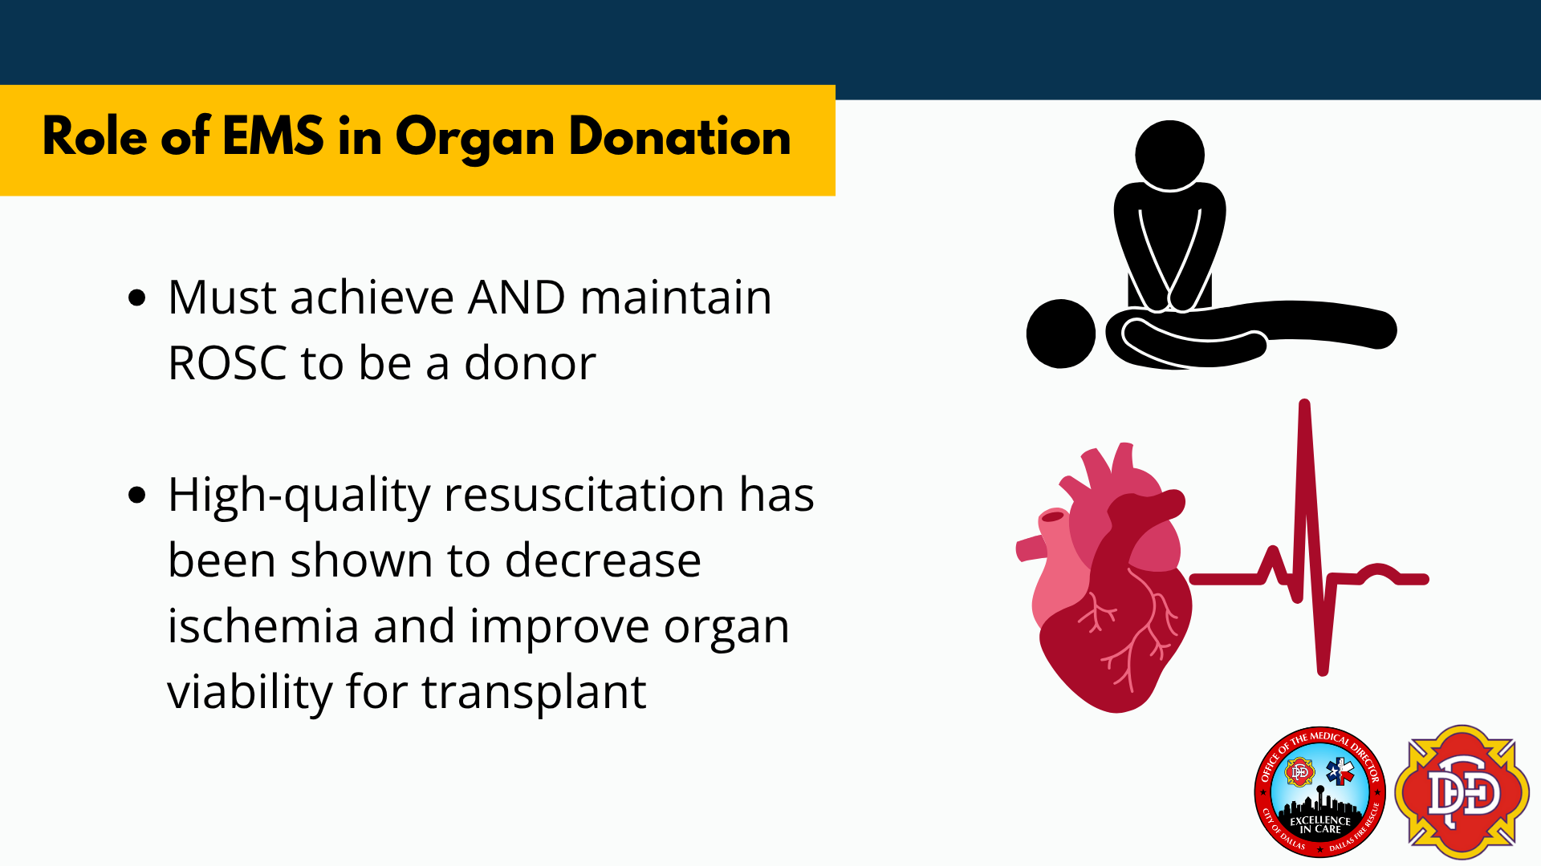

Slide 10
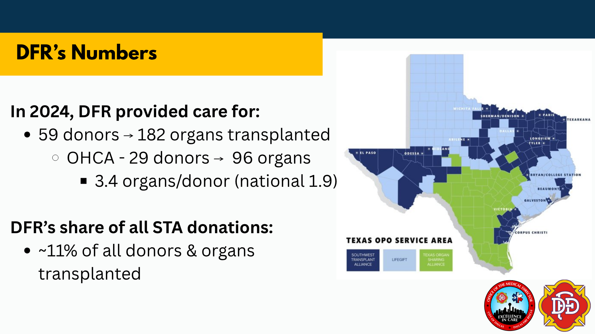

Slide 11


Slide 12
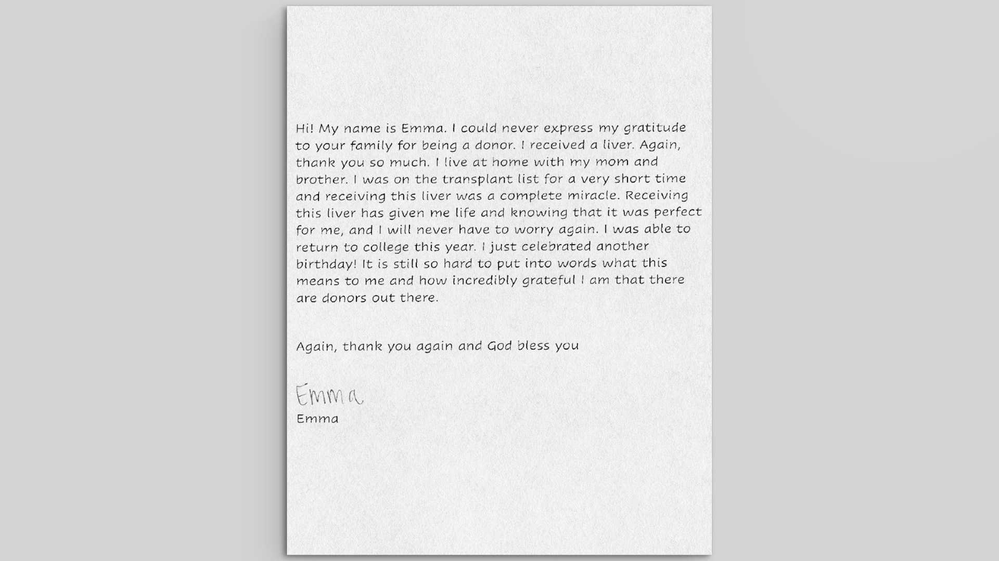

Slide 13
Summary
Learn about your local OPOs and cultivate a relationship
Obtain outcomes related to organ donation for your EMS clinicians and recognize them for the key role they play in this process

Slide 14
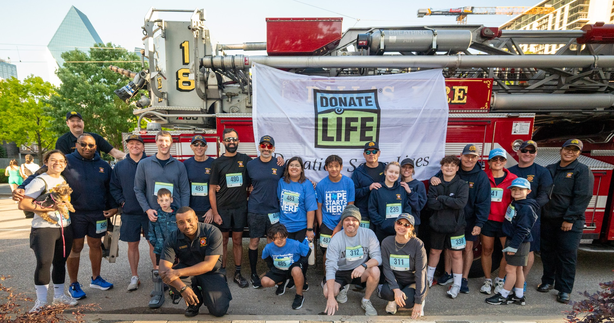
Acknowledgements
Dr. Marshal Isaacs, Chief Medical Officer
Dr. Al Lulla, Deputy Medical Director – QM
Lt. Casey Mantyh, EMS Lieutenant
Chief Scott Clumpner, Deputy Chief of EMS
Chief Chris Chiara, Section Chief of EMS
Lt. Rudy Woolridge, QA/QI Lieutenant
Chief Dominque Artis, Chief of Public Safety
Chief Justin Ball, Fire Chief
Contact: Brian.Miller@utsouthwestern.edu

