Slide 1
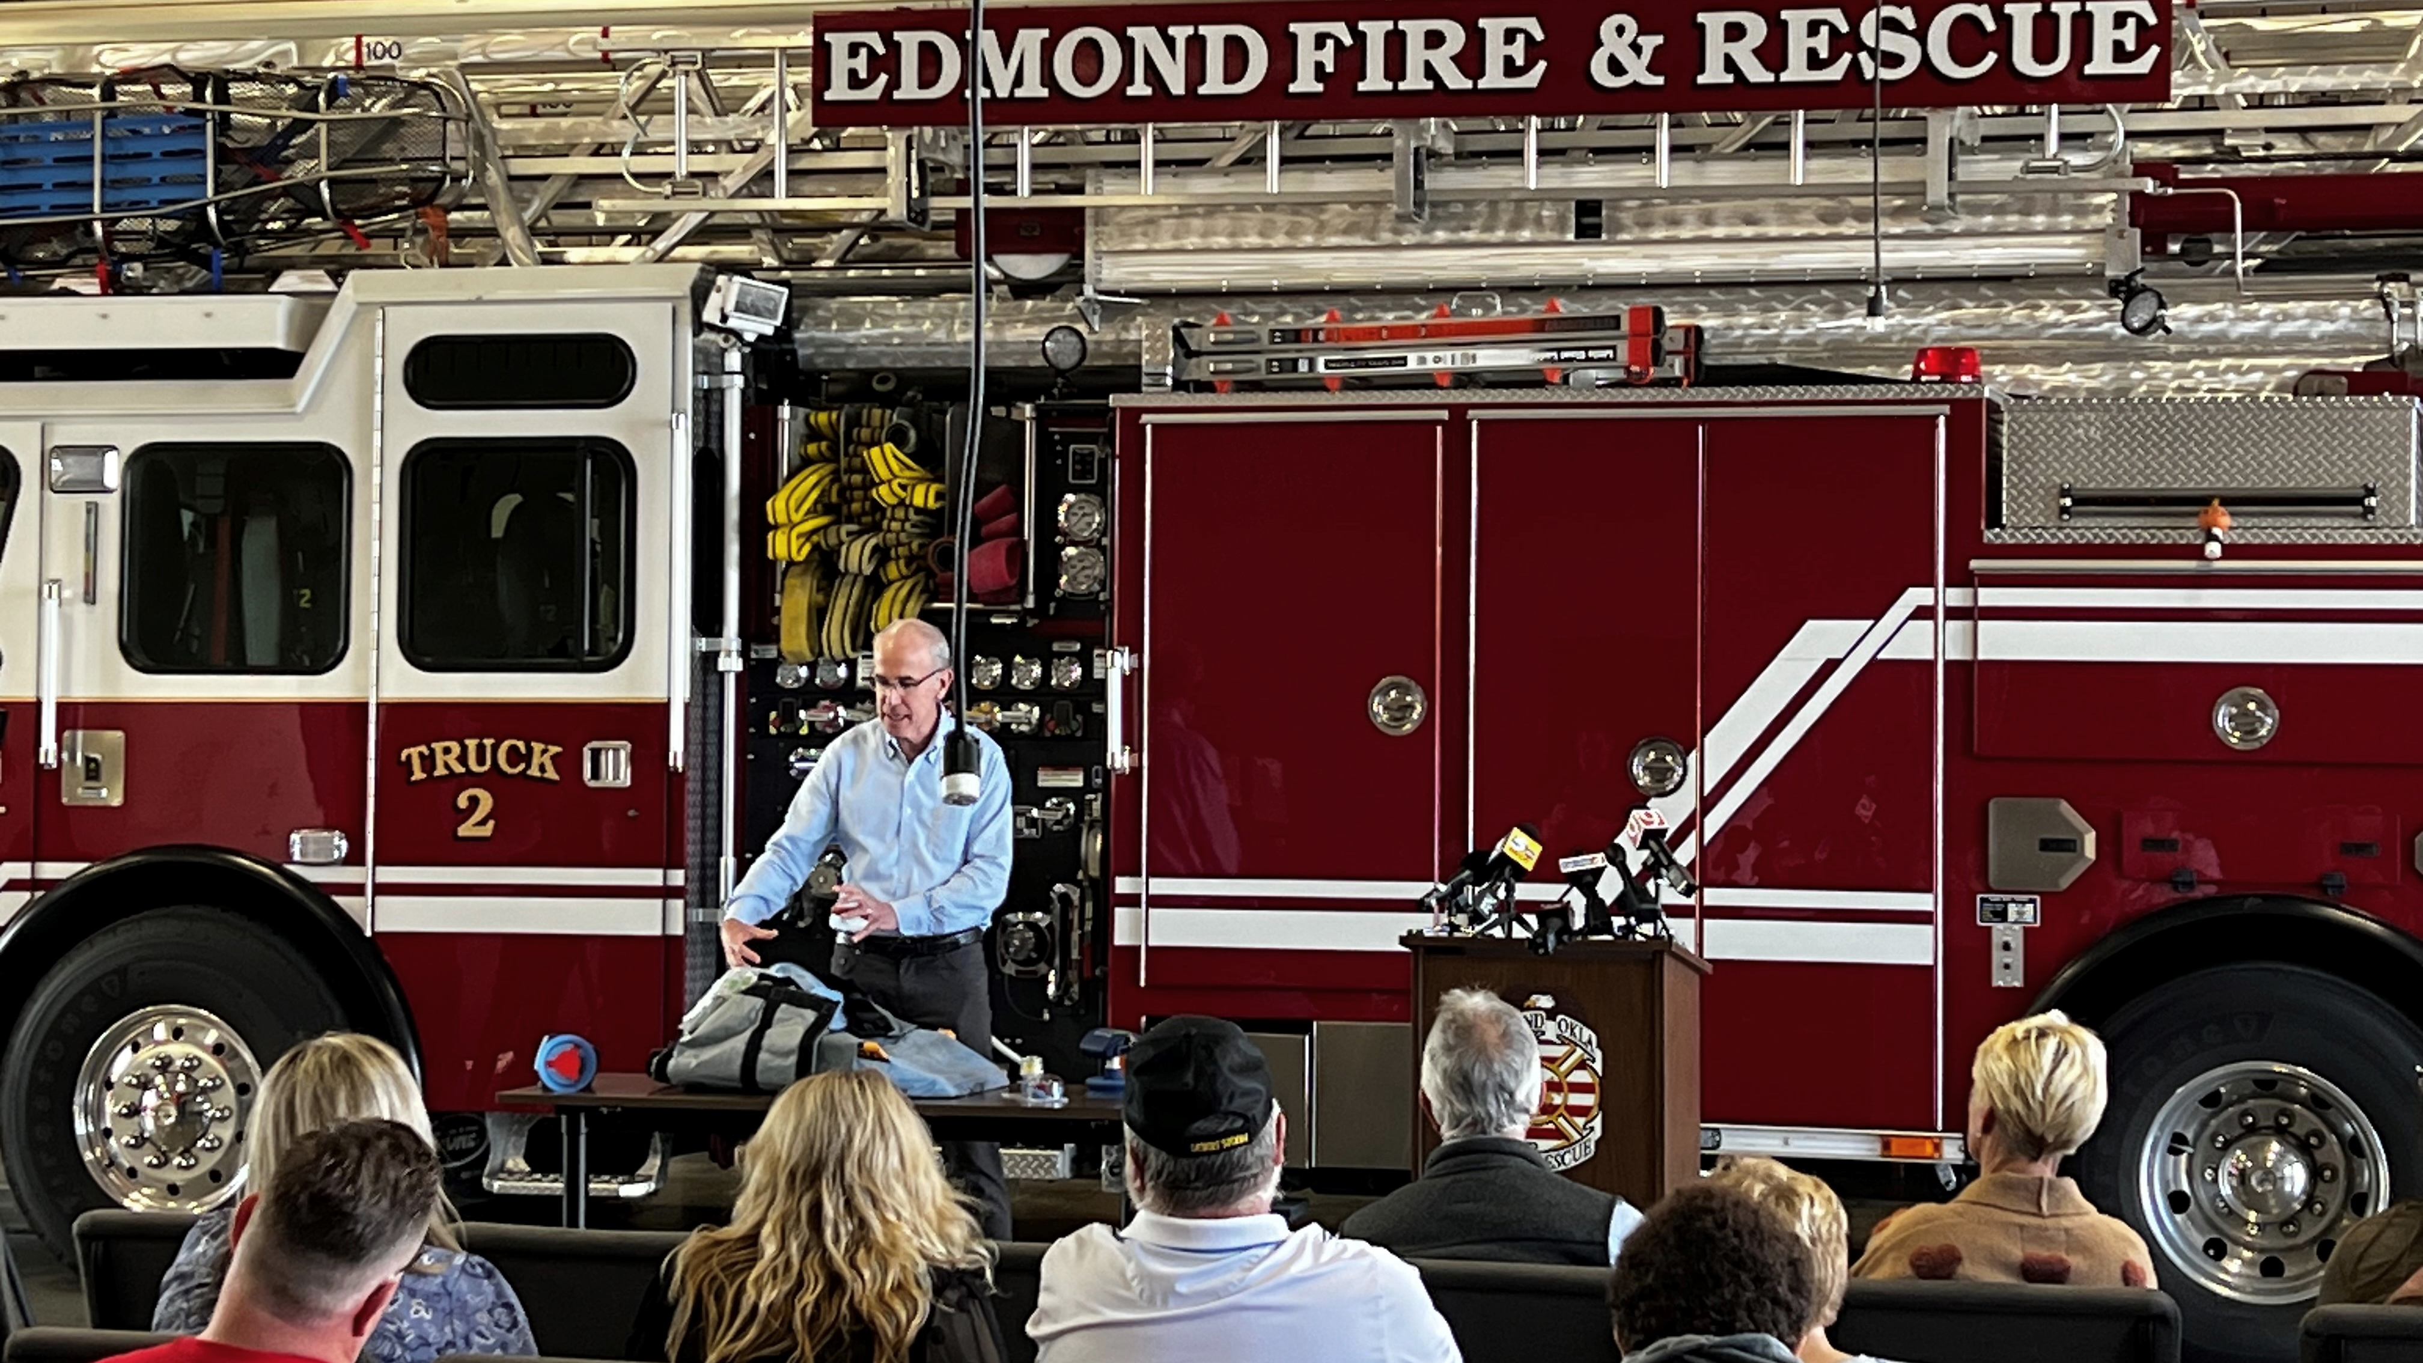
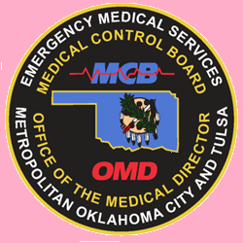
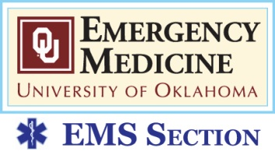
CPC-2 in the Rearview Mirror:
Is Neuroprotective CPR Improving Cardiac Arrest Neuro Outcomes?
Jeffrey M. Goodloe, MD, NRP, FACEP, FAEMS
Chief Medical Officer
EMS System for Metropolitan Oklahoma City & Tulsa
Professor & EMS Section Chief
University of Oklahoma School of Community Medicine

Slide 2
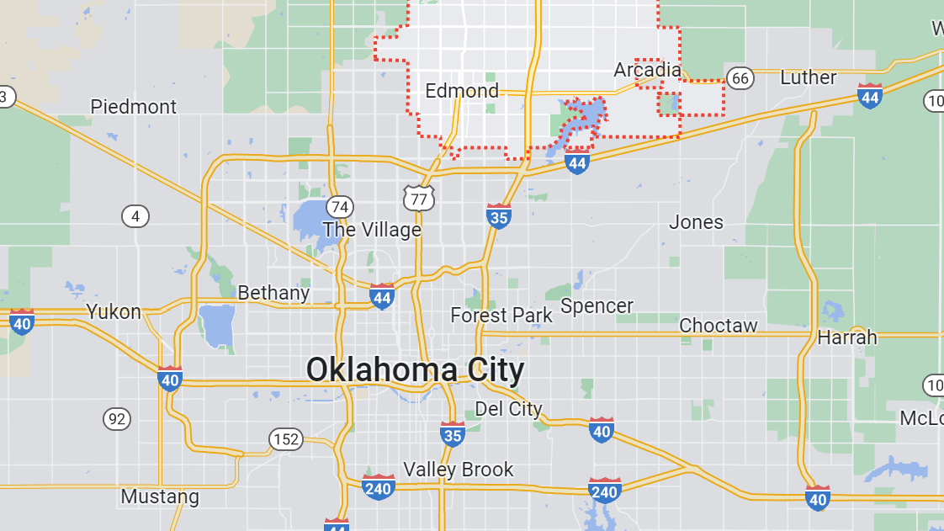
Population 95,871
City Rank by Pop. 351
EFD Stations 5
Engines/Ladders ALS
1 BLS Squad

Slide 3
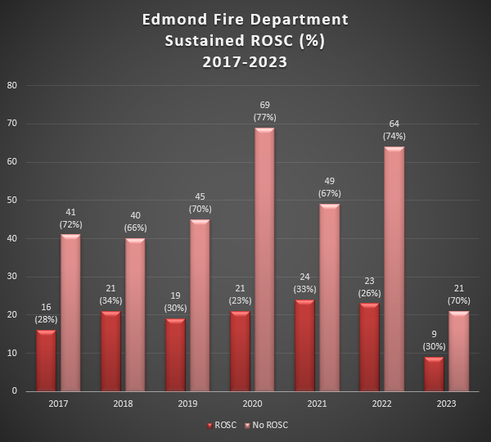

Slide 4
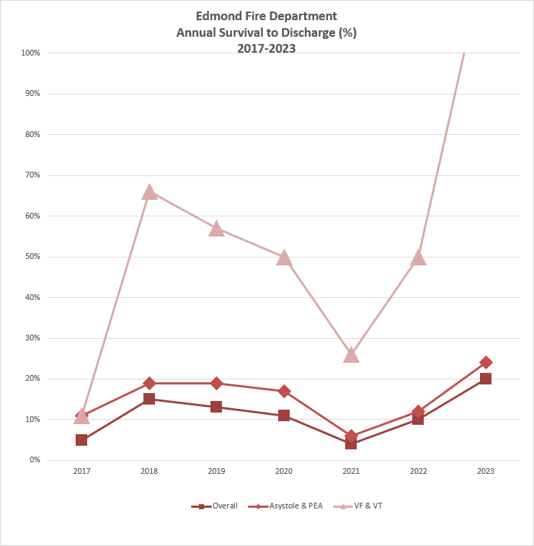
*to June 1

Slide 5
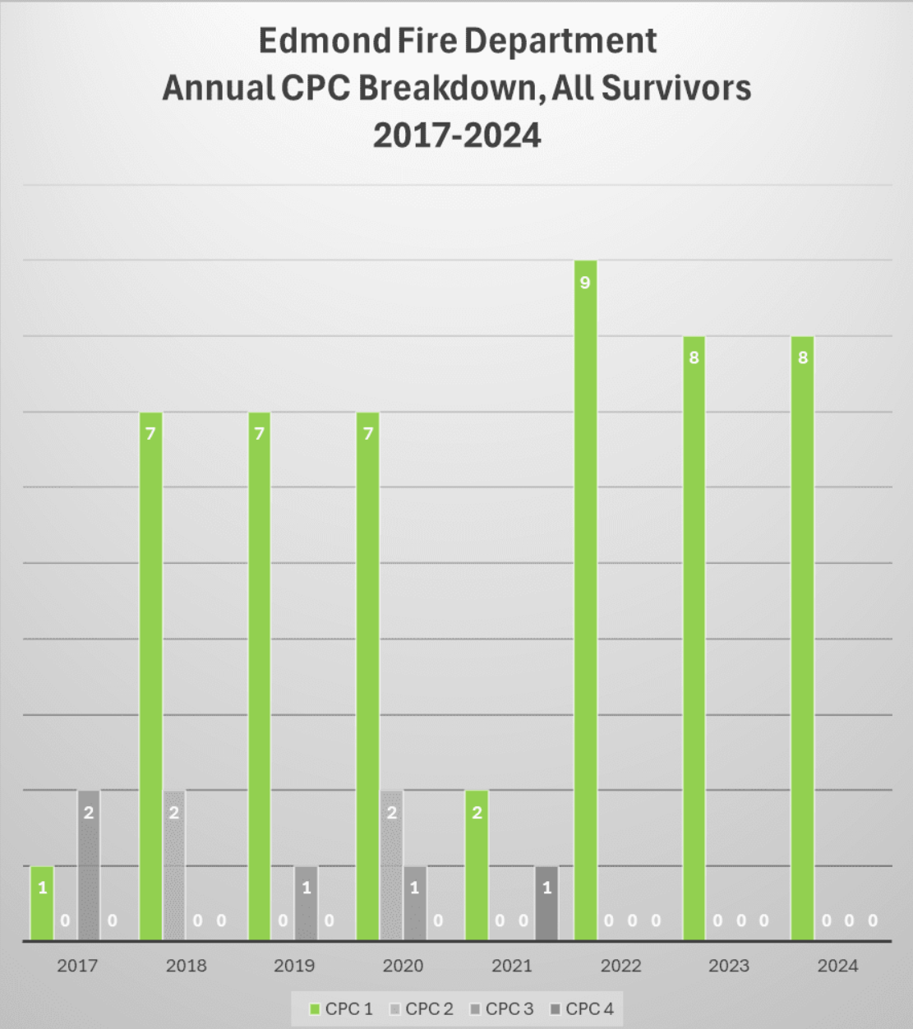

Slide 6
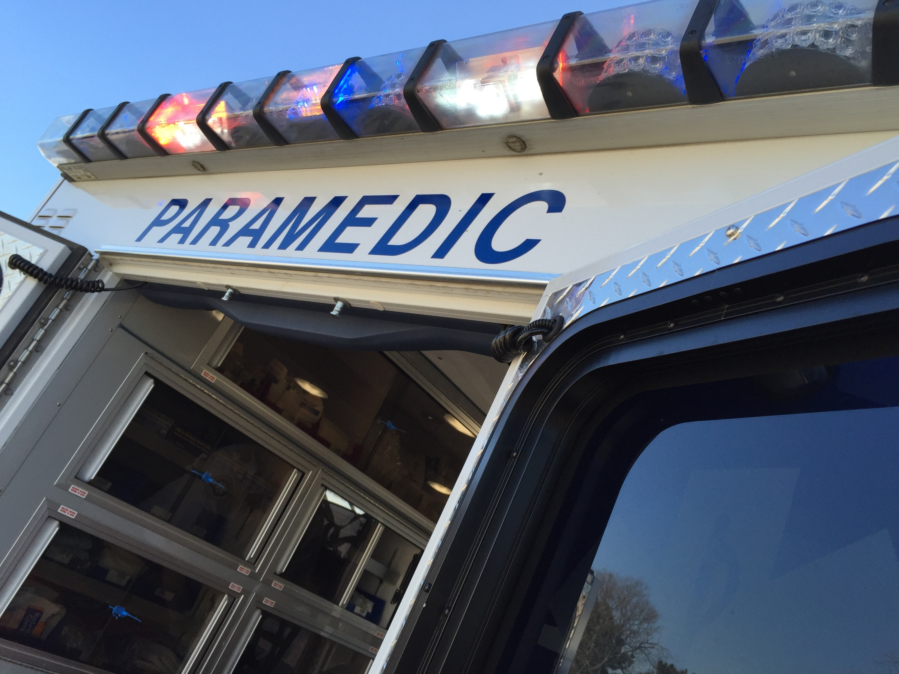
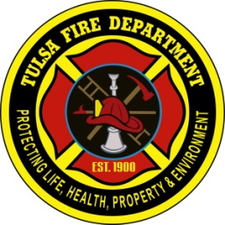
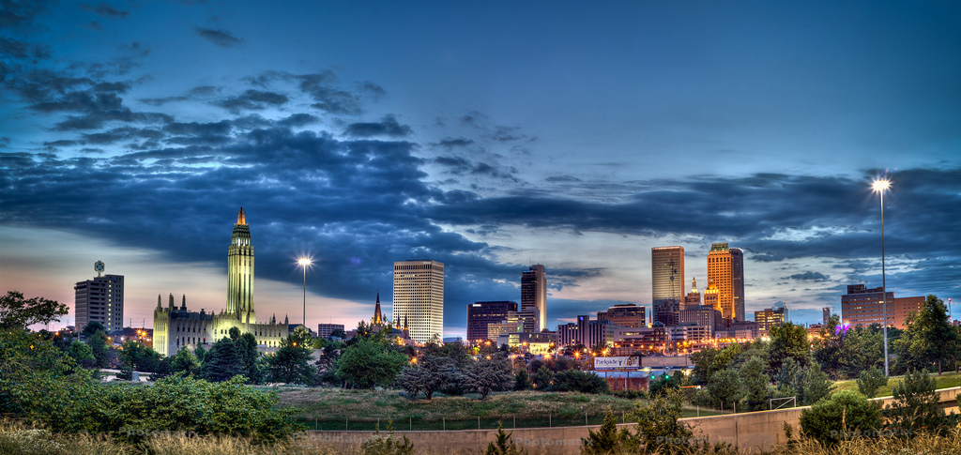
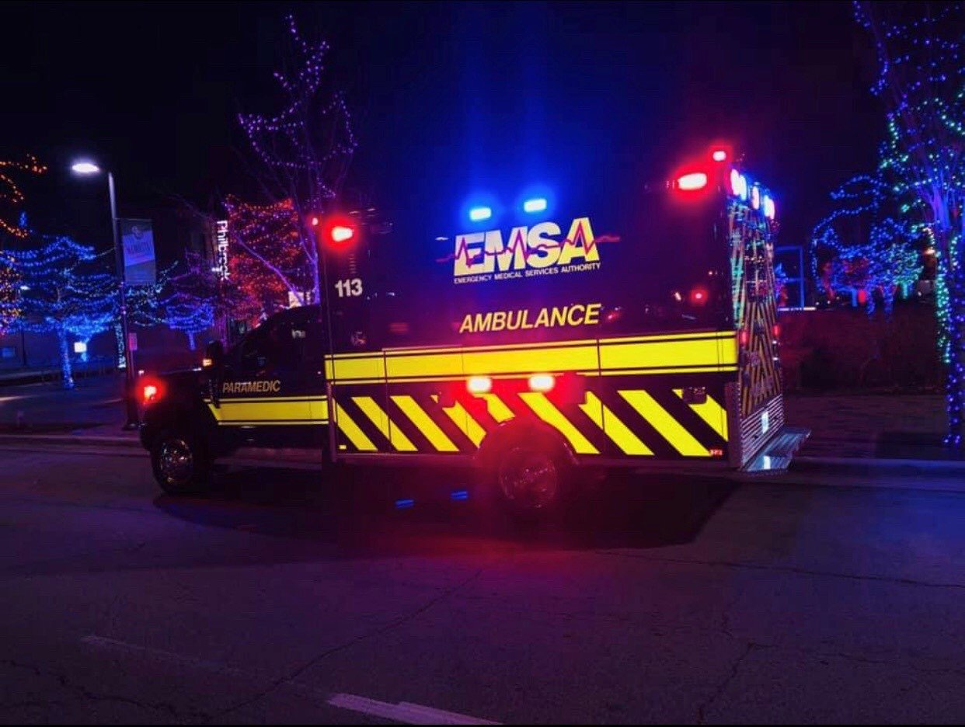
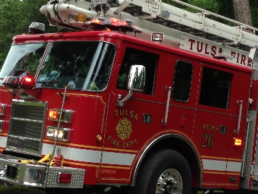
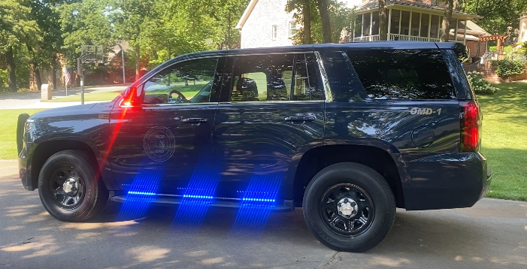
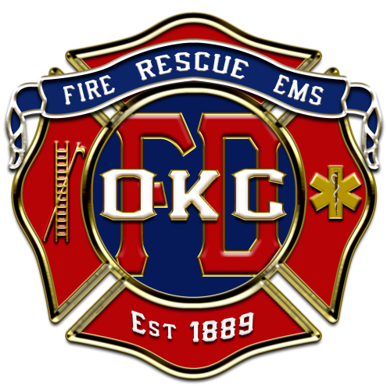
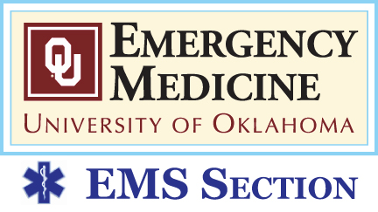
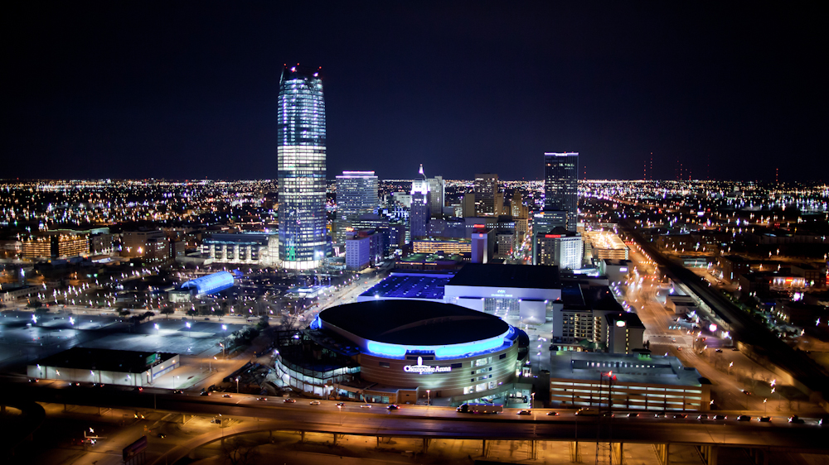
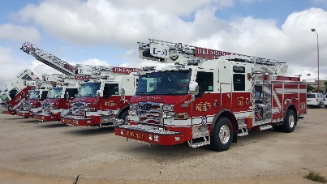



TULSA
Contact Info:
jeffrey-goodloe@ouhsc.edu
Office of the Medical Director
www.okctulomd.com
918-596-3147
@drjeffgoodloe
OKLAHOMA CITY

Slide 8
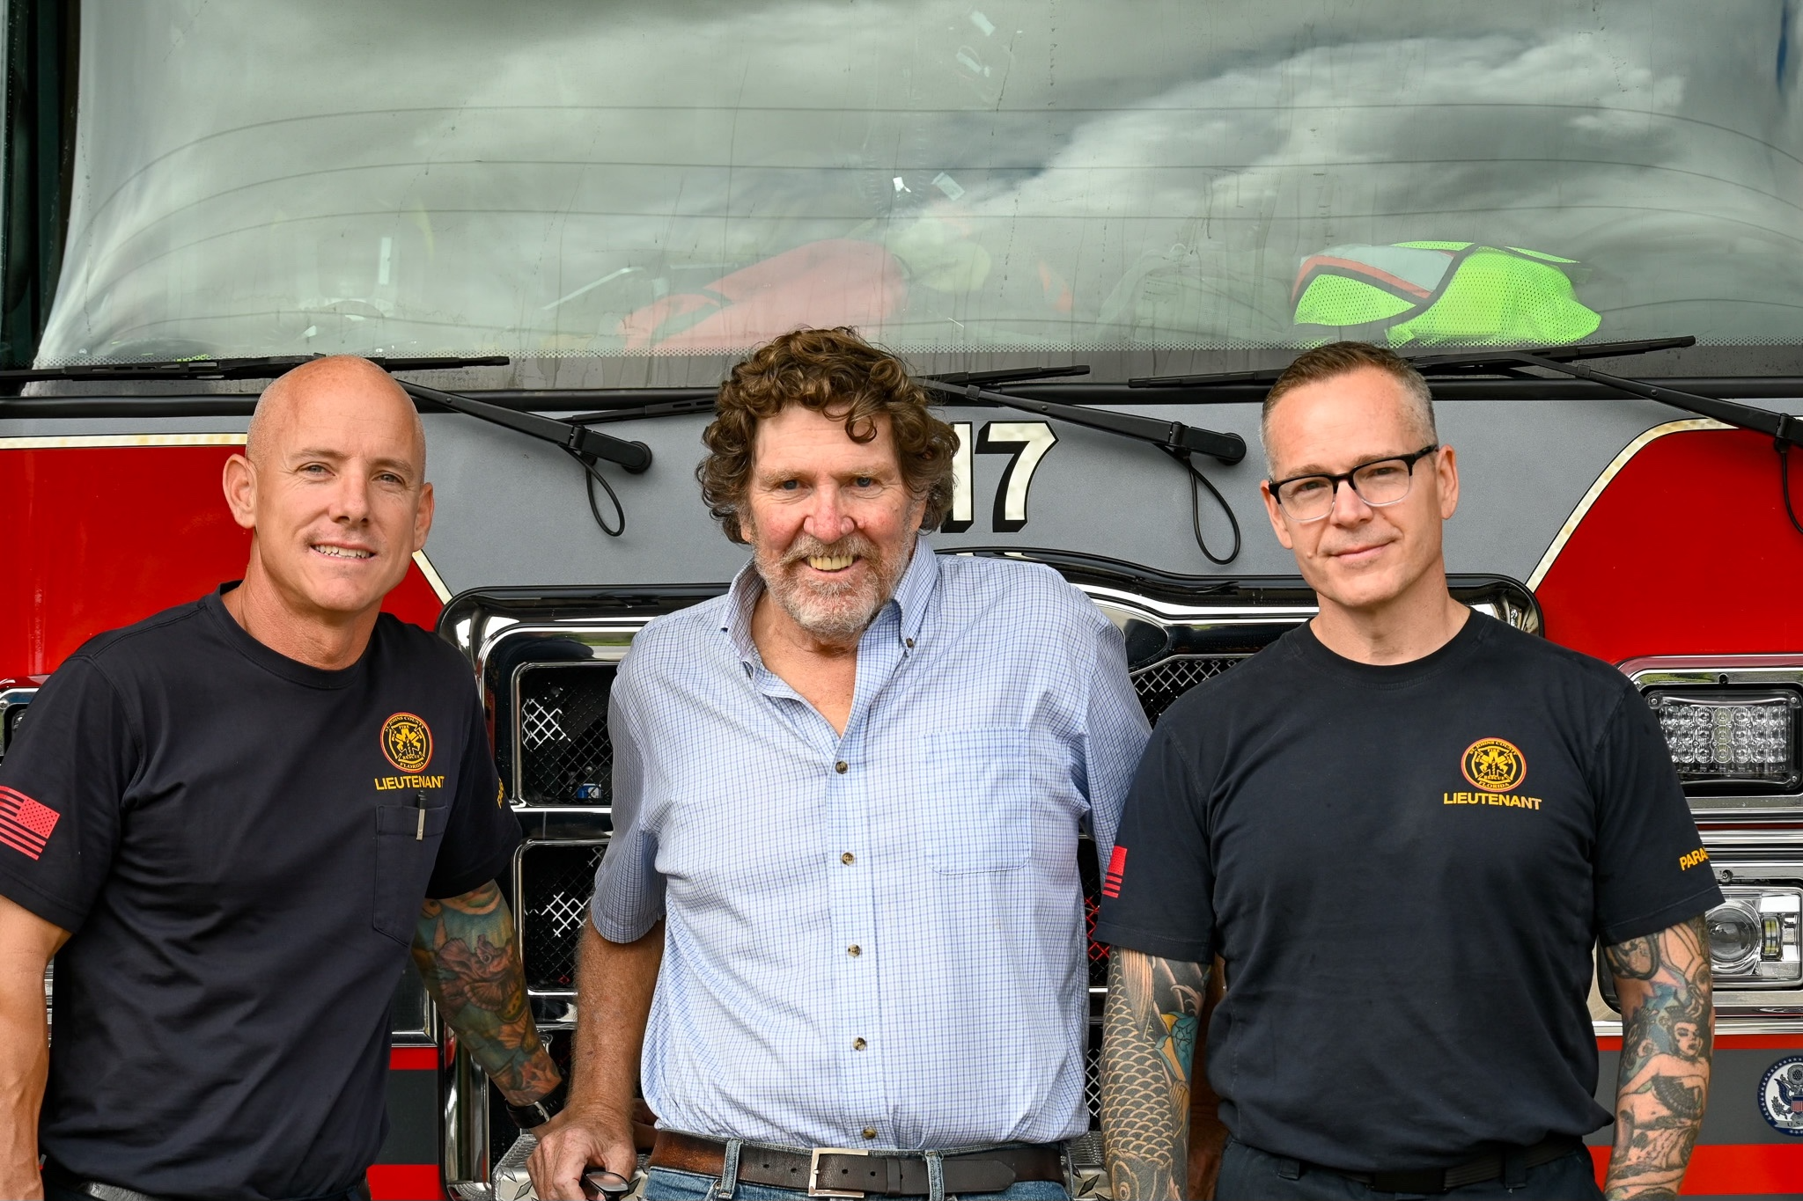
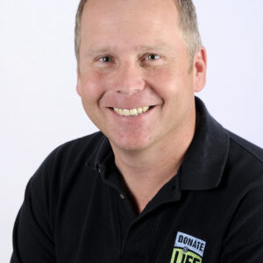
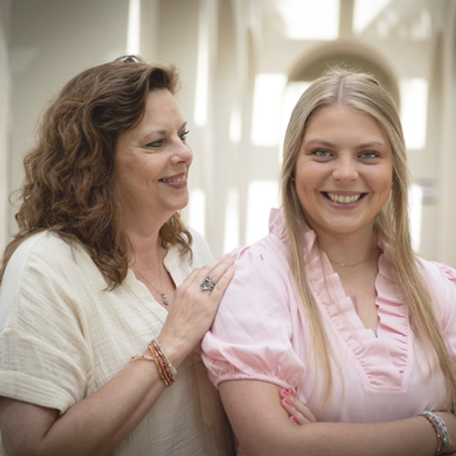
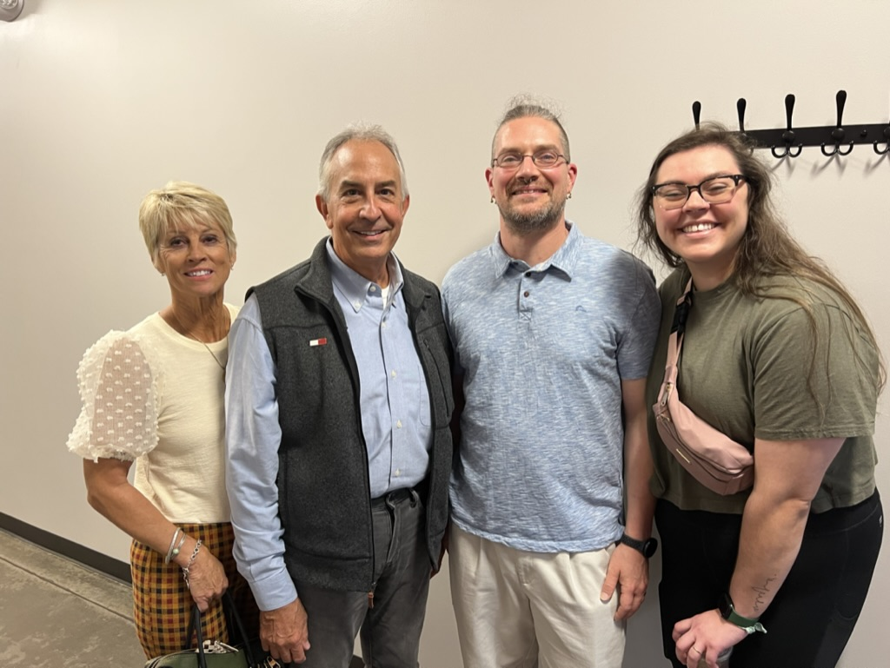
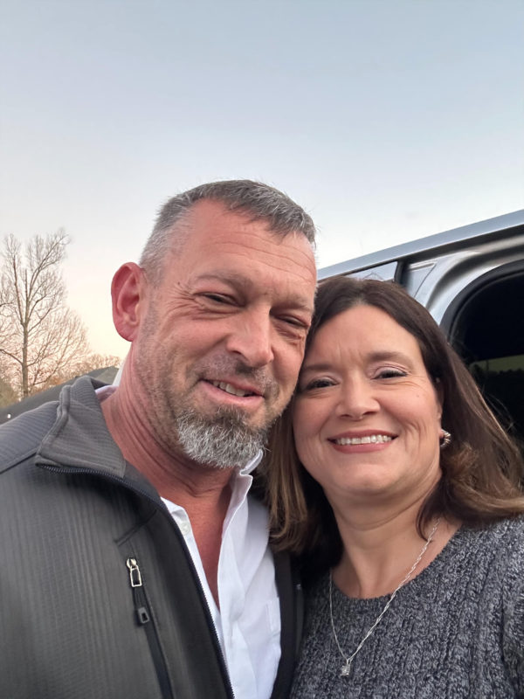
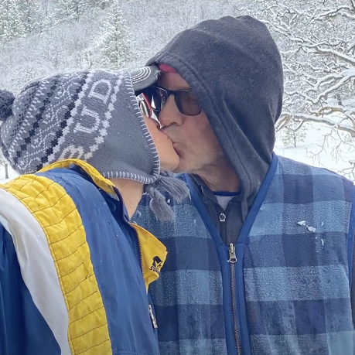
Not Just Numbers. Prolonged Arrest Times → Just Some of the Survivors
72 Minutes
30 Minutes
33 Minutes
28 Minutes
20 Min
29 Minutes
30 Min.

Slide 9
Very Recent Success Story
May 29, 2025 (Memorial Day wknd)
Prominent 64 yo cardiologist
Nationally recognized leader in American College of Cardiology
28 minutes of arrest on 8th hole of a golf course
4 shocks, 2 rounds of amiodarone, multiple doses of epi
Awake upon arrival to ED!
Completely neurological intact that same evening
Back at work reading echocardiograms this past Monday, June 9
Starting cardiac rehab this Monday
Wants to attend and tell his story at Eagles next year

Slide 10
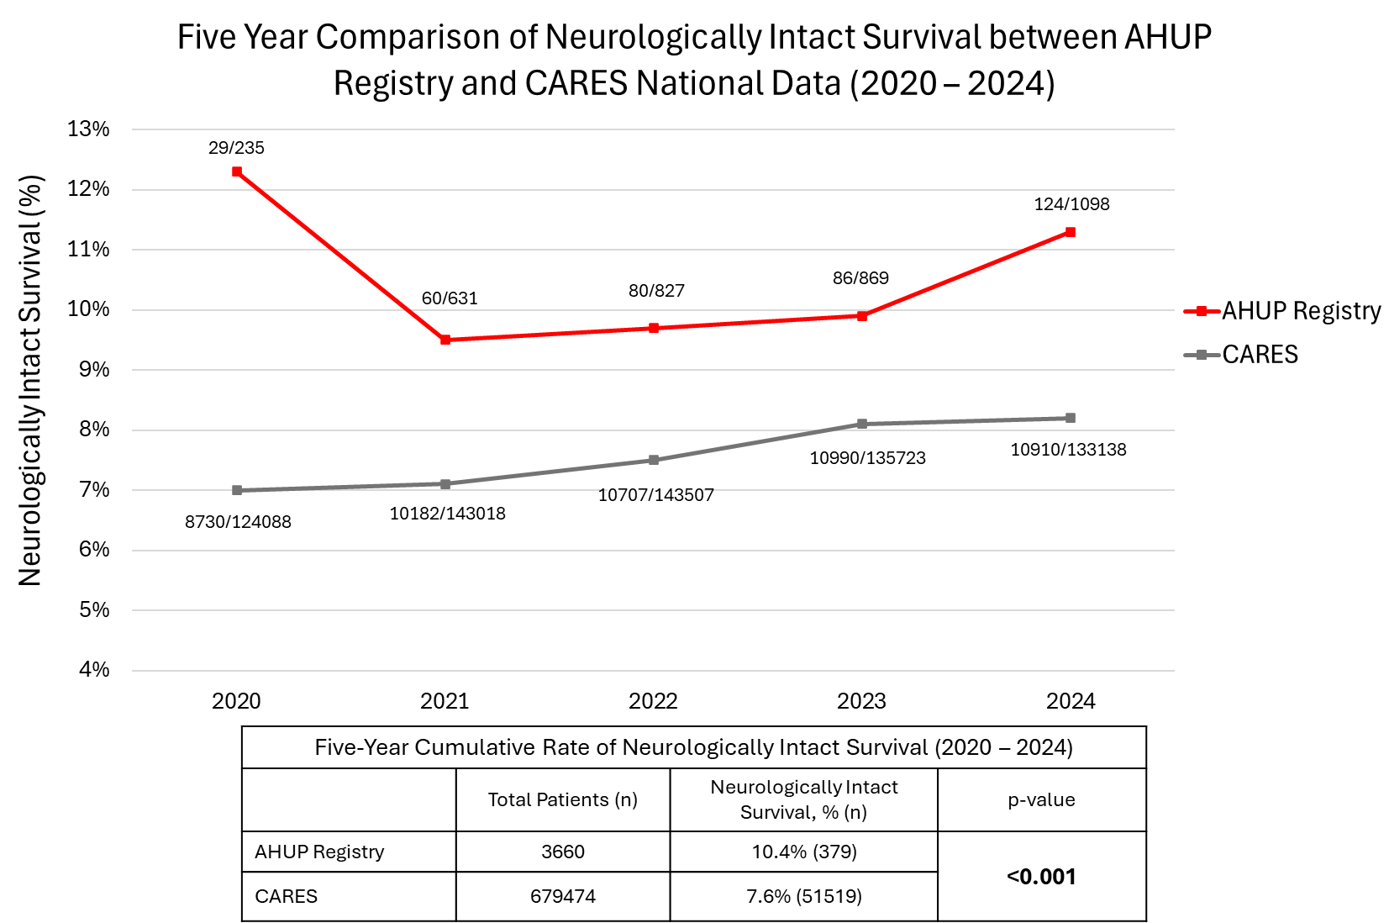

Slide 11
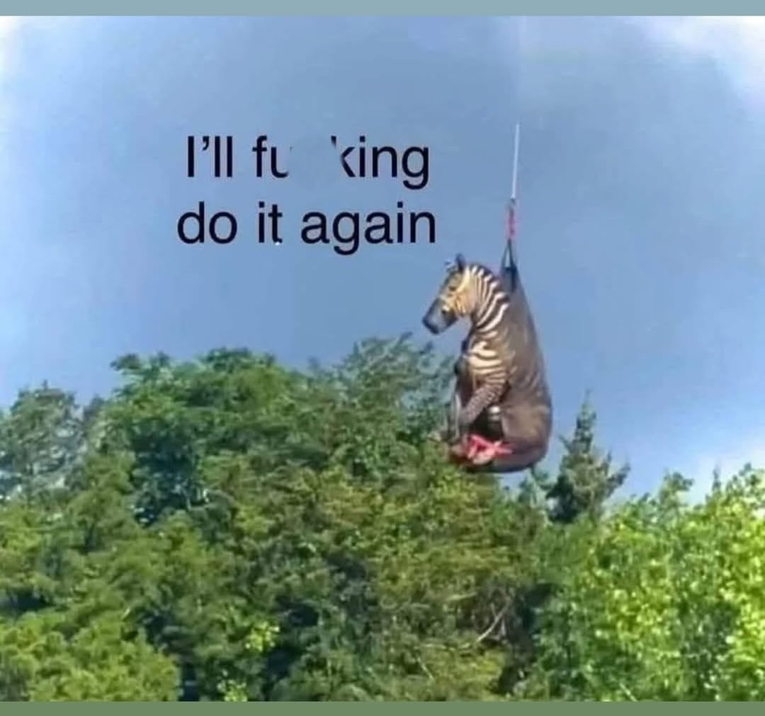
Thank you!
Jeff Goodloe jeffrey-goodloe@ouhsc.edu
Joe Holley joe.holley@memphistn.gov

