Slide 1


Pregnant Pauces & Some Perinatal Causes
Why Do EMS Systems Need to Become More Attentive, More Involved and More Assertive in Managing Perinatal / Postpartum Emergencies?
Ben Weston, MD, MPH, FAEMS
Chief Medical Director
Milwaukee County EMS
@BenWWeston

Slide 2


What are we looking for ?

Slide 3



>160/110 for 15 minutes
20 weeks gestation through 6 weeks postpartum

Slide 4
Is it common enough that we need to worry about it ?

Slide 5
150,000 patients
1,575 pregnant
504 hypertensive
75 severe hypertensive
Hutchcraft ML, Ola O, McLaughlin EM, Hade EM, Murphy AJ, Frey HA, Larrimore A, Panchal AR. A One-Year Cross Sectional Analysis of Emergency Medical Services Utilization and Its Association with Hypertension in Pregnancy. Prehosp Emerg Care. 2022 Nov-Dec;26(6):838-847.

Slide 6
If you don’t look, you don’t see.

Slide 7
150,000 patients
1,575 pregnant
504 hypertensive
75 severe hypertensive
1 hypertension as chief complaint
Hutchcraft ML, Ola O, McLaughlin EM, Hade EM, Murphy AJ, Frey HA, Larrimore A, Panchal AR. A One-Year Cross Sectional Analysis of Emergency Medical Services Utilization and Its Association with Hypertension in Pregnancy. Prehosp Emerg Care. 2022 Nov-Dec;26(6):838-847.

Slide 8
We are missing severe, damaging hypertension in pregnant woman.

Slide 9
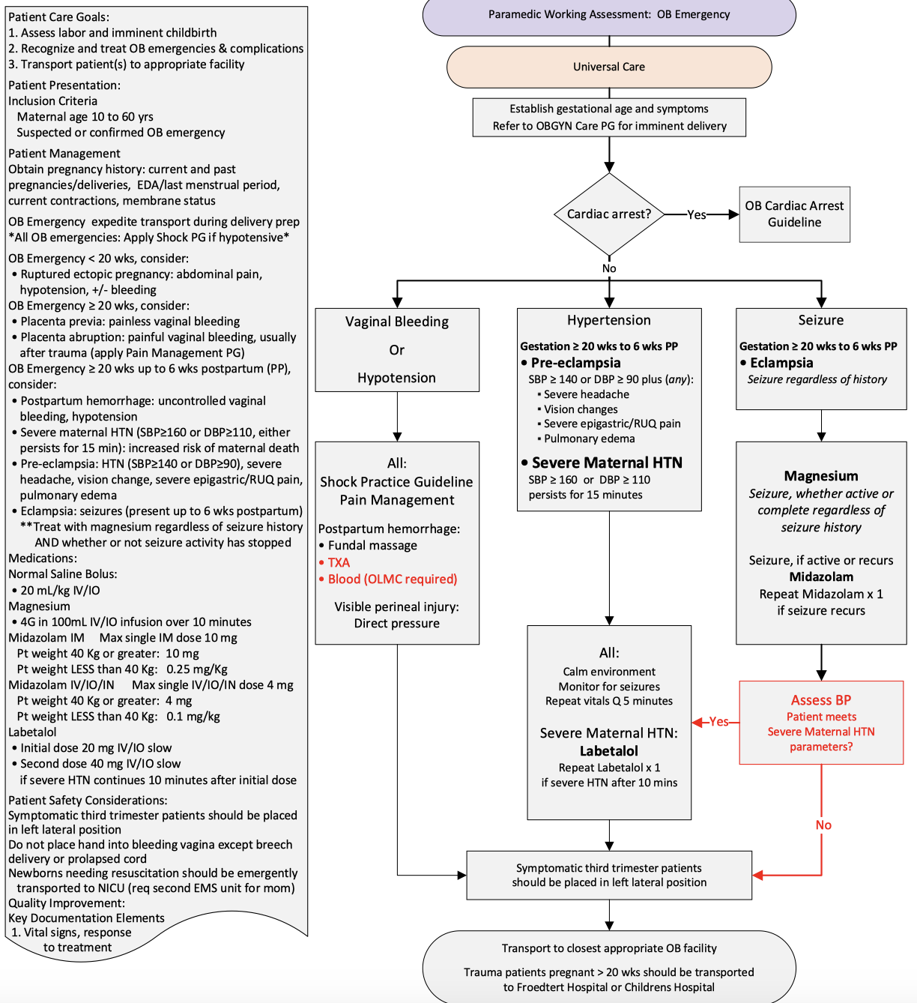



Slide 10
Thank you
Ben Weston, MD, MPH, FAEMS
Chief Medical Director
Milwaukee County EMS
@BenWWeston
beweston@mcw.edu

Slide 11


What is the role of EMS in Identifying and aggressively treating Hypertension in Pregnancy ?
Dr. David Miramontes MD FAEMS FAEMS EMT-P
EMS Medical Director
San Antonio Fire Department
Univ. Texas Health San Antonio

Slide 12
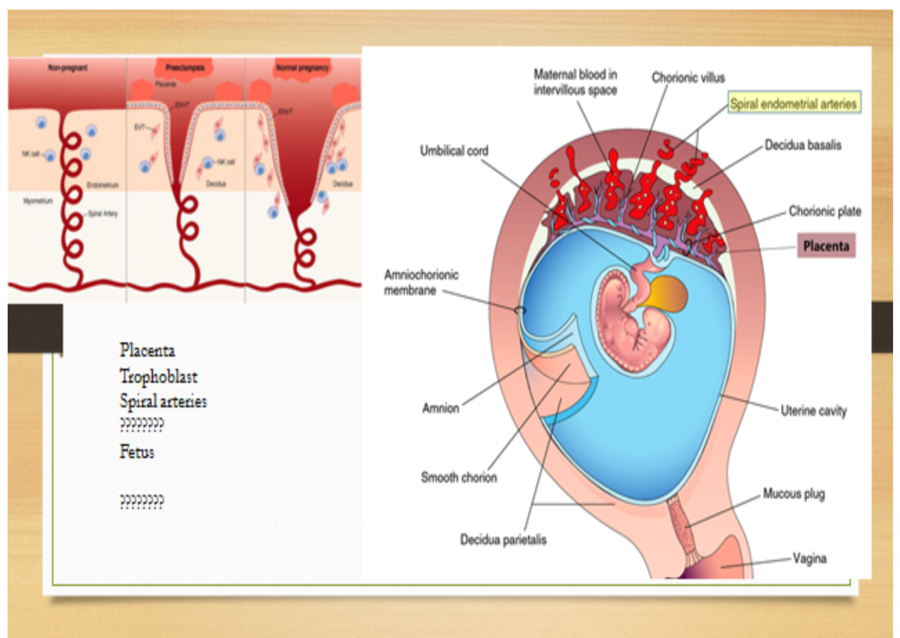
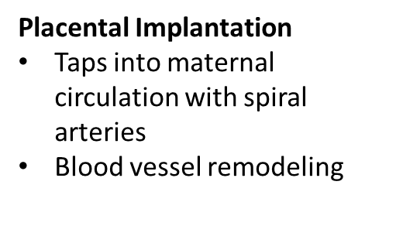
Pathophysiology of Preeclampsia
“A disorder of widespread endothelial malfunction and vasospasm”
Notes:
The pathophysiology of preeclampsia likely involves both maternal and fetal/placental factors. Abnormalities in the development of placental vasculature early in pregnancy may result in relative placental under perfusion/hypoxia/ischemia, which then leads tor release of antiangiogenic factors into the maternal circulation that alter maternal systemic endothelial function and cause hypertension and other manifestations of the disease (hematologic, neurologic, cardiac, pulmonary, renal, and hepatic dysfunction). However, the trigger for abnormal placental development and the subsequent cascade of events remains unknown.

Slide 13
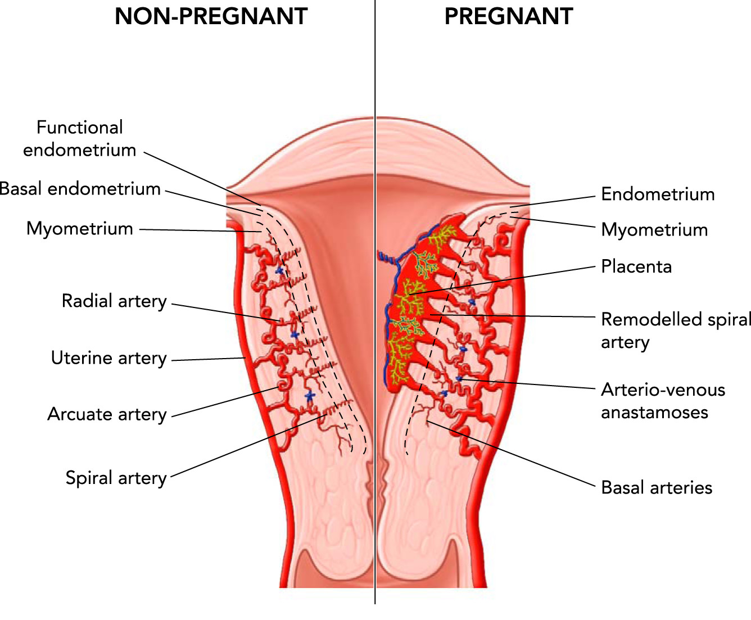
DOI: (10.1152/physiol.00033.2016)

Slide 14
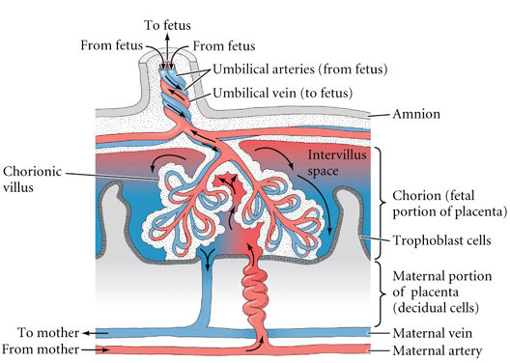

Slide 15
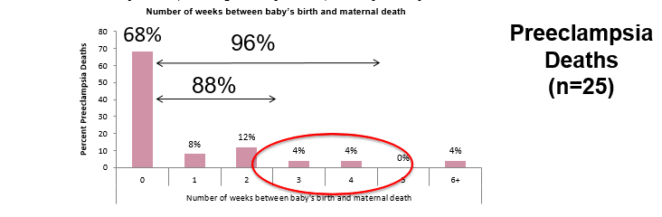


Timing of Pregnancy-Related Deaths,
CA-PAMR, 2002 to 2004
Onset of Pre-Eclampsia can occur up to 6weeks or longer after Birth
Notes:
Preeclampsia and non-preeclampsia cases have about the same proportion of deaths in the 2 week postpartum period,
Targeting early follow-up for preeclampsia should help to address this group of patients.

Slide 16
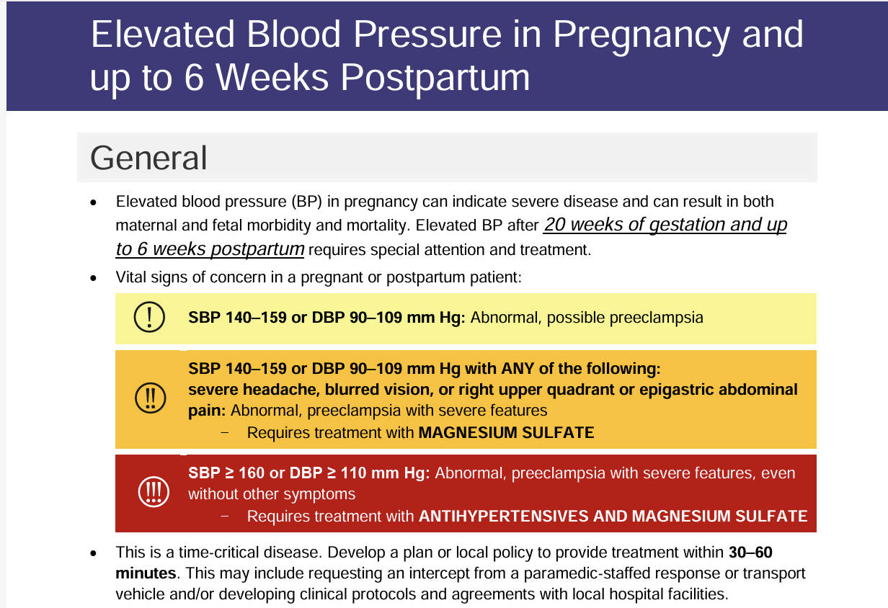

Slide 17
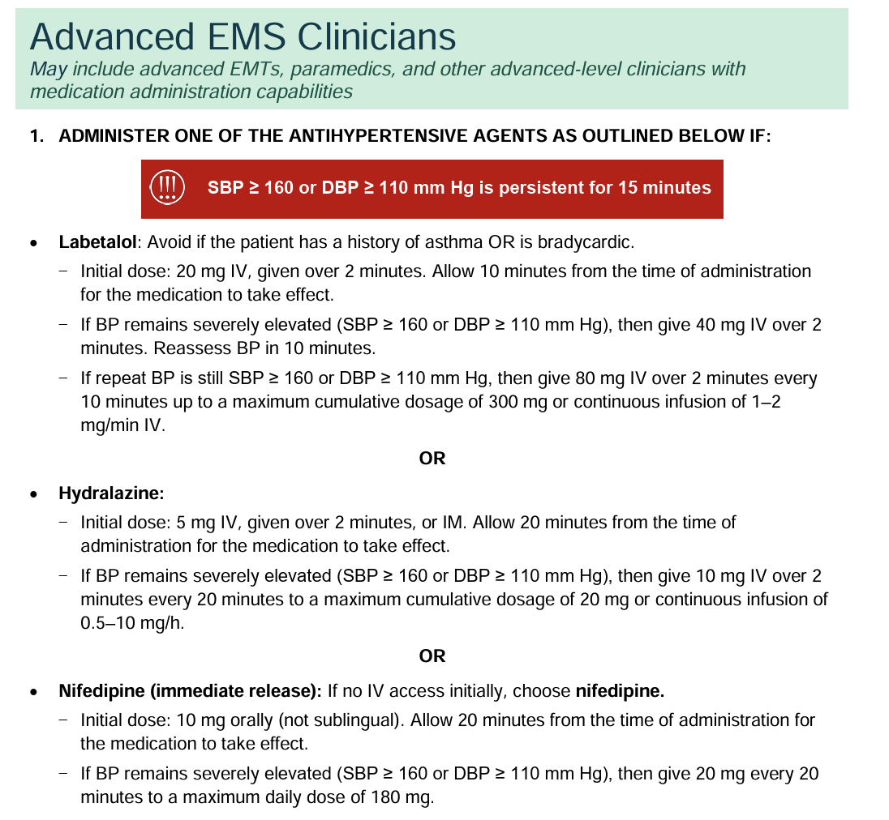

Slide 18
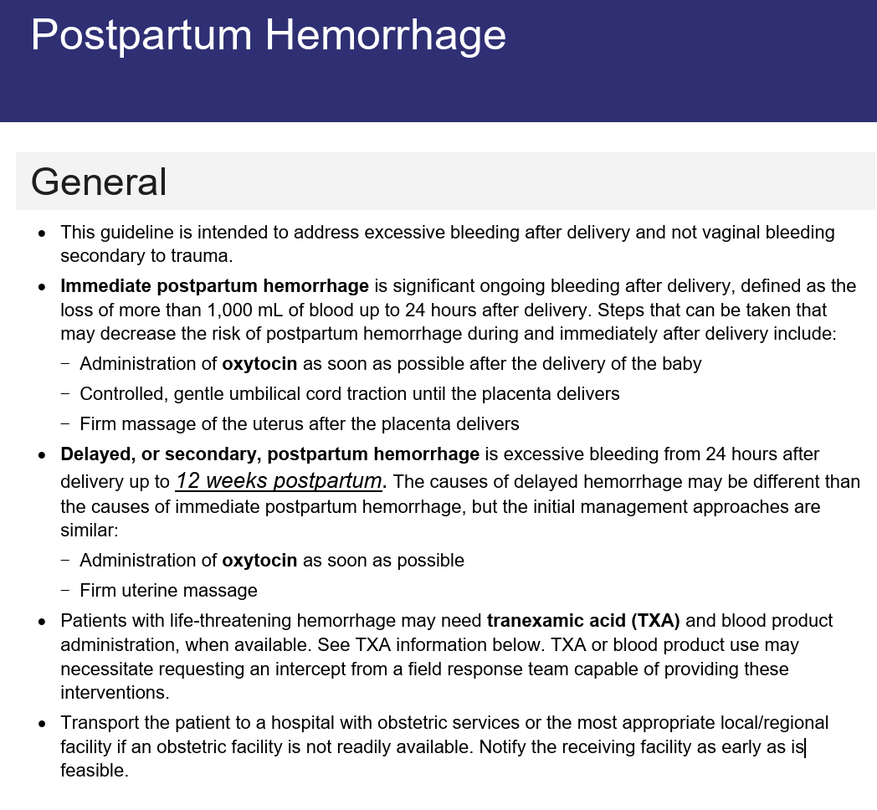

Slide 19
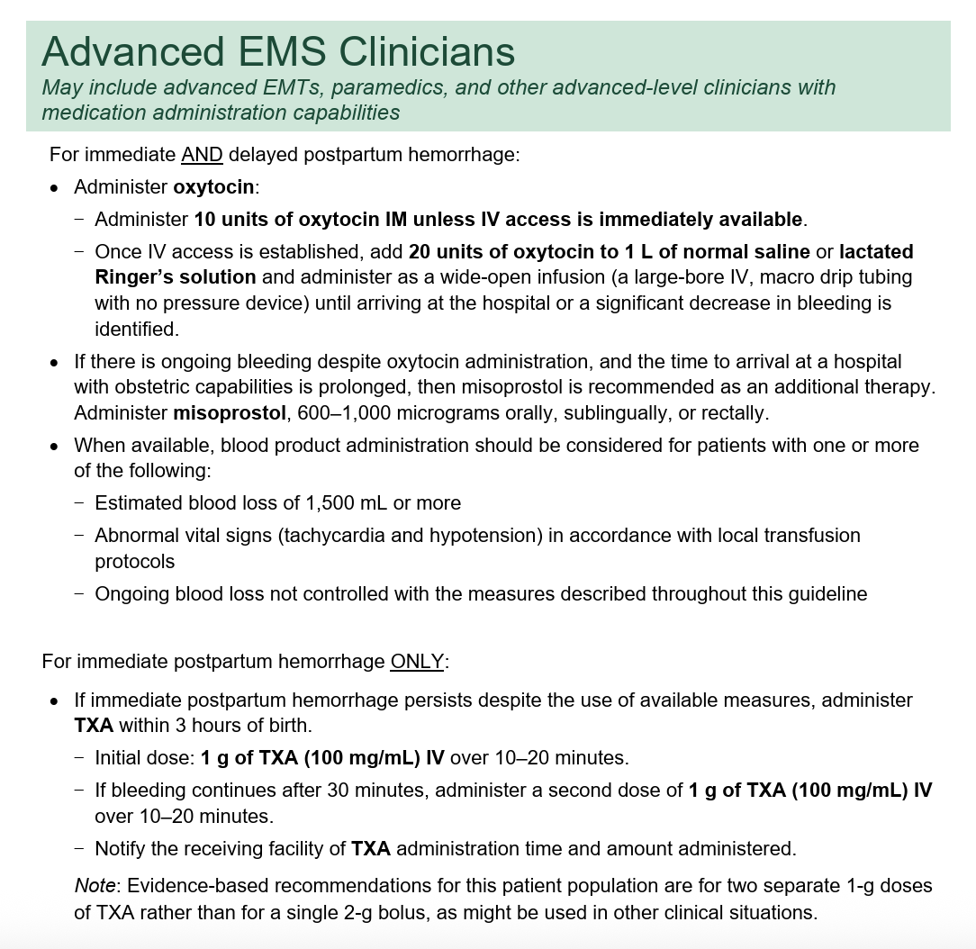

Slide 20
Google- NAEMSP ACOG Guidelines
https://naemsp.org/news/now-available-new-ems-obstetric-emergency-guidelines/

Slide 21
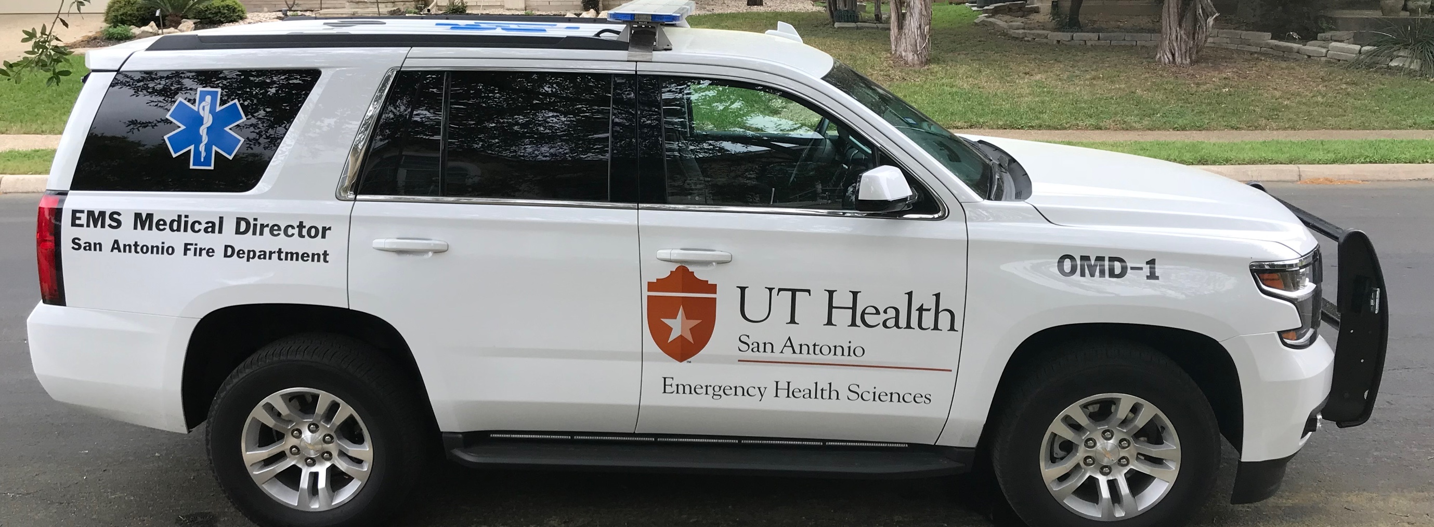



David Miramontes MD FACEP FAEMS EMT-P
210-265-7891 miramontesd@uthscsa.edu

Slide 22


Slide 23

OB Deserts
Kevin Mackey MD, FAEMS
Medical Director, Sacramento Fire Department
Medical Director, Sacramento Airport Fire
President Elect, National Association of EMS Physicians

Slide 24
What are OB Deserts?
Definition:
  A county qualifies as a maternity care desert if it has no hospitals providing obstetric care, no birth centers, no OB/GYN and no certified nurse midwives.
  Impact:
    OB deserts can lead to higher maternal and infant mortality rates, delayed prenatal care, and increased complications during childbirth.

Slide 25
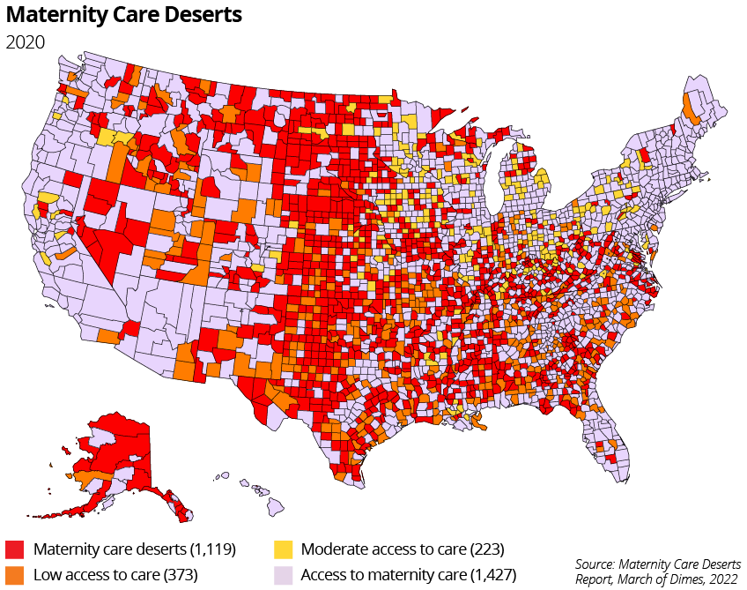

Slide 26
OB DESERT FACTS
35%
of US Counties have ZERO access to maternity healthcare (2.3 million at risk women)
2 of 3
Maternity care deserts are in RURAL counties
217
Maternity wards have closed since 2011
1 in 6
Black infants were born in an area defined as an OB desert
29%
Rural or Critical Access hospitals are at immediate or high risk of closure

Slide 27
WHY DO OB DESERTS EXIST?
SHORTAGE OF OB-GYNS
  Many OB-GYNs prefer urban settings with higher patient volume.
  Rural areas face challenges in attracting and retaining specialists.
FINANCIAL VIABILITY
  Low birth rates and fewer patients make rural obstetric services financially unfeasible.
  Hospitals may shut down OB services due to financial strain.
MALPRACTICE INSURANCE COSTS
  High insurance premiums deter OB-GYNs from practicing in high-risk or rural areas.

Slide 28
WHY DO OB DESERTS EXIST?
HOSPITAL CLOSURES
04
Small rural hospitals are closing, and many discontinue OB services.
Patients in those areas face longer travel times for care.
ECONOMIC AND SOCIAL BARRIERS
05
  Low-income populations in rural areas lack access to insurance, transportation, and affordable care.

Slide 29


OB DESERT SOLUTIONS
COMMUNITY BIRTHING CENTERS (DESERT WELLS)
01
Free standing locations in limited access
Prenatal care and perinatal services for low risk deliveries.
LOAN FORGIVENESS/INCENTIVES (DESERT SHERPAS)
02
  Offer financial incentives and loan forgiveness to attract OB professionals to OB deserts

Slide 30
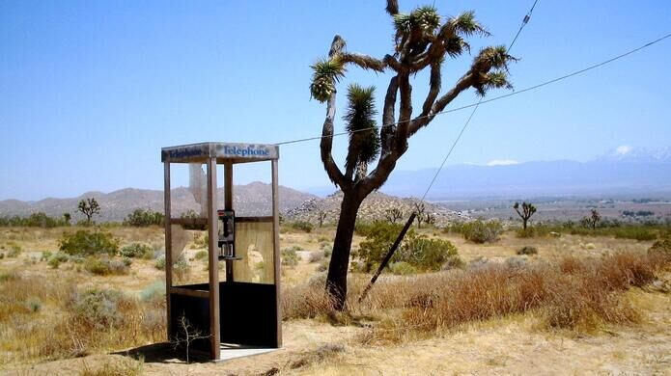

OB DESERT SOLUTIONS
TELEMEDICINE EXPANSION (DESERT PHONE-A-FRIEND)
03
Remote consultation for perinatal services
Leverage telemedicine to bridge the gap for care in rural areas.
LEVERAGE POLICY (DESERT ATMs)
04
  Expand insurance coverage (especially MediCaid services to rural critical access hospitals)
  Move money to the desert

Slide 31

OB DESERT SOLUTIONS
SUPPORT AND EXPAND THE ROLE OF MIDWIVES and MIH-CPs
(JAWAS FOR PRENATAL CARE and BIRTHING)
05
23 states still do not support the practice of CNMs
CNMs have demonstrated lower birth complications, and higher patient satisfaction, for a fraction of the cost

Slide 32

Creative solutions, with a sprinkle of collaboration, can turn OB Deserts into OB Oasis’
Creative solutions, with a sprinkle of collaboration, can turn OB Deserts into OB Oasis’

Slide 33

Laborious Challenges in EMS: How should we Deal with Precipitous Deliveries in the Field
Christopher B. Colwell, MD
Zuckerberg San Francisco General Hospital and Trauma Center
San Francisco EMS

Slide 34
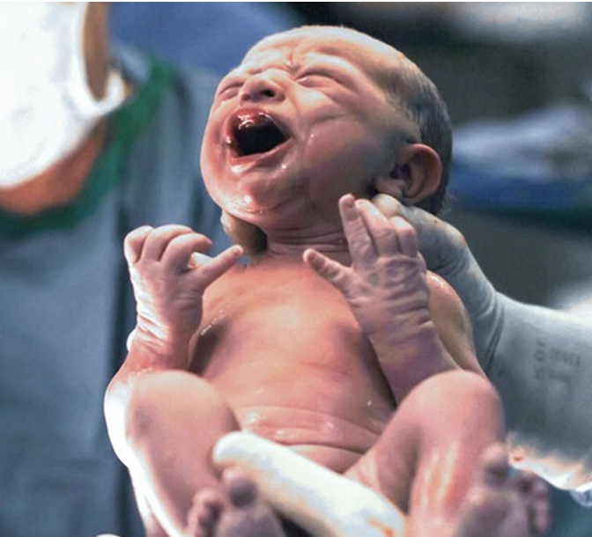
Prehospital Delivery
Rare
Most will go just fine!
Issues do occur

Slide 35
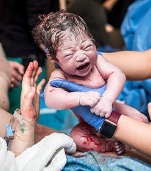
“Normal” Delivery
Confirm presentation
Digital stretching of the perineum
  Particularly posteriorly
Controlled expulsion
Gentle downward traction on the head
  Subsequent upward motion
Suction the mouth and nose
Clamp and cut the cord
Dry and stimulate the infant
Notes:
It is happening in the ambulance, so by definition it isn’t really normal. The gentle downward traction of the head will often deliver the anterior shoulder and the subsequent upward motion pulls the posterior shoulder through the pelvic outlet. Placenta should be delivered 5-7 minutes later.

Slide 36

Biggest Issues
Breach
  Most common
    4%
Shoulder dystocia
    3%
Prolapsed cord
    Less the 0.2%
Notes:
Breech presentations occur in 4% of all deliveries. Less the 0.2% or about one in every 300 births.

Slide 37
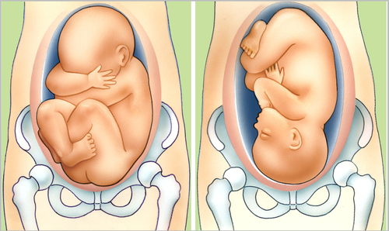
Breech Presentation
Notes:
The buttocks and legs to not provide a sufficient wedge, hindering cervical accommodation of the relatively larger head. Also, because the presenting part does not occlude the cervical opening completely, umbilical cord prolapse may occur.

Slide 38
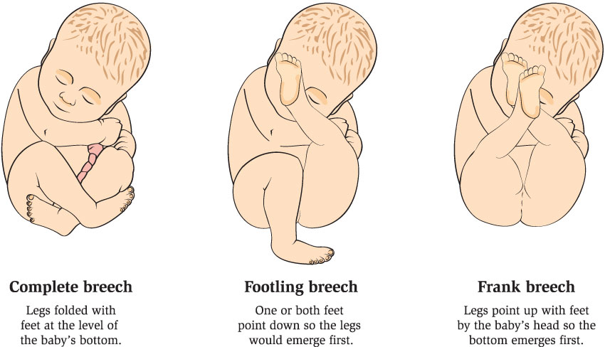
Breach Delivery
Three types
  Complete
  Incomplete
    Footling
  Frank
Diagnosis
  Physical exam
  Ultrasound
Notes:
Basically the feet or buttocks aren’t shaping the birth canal in the same way the head does.

Slide 39
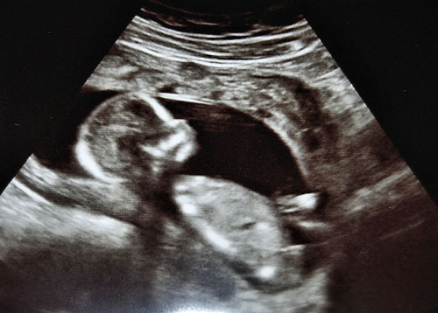
Breech Delivery
Don’t pull!
Hands off until fetal umbilicus is visualized
  Allows better cervical dilation
Then you can assist delivery
  Arms
  Head in flexed position

Slide 40
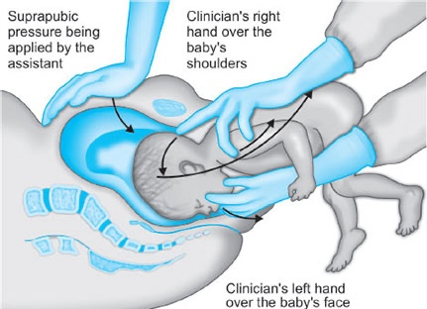
Breech Delivery
Mauriceau maneuver
  Uses the fetal oral aperture to flex the fetal neck and draw in the chin
    Should be done after delivery of the elbows
Notes:
Left finger in the mouth to flex the neck and the right index finger at the back of the head.

Slide 41
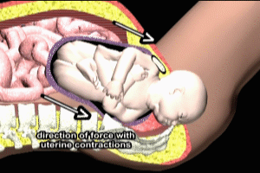
Shoulder Dystocia
3% of vaginal deliveries
Turtle sign
  Retraction of baby’s head back into the perineum between contractions
Several maneuvers
  30 seconds each

Slide 42
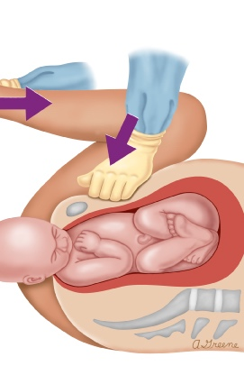
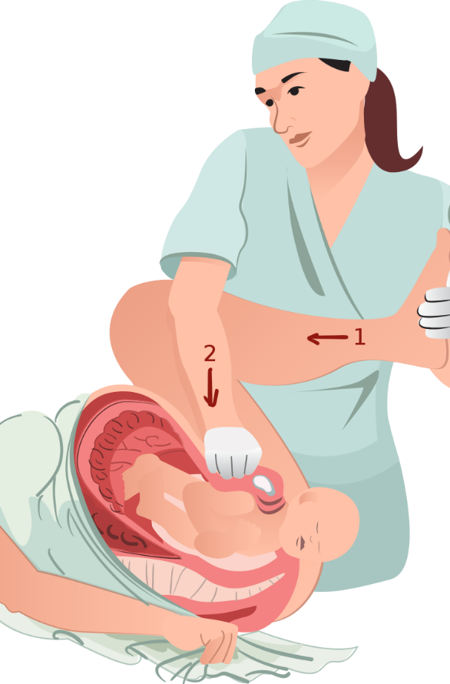
Shoulder Dystocia
McRoberts
  Hyperflexion of the thighs
  Back flat
  Pressure over the pubic synthesis
    Not fundal pressure
Relieves 50% of dystocias

Slide 43
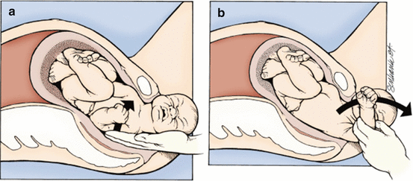
Shoulder Dystocia
Delivery of the posterior shoulder
  Insert your hand and locate the posterior elbow
    Flex the elbow and sweep the forearm across the chest and face

Slide 44
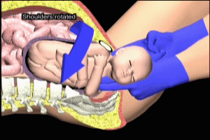
Shoulder Dystocia
Wood’s corkscrew maneuver
  2 fingers behind the anterior shoulder and 2 fingers in front of the posterior shoulder
Reverse Wood’s corkscrew maneuver

Slide 45
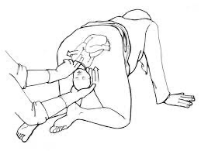
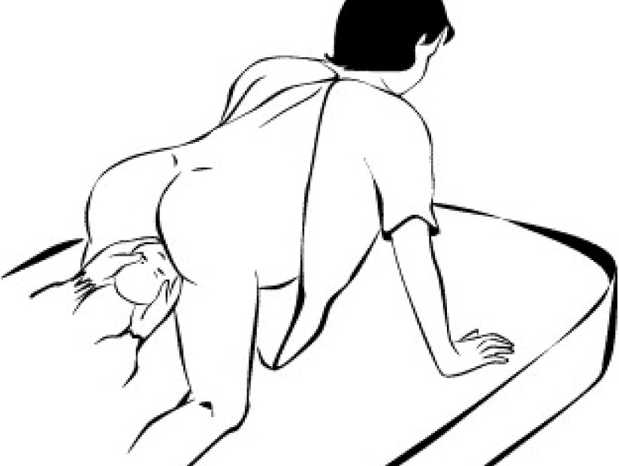
Shoulder Dystocia
Gaskin maneuver
  Roll to “all fours”
  Act of turning the mother may be most useful
    Can get an extra 10-20 mm of the pelvic outlet

Slide 46
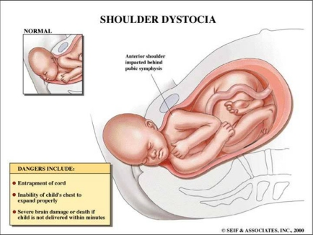
Shoulder Dystocia
HELPER
  Help
  Episiotomy
  Legs flexed
    McRoberts’
  Pressure
    Suprapubic
  Enter
    Vagina
  Remove
    Posterior arm

Slide 47
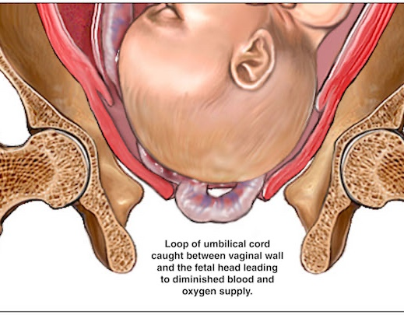
Umbilical Cord Prolapse

Slide 48
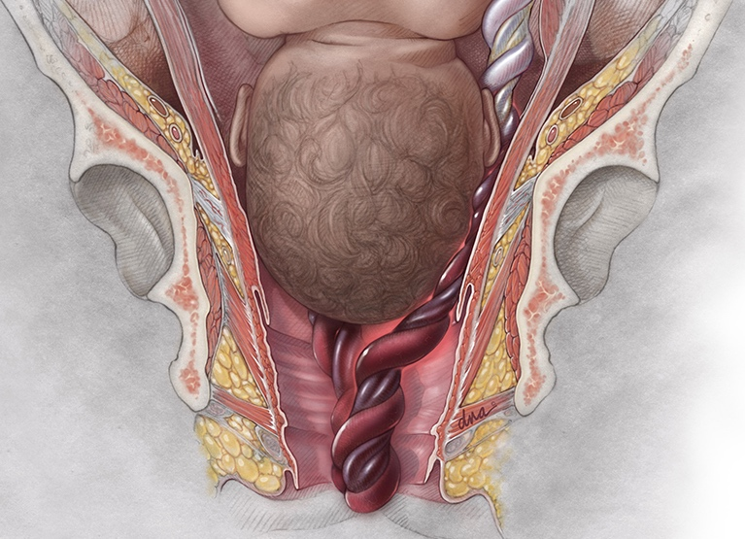
Prolapsed Cord
Cord slides past the presenting part
  Cord compression
    Hypoxia, acidosis
Diagnosis
  Palpation of the umbilical cord on vaginal examination or
  Visualization of the cord protruding through the introitus

Slide 49
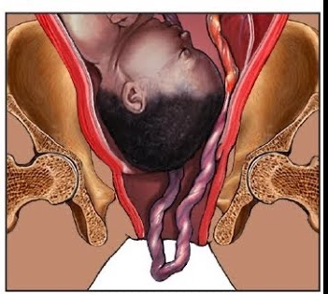
Prolapsed Cord
Manually lift up presenting fetal part
  Relieving pressure on the umbilical cord
  Maintain presenting part away from prolapsed cord
Prepare for emergency delivery while maintaining presenting part off the cord

Slide 50

Summary
Think about this before it happens
If one maneuver is not working, move to another
  30 seconds
Don’t forget post-delivery care
Notes:
In most situations, the most difficult part of these procedures will be the decision to pick of the knife and to a certain extent, you can think about your indications for making this decision before the situation arises….maybe even right now.

Slide 51
Thank you!
Christopher.Colwell@ucsf.edu

Slide 52
911 calls at birthing centers, what could go wrong?
Gail H Bradley, MD, FACEP FAEMS

Slide 53
Goals for today
Why do birthing centers call 911?
What are the issues/problems we can anticipate?
What can we do?

Slide 54
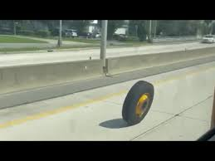
Why are we called?
Things are not going well!
Realize, that once 911 has been called, something is wrong.
You are not part of mom’s birth plan!
Anticipate that everyone’s stress level is going to be high
  Mom
  Midwife and birthing center staff
  EMS crew
Notes:
Mom decided to deliver in a birthing center. Having 911 called and a fire crew respond is not part of her birth plan. Facilities deliver a lot of babies, and 911 is not typically called. Did they call early and appropriately? Or did they wait, and now you have mom and/or baby in extremis? You can augment their care. As EMS providers, resuscitation is your bread and butter. Midwives may have options for hemorrhage control that you don’t have.

Slide 55
What are the ramifications of these calls?
Adverse outcomes with high risk for litigation
Complaints to ems agency
Complaints to licensing entities
  Facility licensing oversight
  Midwife licensure/certifying body
Increase in EMS and staff stress for future calls at facility
Notes:
Everyone is on edge for future calls, staff and EMS.

Slide 56


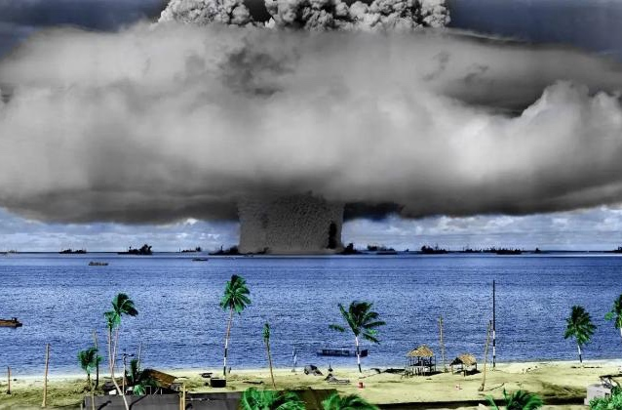
What is happening now?
Facility licensing complaints
News media coverage
Social media coverage
Notes:
Avoid the nuclear option! Try to work with facility first!

Slide 57
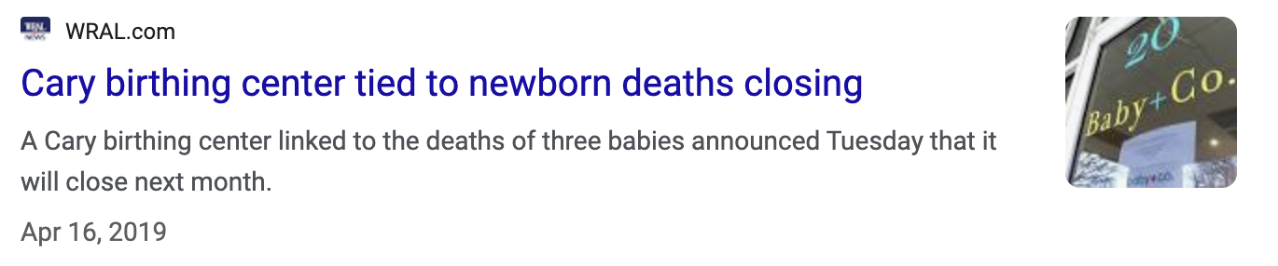

cases across the US

Slide 58
What can you or your agency do?
Work collaboratively with birthing center
  Reach out to birthing center and establish a relationship with them
  Understand why/when they will call 911
  What are their expectation for EMS?
  Explain what you can/cannot do
Play nice in the sandbox – kill them with kindness
Know when to escalate reporting
Notes:
Many states have specific requirements for reporting transfers out of birthing centers.

Slide 59
AABC Toolkit - Coordination + Collaboration with EMS for Safe, Timely Transfer
A member benefit for Birth Center and Alongside Midwifery Unit Members
Emergency transport from a birth center to a hospital is rarely needed, with only about 2% of births requiring urgent transport of the birthing person or baby for serious or potentially serious complications. However, when emergencies do occur in the birth center setting, swift and coordinated transport to a higher level of care is needed. Emergency medical services (EMS), therefore, play an important role in the overall safety of birth centers.
Birth centers, their collaborating hospitals, and local EMS systems need tools to support effective, team-based care across the continuum from the birth suite to the appropriate hospital unit. This toolkit is designed to help facilitate safe and seamless emergency transport between facilities through active engagement and teamwork with EMS providers
https://www.birthcenters.org/aabc-toolkit-ems-collaboration
Notes:
AABC = American Association of Birth Centers. Goal is to proactively pre-plan how/when to coordinate transfer to the hospital.

Slide 60

What can you or your agency do?
Document, document, document
  your chart will be reviewed as part of any complaint or litigation
  Be detailed and factual
  Avoid including your opinions
Notes:
Friday, AG read directly off EMS run sheet that they were reviewing as part of investigation.

Slide 61


Questions?

Slide 62
Questions?

