Slide 1
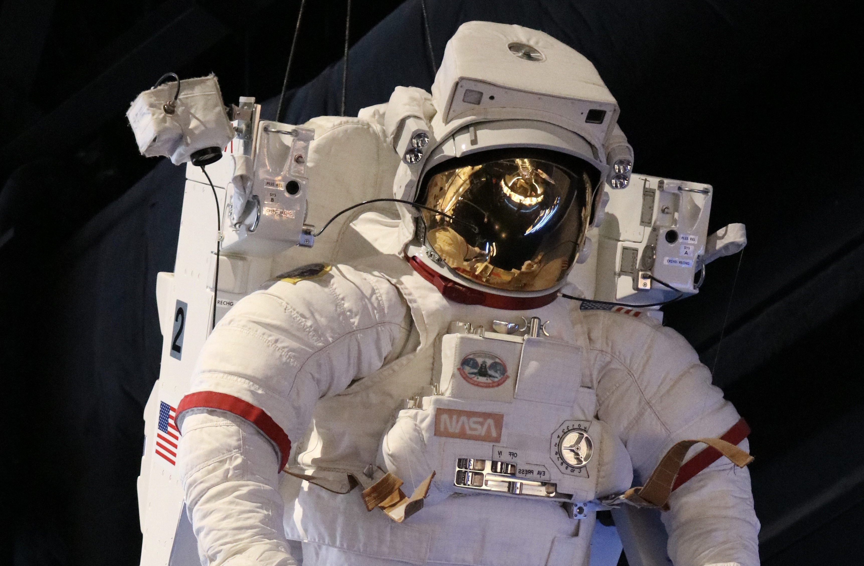
  Special Dockets for Rockets
Joshus Gaither

Slide 2
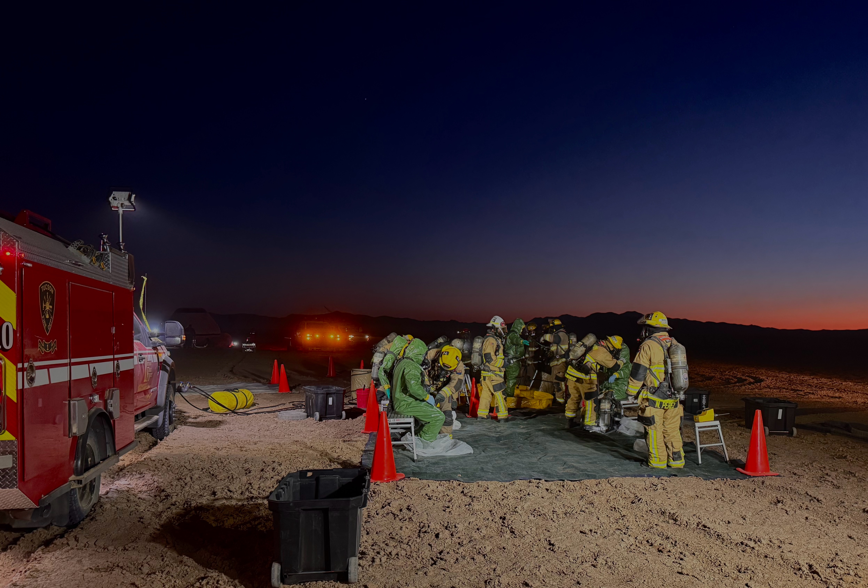
How does a fire-based EMS special operations team aid in aerospace recovery mission?

Slide 3
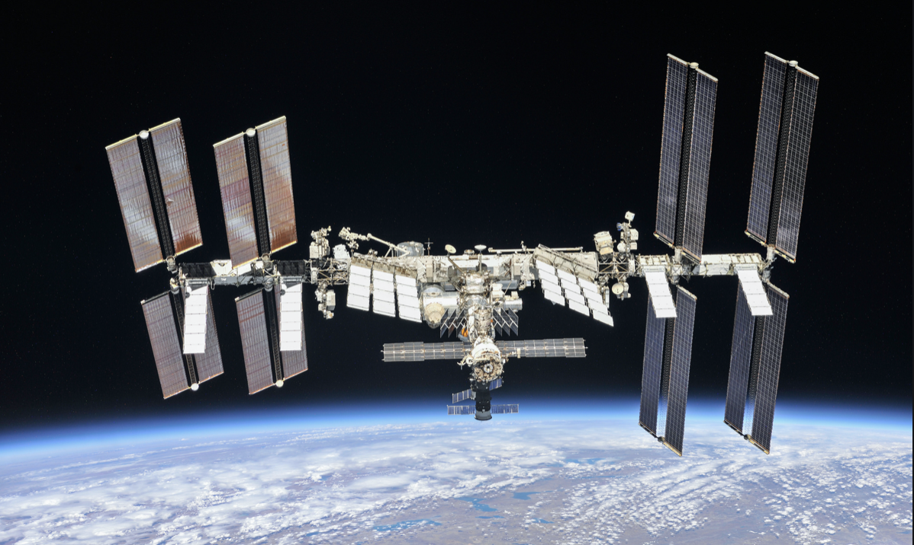
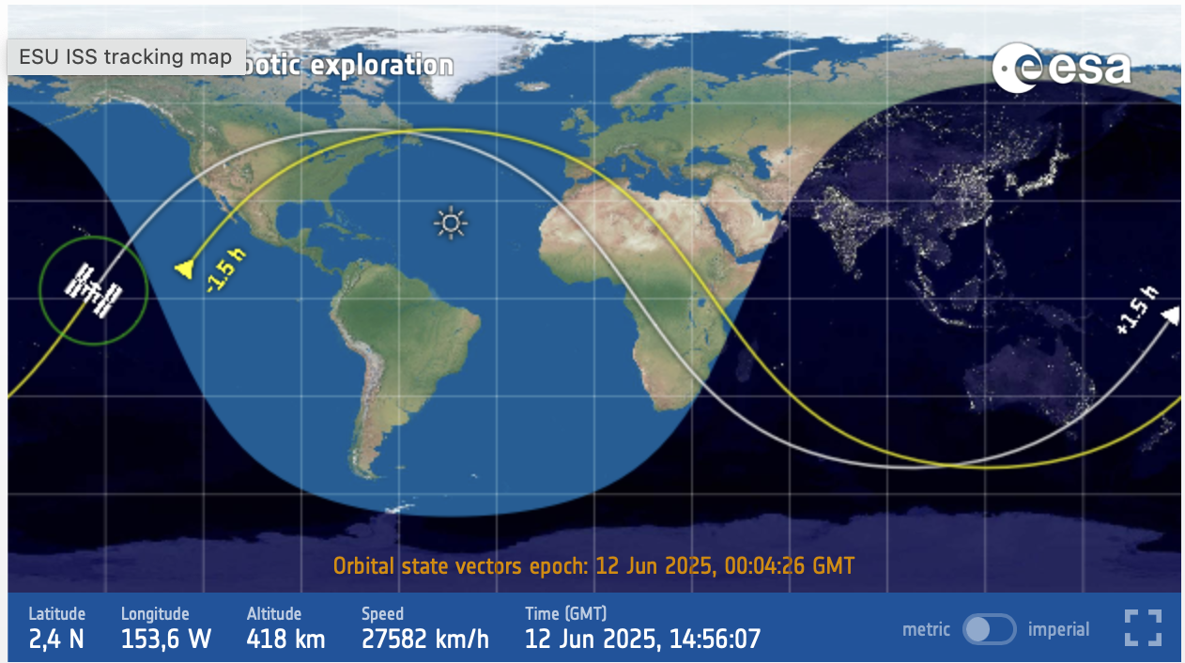
Notes:
Launched in mid 1990s

Slide 4
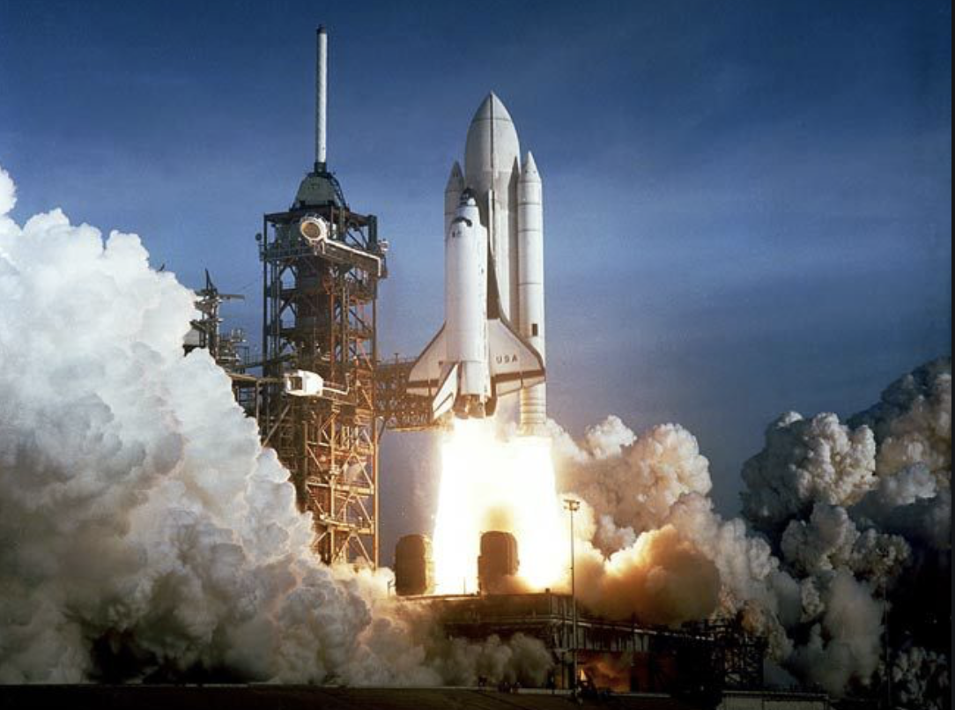
Notes:
The retirement of NASA's Space Shuttle fleet took place from March to July 2011

Slide 5
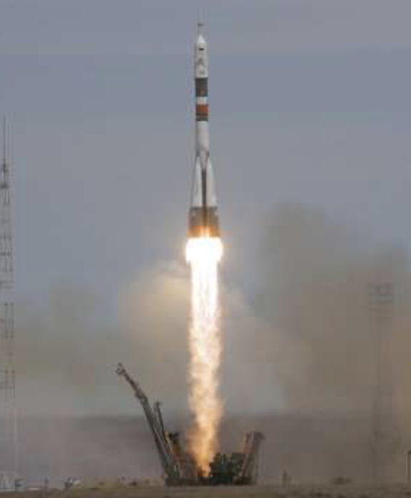
Russian soyuz
Notes:
Cost between 40-80 mil per seat

Slide 6
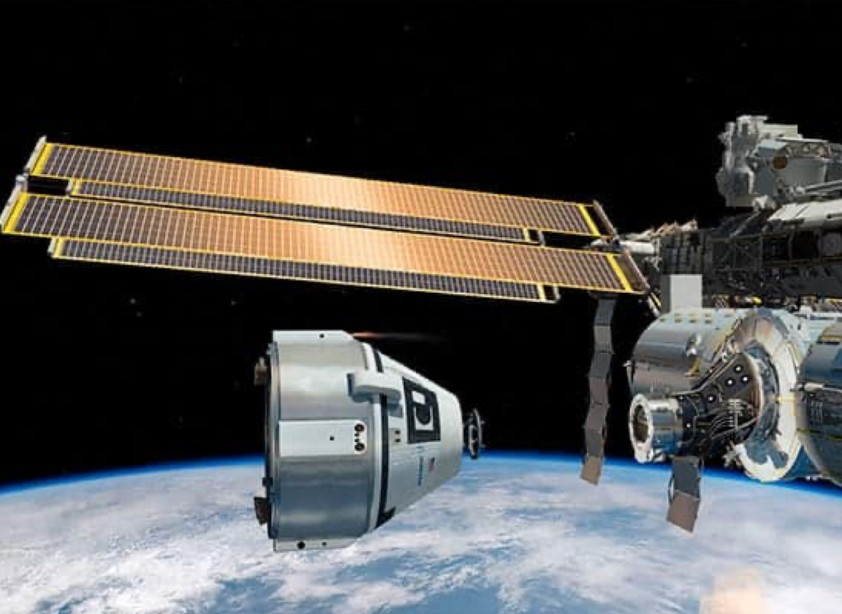
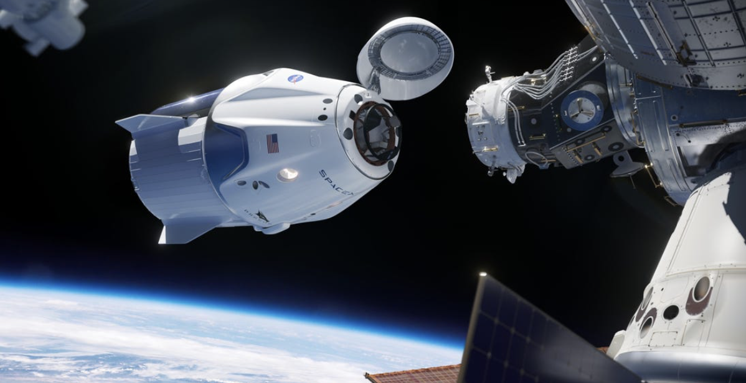
Boeing space X
Notes:
2014 – NASA awarded two contracts

Slide 7
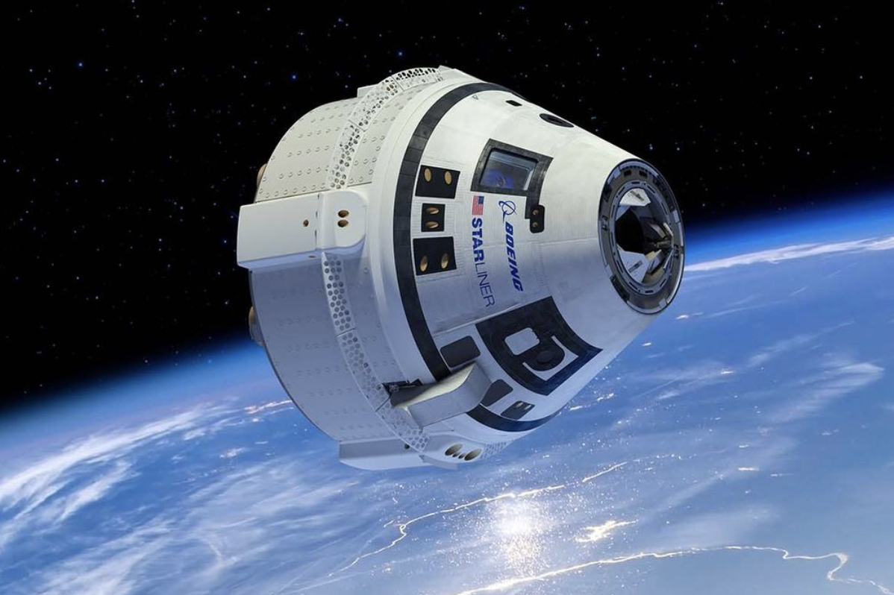
Boeing Starliner
Notes:
Land on land. Cost – $1.5 billion

Slide 8
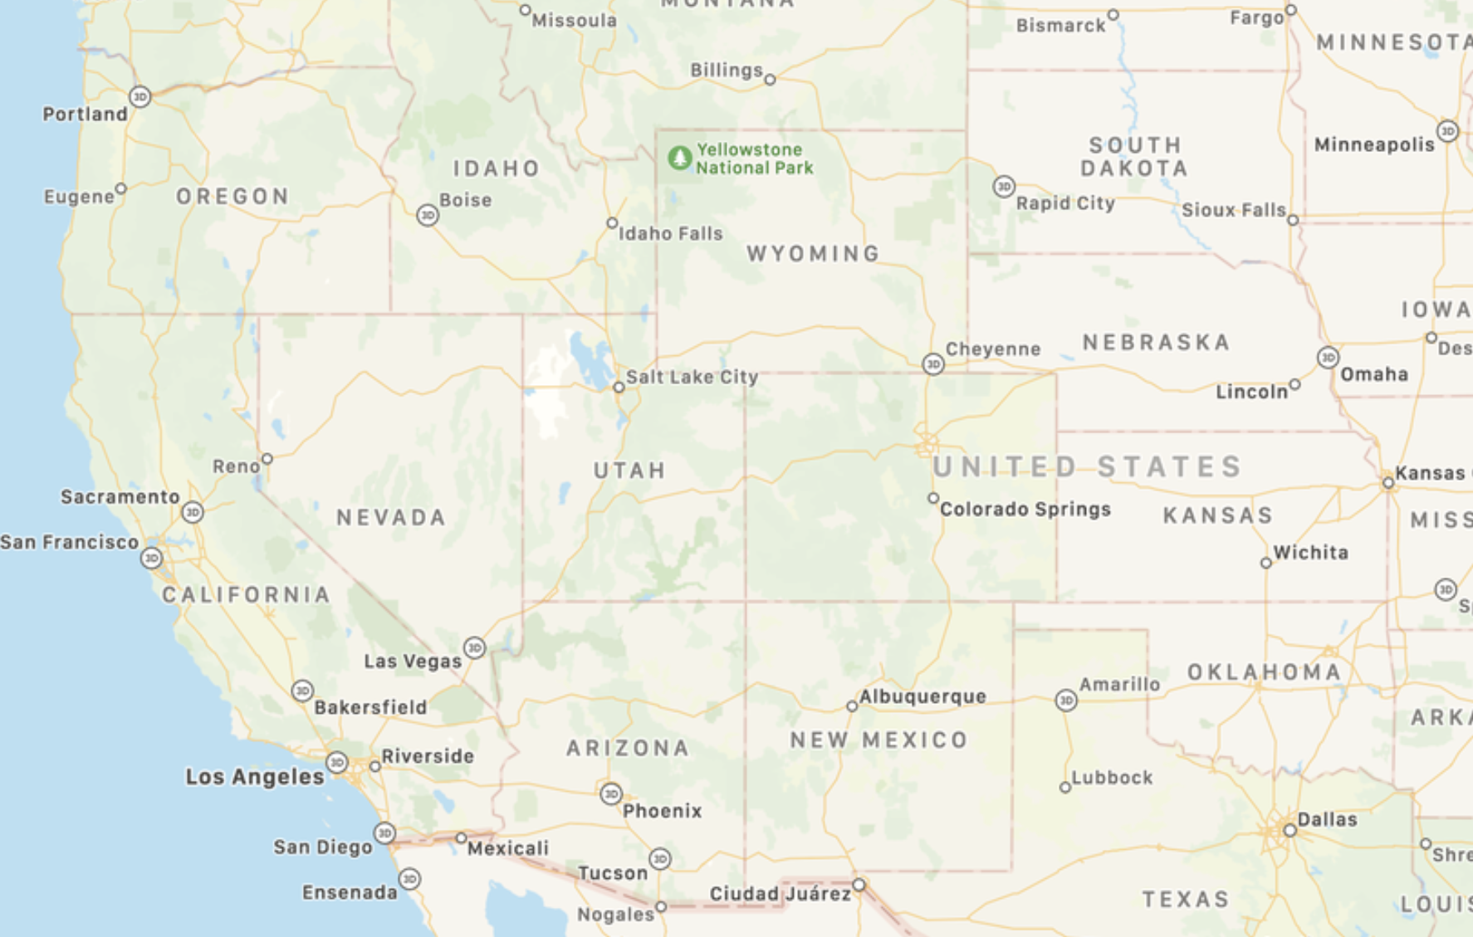
Dugway Proving Ground
White Sands Missile Range
Wilcox Playa
Notes:
Utah – Dugway Proving Ground
New Mexico – White Sands Missile Range
Arizona – Wilcox Playa

Slide 9
Believe It or Not…
This is really just another fire-based Special Response opportunity

Slide 10
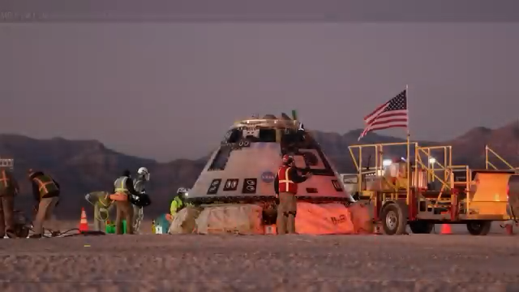

Slide 11
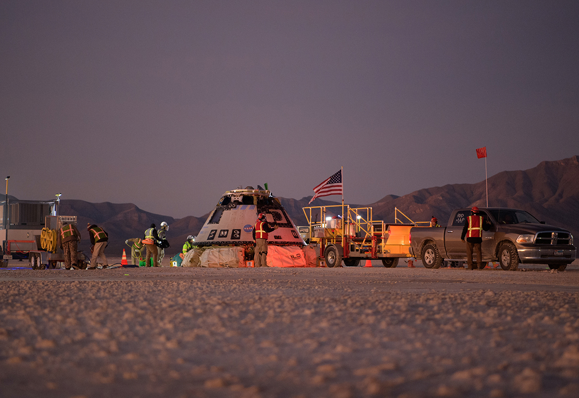
Physical Hazards For Responders
Capsule has a static charge
Capsule is hot
It carries hazardous materials

Slide 12
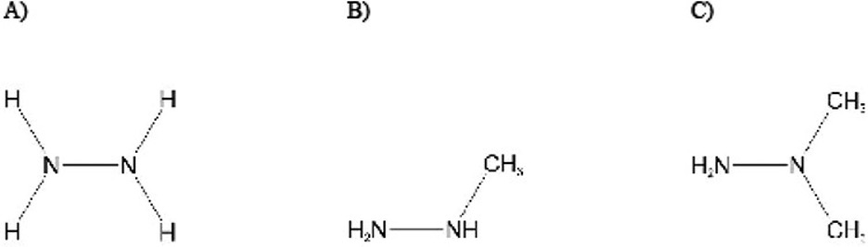
Chemical Hazards
Hydrazine
Properties:
  Clear gas, ammonia like smell
  Oily liquid at room temperature
Toxicity:
  Alkali: chemical skin burns
  Irritant Gas: Resp Sx & Skin Burns
  Consumes B6: Seizure, CNS Depression
Medical Care:
  Decon: water
  Respiratory Sx: Albuterol if wheezing
  Seizure: Pyridoxine (B6), 5 gm
Nguyen et. Al. The Toxicity, pathophysiology , and treatment of Acute Hydrazine Propellant Exposure: A systematic Review, Mil Med, 2021

Slide 13
So How Does All this get taken Care of?
Landing Recovery Team & Plan

Slide 14
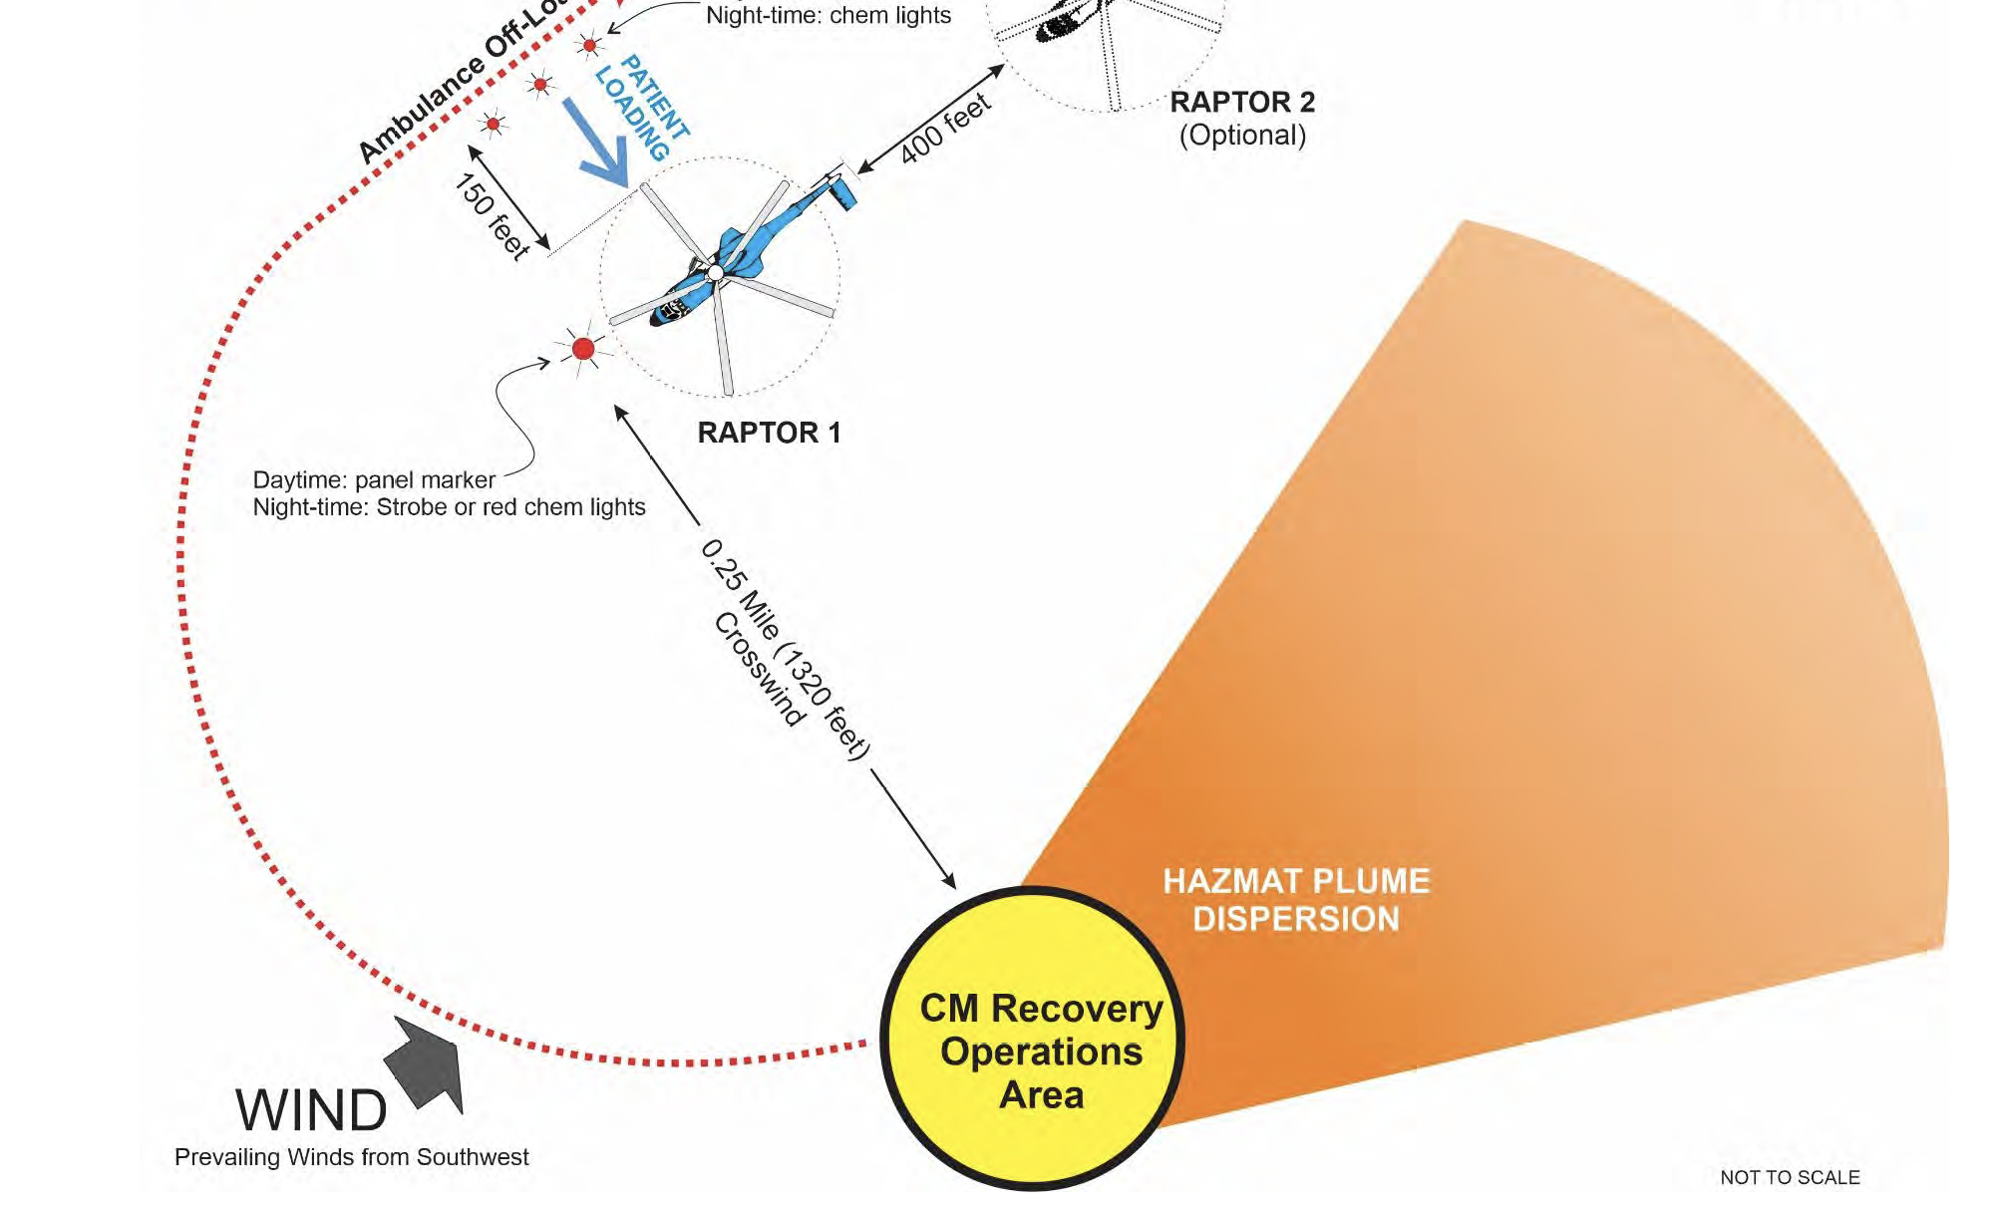
Its Just like any other HAZMAT Special ops
Hot zone
Warm Zone
Cold Zone patient care and extrication

Slide 15
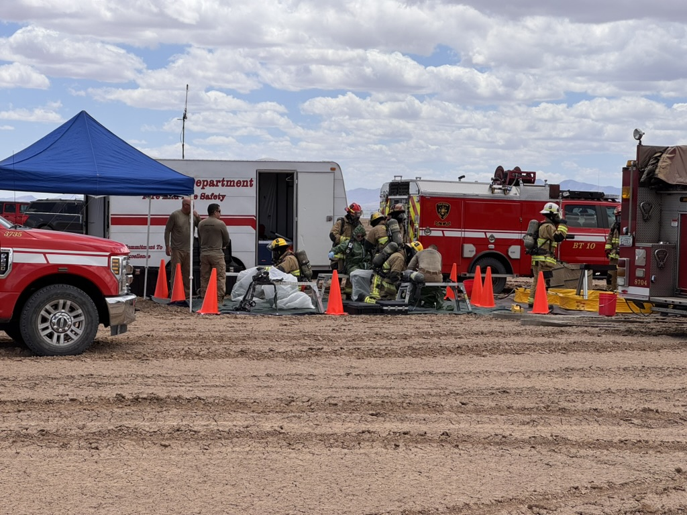
Hot Zone
Level A PPE
Leak detection with standard meter
WARM Zone
Decon in Level B PPE
Secondary screening for contamination

Slide 16
Cold Zone Care
Traditional trauma care
A few nuanced aerospace things: Volume Depletion and Space Vertigo
Hydrazine exposure care for Hazamt team members or astronauts

Slide 17
Figure 1: Consensus Guidelines for the Prehospital Care of Patients with Hydrazine (HZ) or Hydrazine Derivative (HZ-D) Exposures
Care Prior to Decontamination (Hot Zone Care):
Rescuers must wear adequate personal protective equipment (PPE).
Patients who self-extricate and self-decontaminate are unlikely to require patient care prior to decontamination.
Patients who cannot self-extricate should be removed from the hot zone as soon as possible, postponing therapy that is not life-saving.
In patients who are apneic or in respiratory failure, provide ventilation using a Bag Valve Mask (BVM).
In seizing adults administer midazolam, 10 mg, IM, every 5 minutes, preferably in prefilled syringes.
*Decontamination (Warm Zone Care):
Rescuers should ventilate enclosed areas and confirm a nontoxic environment before entering without adequate PPE.
Remove clothing using care to avoid generation of sparks using shears or other cutting devices.
Blot away adherent liquid because HZ and HZ-Ds are colorless liquids at room temperature.
Irrigate skin with water, if there are no immediate life threats continue irrigation to a pH of 7.
Dry the patient’s skin with absorbent towels (e.g., microfiber towels) to prevent hypothermia and remove any residual contaminant(s).
Care After Decontamination (Cold Zone Care):
If the patient is hypoxic, provide high flow O₂ by nonrebreather-reservoir mask.
If the patient has ventilatory failure, provide positive pressure ventilation by BVM and consider ETI or cricothyrotomy.
If the patient has bronchospasm, administer albuterol 2.5 mg, up to 3 times and revaluate.
In seizing adults, administer midazolam 10 mg IM, repeat 10 mg IM or 5 mg IV / IO every 5 minutes until the seizure stops.
In adults with benzodiazepine-refractory seizures, administer pyridoxine 5 gm IV / IO, over 5 minutes.**
Gaither JB, French R, Knotts M, Lerman M, Harrell AJ, McIntosh S, Rice AD, Cole R, Gilmore S, Hindman DE, Edwards C, Nguyen H, Truxillo M, West J, Yeoh A, Davis T, Shirazi F, Wilson BW, Debevec JT, Schertz M, Walter FG. Consensus Guideline for Care of Patients in the Prehospital and Aerospace Settings with Exposures to Hydrazine and Hydrazine Derivatives, Prehosp Emerg Care: January 3, 2025. DOI: 10.1080/10903127.2024.2442097

Slide 18
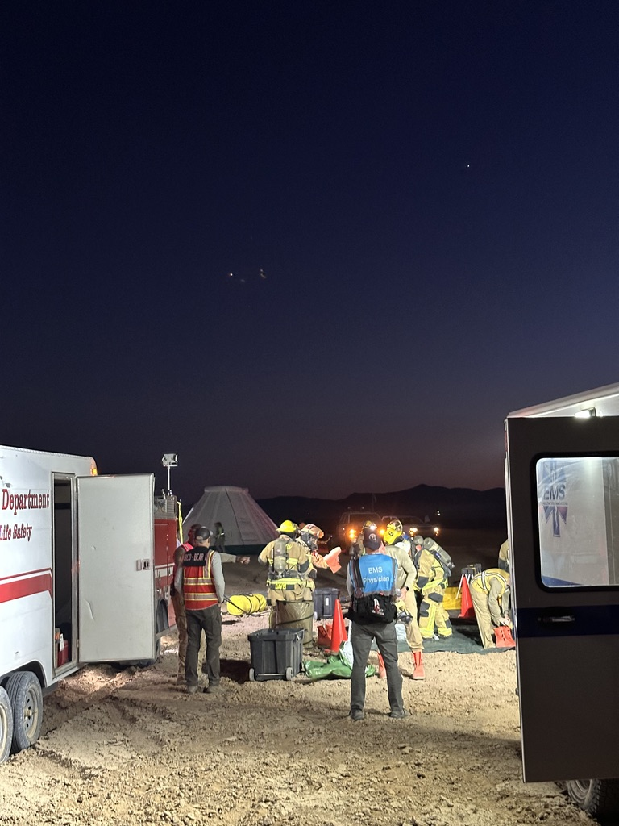
Aerospace Recovery Special Operations Team
Level A Team
Level B team
Medical and rehab team

Slide 19
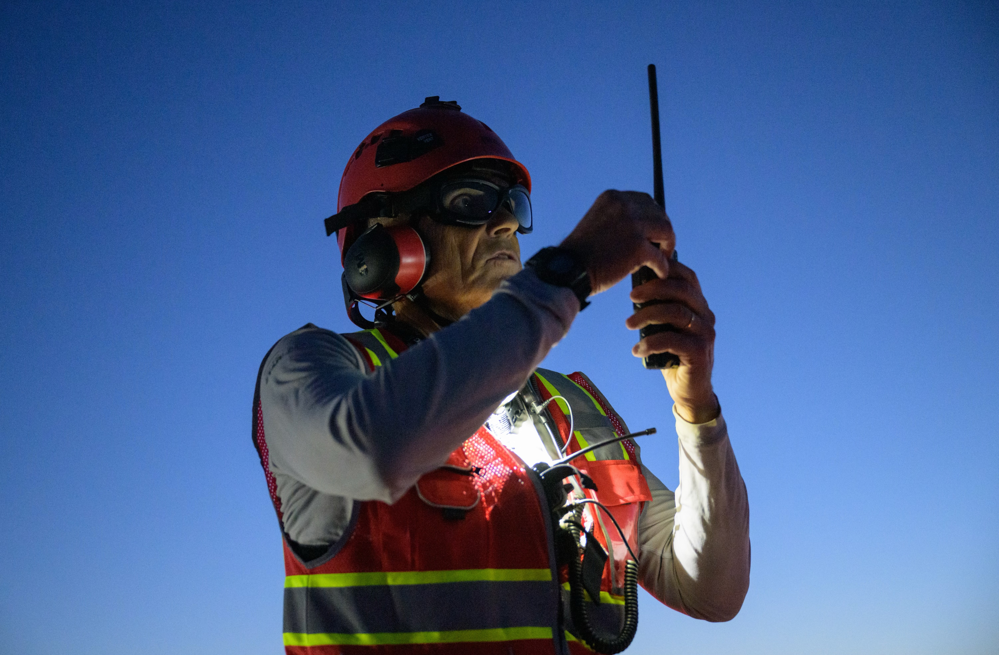
Questions

