Slide 1
OverDose
Follow-up and Linkage:
Meeting the Patient Where They Are
Robert Lowe MD FACP FAEMS
Columbus (OH) Division of Fire

Slide 2
What engagement strategies appear to have the greatest success?
Can be resource intensive but does pay off
Need multiple contact ways for uptake by patients.
Live conversations still better than texting
Team composition

Slide 3
When is the “right” time to engage?
In our experience next day much more receptive than day of

Slide 4
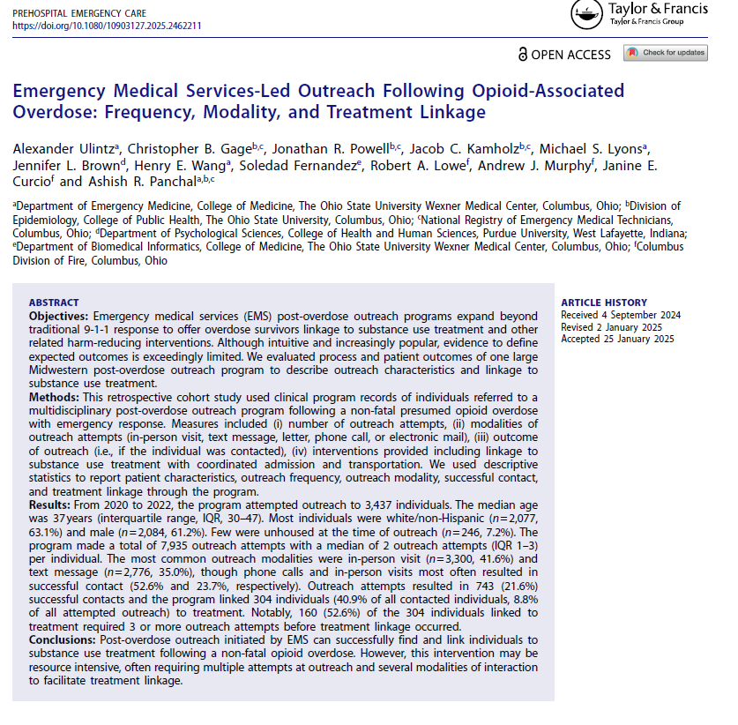

Slide 5
How many attempts does it take?
3437 unique individuals, 7935 outreach attempts
743 successful contact of individuals, 304 linked to treatment (40.9% of contacts made)
160 of the 304 success needed 3 or more outreach attempts to make linkage (52.6%)

