Slide 1

High Reliability Healthcare
Applying the Secrets of the Nuclear Navy to Save Patient Lives
Jeffrey Kuhlman, MD, MPH
Physician to the President 2009-2013
White House Physician 2000-2013

Slide 2
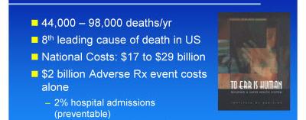
Dawn of the Millennium

Slide 3

Models of exceptional organizational preparedness
Commercial aviation
Emergency rooms
Aircraft carrier flight operations
Firefighting units

Slide 4
Principles of High Reliability
Expectations (repetition) can develop blind spots where unexpected events can develop and become unmanageable. Mindful organizing helps maintain resilience through anticipation and containment.
Anticipation: stops development of undesirable events
Preoccupation with failure: look for it and be sensitive to early signs of failure
Reluctance to simplify: labels and cliches can stop one from looking further into the events
Sensitivity to operations: dynamic and non-linear, difficult to know how one areas will act compared to another part
Containment
Commitment to resilience: absorb strain, preserve function despite adversity, maintain ability to return to service, learn and grow from previous episodes
Deference to expertise: deference downward, greater emphasis on assembly of knowledge, experience, learning, and intuition. Credibility is mutual recognition of skill levels and legitimacy

Slide 5
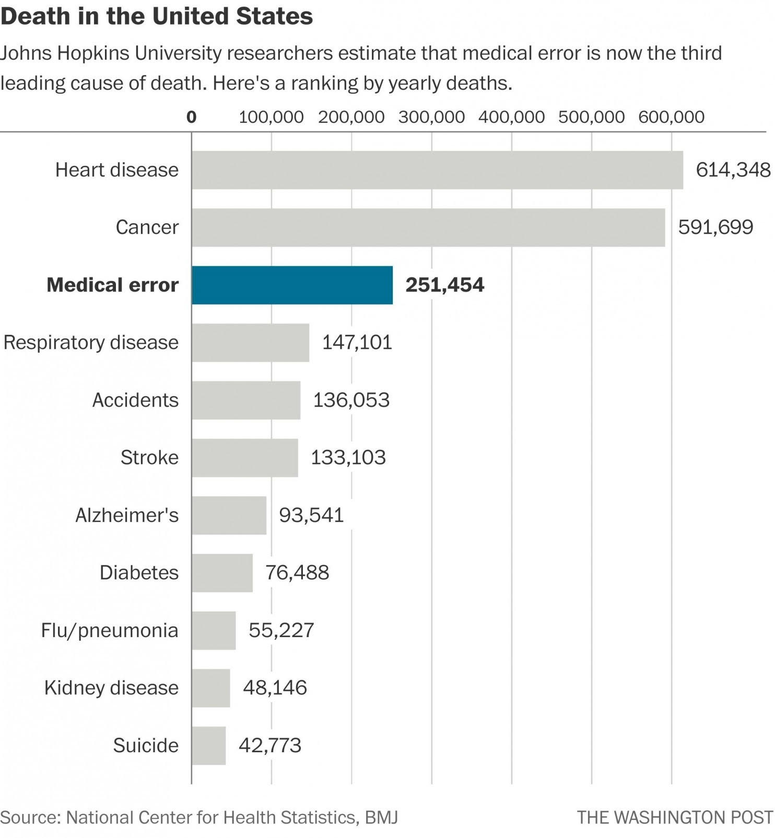
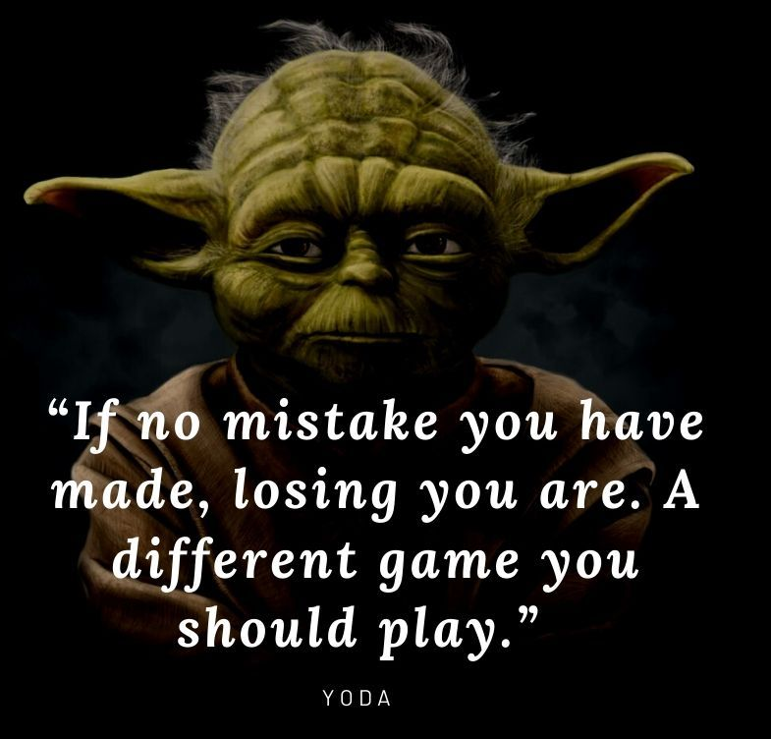

Slide 6
“The principles of high reliability sound great in the boardroom, but they don’t work at the bedside.”

Slide 7
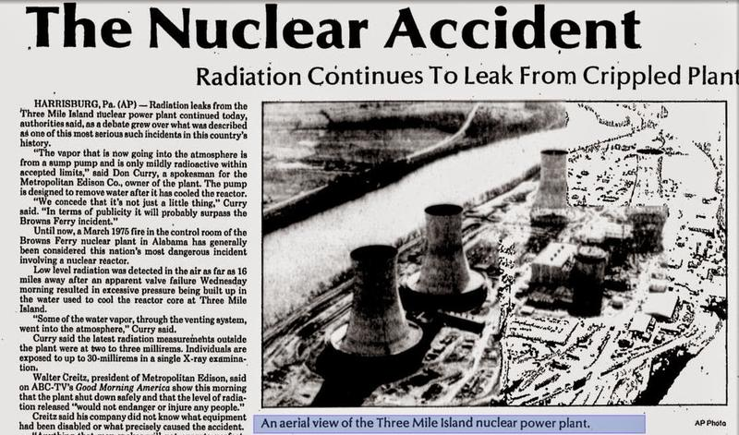

Slide 8
Chernobyl
1986

Slide 9
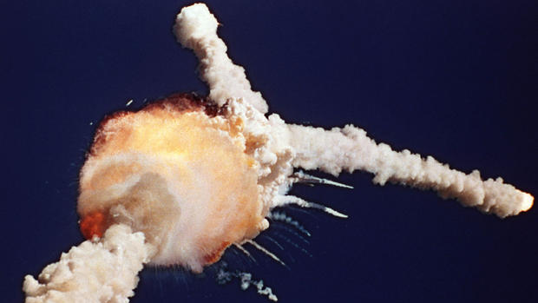

Slide 10

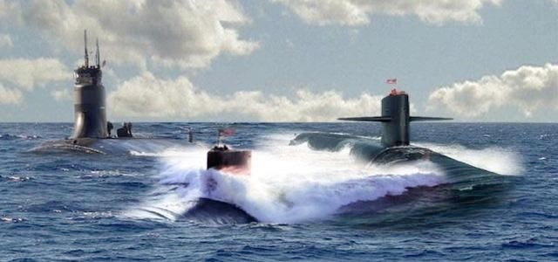
After spectacular failures, all turned to the Nuclear Navy

Slide 11
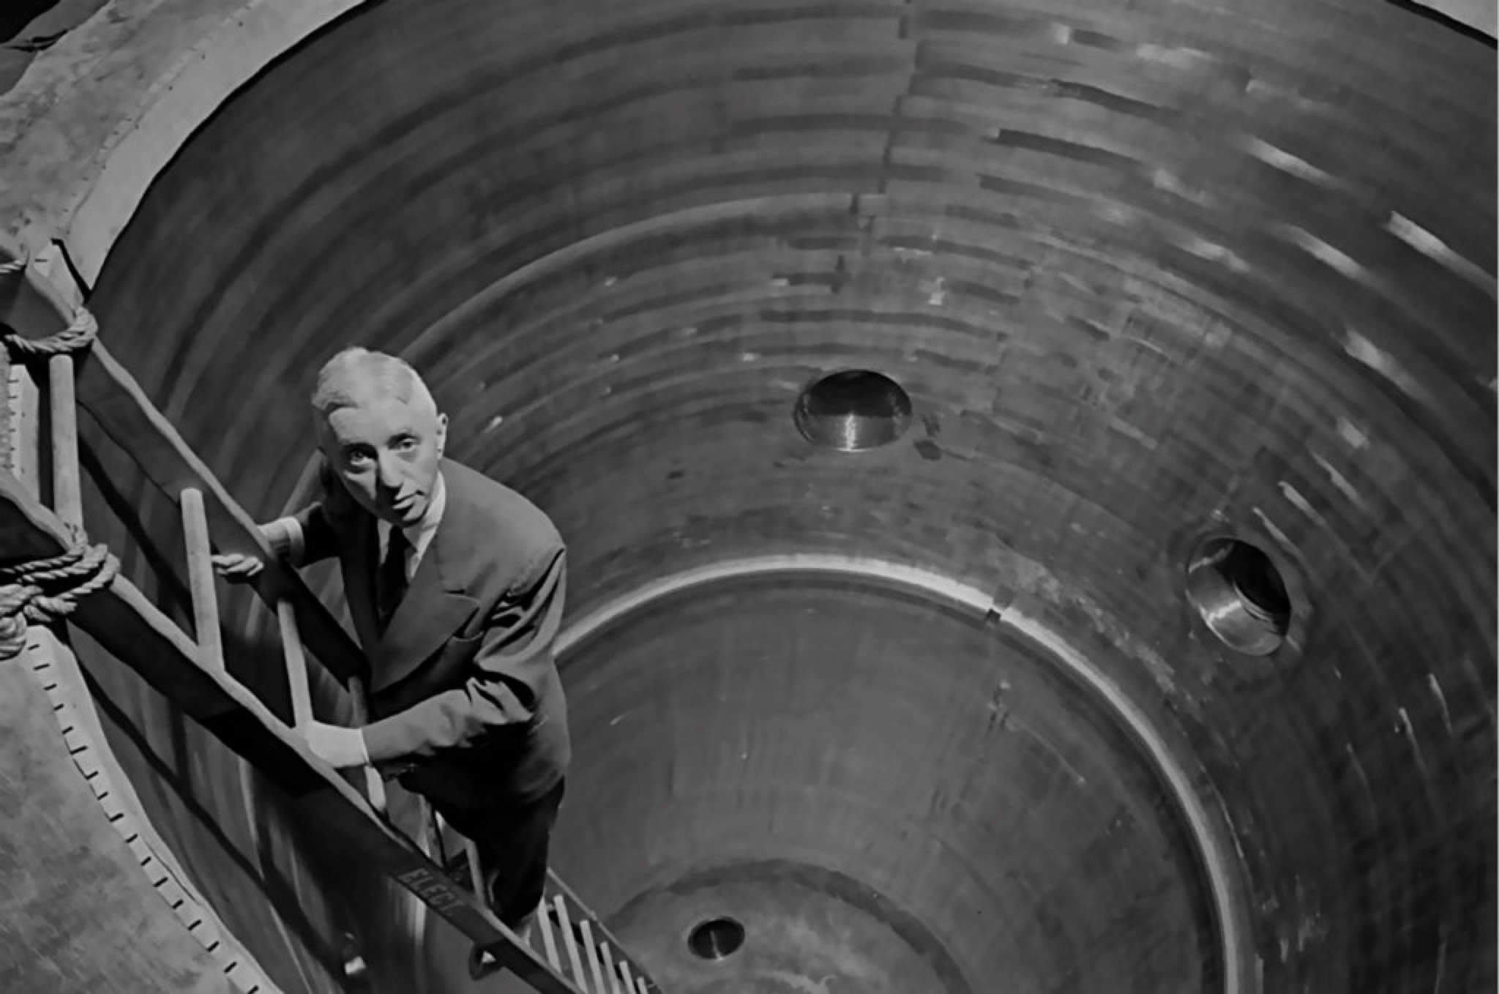
NUCLEAR NAVY
75 years without nuclear accident

Slide 12

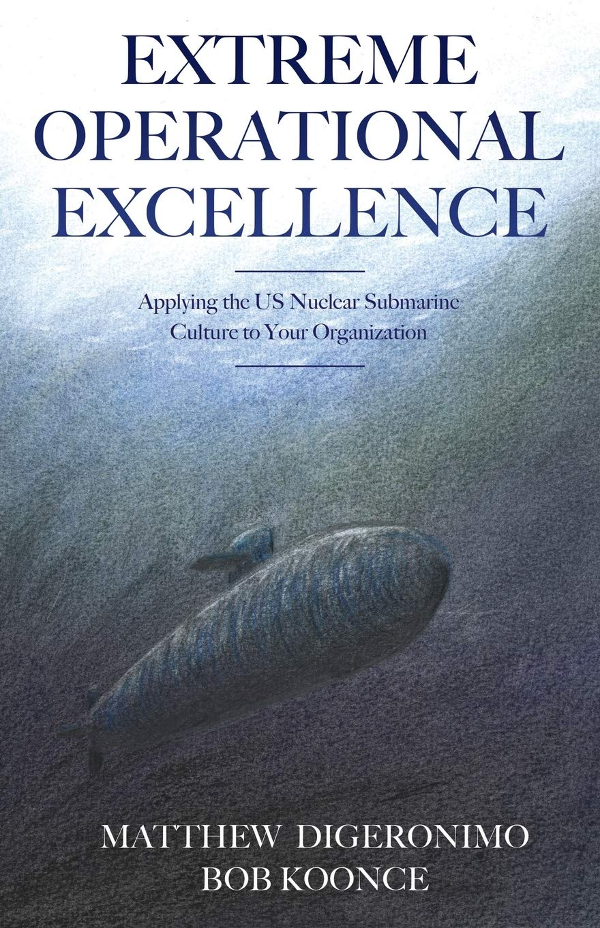

Background to the Pillars of High Reliability
The Rickover Effect (1946-1986)
“Lessons from the Nuclear Navy”
150+ nuclear power plants over 70+ years w/o incident
Organization Structure
Management System
Leadership: Filter & Focus
Organizational Integrity
HRO Culture

Slide 13
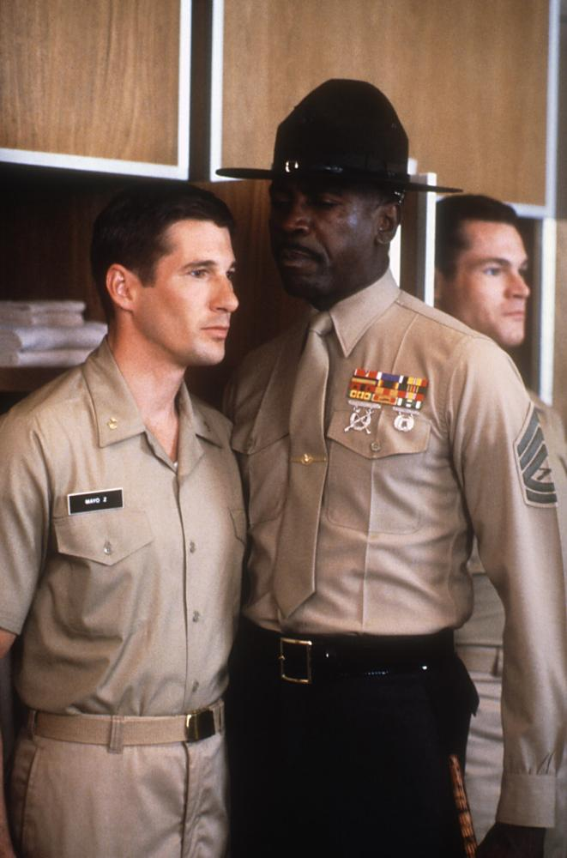

Culture Status Quo (Military, Healthcare?)
Follow orders
Do what you're told
Don’t ask questions
Never challenge superiors
Not forthcoming, situational

Slide 14
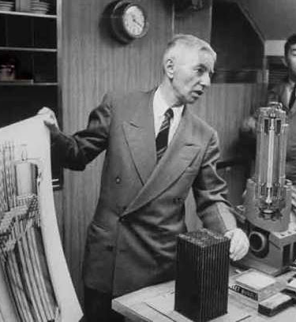

The Pillars
Higher level of understanding
Integrity (individual, organization)
Formality (procedure, communication)
Question when something is not right
Back each other up

Slide 15


