Slide 1


Are We Bloody Well Right?
Dustin J. Calhoun, MD FAEMS
Medical Director
Cincinnati Fire Department
Associate Professor
University of Cincinnati

Slide 2
What we know:
Blood is better than other fluid for hemorrhagic shock
Whole blood almost certainly has advantages over component therapy
There is time sensitivity to the intervention

Slide 3
What’s less certain:
The magnitude / cut off for the time sensitivity
Prehospital transfusion triggers
Cost / benefit analysis
How well does combat data apply to civilian EMS
How does this apply to non-traumatic hemorrhage
Notes:
-Cost benefit examples: surgeons, CTs, thrombolytics
-things that work in the hospital that aren’t proven to be needed in the field: TTM and ETTs
-non-traumatic hemorrhage is a different animal: lacks the coagulopathy inherent in trauma hemorrhage

Slide 4
Decision making
What does the science say directly?
Does it benefit patients?
What does the science say indirectly?
Should we implement prehospital blood ?
What blood product?
What triggers?
How many patients will we have?
Costs?
How will it be distributed?
Non-monetary / indirect costs?

Slide 5
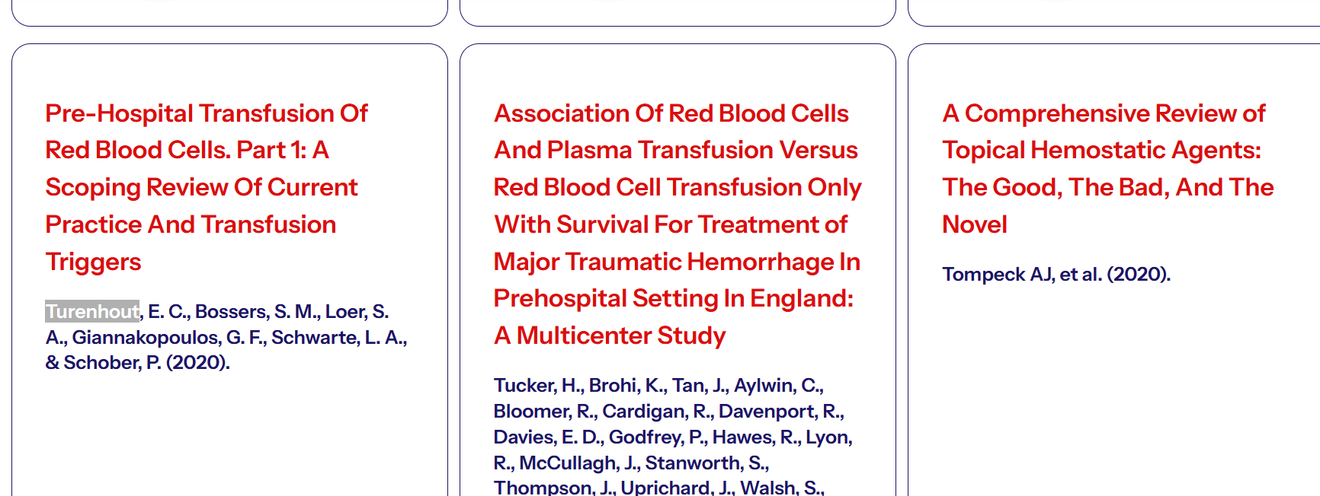
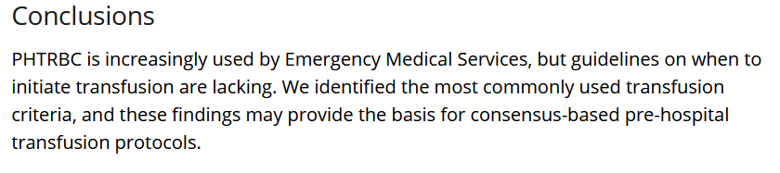
Notes:
Confirmation bias?

Slide 6
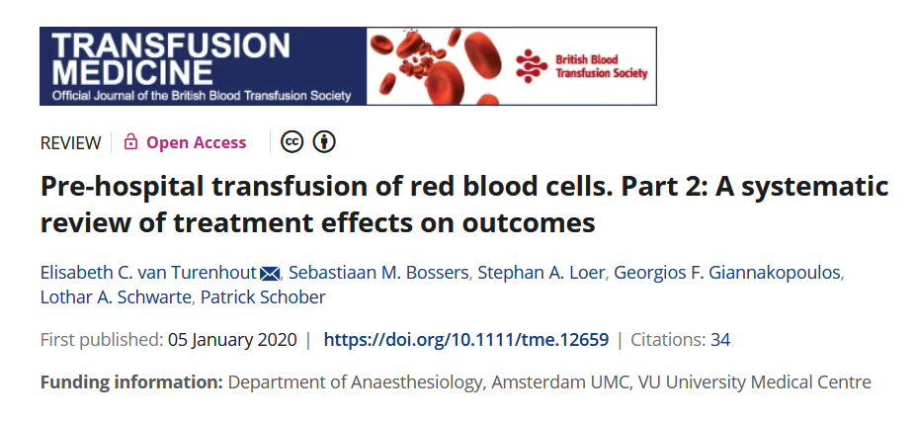
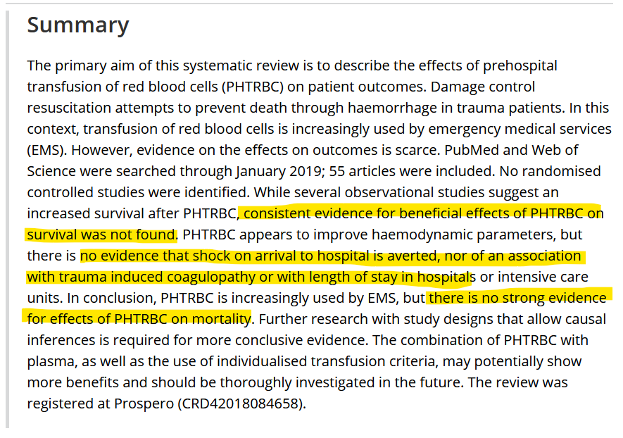

Slide 7
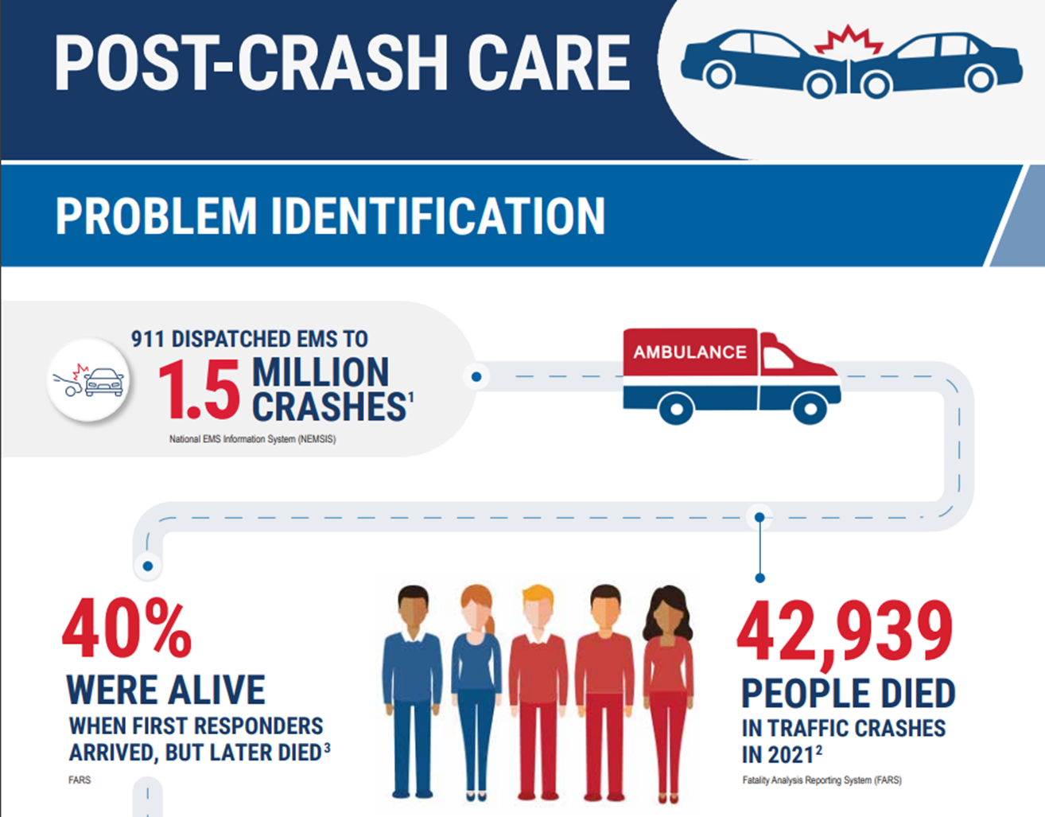
Notes:
This doesn’t equal “prehospital blood would lead to 17K lives saved”

Slide 8
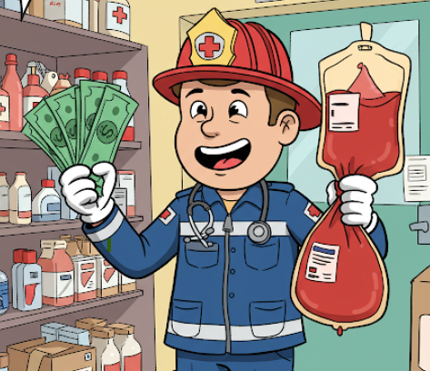
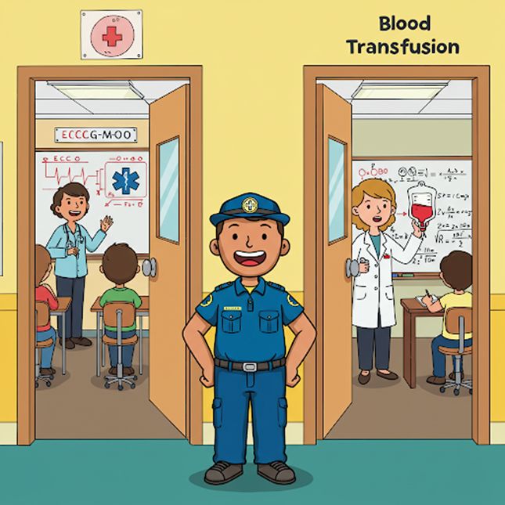
Costs
Financial:
In Cincinnati
Whole blood $475
PRBCs $230
Plasma $70
Opportunity:
Only 13-14% of blood donations can = LTOWB
Training trade-offs
Ops trade-offs
Notes:
Operational trade-offs: if ALS supers only apparatus with it…they get called all over….does that impact cardiac arrest care?

Slide 9
Is Plasma the Goldilocks of EMS Trauma Fluid?
Gruen, et al. Association of Prehospital Plasma With Survival in Patients With Traumatic Brain Injury: A Secondary Analysis of the PAMPer Cluster Randomized Clinical Trial. JAMA Network Open 2020.
Tucker, et al. Association of red blood cells and plasma transfusion versus red blood cell transfusion only with survival for treatment of major traumatic hemorrhage in prehospital setting in England: a multicenter study. Critical Care 2023.
Sperry, et al. Prehospital Plasma during Air Medical Transport in Trauma Patients at Risk for Hemorrhagic Shock. NEJM 2018.
Pusateri, et al. Association of Prehospital Plasma Transfusion With Survival in Trauma Patients With Hemorrhagic Shock When Transport Times Are Longer Than 20 MinutesA Post Hoc Analysis of the PAMPer and COMBAT Clinical Trials. JAMA Surg 2019.
Fujiwara, et al. High fresh frozen plasma to red blood cell ratio and survival outcomes in blunt trauma. JAMA Surg. 2024.

Slide 10
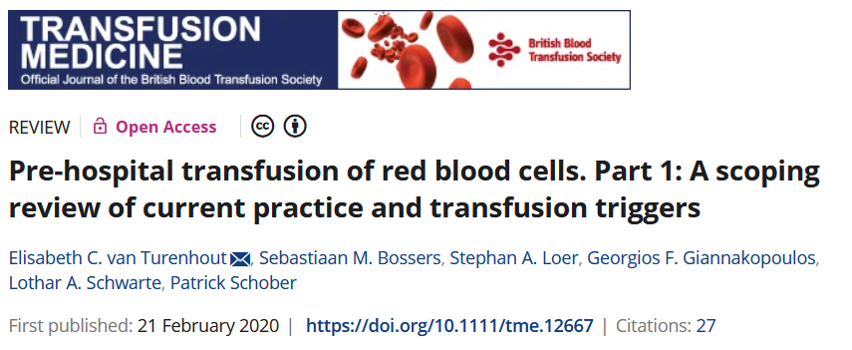
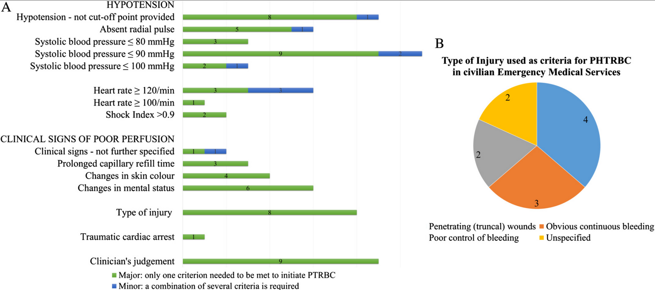
Notes:
Turenhout et al. Pre-hospital transfusion of red blood cells. Part 1: A scoping review of current practice and transfusion triggers. Transfusion Medicine 2020

Slide 11
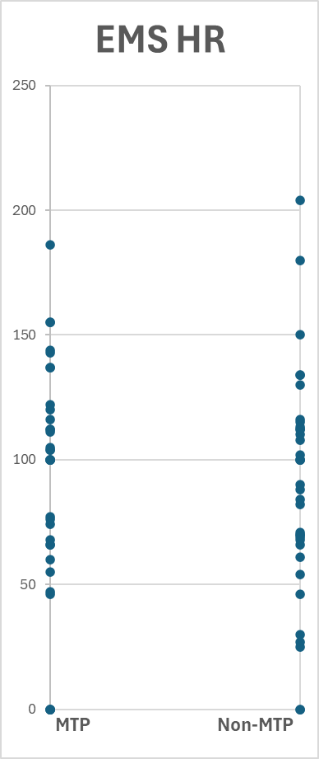
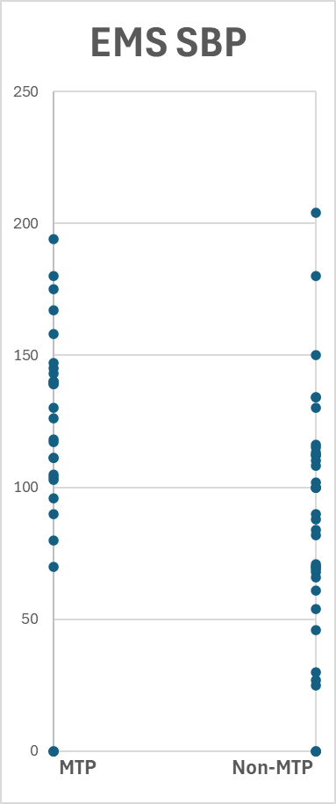
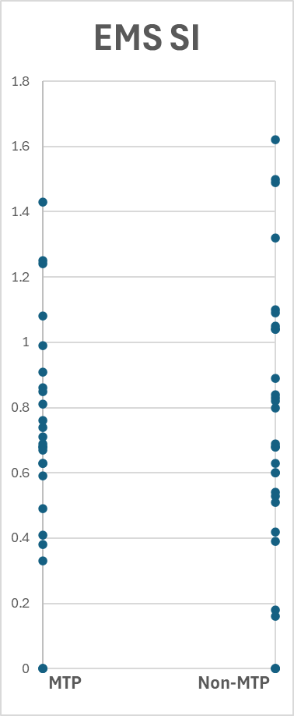
Notes:
May include a few who didn’t survive to hospital admission (out of ED)
Not adjusted for confounders such as other indicators of injury
No assessment of outcome
2024 UCMC trauma registry data

Slide 12
EMS Impression
Anemia
Cardiac tamponade
Epistaxis
Gastrointestinal hemorrhage
Gastrostomy hemorrhage
Hematemesis
Hematoma
Hemorrhage
Hemorrhagic shock
Hemothorax
Injury (and all the "injury of....")
Laceration (major)
Laceration/abrasion/hematoma
Leakage of vascular dialysis catheter
Melena
Postpartum hemorrhage
Spontaneous abortion
Tracheostomy hemorrhage
Traumatic circulatory arrest
Vaginal hemorrhage

Slide 13
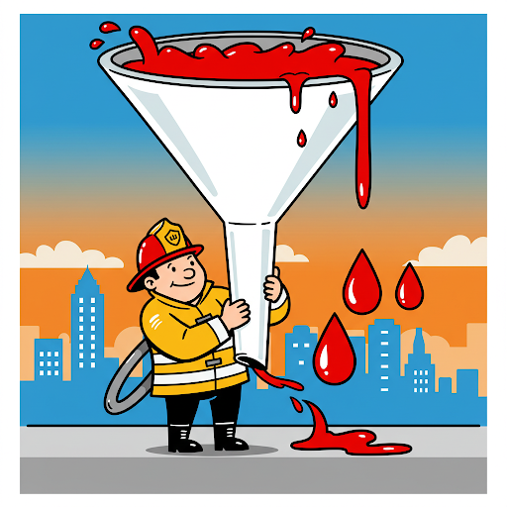

67,803
10,951
225
107
177
Notes:
Approx 10 min avg transport time

Slide 14
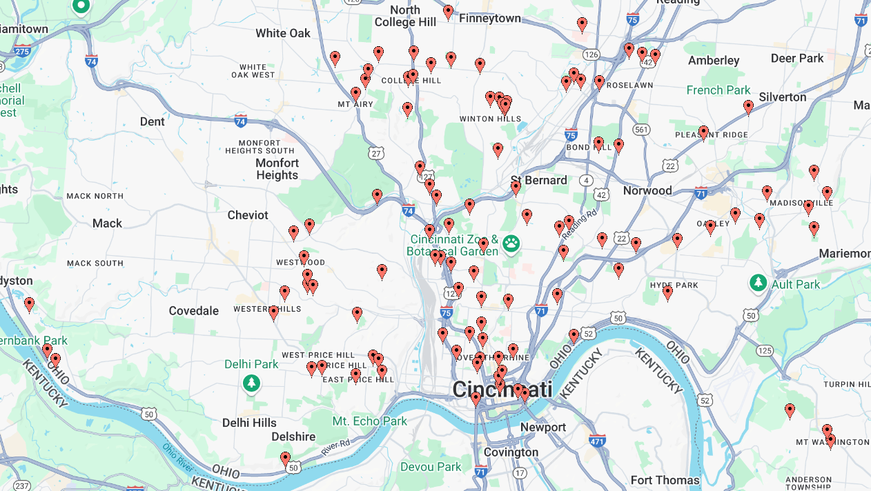


Slide 15
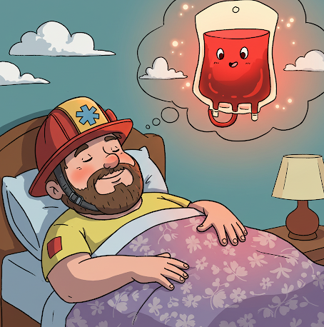
So what am I saying?
Ever-evolving literature
Do your research
Treat your program like research

Slide 16
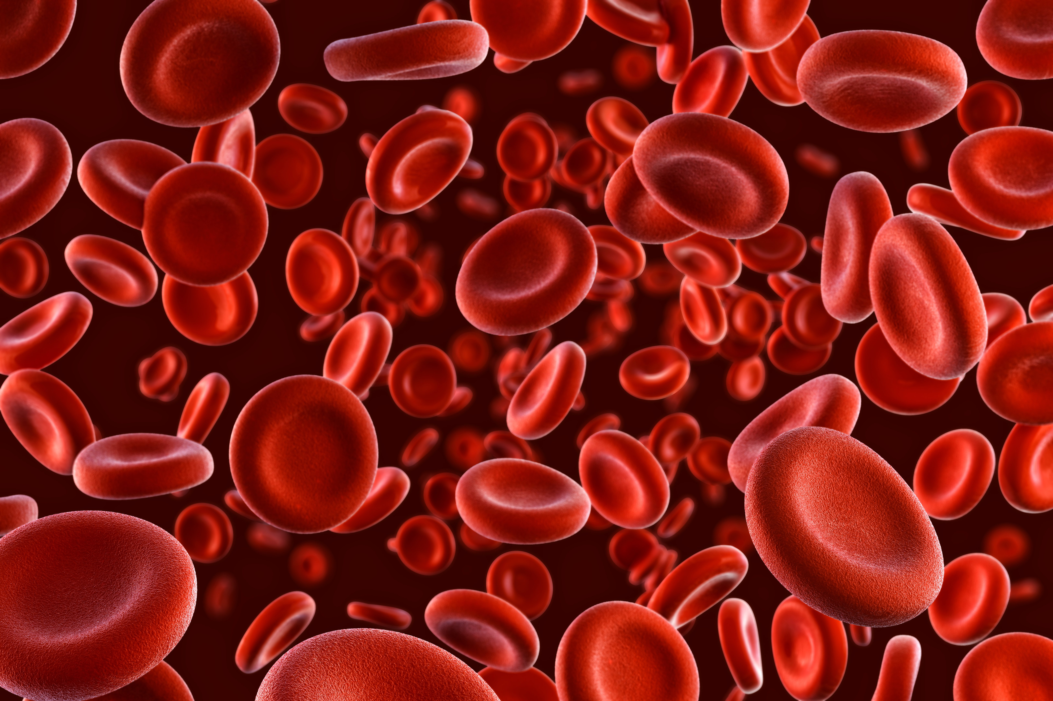
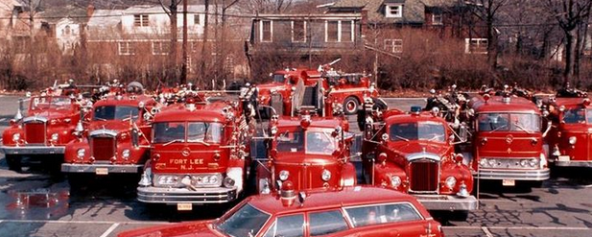
Coincidence?

Slide 17

Blood in the
Big Easy
Decreasing the Murder Rate in New Orleans
Where Minutes Matter
Meg Marino, MD – New Orleans EMS Director / Medical Director
Notes:
disclosures -

Slide 18
3 Years Later
>70 “Blood Medics”
Over 315 patients transfused
  Two units of pRBCs carried on rapid response “Sprint” SUVs - 2 per shift
  Ten additional units at EMS Headquarters
  24/7 ability to restock from The Blood Center
Updated age criteria to include 5-10 year-olds

Slide 19
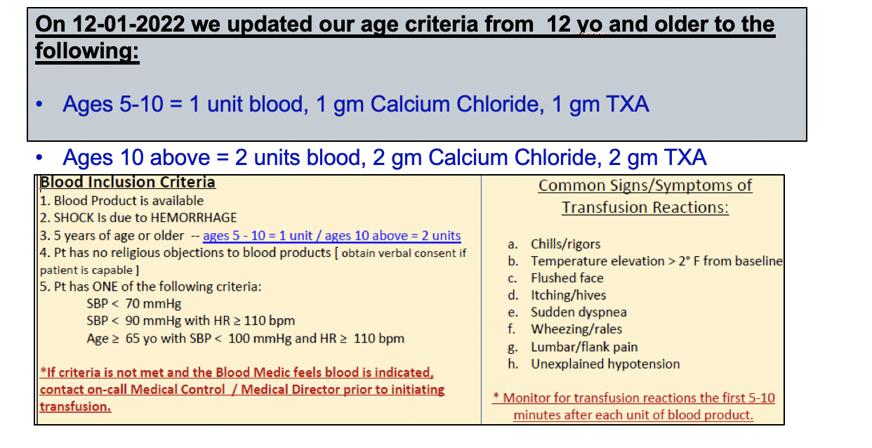
Is there an age requirement?

Slide 20
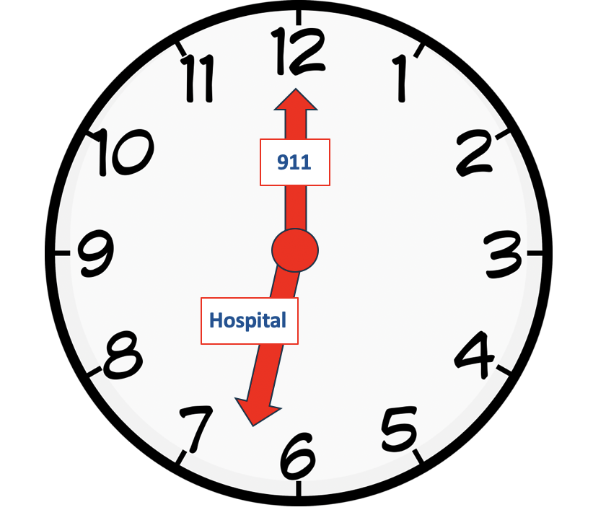
Time Matters
911 to patient contact: 14 min
Scene Time: 9 min
  Our average for all trauma patients
  No additional time needed
Transport: 10 min

Slide 21
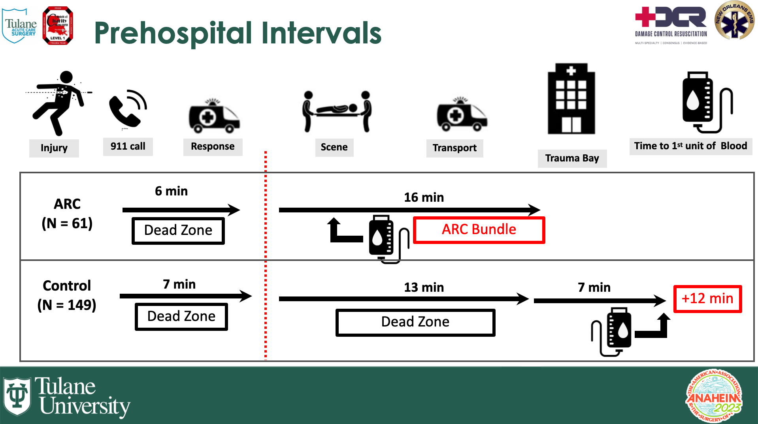

“Faster Refill in an Urban EMS System Saves Lives: A Prospective Preliminary Evaluation of a Prehospital Advanced Resuscitative Care Bundle”
The abstract, titled delves into the life-saving benefits of Advanced Resuscitative Care (ARC) in severe hemorrhage in urban EMS systems. The Tulane research demonstrated that the implementation of ARC—comprising TXA, packed RBCs, and Calcium — significantly reduced in-hospital mortality rates for trauma patients.

Slide 22
What are the common questions?
Why didn’t you use whole blood?
Whole blood was more expensive and could not be rotated with distributor
Whole blood would subtract from the community supply during COVID-19
Agreement with blood center to rotate supply

Slide 23
Murder Rate in Orleans Parish on the Decline
Murder (by gunshot) rate decreased by 62%
Number of Shootings down by 32%
Effect of awesome prehospital trauma care on murder (by gunshot) rate
30%

Slide 24
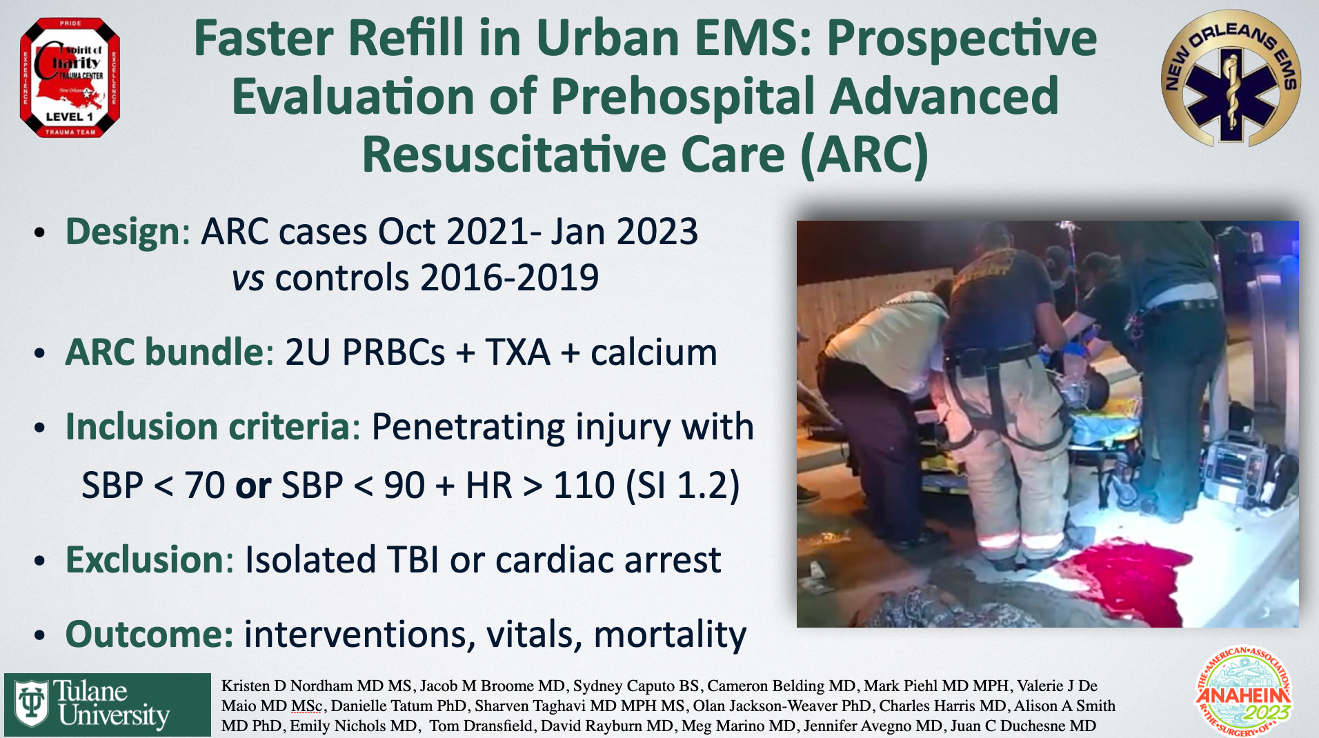
“Faster Refill in an Urban EMS System Saves Lives: A Prospective Preliminary Evaluation of a Prehospital Advanced Resuscitative Care Bundle”
The abstract, titled delves into the life-saving benefits of Advanced Resuscitative Care (ARC) in severe hemorrhage in urban EMS systems. The Tulane research demonstrated that the implementation of ARC—comprising TXA, packed RBCs, and Calcium — significantly reduced in-hospital mortality rates for trauma patients.

Slide 25
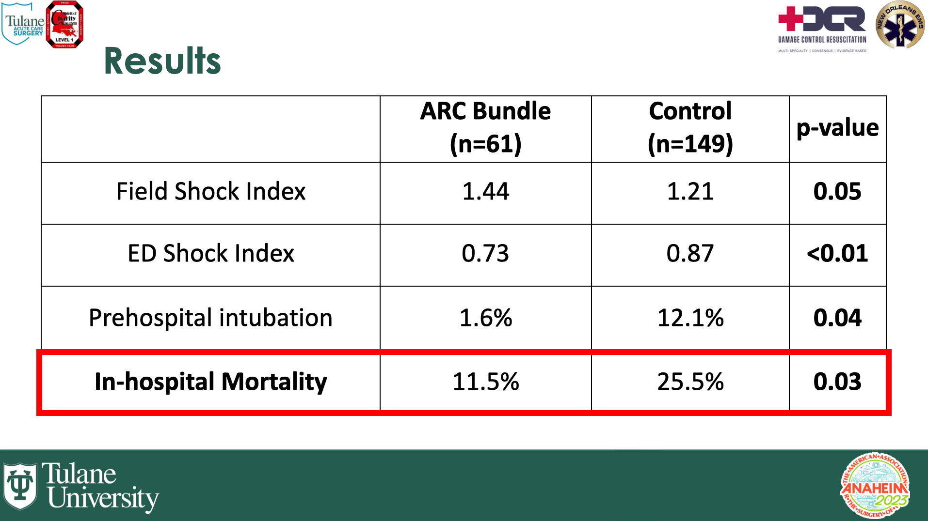
“Faster Refill in an Urban EMS System Saves Lives: A Prospective Preliminary Evaluation of a Prehospital Advanced Resuscitative Care Bundle”
The abstract, titled delves into the life-saving benefits of Advanced Resuscitative Care (ARC) in severe hemorrhage in urban EMS systems. The Tulane research demonstrated that the implementation of ARC—comprising TXA, packed RBCs, and Calcium — significantly reduced in-hospital mortality rates for trauma patients.

Slide 26

Time is of the essence
For every minute that blood is delayed the mortality increases by 11 %

