Slide 1




Clear expectations and repercussions for noncompletion
Standard education schedule
beweston@mcw.edu
+
=
Day 1 Education assigned
Day 30 Education due
Day 31 Overdue reminder
Day 50 Notice to clinician and chief
Day 60 Clinician suspension of privileges

Slide 2
Continued Competence

Slide 3
This model suggested in this document will address two primary areas of concern. The first is competence, which is a measure of minimum proficiency of EMS providers’ knowledge and skills. The second is ongoing education, which is designed to assure that the EMS provider obtain “new” knowledge and skills as we maintain prior knowledge and skills. Underlying the model is the suggestion that credentialing agencies expand the number and types of mechanisms through which a provider can demonstrate competence.
p. 11
Notes:
1999

Slide 4

EMS continuing education and Continued Competency assurance are integral parts of a comprehensive educational system but are not addressed in this document. A similar systems approach to continuing education and Continued Competency assurance in EMS should be developed.​
p. 20​
Notes:
2000

Slide 5
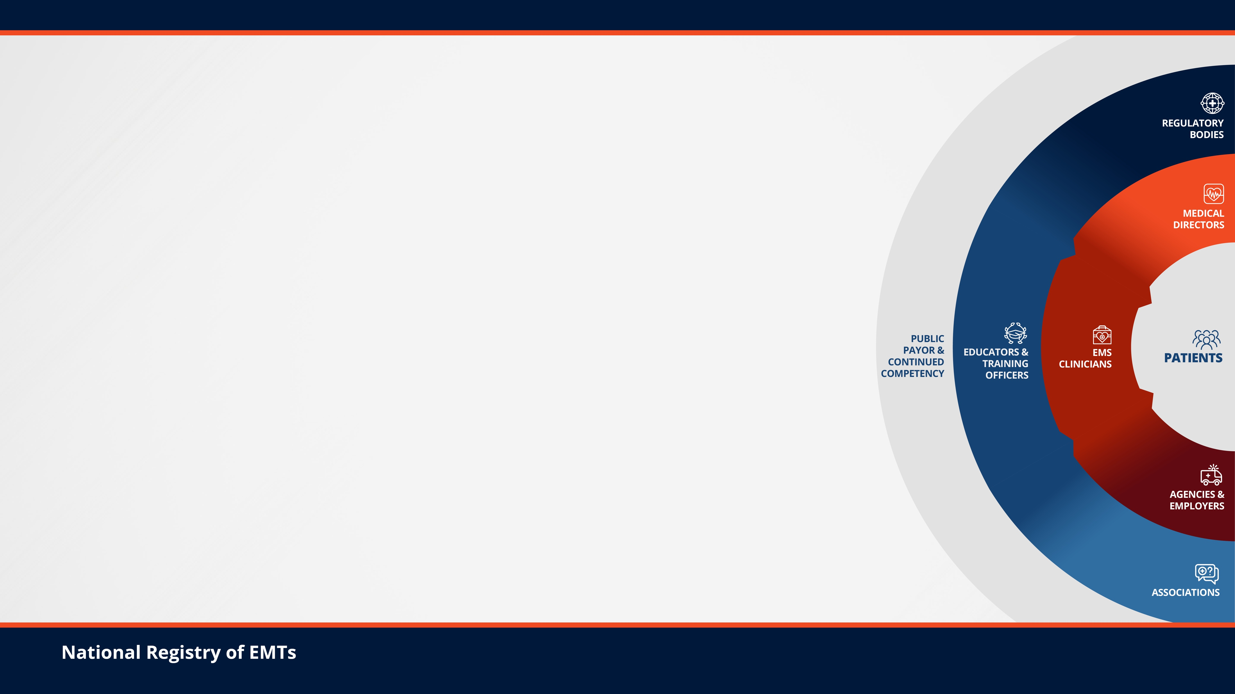
Emergency Medical Services
CONTINUED COMPETENCE AGENDA
FOR THE FUTURE:
A Systems Approach

Slide 6




















Agenda Steering Committee​

Slide 7
Continued Competency
As defined by the Steering Committee in 2021
“The ability to provide service; including, but not limited to patient care, at specified levels of knowledge and skill, not only at the time of initial certification, but throughout the individual’s EMS career. Continued Competency builds on the foundation of maintaining entry level competency as the profession of EMS has advanced since entering the profession. Continued Competency demonstrates lifelong learning and continued professional development.” ​

Slide 8
Why Now?
The current method is too complex
  Licensure periods vary from 2 to 5 years
  No. of CEUs varies from 12 to 28.8 per year of licensure
No consideration of on-the-job performance
  If you have already treated XXX calls of insert call type and it is signed off as being quality care, do you need to have your butt in the seat for CEU on that topic
No consideration of changes in technology
  Can a low stakes app on your phone provide required education
Not a systems approach
The concept of hours needs to be replaced with credits

Slide 9
Airway (BLS) – 1 credit for every ten procedures performed
  Airway opened
  BVM
  LMA
  Oral airway
Preparatory (Paramedic and AEMT) – 1 credit for every 10 IVs inserted

Slide 10
Systems Approach

Slide 11
Questions that Have to Be Answered
How many of a call type to prove continued competency?
Can this be automated through the ePCR vendors?
How long should the certification/licensure period be?
How do we ensure education is on the newest advancements?

Slide 12
Questions? gilmorew@stlouis-mo.gov
Thank You!

