Slide 1



Resuscitating Resuscitation with Resuscitation Centers
Randy S. Katz, DO, MBA, FACEP
District Medical Director emergency services
Memorial Healthcare system city of Hollywood fire rescue

Slide 2
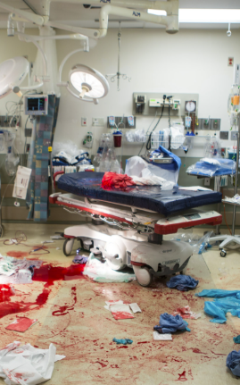
Would you ever?
Take a multi-system trauma patient to the closest hospital?
Take a debilitated stroke patient to the closest hospital?
Take a STEMI patient to the closest hospital?
Where do you take cardiac arrest patients?

Slide 3

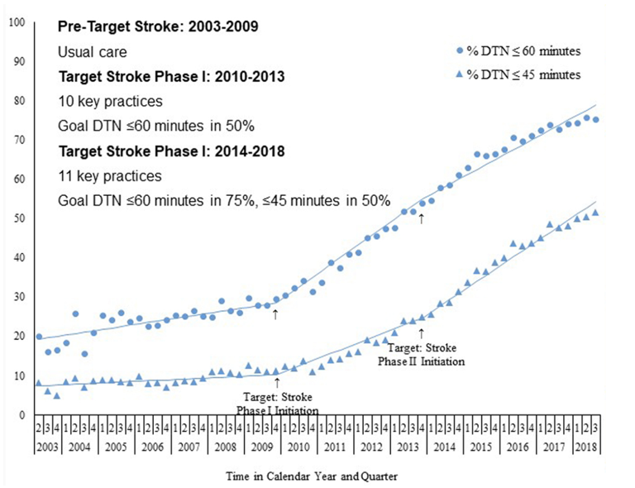
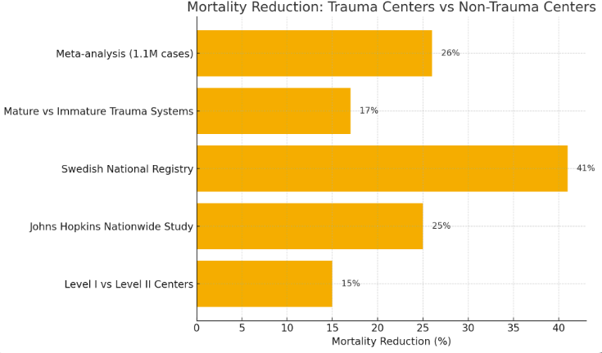
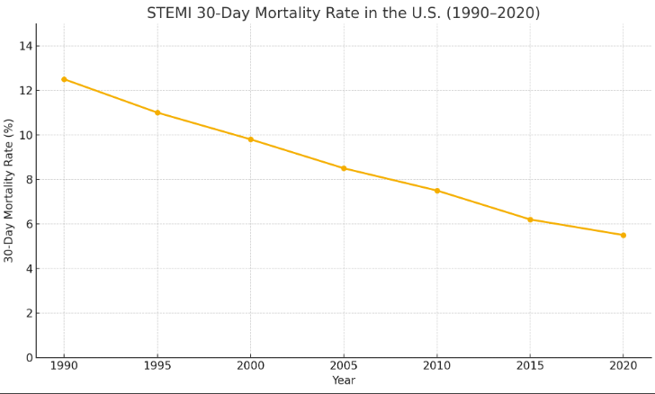

Slide 4
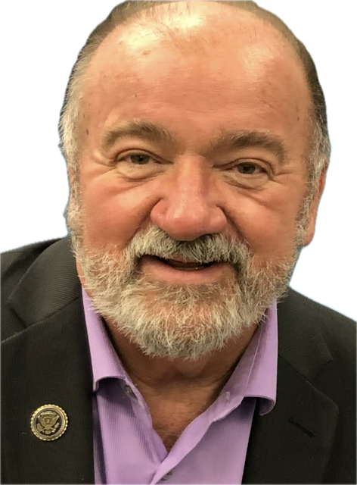

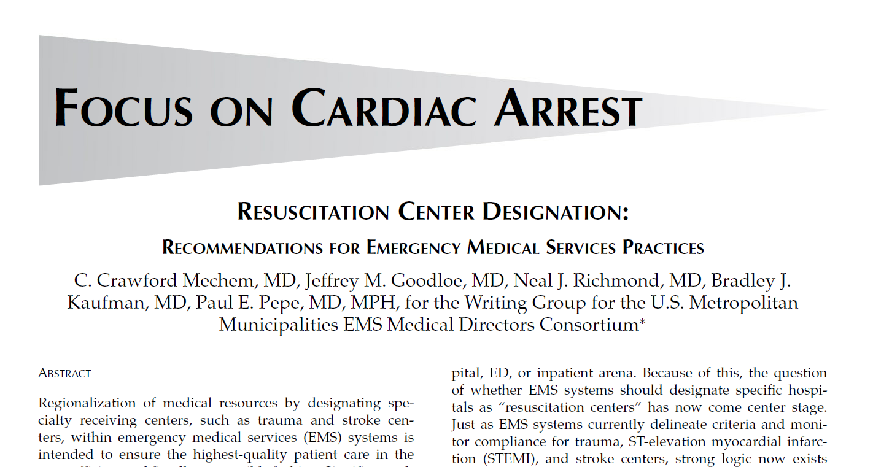
Mechem, et al. Prehospital Emergency Care, 2010

Slide 5
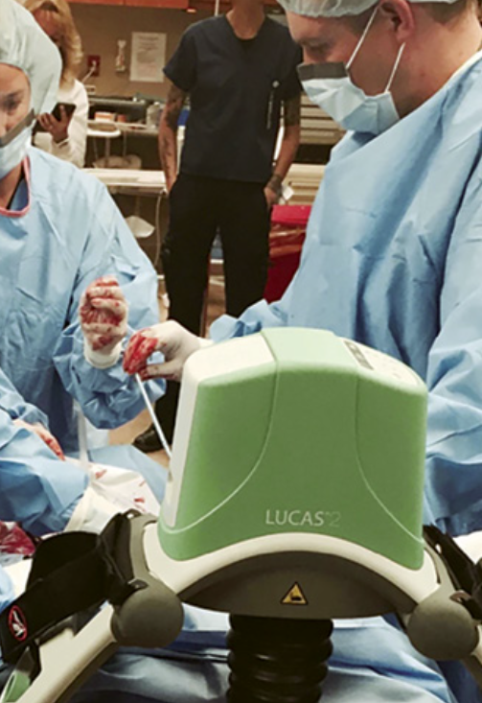
Why does it matter?
> 350,000 Patients Annually
Survival < 10%
“Practice Makes Perfect” – Volume Matters
Evidence-Based, Standardized Care
Accountability & Data Transparency
Support Infrastructure - ED, CVICU & Recovery
Centers of Research
Community Education & Outreach

Slide 6
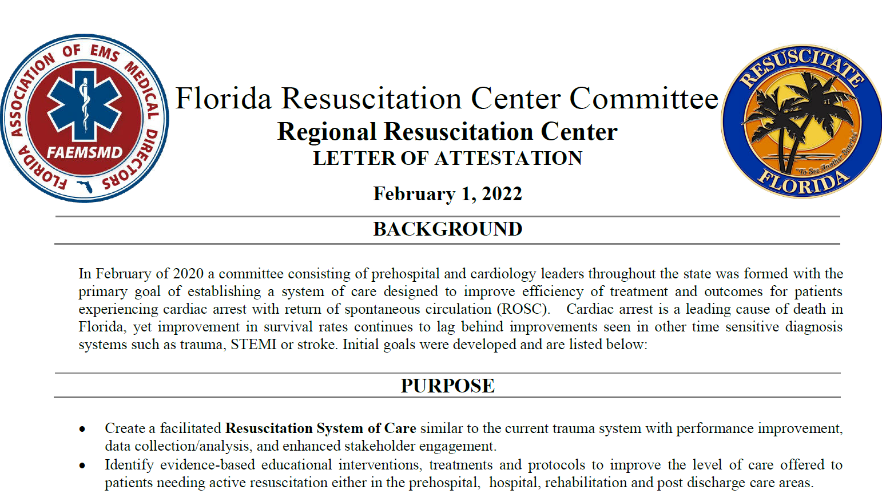
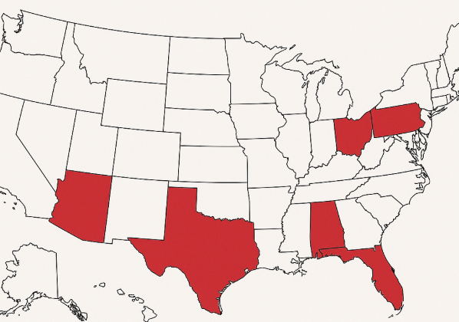

Slide 7
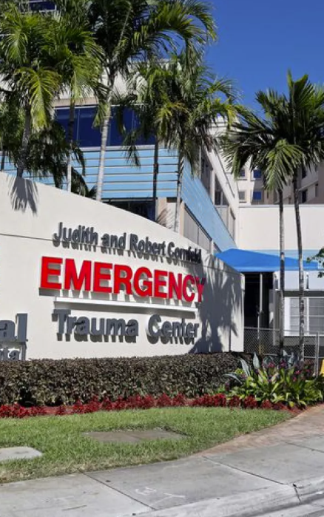
RESUSCITATION CENTER CRITERIA
Primary: Bundle of Care, TOR protocol, Interventional Cardiology, Neurologic Prognostication, Daily EEG, TTM, Mandatory CARES reporting, Multi-disciplinary team.
Comprehensive: All Primary Requirements + 24/7 CVICU coverage, Mechanical Circulatory Support (E-CPR), Neuro-Critical Care, Research and Community Education Program.

Slide 8

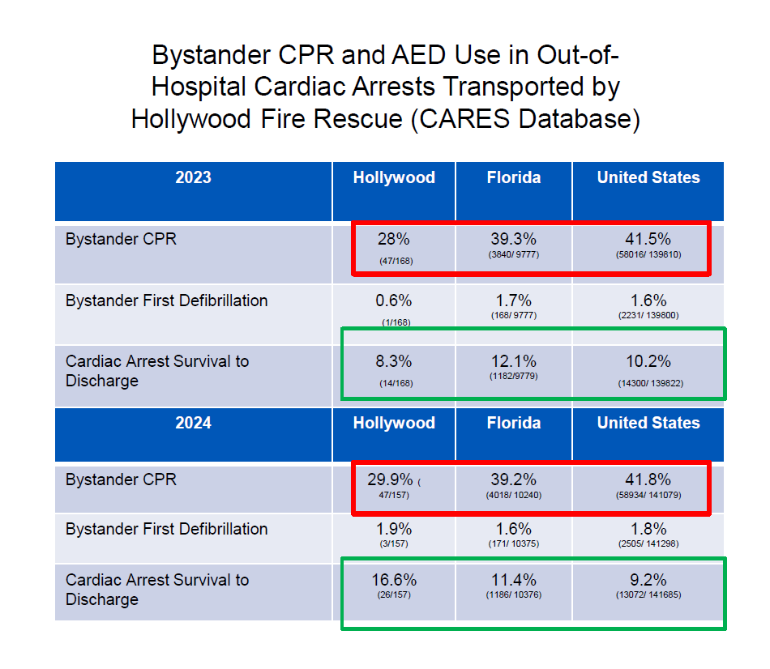

Slide 9

THE ROAD AHEAD
Develop National Standards
Accreditation and Designation
Distance Matters
Cost Considerations

Slide 10
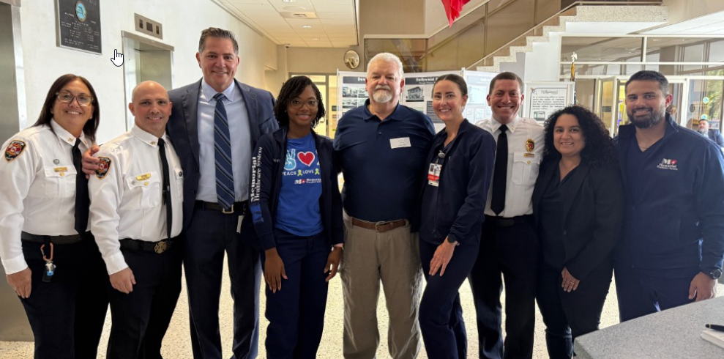

Slide 11
THANK YOU
Randy S. Katz, DO, MBA, FACEP
Rkatz@mhs.net

