Slide 1

Better Production from Our Instruction: How Should We Educate Our Educators?
  Professional Development Assessment & Training in Collaboration with The University of Memphis Adult Education School
Notes:
understand the overall instructional design of the courses and have opportunity to observe/shadow seasoned instructors before teaching their first class. The objective of onboarding is not simply the transfer of information, but more importantly, is a venue for communicating the core learning culture of the Training Academy, including values and expectations. It would provide orientation to the position expectations, preparation for effective teaching and instructor development, and a greater sense of connection to the Training Academy.
Guess who can help you develop this?

Slide 2
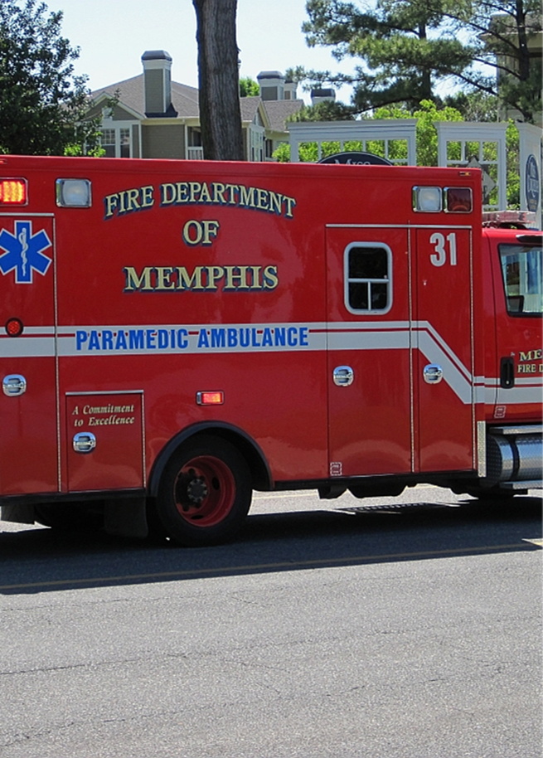
What did we learn?
Agency Types and Needs
Travel, Housing, services and amenities
Notes:
understand the overall instructional design of the courses and have opportunity to observe/shadow seasoned instructors before teaching their first class. The objective of onboarding is not simply the transfer of information, but more importantly, is a venue for communicating the core learning culture of the Training Academy, including values and expectations. It would provide orientation to the position expectations, preparation for effective teaching and instructor development, and a greater sense of connection to the Training Academy.
Guess who can help you develop this?

Slide 3
What do we need?
Desired Campus Features
How important are the following features for a regional training campus?
Classrooms for training and continuing education
Simulation spaces (e.g., mock buildings, street scenes)
Indoor drone training area
Elevator rescue training capabilities
Stairwell search/rescue training
Audio-visual systems for after-action review
Isolated team training for communication testing
Secure storage for agency training equipment
Multi-agency coordination space
Outdoor exercise/training grounds
Notes:
understand the overall instructional design of the courses and have opportunity to observe/shadow seasoned instructors before teaching their first class. The objective of onboarding is not simply the transfer of information, but more importantly, is a venue for communicating the core learning culture of the Training Academy, including values and expectations. It would provide orientation to the position expectations, preparation for effective teaching and instructor development, and a greater sense of connection to the Training Academy.
Guess who can help you develop this?

Slide 4
What’s the commitment?
Support & Partnerships
Would your agency be willing to contribute to the campus in any of the following ways?
Providing instructors
Sharing equipment
Financial contribution
Participating in advisory committees
Donating materials or labor
Other (please specify): ____________
Notes:
What does this mean? Borrowed language of higher ed, this means academic support
Currently extra-curricular academic support is provided informally and sporadically by instructors as time permits. Transition this activity to a formal, scheduled offering and explore the development of a volunteer mentoring program to provide this service. Academic support could also be provided pre-emptively through summer bridge/summer academy styled programs that help potential Training Academy students to learn about the position and gain basic foundational skills needed to successfully complete the courses and be effective in the position of EMS provider. This could include foundational reading and math skills.
Guess who can help you develop this?

Slide 5
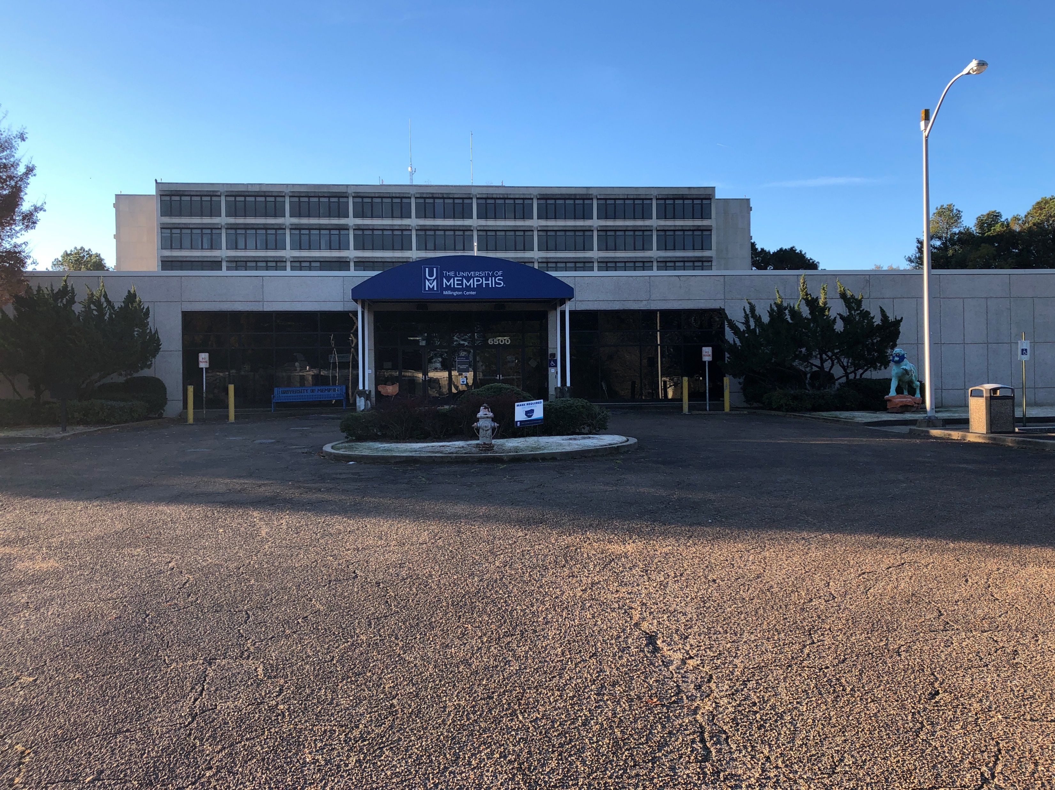
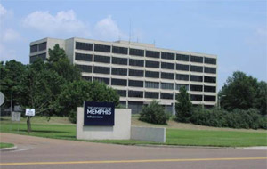
The Opportunity
Notes:
Literacy Mid-South facilitates access to literacy across the lifespan and has been helping learners of all ages for fifty years. Partnering with this organization will help to connect MFD recruits struggling with literacy with resources to help them achieve their learning goals. A partnership between the MFD and Literacy Mid-South could help infuse the Academy with the skills and experience to embed literacy strategies throughout the curriculum. This type of supports benefits all learners.
Guess who can help you develop this?

Slide 6
What are the needs?
Classrooms for training and continuing education
Simulation spaces (e.g., mock buildings, street scenes)
Indoor drone training area
Elevator rescue training capabilities
Stairwell search/rescue training
Audio-visual systems for after-action review
Isolated team training for communication testing
Secure storage for agency training equipment
Multi-agency coordination space
Outdoor exercise/training grounds
Notes:
Combining these two recommendations as they are related. Wrap-around student services is a term that encompasses both academic support and other types of supports adult learners need. All learners need supports, adult learners need specific types of supports. We recommend supports informed by data from our CAM, targeted for academy learners.
Inst
Professional development support: Understanding and acclimating to fire/EMS profession, leadership skills, and development. This support could be developed and offered in tandem with academic support possibly provided by volunteer mentors from the EMS workforce or University of Memphis education students seeking volunteer experiences.
Personal support: Navigating work/school - life balance. Each generation of learners presents unique challenges for educators. How they learn may be different than how their instructors learned and shifts in economic and social spheres may result in learning challenges as well. Technological advances and societal circumstances among other factors shape this and result in learners being in need of basic life skills and counseling. A life coach would be ideal for helping them to navigate their personal life and prioritize wellness. The University of Memphis offers programs in education and counseling. Often these programs offer externships or credit for volunteering to their students. Tapping into community resources like this could provide a way to meet the learners where they are while building competency in the classroom. Everyday life supports for learners as well as EMS professionals helps with retention. Organizations that demonstrate that they care about their employees have less turn over and higher job satisfaction.
Transportation assistance: Exploring transportation options. Memphis is a large geographic area and is not well-served by its public transportation system. Due to the location of the Academy, it is not feasible to expect recruits to rely on MATA as a primary or secondary means of support. A consideration of a wrap-around student support service for Training Academy context includes developing feasible solutions such as organizing car-pool/ride shares or raising funds to reimburse students for taxi/Uber services.
Flexible learning options: Explore hybrid options for content delivery and classroom learning. We recommend a variation of flipped classrooms. In a flipped classroom, learners engage with new content outside of the classroom—usually through videos, readings, or interactive online tools—and then use classroom time for hands-on activities, discussions, and problem-solving. For example, learners might watch a video lecture before class and then work on group projects or case studies during class to apply the material. This approach helps adult learners by giving them control over the pace of learning. It also makes classroom time more interactive and engaging. This method supports adult learners who often prefer practical, real-world applications of knowledge.

Slide 7
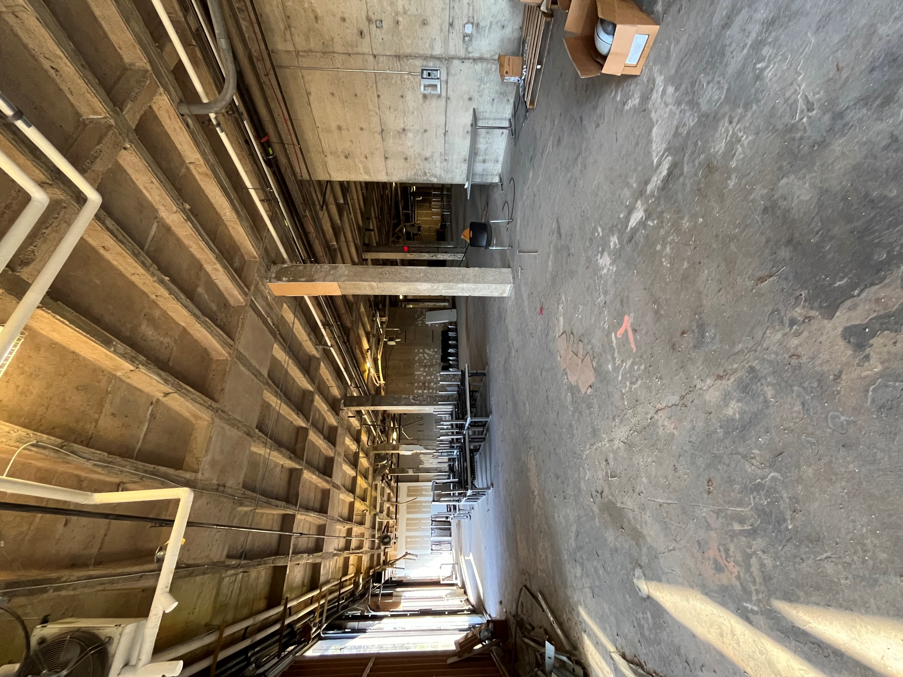
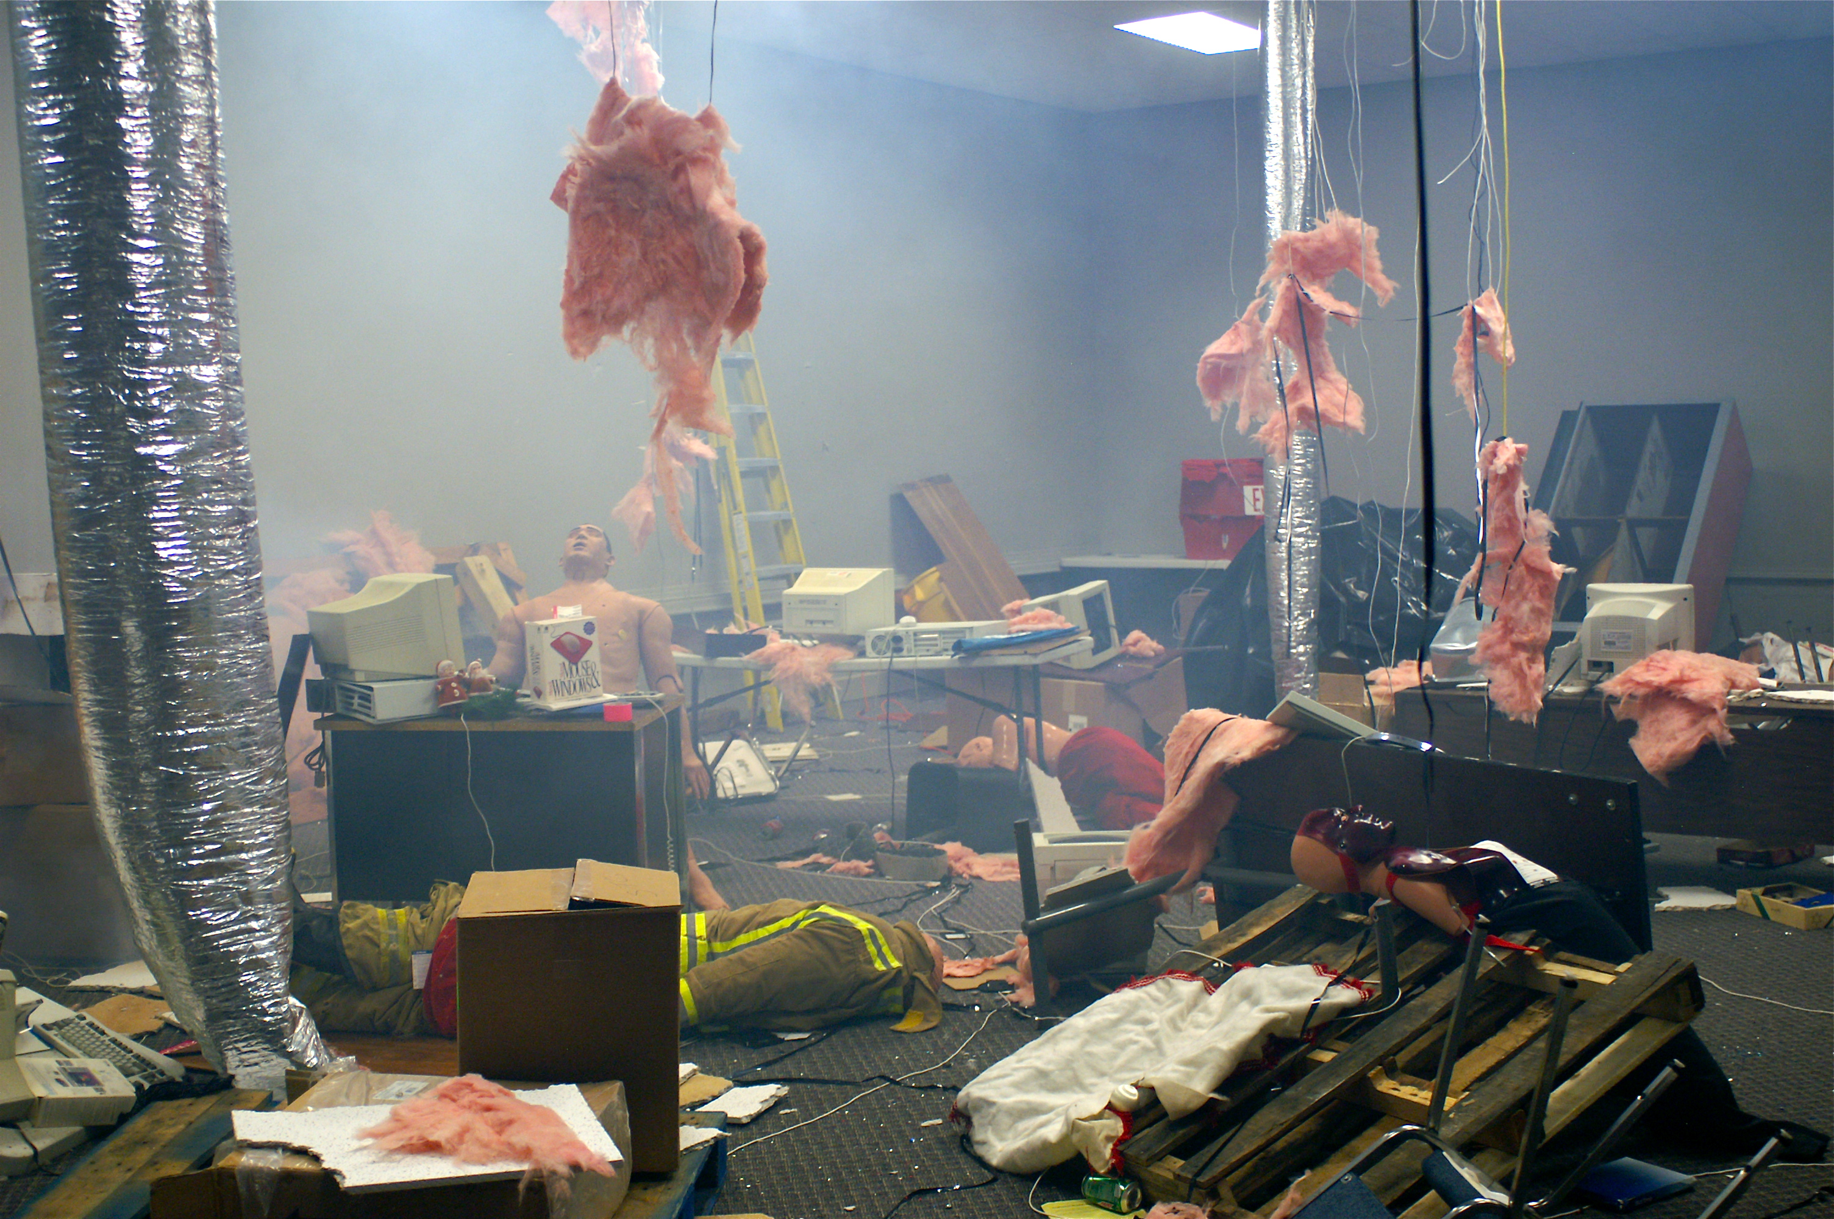
What did we do?
Notes:
let folks read this on their own

Slide 8
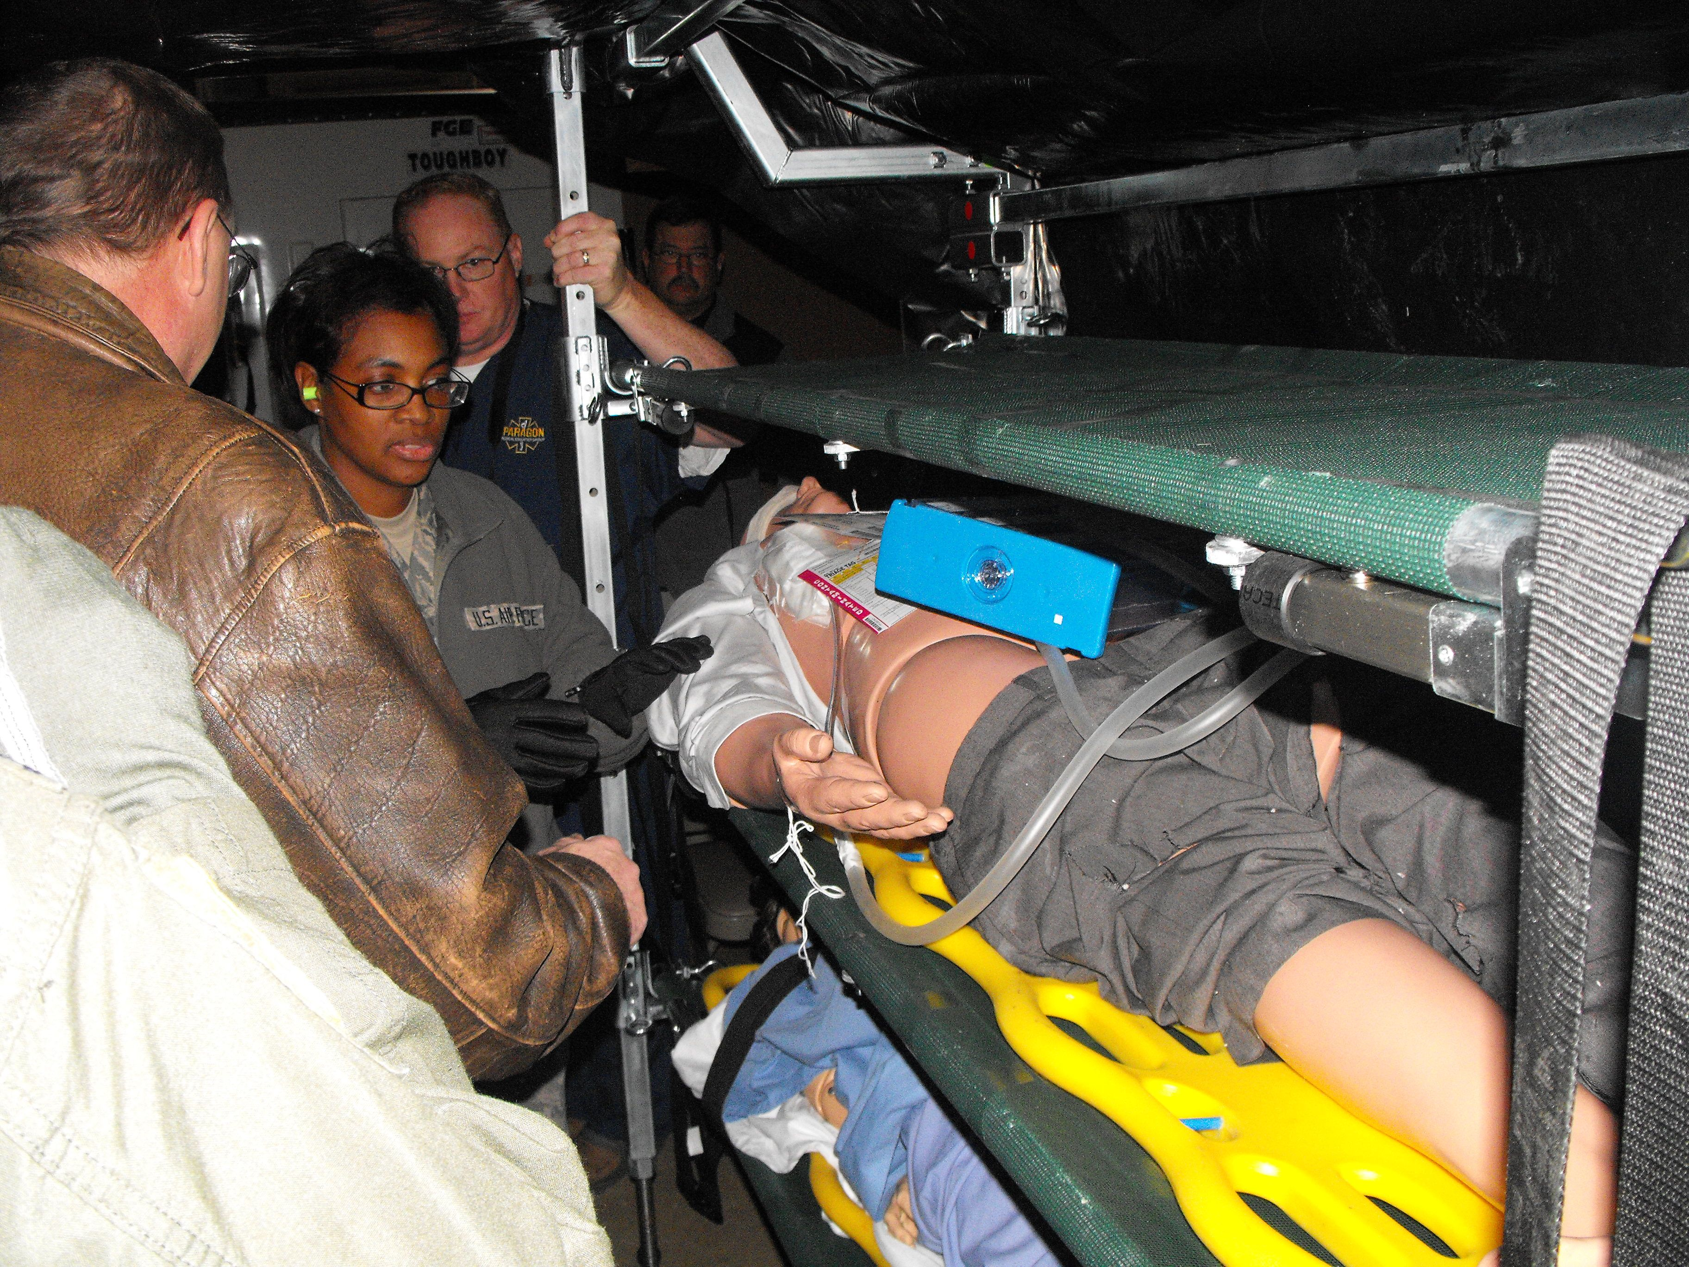
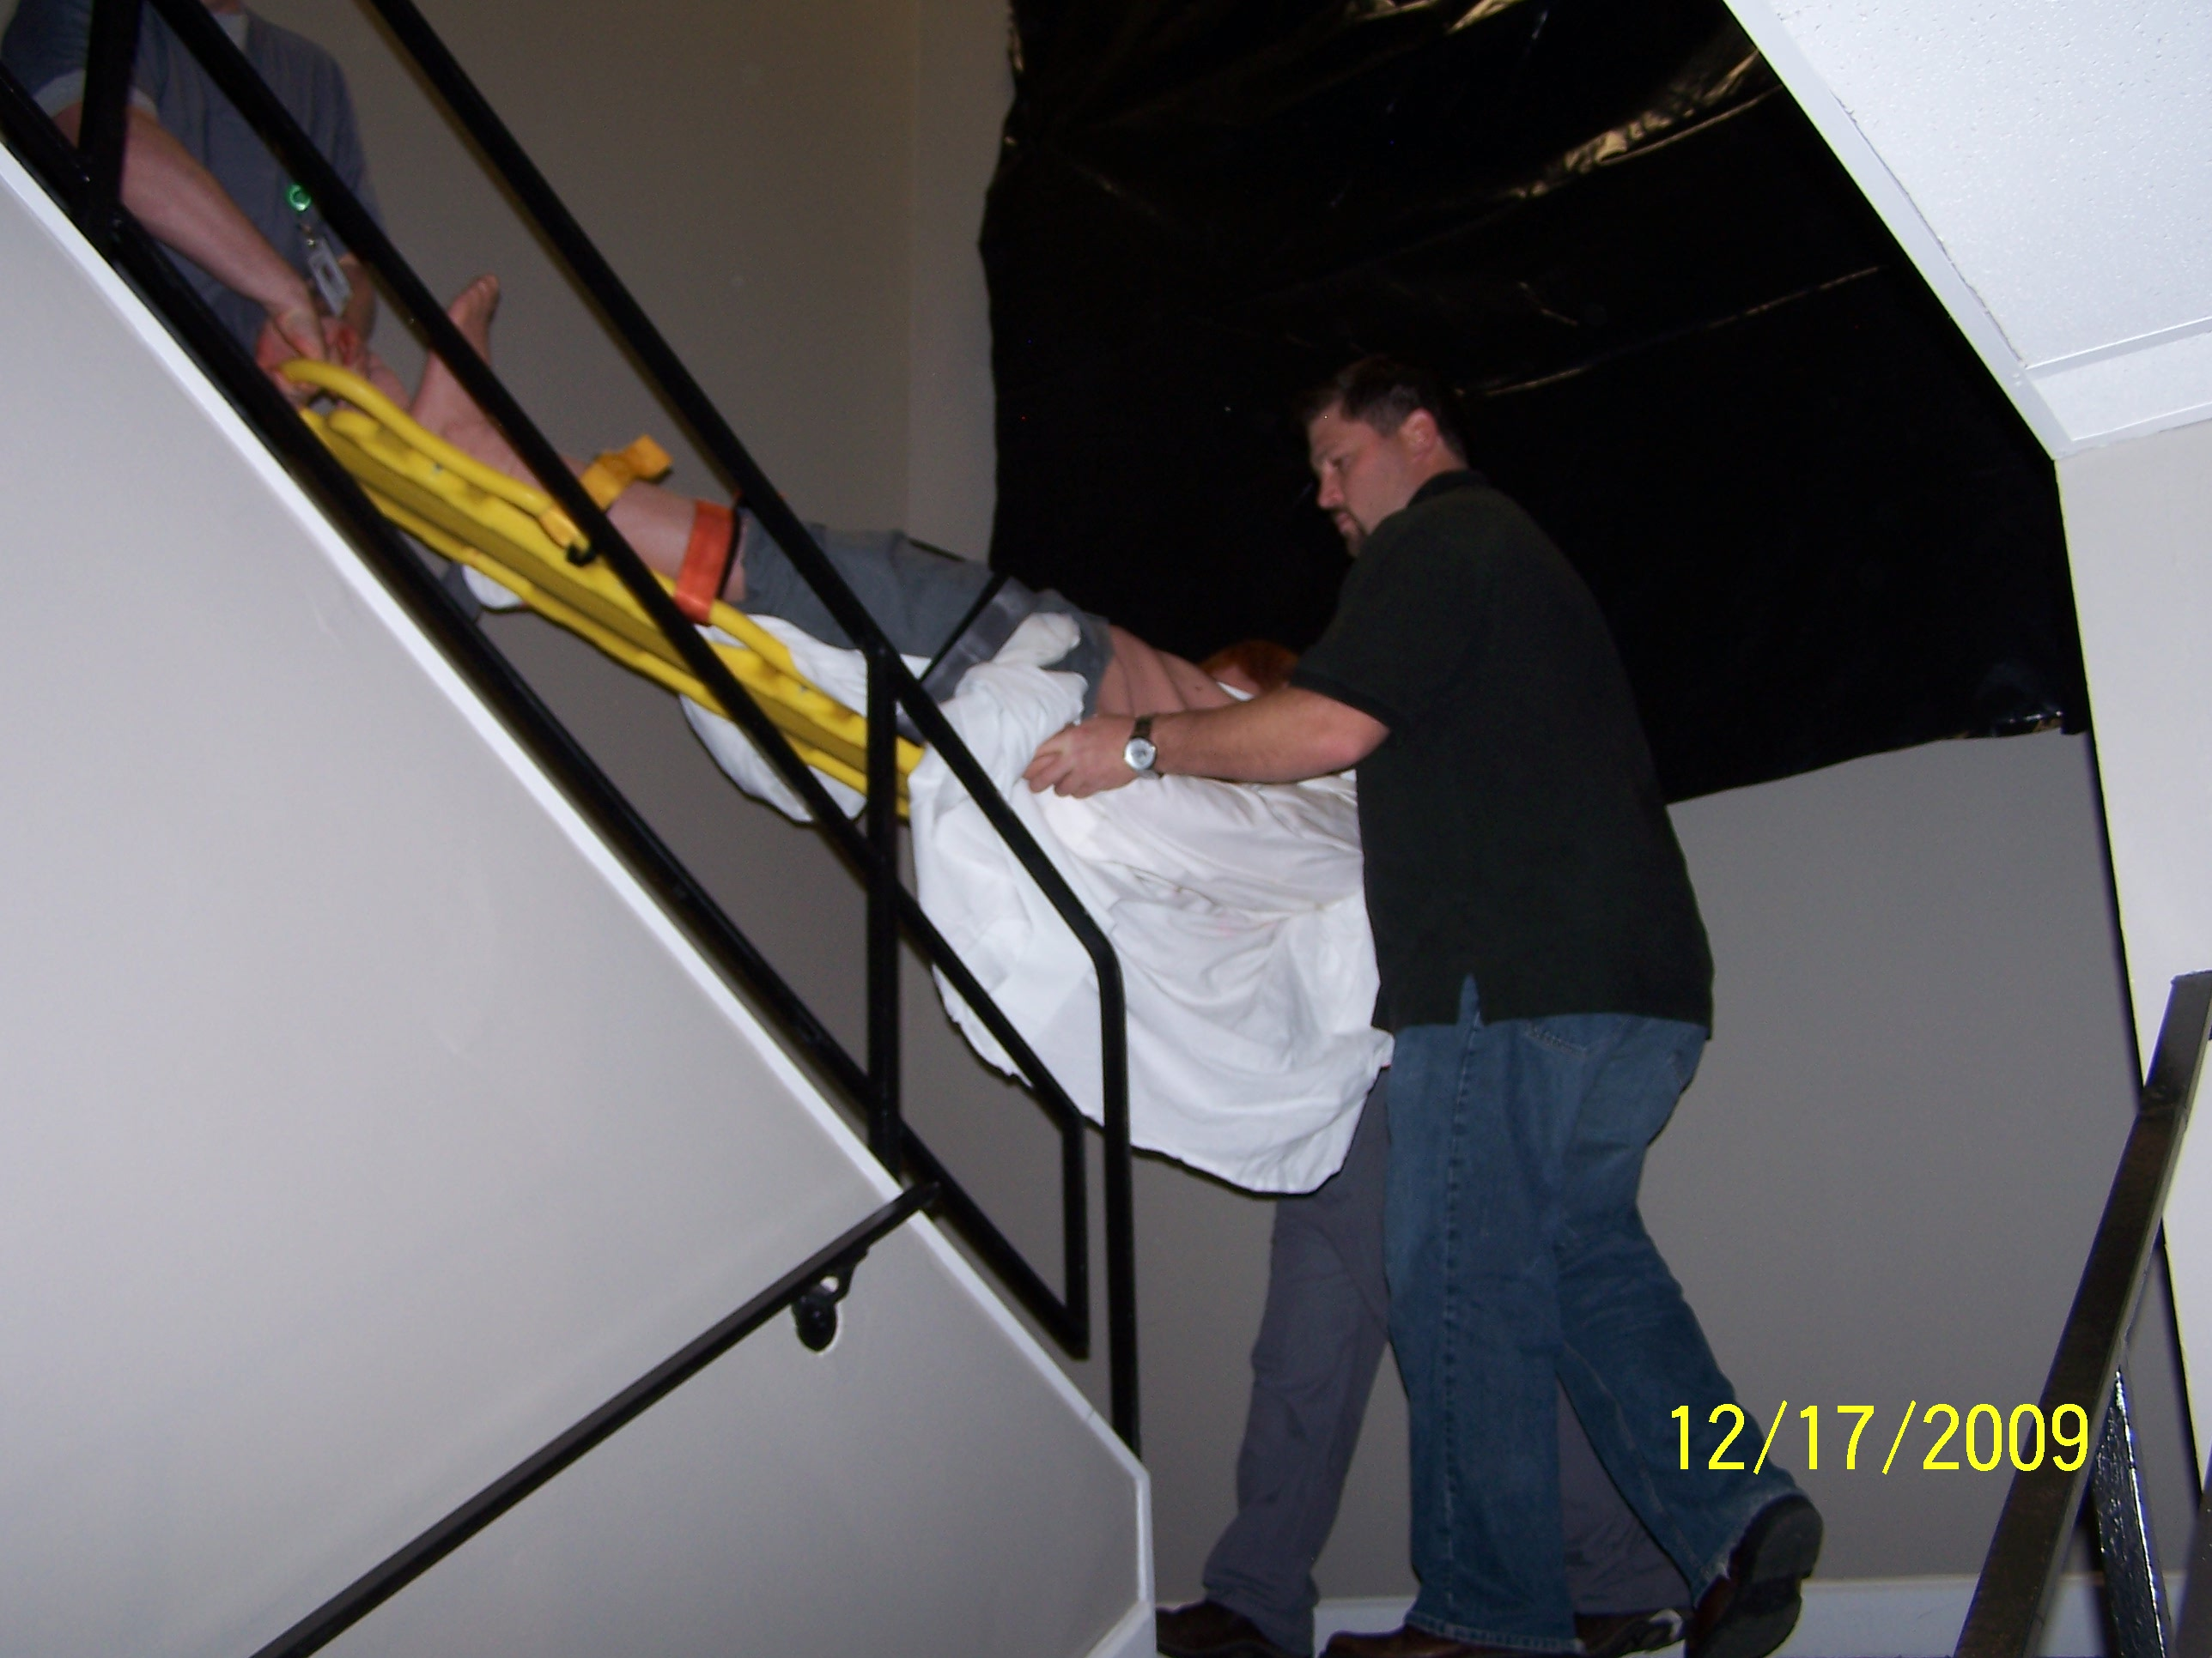
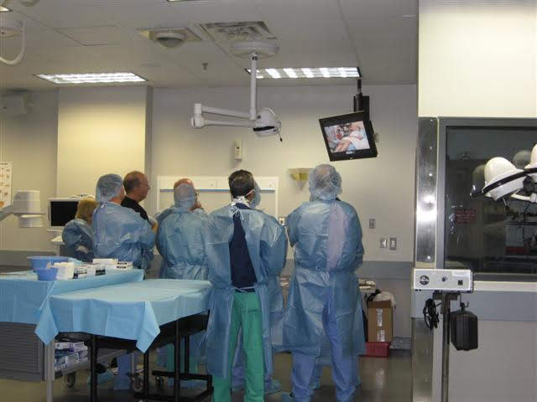

What did we do?
Notes:
let folks read this on their own

Slide 9
Take Aways
Neutral Ground
Third Party Site
Meets multiple entities needs
Support from uncommon partners
Ease of multiagency training
Improved visibility of Preparedness

Slide 10
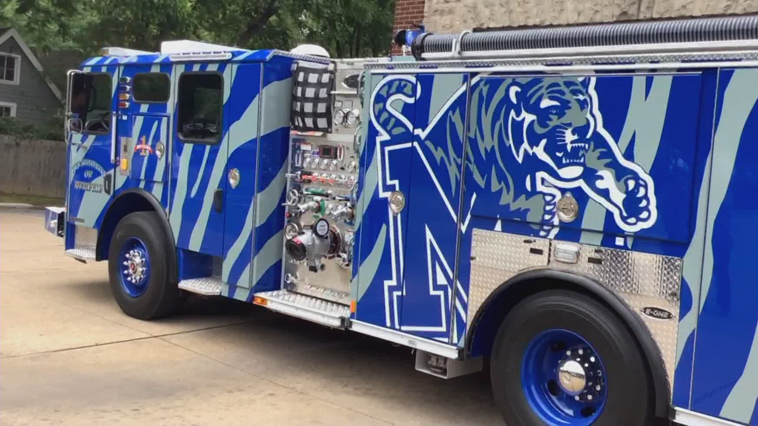

Strategic Partnerships
  Many local HEI and non-profits provide learner supports that you need
    Literacy Mid-South, U of M counseling services
      Internships, class projects
  Seek city support to leverage wrap around support services for learners.
    Explore how MFD can participate in current city workforce development programs, such as OpportunityR3
Thank you!
Joe.Holley@Memphistn.gov
Notes:
You are not alone in this work. Many resources exist in Memphis would gladly partner with you. (If time, story of how you couldn’t say no).
MFD can be a strategic partner in building the capacity and readiness of the local workforce. While providing additional learner supports will help address MFD retention issues and strengthen its workforce, not every recruit will ultimately be a good fit for the job. The wrap around services that MFD could potentially provide would be beneficial for pursuing other job opportunities with the city or other local employers. Likely there are other city services with the same issues with recruiting and retention, like the Police Department.

Slide 11
Better Production from Our Instruction: How Should We Educate Our Educators?
  Professional Development Assessment & Training in Collaboration with The University of Memphis Adult Education School
Notes:
understand the overall instructional design of the courses and have opportunity to observe/shadow seasoned instructors before teaching their first class. The objective of onboarding is not simply the transfer of information, but more importantly, is a venue for communicating the core learning culture of the Training Academy, including values and expectations. It would provide orientation to the position expectations, preparation for effective teaching and instructor development, and a greater sense of connection to the Training Academy.
Guess who can help you develop this?

