Slide 1
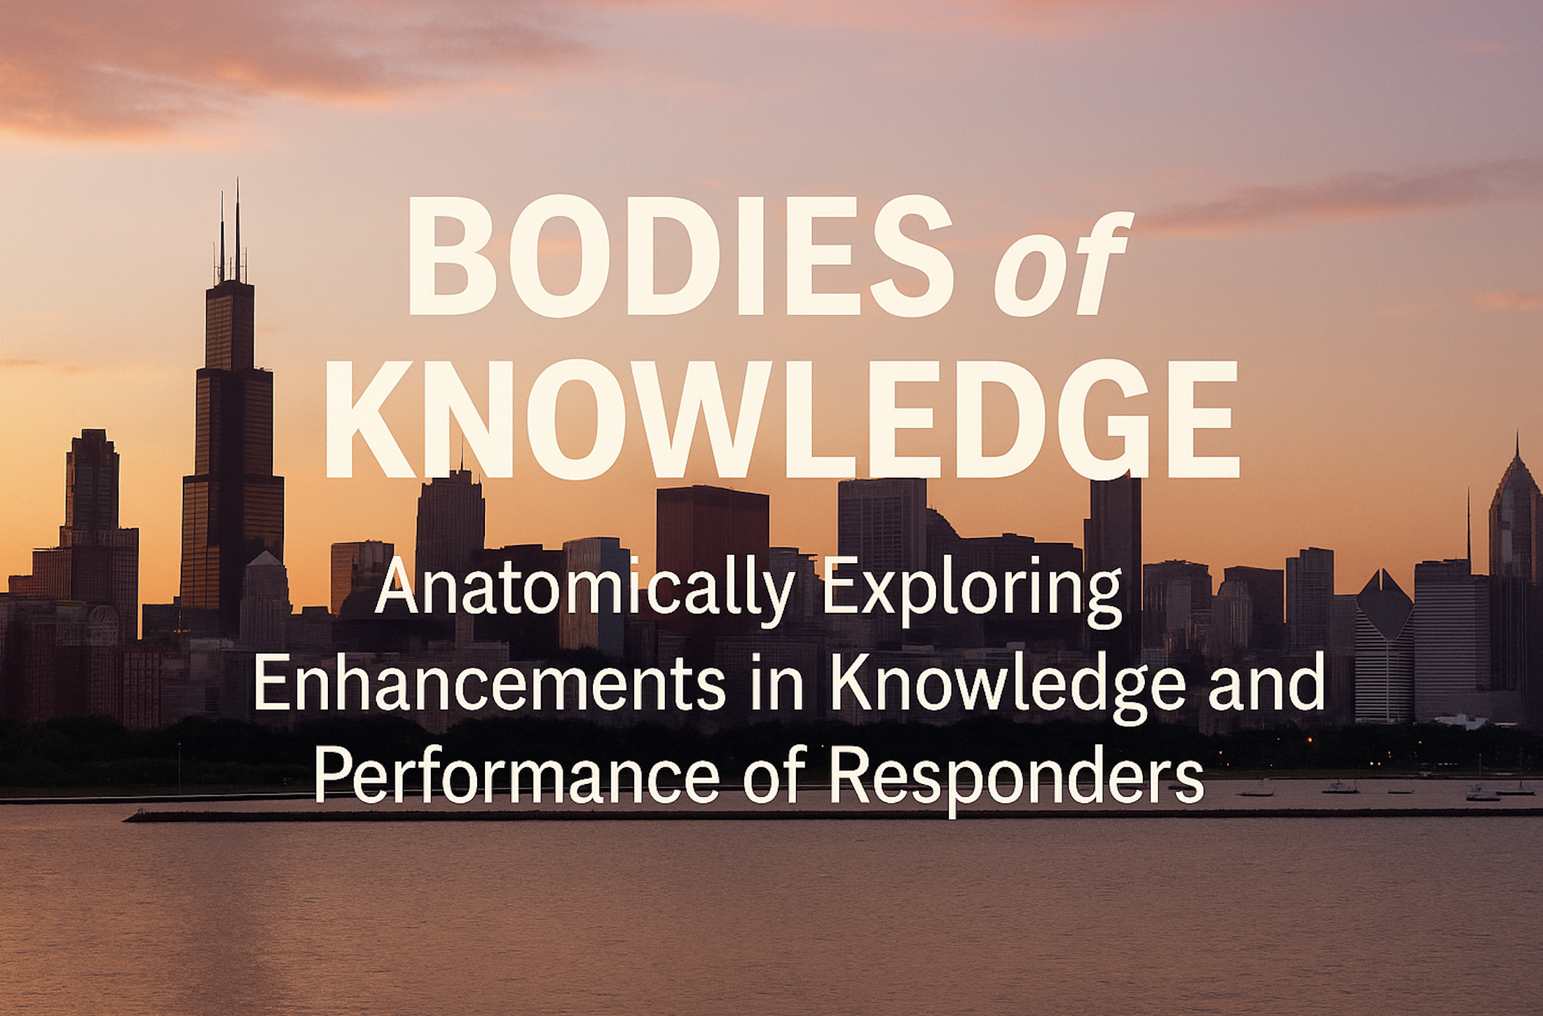
Nicholas P. Cozzi, MD, MBA, FACEP, FAEMS
Medical Consultant, Chicago Fire Department

Slide 2


Slide 3

BENEFITS FOR EMS CLINICIAN
Demonstrate Anatomical Proficiency:
Identify and accurately locate key anatomical structures relevant to prehospital procedures, including airway landmarks, vascular access sites, and thoracic anatomy, using cadaver-based exploration.
Enhance Procedural Competence:
Perform high-acuity, low-occurrence (HALO) interventions—such as cricothyrotomy, needle decompression, and endotracheal intubation of a burned airway—on cadaver models with improved precision and confidence.
Integrate Anatomy with Clinical Decision-Making:
Apply anatomical understanding to real-world EMS scenarios, articulating how structural knowledge influences procedural choices, technique modification, and patient safety in dynamic field environments.

Slide 4

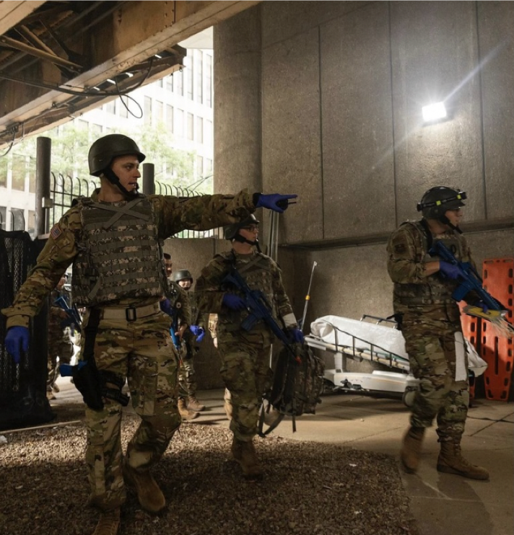
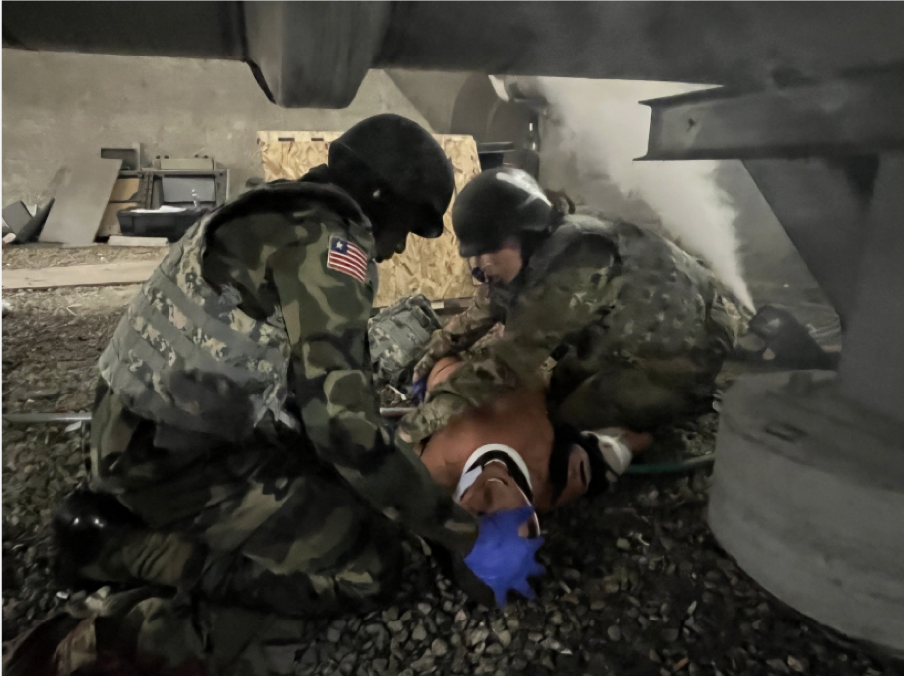


Slide 5
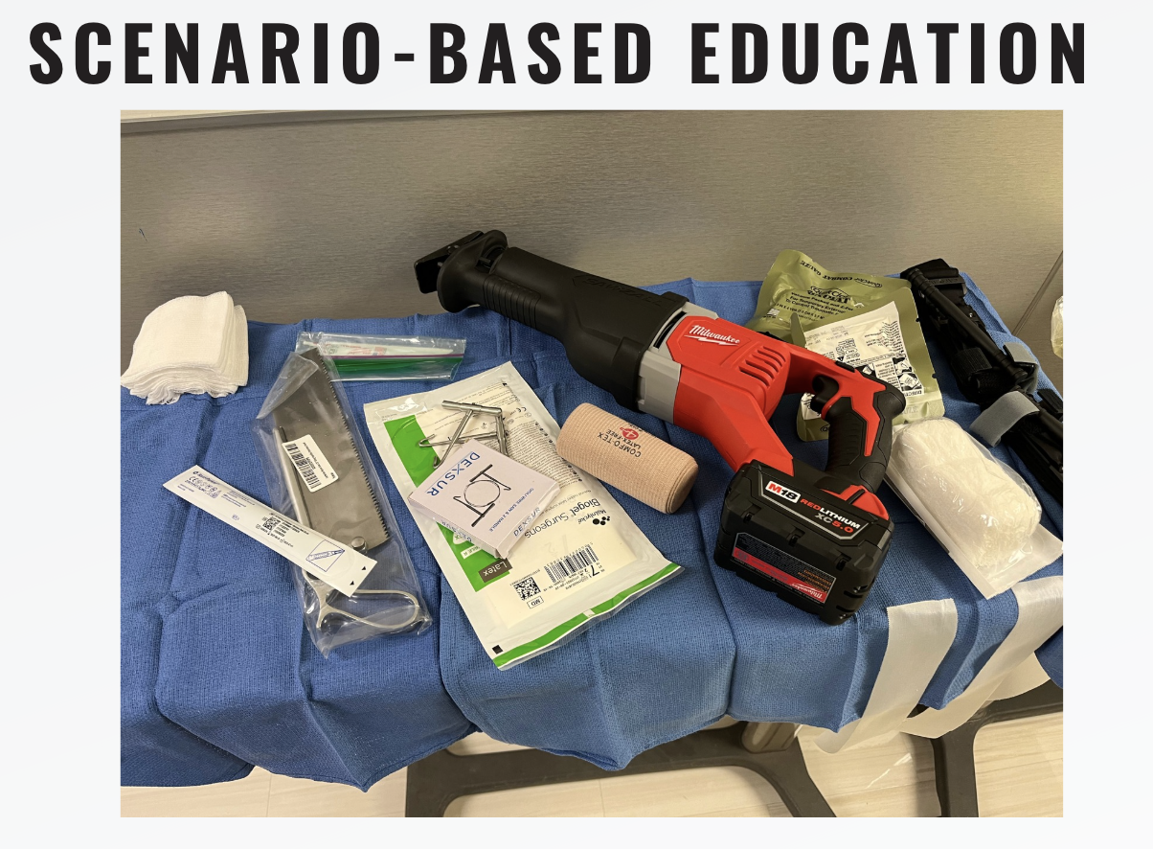

Slide 6
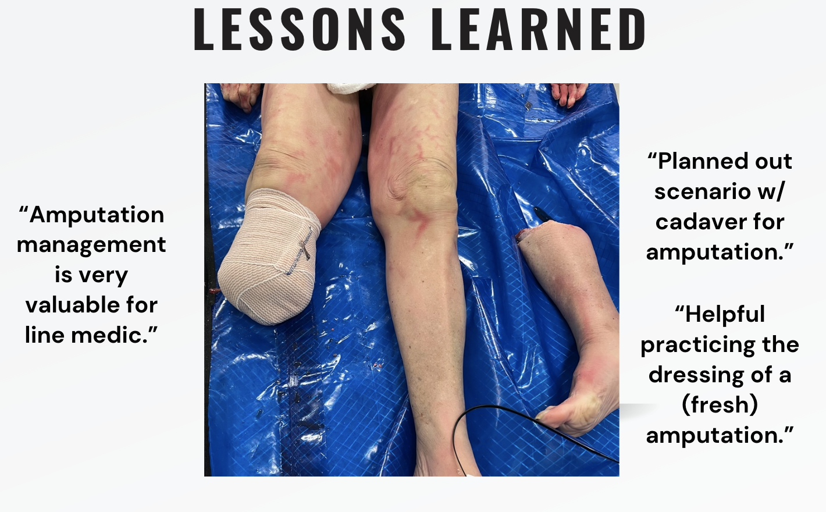

Slide 7
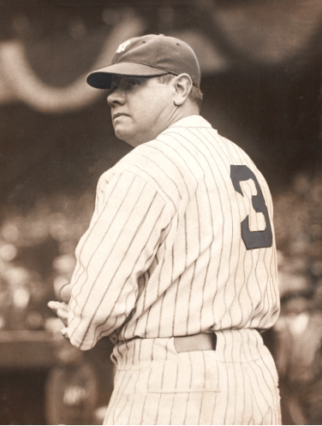
THREE BENEFITS
Hands-On Skill Mastery: Cadaver labs provide EMS clinicians with realistic anatomical exposure, enabling more precise understanding of human structures and enhancing procedural competence in airway management, vascular access, thoracostomy, and other high-stakes interventions.
Bridging Knowledge to Practice: By directly linking didactic content with tactile experience, cadaver-based training reinforces clinical decision-making and procedural confidence under pressure—especially valuable for rare but critical interventions.
Improved Patient Safety: Exposure to real human anatomy fosters respect for tissue handling, improves technique fidelity, and reduces errors in the field, ultimately leading to safer and more effective prehospital care.

Slide 8
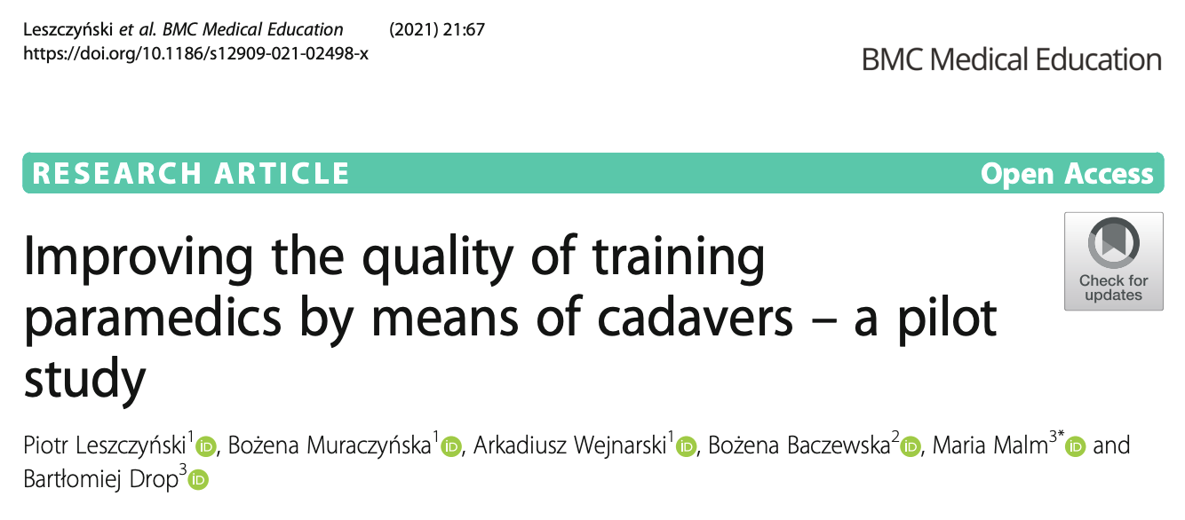
A 2021 BMC Med Educ. study showed paramedic students using cadavers were able to correctly identify trauma injuries (head: 76.5%, torso: 67.9%, limbs: 44.5%), significantly outperforming manikin simulation (p < 0.001).

Slide 9
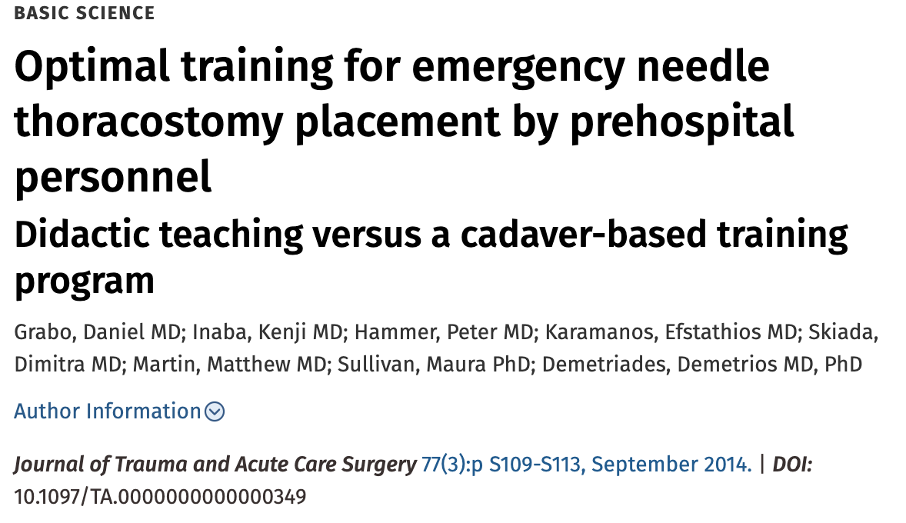
In a CBT module, US Navy corpsmen were better trained to place NT accurately than their traditional didactic SBL counterparts.

Slide 10
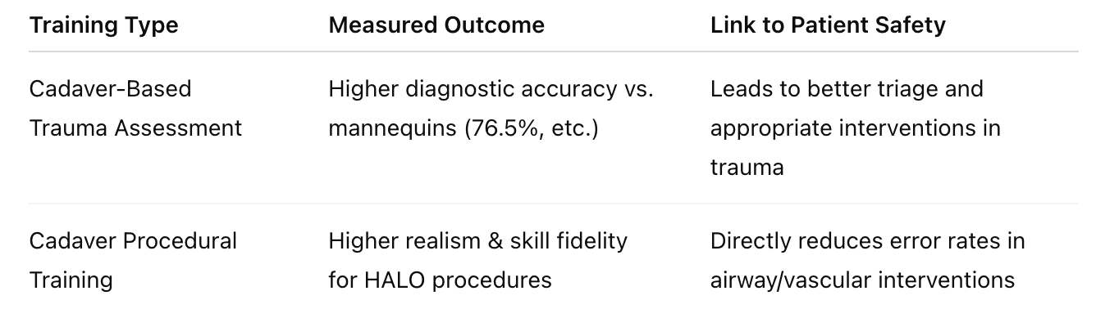
ENHANCING PREHOSPITAL PATIENT SAFETY THROUGH ANATOMICAL PRECISION

Slide 11
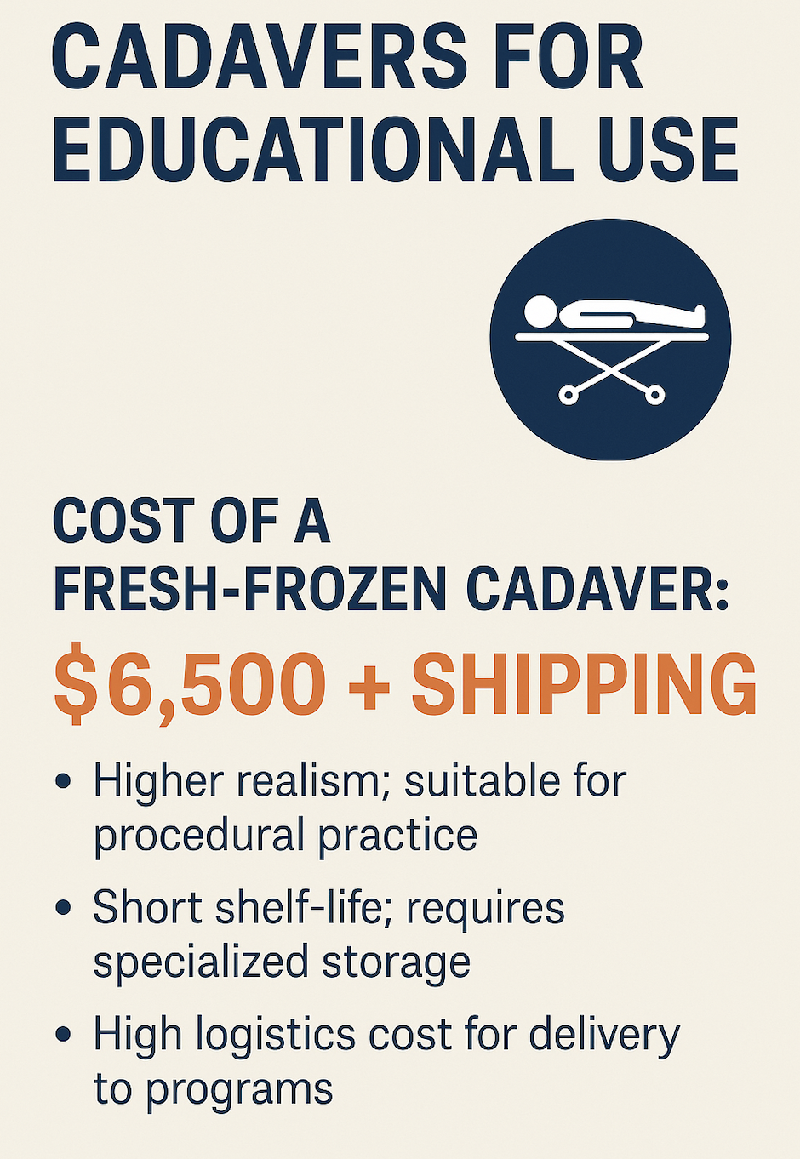


Slide 12
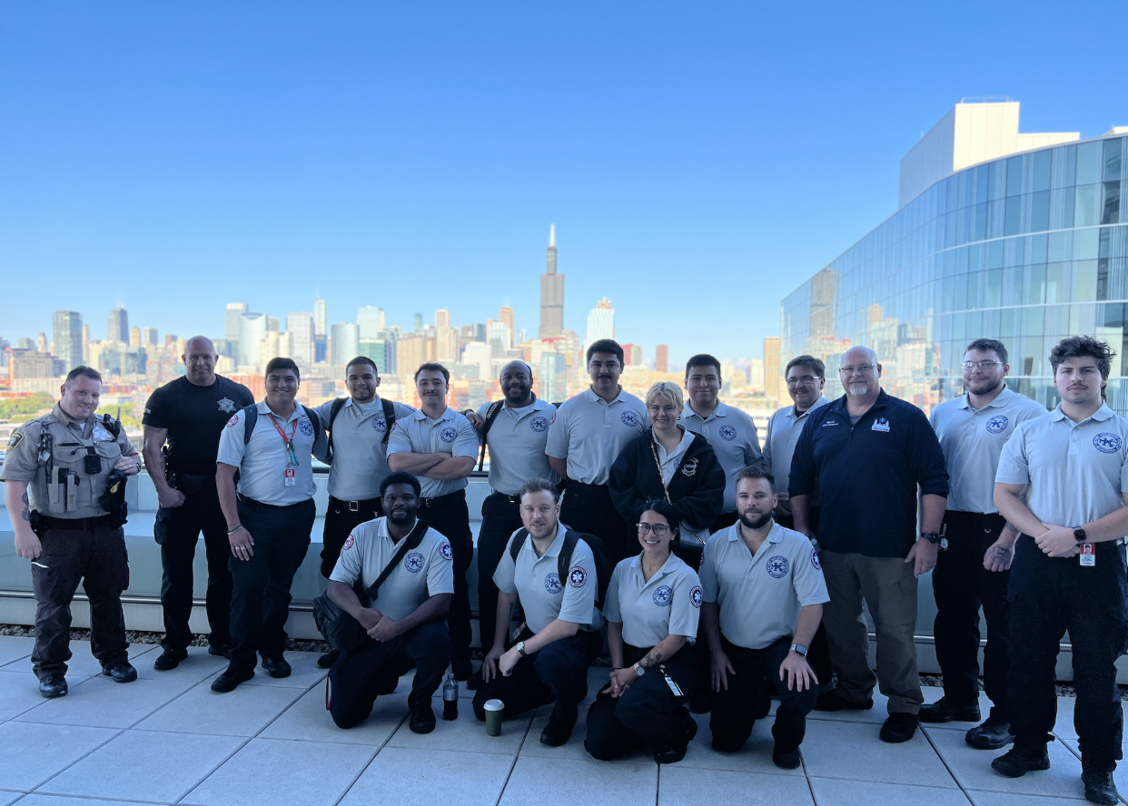

Slide 13
Nicholas.cozzi@cityofchicago.org
@NickCozziMDMBA
773-573-0556

Slide 14
Nicholas P. Cozzi, MD, MBA, FACEP, FAEMS
Medical Consultant, Chicago Fire Department

Slide 15
Nicholas P. Cozzi, MD, MBA, FACEP, FAEMS
Medical Consultant, Chicago Fire Department

