Slide 1

Better Production from Our Instruction: How Should We Educate Our Educators?
  Professional Development Assessment & Training in Collaboration with The University of Memphis Adult Education School
Notes:
understand the overall instructional design of the courses and have opportunity to observe/shadow seasoned instructors before teaching their first class. The objective of onboarding is not simply the transfer of information, but more importantly, is a venue for communicating the core learning culture of the Training Academy, including values and expectations. It would provide orientation to the position expectations, preparation for effective teaching and instructor development, and a greater sense of connection to the Training Academy.
Guess who can help you develop this?

Slide 2
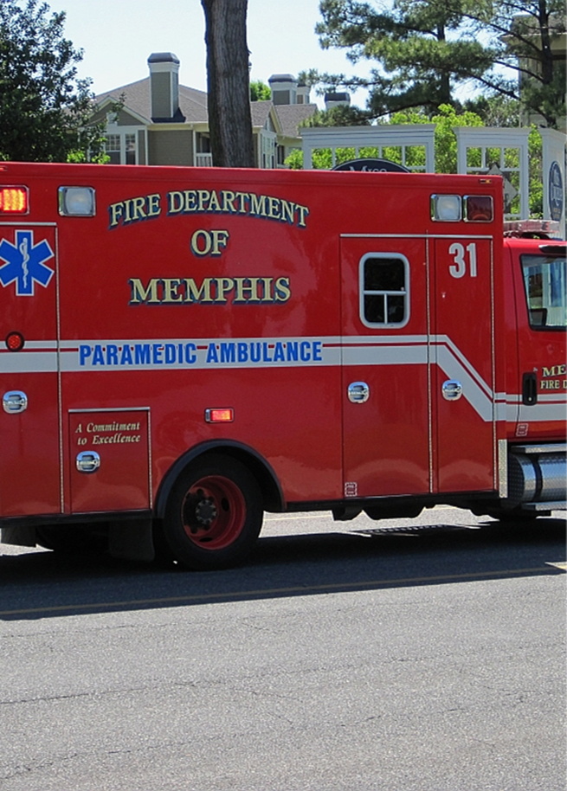
What did we learn?
Expectations for instructors to multitask impacts teaching capacity
Instructors need a more comprehensive training since most do not have a background in teaching
Instructors lack robust onboarding experiences
Dedicated individual in charge of ensuring instructor proficiency and curriculum development
Notes:
understand the overall instructional design of the courses and have opportunity to observe/shadow seasoned instructors before teaching their first class. The objective of onboarding is not simply the transfer of information, but more importantly, is a venue for communicating the core learning culture of the Training Academy, including values and expectations. It would provide orientation to the position expectations, preparation for effective teaching and instructor development, and a greater sense of connection to the Training Academy.
Guess who can help you develop this?

Slide 3
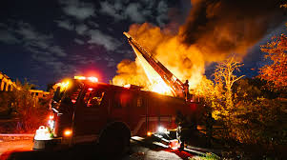
Comprehensive instructor onboarding and training program
  Orientation to overall instructional course design
  Observe/shadow seasoned instructors BEFORE teaching first class
  Communicate core learning culture of the Training Academy
  Orientation to the position expectations
  Preparation for effective teaching and instructor development
  Provide greater sense of connection to the Training Academy
  Formal mentoring and on-going professional development
Notes:
understand the overall instructional design of the courses and have opportunity to observe/shadow seasoned instructors before teaching their first class. The objective of onboarding is not simply the transfer of information, but more importantly, is a venue for communicating the core learning culture of the Training Academy, including values and expectations. It would provide orientation to the position expectations, preparation for effective teaching and instructor development, and a greater sense of connection to the Training Academy.
Guess who can help you develop this?

Slide 4
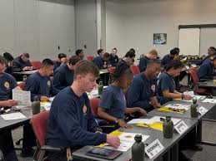
Develop student success support pilot program
Academic support to include:
  Tutoring
  Mentoring
  Study skills workshops
  Access to learning resources
When:
“Summer bridge/academy” type program (space to address foundational skill gaps
Co-requisite model (similar to current model)
Notes:
What does this mean? Borrowed language of higher ed, this means academic support
Currently extra-curricular academic support is provided informally and sporadically by instructors as time permits. Transition this activity to a formal, scheduled offering and explore the development of a volunteer mentoring program to provide this service. Academic support could also be provided pre-emptively through summer bridge/summer academy styled programs that help potential Training Academy students to learn about the position and gain basic foundational skills needed to successfully complete the courses and be effective in the position of EMS provider. This could include foundational reading and math skills.
Guess who can help you develop this?

Slide 5

Initiate partnership with Literacy Mid-South
TAP LOCAL EXPERTISE
Resource/Support for recruits struggling with literacy
Embed literacy strategies throughout the curriculum
Notes:
Literacy Mid-South facilitates access to literacy across the lifespan and has been helping learners of all ages for fifty years. Partnering with this organization will help to connect MFD recruits struggling with literacy with resources to help them achieve their learning goals. A partnership between the MFD and Literacy Mid-South could help infuse the Academy with the skills and experience to embed literacy strategies throughout the curriculum. This type of supports benefits all learners.
Guess who can help you develop this?

Slide 6
Eliminate Deficit Thinking
  Reframe Communication:
  • Promote a language shift in internal documents, meetings, and classroom interactions that focuses on what learners bring to the table rather than what they lack.
  • Emphasize potential and progress.
  Foster Collaborative Environments:
  • Create mentorship and coaching programs where experienced educators share strategies for asset-based instruction.
  • Encourage cross-department collaboration to share success stories and innovative practices that counter deficit narratives.
  Embed Continuous Improvement:
  • Establish systems to regularly monitor learning outcomes and teacher performance with an eye for recognizing improvements and strengths.
  • Celebrate achievements and growth
Notes:
let folks read this on their own

Slide 7
Wrap-Around Student Services
  Professional development support: Understanding and acclimating to fire/EMS profession, leadership skills and development.
  Personal support: Navigating work/school - life balance, basic life skills and counseling
  Transportation assistance: explore feasible solutions - organizing carpool/ride shares or raising funds for reimbursing students for taxi/uber services
  Flexible learning options: Explore hybrid options for content delivery and classroom learning.
    Flipped classroom: engage with new content outside of the classroom and use classroom time for hands-on activities, discussions, and problem-solving.
Notes:
Combining these two recommendations as they are related. Wrap-around student services is a term that encompasses both academic support and other types of supports adult learners need. All learners need supports, adult learners need specific types of supports. We recommend supports informed by data from our CAM, targeted for academy learners.
Inst
Professional development support: Understanding and acclimating to fire/EMS profession, leadership skills, and development. This support could be developed and offered in tandem with academic support possibly provided by volunteer mentors from the EMS workforce or University of Memphis education students seeking volunteer experiences.
Personal support: Navigating work/school - life balance. Each generation of learners presents unique challenges for educators. How they learn may be different than how their instructors learned and shifts in economic and social spheres may result in learning challenges as well. Technological advances and societal circumstances among other factors shape this and result in learners being in need of basic life skills and counseling. A life coach would be ideal for helping them to navigate their personal life and prioritize wellness. The University of Memphis offers programs in education and counseling. Often these programs offer externships or credit for volunteering to their students. Tapping into community resources like this could provide a way to meet the learners where they are while building competency in the classroom. Everyday life supports for learners as well as EMS professionals helps with retention. Organizations that demonstrate that they care about their employees have less turn over and higher job satisfaction.
Transportation assistance: Exploring transportation options. Memphis is a large geographic area and is not well-served by its public transportation system. Due to the location of the Academy, it is not feasible to expect recruits to rely on MATA as a primary or secondary means of support. A consideration of a wrap-around student support service for Training Academy context includes developing feasible solutions such as organizing car-pool/ride shares or raising funds to reimburse students for taxi/Uber services.
Flexible learning options: Explore hybrid options for content delivery and classroom learning. We recommend a variation of flipped classrooms. In a flipped classroom, learners engage with new content outside of the classroom—usually through videos, readings, or interactive online tools—and then use classroom time for hands-on activities, discussions, and problem-solving. For example, learners might watch a video lecture before class and then work on group projects or case studies during class to apply the material. This approach helps adult learners by giving them control over the pace of learning. It also makes classroom time more interactive and engaging. This method supports adult learners who often prefer practical, real-world applications of knowledge.

Slide 8
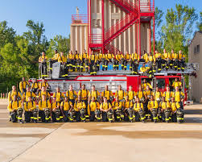
Instructional Advisory Board
  An advisory group comprised of educators, trainers, and other mission relevant stakeholders to support and maintain the Academy’s instructional design processes

Slide 9
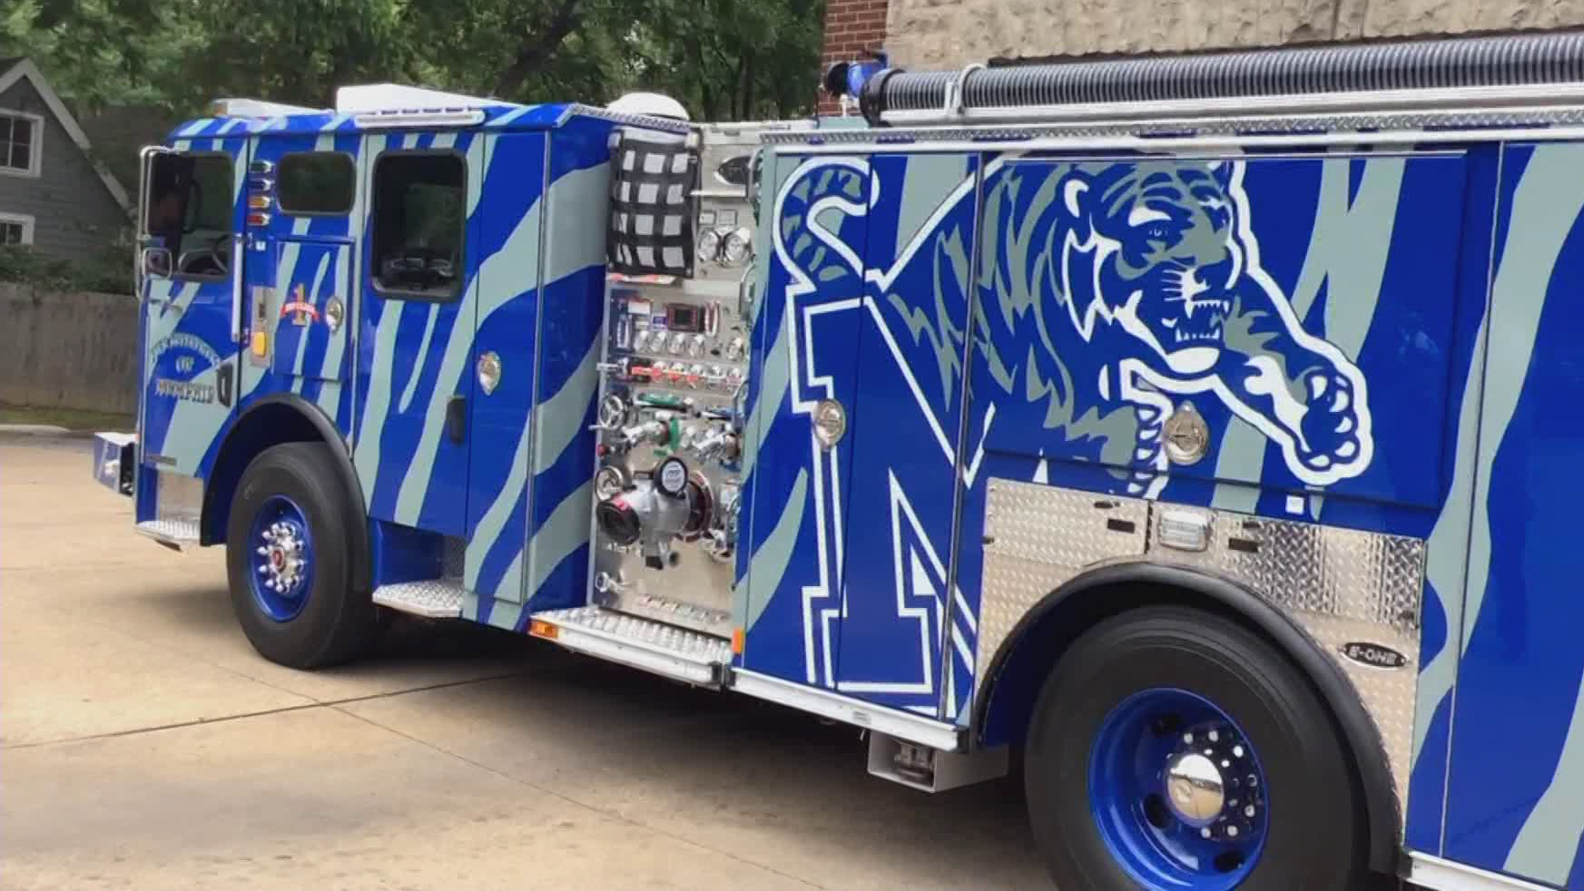
Strategic Partnerships
  Many local HEI and non-profits provide learner supports that you need
    Literacy Mid-South, U of M counseling services
      Internships, class projects
  Seek city support to leverage wrap around support services for learners.
    Explore how MFD can participate in current city workforce development programs, such as OpportunityR3
Thank you!
Joe.Holley@Memphistn.gov
Notes:
You are not alone in this work. Many resources exist in Memphis would gladly partner with you. (If time, story of how you couldn’t say no).
MFD can be a strategic partner in building the capacity and readiness of the local workforce. While providing additional learner supports will help address MFD retention issues and strengthen its workforce, not every recruit will ultimately be a good fit for the job. The wrap around services that MFD could potentially provide would be beneficial for pursuing other job opportunities with the city or other local employers. Likely there are other city services with the same issues with recruiting and retention, like the Police Department.

Slide 10
Better Production from Our Instruction: How Should We Educate Our Educators?
  Professional Development Assessment & Training in Collaboration with The University of Memphis Adult Education School
Notes:
understand the overall instructional design of the courses and have opportunity to observe/shadow seasoned instructors before teaching their first class. The objective of onboarding is not simply the transfer of information, but more importantly, is a venue for communicating the core learning culture of the Training Academy, including values and expectations. It would provide orientation to the position expectations, preparation for effective teaching and instructor development, and a greater sense of connection to the Training Academy.
Guess who can help you develop this?

