Slide 1
H5N1 Avian Influenza in the U.S.: Focus on the D1.1 Variant
Current Status and Public Health Implications
Jon Jui MD, MPH

Slide 2
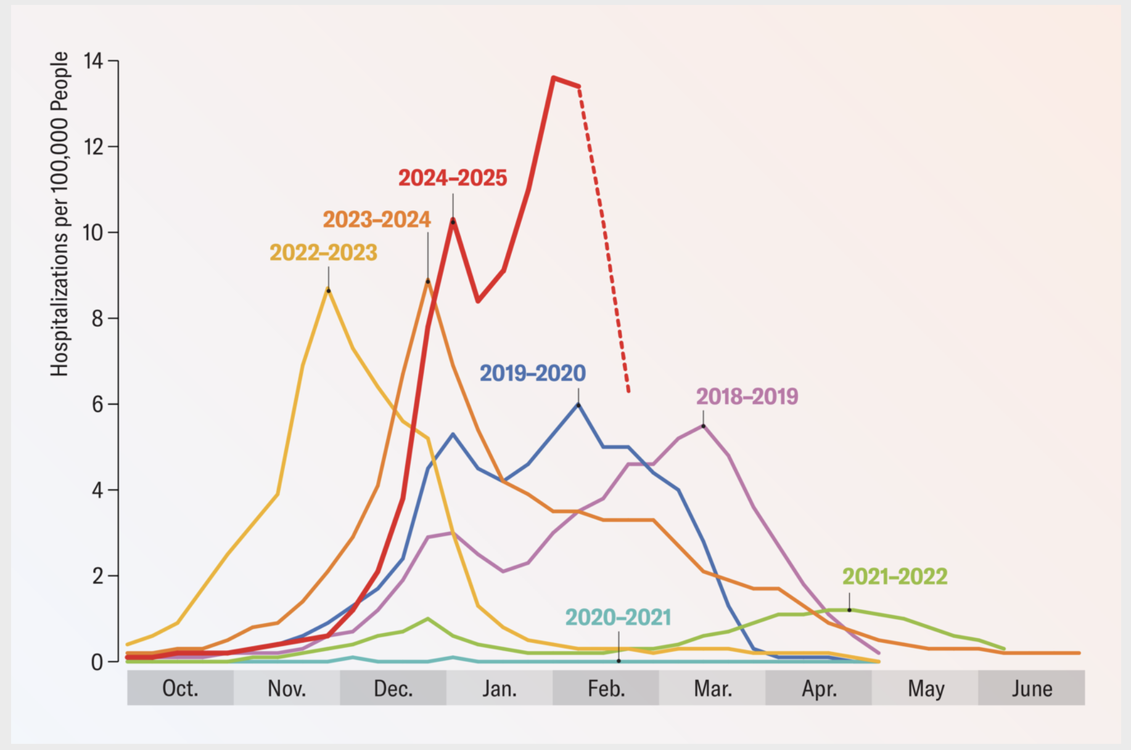
Seasonal Flu is No Joke

Slide 3
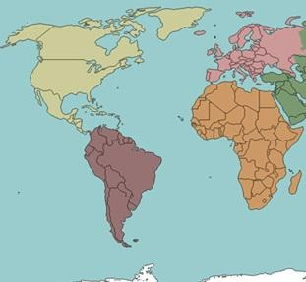

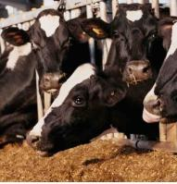
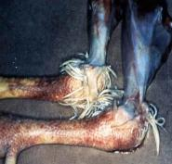
Highly Pathogenic Avian Influenza: H5N1
October through May
Year-Round
April through September
Seasonal Influenza is a perennial problem for humans and other animals
North America and Eurasia see seasonal influenza from October to May. In South America and sub-Saharan Africa from April to September, and in the middle zones, influenza is a year-round issue.
So far, all cases of Highly pathogenic AI have been from H5 or H7 sAg
Aileen M Marty MD, FCAP
Distinguished University Professor, Infectious Diseases
Department of Translational Medicine
Aileen.Marty@FIU.edu
Jonathan Jui, MD, MPH, FACEP
Professor, Department of Emergency Medicine
jonathan.jui@multco.us
While precise dates vary year to year, annual epidemics of seasonal influenza in the USA usually fall between October and May.
Notes:
While precise dates vary year to year, annual epidemics of seasonal influenza in the USA usually fall between October and May.
Image of cows from https://www.avma.org/resources-tools/animal-health-and-welfare/animal-health/avian-influenza/avian-influenza-virus-type-h5n1-us-dairy-cattle

Slide 4
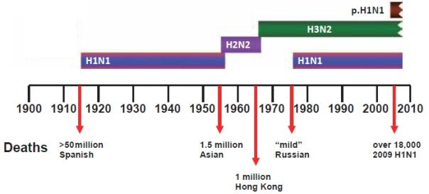
Seven Influenza Pandemics Since Germ Theory
1889: Started in Russia, not characterized
1918: Started in Kansas, USA, detected in Spain “Spanish flu,”
1957: Started in China, “Asian Flu”
1968: Started in China, “Hong Kong Flu”
2009: Started in the USA, detected in California and Mexico
Each pandemic saw a shift in the ability of HA to bind to α2,6 sialic acid and additional shifts in other key influenza genes
What does a Flu Virus need to have to cause a Pandemic?
An HA to which the human population is immunologically naïve
Cause disease in humans
Cause sustained chains of human-to-human transmission.

Slide 5
H5N1 Key Facts
Origin:
Hybrid virus, with half of its genetic segments derived from a highly pathogenic H5N1 virus from Asia and the other half from a low-pathogenic North American flu virus.
Prevalence:
dominant genotype in migratory wild birds in North America.
It was first detected in wild birds in September 2024 and has rapidly spread across all flyways.

Slide 6
H5N1 In SE Asia
Historically, H5N1 infections in Southeast Asia have been associated with a high case fatality rate (CFR) of approximately 50%.

Slide 7
Overview of H5N1 in the U.S
Since April 2024, the U.S. has reported 70 human cases of H5N1 avian influenza.
primarily linked to exposure to infected poultry and dairy cattle.
Predominate genotype : B3:13
CDC assesses the current risk to the general public as low, but moderate to high for individuals with direct exposure to infected animals.

Slide 8
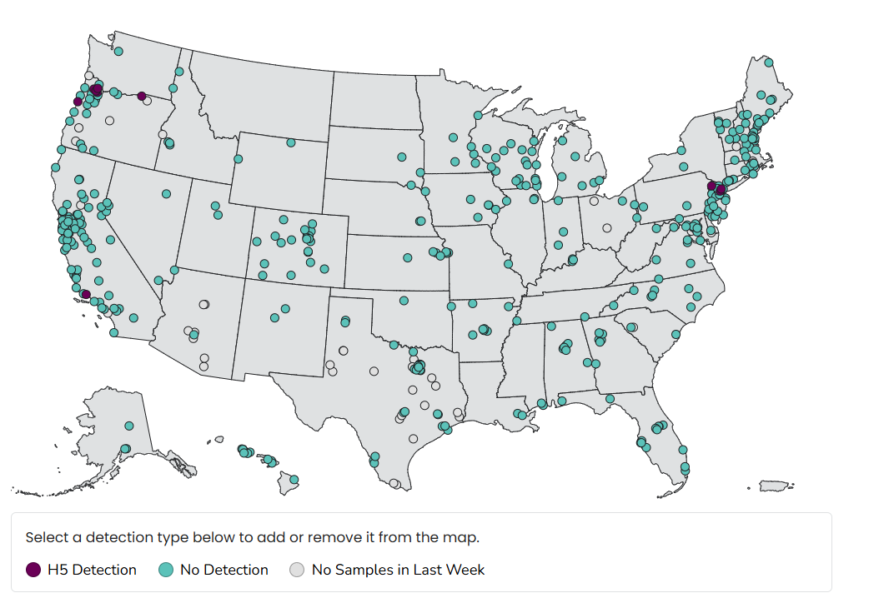
Waste Water Detection of H5n1
May 25-31, 2025

Slide 9
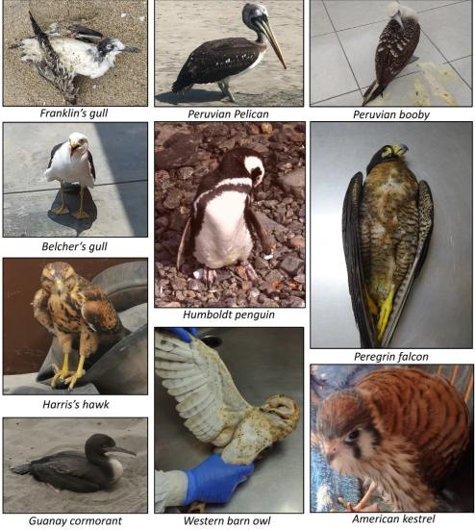
The H5N1 Currently Causing a global panzootic is NOT the same one from 20 years ago!
2010-11, H5N1 clade 2.3.4.4 emerged in China
2014, H5N1 the HA from clade 2.3.4.4 began pairing with different NA subtypes (NA1,NA2, NA5, NA6, and NA8). Migrating birds have spread these H5Nx viruses that carry clade 2.3.4.4 to nearly every continent on earth
2020, H5N1 2.3.4.4b subclade of 2.3.4.4 appeared and spread to all continents except Australia. It has devasted wild and domestic birds and infected at least 26 mammalian species,
2025 Clade 2,3,4,4,4B is the current predominate strain in the world
Notes:
26 mammalian species, including badgers, black bears, bobcats, coyotes, ferrets, fisher mustelids, domestic cats, skunks, sea lions, seals, minks, foxes, leopards, opossums, pigs, raccoons, wild otters, and bovines.

Slide 10
Emergence of H5N1 Dp.1.1 Variant
First detected: United States, 2024.
Genetic changes: Enhanced binding to human-type receptors.
Increased zoonotic spillover risk.
Monitoring by WHO and CDC due to pandemic potential.

Slide 11
H5N1 D1.1 Infection in Humans: Symptoms
Mild, such as eye redness or discharge, to more typical flu symptoms like fever, cough, and sore throat.
Severity: Serious illnesses have been reported, including one fatality in Mexico.

Slide 12
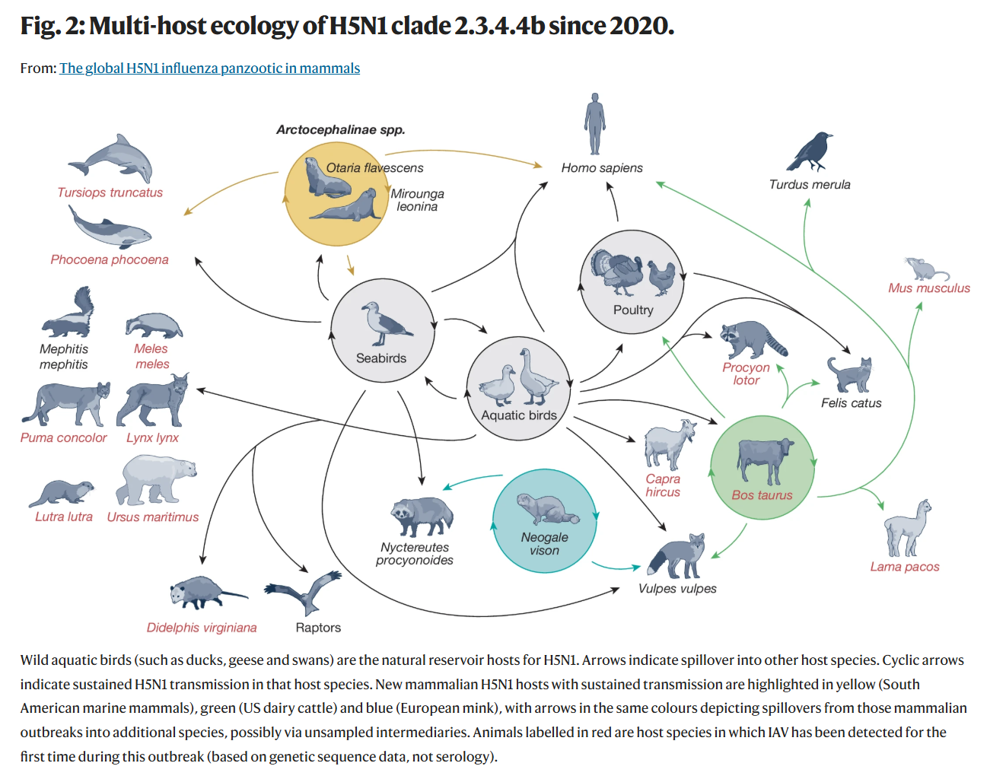
Animal Infections and Cross-Species Transmission
D1.1 has been detected in various species:
  Wild birds and poultry
  Dairy cattle
  Domestic cats, with cases suggesting possible human-to-cat transmission
  Rats, raising concerns about urban spread
The virus's presence in multiple species complicates containment efforts

Slide 13

Antiviral Treatment Options
Jonathan Jui, MD, MPH, FACEP
Professor, Department of Emergency Medicine
jonathan.jui@multco.us

Slide 14
Influenza
Virology
Targets of Intervention

Slide 15
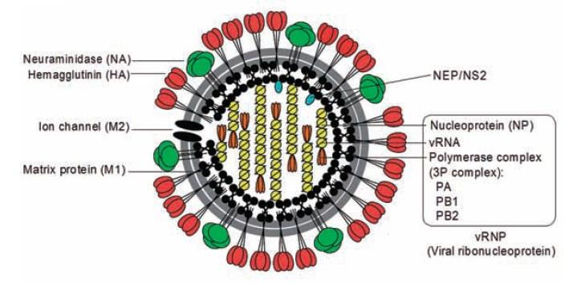
The RNA of Influenza A is packaged in 8 individual Segments.
Each Segment is responsible for specific Structural and Non-structural Viral Genes.
Segment 1 (PB2)
Segment 2 (PB1 & PB1F2)
Segment 3 (PA)
Segment 4 (HA)
Segment 5 (NP)
Segment 6 (NA)
Segment 7 (M1 & M2)
Segment 8 (NS1 &NS2/NEP)
PB1 = Polymerase Basic protein 1 |  | PB2 = Polymerase Basic protein 2
PB1-F2 = Polymerase Basic 1 - Frame 2 |  | PA = Polymerase Acidic protein
M2: Proton channel |  | NS1 = Nonstructural protein 1
NS2 = Nonstructural protein 2
Notes:
PB1 = Polymerase Basic protein 1 [Catalytic core of the RNA polymerase complex, responsible for RNA chain elongation during transcription and replication.]
PB2 = Polymerase Basic protein 2 [part of RNA polymerase complex; has the role of binding to the 5' cap of host pre-mRNA – but does not cleave it.),
PB1-F2 = Polymerase Basic 1 - Frame 2 [localizes to mitochondria and promotes apoptosis of host macrophages]
PA = Polymerase Acidic protein [Endonuclease- it cleaves host mRNA near the 5′ cap to generate primers for viral mRNA synthesis – this is the “Cap snatcher”]
HA = Hemagglutinin [Surface glycoprotein used to bind sialic acid and enter host cells]
NP = Nucleoprotein [coats viral RNA segments, regulates RNA synthesis]
NA = Neuraminidase [Surface enzymatic glycoprotein facilitates viral exit from the host cell]
M1 = Matrix protein 1 [lines inside of viral membrane
M2 = Matrix protein 2 [protein pump helps acidify the cell, allowing for viral uncoating]
NS1 = Nonstructural protein 1 [immunomodulator → inhibits host interferon production and host mRNA processing,
NS2 = Nonstructural protein 2 = Nuclear Export Protein [mediates the export of vRNPs from the nucleus to the cytoplasm by interacting with the CRM1 nuclear export pathway.]

Slide 16
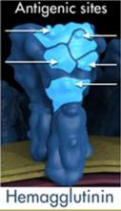
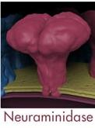
InfluenzAvirus Surface Antigens
HA | 1 | 2 | 3 | 4 | 5 | 6 | 7 | 8 | 9 | 10 | 11 | 12 | 13 | 14 | 15 | 16 | 17 | 18
Avian | X | X | X | X | X | X | X | X | X | X | X | X | X | X | X | X
Bats |  |  |  |  |  |  |  |  |  |  |  |  |  |  |  |  | X | X
Humans | X | X | X |  | +/- | +/- | +/- |  | +/- | +/-
Swine | X | +/- | X | X | X |  |  |  | X
Canines |  |  | X
Equines |  |  | X |  |  |  | X
Seals |  |  | X | X | +/- | X | +/- |  |  | X
Cetaceans | + |  |  |  |  |  |  |  |  |  |  |  | +
Felines | +/- |  | X |  | +/- |  | X |  | +/-
Mustelinae | +/- |  | + |  | +/- |  | +/- |  | +/-
“Bird Flu” is H₅N₁
NA | 1 | 2 | 3 | 4 | 5 | 6 | 7 | 8 | 9 | 10 | 11
Avian | X | X | X | X | X | X | X | X | X
Bats |  |  |  |  |  |  |  |  |  | X | X
Humans | X | X |  |  |  | +/- | +/- | +/- | +/-
Swine | X | X
Canines |  | X |  |  |  |  |  | X
Equines |  |  |  |  |  |  | X
But of course, H₇N₂ is also “Bird Flu,” etc.
Notes:
In 2014, HPAI “H5Nx” viruses that derived the HA from clade 2.3.4.4 paired with different neuraminidase (NA) subtypes started to spread. Clade 2.3.4.4 viruses first emerged in China between 2010 and 2011 and showed a propensity to reassort with other avian IAVs; this H5 HA has reassorted with at least four NA subtypes (N2, N5, N6, and N8).
Recently, 2 other avian influenza viruses have caused human illness.
Highly pathogenic H7N7 avian influenza: began in the Netherlands in February 2003, mild illness in 85 people + death of one veterinarian two months later,
Avian influenza H9N2 caused mild flu in children in Hong Kong in 1999 (two cases) and in mid-December 2003 (one case). (H9N2 is not highly pathogenic in birds).
two strains of the virus that causes dog flu (Influenza Type A): H3N8 and H3N2. B

Slide 17
Sialic Acid
Role of Sialic Acid in Transmission Influenza from Birds to Humans

Slide 18
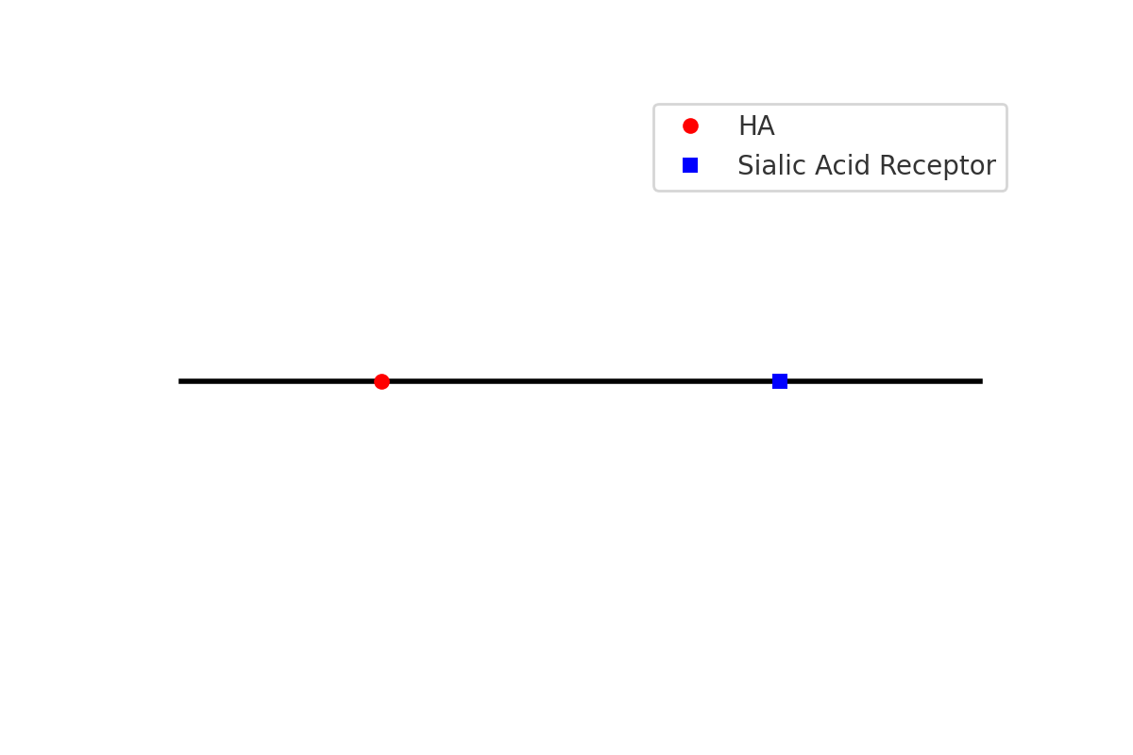
Mechanism of Viral Attachment
Hemagglutinin binds to sialic acid receptors on host cells.
Avian viruses prefer α-2,3 linked sialic acids.
Human upper respiratory tract cells have α-2,6 linked sialic acids.
Adaptations in Dp.1.1 improve binding to α-2,6 linkages.

Slide 19

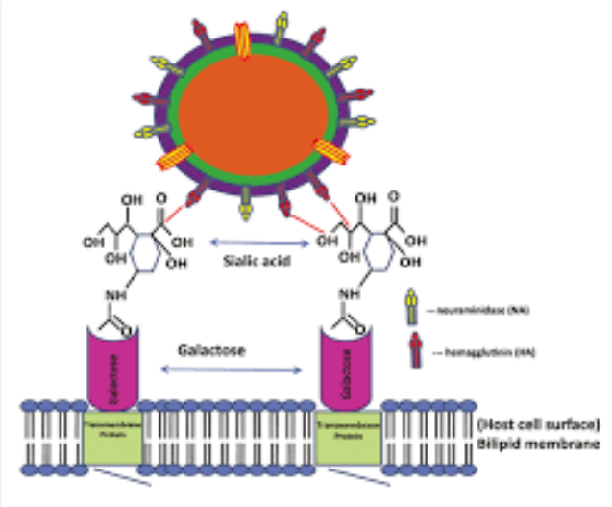
Binding Mechanism of Viral Hemagglutinin HA to Sialic acid

Slide 20
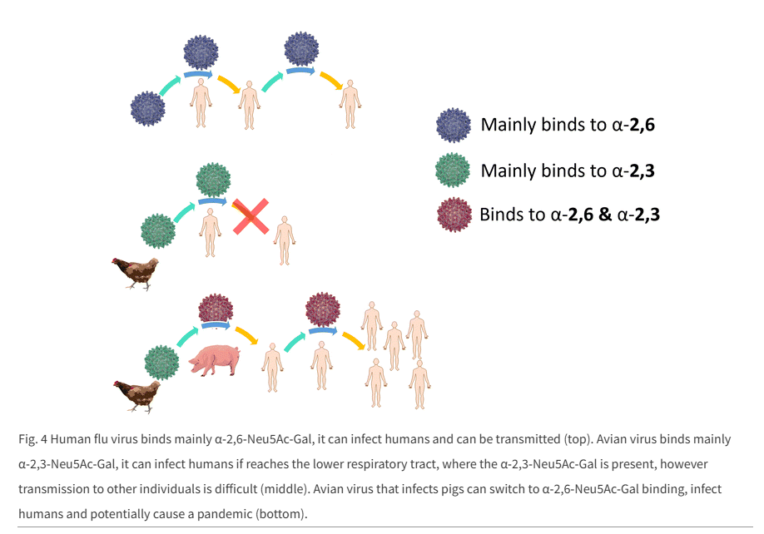
Human vs Avian Flu Variants

Slide 21
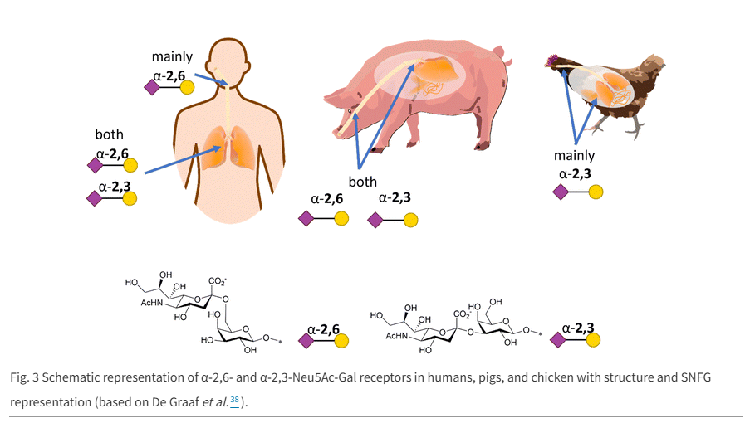
Sialic Acid

Slide 22
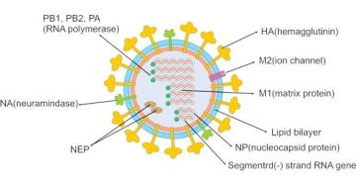
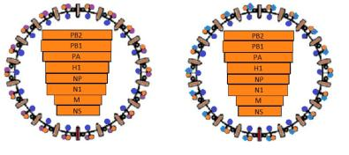
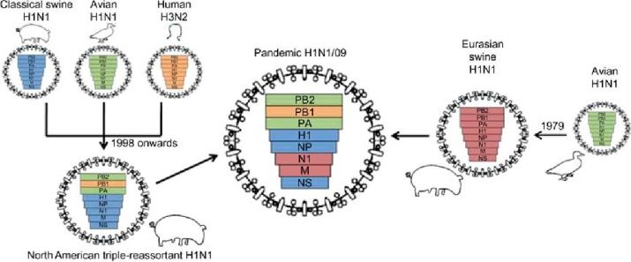
Influenza Viruses
Enveloped ssRNA virus; glycoprotein spikes of hemagglutinin (HA) and neuraminidase (NA) protrude from the envelope.
  HA comprised of HA1 & HA2. HA1 binds the cell’s receptor, and HA2 fuses the virus with the cell membrane
  NA helps the virus exit the host cell, cleaves terminal sialic acid from cell surface glycoproteins & gangliosides
Genome: Segmented: 8 pieces of ssRNA coated with nucleoprotein. RNA-dependent RNA polymerase (3 subunits PB1, PB2, PA) forms a ribonucleoprotein complex. Nuclear export protein is also within the virion
Genetic drift
Maritz et al. Pandemic influenza A (H1N1) 2009: the experience of the first six months. Clin Chem Lab Med. 2010;48(1):11-21. doi: 10.1515/CCLM.2010.023. https://www.degruyter.com/document/doi/10.1515/CCLM.2010.023/html
Genetic Shift
The RNA is in 8 segments that must be packaged in each new virion. Thus, if two flu viruses enter one host cell, the RNA segments from the two viruses can recombine. These recombinations led to the 2009 H1N1 pandemic.
https://www.cusabio.com/infectious-diseases/influenza-virus.html
Notes:
Maritz J, Maree L, Preiser W. Pandemic influenza A (H1N1) 2009: the experience of the first six months. Clin Chem Lab Med. 2010;48(1):11-21. doi: 10.1515/CCLM.2010.023. https://www.degruyter.com/document/doi/10.1515/CCLM.2010.023/html https://www.semanticscholar.org/paper/Pandemic-influenza-A-(H1N1)-2009%3A-the-experience-of-Maritz-Maree/7c84e64cbe0f09bbea10ee651229e696a409c459
https://www.cusabio.com/infectious-diseases/influenza-virus.html
The three largest viral RNA (vRNA ) segments encode the three polymerase proteins: PB2 (segment
1), PB1 (segment 2), and PA (segment 3). Segment 2 also encodes two other proteins: PB1-F2, a proapoptotic virulence factor, and PB1-N40, an N-terminally truncated variant of the PB1 protein. When different Influenza virus find their way into one cell, the 8 gene segments can recombine and create an entirely new virion.

Slide 23
Inside the Influenza Virus

Slide 24
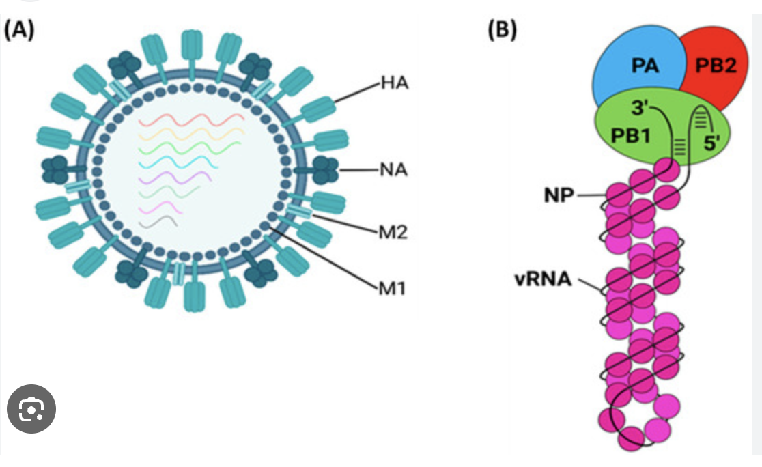

Slide 25
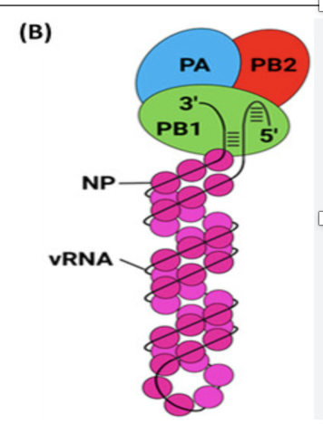
In human cells, the translation of mRNA strands into proteins requires a special “ cap “ structure at the beginning of each mRNA.

Slide 26
The RNA polymerase complex is composed of 3 subunits: PA, PB1, and PB2. The PA unit of Influenza is the “Cap Snatcher”!
  The endonuclease of the RNA polymerase subunit PA “snatches” a cap from the host cell mRNA.
  Then, the viral RNA polymerase subunit PB2 binds the human cap to the viral mRNA.
  Finally, the viral RNA polymerase subunit PB1 is the viral RNA-dependent RNA polymerase, which uses the stolen cap as the starting point for synthesizing viral mRNA.
    Thanks to the stolen cap, viral mRNA enters the host protein-production machinery to make viral proteins, which assemble into new viruses that will spread the infection.

Slide 27
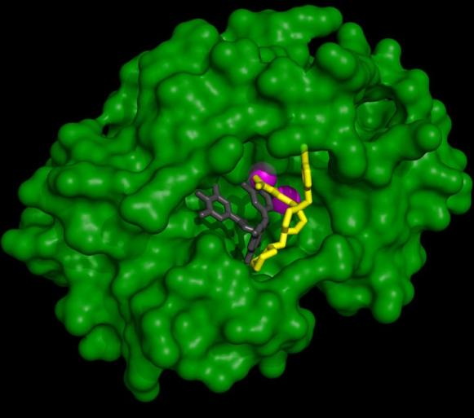
Mutations in the Polymerase can provide Gain-Of-Function
Influenza viruses are unusual among negative-sense RNA viruses in that they transcribe and replicate their genomes in the nucleus
The active site of the endonuclease of the Viral RNA polymerase is shaped like a cave with two metal ions at the bottom.
Notes:
The Influenza genome comprises segmented RNAs, making it more susceptible to antigenic drift and shift. Many strains have developed resistance mutations to traditional antiviral treatments.
Influenza Virus is a “Cap Snatcher!”
The HA of the three human viruses that caused the pandemics of 1918 (H1), 1957 (H2), and 1968 (H3)
arose from avian viruses. Because of the differences in receptor binding specificity of avian and human viruses, cross-species transfer requires changes in the properties of the HA of the precursor avian viruses.
These result from mutations in the receptor binding site of HAs. The mutations are different in H1 from
those in H2 and H3. In H1, the mutations Ser-138 → Ala, and Glu-190 → Asp, and Gly-225 → Asp, are important for cross-species transfer. The substitution Glu-190 → Asp was found in the HA of viruses proposed to be intermediates formed early during transfer. In both H2 and H3, Gln-226 → Leu and Gly-228 → Ser are the major differences between avian and human HA. What differences are there in the H5 that is currently circulating in Birds and Bovines in the USA at those locations? What genetic changes in the binding site of H5 might lead to a form that better binds to α2,6-linked sialic acids present in the human airways? Wouldn’t these call for changes in the nucleic acid sequence of segment 4 of the influenza A virus genome? Please specify the needed changes to the nucleic acid sequence and how likely they are to develop in nature. Please provide a detailed, professional level response detailing the nucleic acid changes.

Slide 28
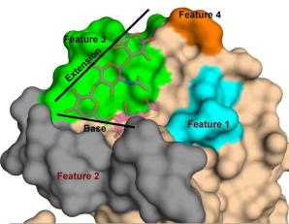
Gain-of-Function Risk
The HA gene is in segment 4 of the influenza A virus genome.
  Avian flu virus HA proteins bind to α2,3-linked sialic acids
  Human flu virus HA viruses need to bind α2,6-linked sialic.
For Gain-of-function
  For H5 to adapt to human hosts, it must mutate HA protein to enable binding to α2,6-linked sialic acids
Only 2 nucleotide changes are needed for gain-of-function of H5 2.3.4.4b to become capable of human-to-human transmission. To achieve the Q226L and G228S mutations so that H5 can bind to α2,6-linked sialic:
  Gln-226 → Leu (Q226L):
    Original Codon: CAG (Gln)
    Mutated Codon: CTG (Leu)
    Nucleotide Change: CAG → CTG
  Gly-228 → Ser (G228S):
    Original Codon: GGT (Gly)
    Mutated Codon: AGT (Ser)
    Nucleotide Change: GGT → AGT
Change in features 1 and 2 RBD of H5
Notes:
Hemagglutinin (HA) is the most abundant glycoprotein on the surface of the influenza virus. It mediates binding to host cells and fusion with endosome membrane. It is coded in segment 4 of the viral RNA

Slide 29
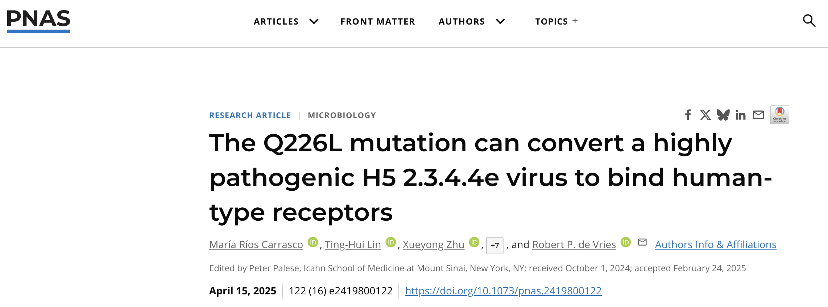

Slide 30
H5N1 Mutation
The key single mutation in H5N1 hemagglutinin (HA) that enables a switch in receptor binding from avian-type α2-3-linked sialic acids to human-type α2-6-linked sialic acids is Q226L—a glutamine-to-leucine substitution at position 226 in the HA receptor-binding domain.

Slide 31
Key Mutations in Dp.1.1 Variant
HA (hemagglutinin) mutations: Increased affinity for α-2,6 linked sialic acid.
PB2 gene mutations: Enhanced replication in mammalian cells.
NA (neuraminidase) adaptations: Potential resistance to antivirals.

Slide 32
H5N1 Mutation
This mutation alters the conformation of the receptor-binding site, enhancing affinity for α2-6 sialylated glycans, which are abundant in the human upper respiratory tract.
In some studies, the Q226L mutation alone or in combination with G228S (in H2 and H3 subtypes) has been sufficient to confer human-type receptor specificity, although the full context of the HA backbone and additional stabilizing mutations can influence the effect.
Recent structural and glycan-binding assays on bovine-adapted H5N1 strains confirm that Q226L significantly increases binding to human-type receptors, marking it as a critical molecular determinant for zoonotic potential.

Slide 33
Influenza treatment options
Antivirals
Immunomodulators
Monoclonal antibodies
Vaccines

Slide 34
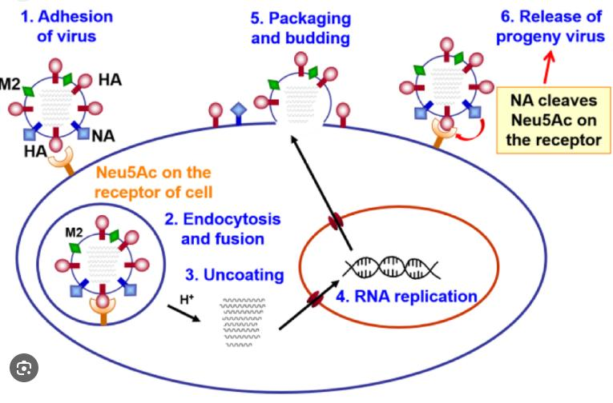

Slide 35
Influenza antivirals
Mechanisms |  | Medications
Viral Penetrator Inhibitors (Blocks M2 ion channel) |  | amantadine, rimantadine
Viral Release Inhibitor (Blocks NA) |  | oseltamivir zanamivir peramivir
Viral replication inhibitor
 | Inhibits RNA-dependent RNA polymerase (binds and blocks PB1) |  | favipiravir (approved COVID)
 | Blocks Cap-snatcher (PA) |  | baloxavir

Slide 36
Flu antivirals in Development
Drug Name | Mechanism of Action | Current Status (for Avian Flu Indication) | Key Efficacy Findings (Specific to Avian Flu/H5N1) | Resistance Profile/Notes | Administration Route/Dosing Frequency | Key Considerations
CC-42344 | PB2 Inhibitor | Phase 2a (Influenza A) ³ | 1000x more potent than Tamiflu against H5N1 in vitro ⁵ | Targets highly conserved site, high barrier to resistance ³ | Oral (Investigational) | High potency, broad-spectrum promise, early development ³
Tivoxavir Marboxil (TXM) | CAP-Dependent Endonuclease Inhibitor | Phase 1 completed, Preclinical for Avian Flu ⁴ | Significantly reduced lung viremia, prevented weight loss in NHPs ⁴ | Consistent efficacy across animal models, effective against recent H5N1 mutations ⁴ | Oral Single Dose (Investigational) | Accelerated approval pathway (Animal Rule) being pursued ⁴
Onradivir | Novel Oral Antiviral | Phase 3 completed (Influenza A) ²³ | Similar curative efficacy to oseltamivir for uncomplicated flu, speeds symptom relief ²³ | Potential alternative as susceptibility concerns grow ²³ | Oral Once Daily (Investigational) | Candidate for combination therapy ²³
Neumifil (HEX17) | Host-Targeting Biotherapeutic (Sialic Acid Binding) | Clinical Trials (Broad Respiratory Viruses) ²⁴ | Full prophylactic protection against A(H5N1) in mice ²⁵ | Targets host, reduced risk of antiviral resistance ²⁴ | Intranasal Spray (Investigational) | Broad-spectrum prophylactic potential ²⁴
Monoclonal Antibodies (e.g., 8A8) | Neutralizing Antibody (HA binding) | Preclinical/Development ¹ | Neutralizes H5N1 by blocking receptor binding/membrane fusion ¹ | Broad neutralizing activity against H5N1 strains ¹ | Passive Immune Therapy | Potential for severe cases or prophylaxis ¹

Slide 37
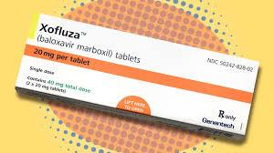
Baloxavir marboxil
(Xofluza)
Antiviral drug
Given as a pill in a single dose by mouth
U.S. FDA Approved on October 24, 2018
Blocks Cap-snatcher (PA)- Inhibits the endonuclease activity of the polymerase acidic (PA) protein found in influenza virus to inhibit virus replication ultimately

Slide 38
Baloxavir
treat the flu (influenza) in people 5 years of age and older who have flu symptoms for no more than 48 hours and who are otherwise healthy
prevent the flu in people 5 years of age and older following contact with a person who has the flu (post-exposure prophylaxis).

Slide 39
Influenza Vaccine

Slide 40
Inflluenza Vaccination Mechanism of Action
Role of Antibodies:
Antibodies bind to HA and NA, preventing the virus from entering and infecting cells.
They also help clear the virus from the body by marking it for destruction by immune cells.

Slide 41
Influenza Vaccine
Regarding the induction of immunity, the surface HA protein of the influenza virus contains 2 structural elements, head and stalk, wherein the head is the primary target of antibodies that confer protective immunity against influenza viruses

Slide 42
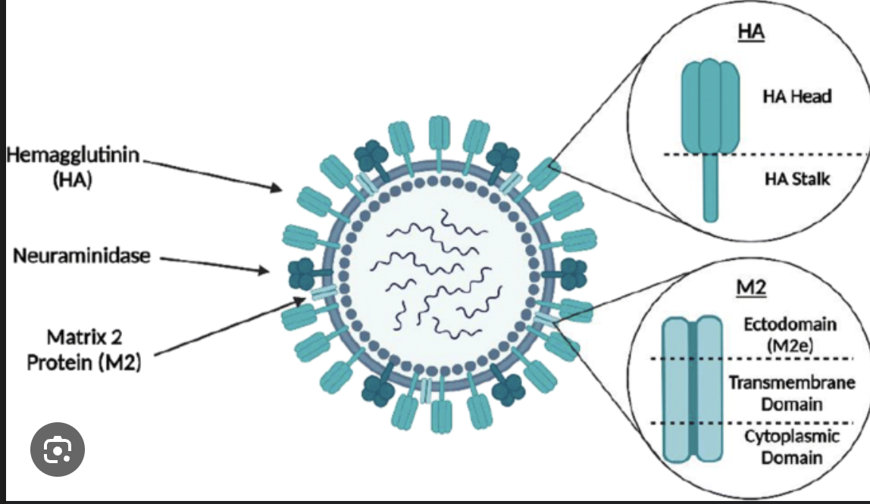
Influenza HA

Slide 43
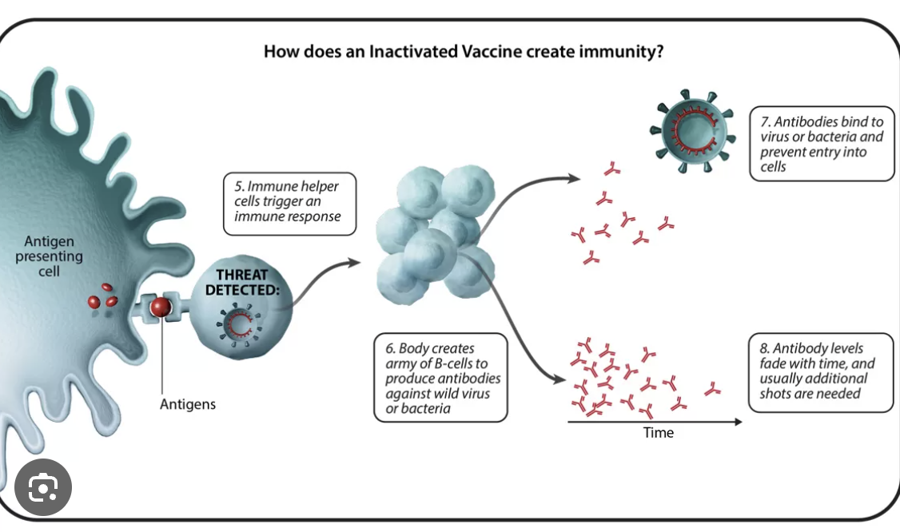

Slide 44
Flu Vaccine
Flu shots offer protection against 3 or 4 strains of the flu virus. Trivalent flu vaccines provide protection against 2 influenza A strains, H1N1 and H3N2, and 1 influenza B strain. Quadrivalent flu vaccines protect against the same strains as the trivalent vaccine and an additional strain of influenza B.
In the US, mainly, 3 types of influenza vaccines are available: Inactivated Influenza Vaccine (IIV), Recombinant Influenza Vaccine (RIV), and Live Attenuated Influenza Vaccine (LAIV).

Slide 45
SUMMARY
H5N1 or similar virus has potential to mutate to pandemic variant with potential for significant spread and / or mortality or morbidity?
Currently antiviral agents are expected to remain effective
Development and production of effective flu vaccine takes time
Remain vaccinated, do not get rid of your PPE

Slide 46
The END
THANK YOU!

Slide 47
H5N1 Avian Influenza in the U.S.: Focus on the D1.1 Variant
Current Status and Public Health Implications
Jon Jui MD, MPH

