Slide 1
NB.1.8.1 COVID Variant

Slide 2

H.1.8.1 in Asia : Increased death and hospitalization of COVID

Slide 3
What is NB.1.8.1?
A newly identified sub lineage of the Omicron variant of SARS-CoV-2.
Designated as a "Variant Under Monitoring (VUM)" by the World Health Organization (WHO) due to its increasing global prevalence.
First detected in samples collected in January 2025.

Slide 4
Increased Cases and Hospitalizations:
NB.1.8.1 has been linked to a significant increase in cases across Asia, particularly in China where it became the dominant strain.
Hong Kong has seen its highest COVID-19 levels in at least a year, with a "significant increase" in emergency room visits and hospitalizations attributed to NB.1.8.1.
Mainland China has also reported a doubling in both the percentage of patients seeking emergency room care and those requiring hospitalization for COVID-19.
Taiwan has seen a rapidly rising outbreak fueled by NB.1.8.1, leading to a sustained increase in severe and fatal cases and a shortage of COVID-19 testing kits

Slide 5
Deaths
While there are reports of increased deaths in specific areas, the World Health Organization (WHO) has stated that there is currently no evidence that NB.1.8.1 causes more severe illness than other circulating variants and considers the global risk to be "low”

Slide 6
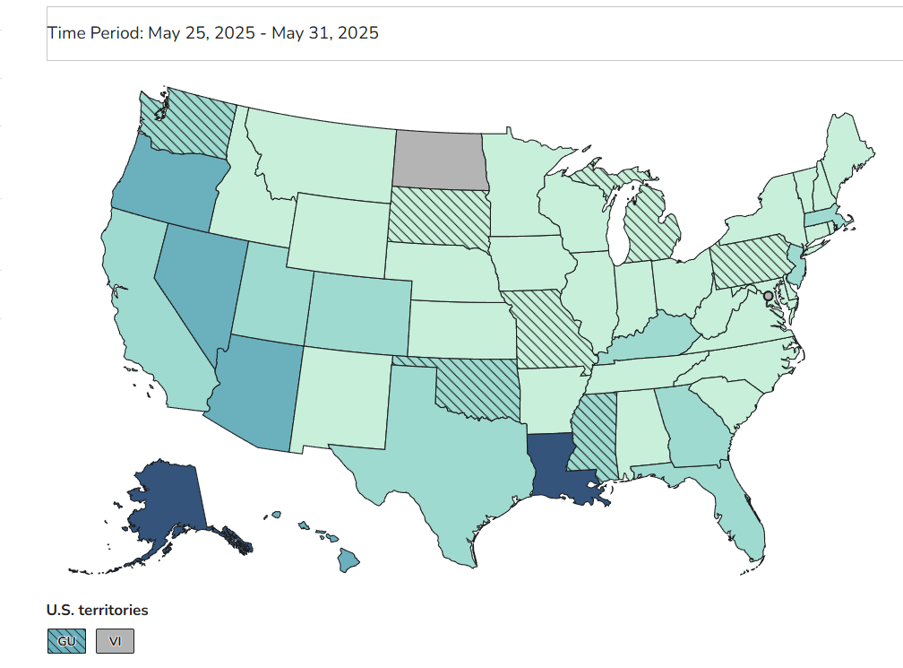
COVID in US May 25-May 31 2025 Waste Water

Slide 7
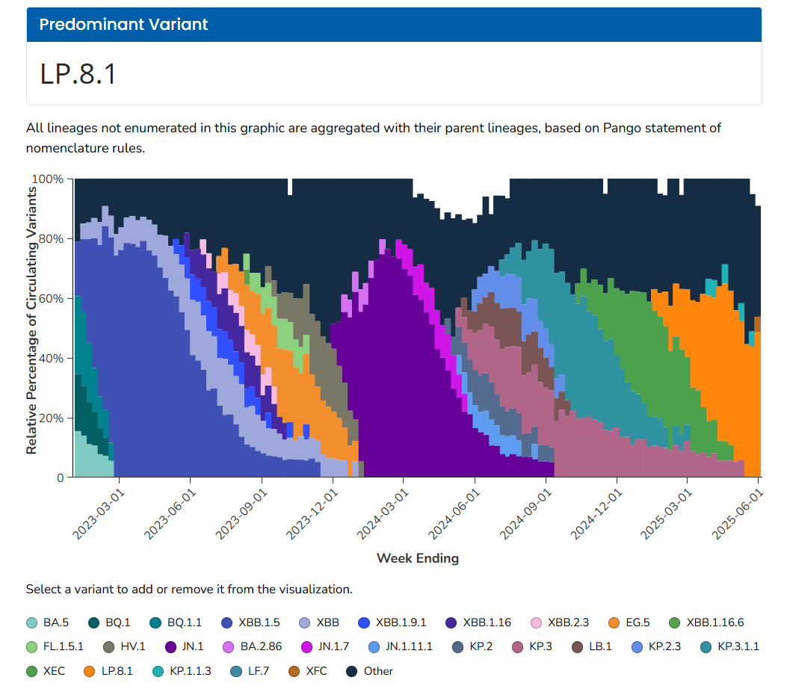
Current COVID Variants in US

Slide 8
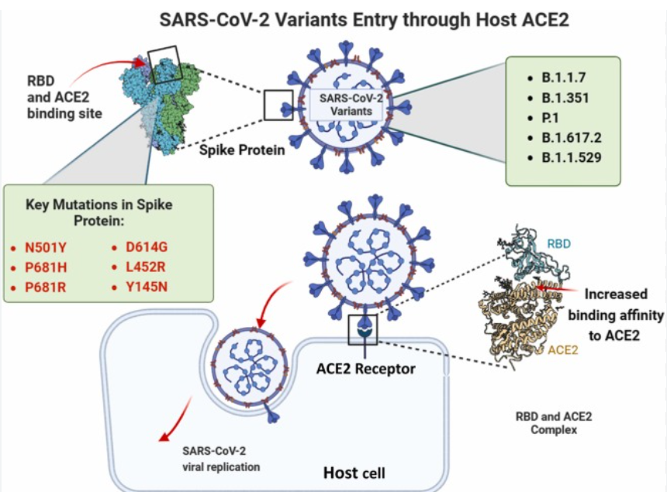
Current COVID Variant NB1.8.1
NB.1.8.1 "retained high ACE2 affinity and humoral immune evasion, supporting its potential for future dominance."

Slide 9
Significance of Mutations
These genetic changes, particularly within the spike protein, can influence the virus's ability to transmit and evade existing immune responses.

Slide 10
Increased Transmissibility
Evidence suggests NB.1.8.1 possesses a "growth advantage," indicating it may spread more easily than earlier variants.
Laboratory data indicates it binds more tightly to human cells, which contributes to its enhanced transmissibility.
It has been linked to rapid increases in COVID-19 case numbers in several affected regions, especially in Asia.

Slide 11
Common Symptoms
Symptoms align with those typically reported for Omicron subvariants and can include:
Fatigue
Fever or Chills
Muscle aches
Sore throat (some reports describe a "razor-blade throat")
Cough
Congestion or Runny nose
Headache
Nausea or Vomiting
Diarrhea
Loss of taste or smell (less prominent than with earlier variants)

Slide 12
Continued Effectiveness Against Severe Illness
Current COVID-19 vaccines, including bivalent and XBB-based boosters, are expected to remain effective in preventing severe disease outcomes such as hospitalization and death caused by NB.1.8.1.
The primary benefit of vaccination continues to be protection against severe illness, rather than complete prevention of infection.

Slide 13
Breakthrough Infections
It is possible for breakthrough infections to occur, particularly in individuals whose immunity may be waning or who remain unvaccinated.

Slide 14
Future Vaccine Development
New COVID-19 booster shots targeting prevalent variants (like LP.8.1 or JN.1) are under development and are anticipated to offer robust protection against NB.1.8.1 as well.

Slide 15
No Indication of Increased Severity
Despite concurrent increases in COVID-19 cases in some countries where NB.1.8.1 is widespread (e.g., China, Hong Kong), current data do not indicate that this variant leads to more severe illness compared to other variants currently in circulation.
The WHO reports no evidence of increases in critical indicators such as COVID-19-related ICU admissions and deaths per hospitalization, or overall all-cause mortality associated with NB.1.8.1.

Slide 16
Summary
NB.1.8.1 represents the continued evolution of the SARS-CoV-2 Omicron variant, demonstrating increased transmissibility.
Current data does not suggest that this variant causes more severe illness.
Existing COVID-19 vaccines are still effective offering substantial protection against severe disease outcomes.

Slide 17
H.1.8.1 in Asia : Increased death and hospitalization of COVID

