Slide 1
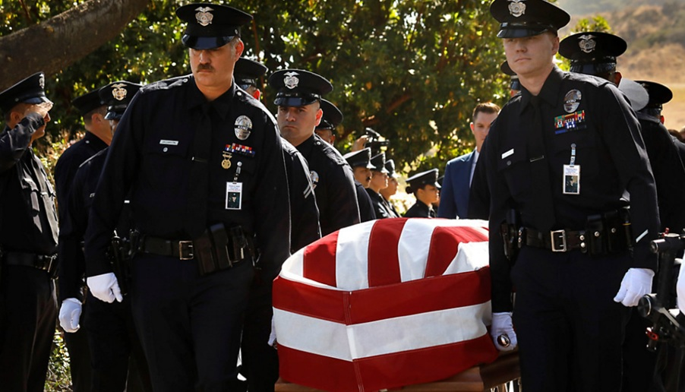
Impact of Vaccine Policy on Public Health and Emergency Planning and on
Emergency Responders
Why Emergency Managers Should Care About Changes in Vaccine Policy
Aileen M Marty MD, FCAP
Distinguished University Professor
Aileen.Marty@FIU.edu

Slide 2
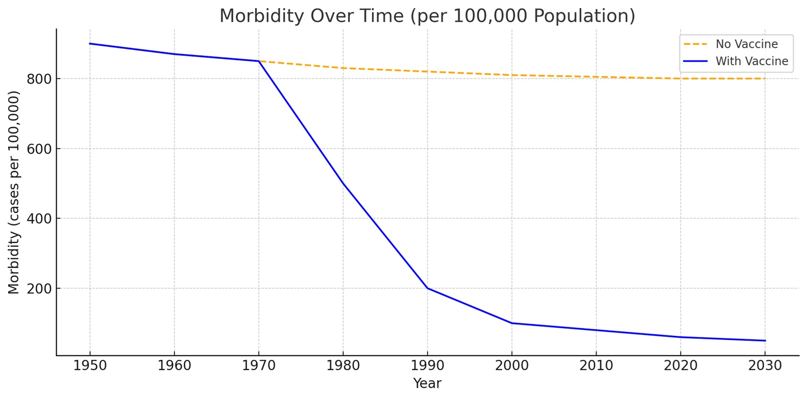
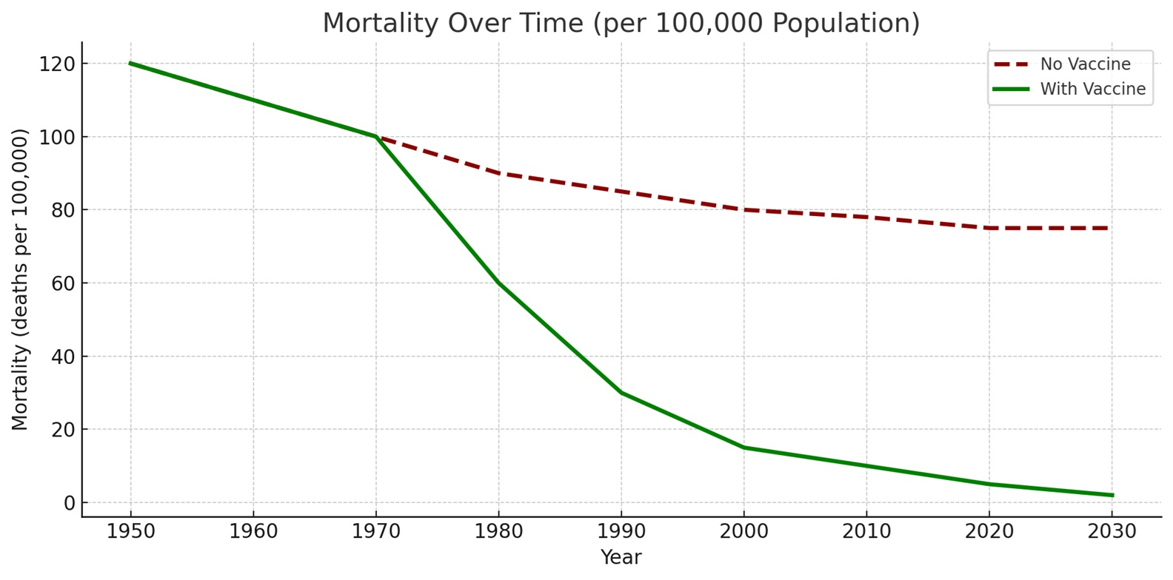
The Role of Vaccines on health is hard to exaggerate -surpassing even antimicrobials in impact. Vaccines can prevent disease and death, disrupt outbreaks, and treat diseases, thus saving lives, averting suffering, and transforming the future of entire populations. Not even clean water and sanitation match the scale of vaccines.
Shattock AJ, Johnson HC, Sim SY, et al. Contribution of vaccination to improved survival and health: modelling 50 years of the Expanded Programme on Immunization. Lancet. 2024 May 25;403(10441):2307-2316. doi: 10.1016/S0140-6736(24)00850-X. Epub 2024 May 2. https://www.thelancet.com/journals/lancet/article/PIIS0140-6736(24)00850-X/fulltext
Since 1974, vaccination has averted > 154 million deaths, including 146 million among children < 5 years, of whom 101 million were infants <1 year
*The charts reflect only commonly used vaccines, largely introduced globally between the 1970s and 2000s: Measles (MMR), Polio, Diphtheria, Tetanus, Pertussis (DTaP), Haemophilus influenzae type b (Hib), Hepatitis B, Pneumococcal conjugate vaccine (PCV), Rotavirus. The chart assumes that the current vaccination schedules are maintained.
Notes:
https://www.nature.com/articles/nm1209
Shattock AJ, Johnson HC, Sim SY, Carter A, Lambach P, Hutubessy RCW, Thompson KM, Badizadegan K, Lambert B, Ferrari MJ, Jit M, Fu H, Silal SP, Hounsell RA, White RG, Mosser JF, Gaythorpe KAM, Trotter CL, Lindstrand A, O'Brien KL, Bar-Zeev N. Contribution of vaccination to improved survival and health: modelling 50 years of the Expanded Programme on Immunization. Lancet. 2024 May 25;403(10441):2307-2316. doi: 10.1016/S0140-6736(24)00850-X. Epub 2024 May 2 https://www.thelancet.com/journals/lancet/article/PIIS0140-6736(24)00850-X/fulltext
Not even clean water and sanitation — long considered pillars of public health — have matched the speed and scale of vaccines in reducing death and disease."

Slide 3
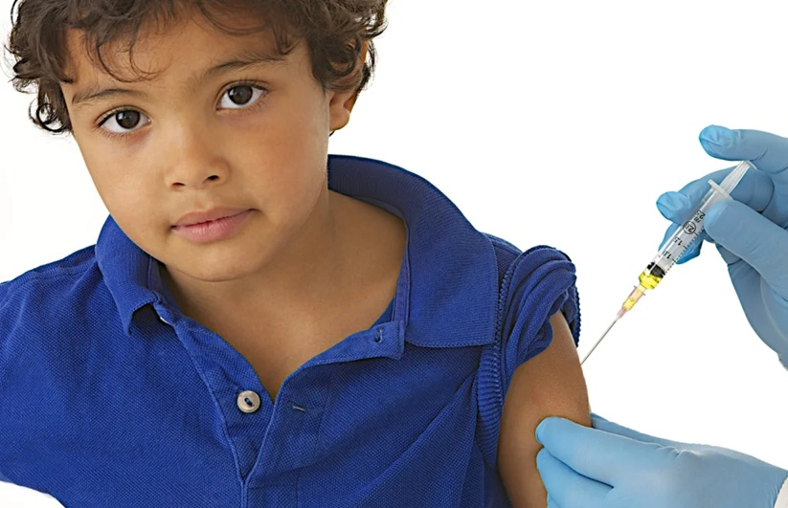
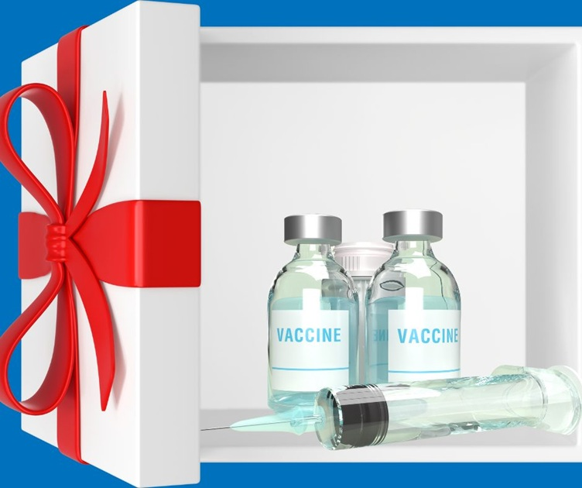
Vaccination is the Gift that Keeps on Giving
Each person vaccinated protects themselves AND the people around them
If neither you or your patient are vaccinated, YOU (and they) are at risk
* Risk from the pathogen is worse if either or both of you are immunocompromised, have an underlying disease, or have other risk factors
* Lack of herd immunity invites outbreaks
Notes:
https://compass.vkcsites.org/giving-the-gift-of-a-vaccine/
https://www.paediatrics.ox.ac.uk/news/what-is-meningitis-b-2013-and-why-don2019t-older-children-get-the-vaccine

Slide 4
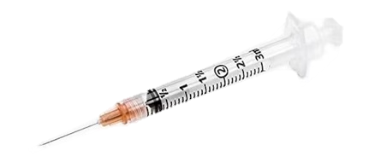
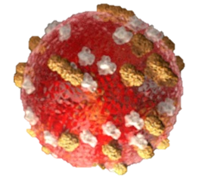

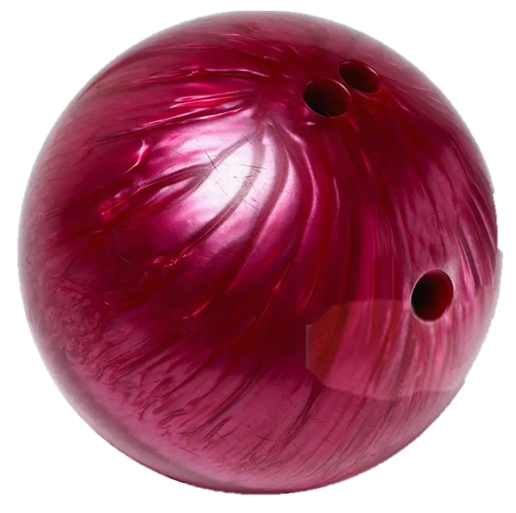
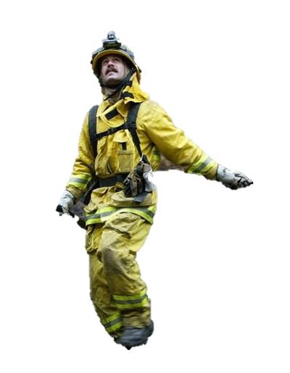
Risk is relative
Would you prefer being hit on the head with a Nerf ball or a bowling ball?
Yes, there are risks from vaccines, but
Vaccines are only approved when their benefits clearly and overwhelmingly outweigh their risks, and any serious adverse events are extremely rare compared to the risk of harm caused by the disease.
https://www.cdc.gov/measles/about/index.html
There has never been a legitimate, non-contested, scientifically valid study that has proven a connection between vaccines (or any of their ingredients) and autism, - including the measles vaccine from the time of its introduction in the 1960s through June 2025 [One discredited report from 1998 had ethical violations, falsified data – scientific misconduct, no control group observation of 12 children without statistical analysis – lack of scientific rigor, and was retracted by The Lancet]
Notes:
https://www.gettyimages.com/detail/news-photo/firefighter-hikes-through-burnt-forest-looking-for-hot-news-photo/2689675?adppopup=true
https://www.cdc.gov/measles/about/index.html
High-Quality Peer-Reviewed Studies: Key Findings
Multiple large-scale, population-based studies across several countries have evaluated the alleged link between MMR and autism. There is no increased risk of autism associated with MMR, even in children at higher genetic risk. Here are some of the most rigorous ones:
1. Madsen et al. (2002) – Denmark Title: A population-based study of measles, mumps, and rubella vaccination and autism Journal: New England Journal of Medicine
Findings: Among 537,303 children, no association between MMR vaccination and autism was found.
2. Honda et al. (2005) – Japan Journal: Journal of Child Psychology and Psychiatry
Findings: After MMR was withdrawn in Japan (1993), autism rates continued to rise, disproving a causal relationship.
3. Taylor et al. (2014) – Systematic Review Journal: Vaccine Findings: Reviewed 10 studies involving over 1.2 million children. Found no evidence that MMR causes autism.
4. Hviid et al. (2019) – Denmark Title: Measles, Mumps, Rubella Vaccination and Autism
Journal: Annals of Internal Medicine
Study size: 657,461 children
The Discredited Wakefield Study: In 1998, Andrew Wakefield and colleagues published their infamous paper in The Lancet suggesting a link between MMR vaccination and autism in 12 children. this study is widely recognized as fraudulent and is not considered valid scientific evidence.
Why It Was Discredited:
Ethical Violations: Wakefield had undisclosed financial conflicts of interest.
Scientific Misconduct: The data was falsified and selectively reported.
Lack of Scientific Rigor: Only 12 children; no control group; no statistical analysis.
Retraction: The Lancet fully retracted the article in 2010.
Vaccine Ingredients & Autism: Examined and Dismissed
1. Thimerosal A mercury-containing preservative never used in the MMR vaccine. It was removed or reduced in all U.S. childhood vaccines by 2001 as a precaution — yet autism rates continued to rise, further disproving any link.
2. Aluminum Used as an adjuvant in some vaccines (not in MMR). Studies have shown that the tiny amounts used are well below safety thresholds and not associated with autism.
3. Combination of Antigens (multiple vaccines) Concerns that receiving multiple vaccines might "overwhelm the immune system" are not supported by immunological science.
Children are exposed to far more antigens daily in their environment.
Leading Authorities' Statements
CDC: “There is no link between vaccines and autism. Some people have had concerns that autism spectrum disorder (ASD) might be linked to the vaccines children receive. However, studies have shown that there is no link.”
WHO: “Available epidemiologic data show no evidence of a causal association between measles–mumps–rubella vaccine and autism spectrum disorders.”
ECDC: “There is no scientific evidence to support a link between the MMR vaccine and autism.”
After an exhaustive review of Decades of peer-reviewed research, Numerous epidemiological studies with large sample sizes, Investigations by global public health authorities, and the fraudulent nature of the only paper that ever claimed a link, there is no credible scientific evidence supporting a connection between the measles vaccine or its ingredients and autism. This conclusion has stood unchallenged by legitimate scientific bodies from the 1960s through June 2025.

Slide 5
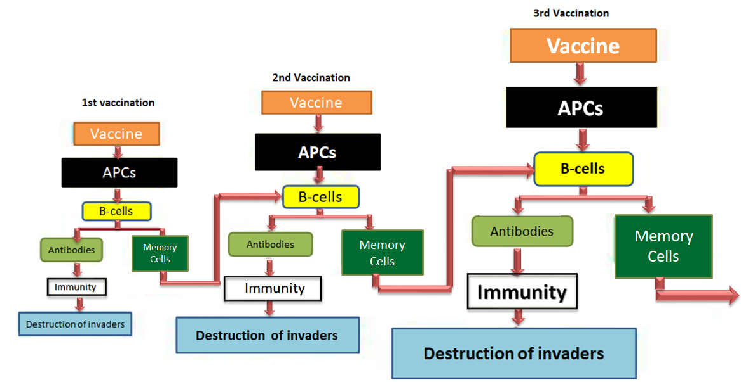
Affinity Maturation, additional Somatic Mutations, and Quantity of Responders or why Repeated Vaccine doses potentiate the Response
Affinity maturation (somatic maturation and affinity-based selection) takes time
Highest affinity antibodies are produced when vaccine doses are well spaced out.
  Antigen concentrations decline over time. When antigen is limiting, cells with the greatest affinity receptors are the ones that get stimulated.
Optimal boosting responses generally require long intervals between doses -- in Humans, this is typically at least 3 to 4 months
…and the neutralizing quality of antibodies improves with re-exposure
In adaptive immunity on 1st exposure, the immune system generates a primary immune response of effector cells intended to destroy the invaders, and simultaneously generates memory cells. On 2nd exposure, these memory cells initiate much stronger immune responses that result in a much more efficient and stronger protection
* Warning! If vaccines are administered too frequently, it interferes with the generation of memory cells and thus reduces protection!
Timing is everything!
Notes:
* If vaccines are administered too frequently, this interferes with the generation of memory cells and thus reduces protection!
In adaptive immunity on 1st exposure to a foreign invader or vaccine, the immune system generates a primary immune response that should destroys the invaders, while at the same time generating memory cells. On second exposure to that invader (or revaccination), these memory cells initiate much stronger immune responses using that result in a much more efficient elimination to the invaders or stronger protection

Slide 6
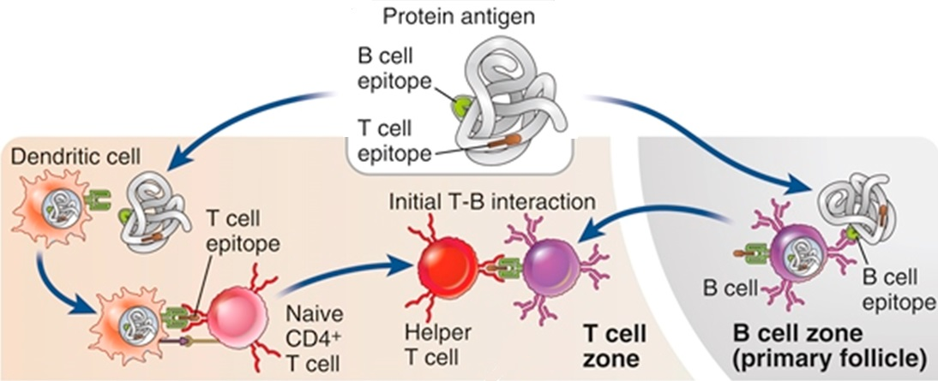
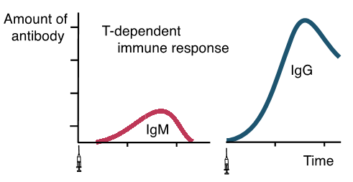
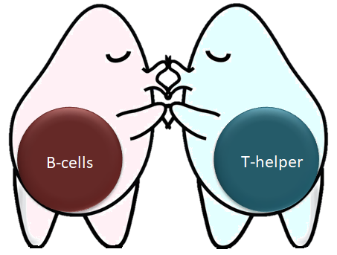
First steps in the process T-dependent Process
Immune responses are initiated by recognizing parts of antigens by B cells and CD4⁺ T cells.
The naïve mature CD4+ T cell recognizes a small peptide from an antigen as shown by a Dendritic cell using an MHC class II molecule
The naïve mature B cell recognizes an epitope on the antigen with its BCR
At the B/T interface of secondary lymphoid organs
The activated B cell and the activated CD4+ T lymphocytes migrate toward one another and interact at the interface of the T and B cell zones.

Slide 7
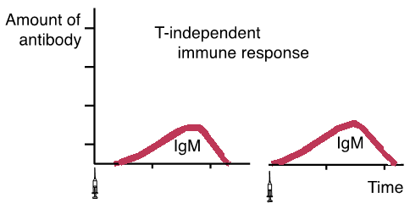
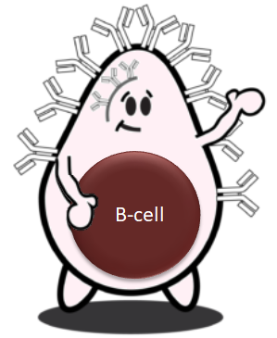
T-independent antigens:
Can stimulate B-cells without the help of Th Cells
Type I
    Most are polyclonal B-cell activators (mitogens); i.e., they can activate B cells regardless of their antigenic specificity
    Bind to PRRs to provide cloning signals
Type II
  Simple repeating polymers (e.g., mainly epitopes of encapsulated bacteria)
    Certain PAMPS for example:
      Lipopolysaccharide from E. coli
      Polymerized flagellin from Salmonella
      Polysaccharide from S. pneumoniae, H. influenzae, N. meningitidis, or Salmonella enterica Typhi strain
    Can be
      Polysaccharides
      Glycolipids
      Nucleic acids
Usually, Only trigger IgM responses
Fail to generate long-lived memory cells
Marginal Zone B2 cells (MZ-B2) are the key mediators of T-independent type II antibody responses. MZ-B2 cells are not functionally mature in humans until after 12 months of age
Notes:
TI-1 = thymus independent
Cartoons modified from https://cellcartoons.net/cartoons-all/

Slide 8
Live Vaccines
Method used to create or derive the pathogen | Date | Vaccine or target
Use of a related animal virus | 1798 | Smallpox, mPox
Chemical attenuation | 1885 | Rabies (discontinued in the 1930s)
Passage in vitro [random mutagenesis] | 1927 | BCG
 | 1935 | Yellow fever
Naturally avirulent strain | 1934 | Anthrax (Sterne Strain)
Cell culture passage [random mutagenesis] | 1954 | Anthrax (AVA derived from Vollum strain)
 | 1962 | Oral Polio Vaccine
 | 1963 | Measles
 | 1967 | Mumps
 | 1971 | Adenoviruses
 | 1973 | mPox* (using a related animal derived virus)
 | 1995 | Varicella
 | 2005 | Rotavirus 89-12
 | 2023 | Chikungunya
Cell culture passage with cold adaptation [random mutagenesis with deliberate induction of cold mutagenesis] | 1969 | Rubella
 | 2003 | Live influenza
Auxotrophic mutants (deliberately nutrient-needy mutagenesis) | 1989 | Ty21a typhoid
Use of reassortants (mixing strains of a virus to create an attenuated subtype) | 1970s | Inactivated influenza seed
 | 2003 | Live influenza
 | 2005 | Rotavirus bovine-human

Slide 9
Dead/Inactivated Whole-Organism Vaccines
Inactivated whole organisms | Date | Vaccine or target
 | 1896 | Typhoid
 | 1896 | Cholera
 | 1897 | Plague
 | 1926 | Whole-cell pertussis
 | 1938 | Influenza
 | 1955 | IPV
 | 1995 | Hepatitis A
 | 2020 | SARS-CoV-2 (China)
Denatured Toxin
Toxoids | Date | Vaccine or target
 | 1923 | Diphtheria
 | 1927 | Tetanus
 | 1981 | Acellular pertussis (Japan, not available in USA until 1991)

Slide 10
Polysaccharide Vaccines
T-independent antigens Polysaccharide of capsules | Date | Vaccine or target
 | 1977 | Pneumococcal (14 valent, discontinued)
 | 1983 | Pneumococcal (23-valent, still used for ≥ 65 along with conjugated)
 | 1974 | Meningococcal (1 valence, discontinued in 1978)
 | 1978 | Meningococcal (4- valent, replaced by conjugate 2017)
 | 1985 | Hemophilus influenza (discontinued in 1990)
 | 1994 | Typhoid
Polysaccharide-Conjugated to Protein Vaccines
T-dependent antigens Polysaccharide + Protein | Date | Vaccine or target
 | 1987 | Hemophilus influenza (better versions created in 1990 and 1993)
 | 2000 | Pneumococcal ( Better versions in 2010, 2021, 2024)
 | 2005 | Meningococcal (newer versions 2010, 2012, 2020, 2023)
 | 2017 | Typhoid (alternative version 2020)

Slide 11
Many other Vaccine Platforms: Example of Platforms Developed for COVID-19
Platform |  | Candidate vaccines (no. and %)
PS | Protein subunit | 59 | 32%
VVnr | Viral Vector (non-replicating) | 25 | 14%
DNA | DNA | 17 | 9%
IV | Inactivated Virus | 22 | 12%
RNA | RNA | 43 | 24%
VVr | Viral Vector (replicating) | 4 | 2%
VLP | Virus Like Particle | 7 | 4%
VVr + APC | VVr + Antigen Presenting Cell | 2 | 1%
LAV | Live Attenuated Virus | 2 | 1%
VVnr + APC | VVnr + Antigen Presenting Cell | 1 | 1%
BacAg-SpV | Bacterial antigen-spore expression vector | 1 | 1%
Notes:
March 2023

Slide 12
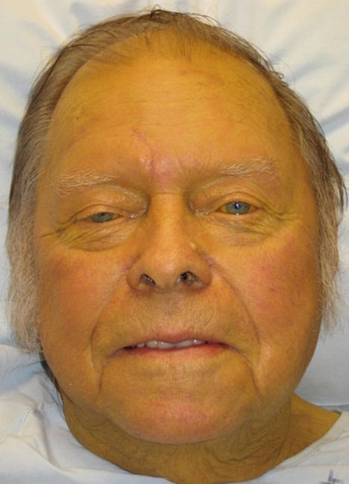
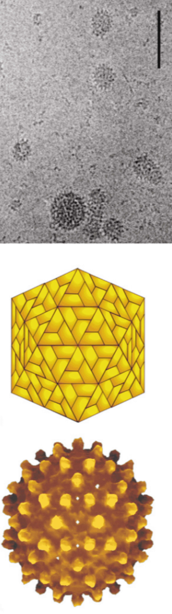
Hepatitis B
1.5 million people become newly infected each year.
Globally, > 2 billion people (1/3 of the world population) have been infected with HBV.
Rates of acute hepatitis B infection have risen 50%-450% in states impacted by the opioid crisis.
Following acute infection with HBV,
>378 million people (6% of the world population) are chronic carriers,
30–90% of infected babies become chronic carriers (and up to 10% of adults)
  Increased risk of
    Life-threatening cirrhosis and
    Hepatocellular carcinoma (HCC).
Currently, ~ 620,000 people die each year from acute and chronic sequelae secondary to HBV infection
https://www.hepb.org/what-is-hepatitis-b/what-is-hepb/facts-and-figures/
Notes:
https://britishlivertrust.org.uk/information-and-support/liver-conditions/hepatitis-b/symptoms/
https://www.hepb.org/what-is-hepatitis-b/what-is-hepb/facts-and-figures/

Slide 13
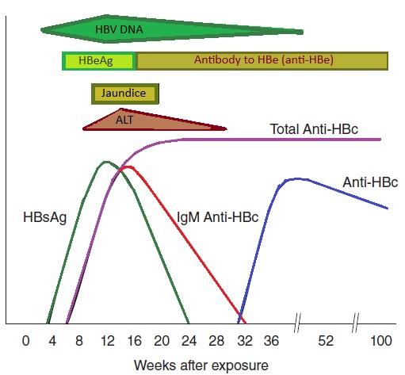
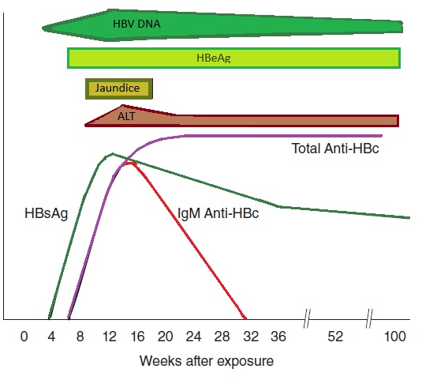
Hepatitis B, Clinical
Acute Resolving Hepatitis B infection
(Serologic profile of Patients that do not develop chronic infection)
Transmission: Blood and other body fluids (semen, vaginal fluid, saliva, etc.), thus sex, percutaneous (e.g., IV drugs), and perinatal transmissions cause most transmissions. Less often, organ transplants.
Incubation: 1-6 months
Clinical
  Acute Hepatitis B infection If symptomatic: ranges from
      Asymptomatic: 65-70%
      Acute hepatitis (5% adults, 90-95% infants)
      fulminant hepatitis and death (<1%)
    Prodrome (pre-icteric): fever, fatigue, abdominal pain, n, v, joint, and muscle pain (lasts up to 7d)
      Elevated ALT and AST
    Icteric phase: jaundice, fatigue, often with extrahepatic symptoms caused by Hypersensitivity Type III (Antigen-Antibody complexes get trapped in blood vessel walls, causing rash, joint pain, angioneurotic edema)
  Chronic hepatitis B (20-30%)
    Inactive carrier state 50%
      Includes “Occult Hepatitis B”
    Cirrhosis 30%
    Liver cancer 2% per year (especially those with cirrhosis)
Switch from HBeAg to anti-Hbe is “Hbe seroconversion” and signals recovery
Acute Hepatitis B that becomes Chronic
(Serologic profile of Patients that develop chronic infection)
13

Slide 14
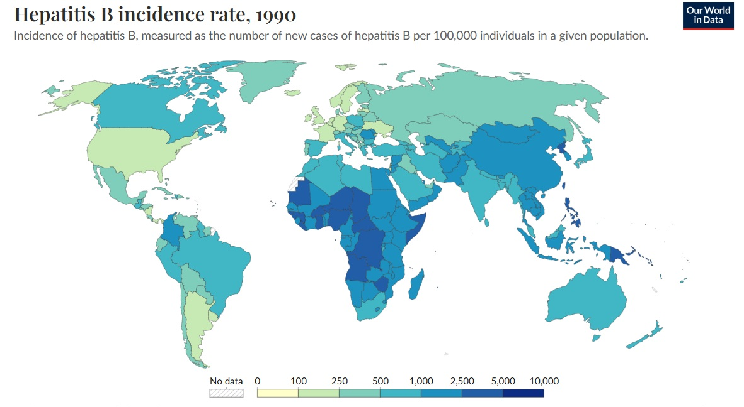
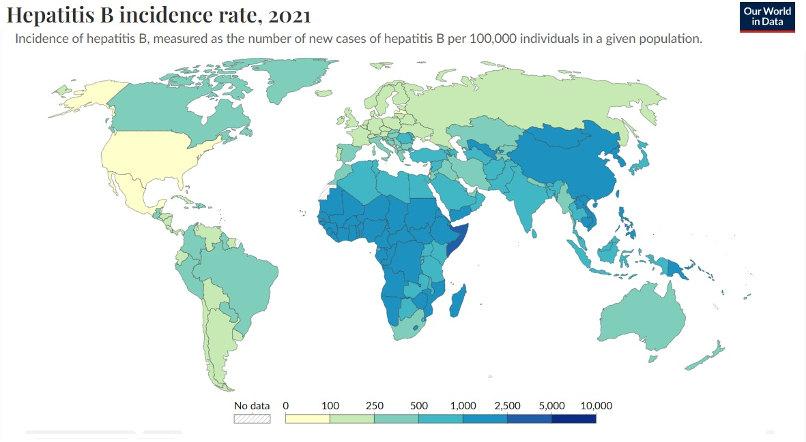
Impact of Hepatitis B Vaccine Programs – Fewer cases --- FOR NOW
https://ourworldindata.org/grapher/hepatitis-b-incidence-sdgs?time=latest
Hepatitis B vaccine is an Anti-Cancer Vaccine
Notes:
https://ourworldindata.org/grapher/hepatitis-b-incidence-sdgs?time=latest

Slide 15
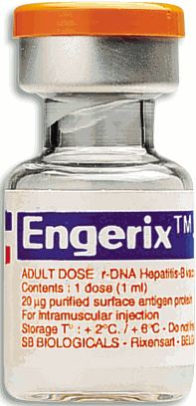
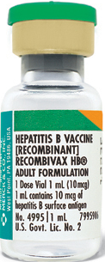


Hepatitis B Vaccines
Both are Recombinant HBsAg vaccines
Engerix
GlaxoSmithKline: Sterile suspension of non-infectious purified surface HBsAg obtained by culturing genetically engineered Saccharomyces cerevisiae yeast.
Adult doses
  series of 3 doses (1.0 mL each) given on:
    0 – day 1
    1 - month
    6- month
  Persons on dialysis receive series of 4 doses (2.0 mL each); monitor ab levels annually and give additional doses as needed.
Recombivax HB
Merck: Attenuated strain
Sterile suspension of non-infectious subunit viral vaccine derived from HBsAg produced in yeast cells. A portion of the hepatitis B virus gene, coding for HBsAg, is cloned into Saccharomyces cerevisiae yeast
Adult doses
  series of 3 doses (1.0 mL each) given on:
    0 – day 1
    1 - month
    6- month
  RECOMBIVAX HB Dialysis Formulation has same schedule
Persons >60 have diminished Ab response
Notes:
wait before vaccinating see ACIP’s General Recommendations on Immunization regarding time to.

Slide 16
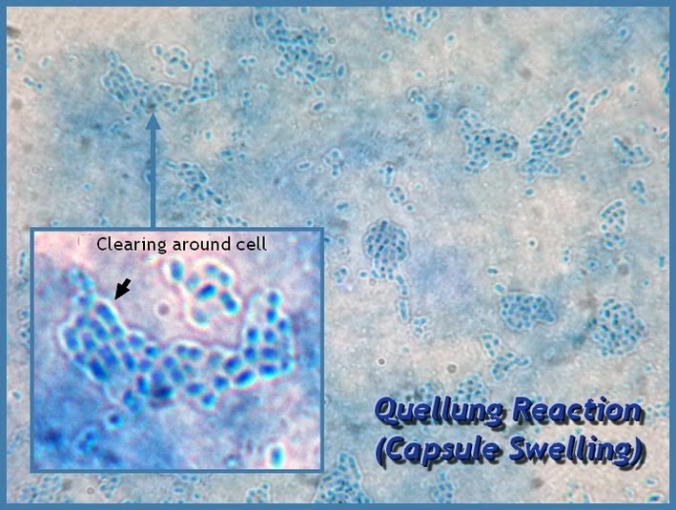
Strep Pneumonia: “The Captain of Death”
S. pneumoniae Virulent Factors
Capsule
  Most important virulent factors
  Polysaccharide
  Prevents complement component opsonization
  Inhibit chemotaxis & phagocytosis, facilitate adherence
  Uncapsulated strains are avirulent
Cell wall and its components
  Peptidoglycans — Teichoic acid & Lipoteichoic acid (Endotoxin)
Surface proteins PspA & CbpA
  CbpA — Prevents C3 deposition
  PspA — Inhibit complement activation by interfering with the formation of C3 convertase
Enzymes
  IgA protease — Cleave surface IgA
Immune evasion
https://cdn-prod.medicalnewstoday.com/content/images/articles/324/324726/meningitis-rash-image-credit-dermnet-new-zealand.jpg
Notes:
Embolic Phenomena: Purplish discoloration of skin resulting from embolus to. small toe. In this case, the embolus originated from an infected aortic valve.
Petechiae are tiny, circular, non-raised patches that appear on the skin or in a mucous or serous membrane. They occur as the result of bleeding under the skin. Usually, a person will notice petechiae, pronounced (pi-TEE-kee-ee), appearing in clusters on the surface of their skin or inside their mouth or eyelids.

Slide 17
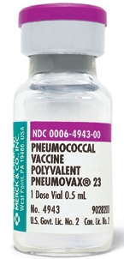
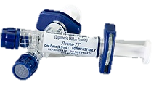
Pneumococcal Vaccines
Streptococcus pneumoniae; > 100 serotypes
1880: Pasteur Isolates
1911: 1st efforts to develop a vaccine
1940: Interest in vaccines decreases with the introduction of antibiotics
1977: PPSV14: (Merck) Polysaccharide Pneumococcal vaccine licensed in the USA (14 strains)
1983: PPSV23 (Merck) inactivated polyvalent polysaccharide pneumococcal vaccine (Pneumovax 23®)
2000: Prevnar-7 PCV7 (Wyeth/Pfizer) for infants ([Diphtheria CRM197 Protein])
2010: Prevnar 13 PCV13 (Pfizer)
2021: Prevnar 20: PCV20 (Pfizer)
2022: Vaxneuvance PCV15® (Merck)
2024: Capvaxive PCV21® (Merck)
Polysaccharide vaccine made to look like the surface of certain bacteria to help the body build protection (not good at stimulating T cells; provides “T-cell independent” immunity)
Conjugate vaccines join a protein to polysaccharides of bacteria to improve the protection provided by the vaccine (are good at stimulating T cells, provide “T-cell dependent” immunity)
Notes:
Prevnar 13 : 1, 3, 4, 5, 6A, 6B, 7F, 9V, 14, 18C, 19A, 19F and 23F
Pneumovax 23: 1, 2, 3, 4, 5, 6B, 7F, 8, 9N, 9V, 10A, 11A, 12F, 14, 15B, 17F, 18C, 19A, 19F, 20, 22F, 23F, and 33F
1977: 1st Pneumococcal vaccine licensed in the USA (14 strains)
1983: 2nd Pneumococcal vaccine (23 strains) PPSV23 inactivated polyvalent polysaccharide (Pneumovax 23®)
2010: 4th Pneumococcal vaccine(13 strains) (Pneumococcal 13-valent conjugate Vaccine [Diphtheria CRM197 Protein]) Prevnar 13
2021: 5th Prevnar 20: Pneumococcal 20-valent Conjugate Vaccine
2024- 6th PCV21 CAPVAXIVE® 21-valent Conjugate Vaccine

Slide 18

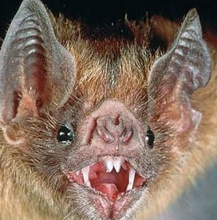
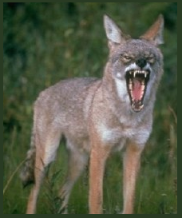
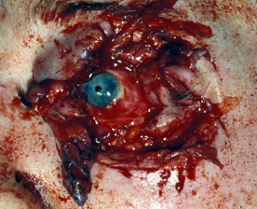
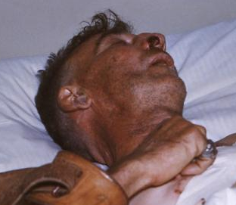
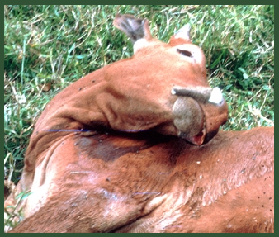
Rabies: Kills unnatural hosts
Where: Nearly global
What: Zoonotic viral disease that affects the central nervous system
Reservoir hosts: Bats, skunks, raccoons, and foxes.
Transmission: Contamination from virus in saliva of clinically affected host; usually transmitted via bite(s)
Prognosis if unvaccinated: death of humans, dogs, cats, horses, cattle, and other unnatural hosts
  Nearly 100% chance of death if an infected unvaccinated human is not given post-exposure vaccine
If you practice wilderness medicine, you are at increased risk of exposure
Notes:
Raccoon rabies virus variant is present in the eastern United States, Skunk rabies in the Central United States and California, Fox rabies in Texas, Arizona, and Alaska, and Mongoose rabies in Puerto Rico.

Slide 19
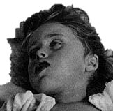
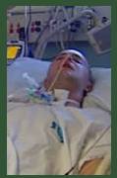
Clinical - Furious Rabies
Clinical – Paralytic (Dumb) Rabies
Mean incubation~ 55 days (range: 7 days to > 6 years).
Hydrophobia
  represents exaggerated irritant reflex of the respiratory tract,
  possibly arising from nucleus ambiguus
Episodic hyperactivity, seizures, and aerophobia
Hyperventilation leads to periodic and ataxic respiration, and eventually, apnea supervenes.
Cardiac arrhythmias (common), predominantly supraventricular tachycardias and bradycardias, reflect either brain stem dysfunction or myocarditis
Autonomic dysfunction, including pupillary dilation, anisocoria, piloerection, markedly increased salivation and sweating, and rarely, priapism or spontaneous ejaculation
Pituitary dysfunction, especially disordered water balance (either inappropriate antidiuresis or diabetes insipidus).
Coma
  Patients entering a coma generally die within 1 to 2 weeks despite maximal supportive care.
Mean incubation~ 49 days (range 7-90 days).
Initial findings suggest ascending paralysis, including hypophonia (resembles acute inflammatory polyneuropathy = Guillain-Barré syndrome) or a symmetric quadriparesis.
Weakness may be more severe in the extremity where the virus was introduced
Meningeal signs (headache, neck stiffness) may be prominent despite a normal sensorium.
As the disease progresses, the patient becomes confused and then declines into a coma.
No hydrophobia, aerophobia, hyperactivity, or seizures
Patients with furious rabies who receive maximal intensive care support and survive for longer-than-expected, appear to pass through a paralytic phase before death.
The mean interval between onset of symptoms and death is 8.4 days (range 7-11 days).
Notes:
Two cases are reported of rabies-associated cerebral artery vasospasm that was treatable with drugs directed at the nitric oxide synthase pathway. This vasospasm may relate to a deficiency of tetrahydrobioterin, and might be ameliorated by its replacement.

Slide 20
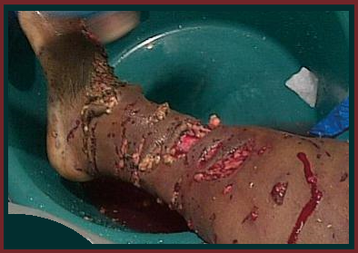
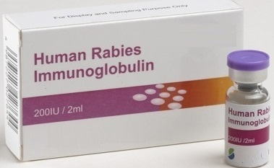
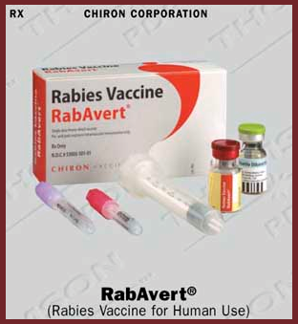
Rabies: Clean, Passive Immunization at wound site, and Vaccination
Post-exposure prophylaxis (PEP) consists of:
Clean the Wound
Passive immunization w/ human rabies immunoglobulin (HRIG) at wound site(s)
Rabies vaccination (series of rabies vaccine shots on day 1, 3, 7, and 14)
Clinical Rabies is ~100% preventable via prompt and appropriate medical care!
Failure after the use of Post-Exposure Prophylaxis (PEP) (with a patient developing Clinical Rabies) can happen if :
omissions and flaws in PEP
true treatment failures (uncommon)
Notes:
Rabies in humans is 100% preventable through prompt and appropriate medical care. Rabies post-exposure prophylaxis (PEP) consists of a dose of Human Rabies Immune Globulin (HRIG) and a series of rabies vaccine shots
Give HRIG immediately, at start of PEP
If anatomically feasible, infiltrate full dose of HRIG within and around wounds
Inject any remaining volume intramuscularly (IM) at a site distant from rabies vaccine administration [Rabies-specific antibody is barely detectable in serum after standard dosing of rabies immune globulin (RIG). Thus, some experts question wisdom of giving RIG other than into wound during post-exposure prophylaxis]

Slide 21
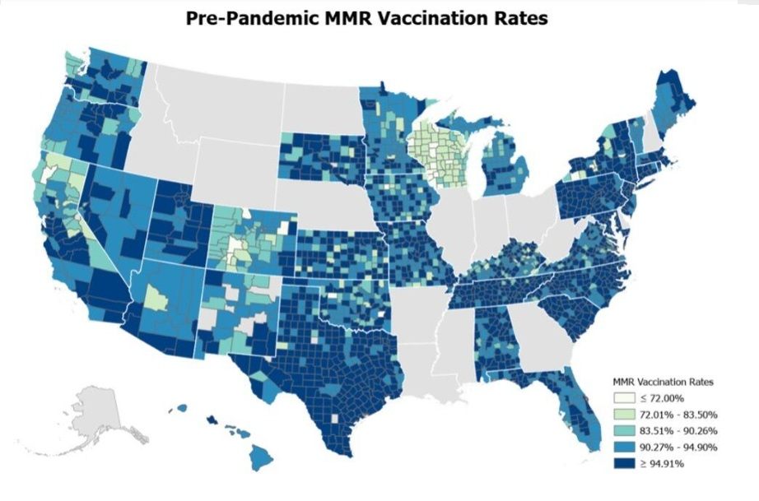
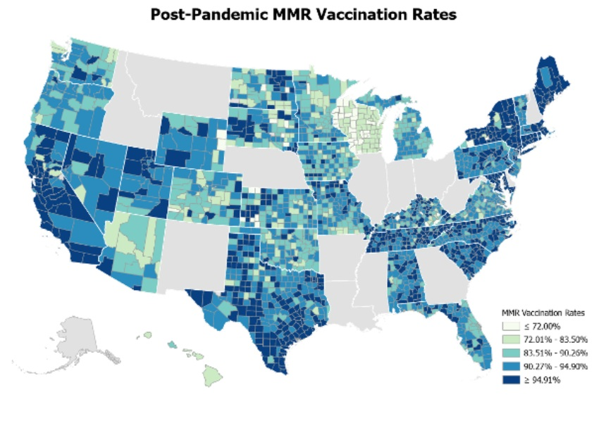
County-Level Measles-Mumps-Rubella (MMR) Vaccination or Complete Immunization Series Rates
Dong E, et al. Trends in County-Level MMR Vaccination Coverage in Children in the United States. JAMA. 2025 Jun 2:e258952. DOI: 10.1001/jama.2025.8952 Epub ahead of print.
Notes:
Dong E, Saiyed S, Nearchou A, Okura Y, Gardner LM. Trends in County-Level MMR Vaccination Coverage in Children in the United States. JAMA. 2025 Jun 2:e258952. DOI: 10.1001/jama.2025.8952 Epub ahead of print. PMID: 40455620; PMCID: PMC12131173.
This study has limitations. Inconsistencies and gaps in reporting across states restricted analysis to 33 states and affected comparability of the data. Reported vaccination data may be inaccurate due to missing student records, home-schooled children, and select schools that are not required to provide records, thus potentially introducing bias.

Slide 22

Measles Outbreaks in USA: Jan- June 2025: > 4 Times Greater than the total # of cases in 2024
U.S. Cases in 2025: Total cases (05 June 2025) 1168 total
Age
  Under 5 years: 339 (29%)
  5-19 years: 438 (38%)
  20+ years: 381 (33%)
  Age unknown: 9 (1%)
Vaccination Status
  Unvaccinated or Unknown: 95%
  One MMR dose: 2%
  Two MMR doses: 3%
U.S. Measles Hospitalizations in 2025:
12% of cases were hospitalized (137 of 1168) for isolation or management of measles complications.
Age
    Under 5 years: 21% (71 of 339)
    5-19 years: 08% (34 of 439)
    20+ years: 08% (31 of 381)
    Age unknown: 11% (1 of 9)
US Deaths: 3
https://www.cdc.gov/measles/data-research/index.html
2024 data: Age
Under 5 years: 120 (42%)
5-19 years: 88 (31%)
20+ years: 77 (27%)
Vaccination Status
Unvaccinated or Unknown: 89%
One MMR dose: 7%
Two MMR doses: 4%
40% of cases (114 of 285) hospitalized for isolation/ management of complications.
2024: U.S. Measles cases: 1 Jan to December 31, 2024: 285 measles cases
16 outbreaks (defined as 3 or more related cases), 69% of cases (198 of 285) were outbreak-associated. [For comparison, in 2023, there were 4, and 49% of cases (29 of 59) were outbreak-associated.
33 jurisdictions:
  Arizona, California, District of Columbia, Florida, Georgia, Idaho, Illinois, Indiana, Louisiana, Maryland, Massachusetts, Michigan, Minnesota, Missouri, New Hampshire, New Jersey, New Mexico, New York City, New York State, North Carolina, Ohio, Oklahoma, Oregon, Pennsylvania, South Carolina, South Dakota, Tennessee, Texas, Vermont, Virginia, Washington, Wisconsin, and West Virginia.
Notes:
https://www.cdc.gov/measles/data-research/index.html

Slide 23
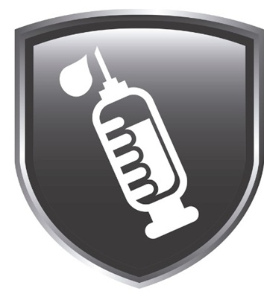
How Vaccines Protect First Responders (Force Protection)
Operational readiness:
Reduced absenteeism (e.g., flu vaccines cut HCW sick days by 40–60%)
Avoided 21-day quarantines for measles-exposed unvaccinated responders.
PPE burden mitigation: Vaccinated responders require fewer stringent PPE protocols (e.g., no post-exposure prophylaxis for HBV if anti-HBs ≥10 mIU/mL)
Occupational exposure reduction:
HBV: Pre-vaccine, 10–30% of unvaccinated HCWs contracted HBV annually via needlesticks; post-vaccine, infections dropped by 98%.
Measles: MMR vaccination eliminated measles in the U.S. by 2000, protecting responders from airborne transmission (R0 = 12–18) – until NOW, that protection is slipping away!
COVID-19: Vaccinated EMS workers experienced 79–85% lower infection rates during surges, thereby preserving workforce capacity.

Slide 24

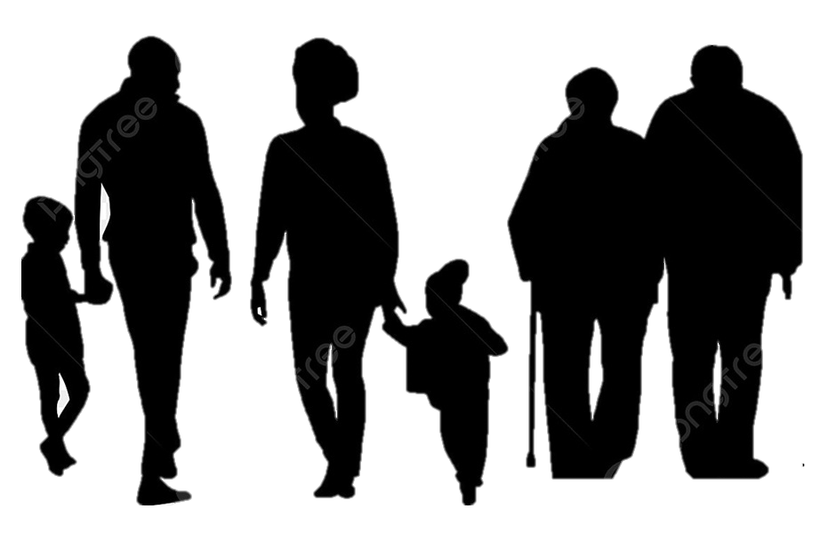

What Vaccines Mean for Responders, Families, and Communities
Personal safety:
Near-elimination of occupational transmission risks (e.g., HBV, measles).
Reduced mortality: COVID-19 vaccines have lowered healthcare worker (HCW) death rates by 94%.
Household protection:
Vaccinated responders are 72% less likely to transmit infections like COVID-19 to immunocompromised family members.
Herd immunity thresholds (e.g., 95% for measles) protect unvaccinated children and elderly relatives.
Community resilience:
EMS vaccination correlates with 30–50% lower outbreak rates in high-risk settings (e.g., nursing homes, schools) .
Economic benefits: Every $1 spent on childhood vaccines saves > $11 in societal costs.

Slide 25

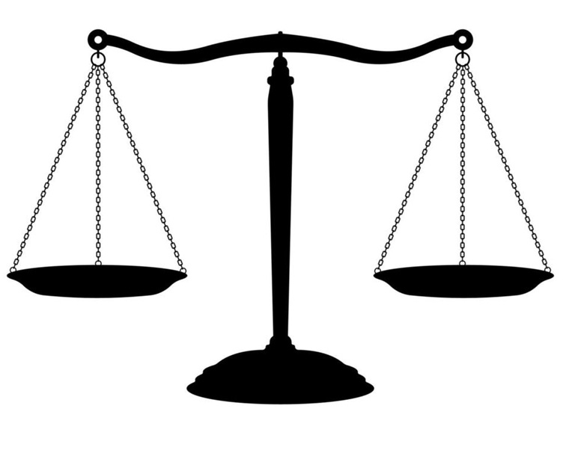

Why First Responders Should Advocate for Science-Based Vaccine Policy
Workload sustainability
Public trust:
According to WHO surveys, 89% of patients trust vaccinated providers more.
ACEP warns that inconsistent policies (e.g., ACIP dismantling) erode confidence in emergency care.
Non-vaccination policies increase ED/EMS caseloads
-2025 measles outbreaks required 500% surge capacity in Ohio EDs).
Staff shortages from preventable illnesses strain 24/7 emergency system
Legal/liability risks:
Unvaccinated responders risk malpractice claims if they transmit infections to vulnerable patients.

Slide 26

Why Science—Not Ideology—Must Guide Vaccine Policy
Evidence vs. misinformation:
HBV: Mandates reduced HCW infections from 50/100,000 (1981) to 0.003/100,000 (2025) .
Measles: Vaccine refusal caused 1,168 U.S. cases in 2025 vs. 0 in 2000 .
Dangers of politicization:
RFK Jr.’s HHS policies halted NIH funding for next-gen Hib vaccines, risking resurgence .
CIDRAP analysis shows ACIP’s removal bypassed 50 years of independent safety/efficacy reviews .
Global health security:
WHO confirms vaccine mandates for HCWs are ethical when benefits (e.g., reduced staff shortages) outweigh risks .
Anti-vaccine ideologies ignore One Health linkages (e.g., H5N1 in dairy workers threatening responders) .

Slide 27

Call to Action for Emergency Responders
Advocate for institutional mandates: Follow SHEA/ACEP guidelines to maintain ≥95% HCW vaccination rates.
Counter misinformation: Use WHO-approved messaging (e.g., "Vaccines kept 154 million alive since 1974").
Monitor policy shifts: Oppose ideologically driven rollbacks (e.g., HBV birth-dose opt-outs) that revive preventable risks.
Vaccines remain the most effective force protection tool for emergency responders—a truth validated by 50 years of data and reaffirmed by every major medical organization globally.
It is a matter of life and death

Slide 28
Impact of Vaccine Policy on Public Health and Emergency Planning and on
Emergency Responders
Why Emergency Managers Should Care About Changes in Vaccine Policy
Aileen M Marty MD, FCAP
Distinguished University Professor
Aileen.Marty@FIU.edu

