Slide 1
Eagles 2025
ERC and the warranty: The challenge of DSED implementation!
Sheldon Cheskes, MD CCFP(EM) FCFP DRCPSC
Medical Director, Sunnybrook Centre for Prehospital Medicine
Professor, Division of Emergency Medicine, University of Toronto
Scientist, Li Ka Shing Knowledge Institute, St. Michael’s Hospital
Affiliate Scientist, Sunnybrook Research Institute
Co-Principal Investigator, Toronto Site, Canadian Resuscitation Outcomes Consortium

Slide 2


Are DSED/VC Ready for Prime Time?

Slide 3
ILCOR Recommendation
We suggest that a double sequential defibrillation strategy may be considered instead of a standard defibrillation strategy for adults with cardiac arrest who remain in ventricular fibrillation or pulseless ventricular tachycardia after 3 or more consecutive shocks in settings where this practice is feasible.”

Slide 4
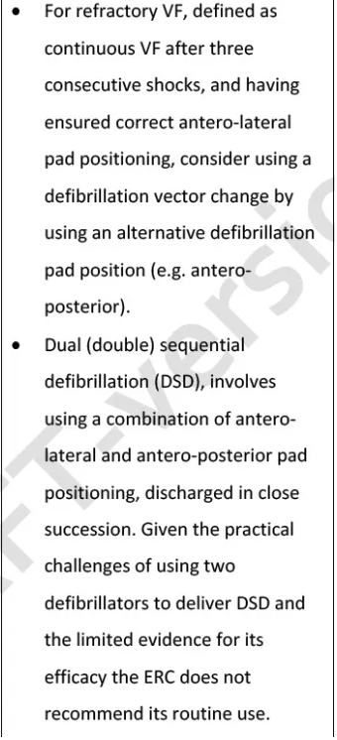
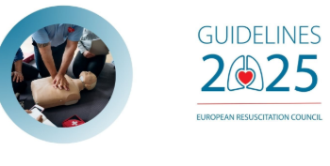
ERC recommendation

Slide 5

Pass me whatever your smoking!

Slide 6
Primary and Secondary Outcomes - Unadjusted
Outcome | DSED (n=125) | VC (n=144) | Std (n=136)
VF termination | 105/125 (84.0%) | 115/144 (79.9%) | 92/136 (67.6%)
ROSC | 58/125 (46.4%) | 51/144 (35.4%) | 36/136 (26.5%)
mRS ≤ 2 | 34/124 (27.4%) | 23/142 (16.2%) | 15/134 (11.2%)
Survival to hospital discharge | 38/125 (30.4%) | 31/143 (21.7%) | 18/135 (13.3%)

Slide 7
Primary and Secondary Outcomes – Adjusted
Outcome | DSED vs Std RR (95% CI) | VC vs Std RR (95% CI)
VF termination | 1.25 (1.09, 1.44) | 1.18 (1.03, 1.36)
ROSC | 1.72 (1.22, 2.42) | 1.39 (0.97, 1.99)
mRS ≤ 2 | 2.21 (1.26, 3.88) | 1.48 (0.81, 2.71)
Survival to hospital discharge | 2.21 (1.33, 3.67) | 1.71 (1.01, 2.88)

Slide 8
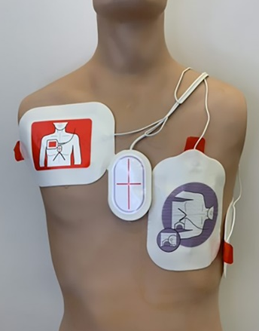
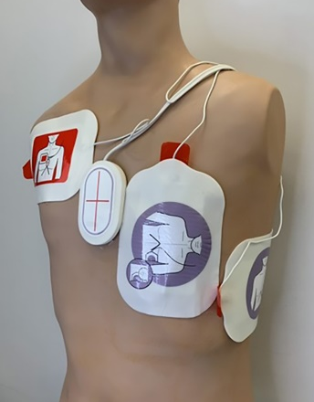
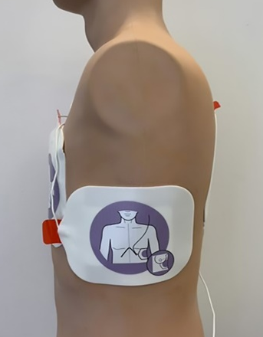
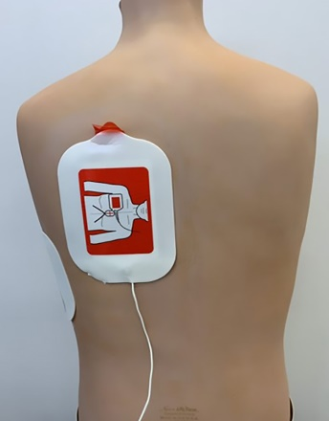
DSED or VC for Refractory VF
Point estimates favour DSED
Sensitivity analysis favour DSED
Rate of re-arrest higher in VC
Fragility index VC=1, DSED = 9
Neurologically intact survival improved for DSED only

Slide 9

“Real Life”

Slide 10
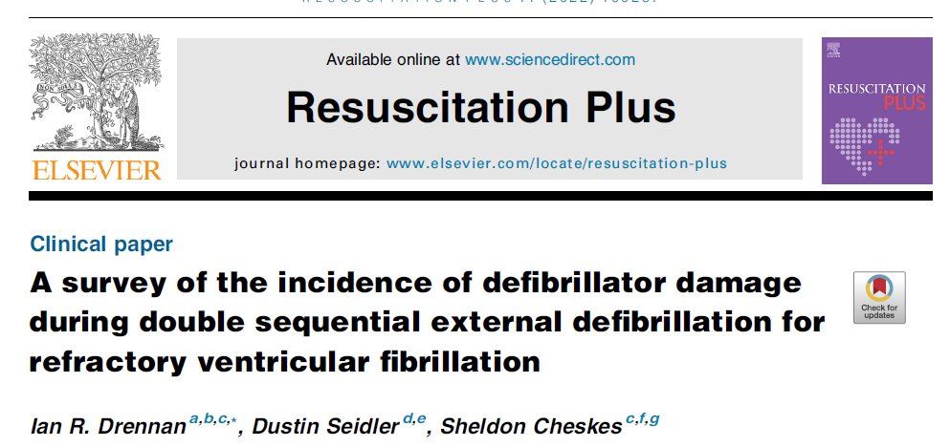
Defibrillator Damage an DSED

Slide 11



Stryker Warranty and DSED implementation

Slide 12

Incidence of Defibrillator Damage
1130 Cases
5 cases of defib damage (0.4%)
All simultaneous (Zero sequential)
Damage on per shock basis (0.1−0.2%)

Slide 13
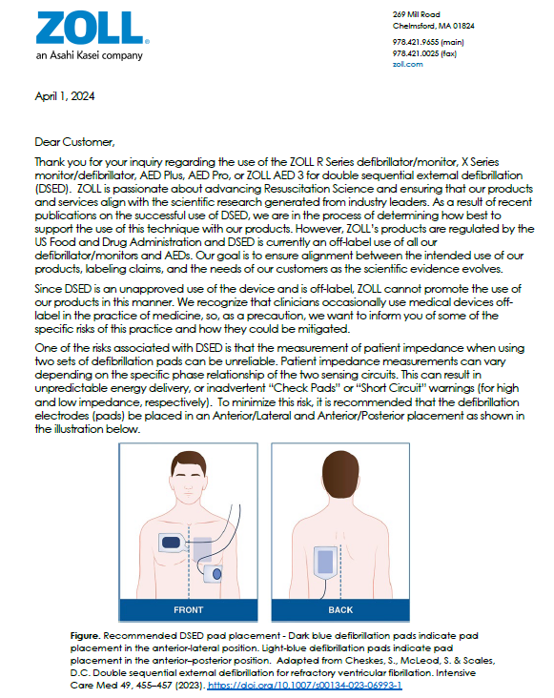
Zoll Customer Letter

Slide 14

Stryker Customer Letter
It is important to note that, damage caused by performing double sequential defibrillation will not be covered by our standard product warranty (performance of DSD with our product does not void the warranty; however, damage caused specifically by DSD will not be covered under the warranty).

Slide 15

Thank You!

Slide 16
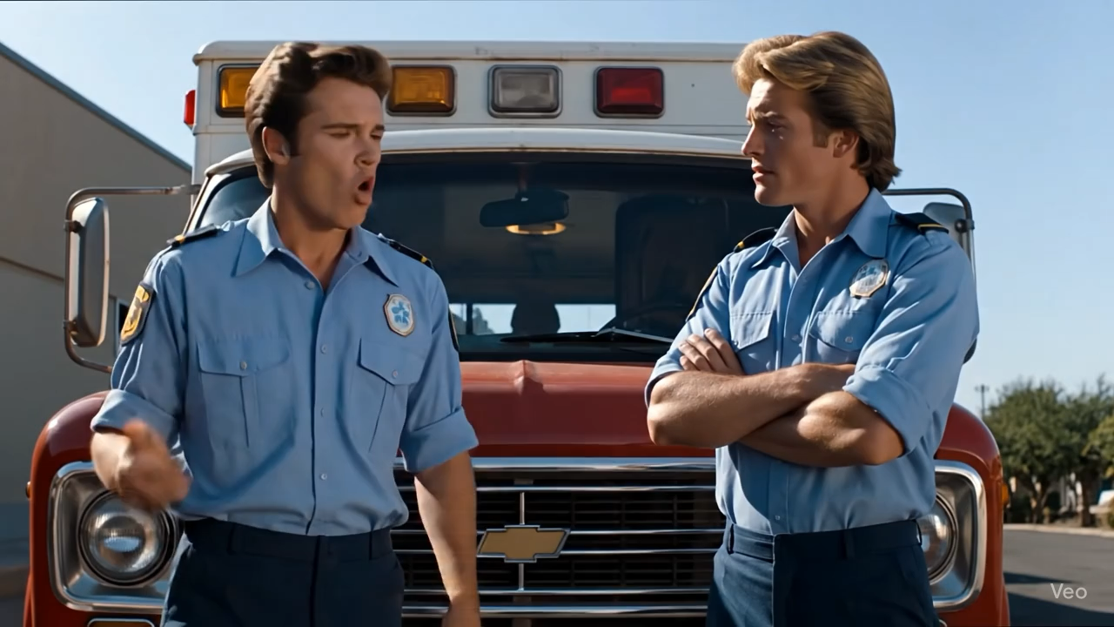

Slide 17


Double Sequential Defibrillation

Slide 18
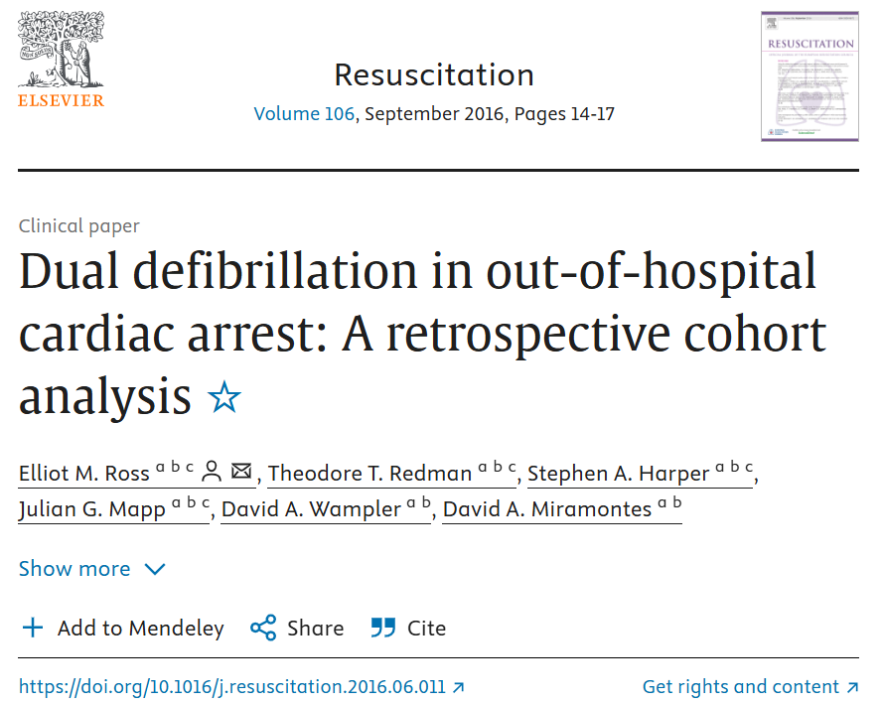

Slide 19
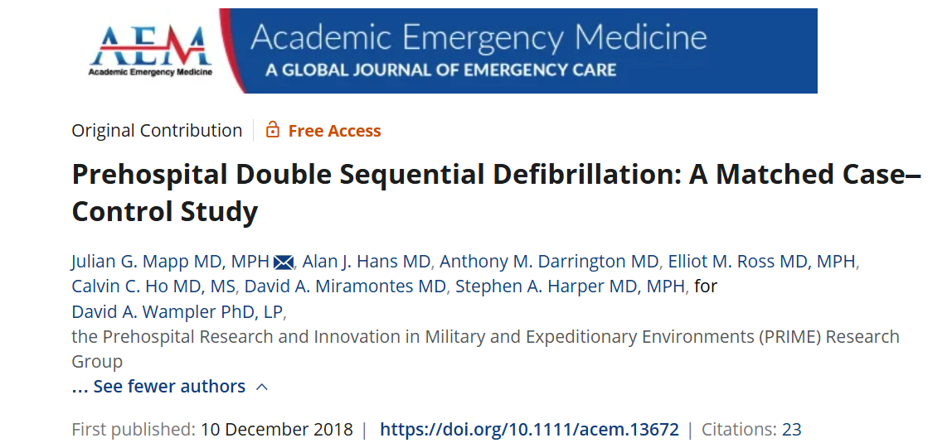
Not effective in our system!

Slide 20
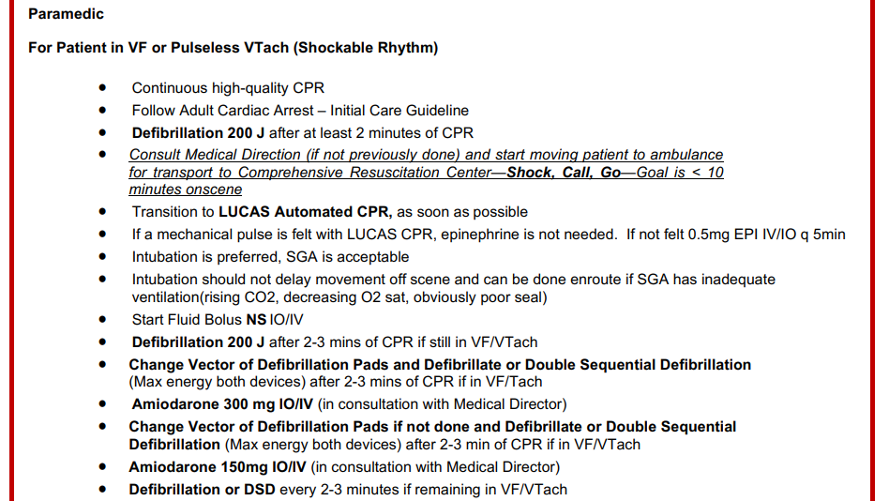

Slide 21
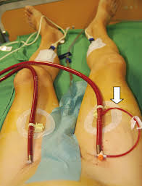
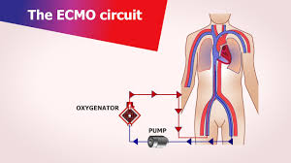
Shock CALL MD GO!!! (for ECMO CPR)

Slide 22
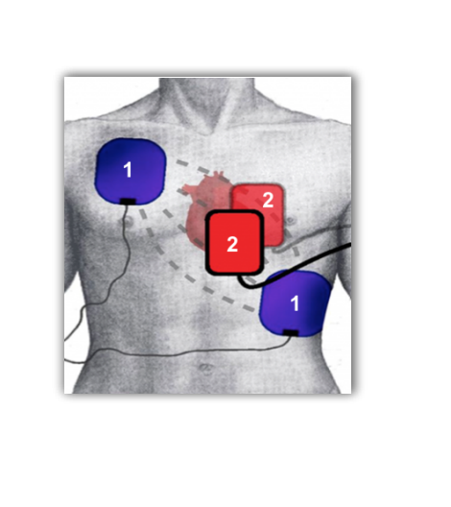
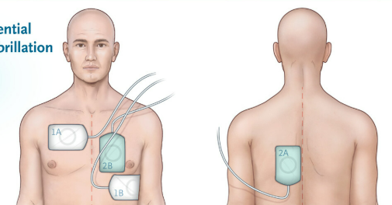

Slide 23
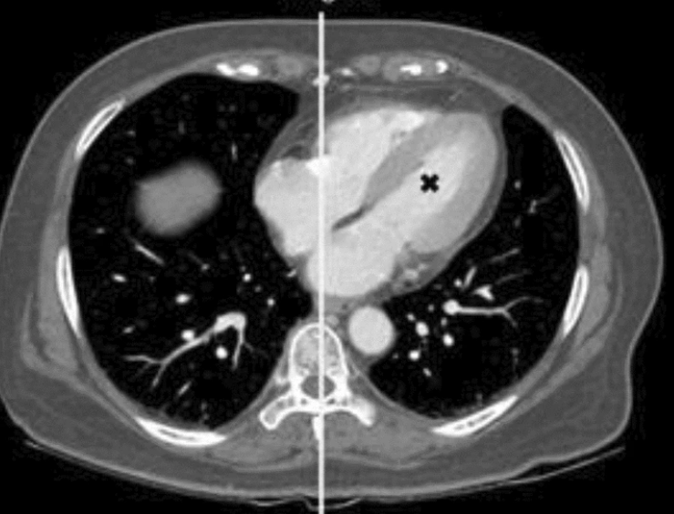
Getting ROSC

Slide 24

Getting ROSC

Slide 25
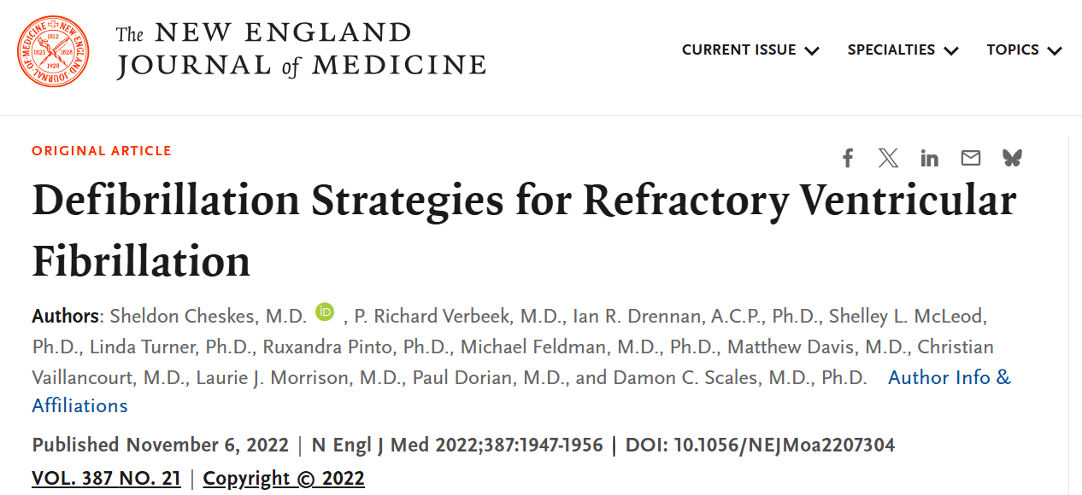
Sheldon proved we were wrong ?…. BE Aggressive !!!!

Slide 26
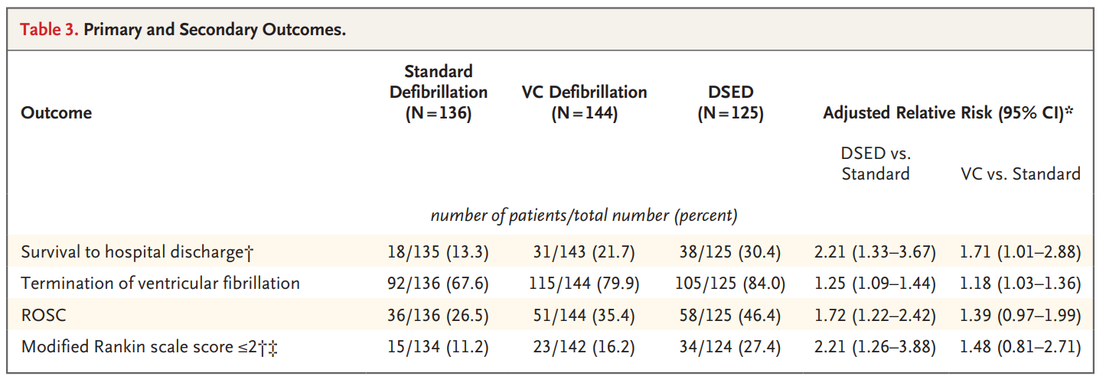

Slide 27
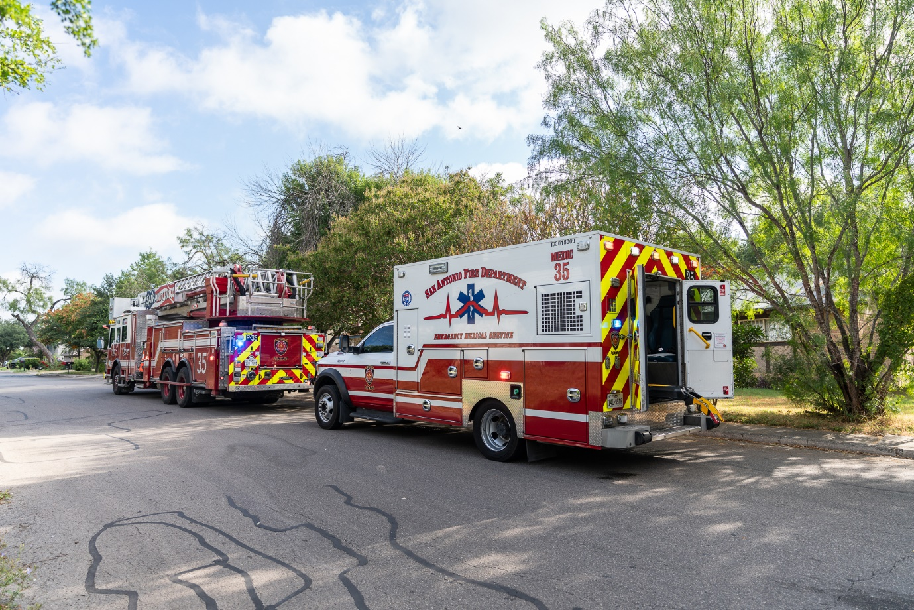

Slide 28
Pad Placement
Start Ant Lat
If shocked
  When ambulance medics arrive w/ LUCAS
  Second set Ant Pos for DSD

Slide 29
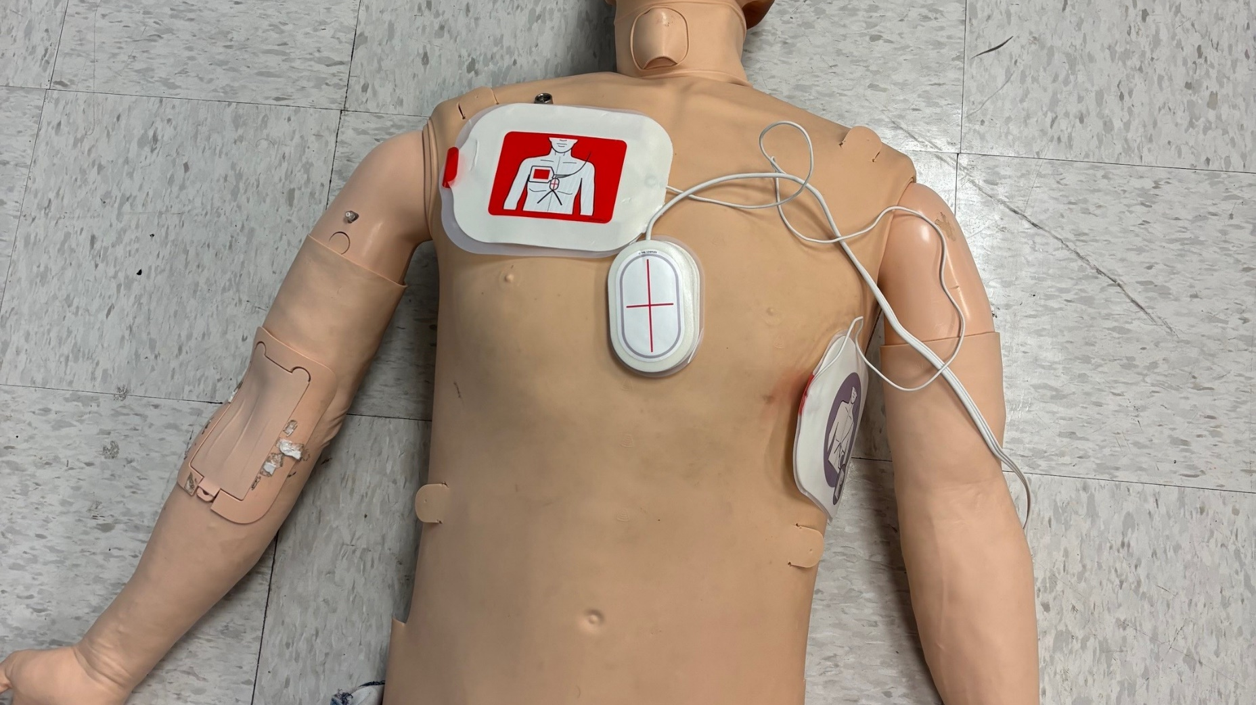

Slide 30
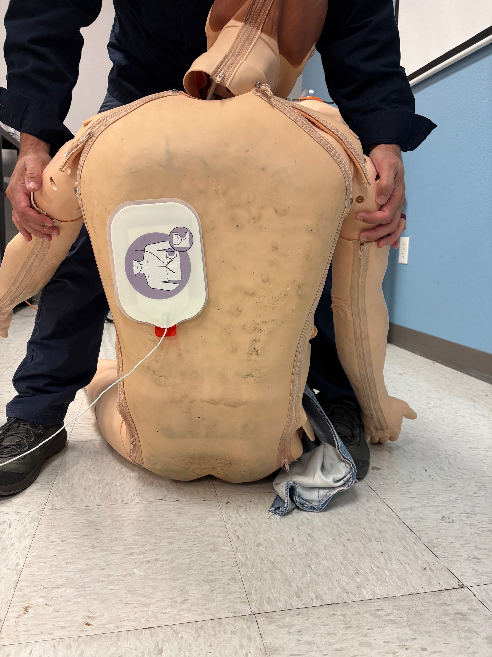

Slide 31
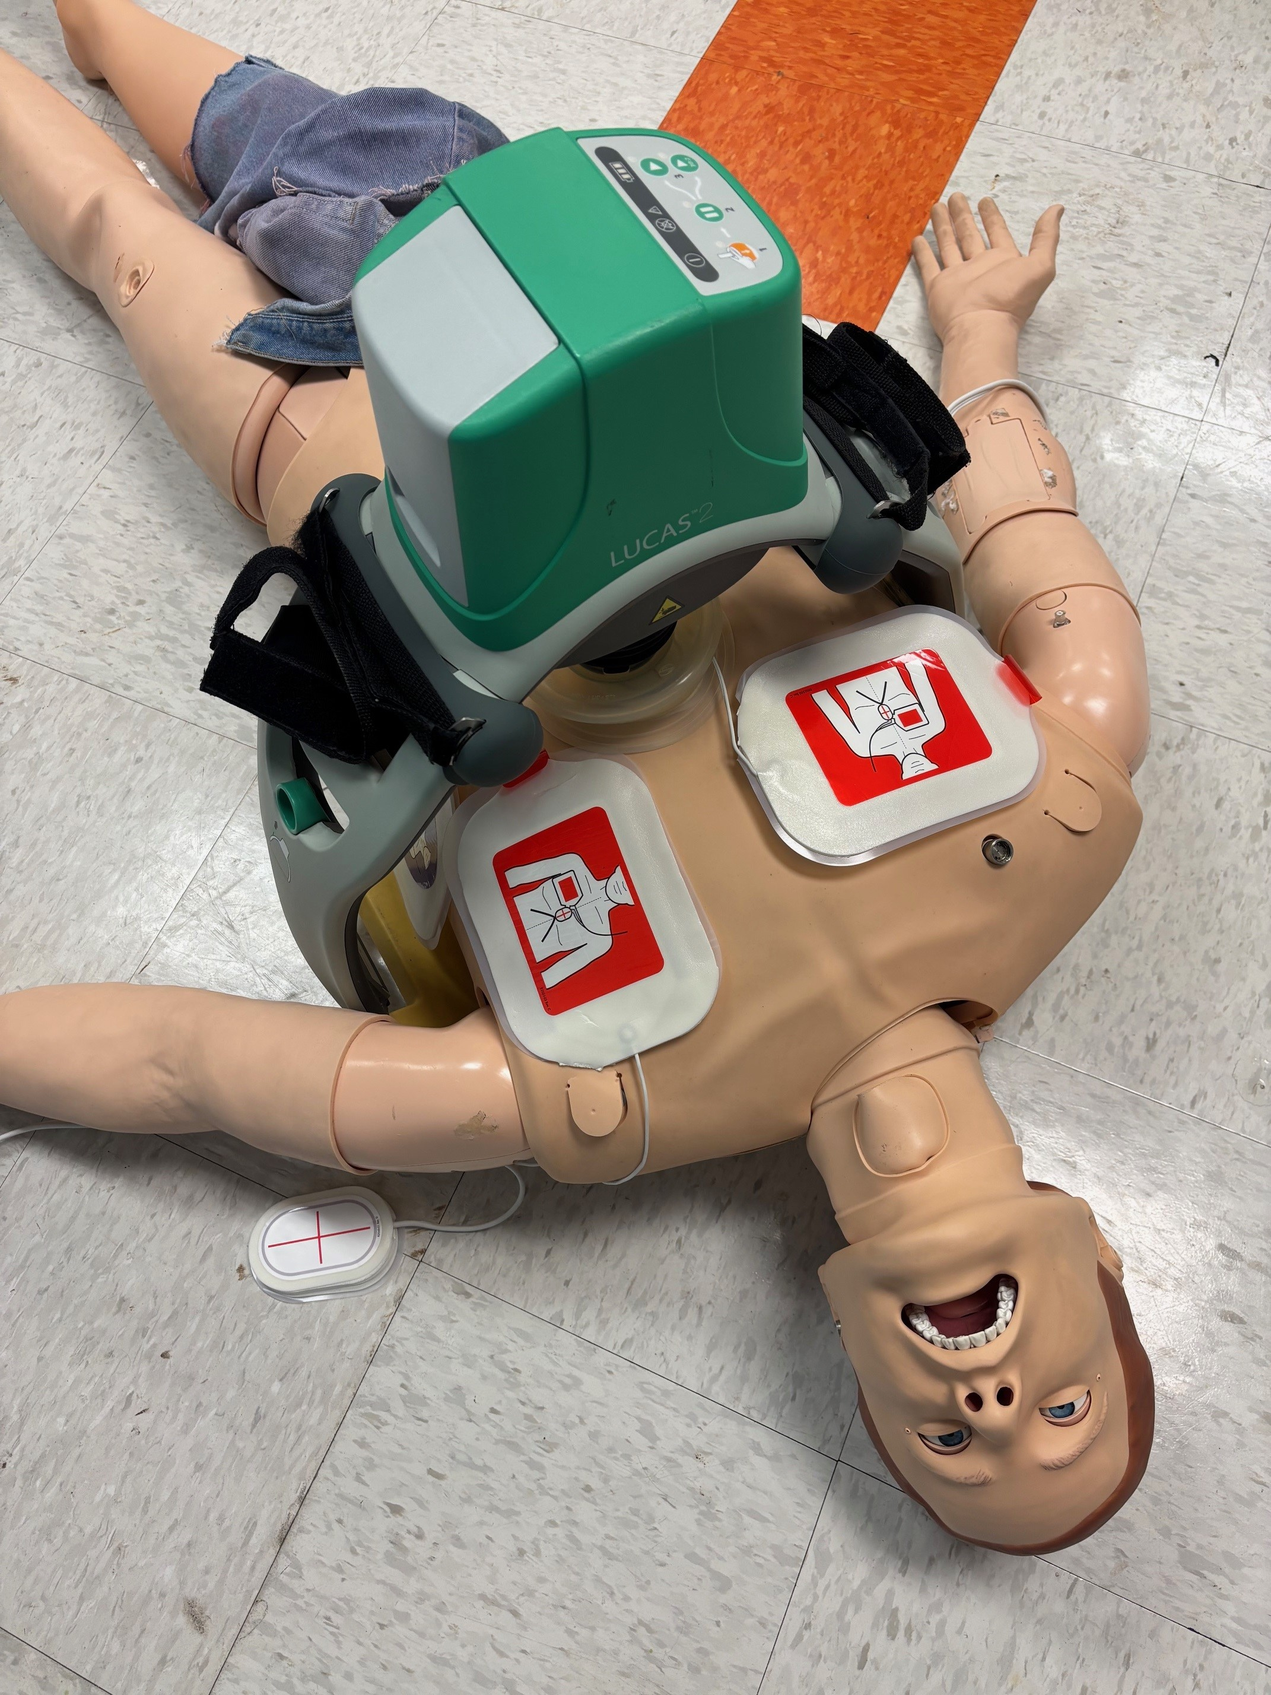
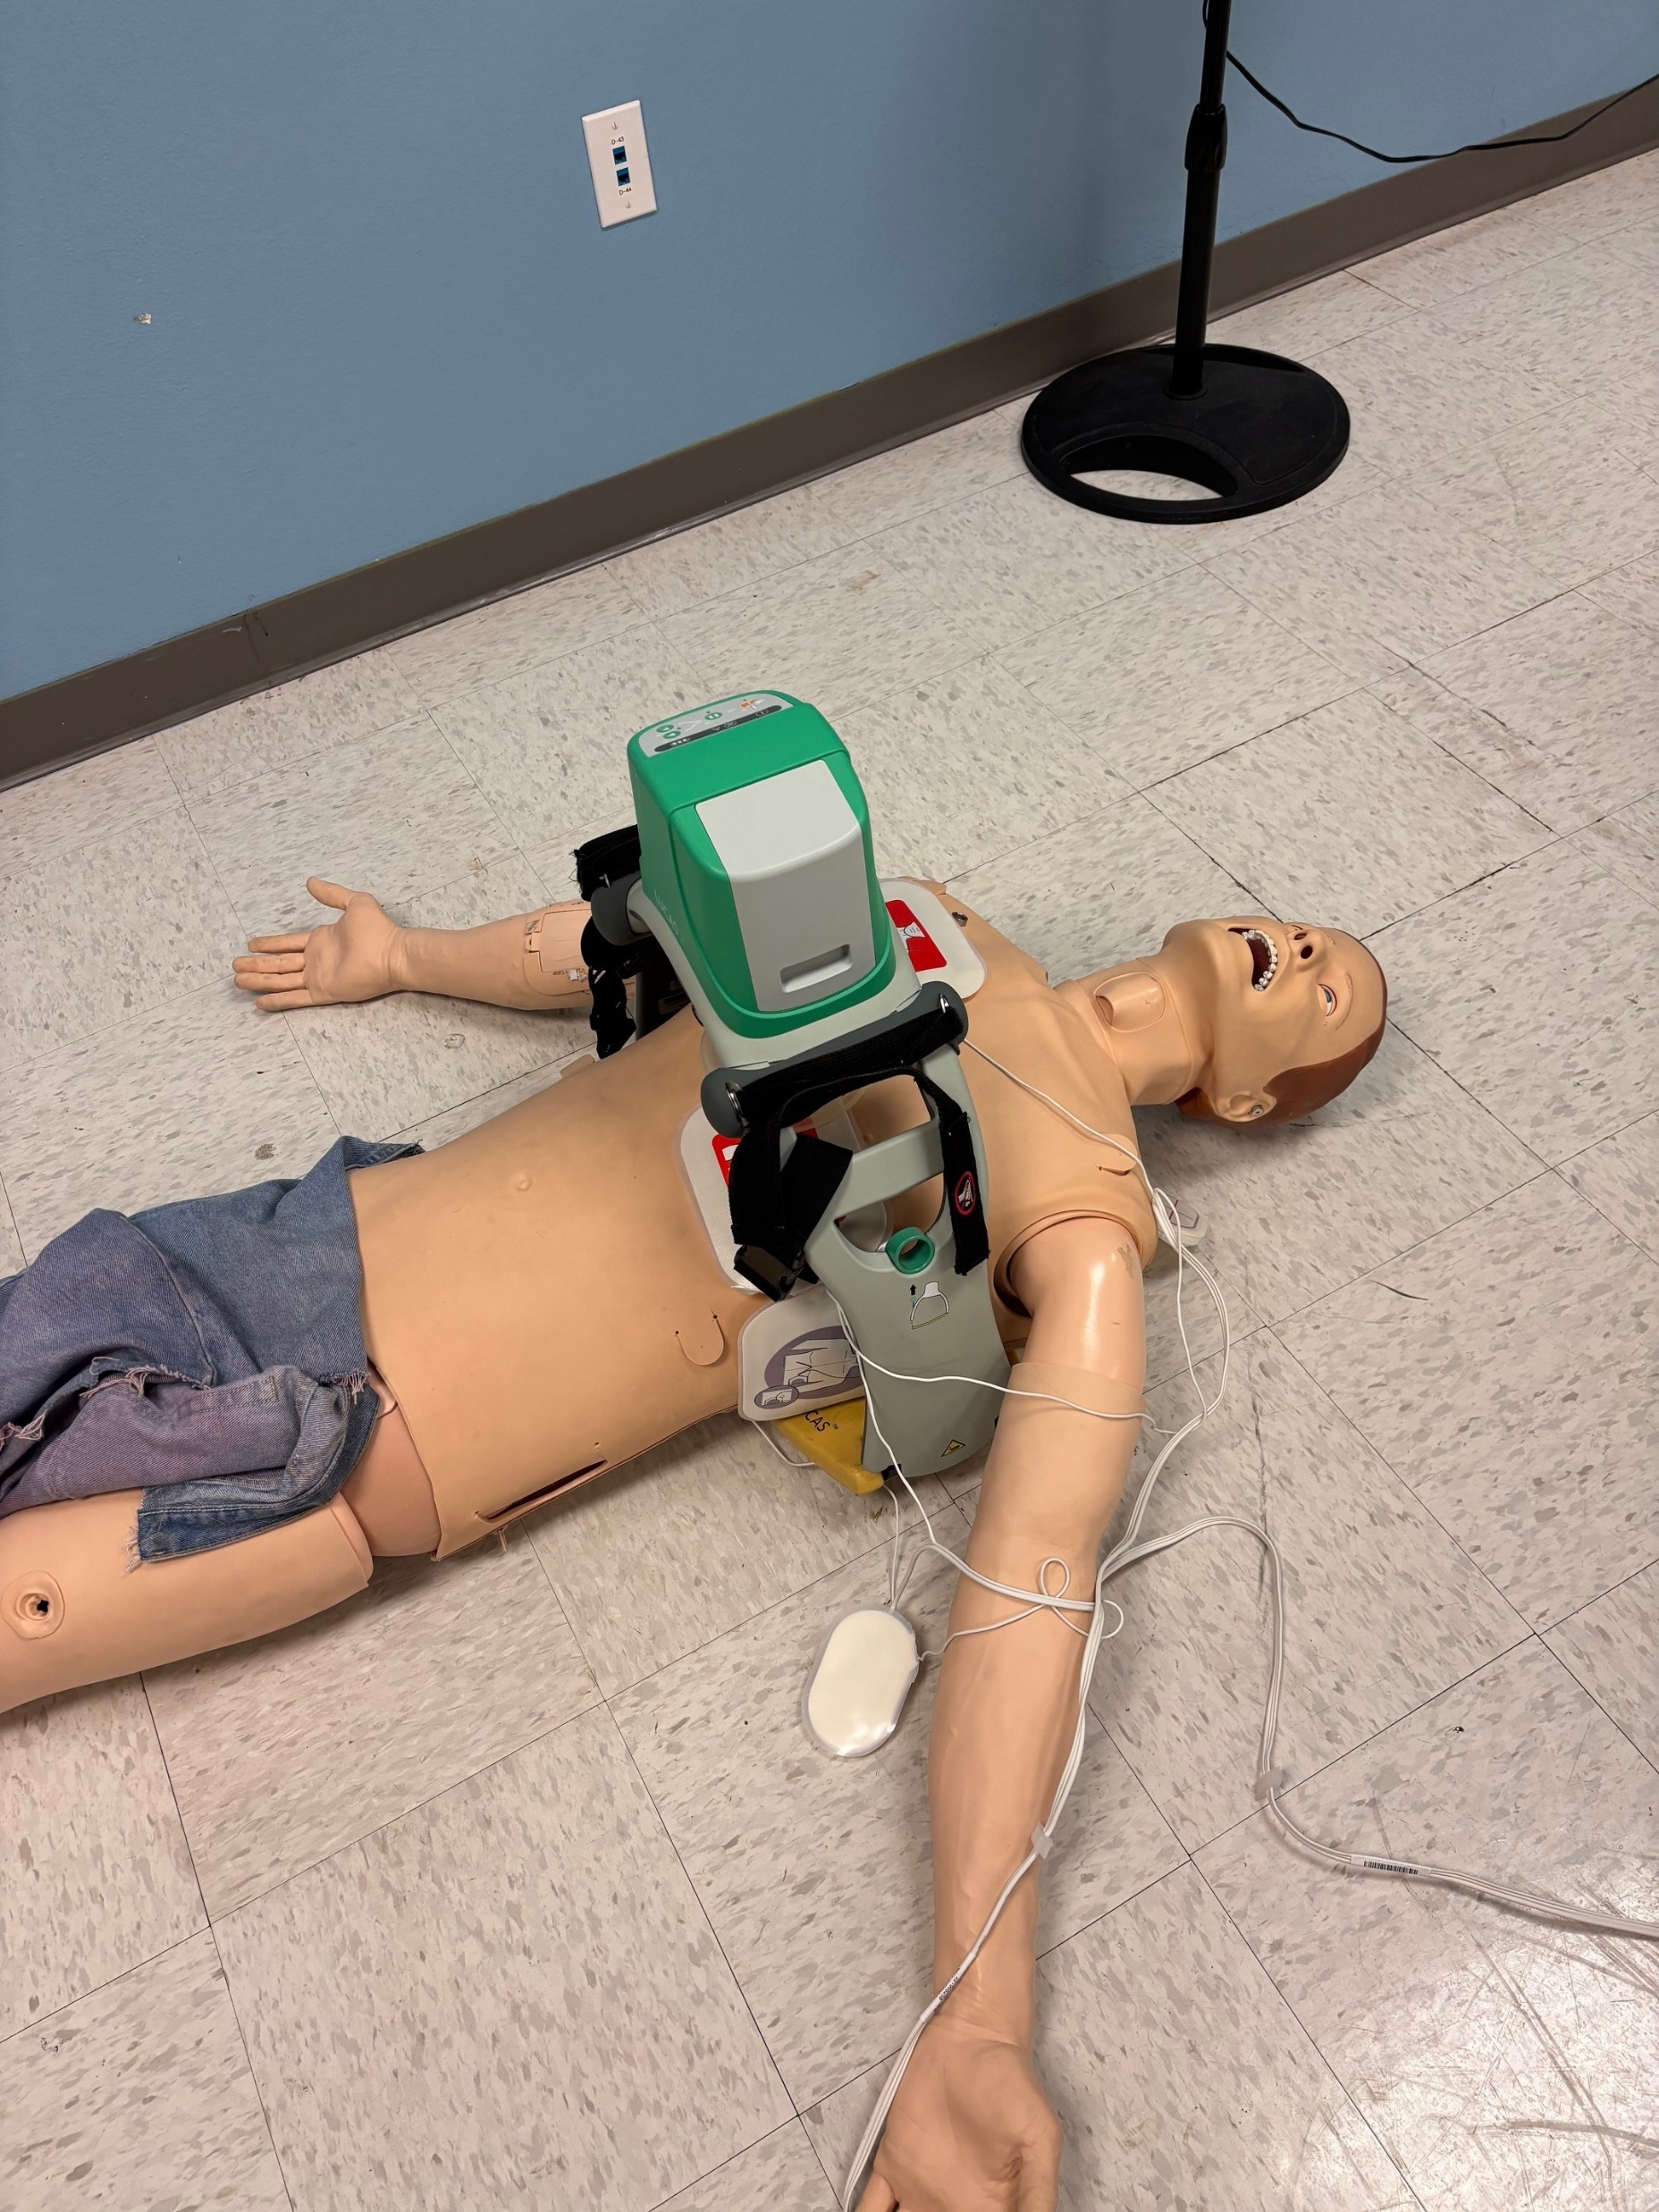

Slide 32
