Slide 1
Shocking Considerations: Are We Giving Amiodarone Much Too Late?
Jon Jui MD, MPH

Slide 2
Discussion Items
Does Timing of administration of amiodarone in patients presenting with shockable rhythms affect overall outcome and survival ?

Slide 3
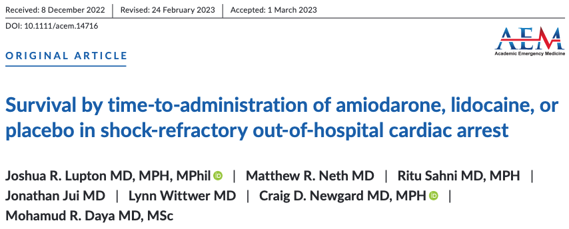

Slide 4
2020 American Heart Association Advanced Life Support Algorithm
2021 European Resuscitation Council Advanced Life Support Algorithm
Rhythm check 1: VF/VT
Shock # 1
No Drugs
Rhythm check 2: VF/VT
Shock # 2
Epi # 1
Rhythm check 3: VF/VT
Shock # 3
Amio # 1
Rhythm check 4: VF/VT
Shock # 4
Epi # 2
Rhythm check 5: VF/VT
Shock # 5
Amio # 2

Slide 5
Ornato et al., 2021
Times from 911 Call to Interventions
Rhythm check 1: VF/VT
11.0ª & 9.2^{b} & 8.5^{c} minutes
Shock # 1
IV/IO Access
Rhythm check 2: VF/VT
Shock # 2
Epi # 1
15.0ª & 16.0^{d} minutes
Rhythm check 3: VF/VT
Shock # 3
Amio # 1
26.6ª & 20.9^{b} & 24.5^{c} & 19.3^{d} minutes
Rhythm check 4: VF/VT
a = Richmond Ambulance Authority (local registry)
b = ARREST Trial
c = ALIVE Trial
d = ALPS Trial
Shock # 4
Epi # 2

Slide 6
Times from Arrival On-Scene to Interventions
Rhythm check 1: VF/VT
PDX Epistry 2022:
30% PIV; 15% TIO; 55% HIO
ALPS:
75% PIV; 24% TIO; 1% HIO
4.0 minutes
Shock # 1
IV/IO Access
6.1 minutes
Rhythm check 2: VF/VT
7.4 minutes
Shock # 2
Epi # 1
7.4 minutes
Rhythm check 3: VF/VT
10.7 minutes
Shock # 3
Amio # 1
11.2 minutes
Rhythm check 4: VF/VT
13.4 minutes
Shock # 4
Epi # 2
Portland Cardiac Arrest Epidemiologic Registry (2018-2022)

Slide 7
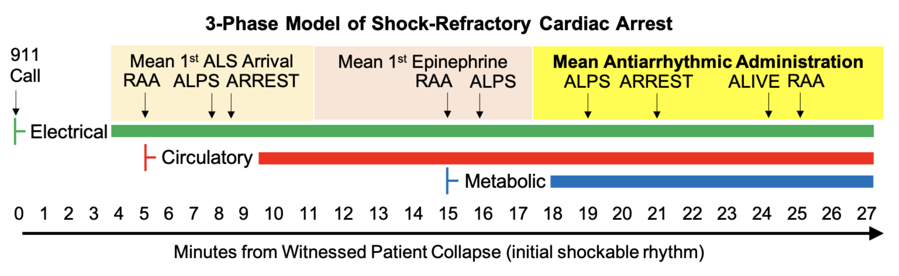
a = Richmond Ambulance Authority (local registry)
b = ARREST Trial
c = ALIVE Trial
d = ALPS Trial
Ornato et al., 2021

Slide 8
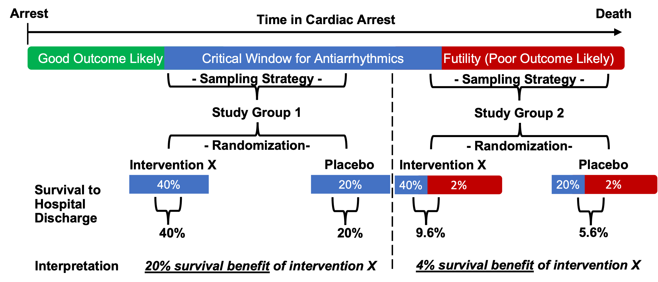
3-4 minutes
20-23 minutes
> 28 minutes

Slide 9
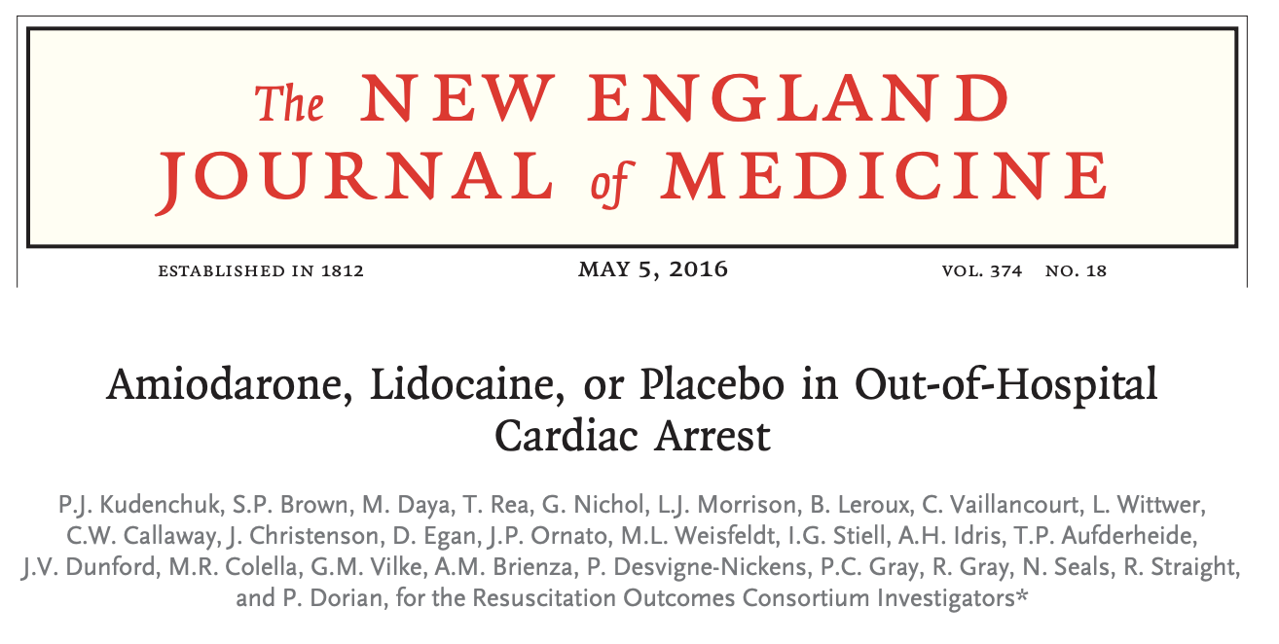
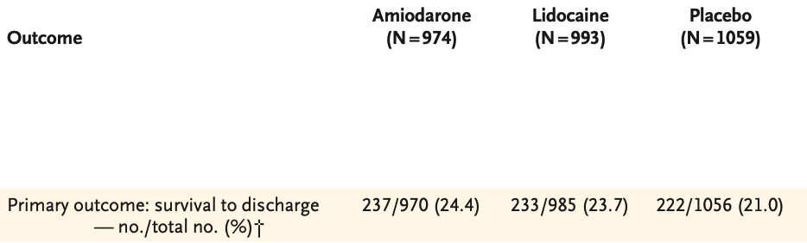
Randomized, double-blind trial comparing amiodarone, lidocaine, and saline placebo in shock-refractory VF/VT out-of-hospital cardiac arrest
Refractory to at least one shock.
Drugs via IV or IO
Per-protocol (primary) analysis: Initial VF/VT rhythm, received study drug

Slide 10
Our objective was to evaluate if early antiarrhythmic administration was association with higher survival and survival with a favorable neurologic outcome for patients with shock-refractory OHCA compared to the placebo (normal saline) arm in ALPS.

Slide 11
A priori cutoff for “early” antiarrhythmics
From ALS arrival on-scene:
Rhythm check 1: VF/VT
From ALS arrival on-scene:
0-2.0 minutes
Shock # 1
IV/IO Access
Rhythm check 2: VF/VT
2.0-4.0 minutes
Shock # 2
Epi # 1
4.0-6.0 minutes
Rhythm check 3: VF/VT
4.0-6.0 minutes
Shock # 3
Amio # 1
6.0-8.0 minutes
Rhythm check 4: VF/VT
Shock # 4
Epi # 2

Slide 12
A priori cutoff for “early” antiarrhythmics
Timing-based “early” definition: Administration of the double-blinded study drug (amiodarone, lidocaine, or placebo) in ALPS within 8 minutes of ALS arrival on-scene
Sequence-of-care based “early” definition: Administration of the double-blinded study drug (amiodarone, lidocaine, or placebo) in ALPS within 1 minute of the initial epinephrine dose.

Slide 13
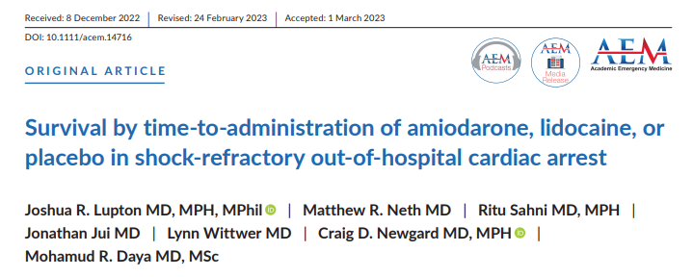

Slide 14
ALPS Trial
This was a secondary analysis of data from the randomized, double blind ALPS trial
The ALPS trial enrolled adult (age ≥ 18) patients from 10 North American sites and 55 EMS agencies.
Examined the effectiveness of amiodarone and lidocaine compared to placebo in patients with shock-refractory ventricular fibrillation or pulseless ventricular tachycardia

Slide 15
Key Findings: Subgroup Analysis of ALPS
In patients with a witnessed cardiac arrest, survival to discharge was higher in the groups receiving either amiodarone or lidocaine.
In patients with an unwitnessed cardiac arrest, survival did not differ between the treatment groups

Slide 16
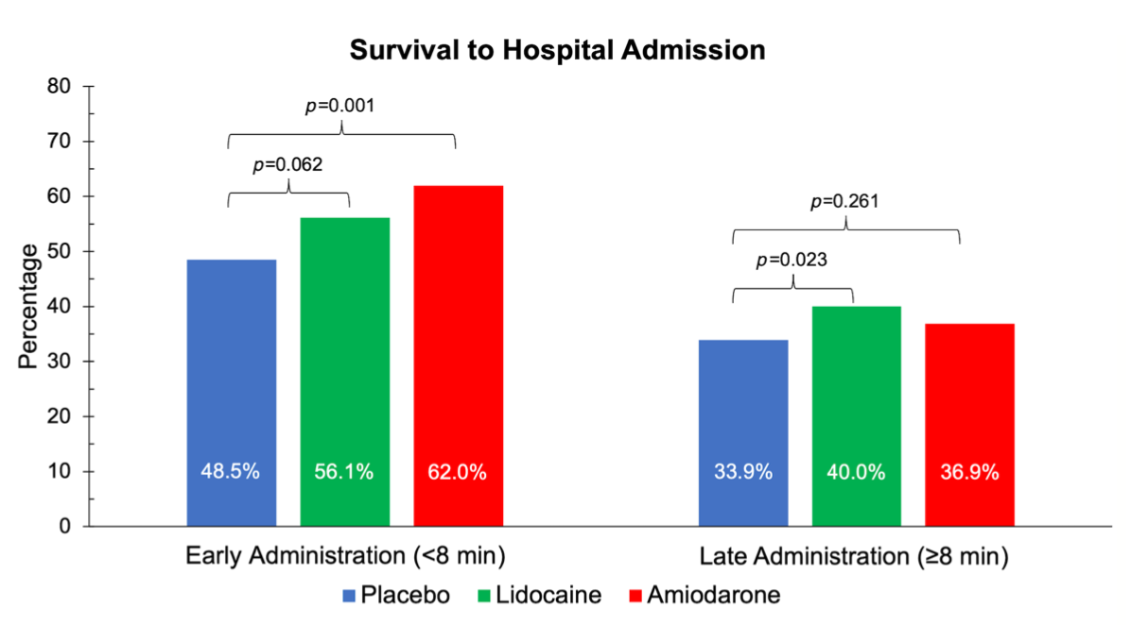
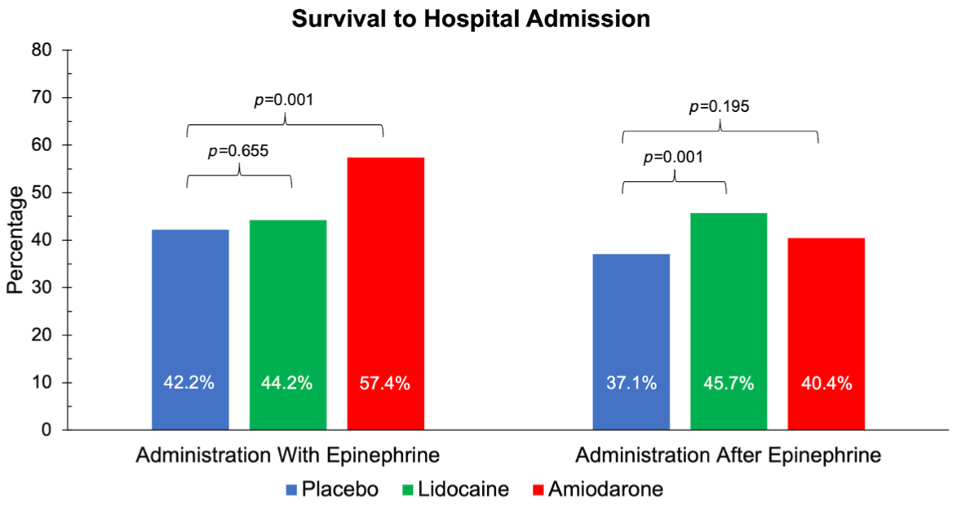
Survival to Hospital Admission
Early vs Late Amiodarone vs Lidocaine

Slide 17
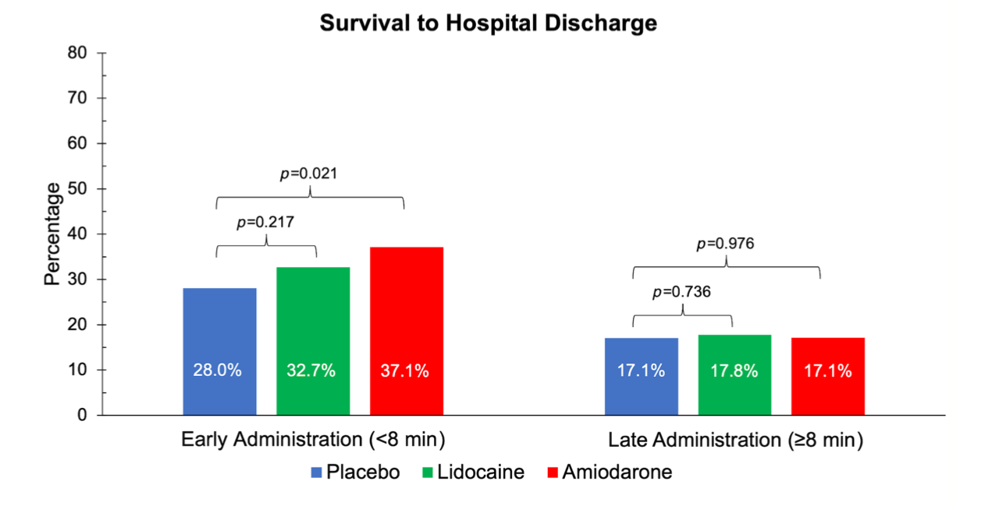
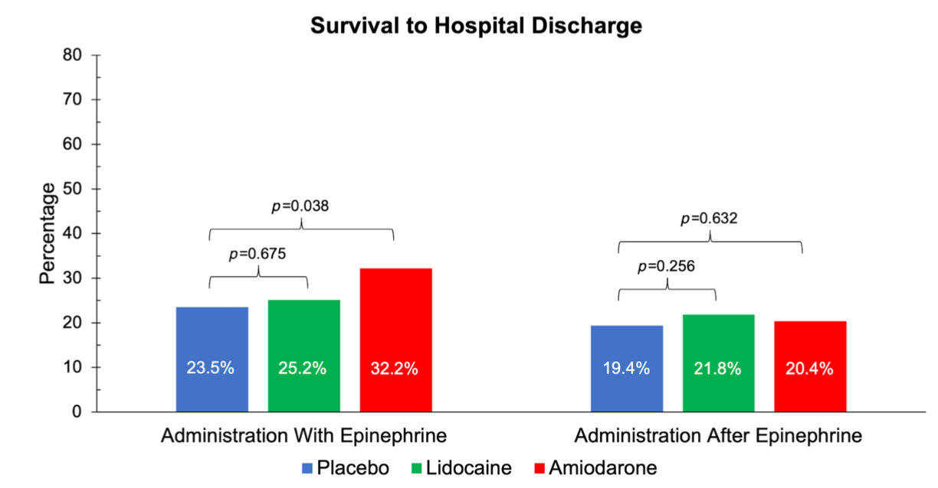
Survival to Discharge
Early vs Late Amiodarone vs Lidoca

Slide 18
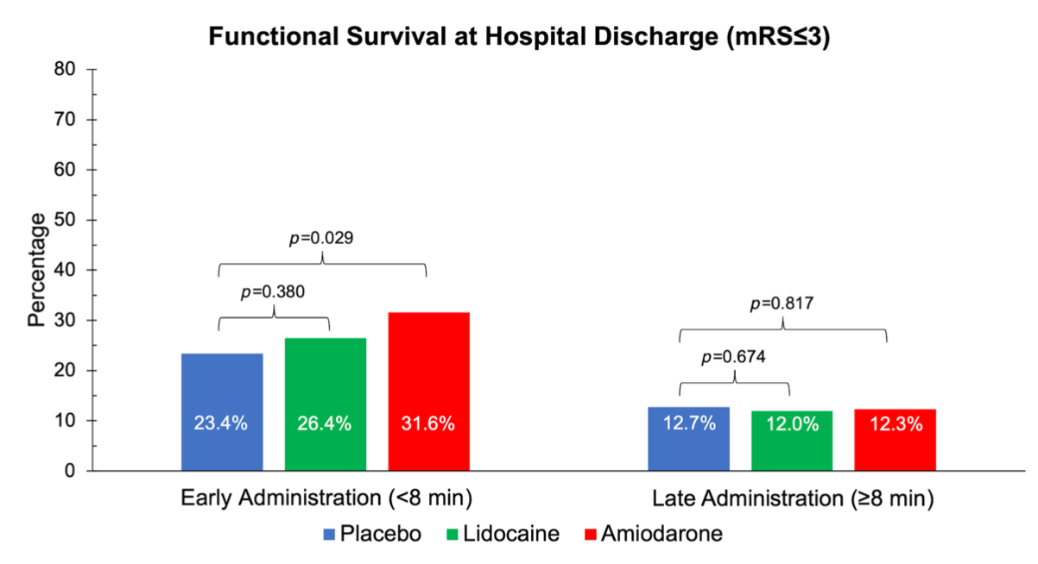
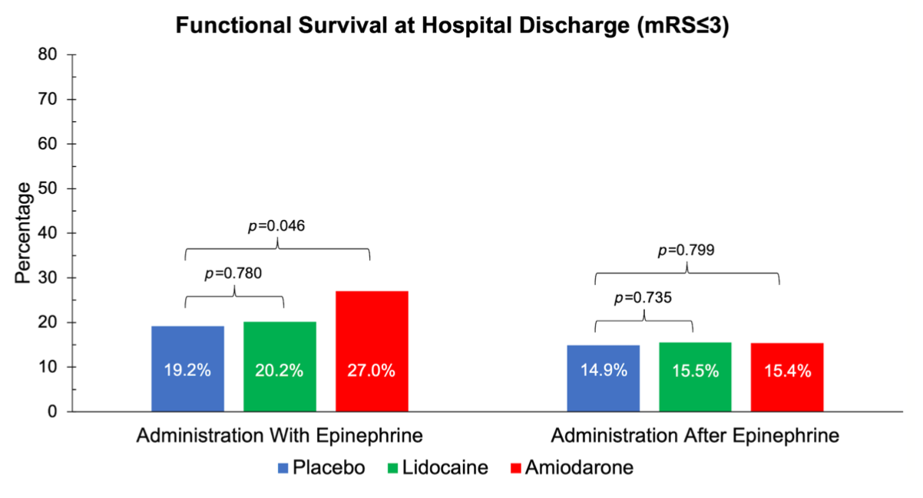
Functional Survival
Early vs Late Amiodarone vs Lidocaine

Slide 19
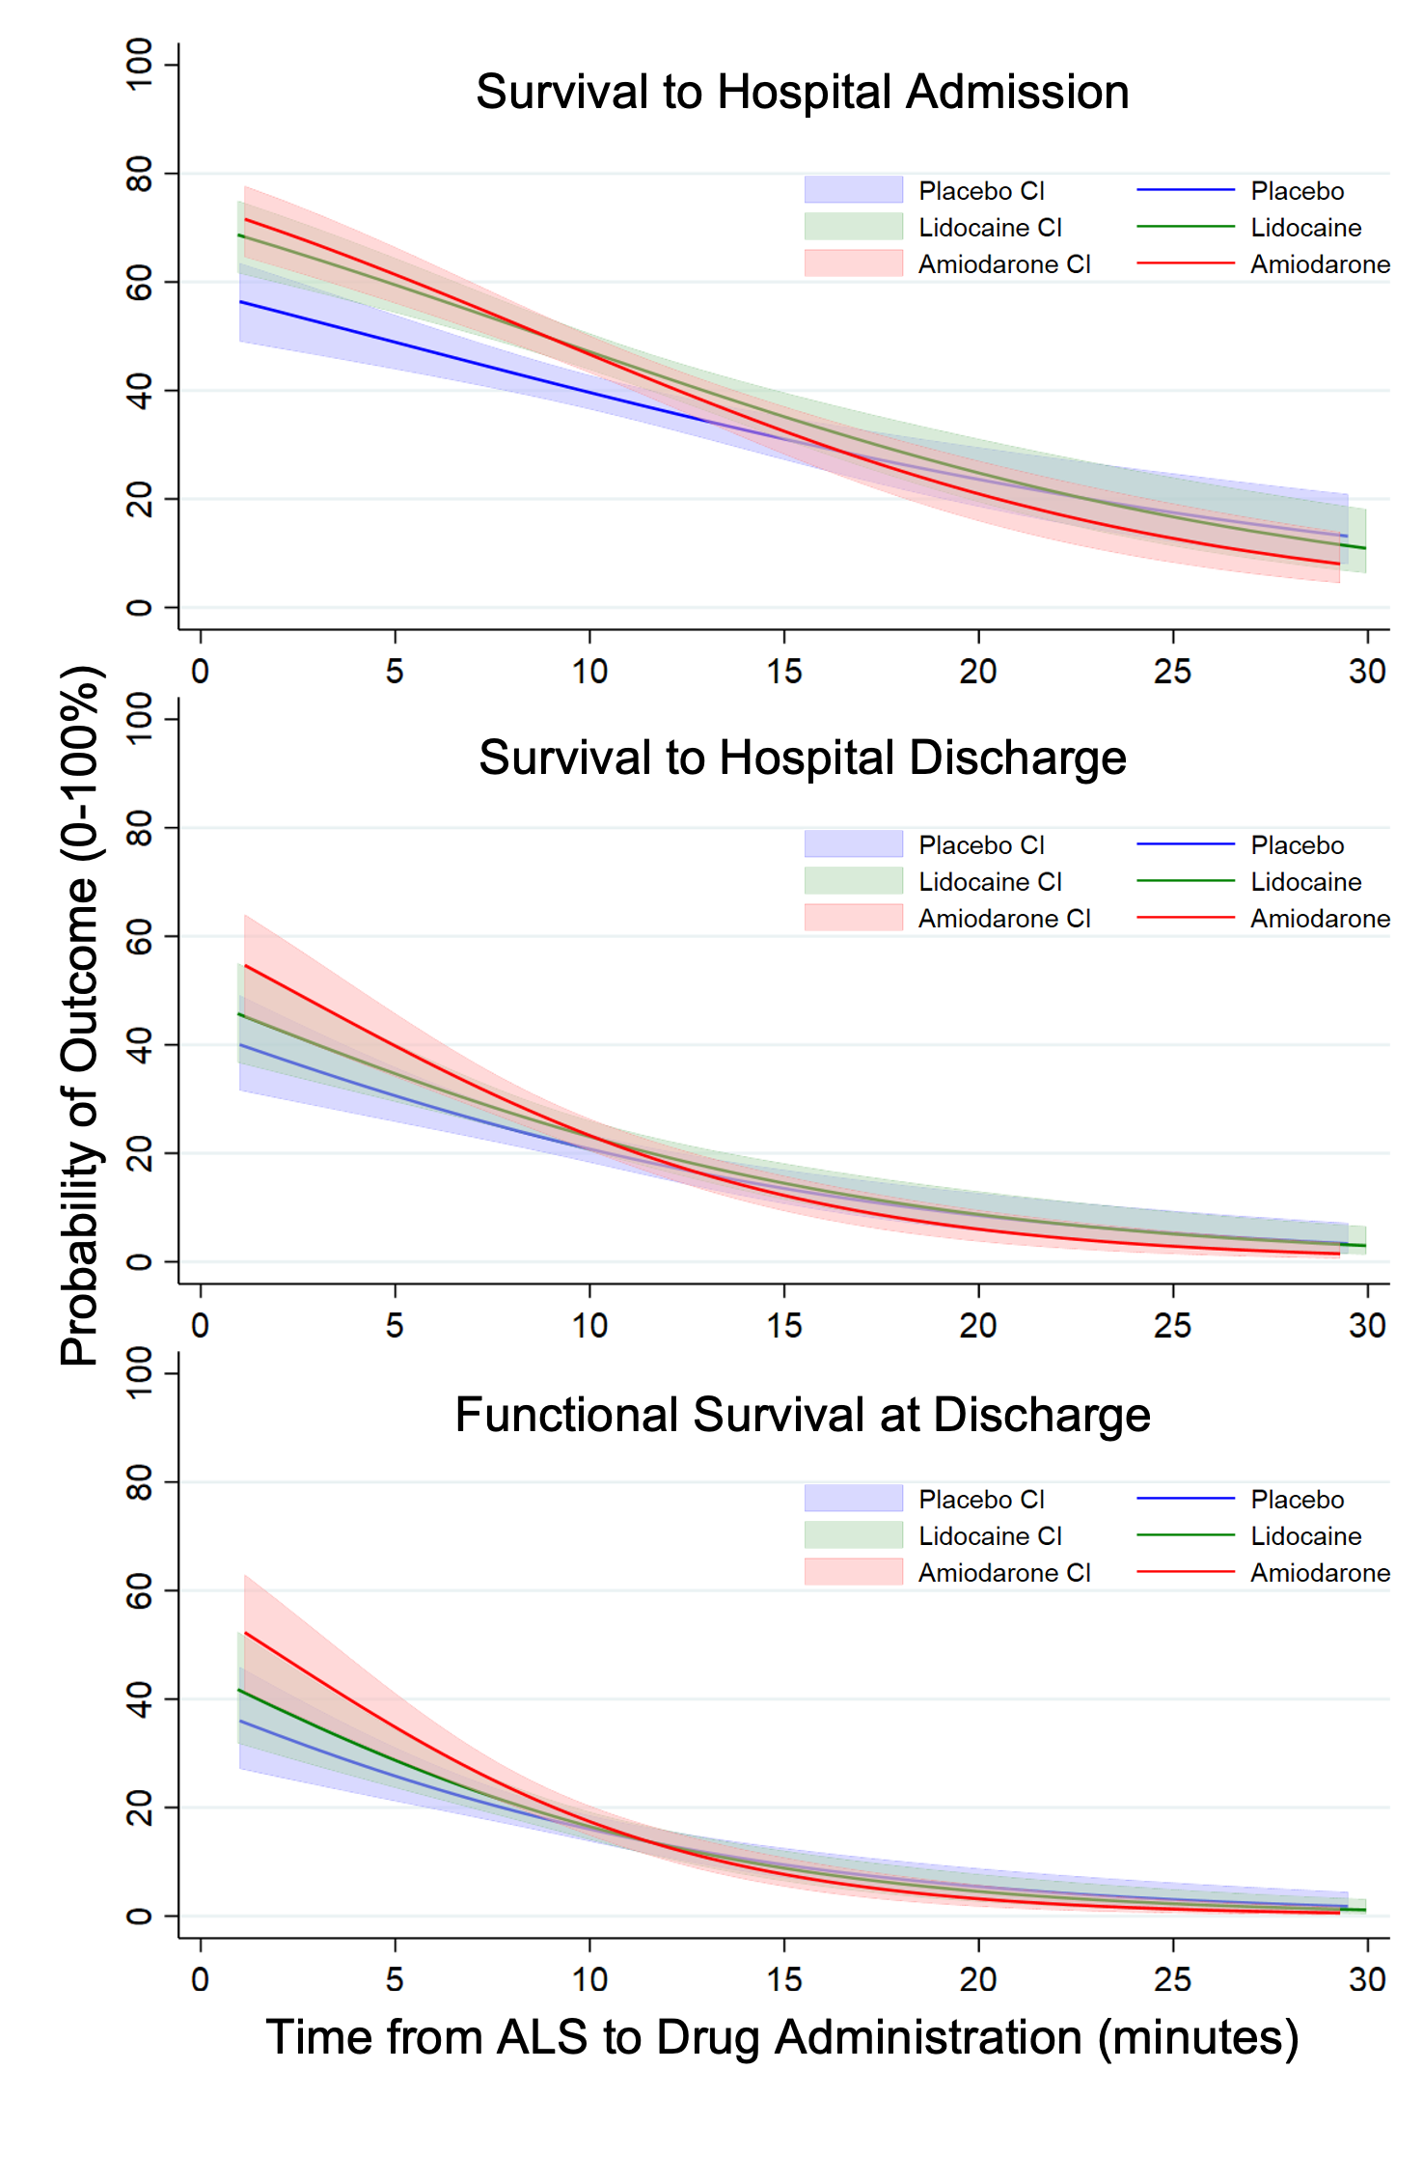
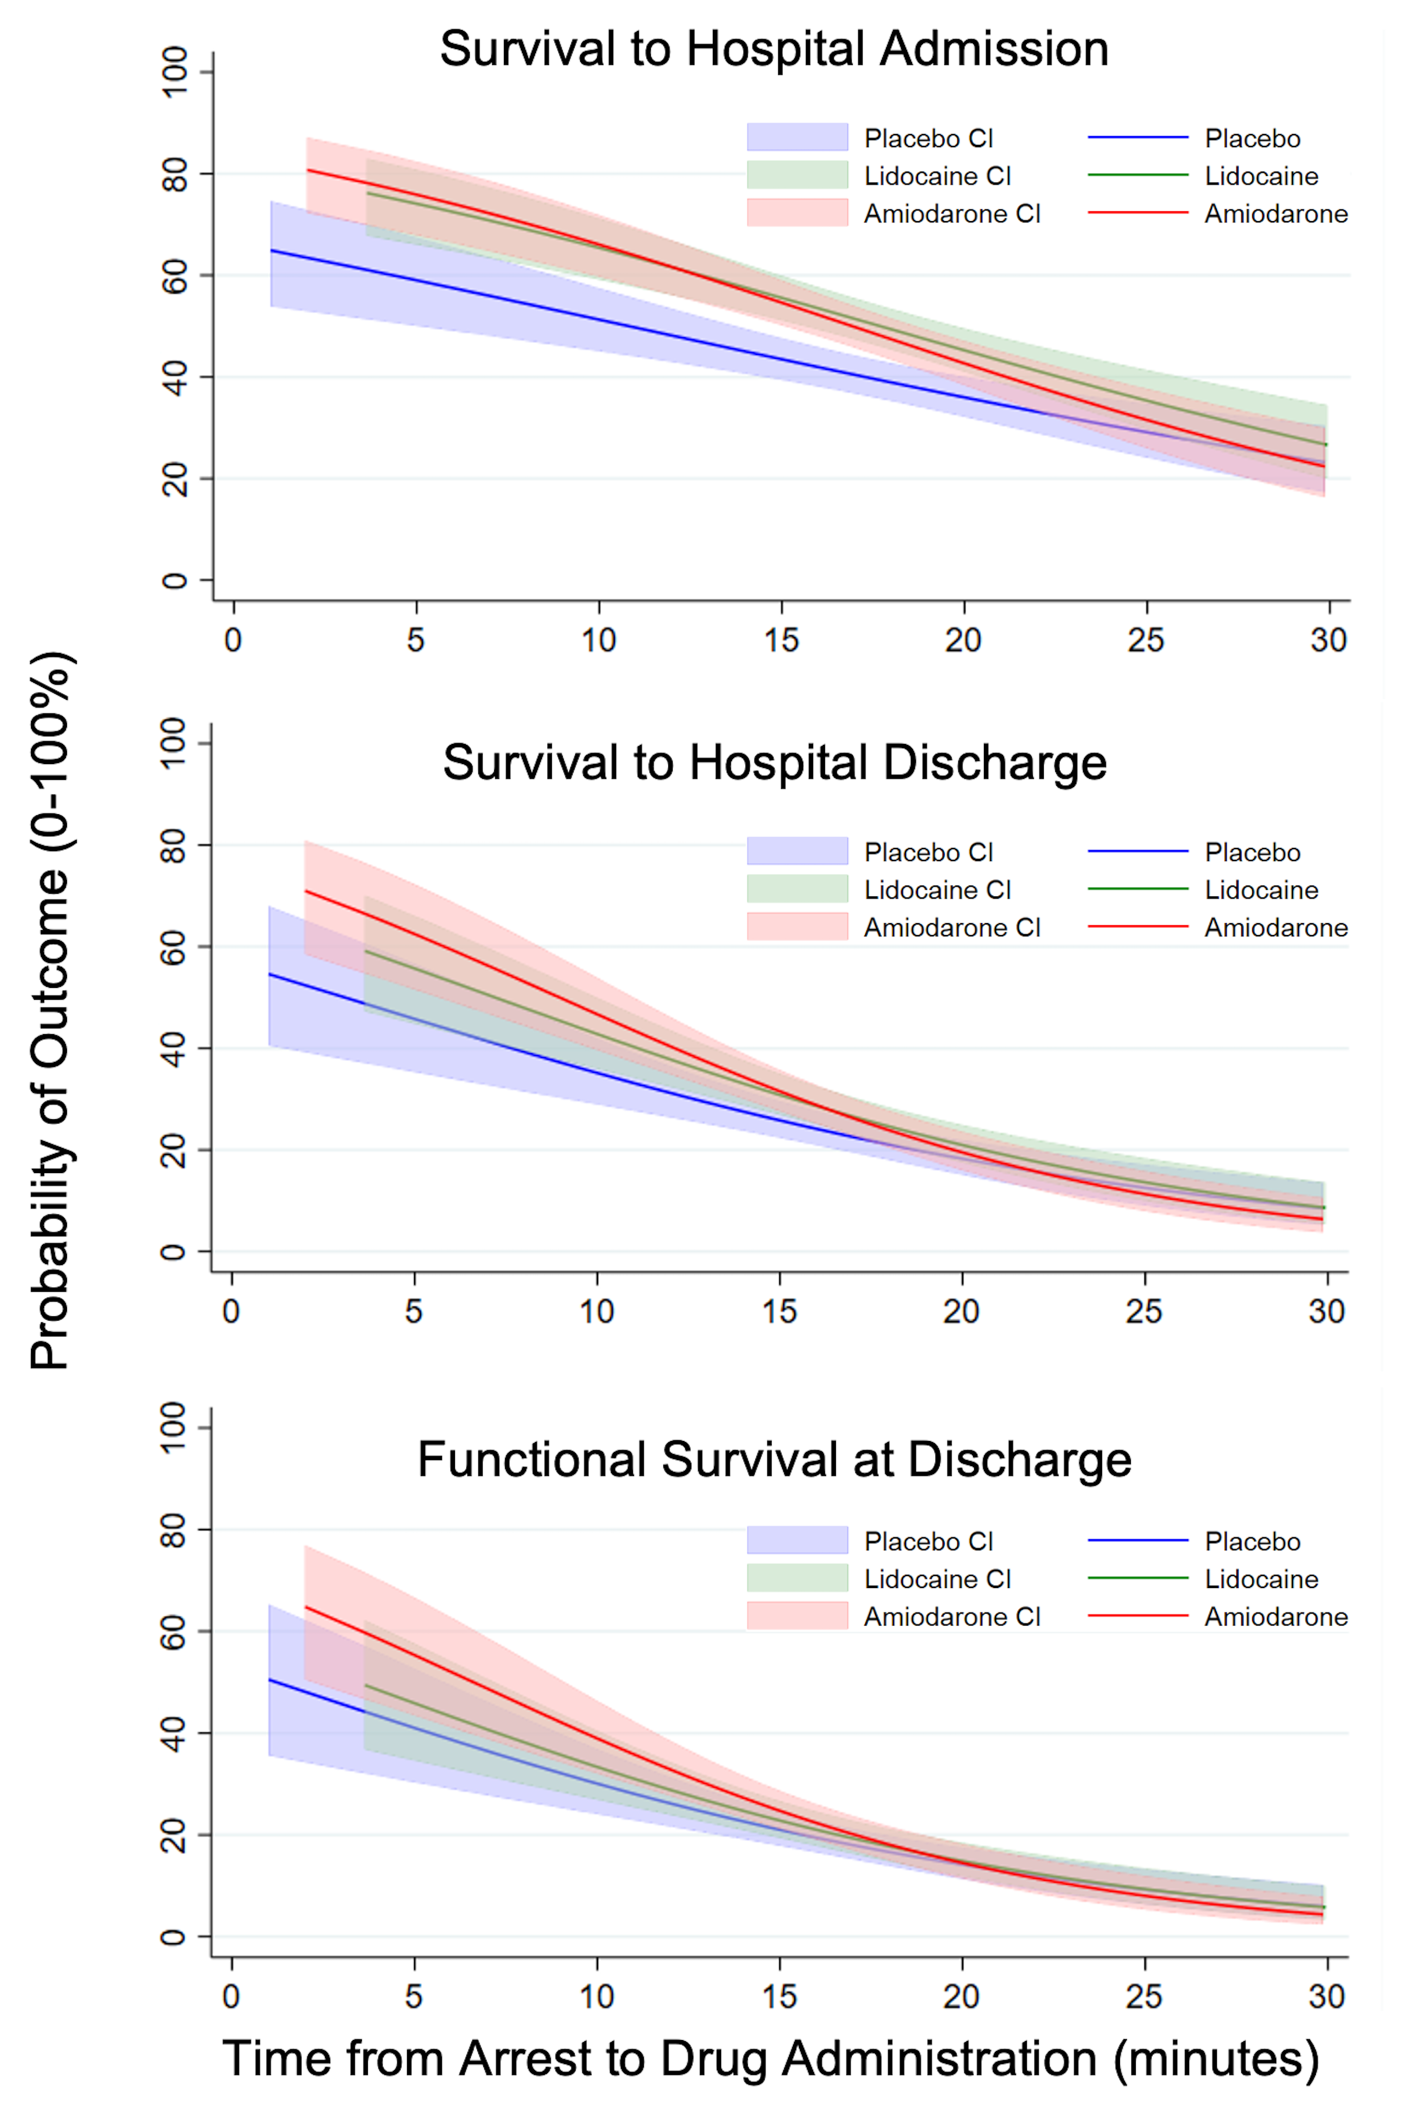

Slide 21
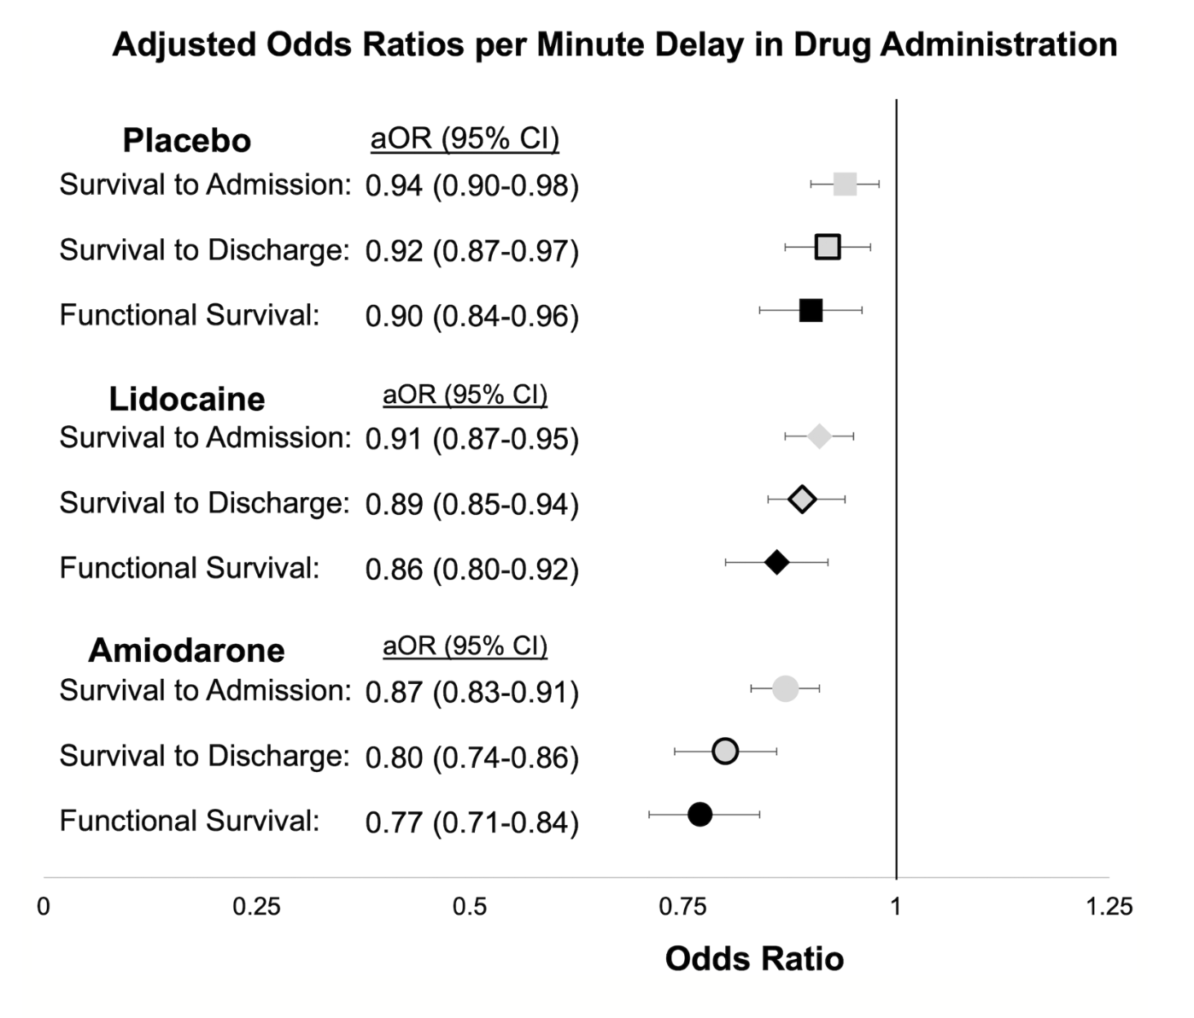
Resuscitation Time Bias

Slide 22
Are there any other studies supporting this hypothesis?

Slide 23
Author | Date of Study | Type of Study | Location | Location | Cohort | Number | Outcome
Wissa | 2015-2019 | Retrospective | Queensland | OHCA | Refractory VF | 502 | Earlier amiodarone improved outcomes
Lee | ?? | Retrospective | South Korea | OHCA | Refractory VF | 134 | Earlier amiodarone improved outcomes
Perry | 2010-2019 | Retrospective | Victoria | OHCA | Refractory VF | 1393 | Longer times to amiodarone or lidocaine administration was associated with lower odds of ROSC in patients with IHCA caused by VF/VT
Paganoni | 2023 | Retrospective | Kansas City | IHCA | Refractory VF | 88 | Longer times to administration of amiodarone or lidocaine lead to lower chances of ROSC
 |  |  |  |  |  |  | Administration of amiodarone or lidocaine prior to second dose of epinephrine lead to increased ROSC and DC Alive

Slide 24
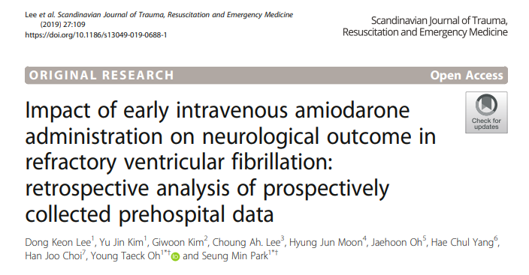

Slide 25
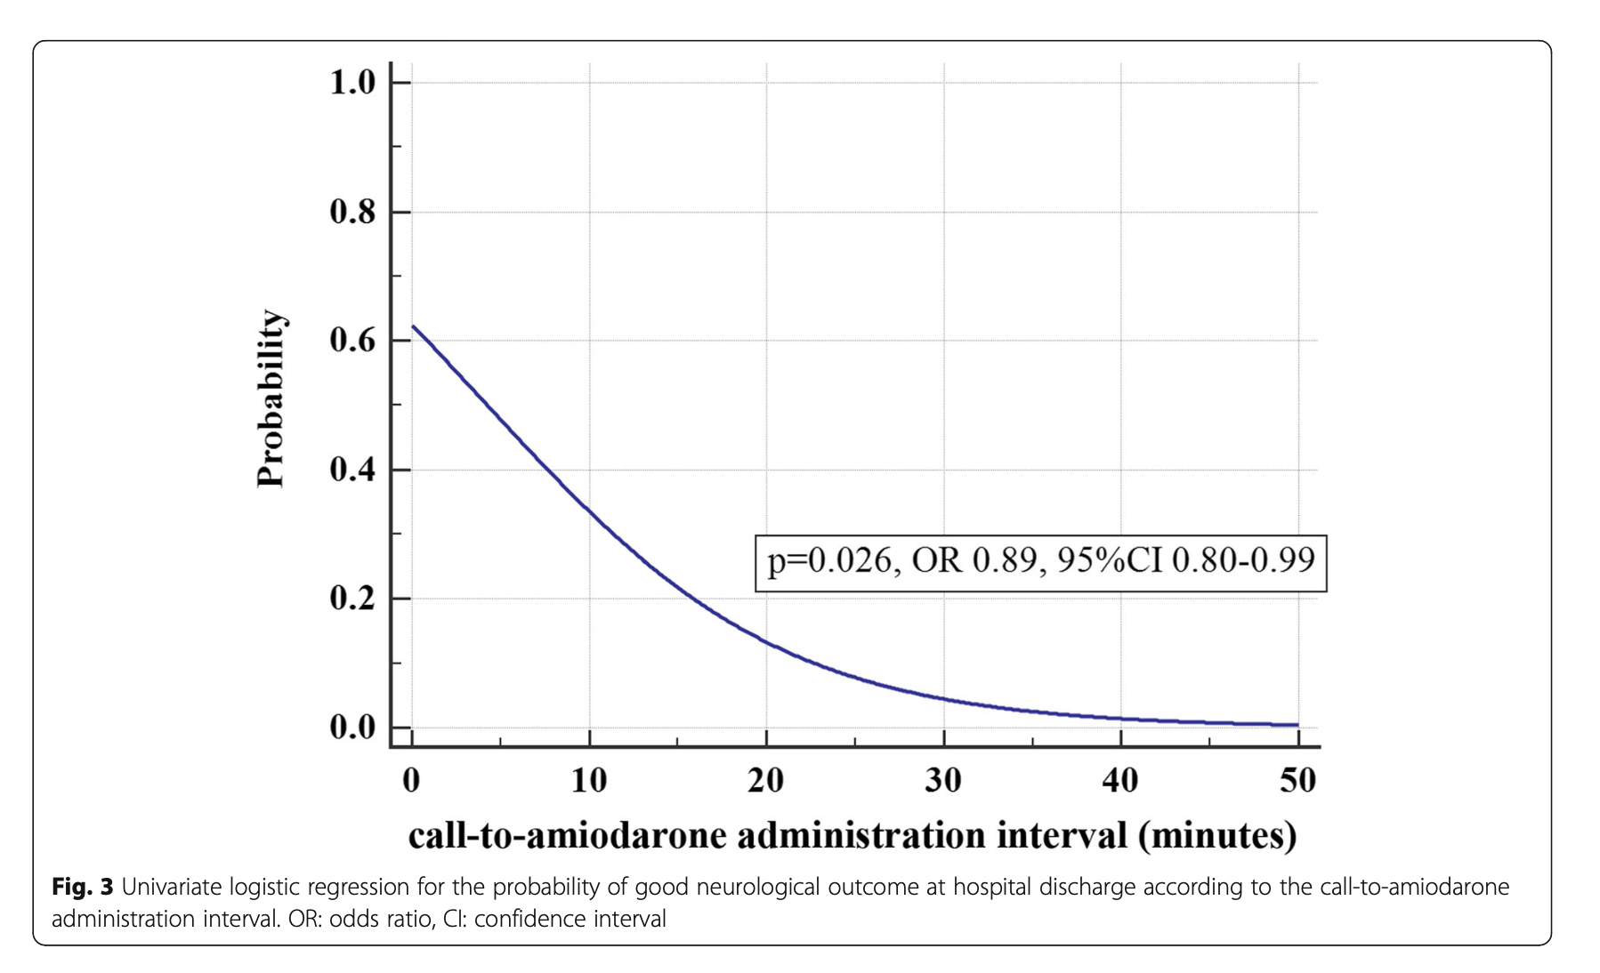
Lee: Probability of Good Neurological Outcome vs Time to Administration

Slide 26
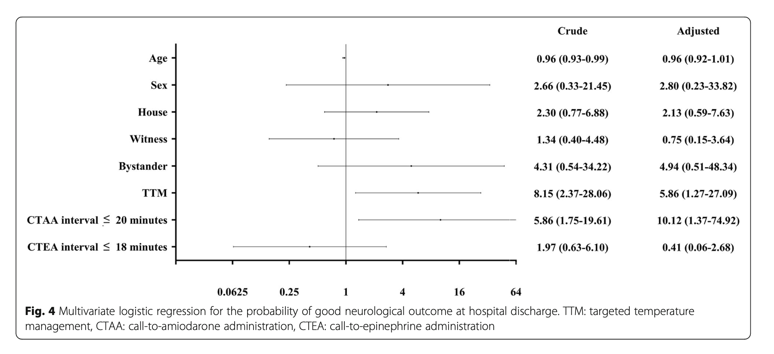
Lee: Multivariate Logsitical Regression of Good Neurological Outcome at DC

Slide 27
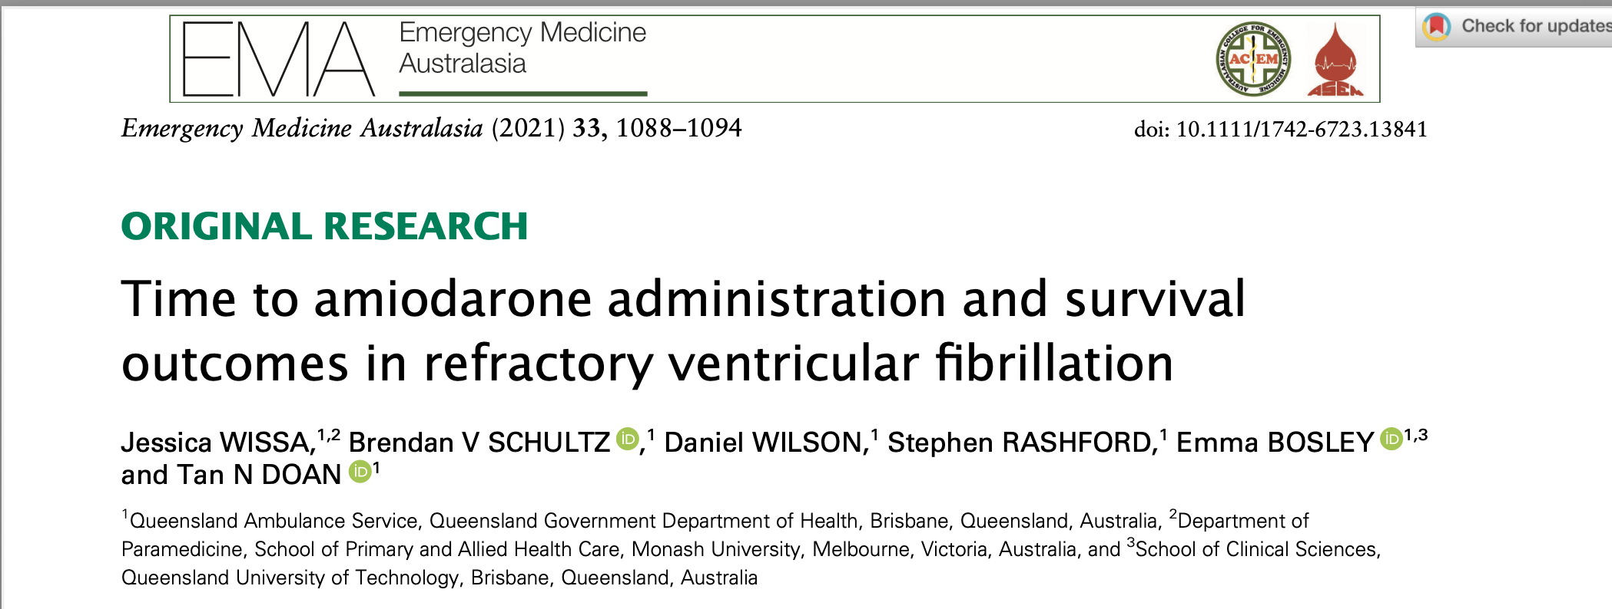

Slide 28
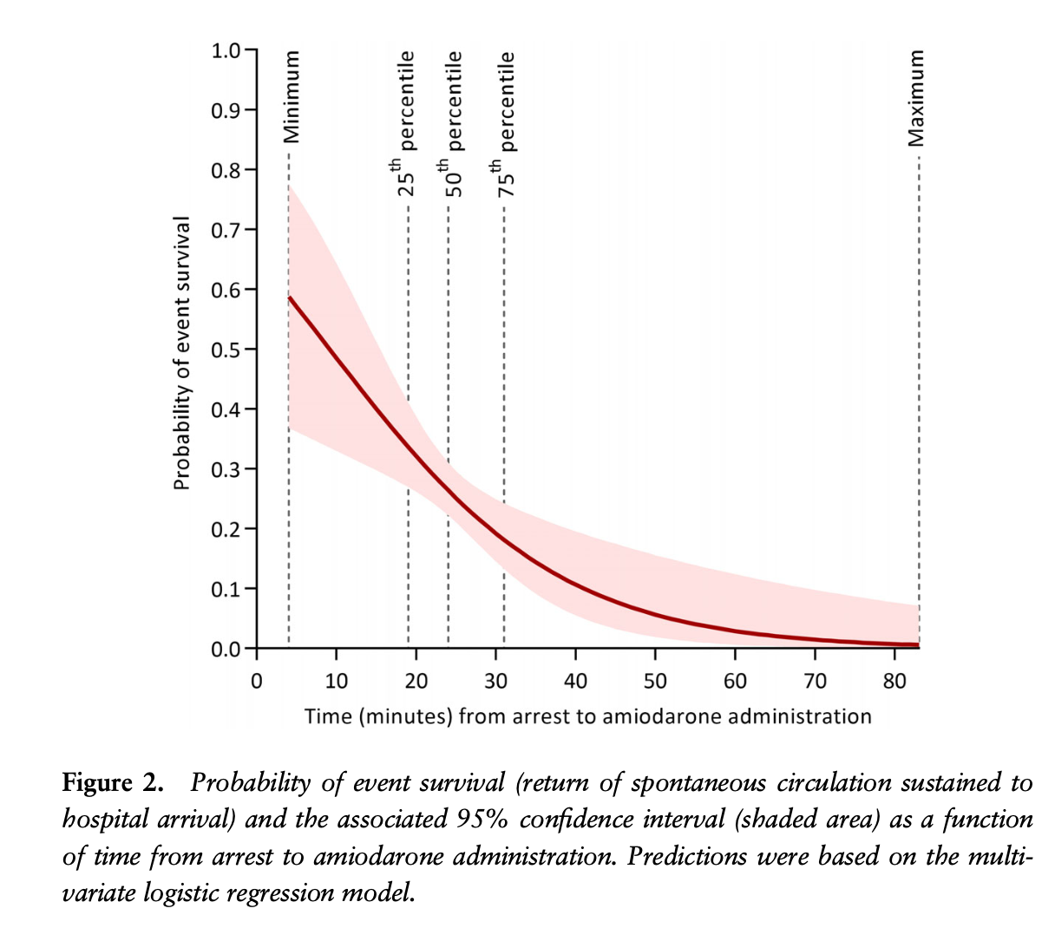

Slide 29
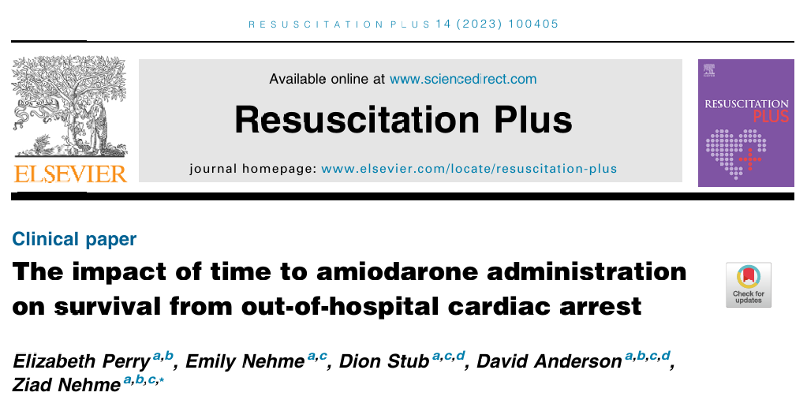

Slide 30
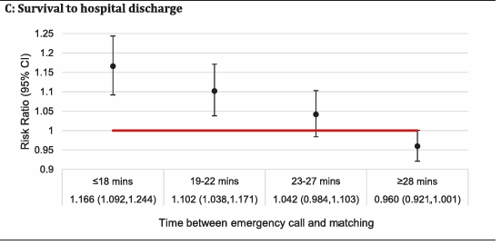
Perry: Survival to Hospital DC

Slide 31
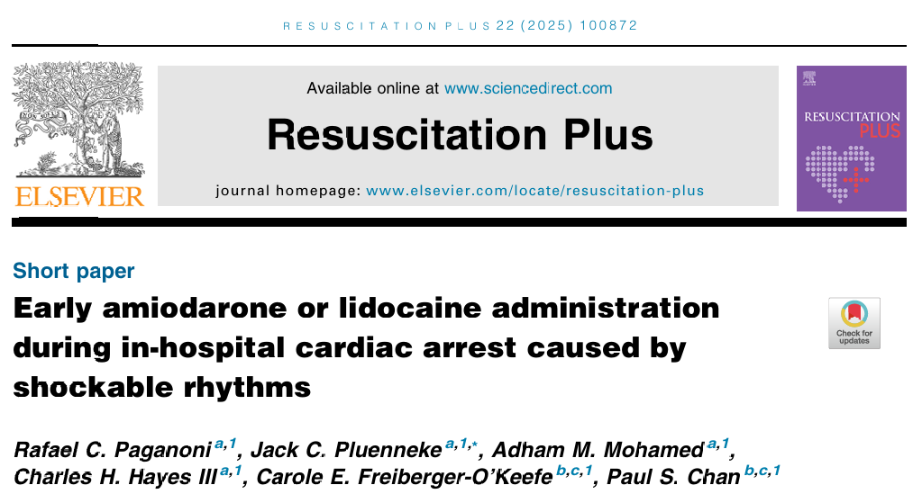

Slide 32
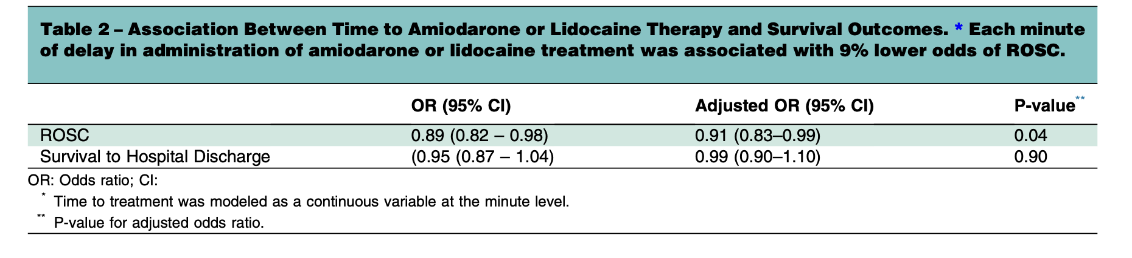
Paganoni: Time to Amiodarone or Lidocaine Therapy and Survival Outcomes

Slide 33
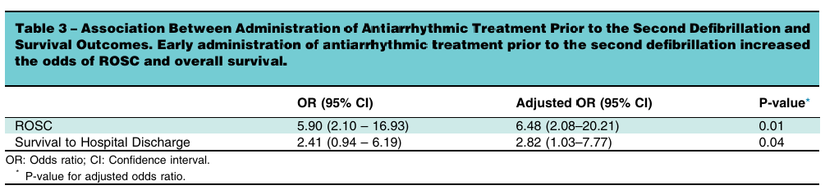
Paganoni: Administration of antiarrhythmic prior to second shock

Slide 34
Conclusion
Earlier amiodarone is associated with significantly greater odds of survival with a favorable neurologic outcome than early placebo in shock-refractory OHCA.

Slide 35
a = Richmond Ambulance Authority (local registry)
b = ARREST Trial
c = ALIVE Trial
d = ALPS Trial
Ornato et al., 2021

Slide 36
Thank you!

