Slide 1
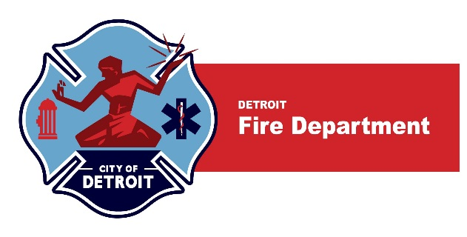
Playing the Cyanosis Blues (and other Maladic Refrains from Fiery Plains): Where’s There’s Smoke, There’s Fire (and Other Chemicals)
Robert B Dunne, MD FACEP, FAEMS
Medical Director
Detroit Fire Department
Detroit East Medical Control Authority

Slide 2
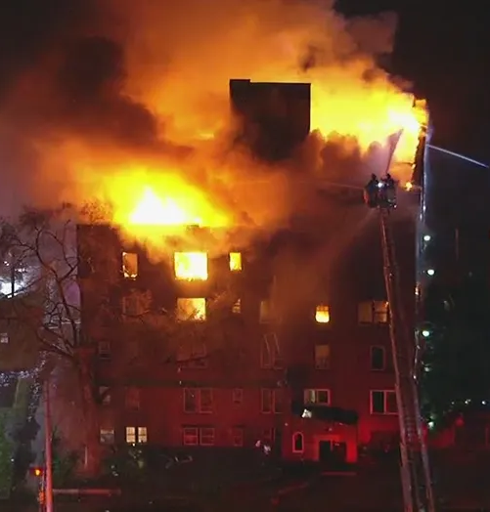
Why are we here?
Why are fires killing people?
Why is fireground resuscitation different?
How can we save more people?
How can we best protect our firefighters?
Notes:
April 27 2023

Slide 3
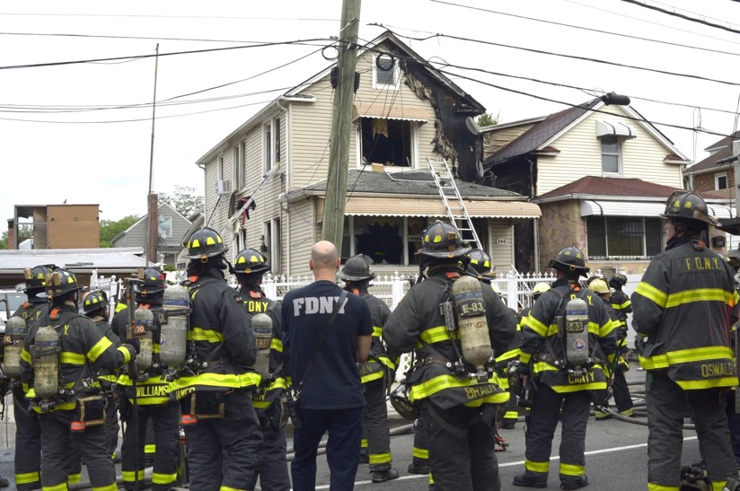
CASE REport
May 17th 2024
The Fire Commissioner said that EMS workers helped save the life of the firefighter after he collapsed while spraying water on the blaze by quickly administering the drug Hydroxocobalamin to reduce the effects of cyanide from the smoke inhalation.
“He [the firefighter] was in really bad shape. They did CPR and hit him with [Hydroxocobalamin] that drug,” said a person familiar with the efforts to save the firefighter at Jacobi Medical Center.
From NYC Medical Director “Yesterday, Two FFs got hydroxocobalamin - both went to the chamber and were admitted overnight - one discharged this morning and the second probably tomorrow. A third FF was less injured and was d/c’d from the ED.”.
Three FDNY firefighters injured in Bronx blaze

Slide 4
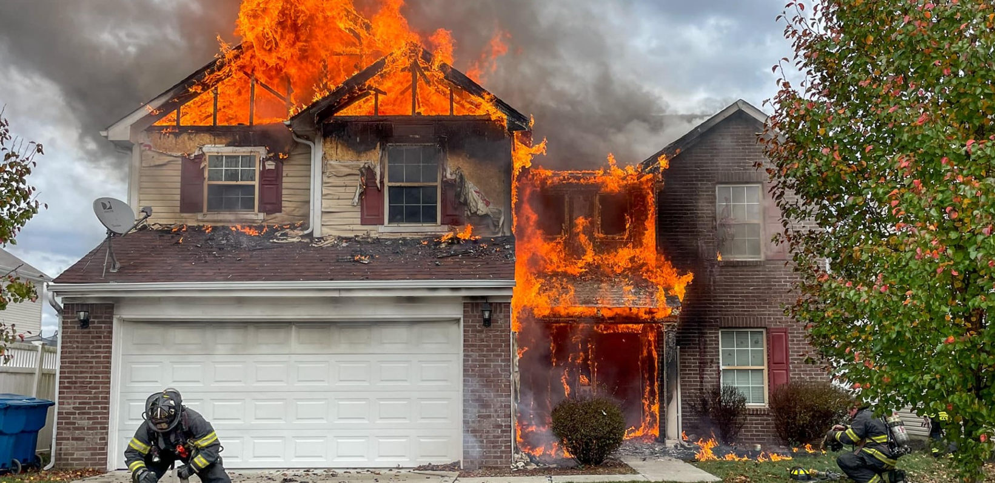
Case Study 2: Civilian victim at structure fire
Recent Detroit Case
Injured civilian at a fire scene; m16 transported a 50-year-old female code 1 to Detroit Receiving Hospital with 1st degree burns to her face, neck and both arms, smoke inhalation and soot in her mouth.
Intubated later in the ED for respiratory failure. Discharged on 8/12 and following up in burn clinic.
CN antidote administered in hospital

Slide 5
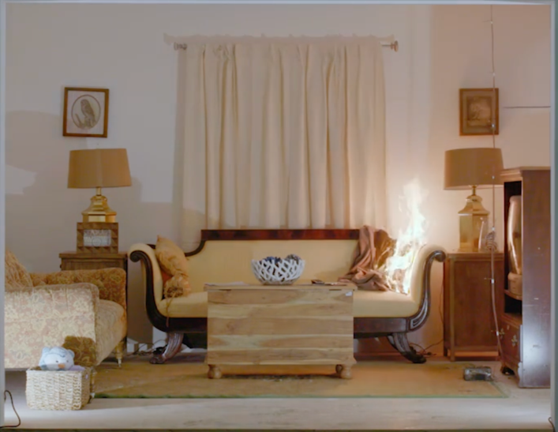
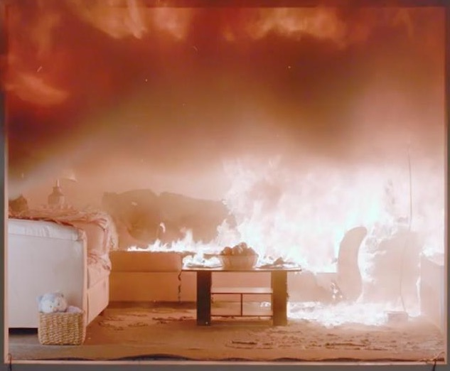
Evolution of Residential Fire Dynamics
Transition from legacy to modern materials changes fire dynamics and fire smoke¹
Natural (legacy)
Synthetic (modern)
at 4:40
at 4:40
200x more smoke and 8x faster burning rate than 50 years ago²
1. New comparison of natural and synthetic home furnishings. (2020, September 30). UL's FSRI – Fire Safety Research Institute. https://fsri.org/research/new-comparison-natural-and-synthetic-home-furnishings. 2. Modern homes burn 8 times faster than 50 years ago. (2013, September 13). CBC. https://www.cbc.ca/news/canada/windsor/modern-homes-burn-8-times-faster-than-50-years-ago-1.1700063
Notes:
Now, the answer to that question is multifactorial, but the most important (?), is because our structures are different. We use different materials, not only to build our structures, but we also fill these structures with different stuff than we did 50 years ago. Synthetic or modern textiles, burn faster, burn hotter, and create more smoke than their natural counterparts. This leads to a few serious considerations:
Look at this experiment, look at all this smoke. We have more smoke faster.
Not only do we have MORE smoke, but because the materials are different, the smoke is different, more on this ‘different smoke’ in a few slides.
Because we are dealing with faster, hotter, smokier fires, there is a decreased time to untenable, life-threatening conditions for victims and fire fighters. Let’s drill in on this.
Side by side burn comparison to demonstrate the impact that furnishing materials have on flashover times.
Look @ the smoke differences. Fires created from combustion of synthetic materials burn hotter, faster, and create more smoke.

Slide 6
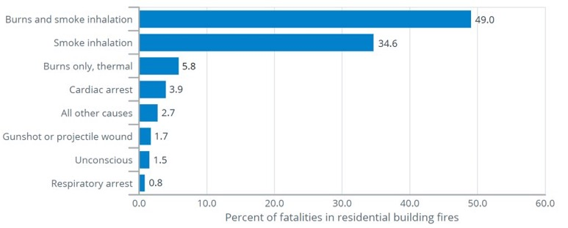
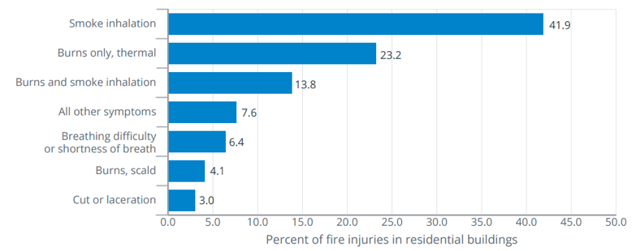
Civilian Fire Fatalities & Injuries in Residential Buildings by Primary Symptom (2017-2019)¹
Fatalities
Injuries
The most common cause of death in fires is the
inhalation of noxious gases rather than thermal injury²
1. (n.d.). U.S. Fire Administration. https://www.usfa.fema.gov/downloads/pdf/statistics/v21i4.pdf 2. Jones, J., McMullen, M., & Dougherty, J. (1987). Toxic smoke inhalation: Cyanide poisoning in fire victims. The American Journal of Emergency Medicine, 5(4), 317-321. https://doi.org/10.1016/0735-6757(87)90360-3
Notes:
What are the consequences we seeing from this fundamental shift in our structure fires?
Burns, as expected, but look at the percentages of patients with smoke inhalation. Over 80% of fatalities and over half of the injuries in residential buildings were due, primary to smoke inhalation. ***Potentially mention cardiac arrest here as well?***

Slide 7

Hazards – What can we do to improve outcomes?
Airway Burns
Carbon Monoxide (CO)
Cyanide (CN)

Slide 8
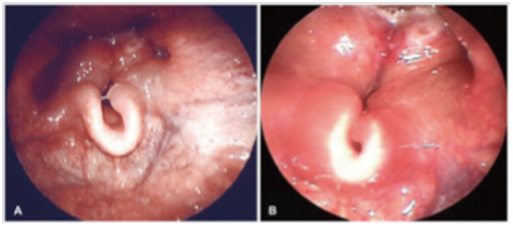
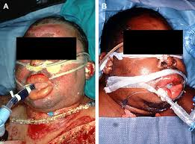
AIRWAY
Expect difficulty
Time is not your friend
Bougie, Video if available, prep for surgical airway
Goal is cuffed tube in Trachea

Slide 9
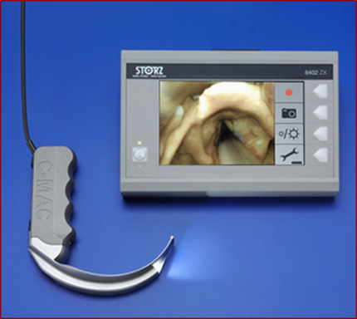

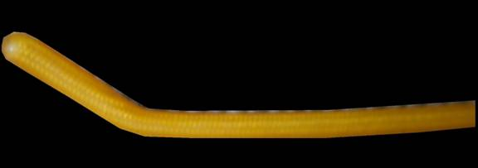
Airway Considerations
  Prepare your gear before you need it
  Expect difficulty
  Time is not your friend
  Bougie, video if available, prep for surgical airway
  Goal is cuffed tube in Trachea

Slide 10
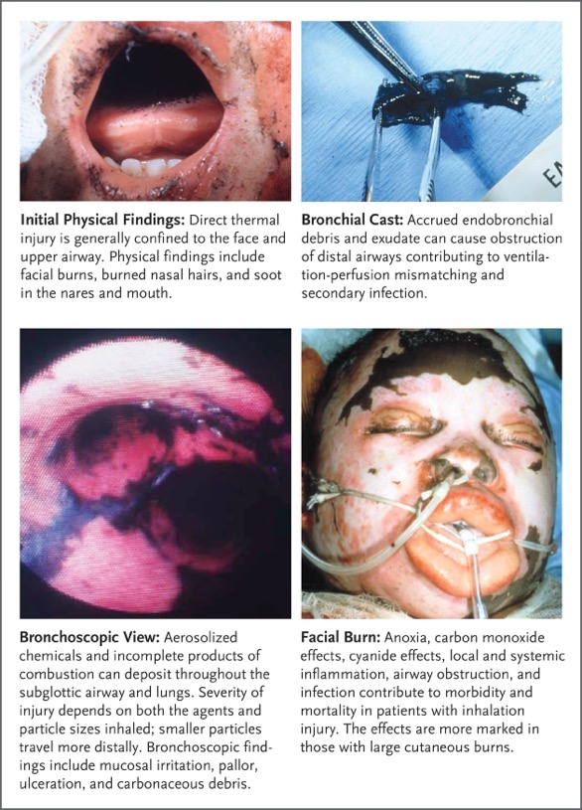
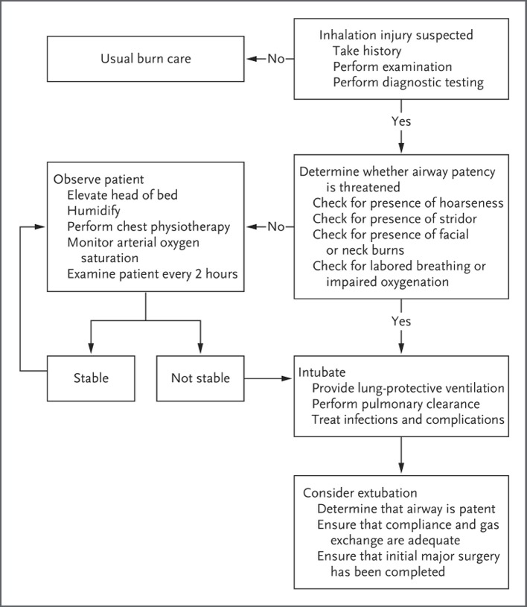

Inhalation Airway Breathing Care Plan
Sheridan RL. N Engl J Med 2016;375:464-469
Notes:
Figure 1 The Pathogenesis of Inhalation Injury. The physiological process of inhalation injury is complex and involves a variable and often unpredictable degree of direct local thermal and chemical exposure, reactive immune responses, systemic effects of inhaled toxins, accrual of endobronchial debris, and secondary infection. Shown are airway soot observed on physical examination, a positive diagnostic bronchoscopic view, a sloughed endobronchial cast, and a patient with inhalation injury.

Slide 11
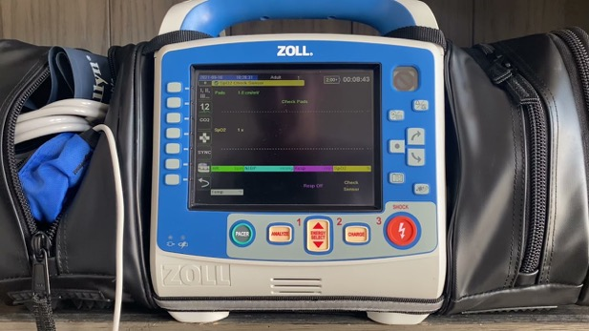
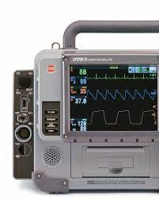
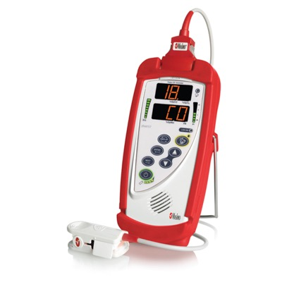
Carbon Monoxide monitoring – USE IT!
In the studies conducted to submit the device for FDA clearance, the CO-oximeter has exhibited accurate readings for COHb values between 0 and 40%.
Cone DC, MacMillan DS, Van Gelder C, et al. Noninvasive fireground assessment of carboxyhemoglobin levels in firefighters. Prehosp Emerg Care. 2005;9:8—13.

Slide 12

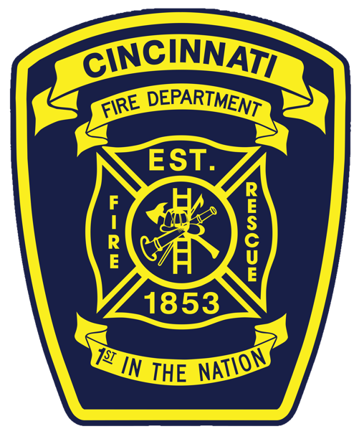
Playing the Cyanosis Blues
Dustin J Calhoun, MD FAEMS
Medical Director
Cincinnati Fire Department
Associate Professor
University of Cincinnati

Slide 13
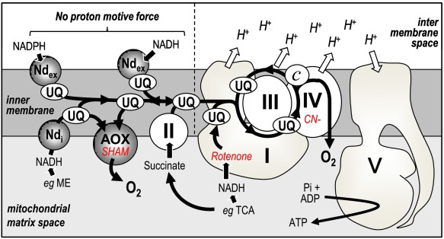

Slide 14
Elimination
Urine
Lung
Sweat
cyt c²⁺
cyt c³⁺
(1)
cyt c³⁺
cyt c²⁺
(2)
Transulfuration*
Renal excretion
Thiocyanates
(SCN)
CN
(enzyme rhodanese)
Hydroxocobalamin
(Vitamin B_{12a})
(4)
cyt a₃²⁺
cyt a₃³⁺
Fe (MetHb-forming agents)†
(3)
Cyanocobalamin
(Vitamin B₁₂)
Stable
non-toxic
compounds
CyanoMetHb
O₂
2 H₂O
Eliminated in urine
Detoxification Pathways (4)
Toxicity Pathway
*In the presence of thiosulfate; †in the presence of nitrites; pathways 2 and 3 are targets of available cyanide antidotes.
Adapted from Megarbane B, et al. J Chin Med Assoc. 2003;66:193-203.

Slide 15
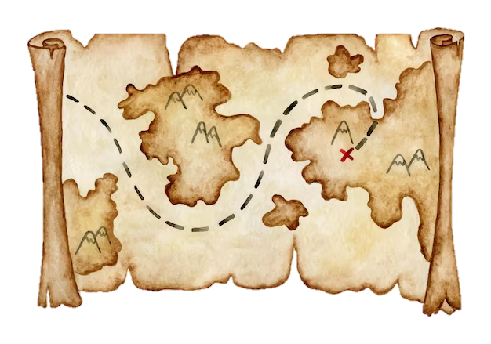
Why/when is this an issue?
What are you looking for?
What should you be doing?

Slide 16
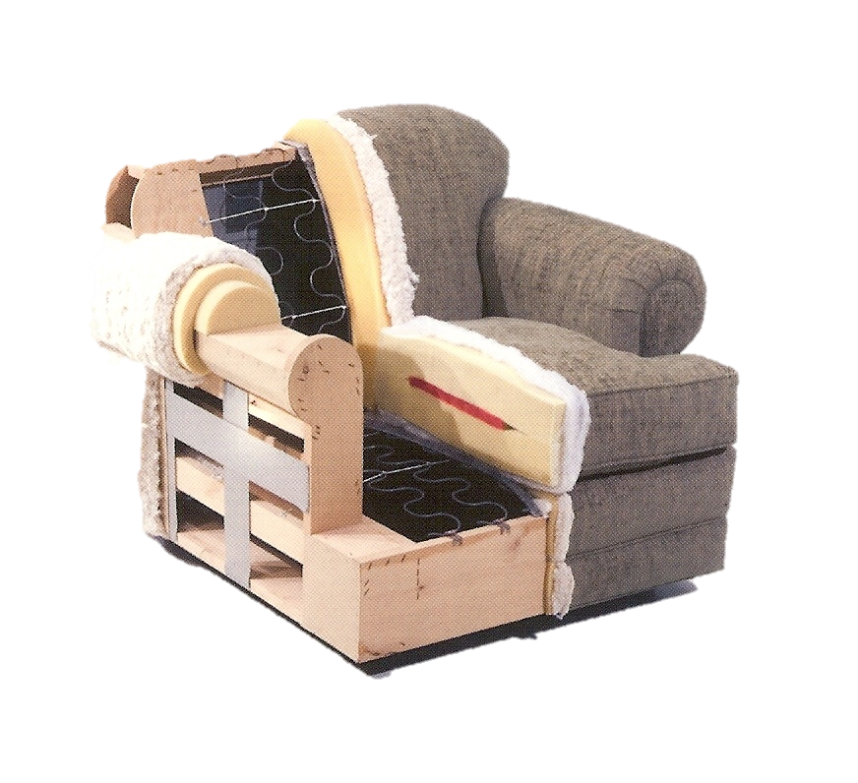

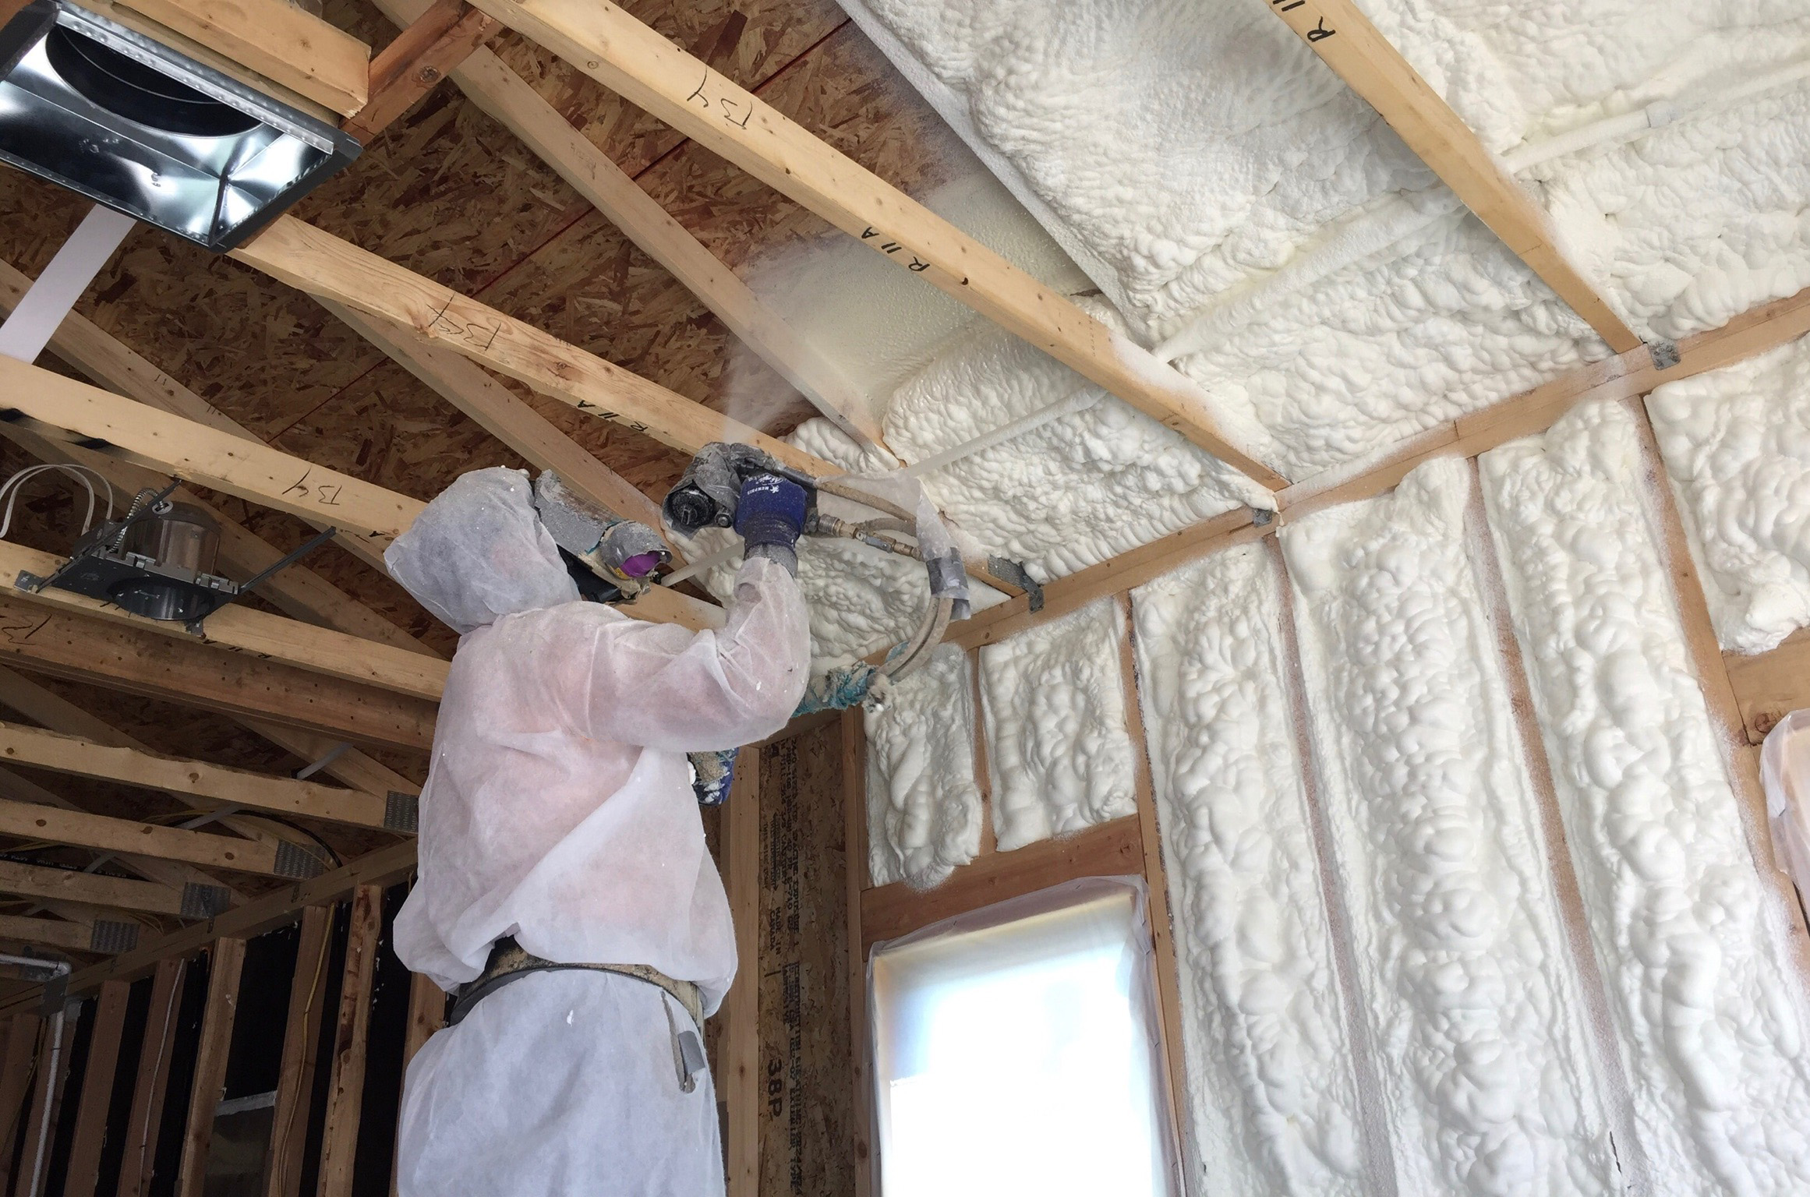
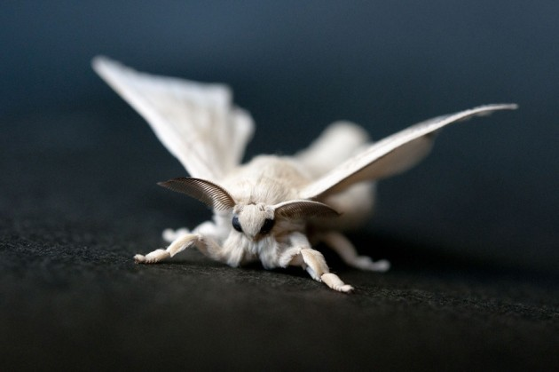

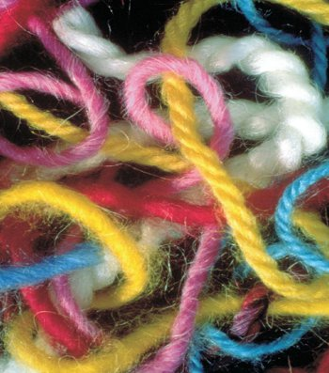
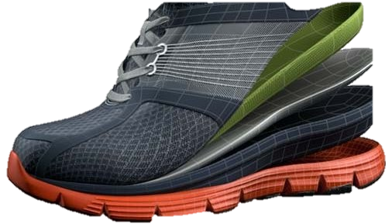
WHY?
Notes:
33-90% of closed-space fire fatalities have toxic levels of CN
-5-15% growth per year in spray foam insulation in houses for past 10 yrs.
-heated objects

Slide 17
Alaire Y. Critical Reviews in Toxicology. 2002;32:259-289.

Slide 18

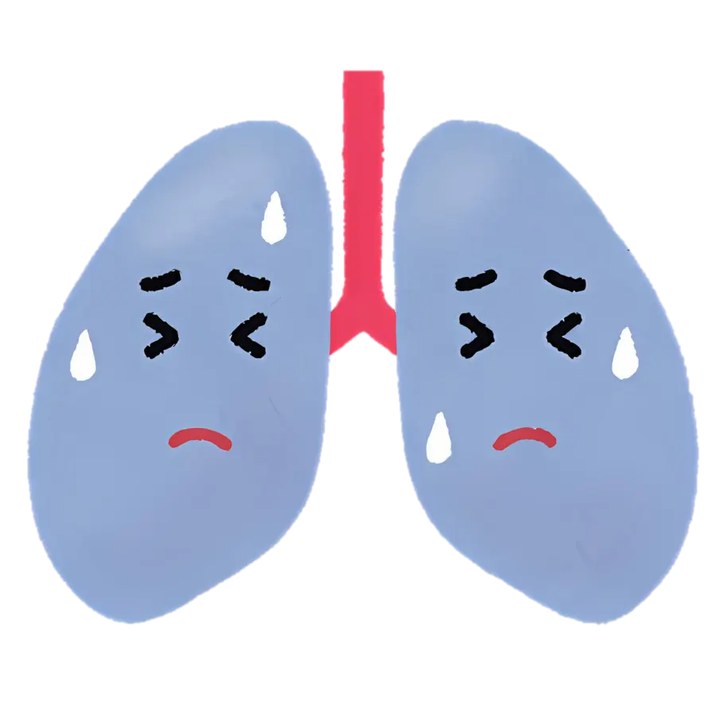

Weak/dizzy
Dyspnea
Diaphoresis
Headache
AMS
Dysrhythmia
Chest pain
Seizure/tremor
Cardiac arrest

Slide 19


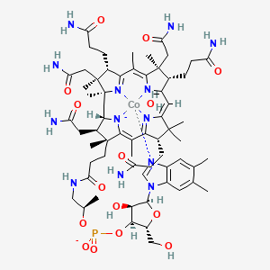
What to do?
Prevention
  PPE
  Understand timeline
Recognition
  Broad range of symptoms
  Understand timeline
Treatment
  Antidote availability
  Transport timing
Notes:
-overhaul – scba, outside the structure?
-remember skin absorption – can delay presentation
-even outside fire (household waste burn)

Slide 20

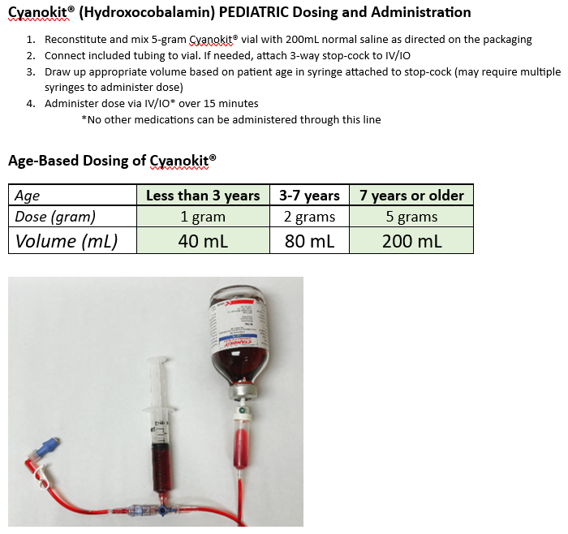
Drip set
Pedi dosing

Slide 21
ALL credit to Jim Augustine, MD

Slide 22


Slide 23
Playing the Cyanosis Blues (and other Maladic Refrains from Fiery Plains): Where’s There’s Smoke, There’s Fire (and Other Chemicals)
Robert B Dunne, MD FACEP, FAEMS
Medical Director
Detroit Fire Department
Detroit East Medical Control Authority

