Slide 1
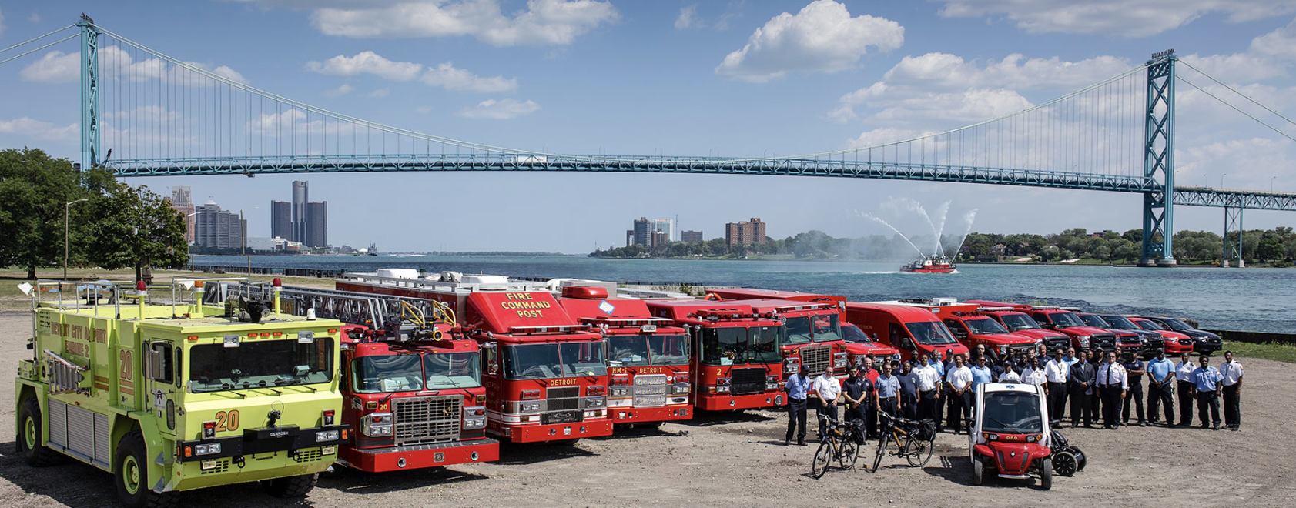

What You’ll Gain When You Maintain and Sustain the Chain?
Robert B Dunne, MD FACEP, FAEMS
Medical Director
Detroit Fire Department
Detroit East Medical Control Authority
Dunner@Detroitmi.gov

Slide 2
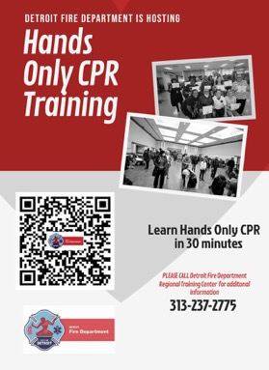
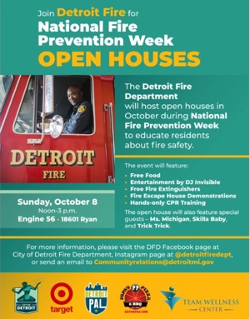
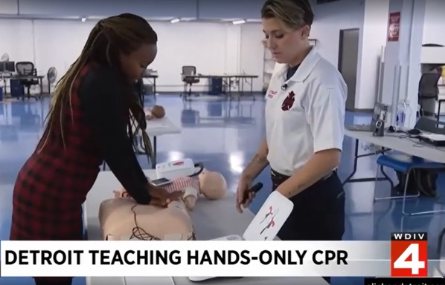

What does it take to improve out comes?
How can you get recognized for your efforts?
What is needed to make change happen?
https://citizencpr.org/heartsafe-community/
Notes:
Position Detroit as an example of systemic transformation and grassroots involvement

Slide 3
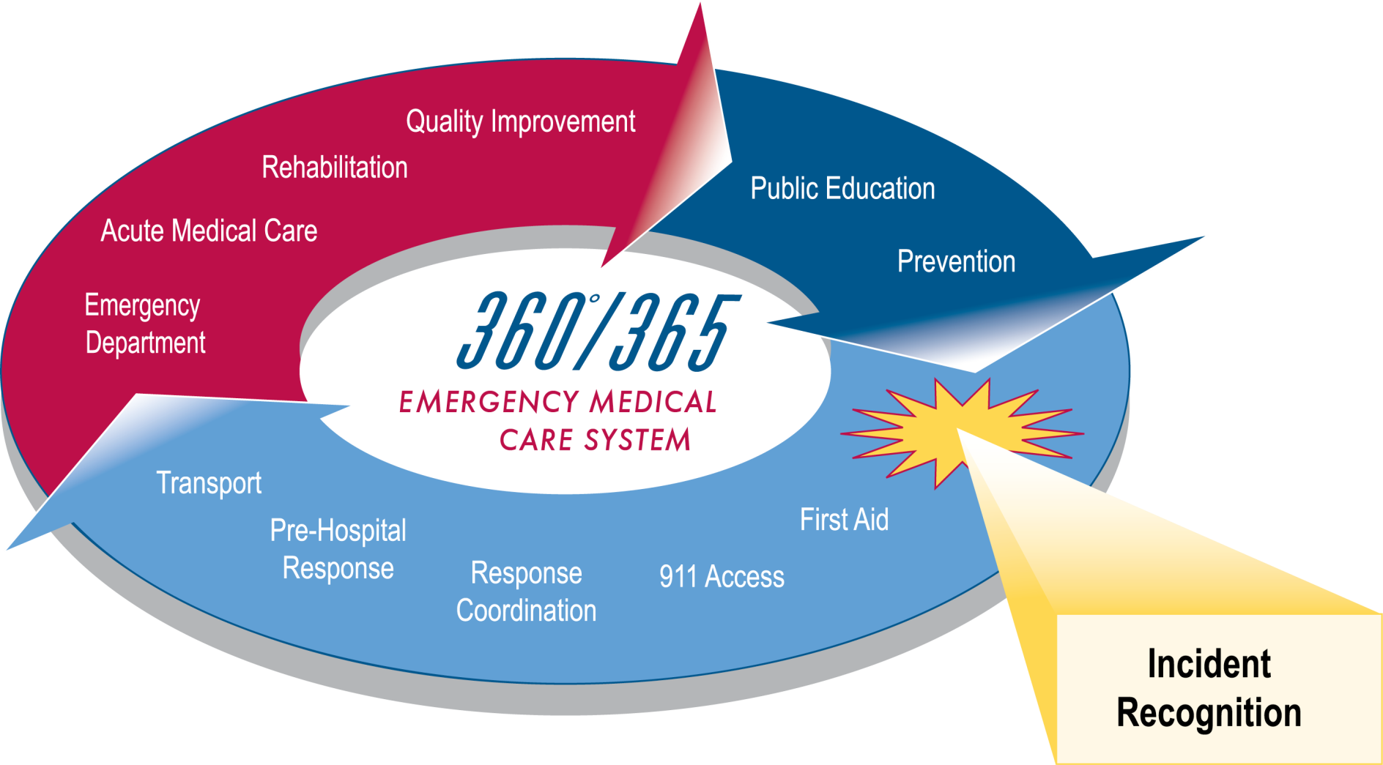
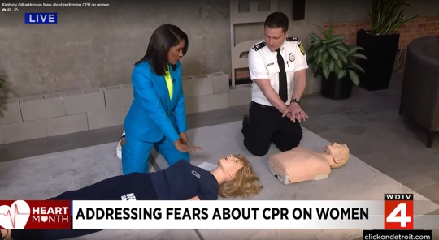
What is a HeartSafe Community?
A HeartSafe Community is a designation recognizing cities that prioritize sudden cardiac arrest survival.

Slide 4
Criteria for heart safe community: where we were in 2020
Requirement | STATUS
Lead Organization | DFD
Cardiac Arrest Data System | In Place since 2004, CARES
Community Training | Ongoing
Recognition of Community Responders | Ongoing, Recent Events
Public Awareness | Education, CPR training, Partnership
911 CPR Coaching | Currently Part of Our Call Taker Training and QA
Emergency Response Plans | GAP: NEEDS to be confirmed and collected,
Community AEDs | Continue to expand
AED Registry | GAP: NEEDS to be established,
First Responder AED | DFD – mostly complete, DPD limited
High Performance CPR | Training and Protocols in Place, just updated
Quality Improvement Project | Ongoing
Public Health Interventions | Ongoing, DHD, community Partners

Slide 5
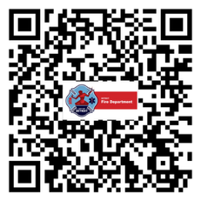
Lead Agency and Community Team
Lead: Detroit Fire Department
Over 50 community partners:
Health Systems: Henry Ford, Corewell, DMC, Ascension
Government: Mayor’s Office, DEMCA, State of Michigan
Community: Wayne State, Schools, Churches, Businesses, News Outlets
Notes:
Emphasize the power of partnerships in large-scale public health efforts

Slide 6
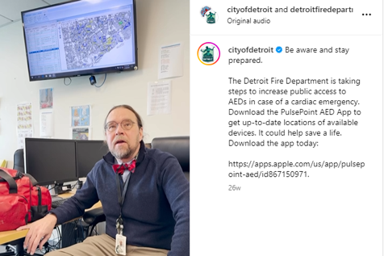
Data Collection and CARES Registry
Registry since 2003
CARES since 2013
Daily review of EMS monitor/CPR device data
Weekly quality improvement meetings
911 audio reviewed for cardiac arrests
Data informs real change

Slide 7
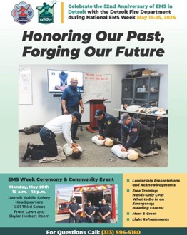
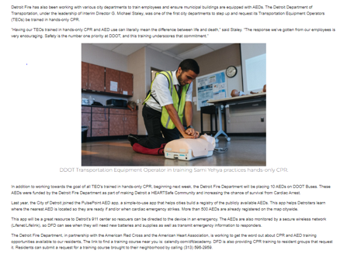
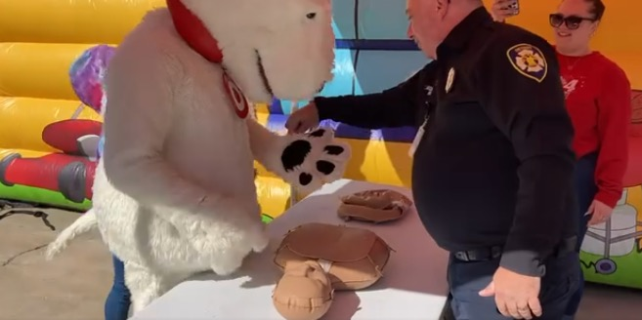
Public CPR Education
130,000+ trained in 1 year
AHA, Red Cross, DFD Hands-Only Training
Schools, Churches, City Employees, Recreation Centers
Door to Door

Slide 8
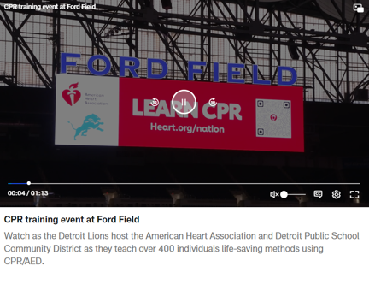
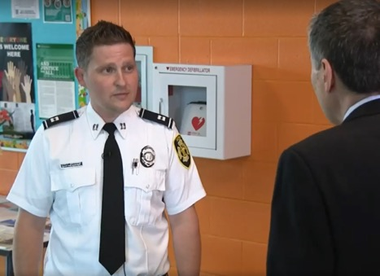
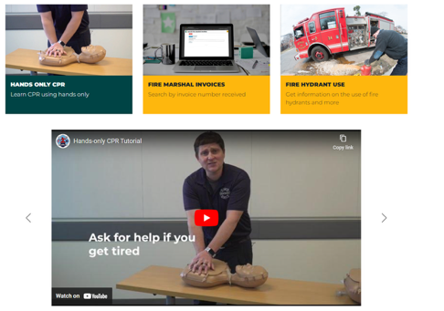
Hands-Only CPR Outreach
Custom training video distributed to:
  City employees
  Churches
  Sporting Events
  TV networks
  Lifesavers events, schools, and more
Notes:
Highlight the broad and creative delivery of CPR training

Slide 9
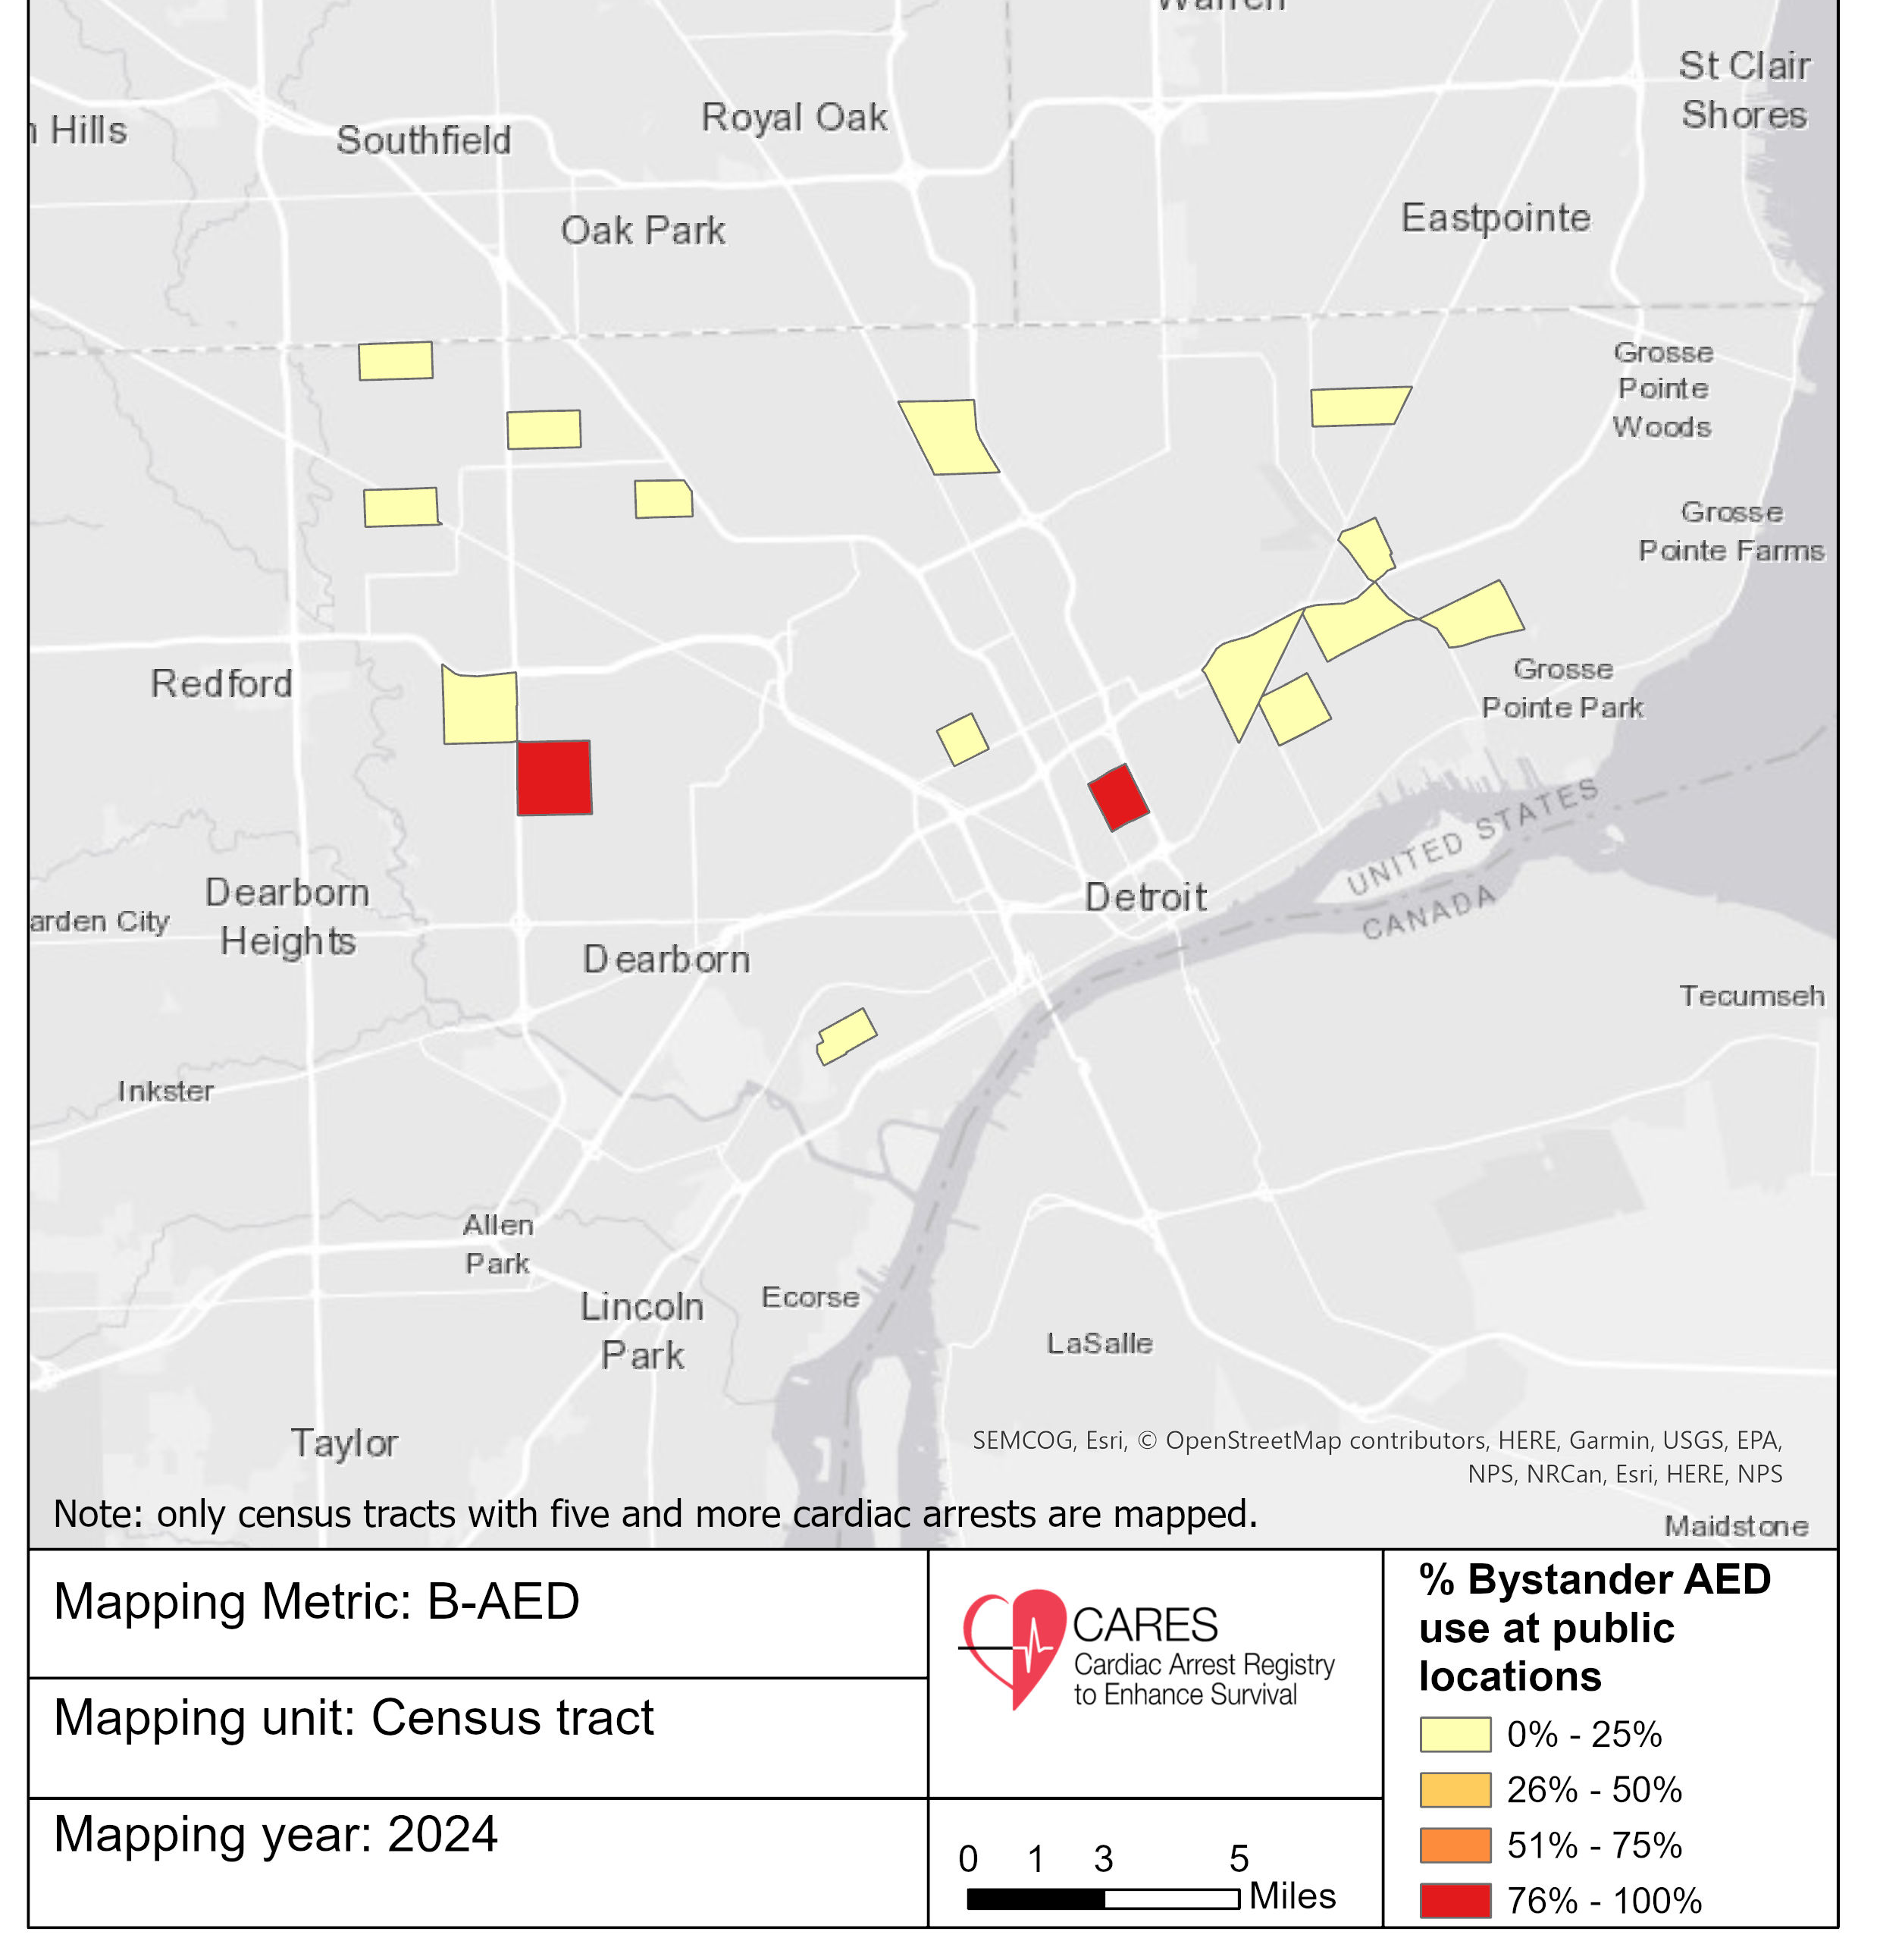
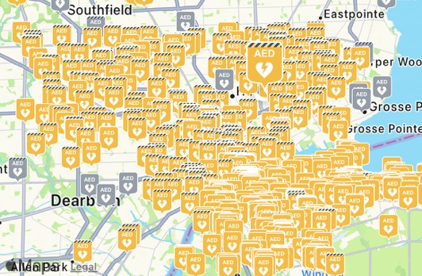
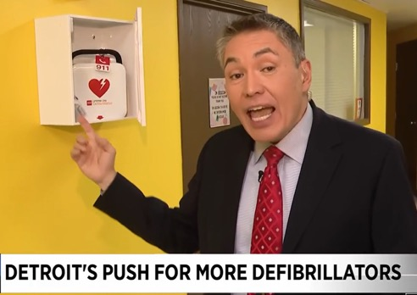
AED Mapping and PulsePoint
PulsePoint integration in Detroit
  600+ AEDs mapped
  AEDs placed in:
  Select DPD units and precincts
  Select DDOT buses
  Places could request
Notes:
PulsePoint makes AEDs visible in real time to dispatch and public

Slide 10
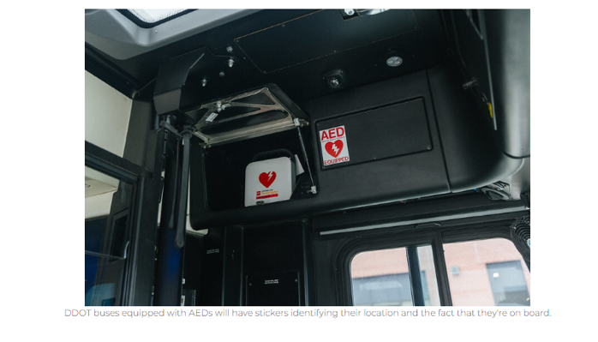
Telecommunicator CPR (T-CPR)
All 911 calls answered by medically trained dispatchers
T-CPR instructions for adults, children, and infants
Ongoing dispatcher training and QA review
Notes:
T-CPR dramatically increased bystander CPR rates

Slide 11
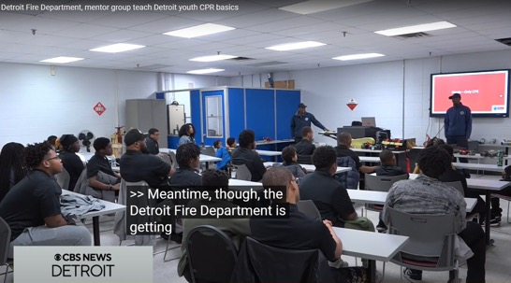
First Responder AED Programs
Detroit Fire: All vehicles equipped with minimum of an AED (admin etc)
DPD: CPR certified, AED-equipped units where needed
DPS Police and Transit Police partial AED
Quarterly training and debriefs after CPR calls

Slide 12
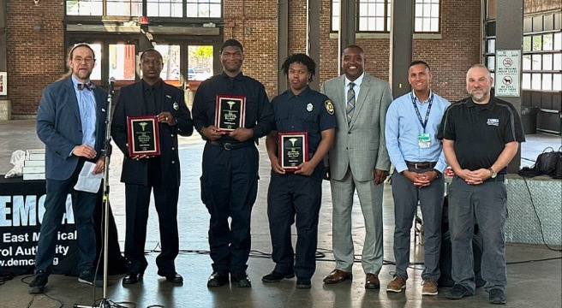
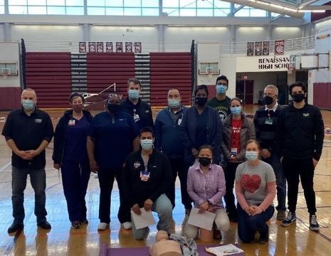
Recognition and Celebration
Partnership with SaveMiHeart (MI-CARES) and MCA
Celebrations for bystanders and responders
Spirit of Detroit awards for youth and citizens
Public media coverage to highlight success

Slide 13
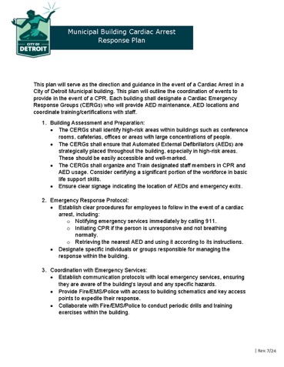
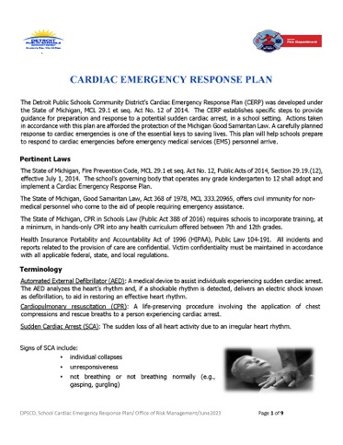
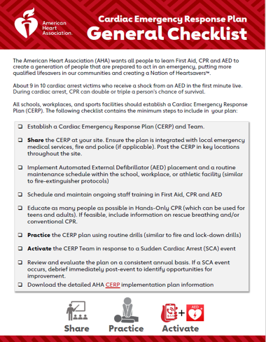
Emergency Action Plans (EAPs)
Updated plans in city buildings and all Detroit Public Schools
Annual drills and training required
Coordination with Auditors and school staff
Notes:
Promotes readiness beyond EMS – involving all sectors

Slide 14

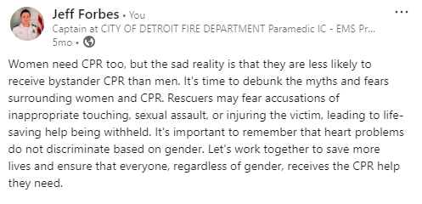
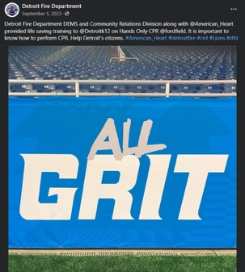
Public Awareness Campaigns
Year-round messaging via:
  TV/Radio/Online media
  Hired Media Relations and Social Media Manager
  Live Streaming Events
  Billboards (upcoming)
  Booths at events and council meetings

Slide 15
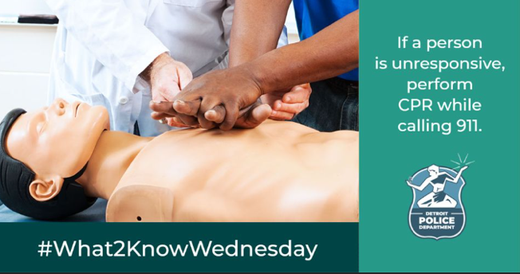
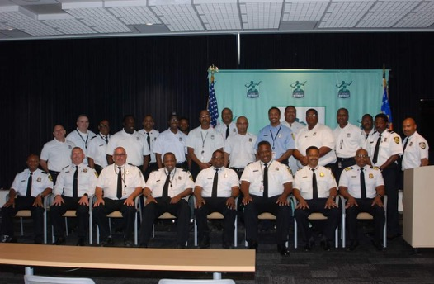
Sustainability and Accountability
Annual CPR refreshers for city employees
New hire CPR for all City Employees
CPR Data reporting made public
Monthly fellowship meetings, protocol reviews

Slide 16
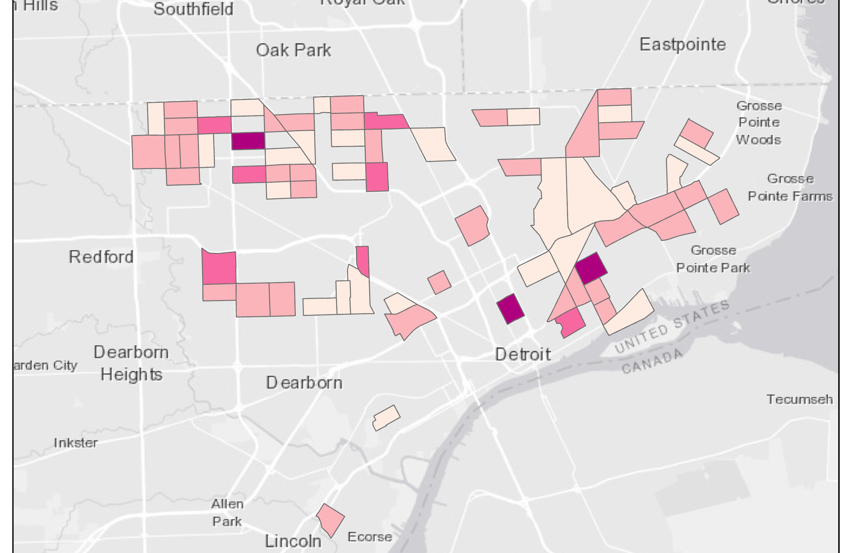
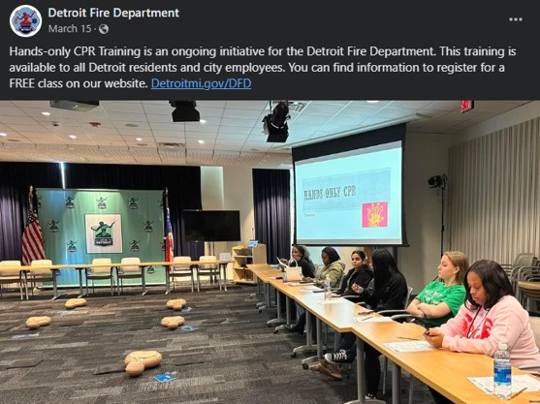
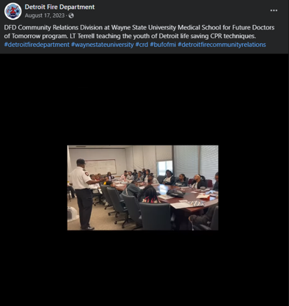
Future Commitments
Expand AEDs to all buses and some police units
100% CPR trained city workforce
CPR growth in targeted communities

Slide 17
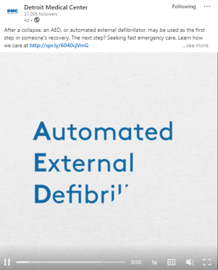

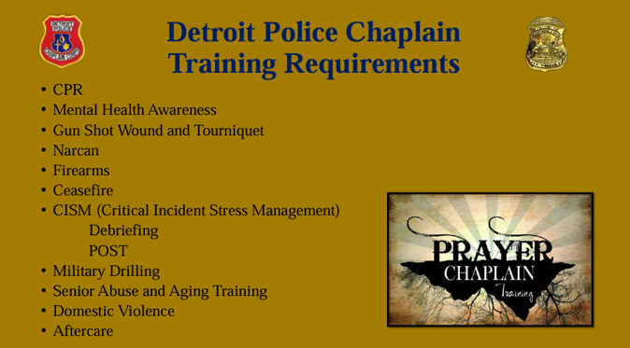
Impact Snapshot
130,577 CPR-trained residents (2023–24)
20+ published studies from Detroit CPR Data
600+ AEDs mapped
PulsePoint Campaign
50+ partnerships citywide
Increased CPR

Slide 18
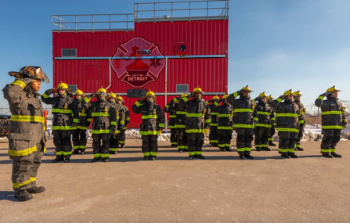
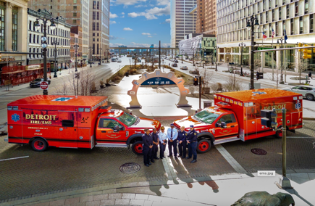
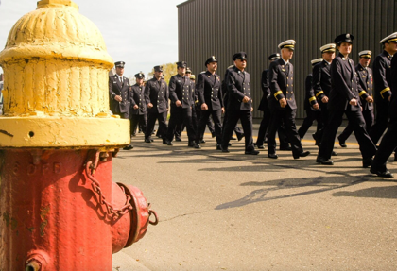
Final Takeaway
YOU CAN DO THIS
"You don’t become HeartSafe by accident. It takes leadership, data, relentless follow-through — and a community committed to saving lives." D Hiltz Citizen CPR Foundation
Notes:
End strong with a motivating quote or message

Slide 19
The 4 Minute Community
Roadmap
El Paso/Teller County, CO
Stein Bronsky, MD
Gathering of The Eagles
June 12, 2025

Slide 20
Questions:
Are we considering the barriers to using an AED?
Some of them at least
Is it time to reassess whether AEDs are achieving their full potential?
Are we placing AEDs in the
wrong locations?

Slide 21
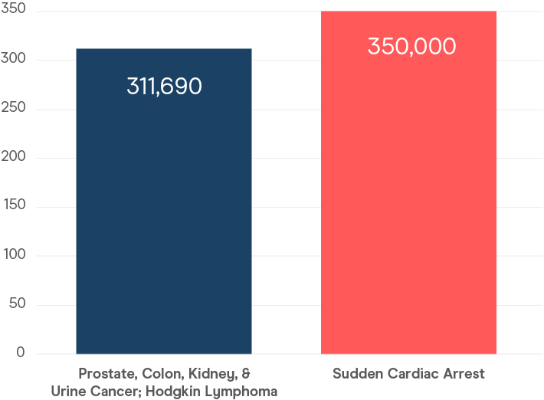
The Problem is Massive
Low Survival Rate Nationally
~10-12% of OHCA victims survive to hospital discharge
Despite a Proven Therapy
Death from OHCA vs. 7 Cancers in 2020 in the U.S.
#1 Cause of Death
for people over 40 years old
Proven Therapy
Early defibrillation can increase survival to >50%.

Slide 22
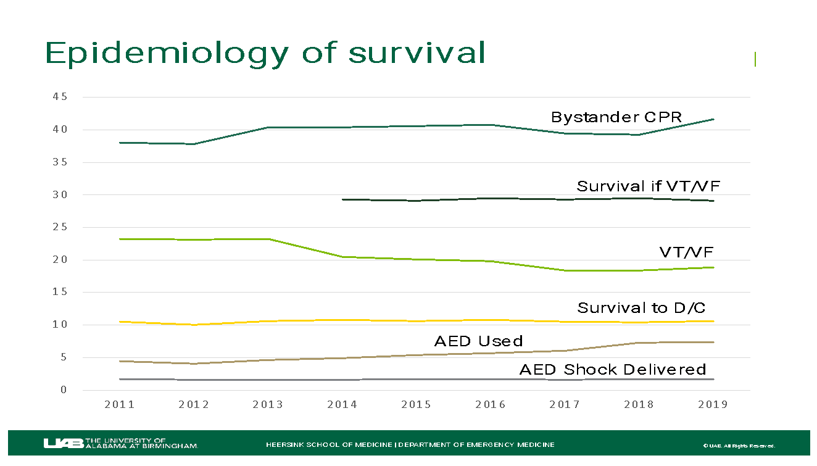
Survival Rates Remain Stagnant
Despite A Lot of Effort
Epidemiology
of Survival
Every minute without defibrillation decreases survival by 7–10%.
AEDs used before EMS arrival can x2 or x3 survival compared to waiting for EMS.
Bystander CPR + AED use: Combined, this yields the highest survival rates
  often exceeding 50% for witnessed VF/VT in public locations.

Slide 23
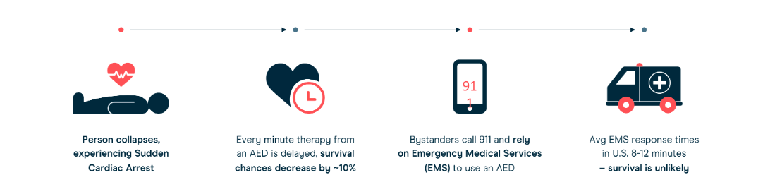
OHCA Response Chain is Broken
Dismal Survival Rates
Survival rates have remained
unchanged for decades.
70-80% of OHCA occur in the
residential setting
Notes:
point-by-point of specifics to fix the problem
about the solution, not the supplier

Slide 24
01
Definitions & Methodology

Slide 25
01
Definitions & Methodology
02
OHCA Data
Table of Contents
03
OHCA Locations & Demographics
04
EMS Response & AED Use
05
Next Steps

Slide 26
Data Analysis Overview
Analyzed 1,557 unique OHCA shared for the period between September 2022 and September 2024.
  supplemented by the publicly available 2022 US Census Bureau data, which examines “median income” and “rate of poverty.”
Incidents from nursing homes, assisted living centers, police/jails, Hospitals and dialysis centers were omitted from the data set because we assume these locations are covered with AEDs and trained responders.
The data was obtained from ePCR software from all the transporting EMS agencies within two counties.
We defined bystander AED use as any of the following data elements being inputted into the ePCR: “Family Member” and “Lay Person—Non-Family.”

Slide 27
02
OHCA Data

Slide 28
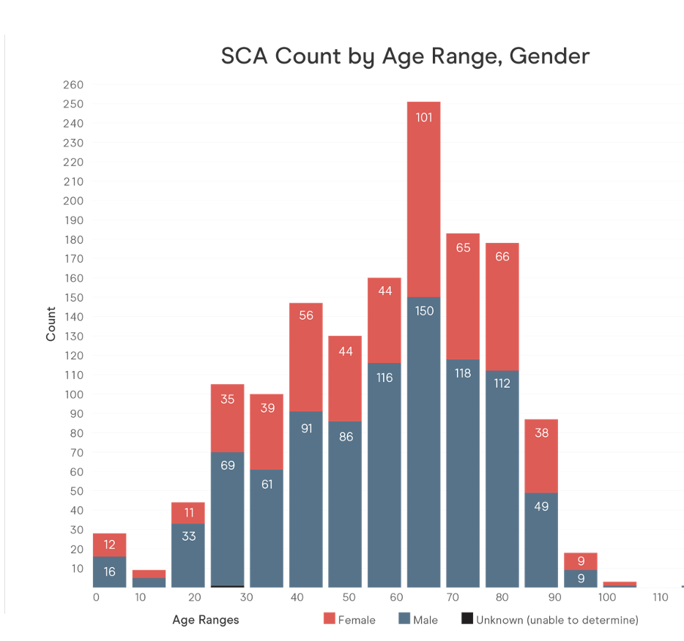
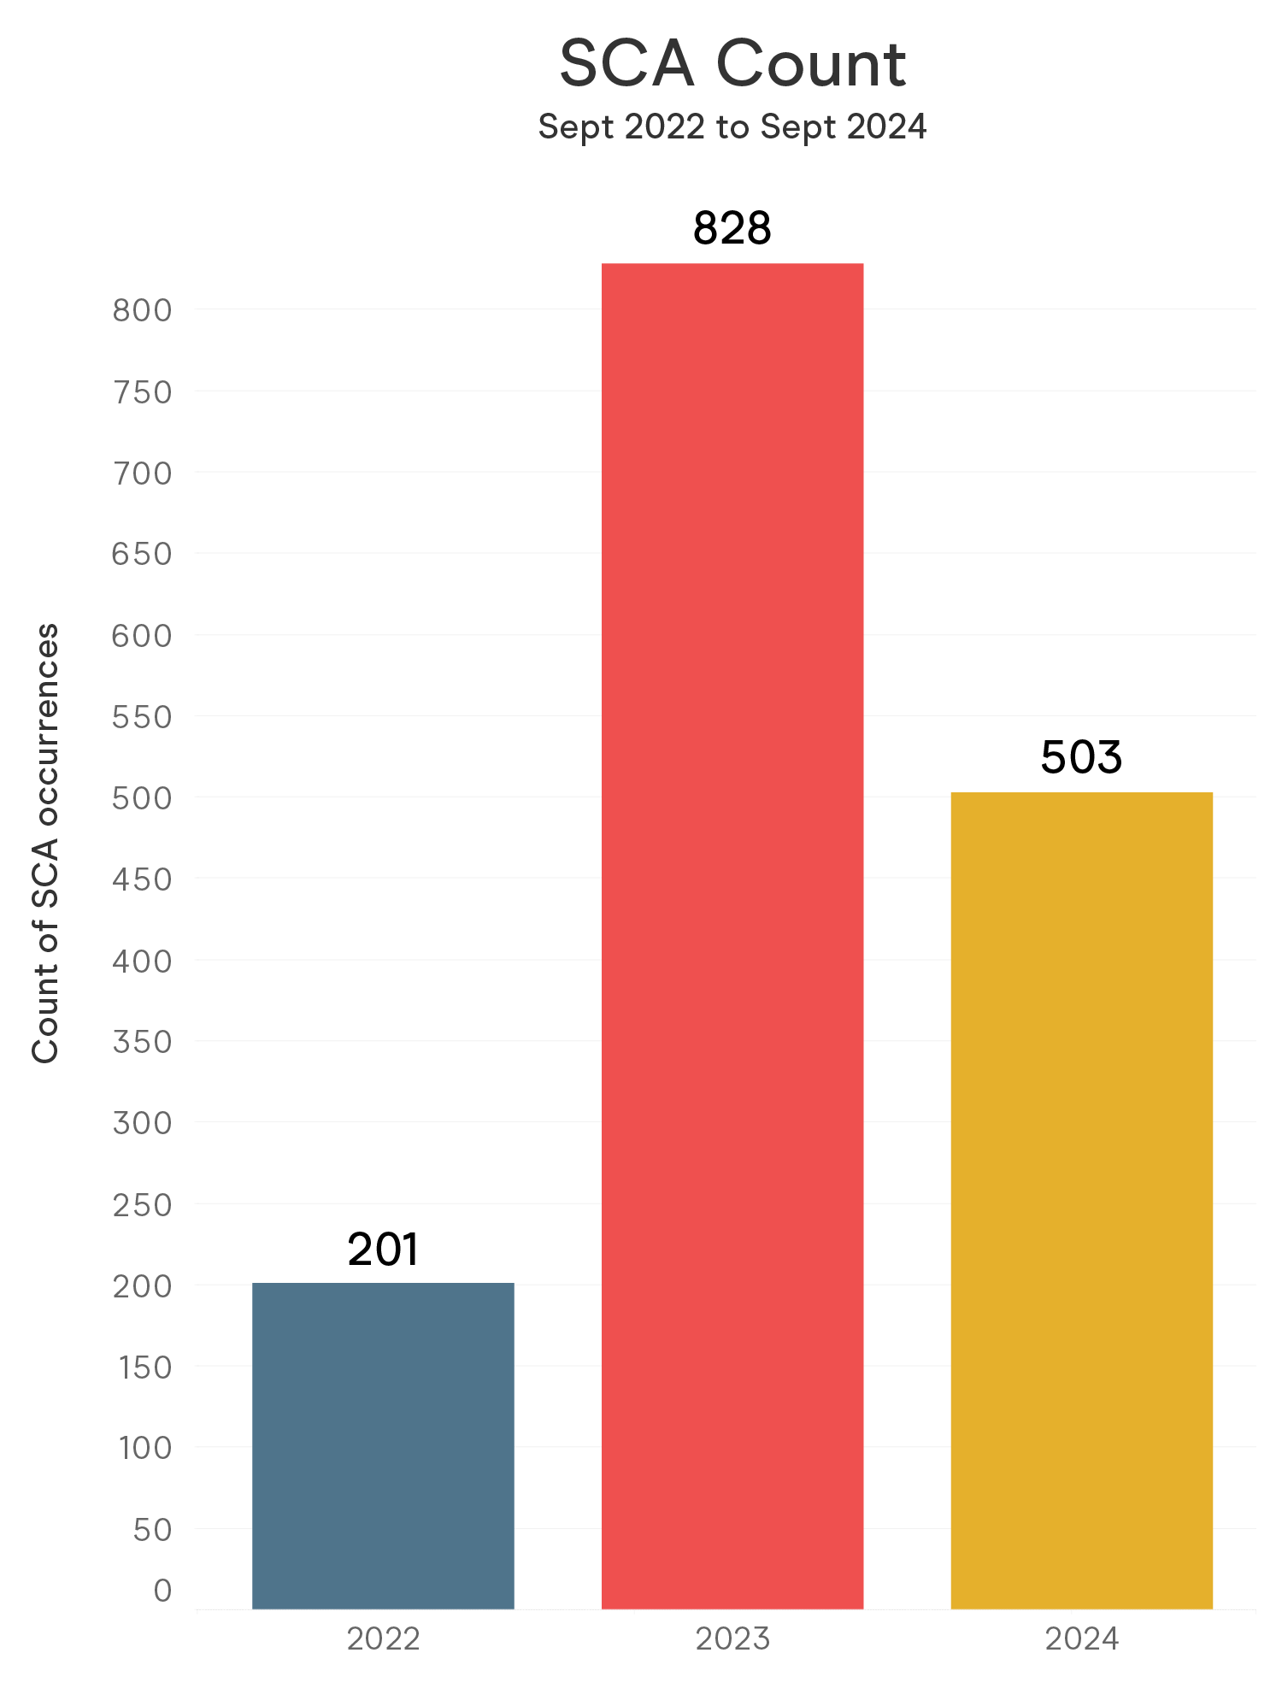
Demographics Summary
Percent male/female and average
age range of OHCA victims
Gender | Count | % of Total | Average Age
Male | 959 | 64% | 57
Female | 543 | 36% | 58

Slide 29
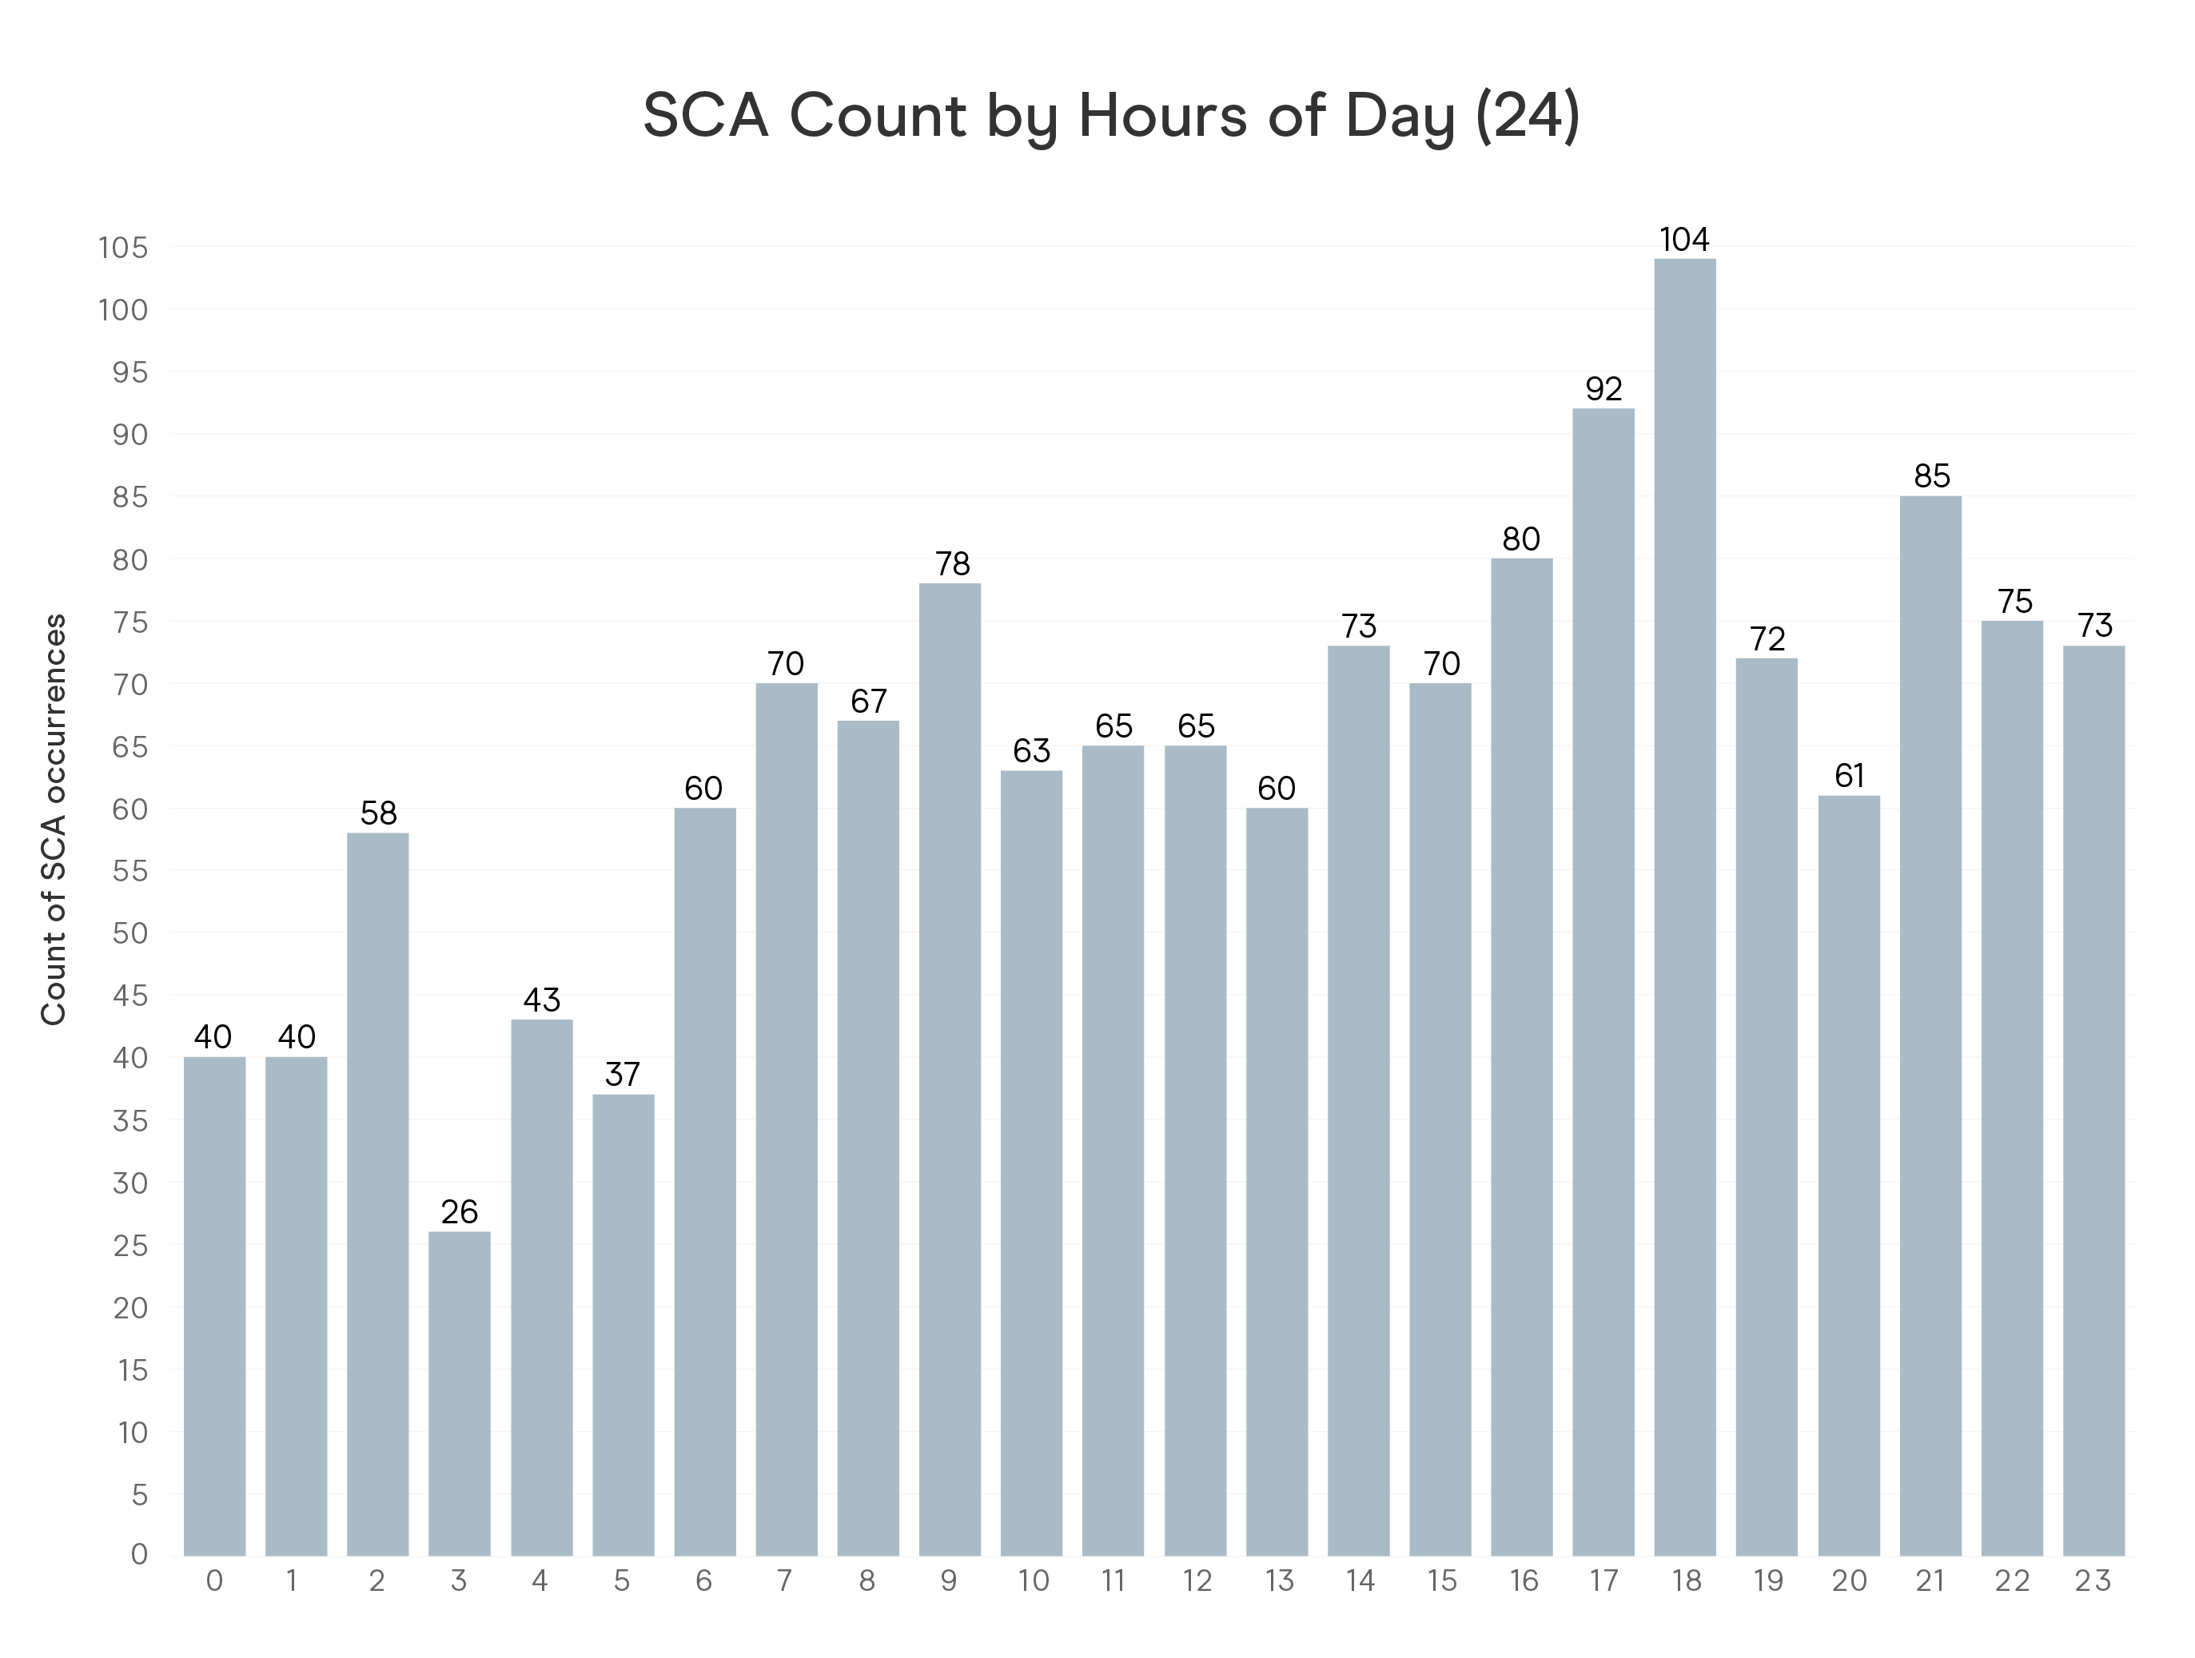
Event Summary
Histogram of time suspected OHCA calls placed to 911

Slide 30
Event Summary
Average total response time (minutes) from Call to At Patient Side for each cohort, further broken down into key segments of a call.
 | Location Gen
Call to dispatch (average) | Home/Residence | 2.2
 | Other | 2.3
 | Unknown | 1.4
Dispatch to patient (average) | Home/Residence | 9.1
 | Other | 8.1
 | Unknown | 6.7
Total overall (average) | Home/Residence | 10.8
 | Other | 10.0
 | Unknown | 8.1

Slide 31
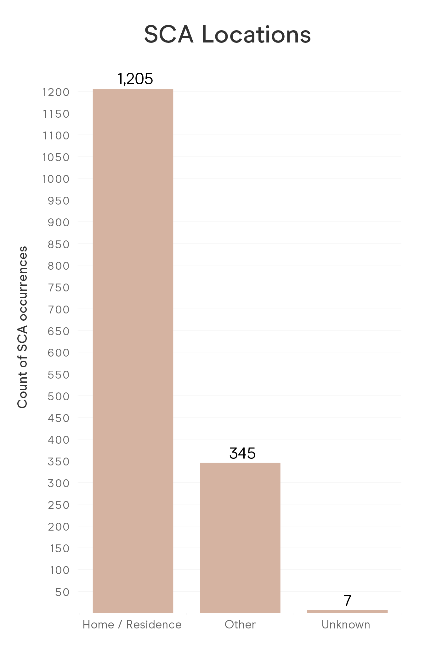
Event Summary
Location of SCA
Home / Residence | Other | Unknown
1,205 | 345 | 7

Slide 32
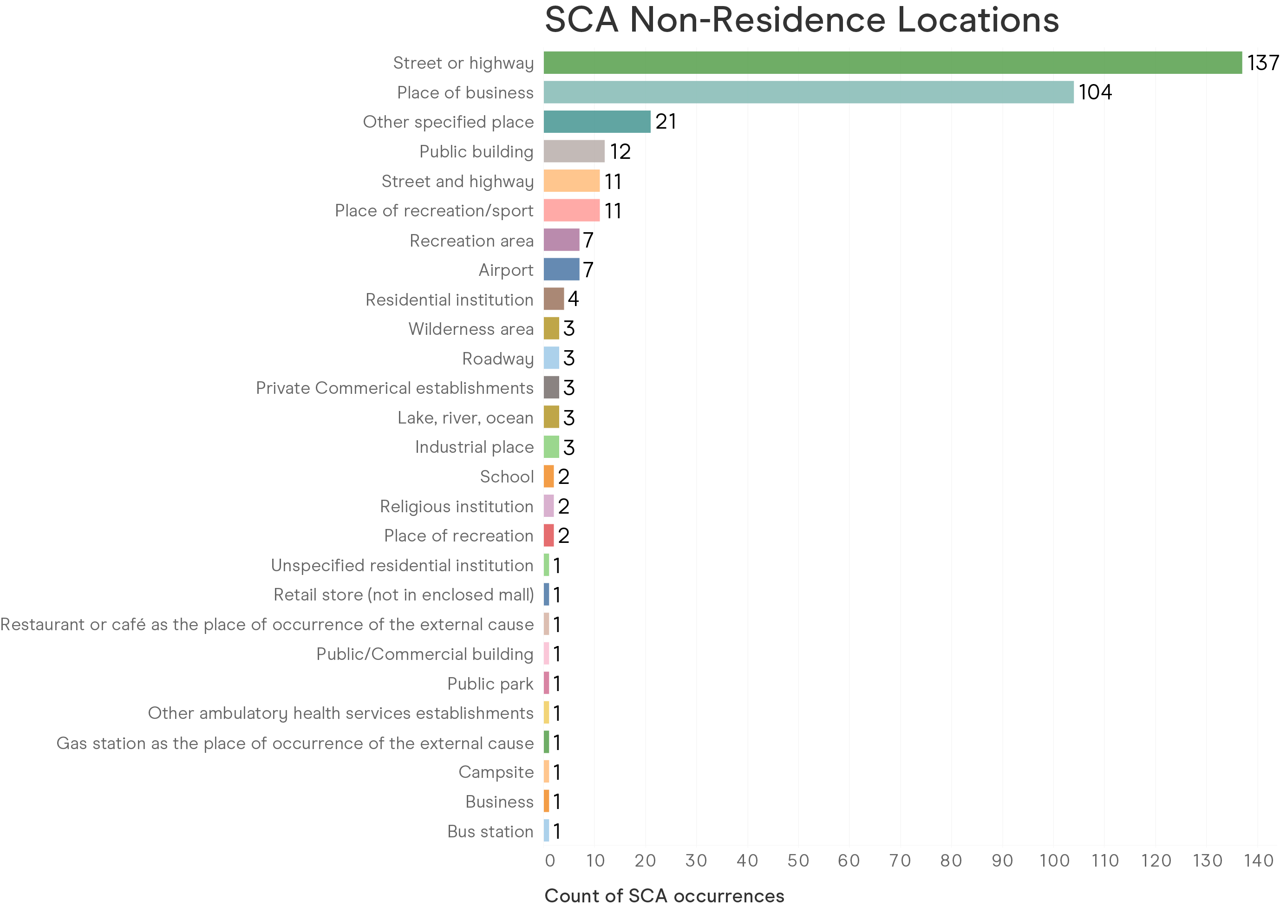
Event Summary
Location of OHCA

Slide 33
03
OHCA Locations
& Demographics

Slide 34
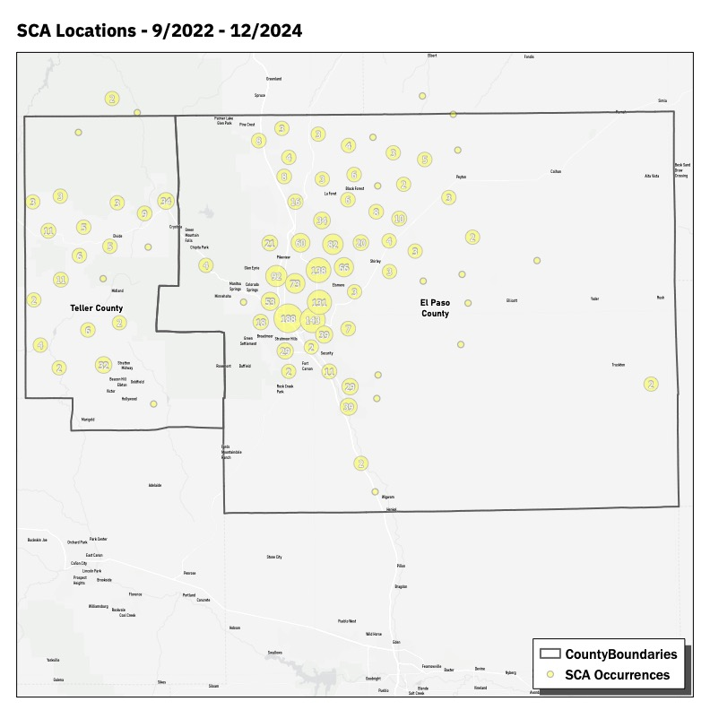
All OHCA Locations
Combined square miles: 2,689
Combined population: 777,634

Slide 35
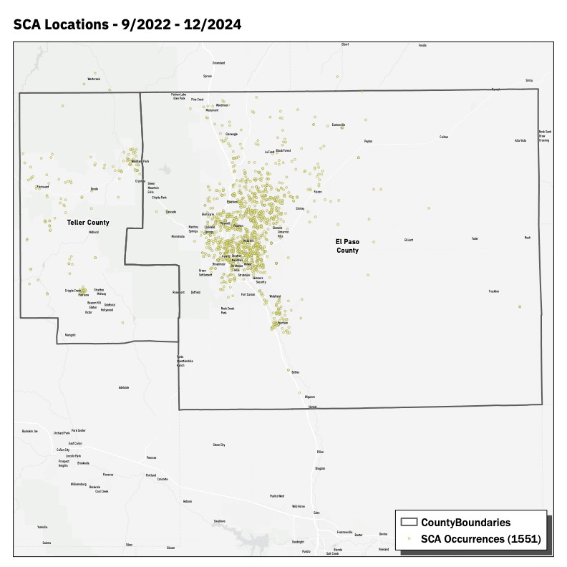
All OHCA Locations

Slide 36
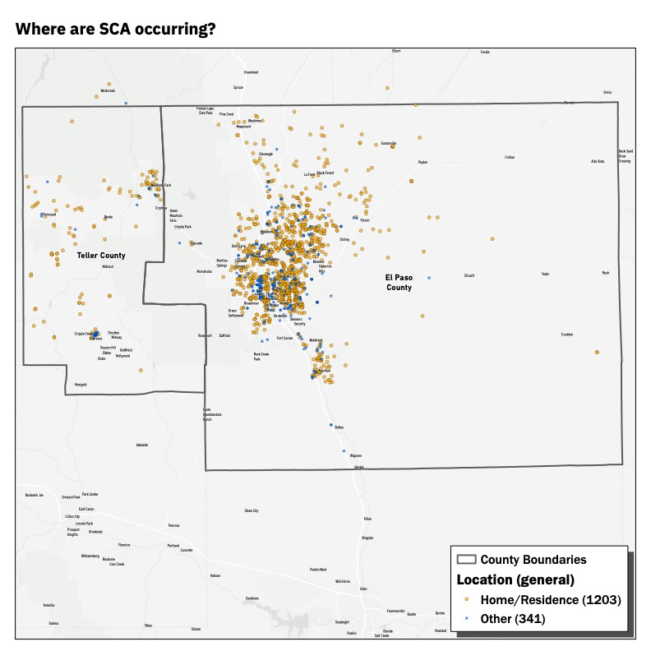
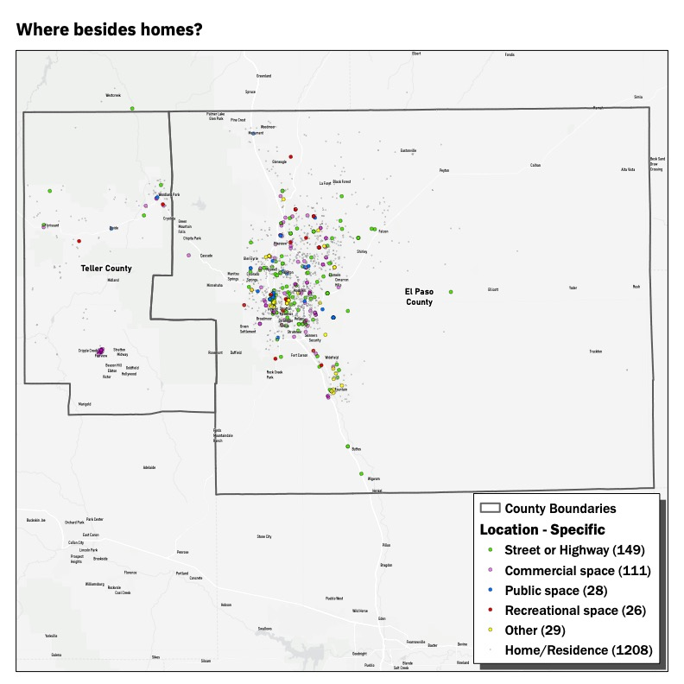
OHCA Locations –
Home vs. Other
77% of OHCA occurred in the home, with the next largest cohort being street/highway at 9.5% of OHCA.

Slide 37
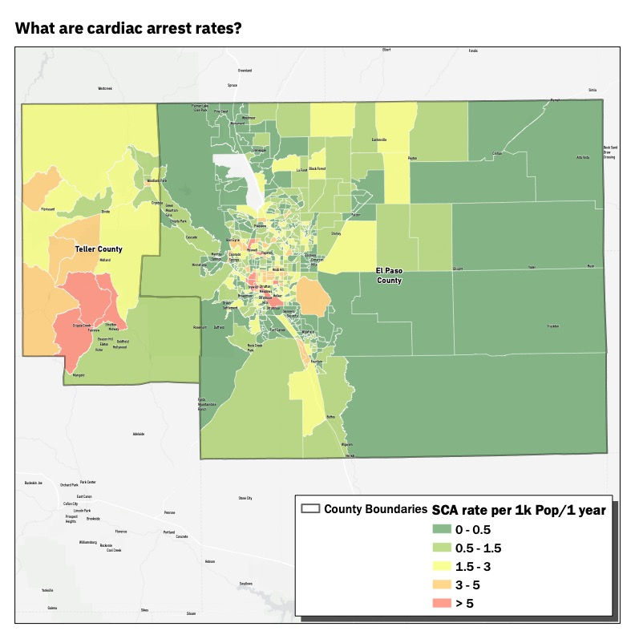
OHCA Rate per
1K population.

Slide 38
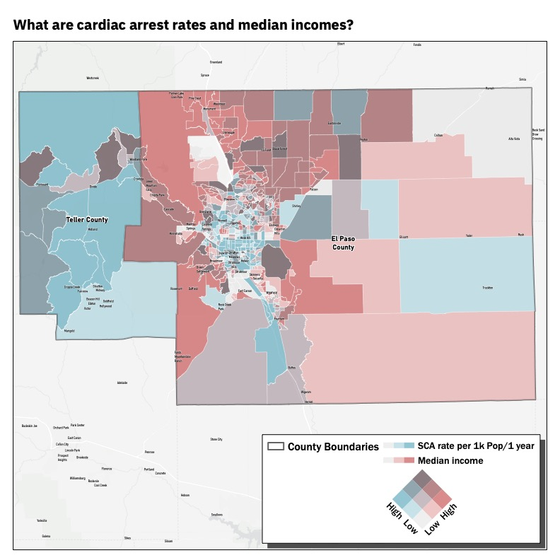
OHCA Rates and
Median Income

Slide 39

OHCA Rates and Percentage
of Population in Poverty

Slide 40

Day time population

Slide 41

Night time population

Slide 42

Population Over 65

Slide 43
04
EMS Response
& AED Use

Slide 44

EMS Response Times
What were the total
response times?
11% of OHCA had a response
times 5 mins or less
60% of OHCA had a response
times between 5-10 mins
29% of OHCA had a response
times greater than 10 mins

Slide 45

Total Response Times
What were the total
response times?
11% of OHCA had a response
times 5 mins or less
60% of OHCA had a response
times between 5-10 mins
29% of OHCA had a response
times greater than 10 mins

Slide 46
Response Times & Initial ECG Rhythm
 | Initial ECG Rhythm | Count | %
Less than 5 minutes | Shockable | 16 | 19%
 | Unshockable | 68 | 81%
5-9 minutes | Shockable | 121 | 16%
 | Unshockable | 637 | 84%
Above 9 minutes | Shockable | 88 | 16%
 | Unshockable | 454 | 84%

Slide 47

Existing AED Locations
AED applied by
a bystander for 1.5% of total OHCA in data set.

Slide 48
Goals for 4 Minute Community project
Deploy AEDs to places that the majority of OHCA occur – Residential
AEDs must have “smart tech” – comparison of traditional phone to smart phone
Also, AEDs must be:
  Accessible – usable by the widest range of people, especially those with limited tech skills
  Approachable – not intimidating; easy to use
  Intuitive – easy to understand with little to no training
  Streamlined – simplified and efficient
  Ergonomic – physically and mentally comfortable to use
  Compact – small enough that size is not a barrier for use

Slide 49


Modernized AEDs may bend the curve
Ultra Portable – 2.1 lbs, Small Enough To Take Anywhere
Modern Touchscreen - More Approachable
Fully Connected – Wi-Fi, Cell, GPS
Child Mode – Universal Pads
Female Anatomy
Quick Data Retrieval – Get Patient Data Immediately (providers and facilities)
Rechargeable Battery – Reduce Cost of Ownership
Dynamic Training – Can Train on Same Unit
Espanol Button – Change Instructions to Spanish
AED alerts when SCA nearby – customizable
QuickRescue – AED Calls 911 When Pads Are Applied
Self monitoring and reporting for maintenance
  Takes place of expensive monitoring programs
Packed With New Features
Notes:
This is the new AED we brought to market, new features around it that are designed to make it easier to use but what we really want to focus on is the connected aspect we did not set out to just create a new AED because the problem is they aren’t being used

Slide 50


The New Approach:
Strategically Deployed AEDs That Tell You When and Where They Are Needed
Notes:
point-by-point of specifics to fix the problem
about the solution, not the supplier

Slide 51


Slide 53


Slide 54





The 4 Minute Community
THANK YOU
A Holistic Approach to Out of Hospital Cardiac Arrest Management
AEDs placed in traditional PAD setting, plus residential setting with CARE Team, can be alerted by 911
Stein Bronsky, MD – 719.362.6159 – eric.bronsky@coloradosprings.gov

