Slide 1


Protecting You and Me from the CWA-3:
Preparing for Chemical Warfare in EMS Response and Training
Asa M. Margolis DO, MPH, MS, FACEP, FAEMS​
Chief Medical Officer for Operational Medicine,
United States Secret Service​
Associate Professor, Division of Special Operations​
Johns Hopkins Department of Emergency Medicine

Slide 2
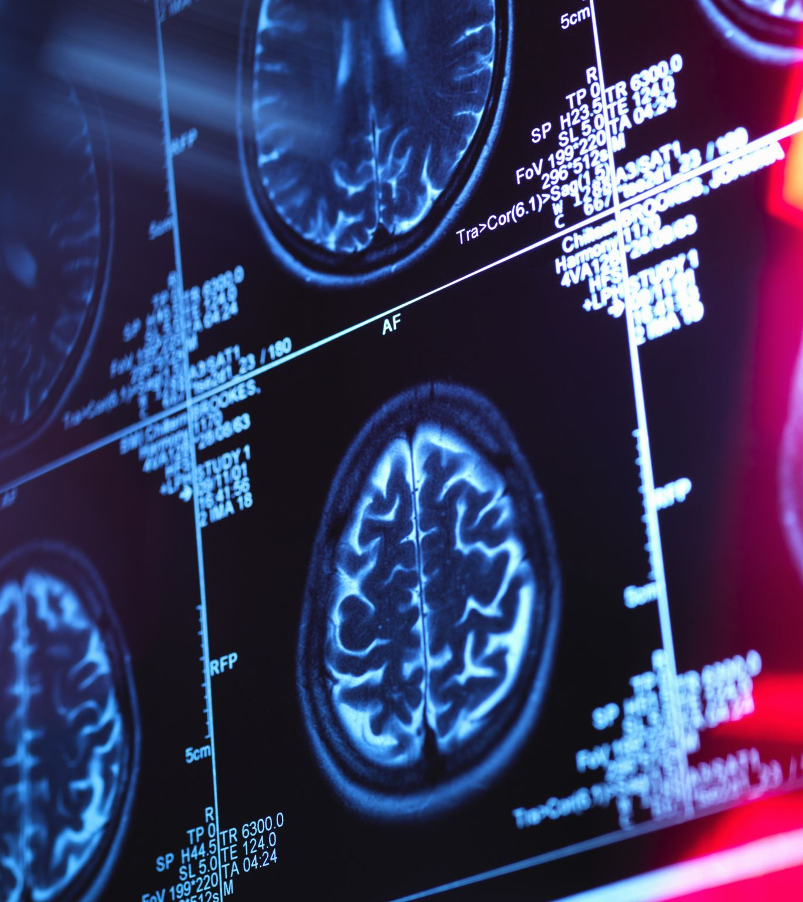
Inside the Mind of the Terrorist
What characteristics of CWA would be most suitable for use in an attack?
  High volatility
  Fast & effective absorption via skin and respiratory system
  Rapid onset
  Lethal / incapacitating effects

Slide 3
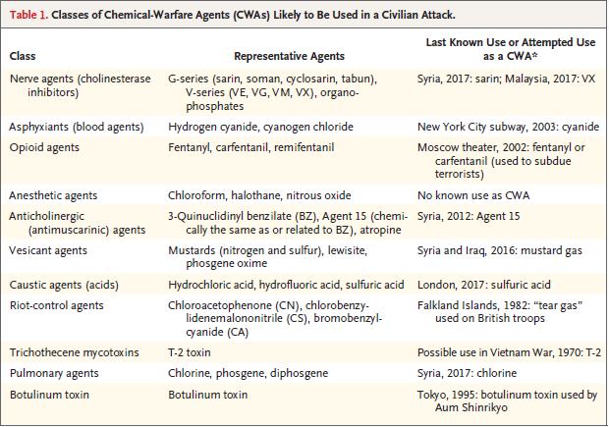
Chemical-Warfare Agents (CWAs)
Ciottone GR. Toxidrome Recognition in Chemical-Weapons Attacks. N Engl J Med. 2018 Apr 26;378(17):1611-1620. doi: 10.1056/NEJMra1705224. PMID: 29694809.

Slide 4
The Objective!
The classes of chemical-warfare agents that are most rapidly lethal (i.e., nerve agents, opioid agents and asphyxiants), should be quickly identified with the use of a toxidrome-based system of rapid triage

Slide 5
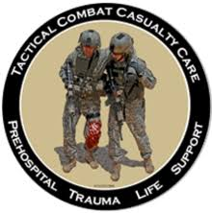
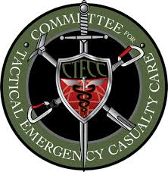
How Can we deliver the right care at the right time IN the cbrn environment?

Slide 6
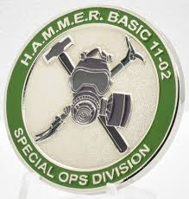
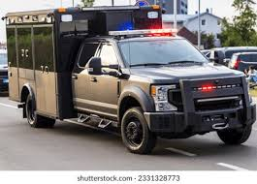
MARCHE²
M – Mask up
A – Antidotes
R – Rapid Spot Decontamination
C – Countermeasures
  Antidotes are challenging in the HOT ZONE
  Medical management
H – Hypothermia
E – Extrication
*DeFeo DR, Givens ML. Integrating Chemical Biological, Radiologic, and Nuclear (CBRN) Protocols Into TCCC Introduction of a Conceptual Model - TCCC + CBRN = (MARCHE)2. J Spec Oper Med. 2018 Spring;18(1):118-123. PMID: 29533446.

Slide 7
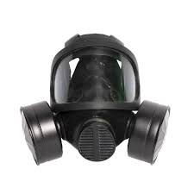
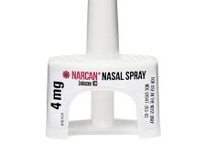
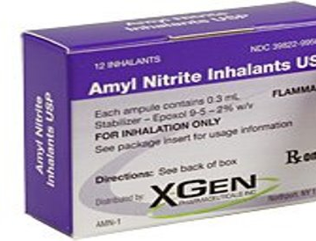
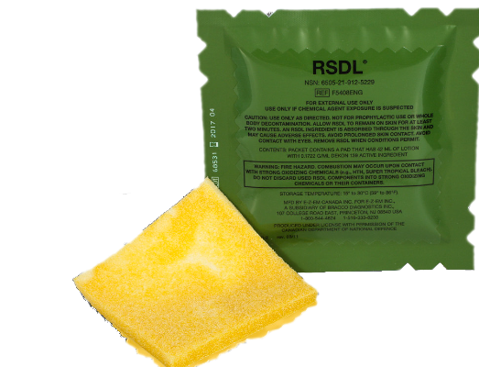
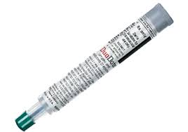
Hot Zone (DTC)
M – Mask up
A – Antidotes (toxidrome-specific)
  ATNAA/CANA
  Naloxone IN/IM
  Amyl Nitrite
R – Rapid Spot Decon
  Life-threatening hemorrhage controlled
  Remove visible contamination
  Apply RSDL on affected areas
  Do NOT breach clothing further in HOT ZONE

Slide 8
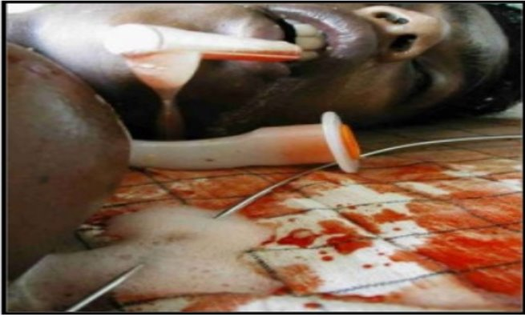
How do we treat nerve agent (organophosphate) poisoning?

Slide 9
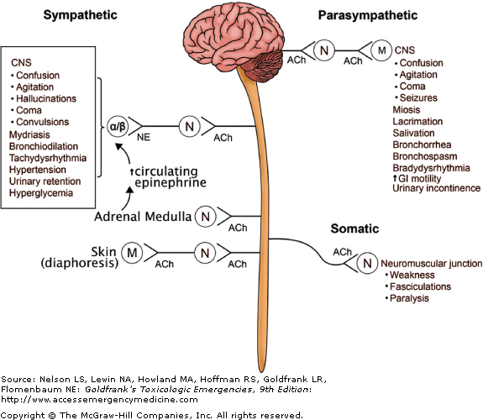
Cholinergic Toxidrome (Crisis)
SLUDGEM
​
DUMBELS
​
SLUDEM + Killer Bs

Slide 10
Drug Therapy (Antidotes)
Atropine = anticholinergic antidote for the muscarinic effects; Does NOT reverse nicotinic effects
  Therapeutic end point = drying of respiratory secretions and resolution of bronchoconstriction/bradycardia
Pralidoxime chloride (2-PAM Chloride) = oxime = reverse nicotinic effects of fasciculations, weakness, paralysis​
The 2-PAM Cl removes the nerve agent from AChE​
Must be done before aging occurs​

Slide 11
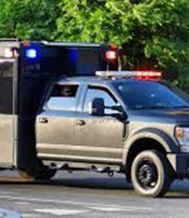

What is the Purpose of Decon?
Medical countermeasure that mitigates the conversion of an exposure to a dose

Slide 12
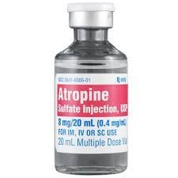
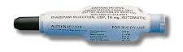
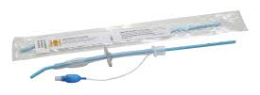
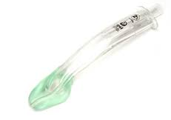
Warm Zone (ITC)
C - Countermeasures
Antidotes
  Atropine
  CANA (additional)
Airway Management
  Secure airway
  Replace interventions done prior to decon

Slide 13
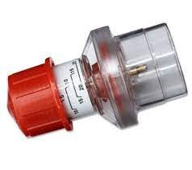
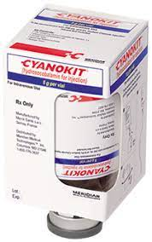
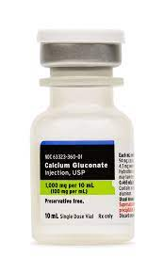
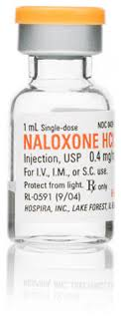
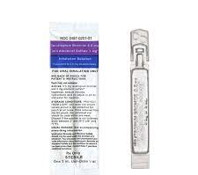

Warm Zone (ITC)
C - Countermeasures
PEEP!
Respiration
  Nerve Agents
    Atropine
  Opioids
    Naloxone
  Cyanide (Asphyxiants)
    Hydroxocobalamin
  Hydrofluoric Acid (Caustics)
    Calcium gluconate
    Bronchodilators
  Blister Agents
    Bronchodilators

Slide 14
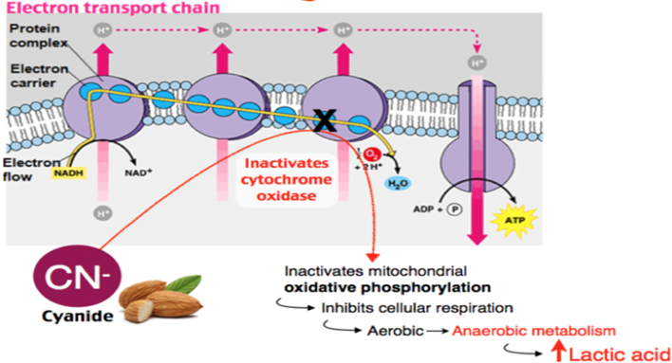
How do we treat cyanide (asphyxiant) poisoning?

Slide 15
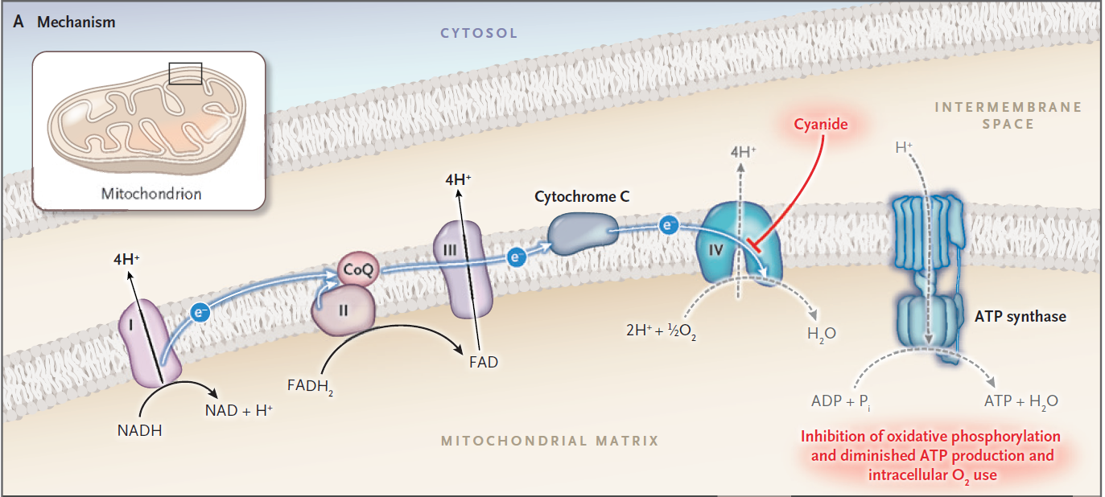
Cyanide (Asphyxiant)
High concentrations of cyanide will produce:
Markedly altered level of consciousness
Seizure
Respiratory depression or respiratory arrest
Cardiac dysrhythmia (other than sinus tachycardia)
Administer 5 g IV/IO over 15 minutes
70 mg/kg IV/IO for pediatrics
Consider additional 5 g over 15 minutes for lactate > 8
N Engl J Med 2019;380:1638-55.

Slide 16
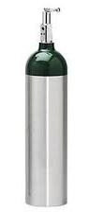
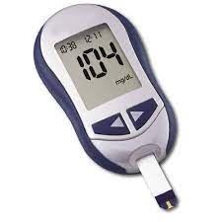
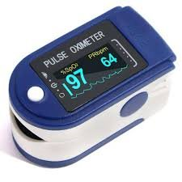
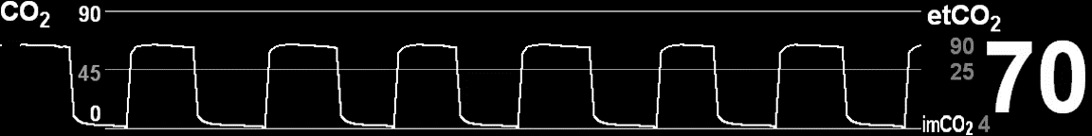
Cold Zone (EVAC)
Definitive airway control
Use of oxygen
Cardio-resp monitoring
Pain management
Delayed presentations

Slide 17
Let's Summarize
Toxidrome-based approach for recognition and rapid management of suspected chemical-warfare agents
Decon – Medical countermeasure that mitigates the conversation of an exposure to a dose
MARCHE² for CBRN
Hot Zone – Mask, Antidotes, Rapid spot decon
Hot Zone Antidotes – DuoDotes/CANA; DuoDotes + Atropine for drying of secretions
Warm Zone – Countermeasures based on suspected toxidrome; Hydroxocobalamin for suspected CN
Cold Zone – Reassessment and advanced monitoring

Slide 18
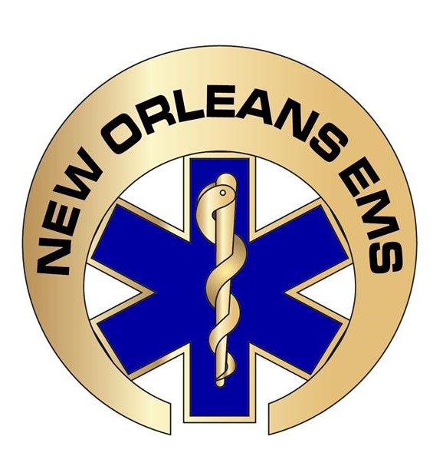
New Orleans EMS Response to the
2025 New Years Day
Terror Attack
Meg Marino, MD, Director and Medical Director
No Conflicts of Interest

Slide 19
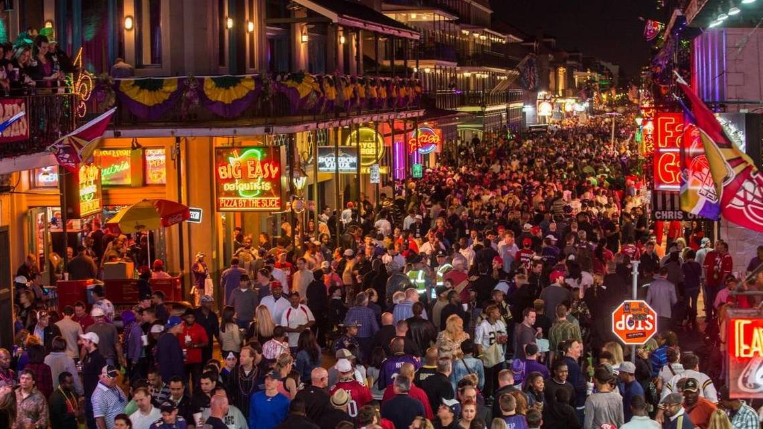
Bourbon Street on New Years Eve at Midnight

Slide 20

Bourbon Street New Years Day at
3 am

Slide 21
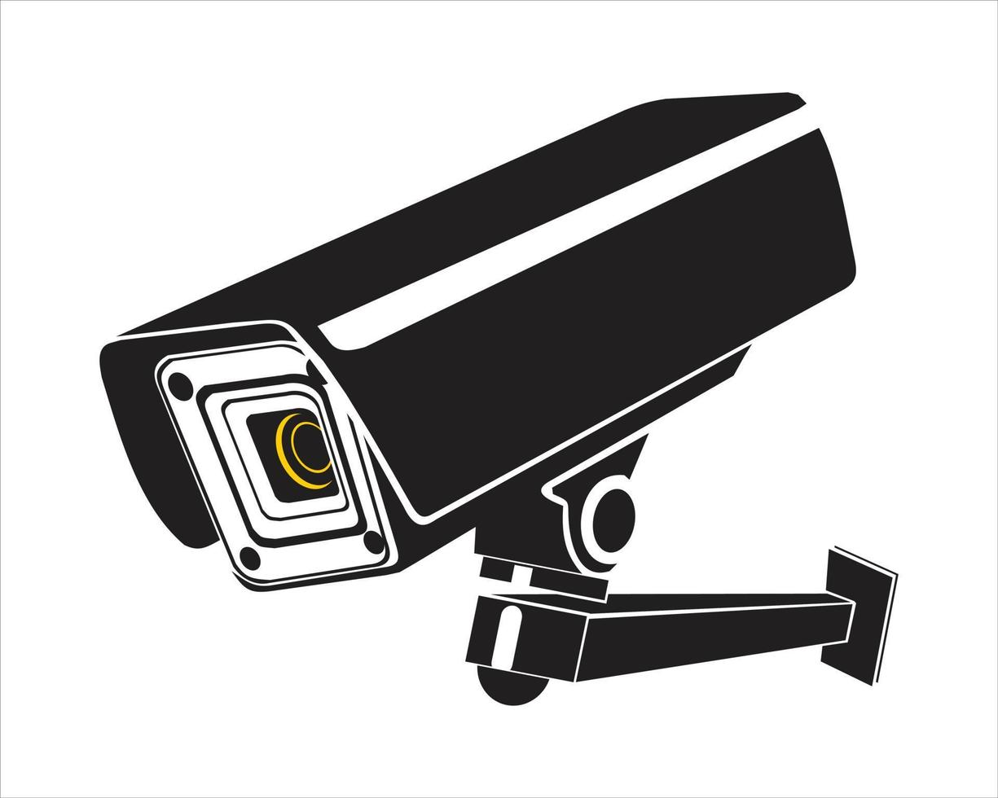
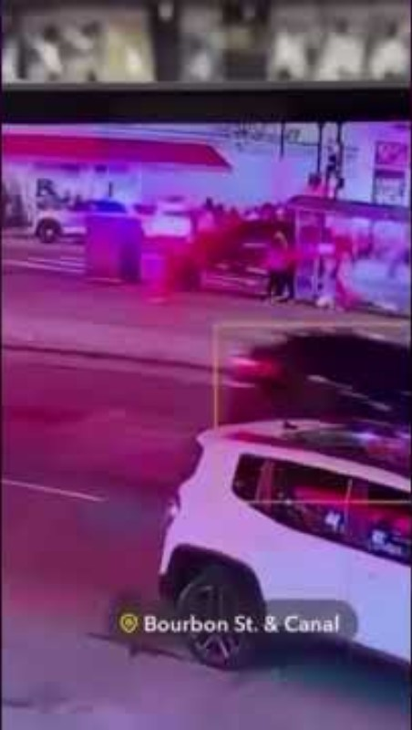
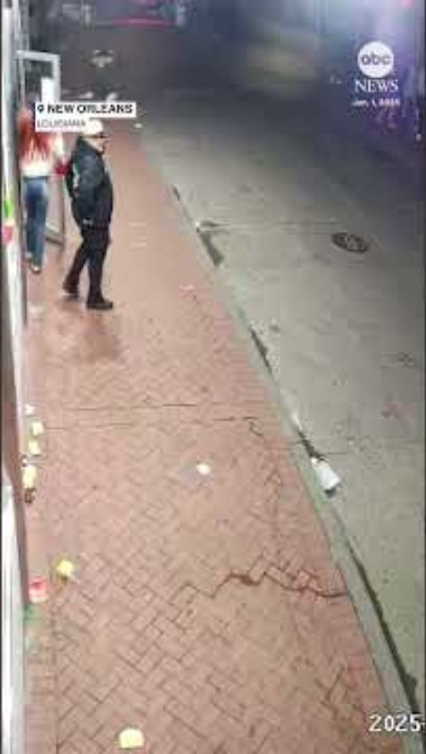
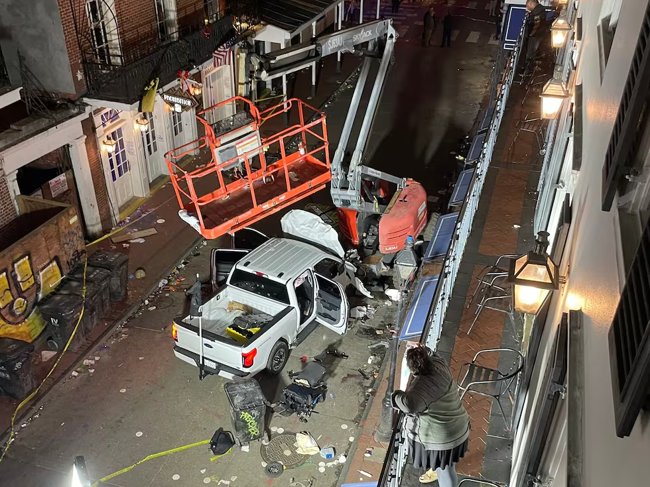
Incident
Crash & Shootout
Turns onto Bourbon
High Speeds Down Bourbon

Slide 22
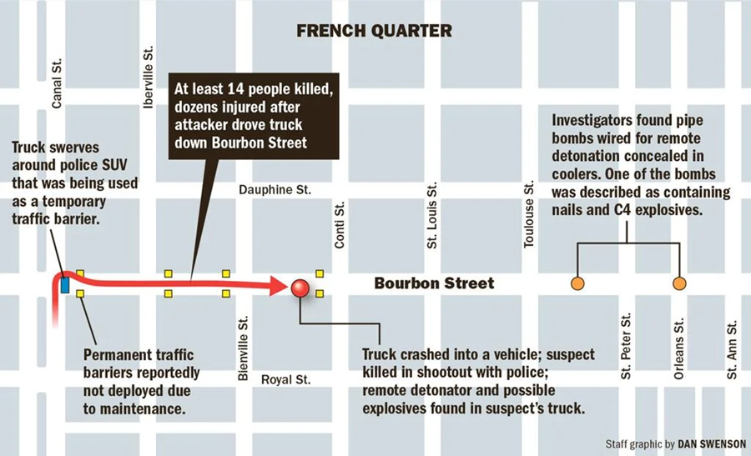
The Scene

Slide 23
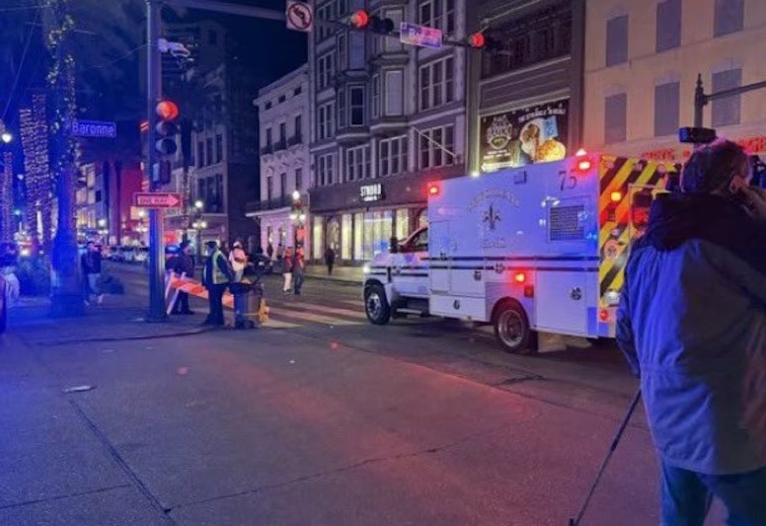
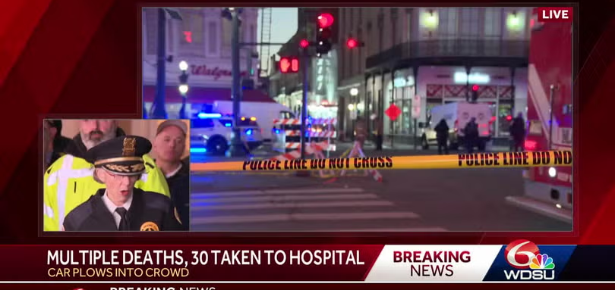
Initial Response
NOEMS units on Canal & Bourbon witnessed the event and began triaging patients- one became incident command
NOPD and other law enforcement agencies begin treating patients.
EMS Command was established with unit staging on Canal & Bourbon.
The first Casualty Collection Point (CCP) was established 2 blocks into Bourbon to start triage, treatment, and coordinate transports.
An additional Casualty Collection Point (CCP) was established on Canal and Bourbon to accommodate stable green and yellow patients.
The transport officer worked with both CCP’s to send transport units for patients.

Slide 24
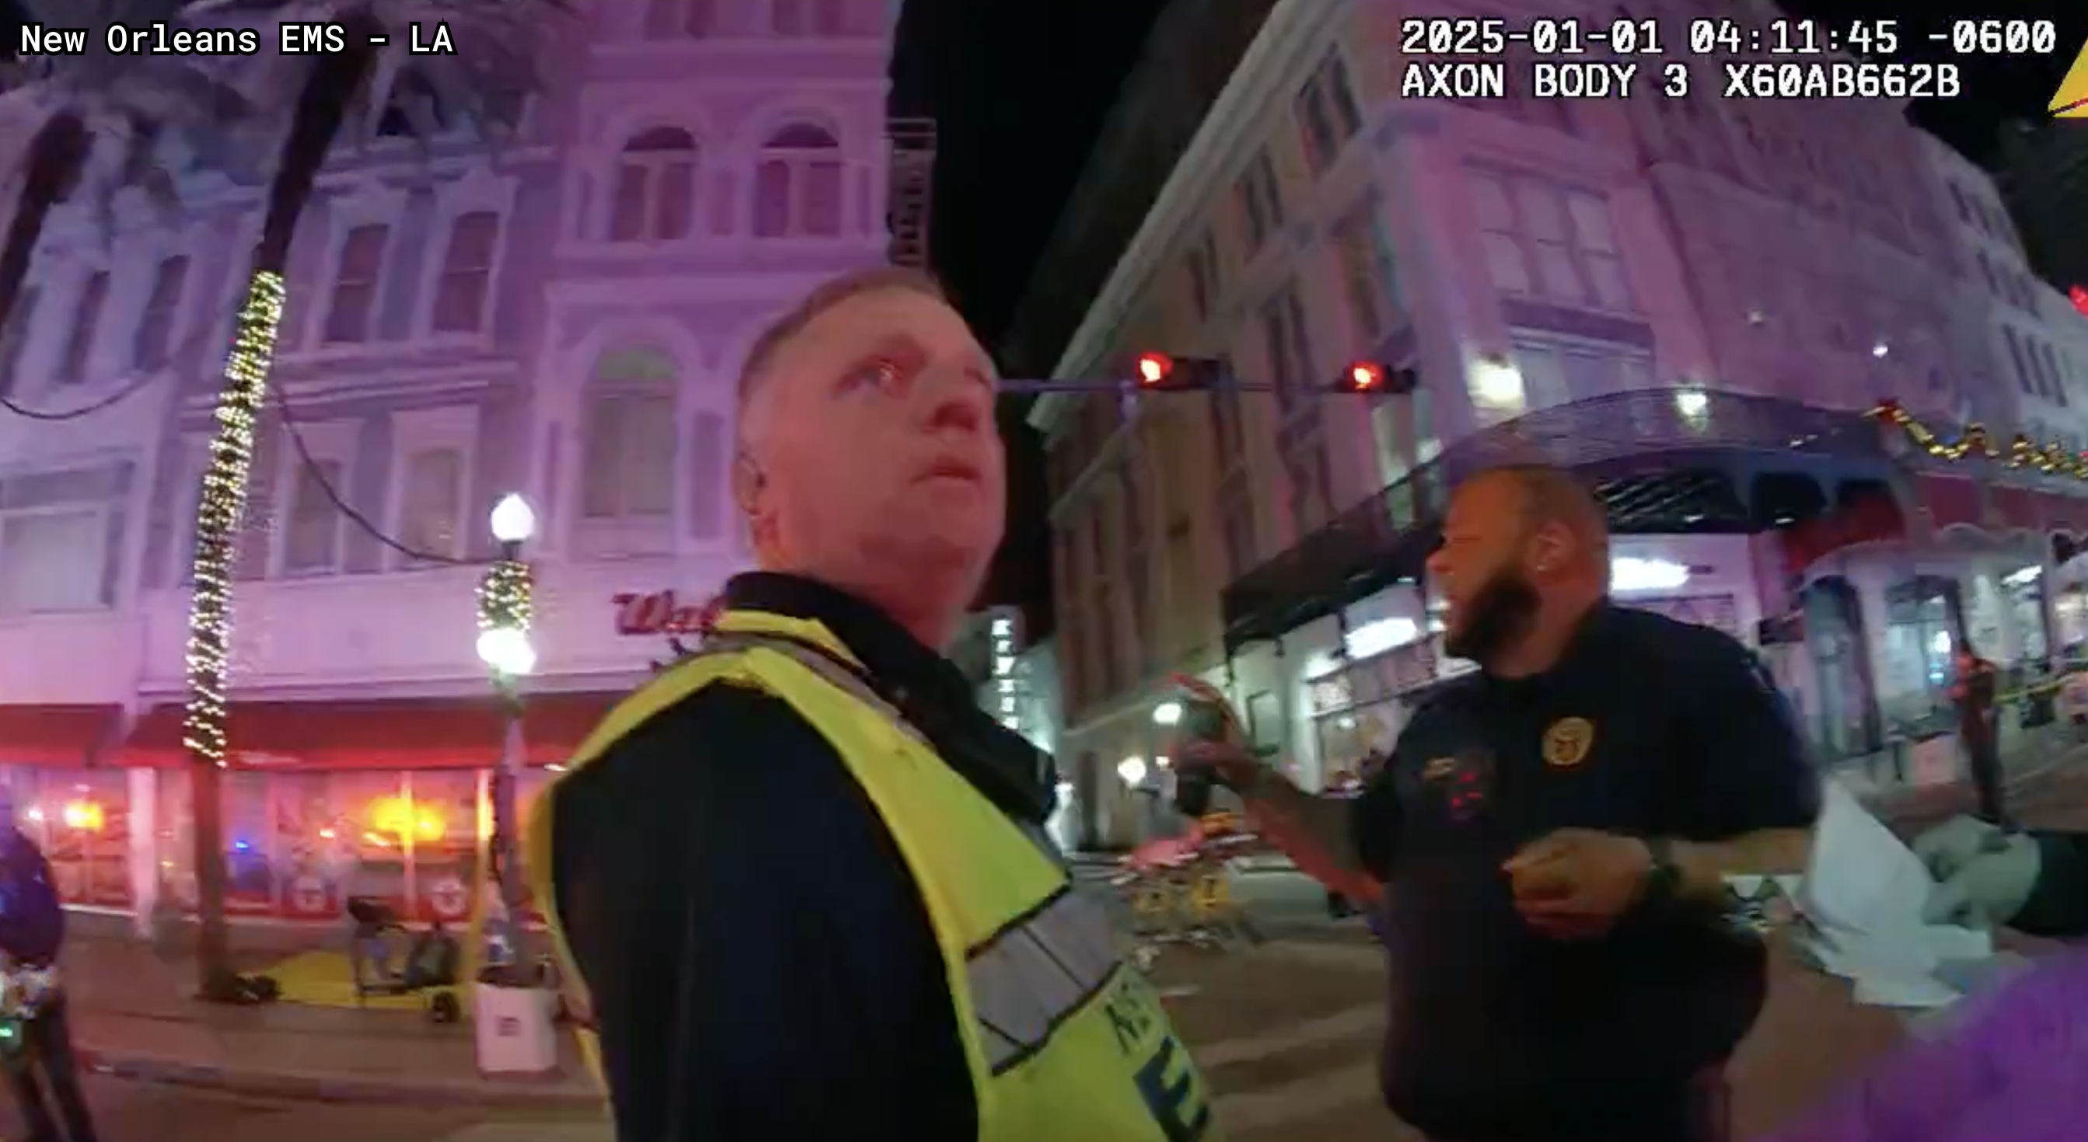
Command

Slide 25
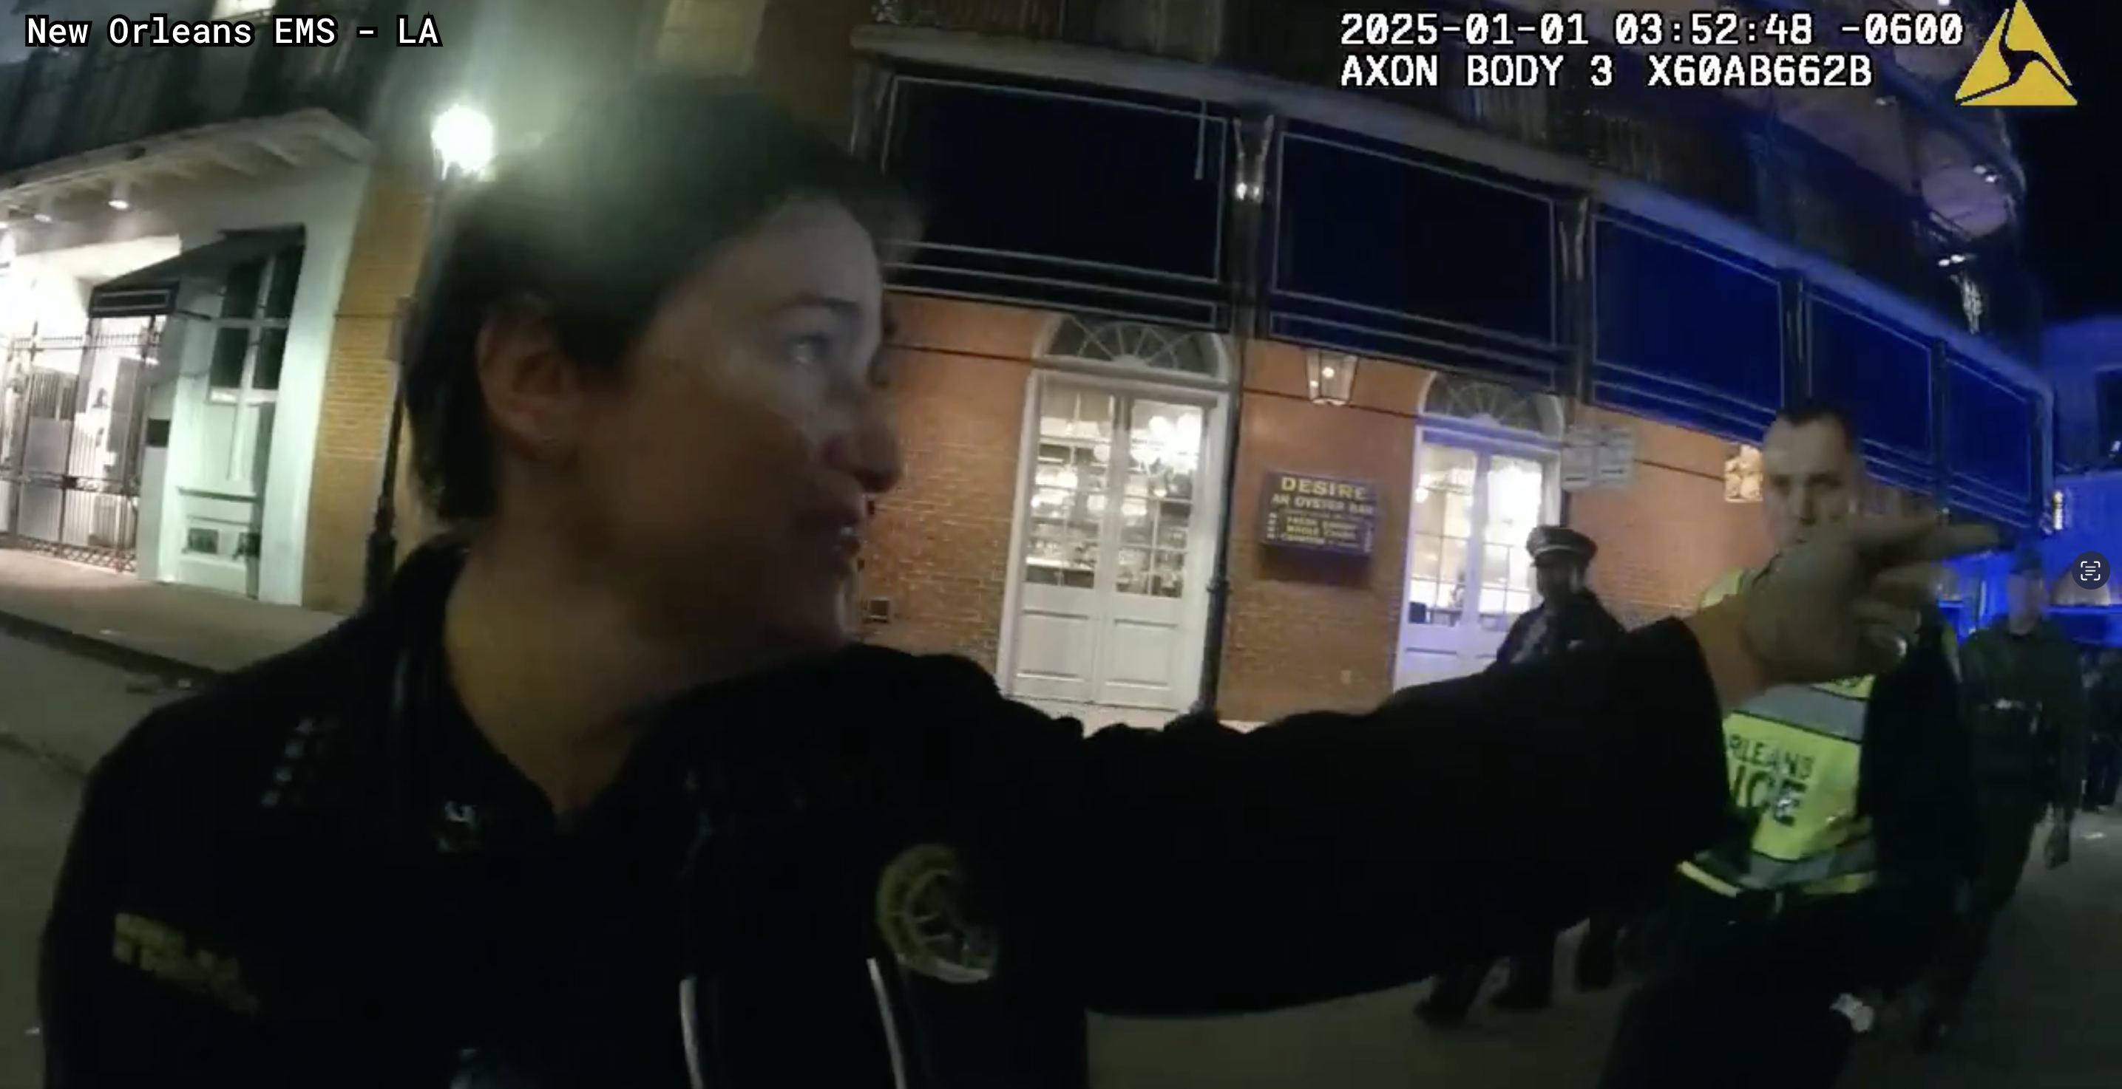
Triage

Slide 26
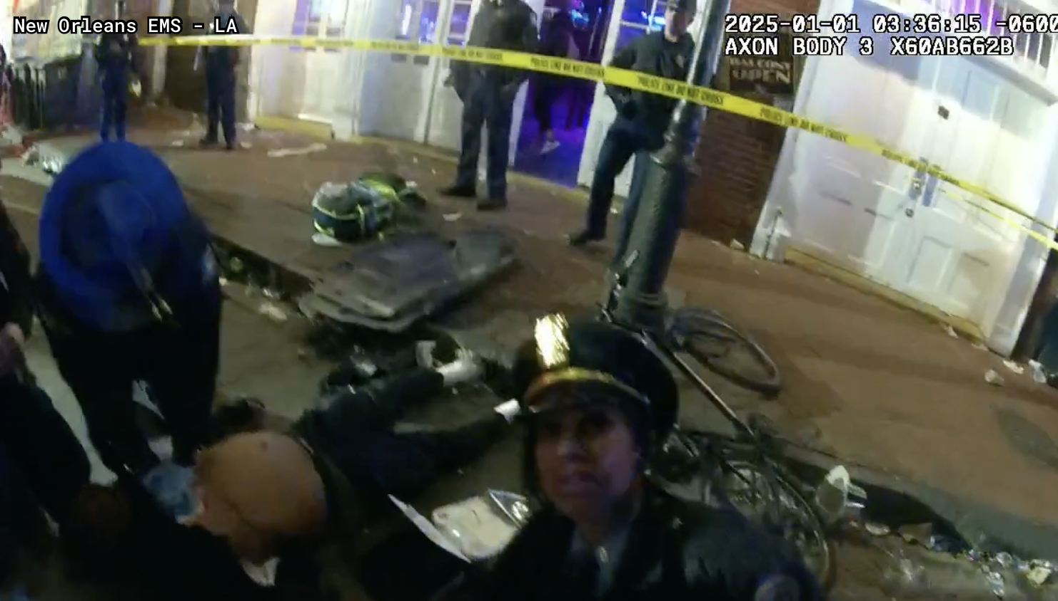
CPR vs. Crisis Standards of Care

Slide 27
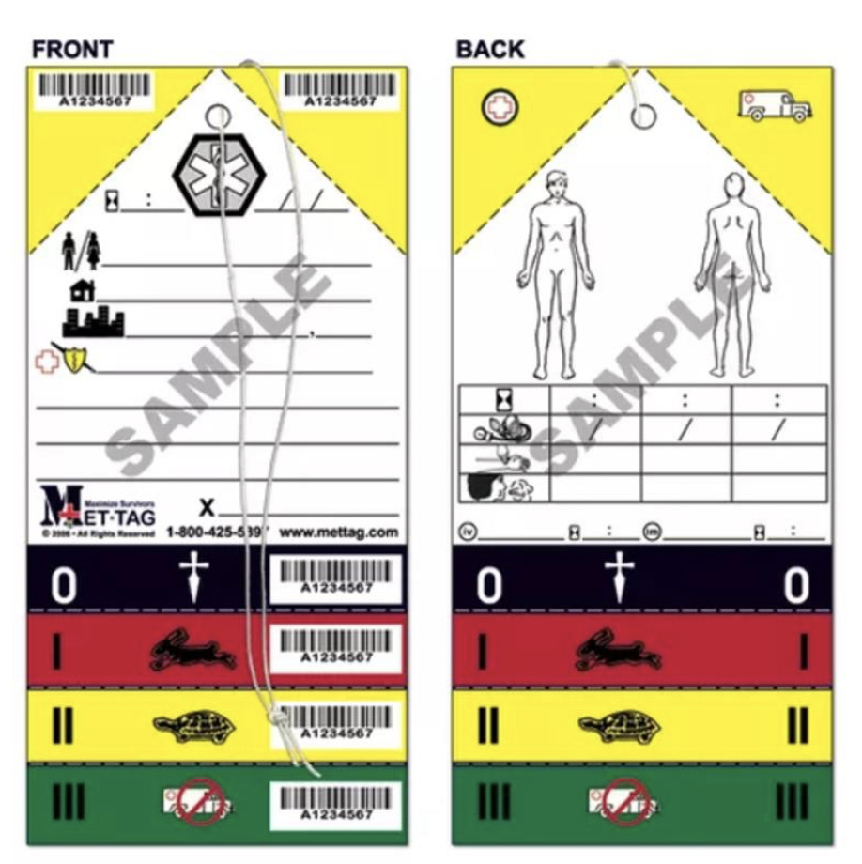
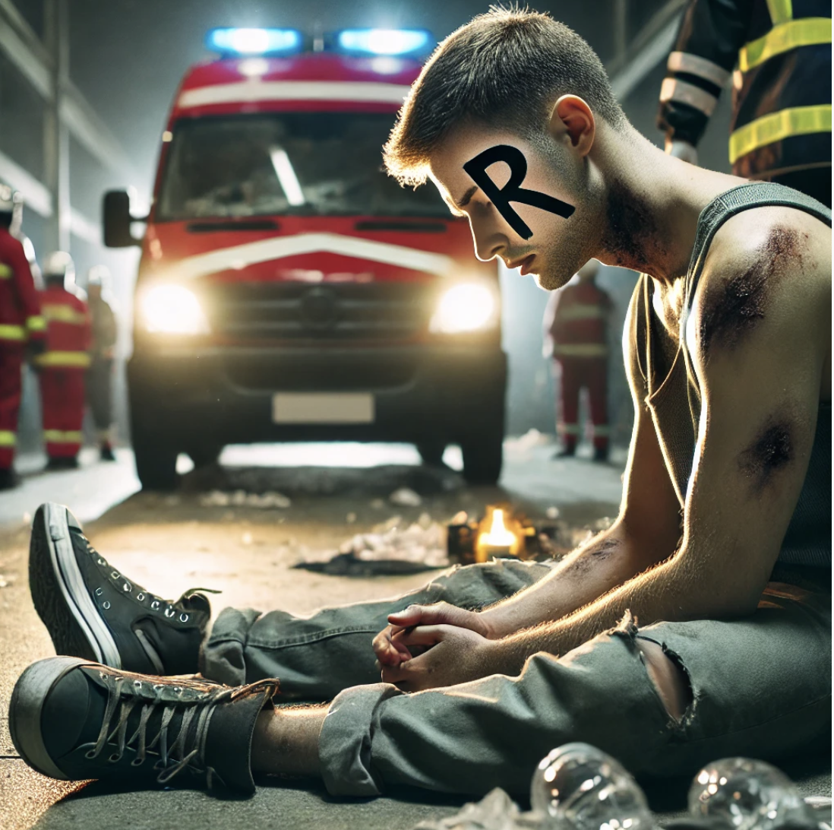

Slide 28
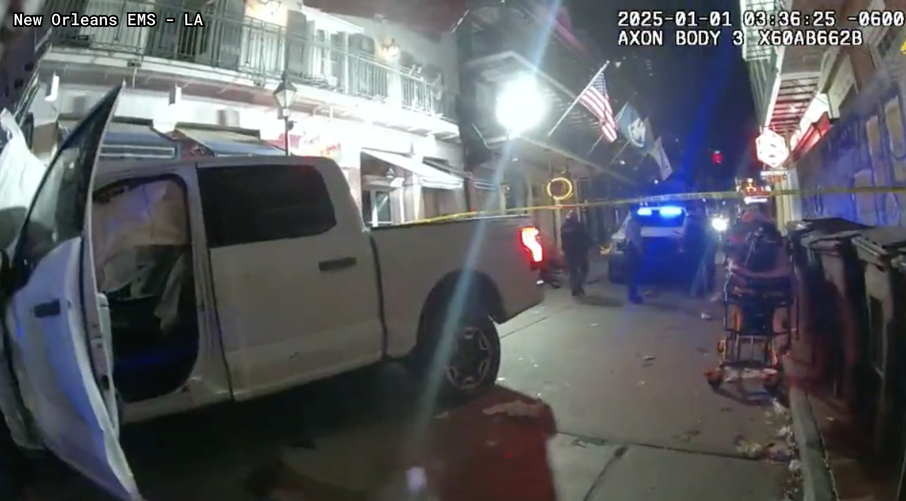
Dangers

Slide 29
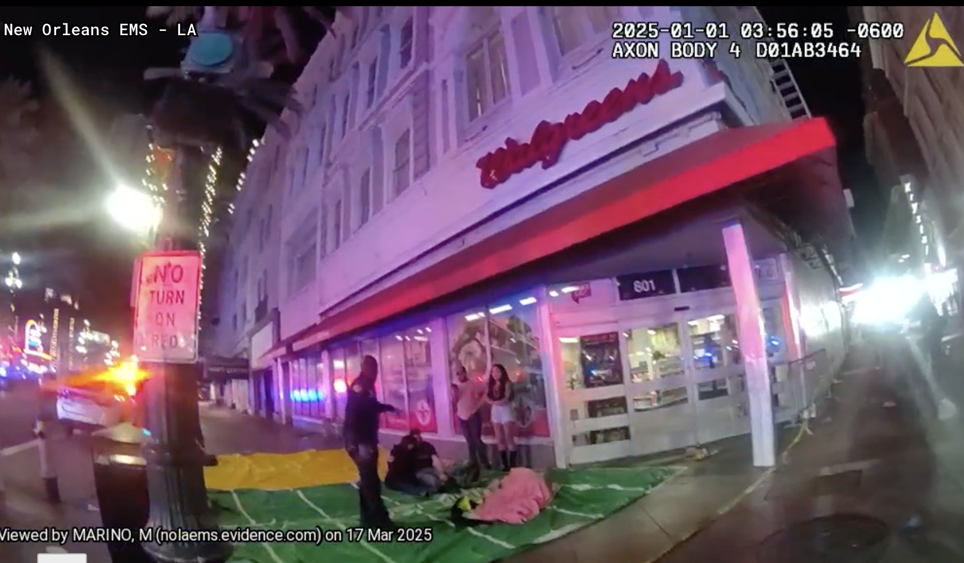
Casualty Collection Points

Slide 30
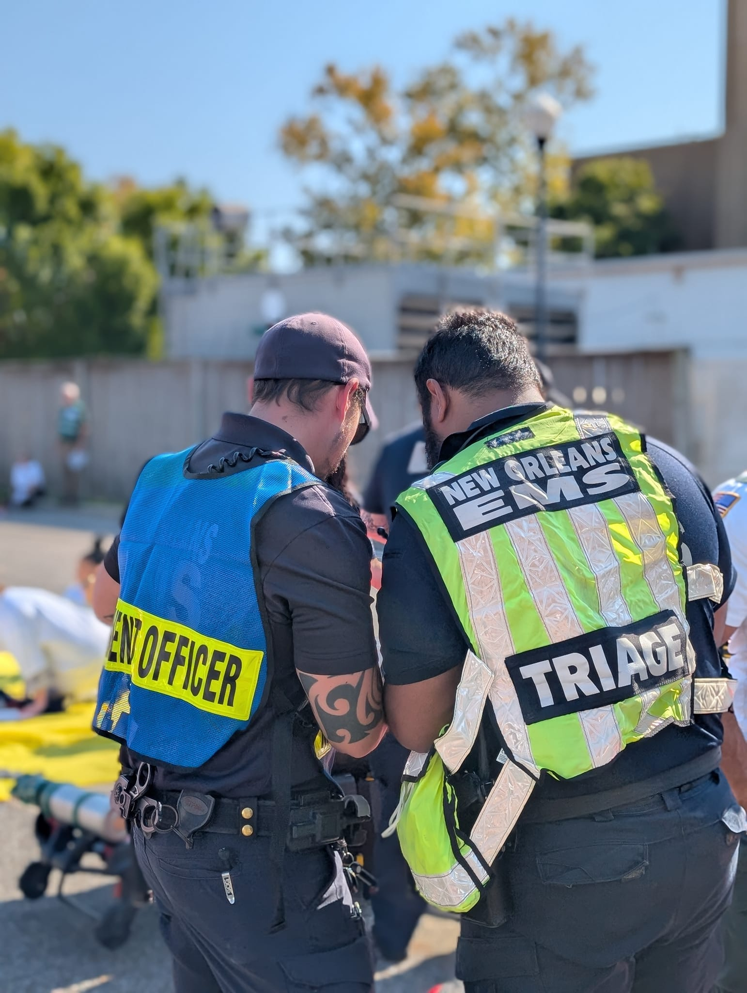
By the Numbers: 71 Patients
On Scene Triage:
  12 dead patients found on scene.
  12 red tags/immediate
  9 yellow/delayed
  8 green/minor
EMS transported 29 patients to 5 hospitals in 95 minutes
In the end, 14 deaths and 57 injuries were related to the incident.

Slide 31
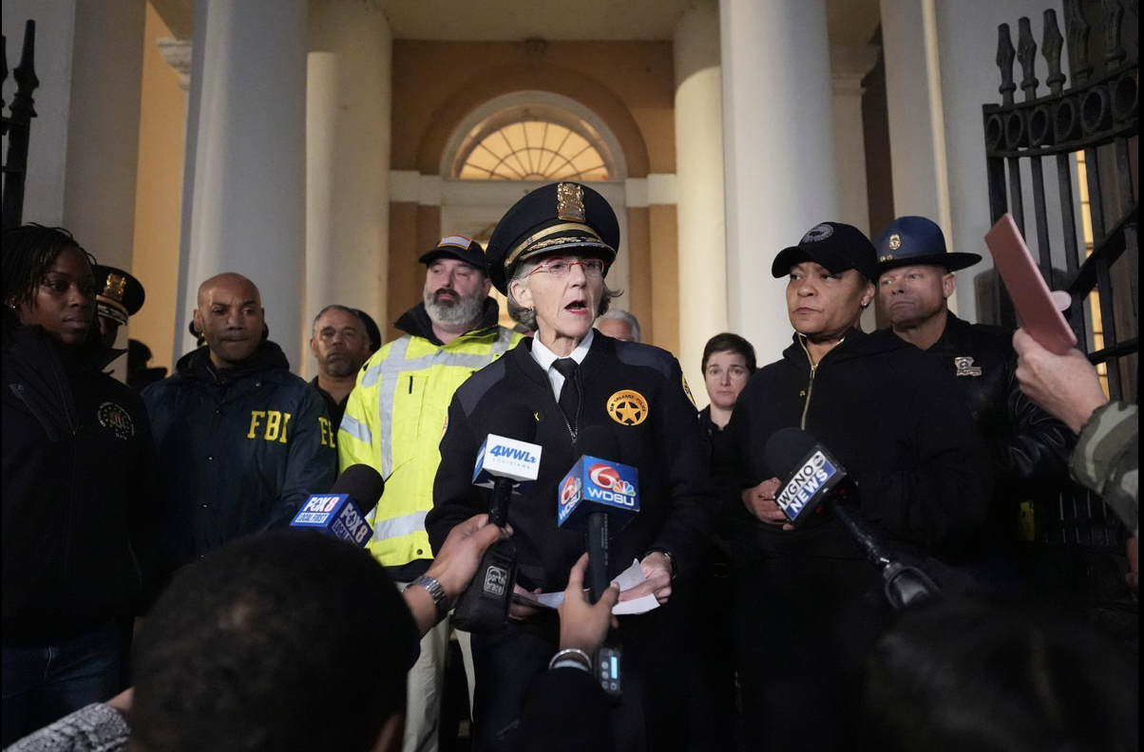
1/1/25 7 am Press Conference

