Slide 1

Is Cold Water Immersion Effective & Safe in Severe Heat Illness?
Brian Miller, MD, FACEP, FAEMS
Associate System Medical Director
Fort Worth Office of the Medical Director

Slide 2
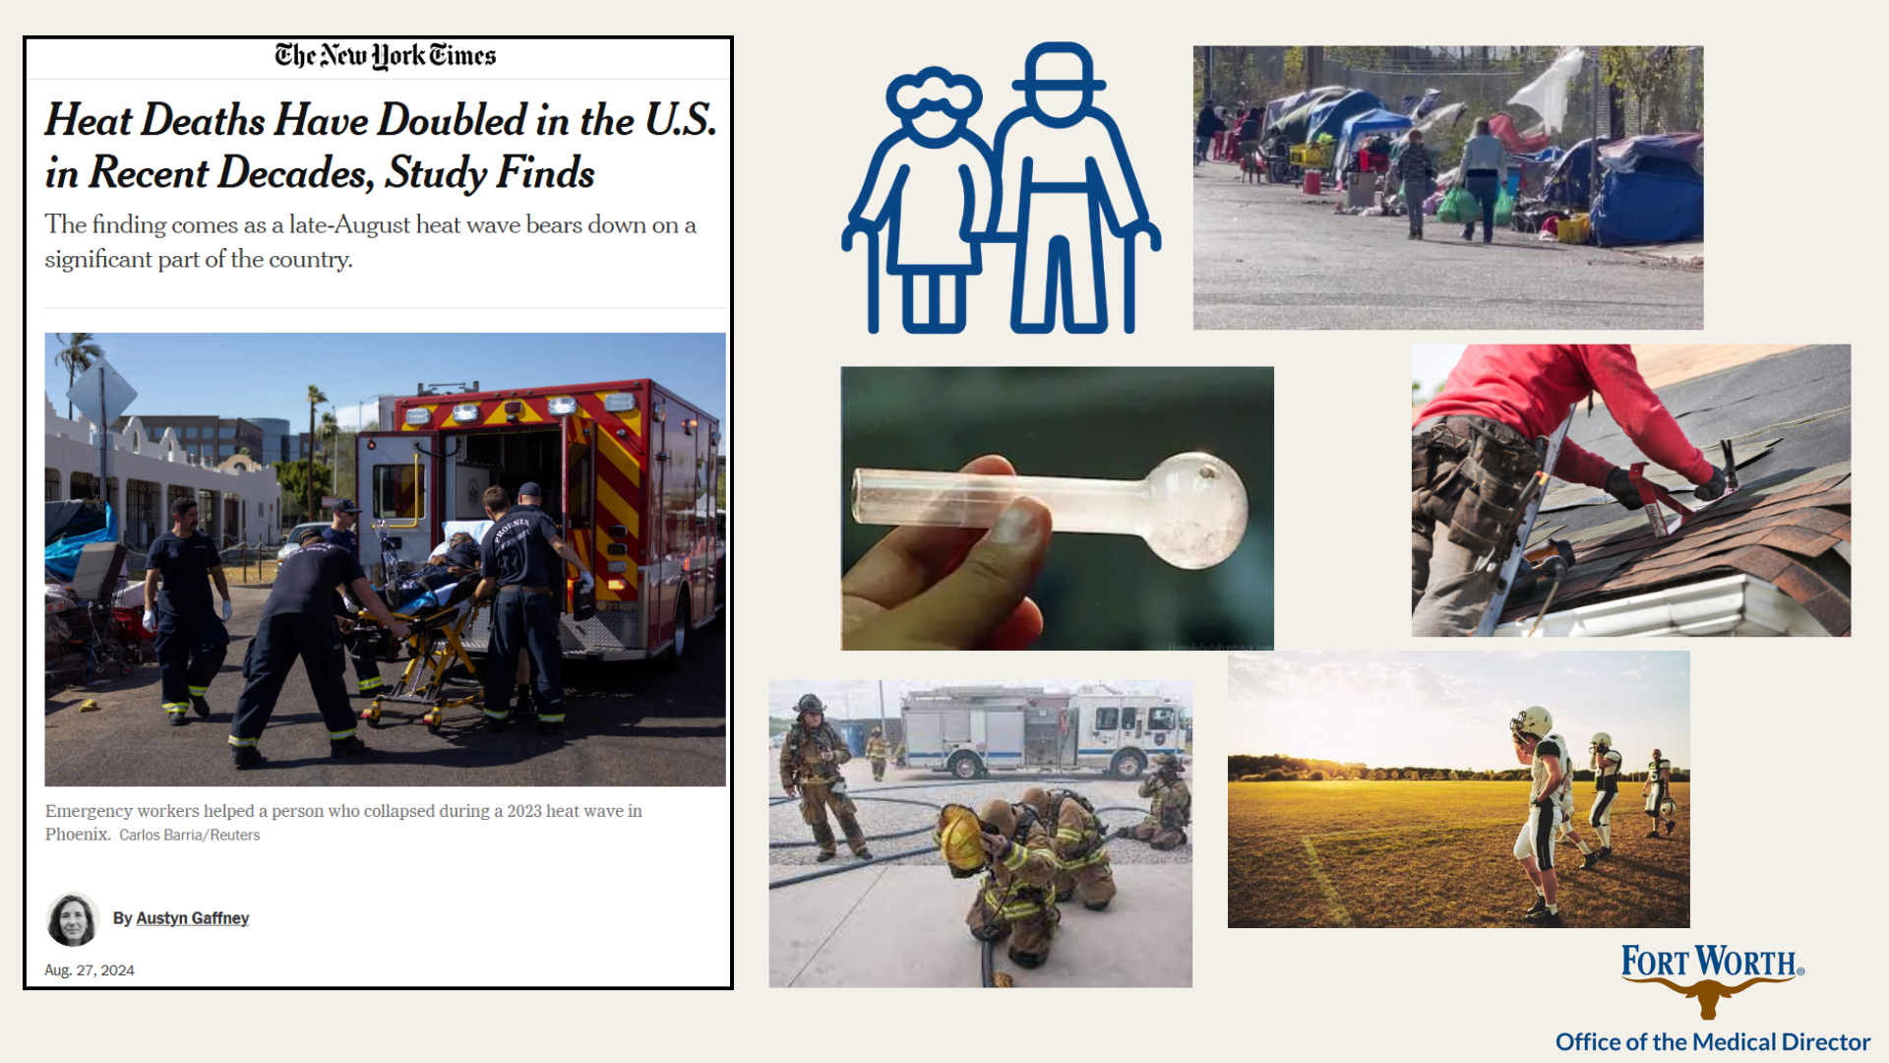

Slide 3
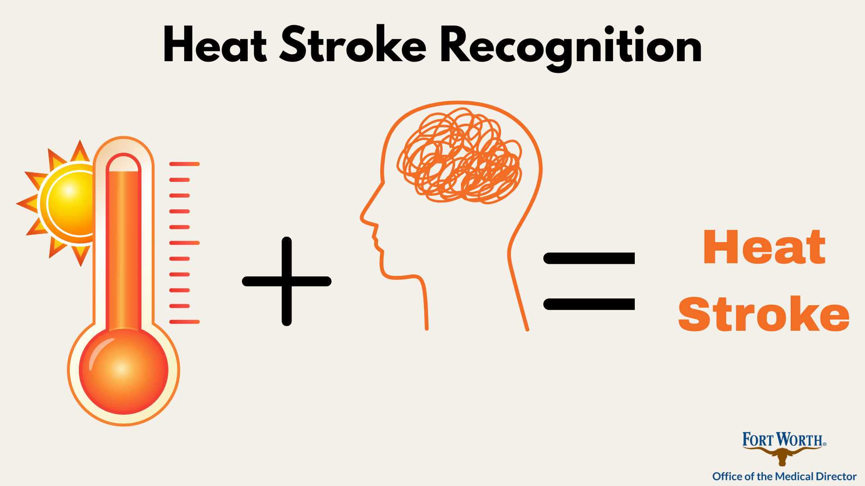
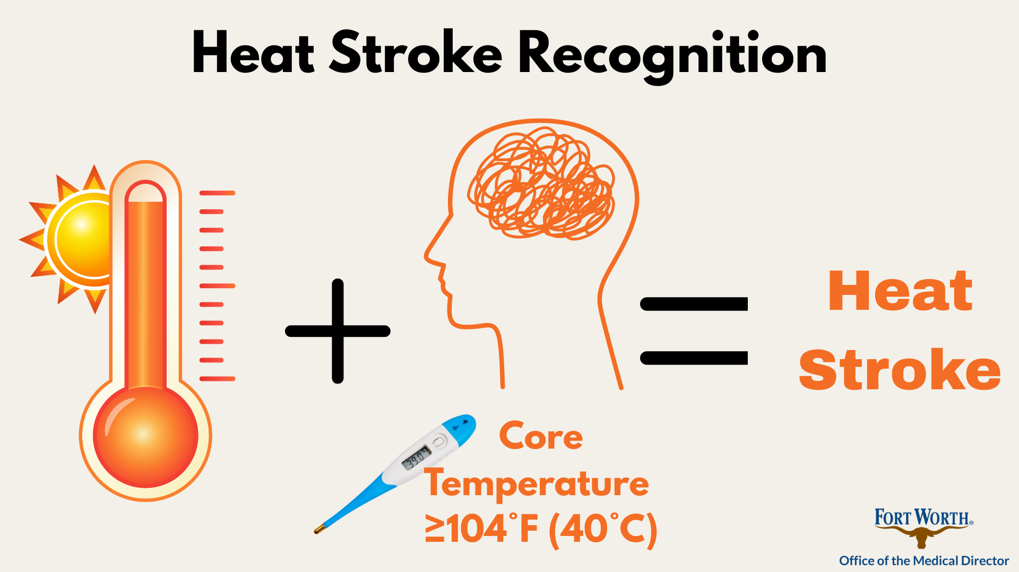

Slide 4
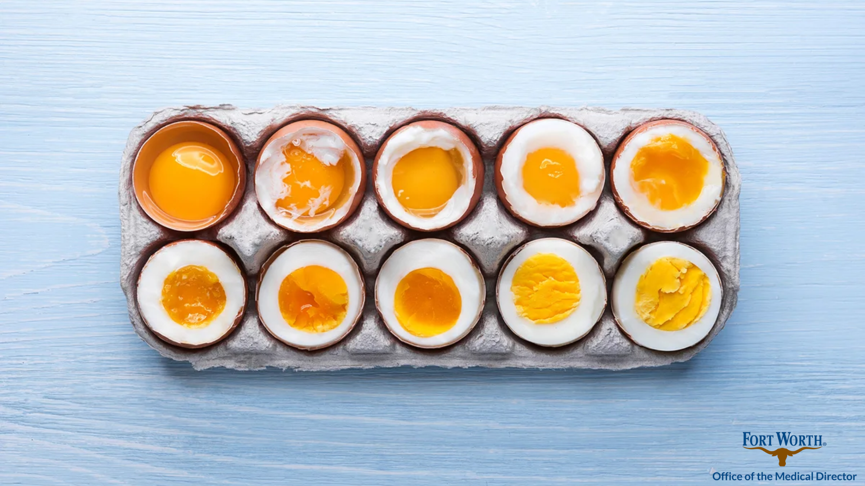
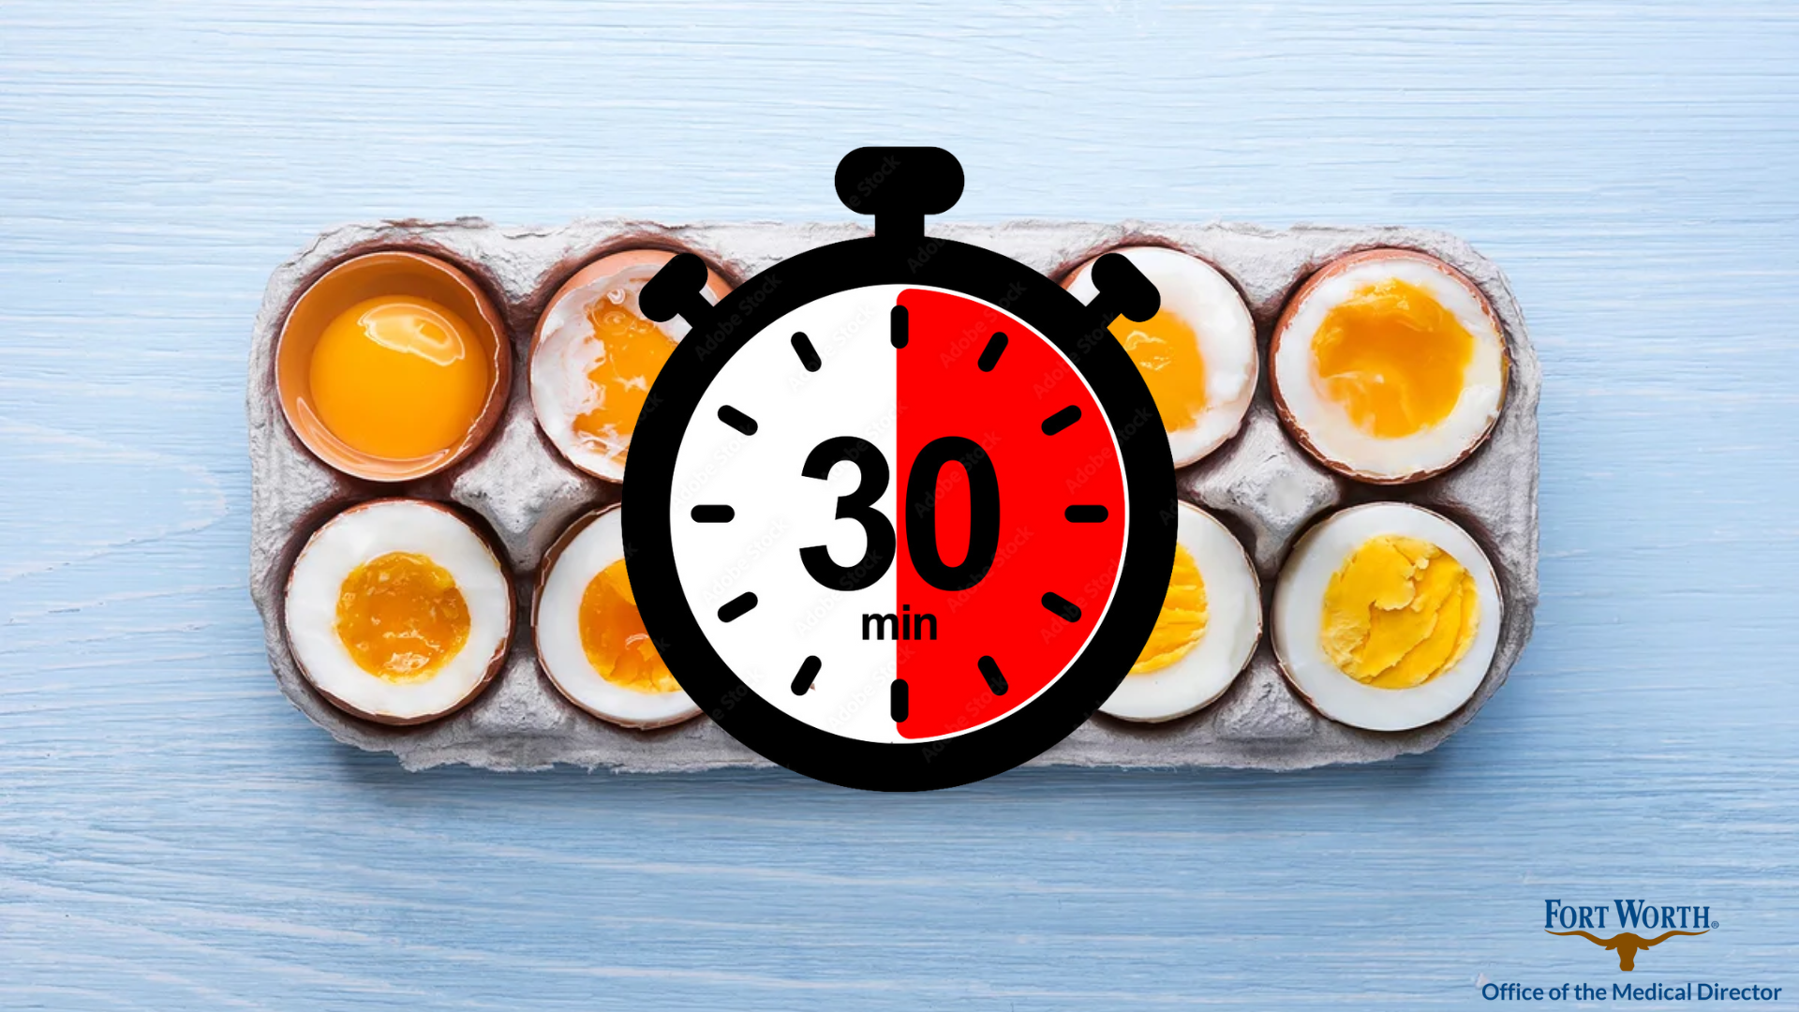

Slide 5
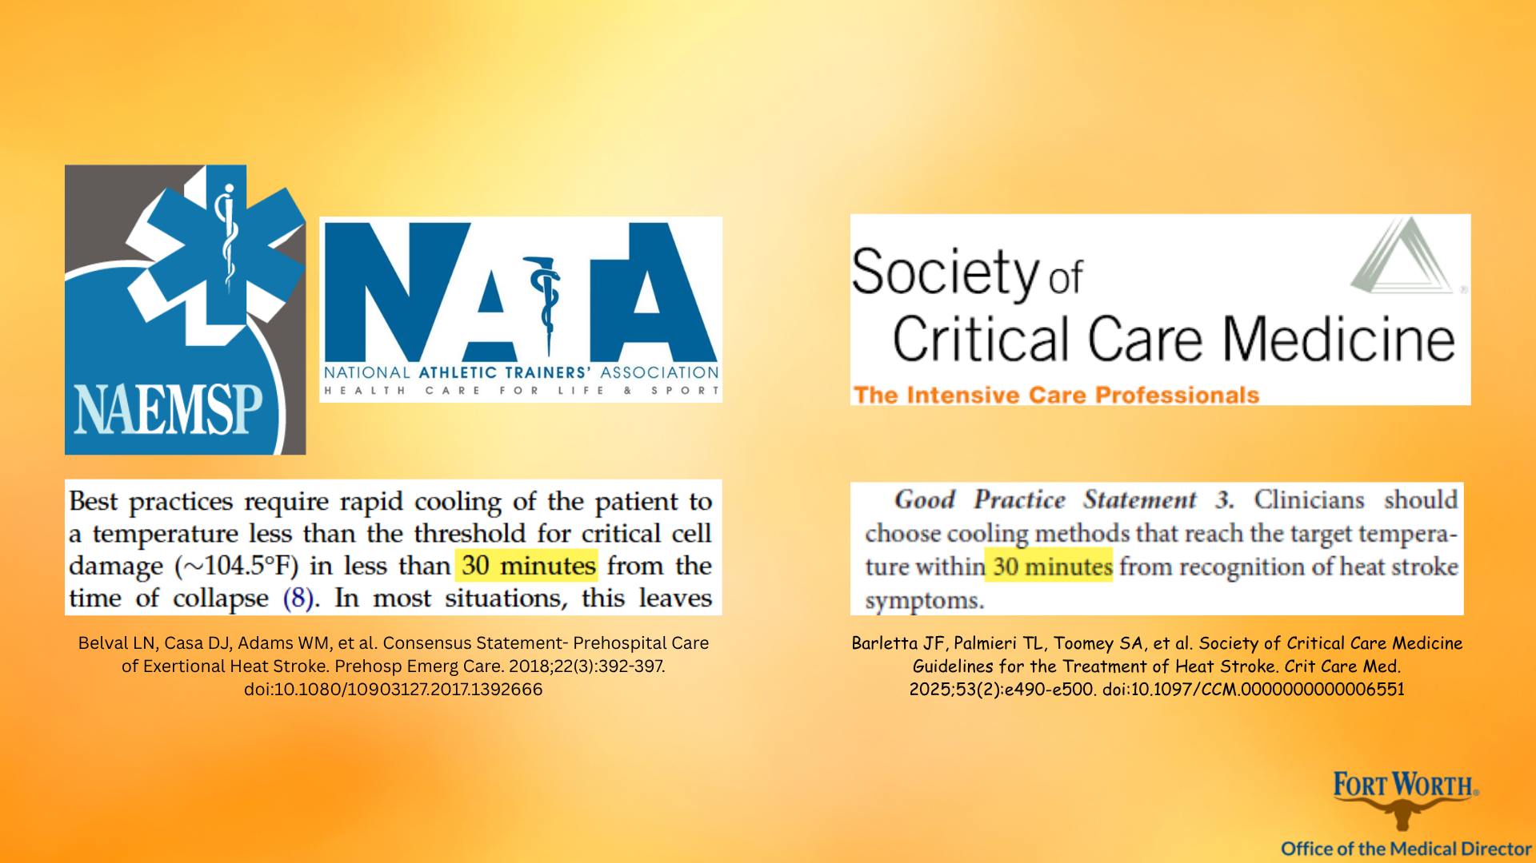

Slide 6
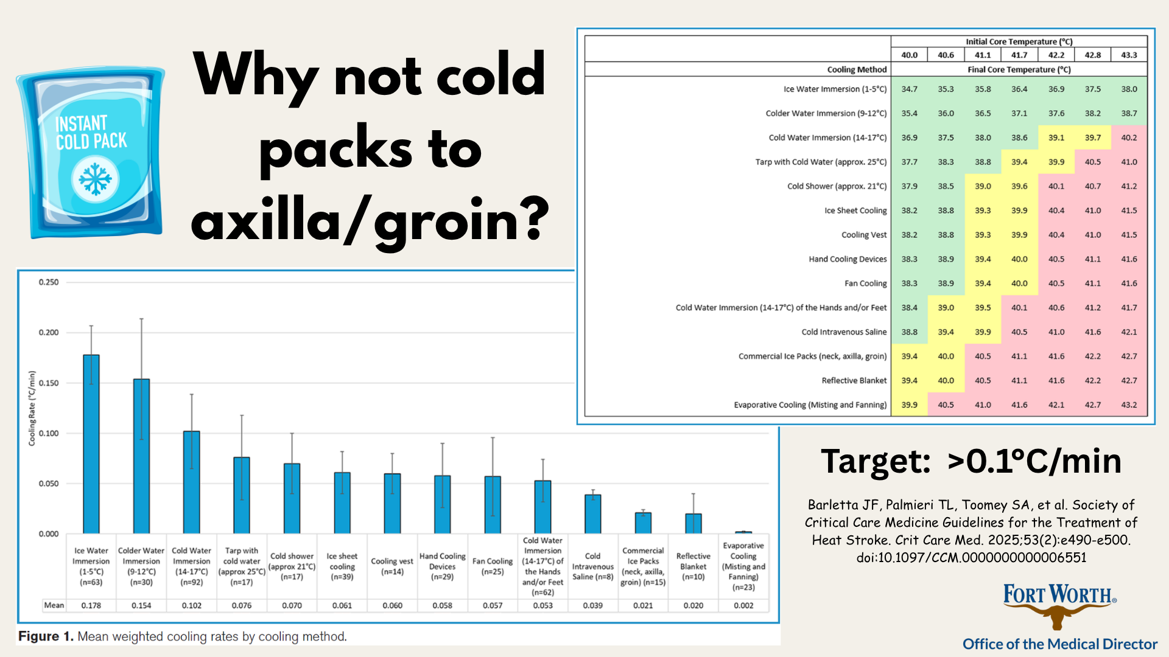

Slide 7
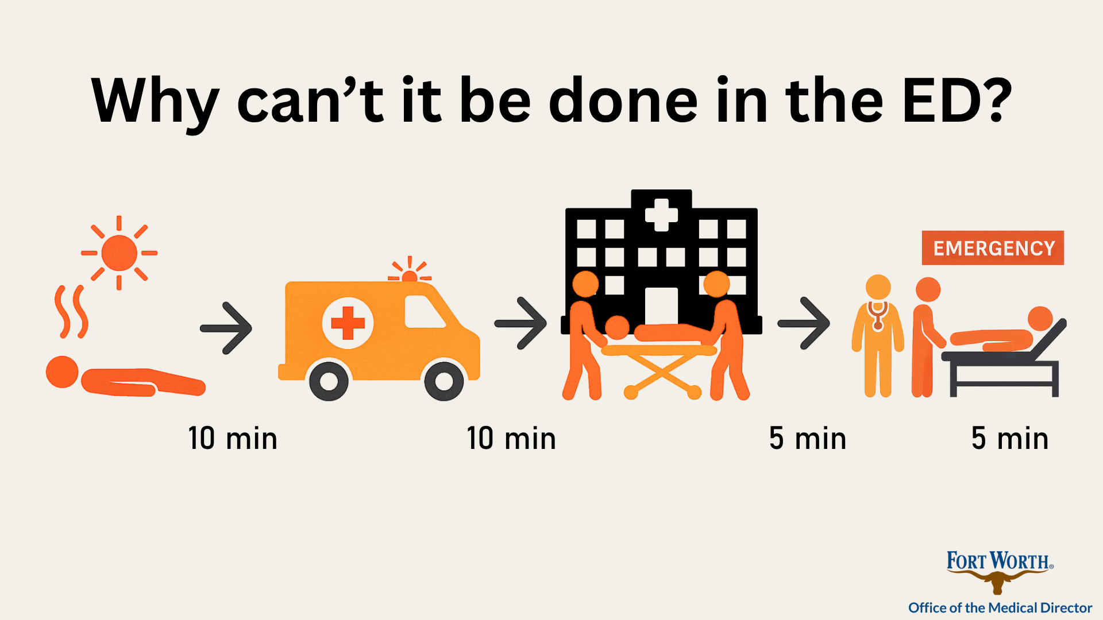
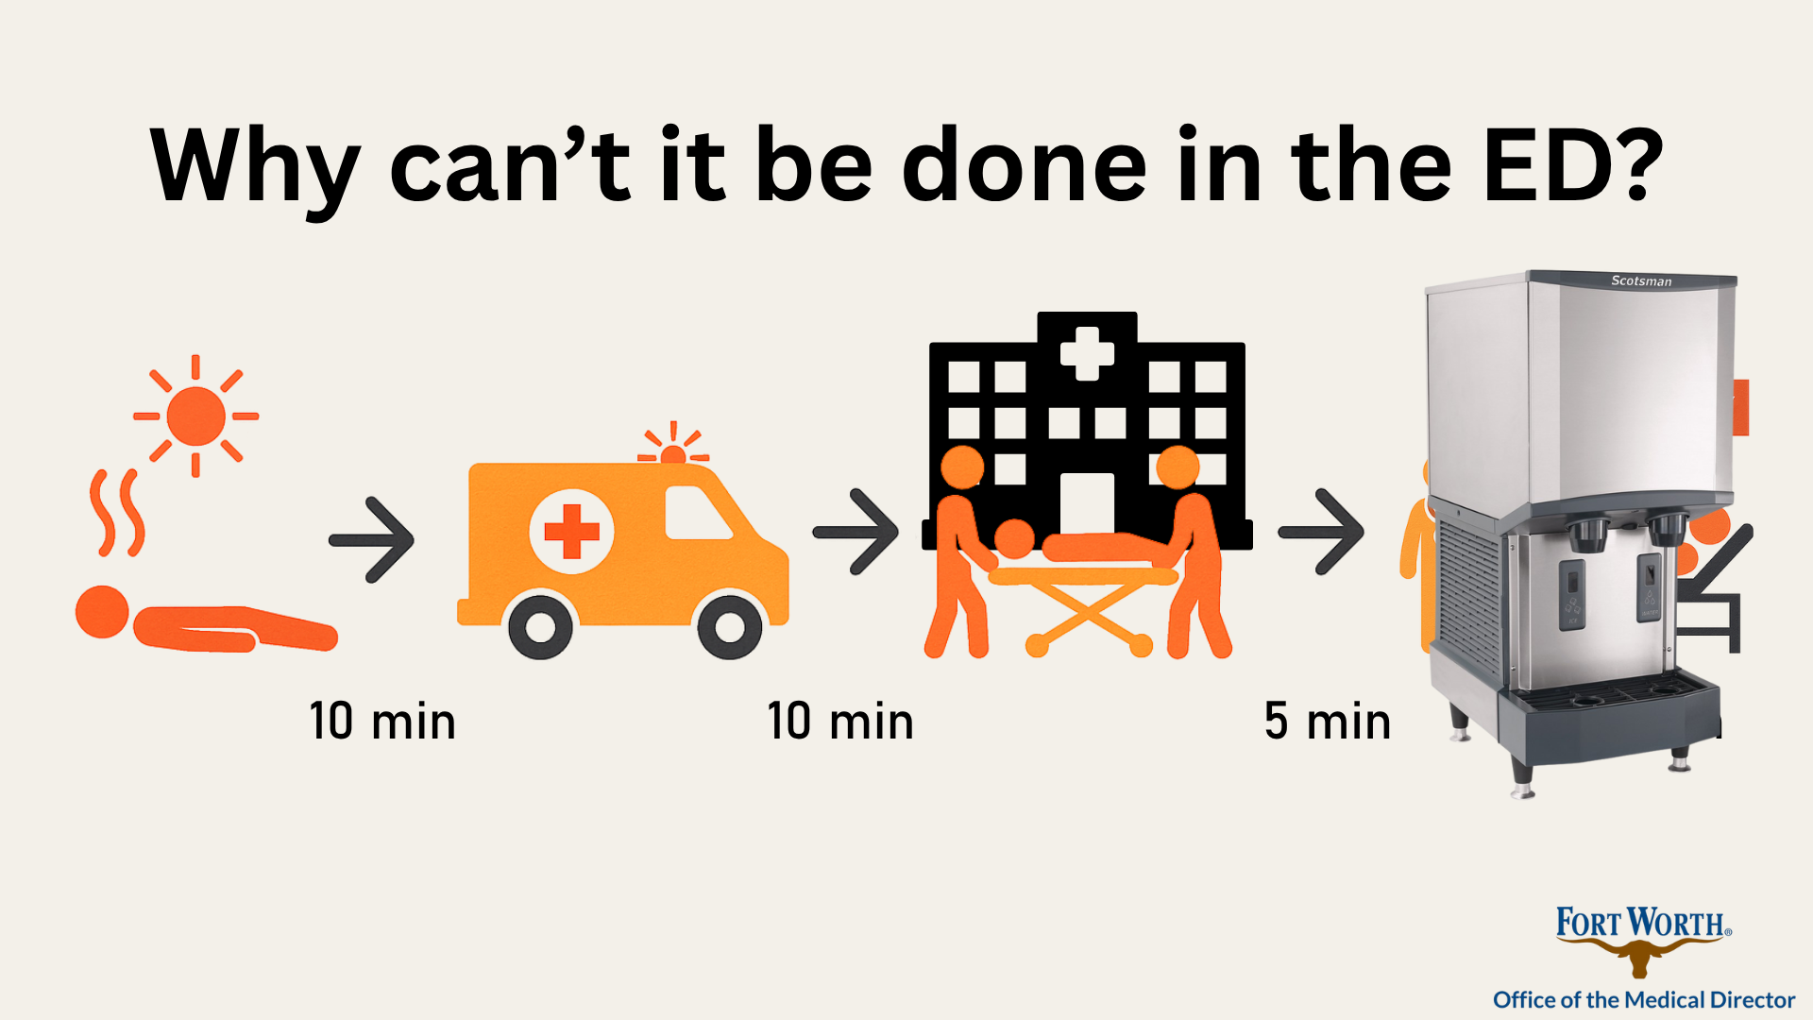

Slide 8


Slide 9
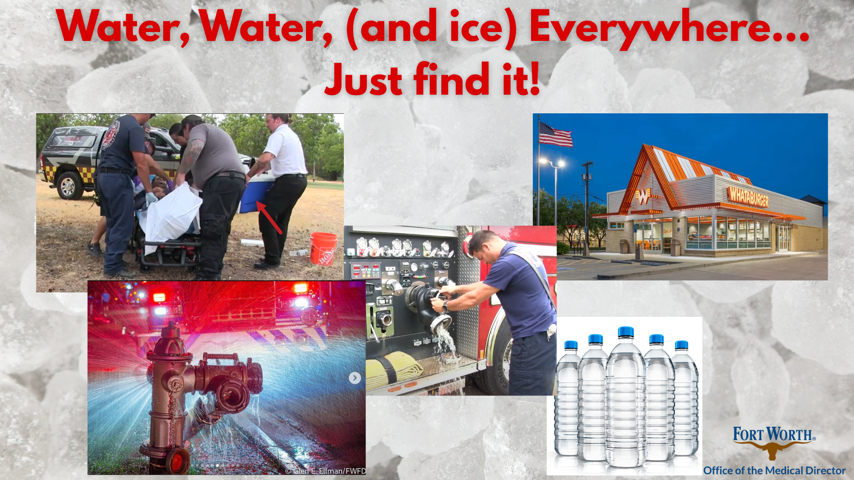
Simulation

Slide 10
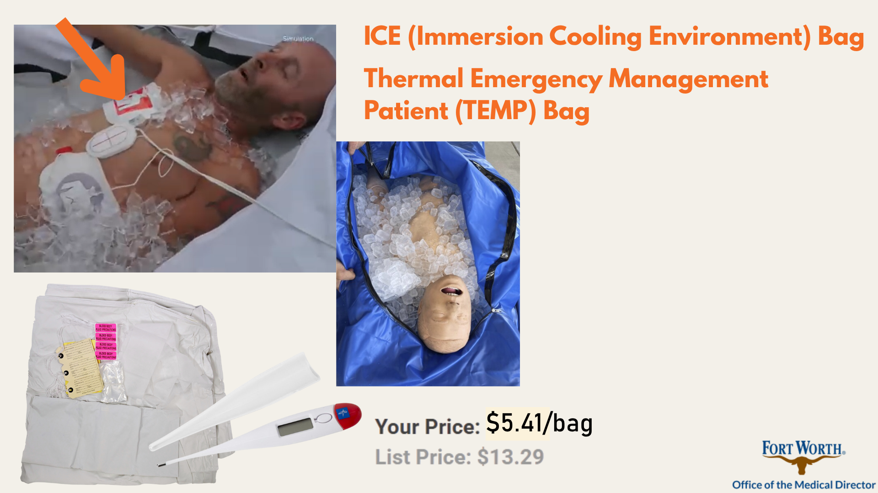
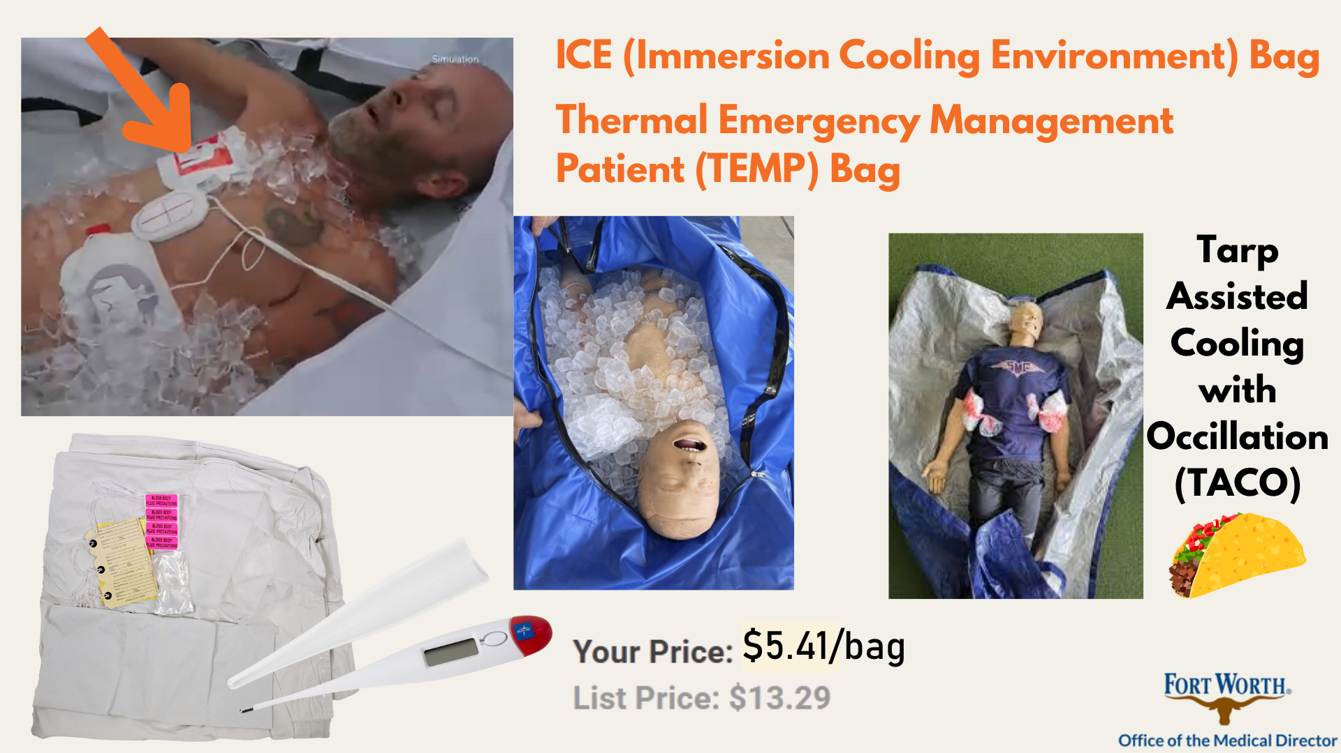

Slide 11
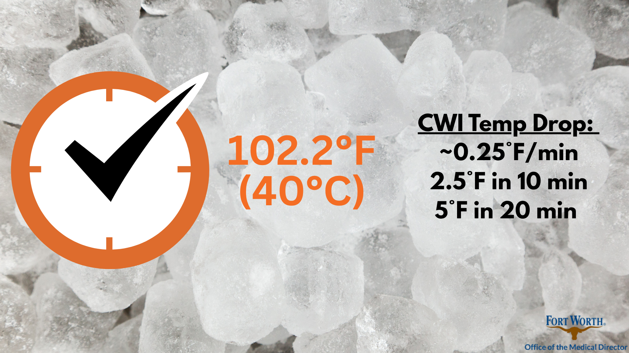

Slide 12
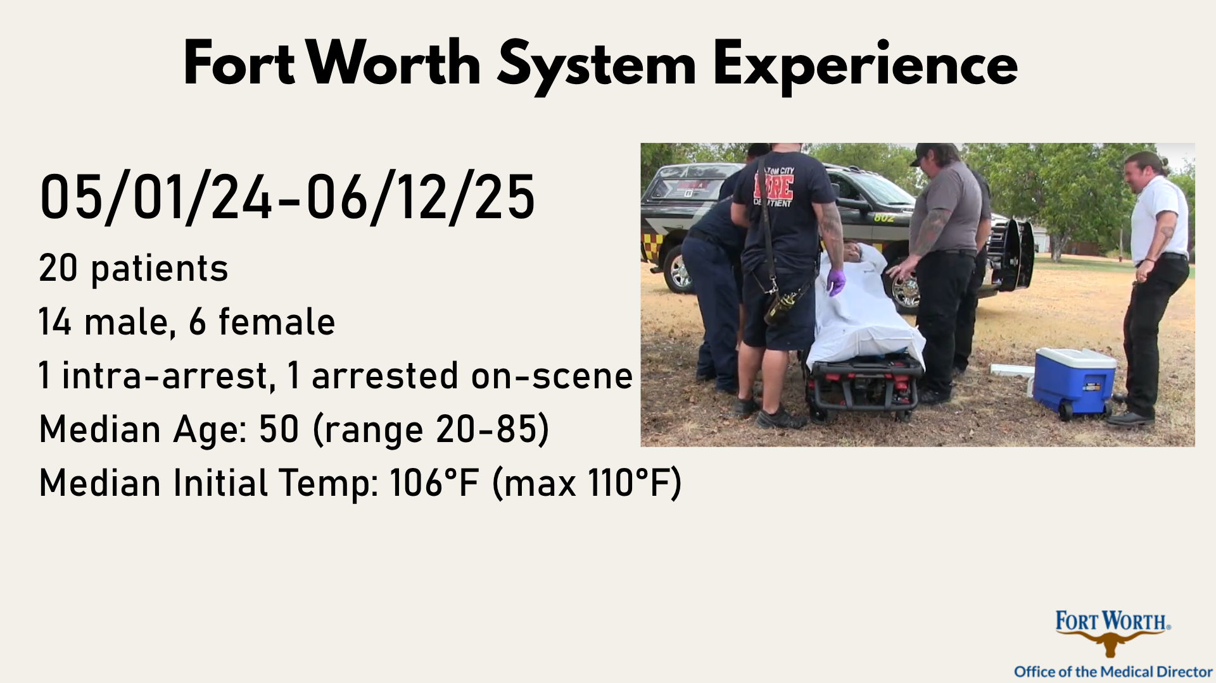
Simulation

Slide 13
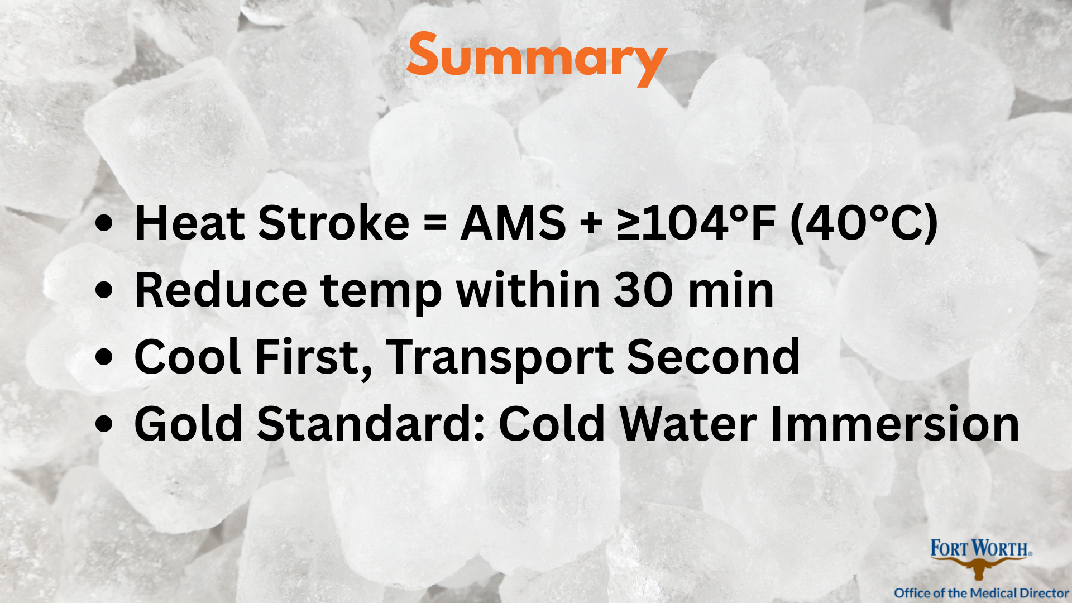

Slide 14
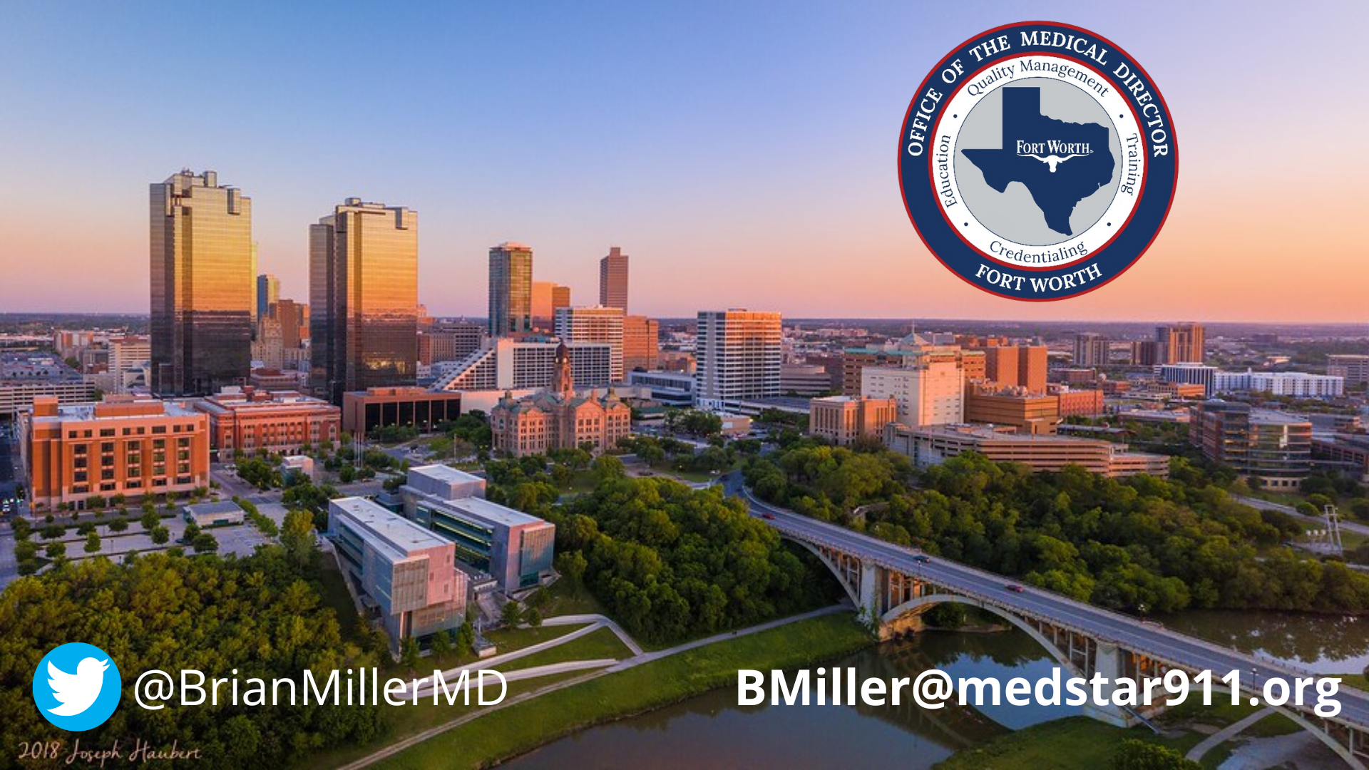


Slide 15
Is Cold Water Immersion Effective & Safe in Severe Heat Illness?
Brian Miller, MD, FACEP, FAEMS
Associate System Medical Director
Fort Worth Office of the Medical Director

