Slide 1




Transcending Any Transformative Transfer Transactions: What’s the Evolving Story with Interfacility Transporting ?
C. Crawford Mechem (Philadelphia)
Clayton D. Kazan (Los Angeles)
Roger M. Stone (Montgomery County, MD)
Michael J. Feldman (Toronto)

Slide 2

Four Questions
Should 9-1-1 EMS agencies perform interfacility transports?
If so, under what circumstances?
Are there consequences, including liability, for not doing these transports?
Are there ethical and legal considerations for habitually doing them?

Slide 3

The Context In Philadelphia
Rising EMS call volumes
Often run out of ambulances to dispatch
Hospital closures
Increasing regionalization of care
Because of this, hospitals not always able to care for all pts who walk through their doors
When in doubt, EDs turn to 9-1-1 for help

Slide 4
Requests for PFD Interfacility Transports
The FCC is receiving increasing calls from EDs to transport pts to other hospitals, mostly for specialty services
Usually emergent, sometimes less so
Most common scenarios:
  Trauma, stroke, STEMI
  OB, trauma + OB, peds, ortho, ENT, psych

Slide 5

Some Questions
The PFD runs the sole 9-1-1 EMS service in the City
Is it also responsible to honor these requests?
What if it has no available ambulances, or just a few?
What if ED has contract with private ambulance service, patient is stable, but ambulance cannot arrive for 3 hrs?
If the PFD cannot accommodate the request, and patient has bad outcome, who is liable?
What is best for the patient?

Slide 6

State EMS Rules and Regs
Response to dispatch by PSAP
  An EMS agency shall respond to call for emergency assistance communicated by the PSAP, provided it is able to respond as requested
    Has the staff and vehicle capable of responding
  An EMS agency may not refuse to respond based on desire to keep staff or vehicles in reserve to respond to future calls
EMS Regulation - 28 Pa.Code § 1001

Slide 7
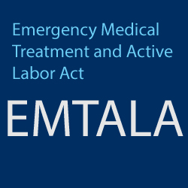
What Does EMTALA Say?
Are 9-1-1 ambulance services obligated to perform an interfacility transport if requested?
Probably not. Burden seems to fall on the hospital to ensure safe and appropriate transfer
Is calling 9-1-1 a way for EDs to shift their EMTALA responsibility for patients to EMS?

Slide 8

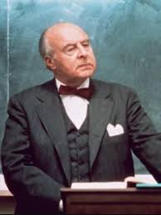
The Next Step?
FCC has had long-standing “guidelines”
  Gather pt information, determine level of care, will ED staff go with pt, get Ops chief approval
Have never been vetted
Next step: Call in the lawyers!
City Risk Management to review, provide guidance on how to address the needs of patients and liability considerations

Slide 9

Interfacility Transfers
Clayton Kazan, MD, MS, FACEP, FAEMS

Slide 10
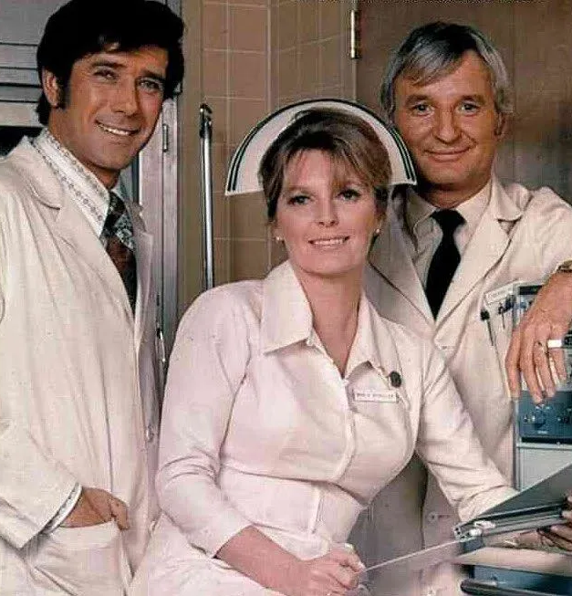
Trauma, STEMI, Emergent Surgery, ????
Early 2000s – Adopted a policy for trauma re-triage. Nobody should have a worse outcome at a community ED compared with calling 911 from a sidewalk.
2010 – Adopted STEMI re-triage. IFT ambulance response time was too long to hit E2B targets.
Emergent Surgery – “Ruptured AAA” exception

Slide 11

Stroke Centers
2009 – Los Angeles County EMS began routing patients to “primary stroke centers.” Rarely, a community hospital would request re-triage to a primary stroke center for thrombolytic consideration.
2018 – Los Angeles County EMS began routing patients to thrombectomy capable/comprehensive stroke centers based on stroke severity.
911 re-triage not allowed to try to contain 911 IFT overuse.
  TSC/CSCs required to have a system of retrieval

Slide 12

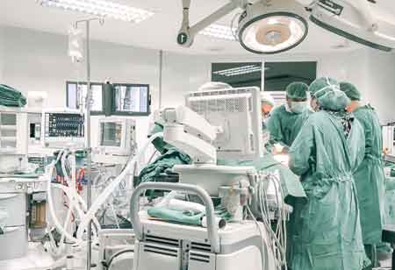
New Frontiers???
Testicular torsion
  Is there such a thing as private auto transport anymore?
Fingertip amputations for reimplantation
ECMO capable hospitals for ROSC?
Burns?
Hyperspecialization leading to growing gap in capabilities between Community and Tertiary/Quaternary Hospitals

Slide 13
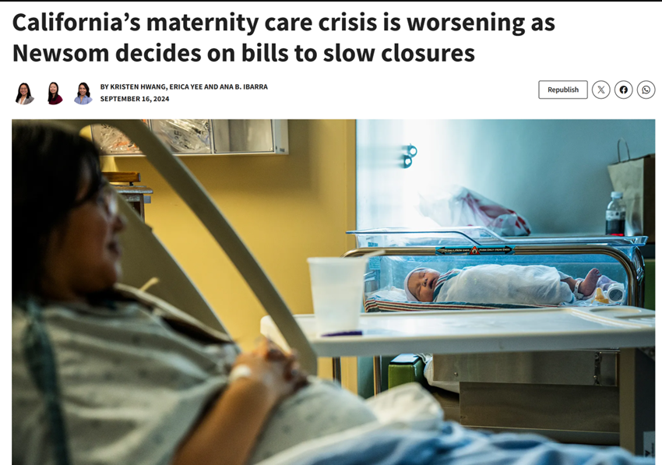
New Frontiers – OB/GYN Deserts
Standard labor in community ED
High risk labor in community ED
Newborns
Ruptured ectopic pregnancies
Ovarian torsion
Calmatters.org

Slide 14
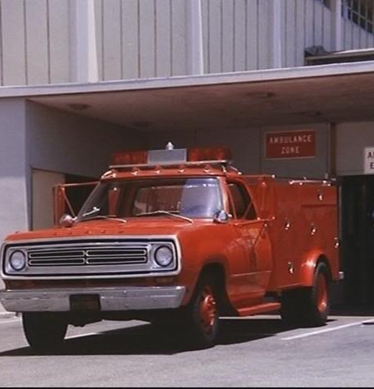
Inpatients vs. Outpatients
ED patient only
What about inpatients?
  Code Blue→ROSC/STEMI
  Chest pain→STEMI
  Hemorrhagic strokes

Slide 15
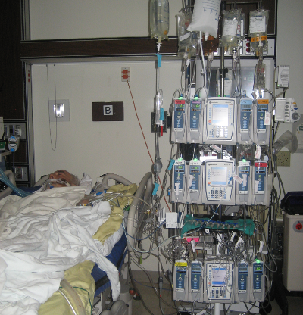
Scope of Practice
ALS vs CCT
  No IV pumps, no ventilators
Sedation – we only intubate post-ROSC. Only agents carried are morphine, midazolam
Many hospitals give etomidate, rocuronium, and want us to take.

Slide 16
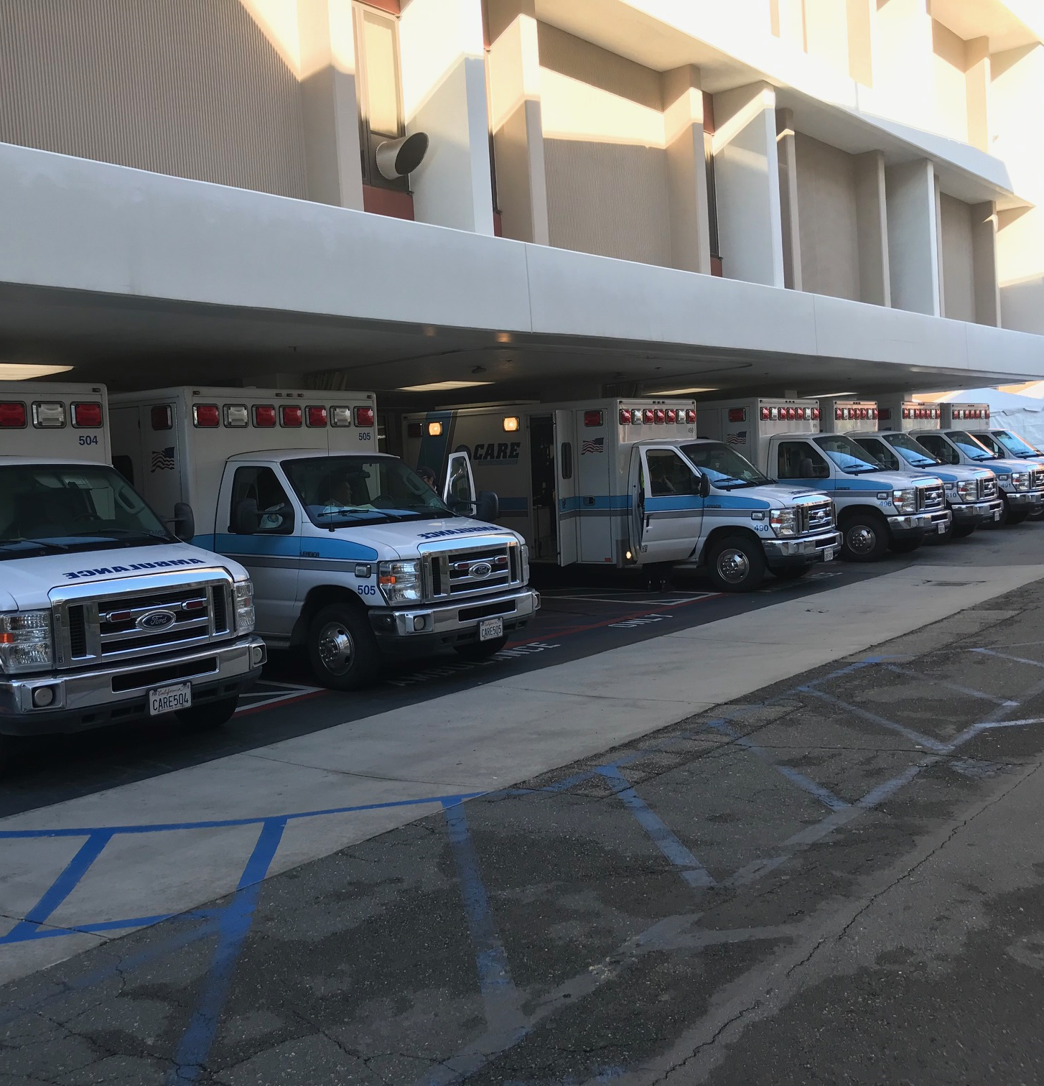
Reimbursement
Non-hospital-based EMS is a community resource.
Hospital IFTs delay response to undifferentiated community emergencies.
Reimbursement for Emergent IFT is not sufficient to supplement EMS resources

Slide 17
Conclusions
Negotiate with health system partners on when 911 is allowable
  Hold the hospitals/physicians accountable for misuse
Be a facilitator, not an enabler.
  Don’t be the band-aid for all medical system problems.
Speed is not in best interest of every patient.
  Mind your scope of practice
Advocate for proper reimbursement.
  You are providing a major service to the sending hospital but billing the patient.

Slide 18



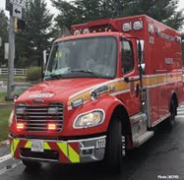
“Get Back to Where You First Belonged” : Municipal 911 Emergency Transports (ET)
Eagles 2025
Roger M. Stone, MD, MS FAAEM FAEMS
Montgomery County (MD) Fire Rescue Service
Faculty, University of Maryland EM
Generous Contribution by
Section Chief Ben Kaufman, BS, NRP
EMIHS Ops Batt Chief Pete Dugan, AA, NRP
QM Batt Chief Anthony Scott, BS, MSL, NRP
Emergency Medical & Integrated Health Section

Slide 19
Definitions & History
We named the IHT an “Emergency Transfer” (ET-2010s)
Have been supporting hospitals via the duty officer
    Many years ➔ Only 1 EMSDO in the County ➔ Often said “yes”
Tightened up around same time as 3rd EMSDO (2023)
Call Volumes ➔ “ET Stand Down” 5/23/2023
Updated specific guidelines for EMSDOs to consider
Specific demands on hospitals to follow process
    Including how we may have to say no
Notes:
We have been helping the hospitals in a limited fashion for some years now, and we initially named the inter hospital transportation the “ET” .
For many years it was an an ad hoc process and managed through the one county wide duty officer we were limited to for quite a while..
Initially, many to most of them were approved
As we noted a greater challenge over the years in the availability of IHT ambulances, we noted an uptick in the requests.
Alongside this consideration was a up to a 2% increase yearly in our own call volume and so the process had to be tightened .
Around the same time as the budgeting for our third duty officer in 2023 we had an ET stand down where we updated specific guidelines for the duty officers to consider.
We meet with hospitals by monthly, so we emphasized the need for them to strictly follow our process.

Slide 20
Basis
Is it legal? Not primary mission of municipal EMS
    Maryland (MIEMSS) ➔ separate commercial regulatory division
    911 Clinicians not credentialed to carry out IHTs
    Safe haven providing transportation & in scope support
Is it ethical? Our 911 pts do not have any other help
  We triage every day ➔ Must weigh consideration of lay public availability ➔ Life saves are part of our missions
    Surprise?: Other Eagles say MUST respond to hospital 911 call
Notes:
When we consider the basis for a program of response to the ED, we must first ask whether it is legal in our state or region, especially given this is not the primary mission of municipal EMS
In Maryland, the regulatory body MIEMSS has an entire separate division regulating this commercial IT division known as SoC LAR. Technically, our 911 clinicians are not credentialed to carry out IHT, specifically higher acuity.
There has been a safe haven for municipal ambulance to provide transportation and support in scope practices
There's a separate question on how ethical the practice is given the 911 patient population does not have any other help on the scene when they summon an ambulance to their location of emergent need .
On the other hand, EMS is a traditional expert in triage every moment of every day. As we weigh the consideration of our duty to the public, part of our mission has always been a life save
is it a surprise when other eagles report that they have a strict duty to respond to a 911 call to a hospital ?when i heard that it made me wonder about the ethical and legal framework for what we're talking about

Slide 21
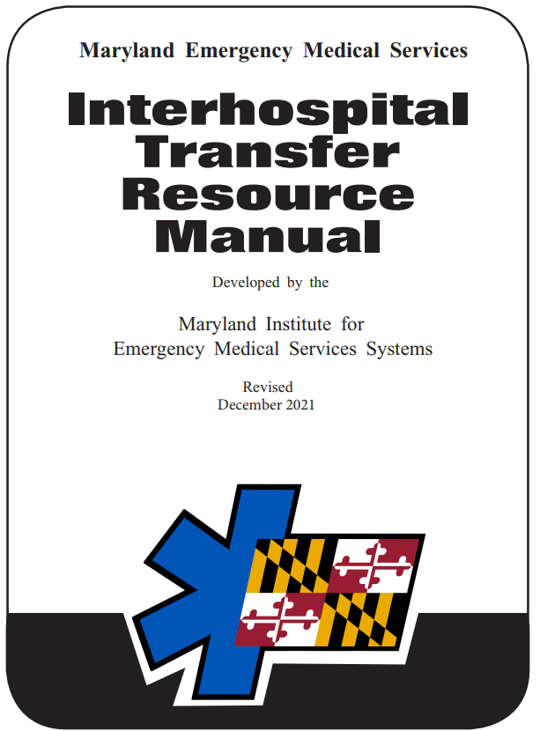
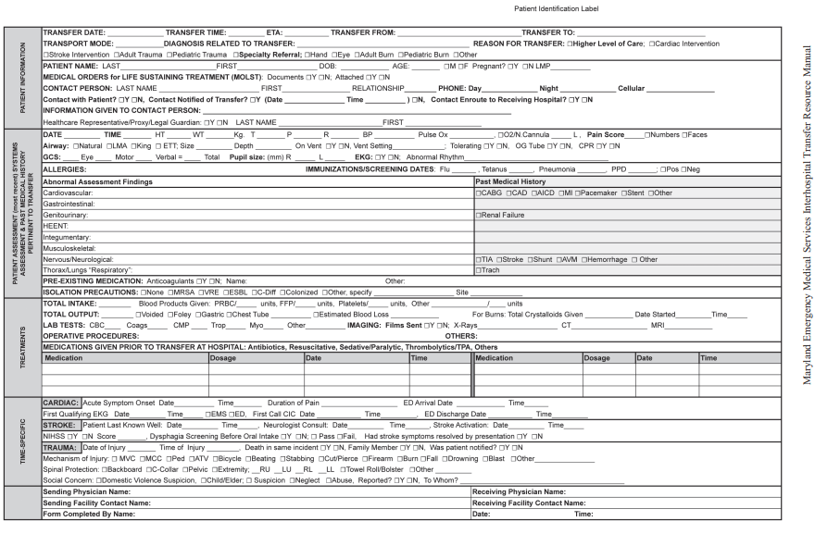
State Documentation & Guidance
State Regulation Late 2021
Transfer Form
Statement on Municipal 911
PUBLIC SERVICE AMBULANCES: The primary mission of public service ambulances is to respond to the scene or a 9-1-1 call for emergency medical assistance from a residence or scene. Rarely are these ambulances available to hospitals for interhospital transport. However, if a commercial ambulance is not able to respond for a patient requiring emergency transport to a referral center and if the public service ambulance is available, along with the required staff, they may agree to assist with an interhospital transport.
Notes:
Here's the most recent state guidance in regulation for Maryland.
Maryland has had a required transfer form for commercial /SoC LAR ambulances., And that is quite complex.
But the main part of the resource manual that speaks to municipal 911 is the following statement on the slide , underscoring the non commercial primary mission. Note it says that rarely should these ambulances be available for this purpose. It leaves the public safety agency completely in charge of accepting the mission , Unlike other eagles who reported some sort of a mandate to the opposite effect .

Slide 22

Process with Limitations
Does hospital use 911? No way to control if we allowed
    EMSDO has credentials to manage ➔ Each has 1-2 hospitals
Requesting physician initiates after depleting options
  Commercial service always called first
Must be a life-save: “Long ETA s” “we go instead”
Hospital MUST provide staff to accompany patient
      Never commandeer an Ambulance in the ED
Notes:
Whatever the regulatory basis for an ED activation of a municipal ambulance, the first question each system address is whether it is sound for the hospital to use 911 ?
in Montgomery County, we argue that there's no way to control the program if that Manner of access is allowable .
Specifically, we credentialed our EMS duty officers to manage the real-time program, and each of our four full time EMS DO's are responsible for one or two hospitals.
They each have the regional supervisors cell phone # and the requesting physician must initiate the request outside of 911 and only after depleting his or her options. Stipulated is the fact that the commercial service must always be called first
secondly, the request must represent a life save: invariably, commercials will frequently give longer ETA's than a 911 ambulance, but that doesn't constitute the need for us to go instead
In discussing those specific demands on hospitals to follow the process, we require that they provide staff for the continuity of care given that we are not licensed under SoCLAR and are essentially a mode of transportation after hospital stabilization

Slide 23
Process Details
Prior to initiating the transport all of the following conditions must be met:
The patient being transferred has a life-threatening medical condition or needs an emergent life-saving intervention that is not available
A commercial ambulance service was requested first and is either unavailable or provided an unacceptable ETA given the patient’s condition.
Sending physician must provide stabilization to minimize risks of transport
A receiving physician has accepted patient and the facility is ready
A nurse or physician must accompany the patient. When using a nurse, physician must remain available for on-line medical consult.
The patient and all medical records must be ready to leave the ER in 15 m
Sending facility must send all required medications, fluids, and specialized equipment (MCFRS now has pumps that may assist)
•If approved, MCFRS will provide a transport unit with ALS capabilities.
By law, ALS is required in order for municipal 911 systems to perform an interfacility transport.
EMS700 240-243-7800 Any sending facility / contact between 0700-2300
EMS702 240-243-7802 SUB, HCH
EMS703 240-243-7803 SGMC, GEC, HCG
EMS704 240-243-7804 WOMC, MMMC

Slide 24
Literature in Favor of Activation
Regional “Call 911” Emergency Department Protocol to Reduce Interfacility Transfer Delay for Patients With ST‐Segment–Elevation Myocardial Infarction
Nichole Bosson, T Baruch, W J French , A Fang, AH Kaji , M Gausche‐Hill , A Rock, D Shavelle, JL Thomas, JT Niemann
    Using a Call 911 protocol in this regional cardiac care system, patients with STEMI requiring interfacility transfers had a median FMC2B time of 111 minutes, with 56% meeting 120‐m goal.
Emergency Interhospital Transfer of Patients With ST‐Segment–Elevation Myocardial Infarction: Call 9‐1‐1—The American Heart Association Mission: Lifeline Program
WJ French, MD, M Gunderson (Ret) , David Travis, PMD, MPH, M Bieniarz, MD, J Zegre‐Hemsey, PhD, RN , A Goyal, MD, MHS, and AK. Jacobs, MD
STAT TRANSFER process uses a systems approach that considers diverse ways in which patients access care … and how receiving hospitals prepare for an incoming patient with STEMI
San Mateo Co has Send on Demand: AMR
  Richmond AA controls all transports anyway
Notes:
So we are aware of some literature in the past decade that shows benefit to a 911 activation by local emergency departments for STEMI patients; this may have formed the basis for activation programs in Clayton’s region.
Notwithstanding, we have to manage requests for a very diverse group of individual medical presentations, as well as the fact that our call takers may put the ED requesting physician through lines of questioning that is non applicable to the nature of the request.
The literature being specific for some processes, there are multiple factors that we had to take into consideration and this a model would not work everywhere.
The de facto result of our Duty officer process and direct contact with hospitals is that many of the same STEMI patients are assisted within the window .

Slide 25
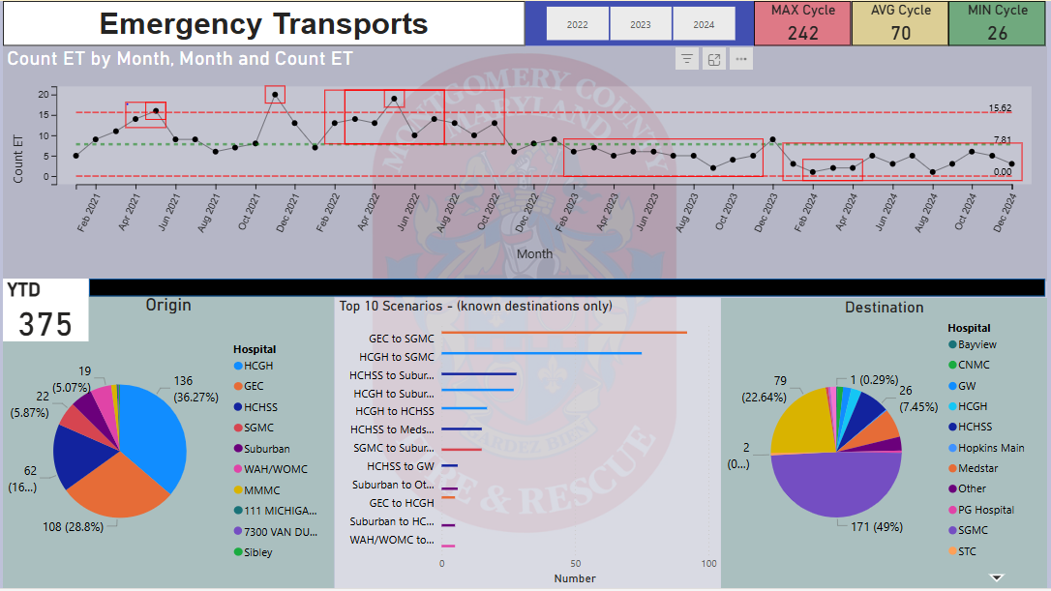
ET Data 2024: 1/day
Notes:
Our data pictured here shows that after a creeping up of the ET census earlier in the decade, we were able to bring these numbers down after the ET stand down.
This left us with about one accepted request per day for 2024. It shows that our process has been able to place some controls without burdening the 911 resources and without significant adverse effect.

Slide 26
Separate Mention
Clayton mentioned laboring moms in a local ED? ➔ EMTALA has special mention: Stabilizing = delivery
    Pitfall is delivery in moving ambo vs. controlled environment
    Local data: 3/11 transfers delivered enroute to L&D
All STEMIs? Strokes? Do we owe the work?
  Occasional ask ➔ Very different from expectation
If Not mission of municipal EMS, how much is OK?
Notes:
A separate mention is worthy of the laboring mom in a non L&D center, which was the source of separate discussion in our eagle's curriculum this year .
The issue came up for us because of some hospitals no longer or not having an L&D suite and their request to be the primary resource to solve that problem.
This brings up the separate mention that the L in EMT L A stands for labor, and that the delivery of a child could constitute the required stabilization under federal law depending on the situation
Our service in the recent past had 3/ 11 transfers for OB pts result in a birth in the ambulance or in a hospital hallway. On the other hand , some of the deliveries occurred many many hours later. Those are potentially a sub optimal outcomes , the former based on both local and federal considerations , and certainly places the burdens on the sending institutions to have advanced practitioners available for the transportation .

Slide 27
Take Home Points
We specialize in undifferentiated patients with major responsibility to lay caller without help
BUT are we not here for life saves?
Each system must ask: Legal? Ethical? Possible?
If so, answer may be … “Yes, sometimes”: But we chose a judicious approach to processing the ET/IHT
    Including how to say no
Some systems are already set up for both missions
“Get Back, JoJo, your patient’s waitin’ for ya”
Notes:
So our take home point is that we decided to say vote “yes, sometimes”, As our answer to the legal and ethical question of providing ETs.
We chose a judicious approach to processing and a checklist.
What works for us may not work for other systems who have a different legal, regulatory or ethical framework, or who are already set up for both missions.

Slide 28

If EMS is Relied Upon for IFTs…
next
Issues:
  Level of Care
  EMS resources
  Triage – risk of deterioration in current facility
We only use paramedics for conveyance; hospitals to provide staff and equipment
Protocol-based interrogation vs. clinician judgement (paramedic? RN? MD?)

Slide 29
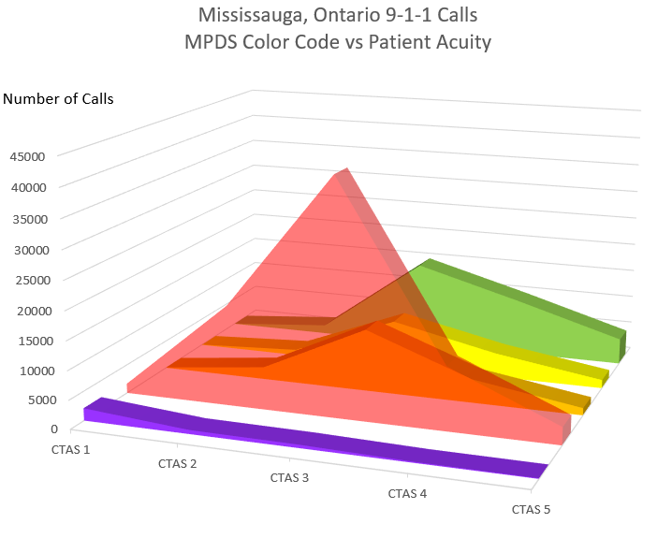
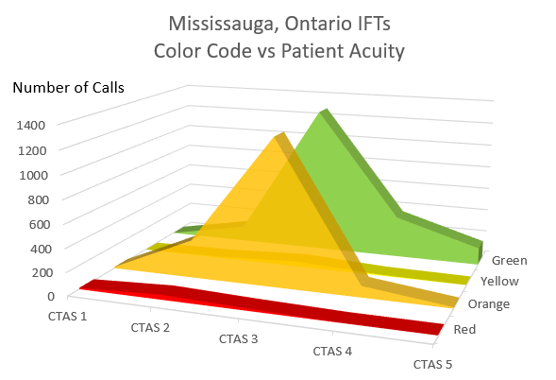
Balancing 9-1-1 calls and IFTs
next
Challenging when called for higher level of care
Which comes first? IFTs are sicker than similarly coded 9-1-1 calls

