Slide 1
What to do when your emergency department hospital closes!
Glenn Asaeda, MD, FACEP, FAAEM, DABEMS
Chief Medical Director
Fire Department of New York City

Slide 2
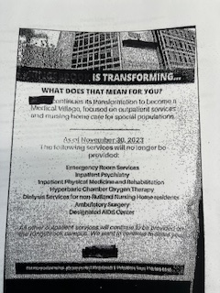
Depends on HOW the hospital closes.

Slide 3
Hospital X – opened in 1925 - Community ED
303 bed hospital with an annual ED volume of 33,800 in 2021 – advised that they were looking to become a free-standing ED (FED)
Then closing/no FED/no closing
Final determination in early 2023 – will be closing several meeting – would not close until all meetings/community meetings/notifications
ED Chair assured me – will do this the “right Way”
Then flyer – ED chair no where to be found

Slide 4
At 10:30 pm on November 30th – received a call from our FDOC
“ah Dr. Asaeda, I’m sorry to bother you, I know you are not the on call physician, but are you aware of what’s going on at hospital x?!!” yes, I am they are closing but not until the beginning of next year
Ah – maybe you should just look at this.

Slide 5
What the Heck is going on?
Reached out to the chair of the ED, no response hospital put on immediate total diversion

Slide 6
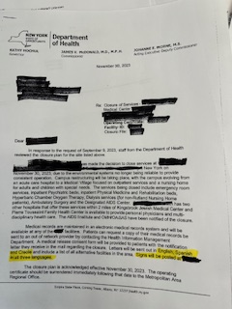

Slide 7
Hospital – closed on April 9, 2025 opened in 1889, 800 bed hospital, 75,000 annual Ed census severe financial crisis initially (2023) moving location to a smaller footprint to remain a hospital then advised the need to close community meetings, community protests and law suites – hospital court ordered to remain open – in limbo for months services started to become unavailable (stemi, lvo, stroke) final court authorization to close

Slide 8
Hospital b – did the right thing community outreach ems contact contact with the surrounding hospitals (very concerned about the increase in patient volume to their facilities) as services became unavailable, ems diverted then total diversion when officially allowed to close by the court system

Slide 9
So what to do?
Depends on “how” they close and what type of hospital it is

Slide 10
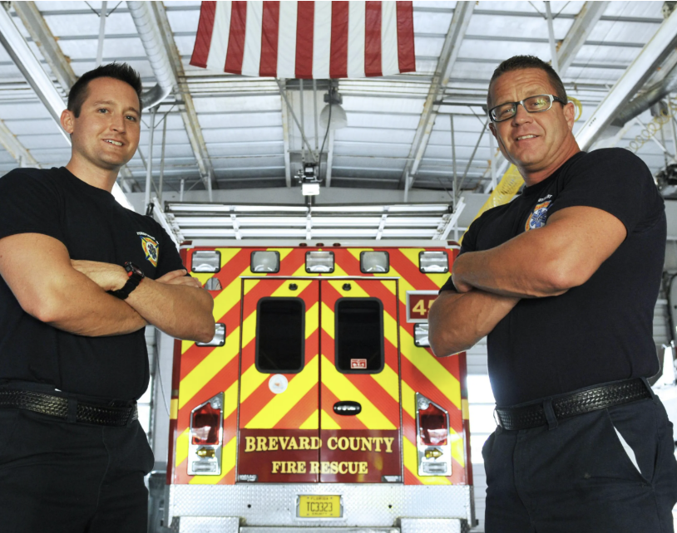
Brevard County
Fire Rescue
Peter Antevy
- Chief Medical Officer
Bobby Ford
- EMS Medical Director
LeeAnne Lee
- Associate Medical Director
John McPherson
- Associate Medical Director
Paul Pepe
- Medical Director of Research
50,000 Call Volume
500 FF/PM/EMTs

Slide 11
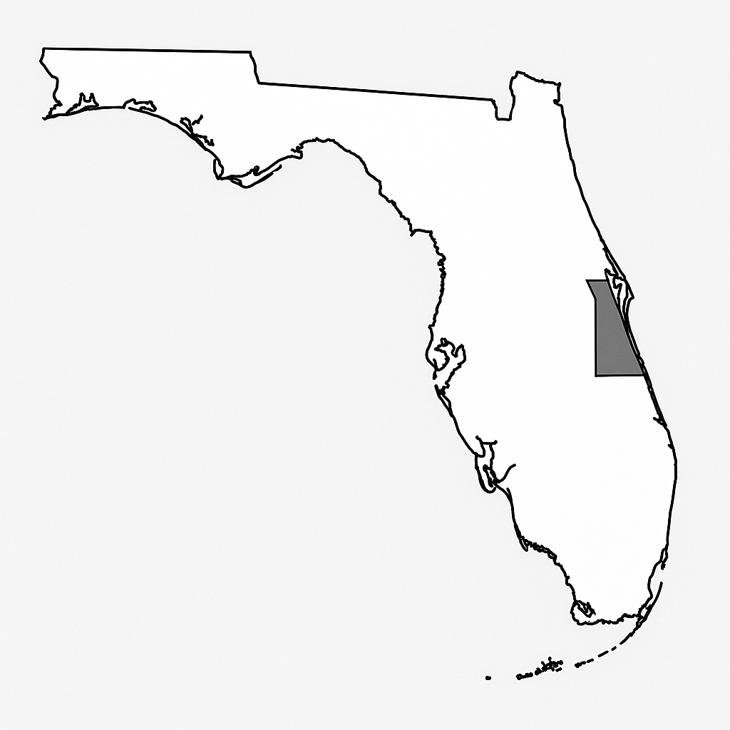
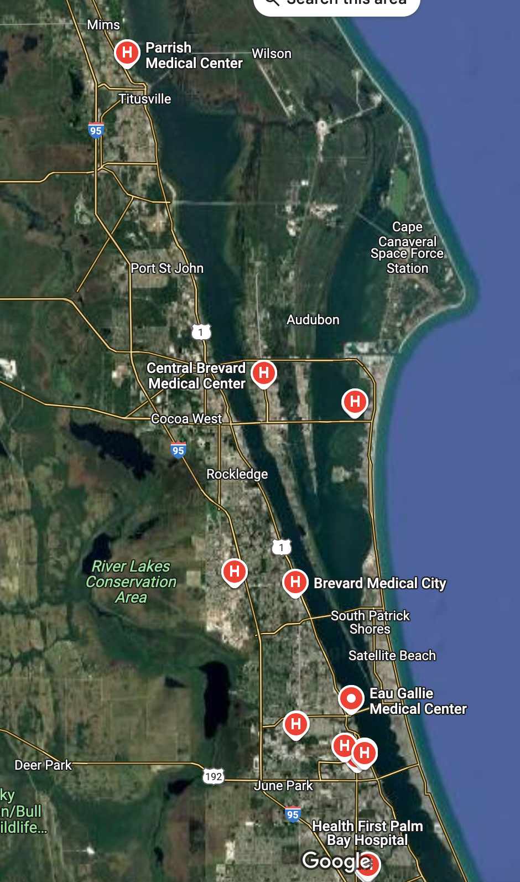

R

Slide 12
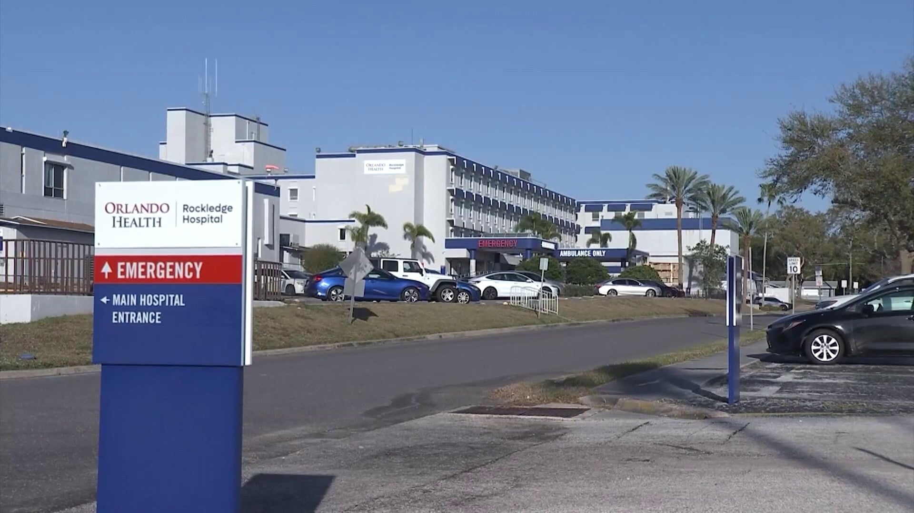
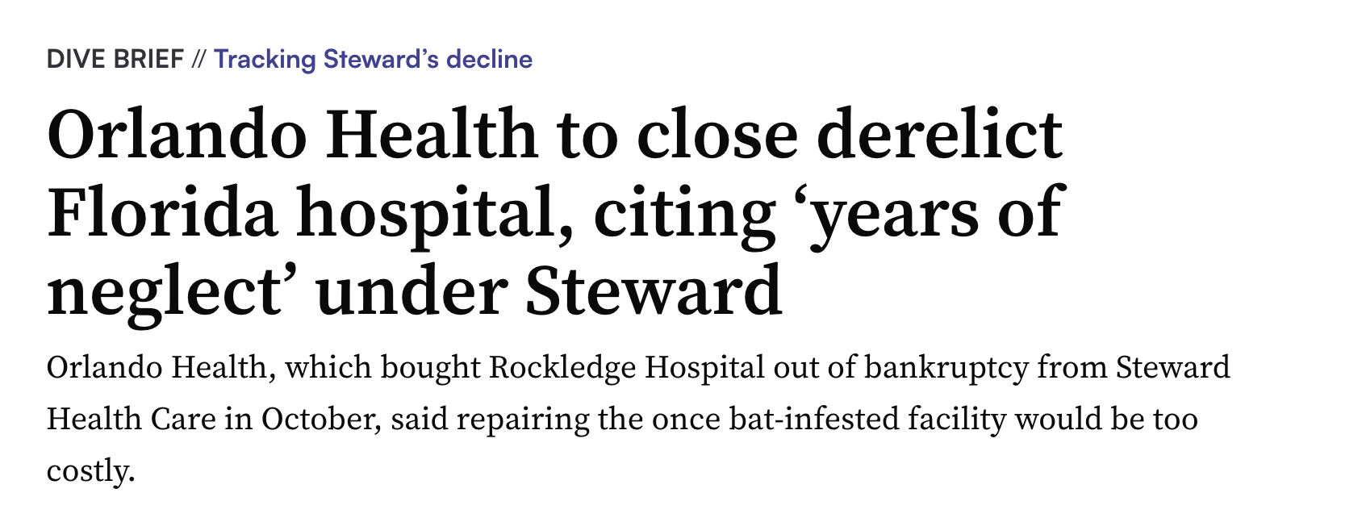
Born: December 1941
Purchased by Orlando Health: October 2024
Announced Closure: February 2025
Laid to Rest: April 2025
ED Visits: 30,000/year
EMS: 8,000/year

Slide 13
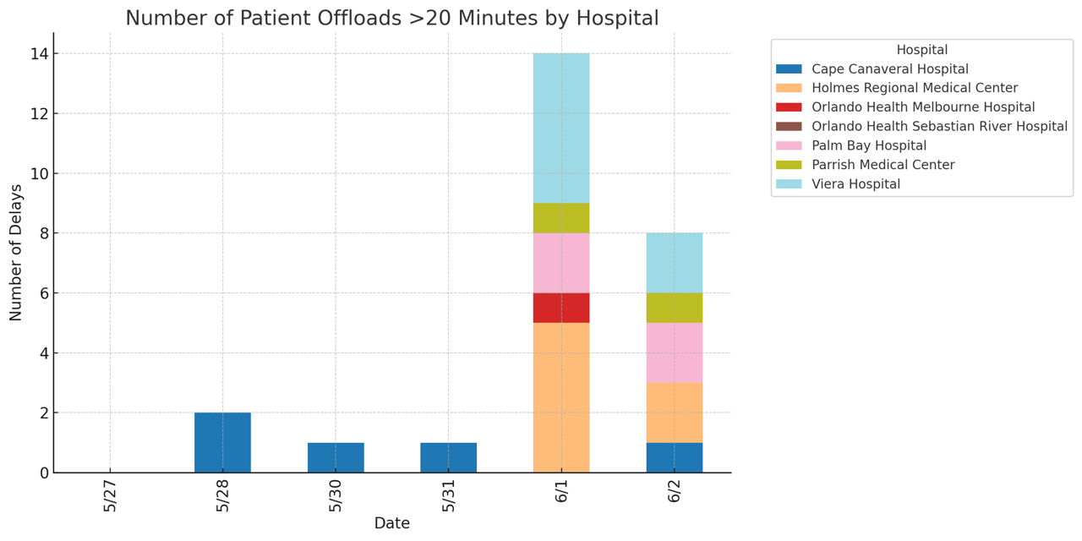
EPIC Launched

Slide 14
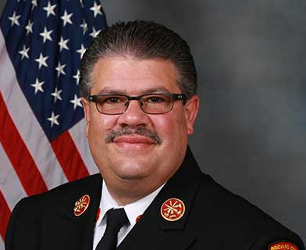

The Fixers!

Slide 15


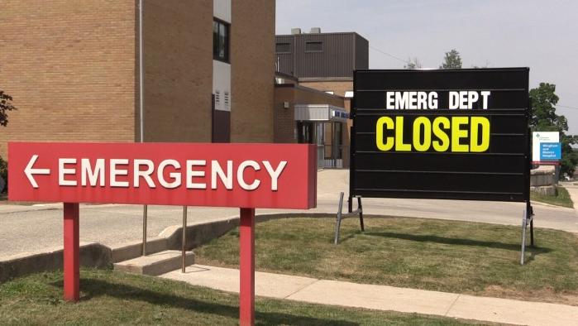

Hospital ER Closures in Ontario Canada
Prevalence, Impact on EMS, and Work-arounds
Dr. Michael Feldman, Toronto

Slide 16
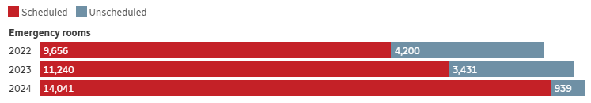

next
Hospital ER Closures – A Growing Rural Problem
Source: Compiled from hospital news releases
176 public hospitals in Ontario; 38 experienced ER closures in 2023
Mainly ER rural hospital closures – often due to lack of nursing staff, sometimes lack of physicians; scheduled or unscheduled
Sometimes very limited notice
ICU, obstetrics closures
Some closures of CT/MRI due to scheduled or unscheduled maintenance
Notes:
16

Slide 17
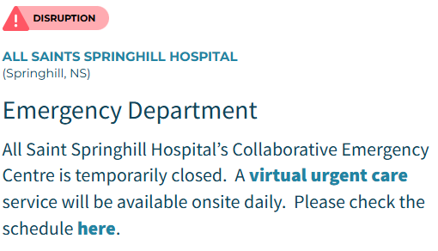
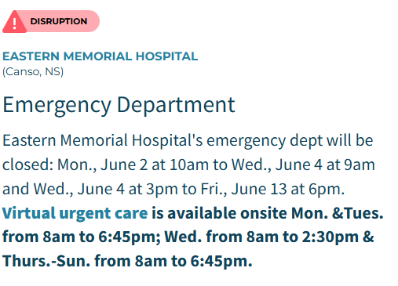
next
Work-arounds and System Impact
Virtual emergency consults with nursing assistance
Peer-to-peer support for ED physicians
Patients self-diverting
Ambulance on standby
Remote hospitals asking to medevac patients hours away
Ambulances re-routing and depletion of resources
Increased wall times
Notes:
17

Slide 18




Slide 19



Up Against the Wall:
The Costs of Living on Tulsa Time & OKC No Empty Beds to See
Jeffrey M. Goodloe, MD, NRP, FACEP, FAEMS
Chief Medical Officer
EMS System for Metropolitan Oklahoma City & Tulsa
Professor & EMS Section Chief, Department of Emergency Medicine
University of Oklahoma School of Community Medicine

Slide 20
2.4
Percent of Ambulance Services Annual Budget Spent on Hospital Bed Delay

Slide 21
14.7
Hours of Hospital Bed Delay per Day

Slide 22
230
Cost in Dollars
Per Unit Hour of Ambulance Service

Slide 23
5,375
Hours of Hospital Bed Delay CY 2023

Slide 24
1,238,773
Dollars Spent on Hospital Bed Delay

Slide 25
2,447,546
Dollars Spent on Hospital Bed Delay

Slide 26


So…where can we look for help?

Slide 27



The Rand Report

Slide 28

The “ABC-ED” Act of 2025

Slide 29



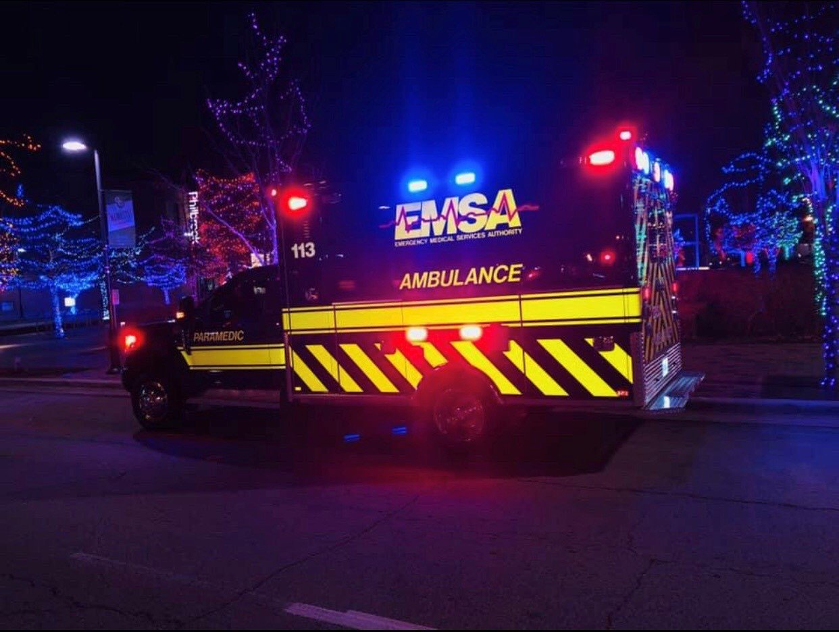
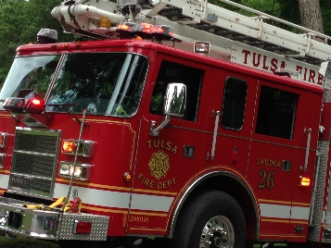
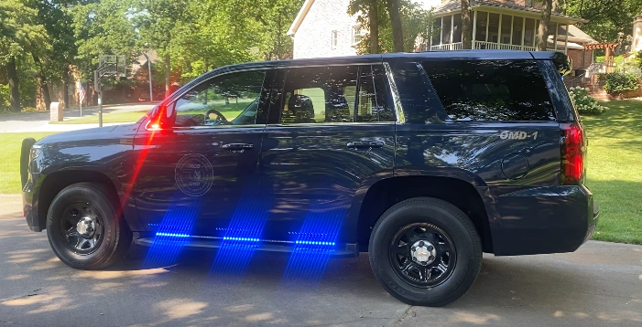

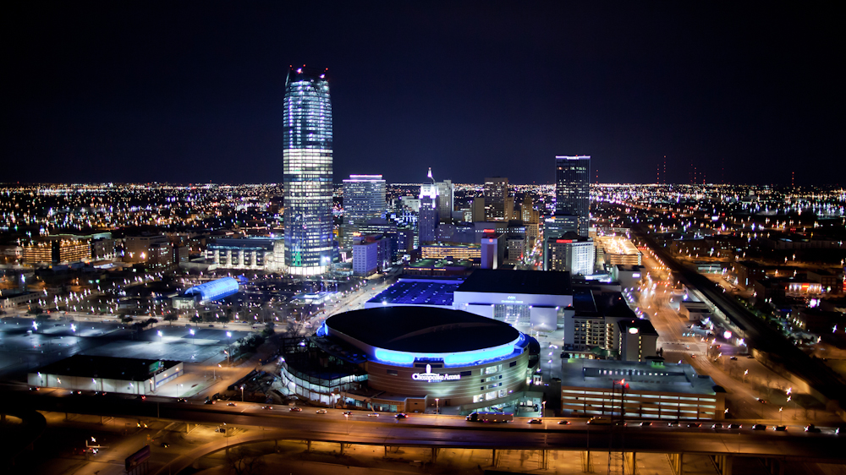
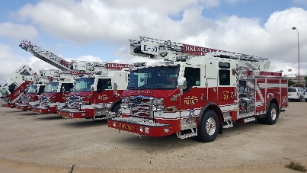



TULSA
Contact Info:
jeffrey-goodloe@ouhsc.edu
Office of the Medical Director
www.okctulomd.com
918-596-3147
@drjeffgoodloe
OKLAHOMA CITY

Slide 30
TULSA
Contact Info:
jeffrey-goodloe@ouhsc.edu
Office of the Medical Director
www.okctulomd.com
918-596-3147
@drjeffgoodloe
OKLAHOMA CITY

Slide 31
What to do when your emergency department hospital closes!
Glenn Asaeda, MD, FACEP, FAAEM, DABEMS
Chief Medical Director
Fire Department of New York City

