Slide 1
Should Patients Have a Choice as to What Hospital to be Transported to by EMS
Glenn Asaeda, MD, FACEP, FAAEM, DABEMS
Chief Medical Director
Fire Department of New York City

Slide 2
One of the biggest complaints that I receive when I speak to Field Providers – Doc, we feel like we are just a cab ride!!!
Past “10-Minute Rule”
“new” 10-Minute Rule effective 03/12/2025 – low acuity, stable patients – will be transported to one of the 2-3 NY State Certified 911-receiving EDs within 10 minutes of the incident location
Specialty (Trauma, Burn, Stroke, STEMI, etc) – still same rules– closest appropriate
High index cases – same rules
Some Specialty Hospital Rules (Cancer – no ED) – same rules

Slide 3
Immediate Results
Private Hospitals Claim – “you are harming patients by not allowing them to stay within network!”
Huh, is that patient steering?
Medical Necessity absolutely remains – but will ALWAYS trump “Continuity of Care”
Continuity of Care DOES NOT EQUAL Medical Necessity
Yes, certain cases still will make sense to have our OLMC Physician authorize transport to a further hospital – had surgery there and now having complications
Can that State Certified 911-Receiving ED handle that patient – YES, absolutely

Slide 4
We Continue to Monitor Cases and Review Those That were Felt to be “Harming” Patients
NOTHING YET!!

Slide 5
Other Measures
Diversion – yes we still try to honor requests as a courtesy
Redirection – EMS system “re-directs” 911 ambulances from hospitals that have an “x” number of units in the ED bay (because they are stuck in ED Triage) for 20 minutes or greater – Automated through our CAD system
HLO (Hospital Liaison Officer) Program – one EMS Supervisory Officer and 2 EMTs with a tablet in the ED, to take ambulatory, stable, low index patients (several at a time) from the transporting crew to stay with the patient through the triage process so that the crew can go back into service

Slide 6

Benjamin Lawner, DO, MS, EMT-P, FACEP
Associate Professor, Department of Emergency Medicine
University of Maryland School of Medicine
Medical Director, Baltimore City Fire Department
Medical Director, Maryland ExpressCare Critical Care Transport
Finding New Homes for EMS Patients: Triage, Alternative Transport, and Diversion

Slide 7
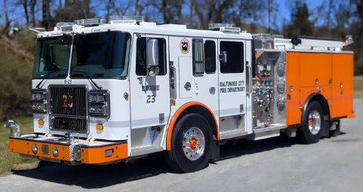
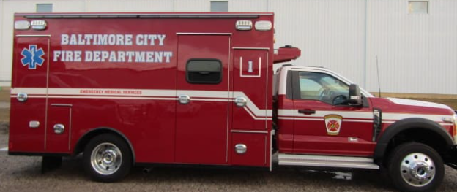
Are there viable/sustainable alternatives to the emergency department ?
Baltimore City Fire Department
Urban, fire based response
BLS and ALS
160,000 EMS responses
30 FT ambulances + 4 peak units

Slide 8
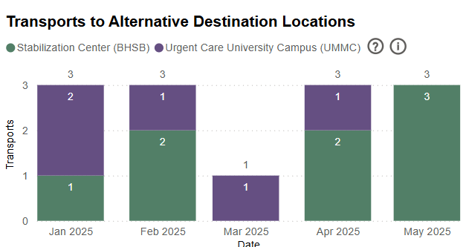
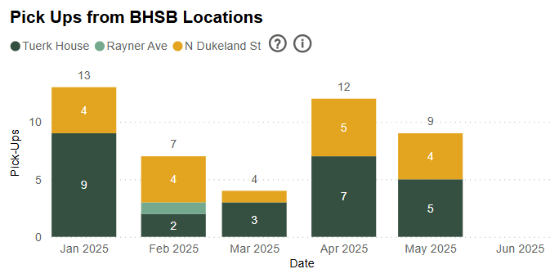

Alternative destinations represent low volume of overall transports
Difficulties in screening patients and changing culture
Impact upon daily EMS operations minimal

Slide 9
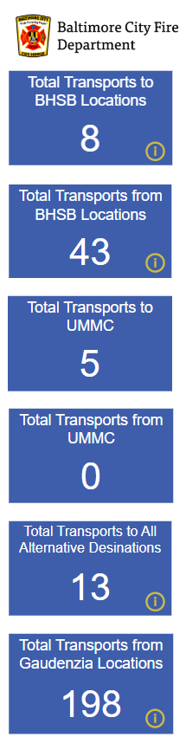
Alternative destinations are feasible
Not the totality of the solution
Training/education/availability keys to success
Low utilization by medic personnel

Slide 10

What about “diverting” calls away from EMS/911 ?
Low Acuity
Behavioral Health/Crisis

Slide 11
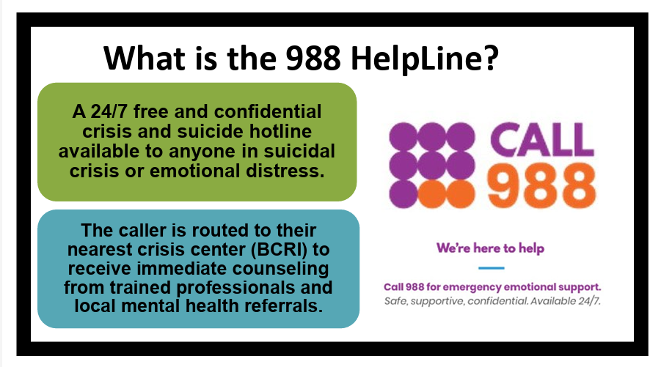
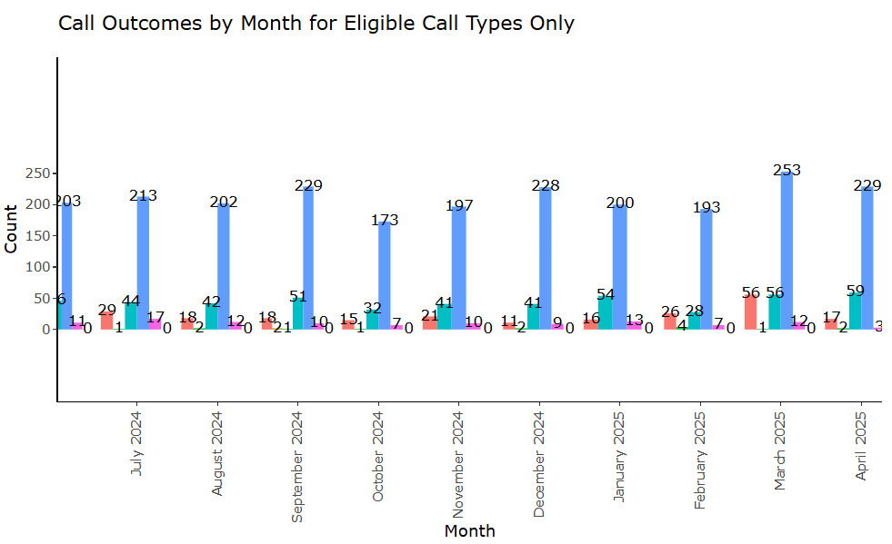
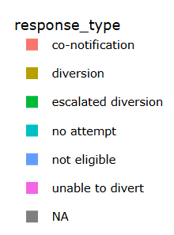
Behavioral Health Diversion 911-988

Slide 12
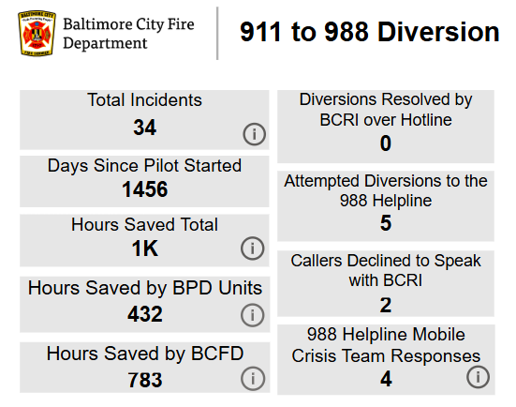
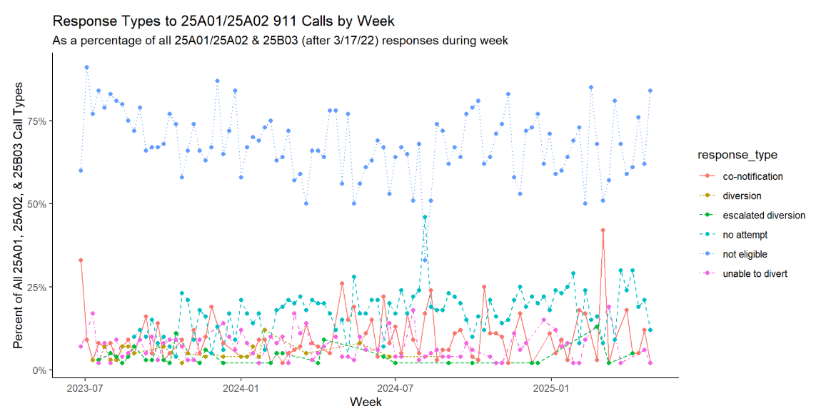
Behavioral Health Diversion 911→988
01/2025-06/2025

Slide 13
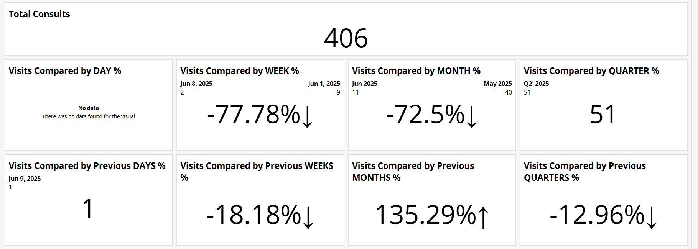
What about bringing the physicians to the scene of the emergency- virtually?
April 1, 2024-present

Slide 14
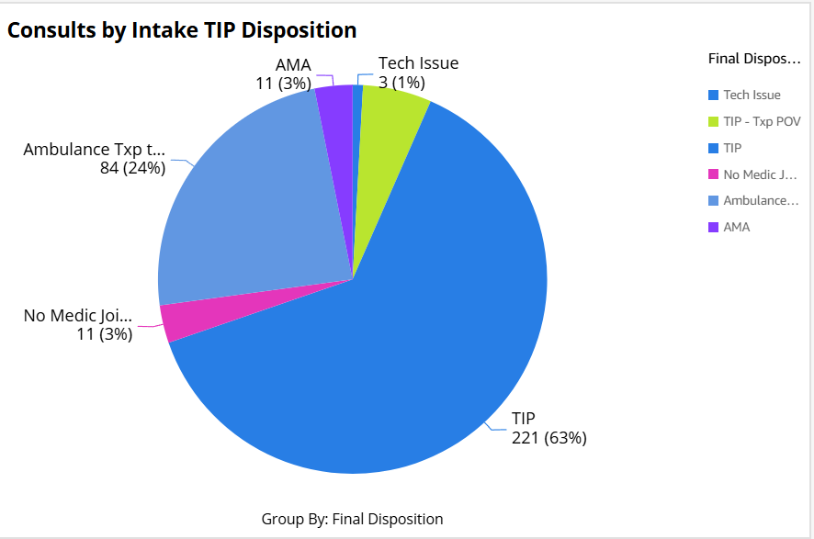
911 Telemedicine Diversion
Buy in is essential
Need for broad utilization across EMS/fire
No sentinel events
Timely connection to care
Feasible
Legal considerations

Slide 15
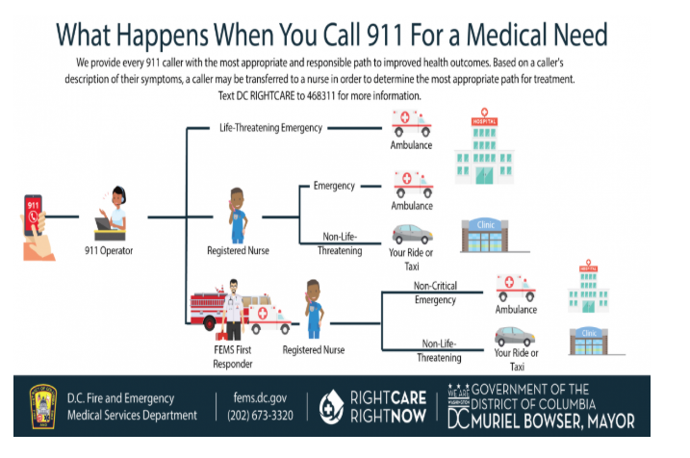
What about medically informed dispatch?

Slide 16

What are Reasons to Consider NTL / Medically Informed Dispatch ?
BENEFITS
-Reduction in call volume
-Improved resource utilization
-Cost savings
-Improved coordination between service lines
-Reduced ED utilization
CHALLENGES
-Resource intensive
-Broad based collaboration
-Long start up time
-Internal and external training
COMPONENTS:
Sending alpha calls without priority determinants to ECN/emergency care nurse
“Back to 911” provision from field clinicians
Alternative transport modalities (Uber/Lyft)
Network of community based resources/health clinics
Telemedicine

Slide 17



Reengineering your Resources
Kevin Mackey MD, FAEMS
Sacramento Fire Department

Slide 18
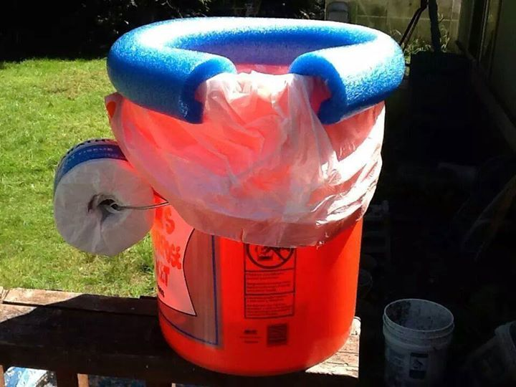

Slide 19
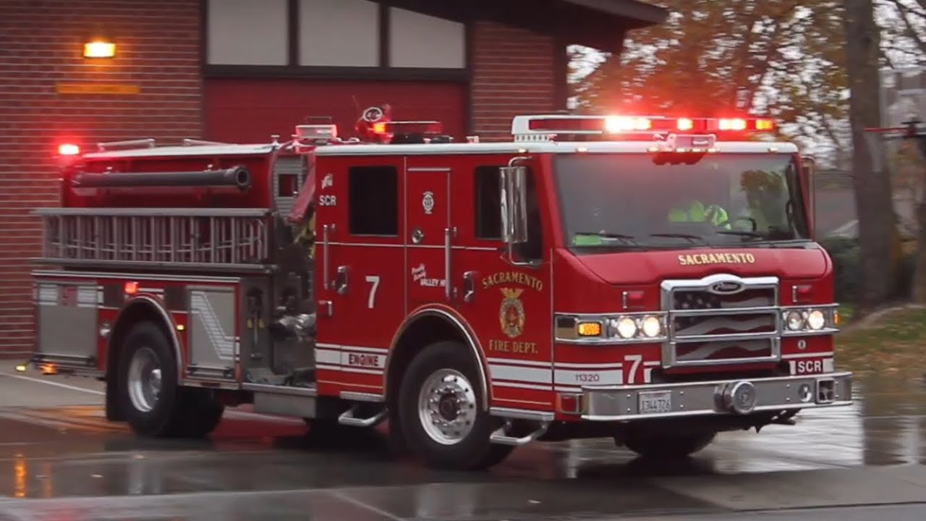
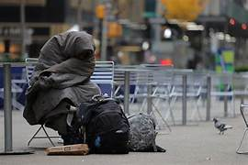
Emergent Problem?
Mental Health Crisis?
Drug Addiction?
Alcoholism?
Unsheltered?

Slide 20

Notes:
Maybe it’s the paramedic, the paramedic’s partner, what’s in the bag, or the vehicle itself.

Slide 21
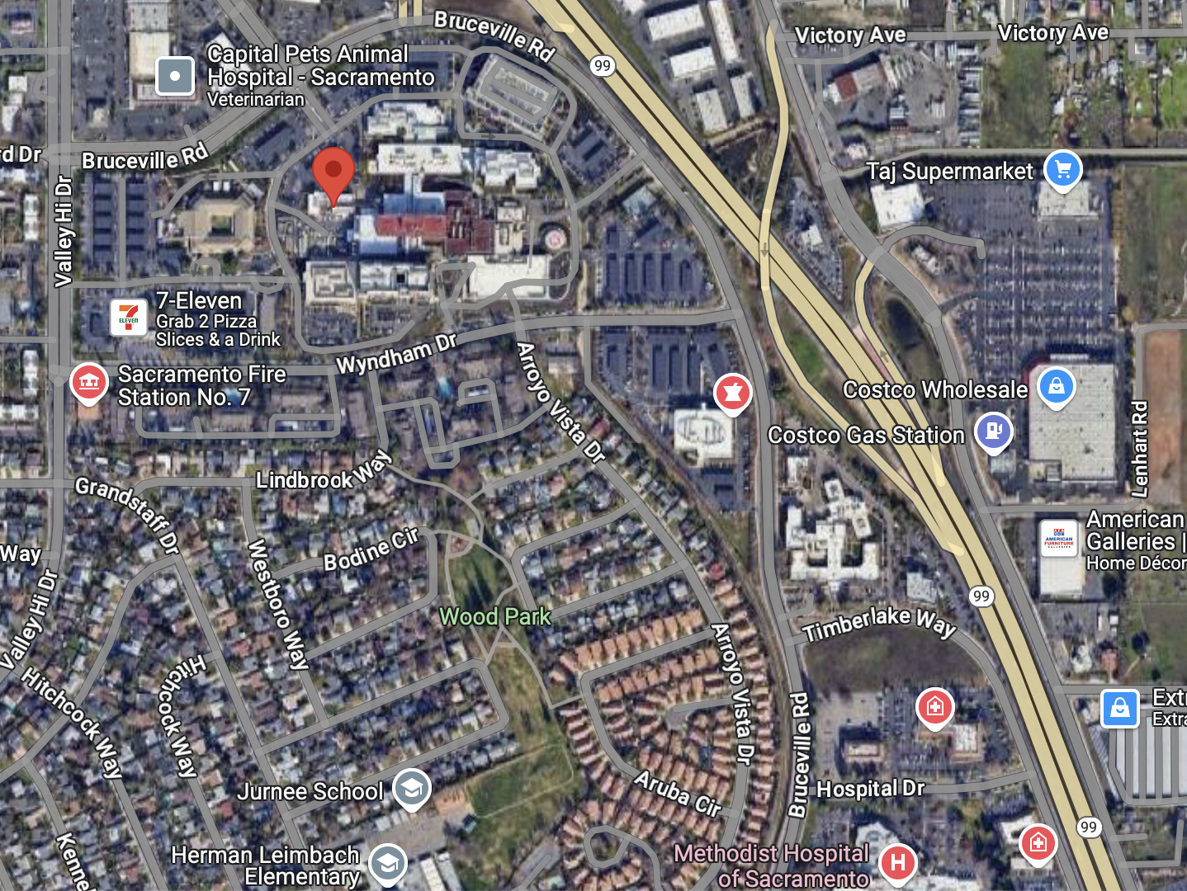

Slide 23
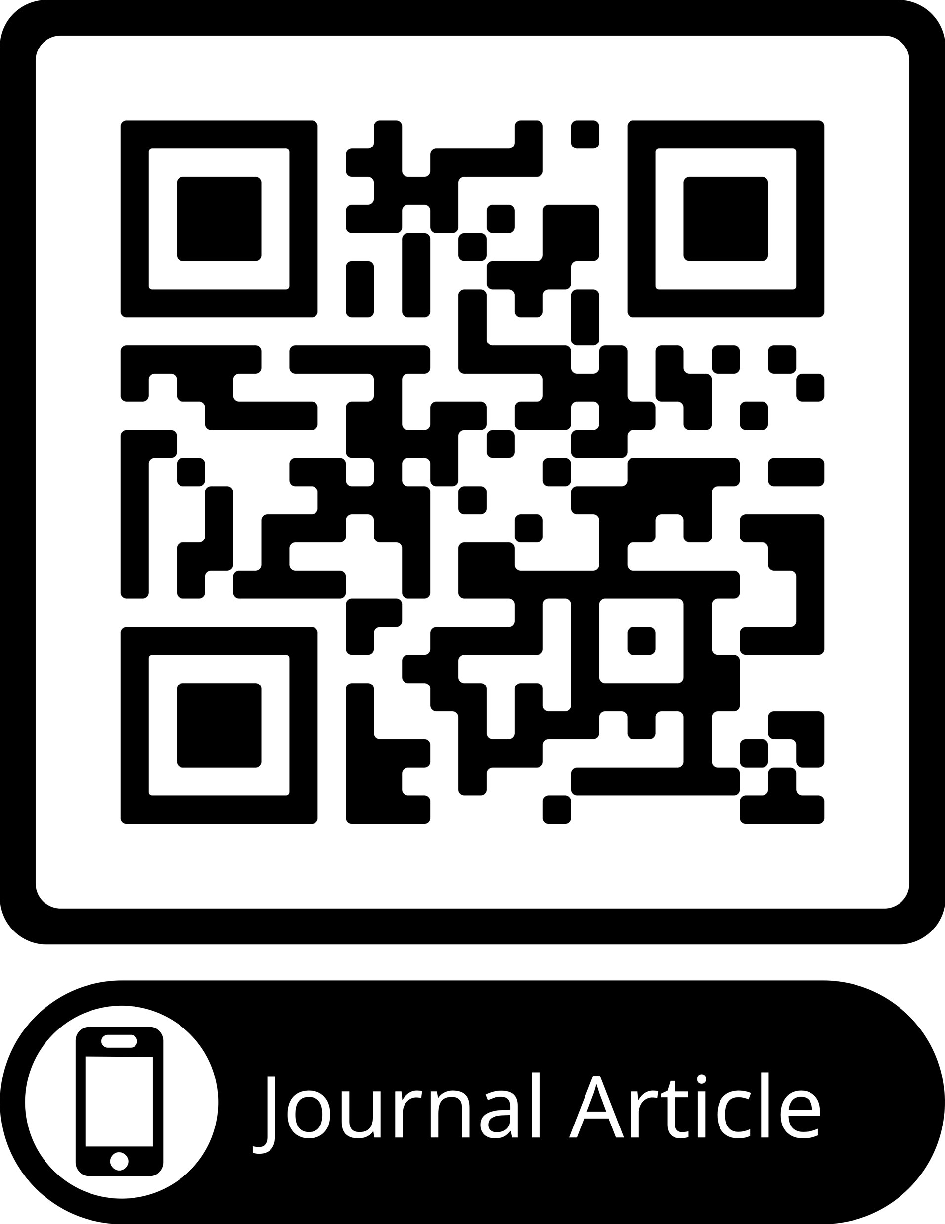
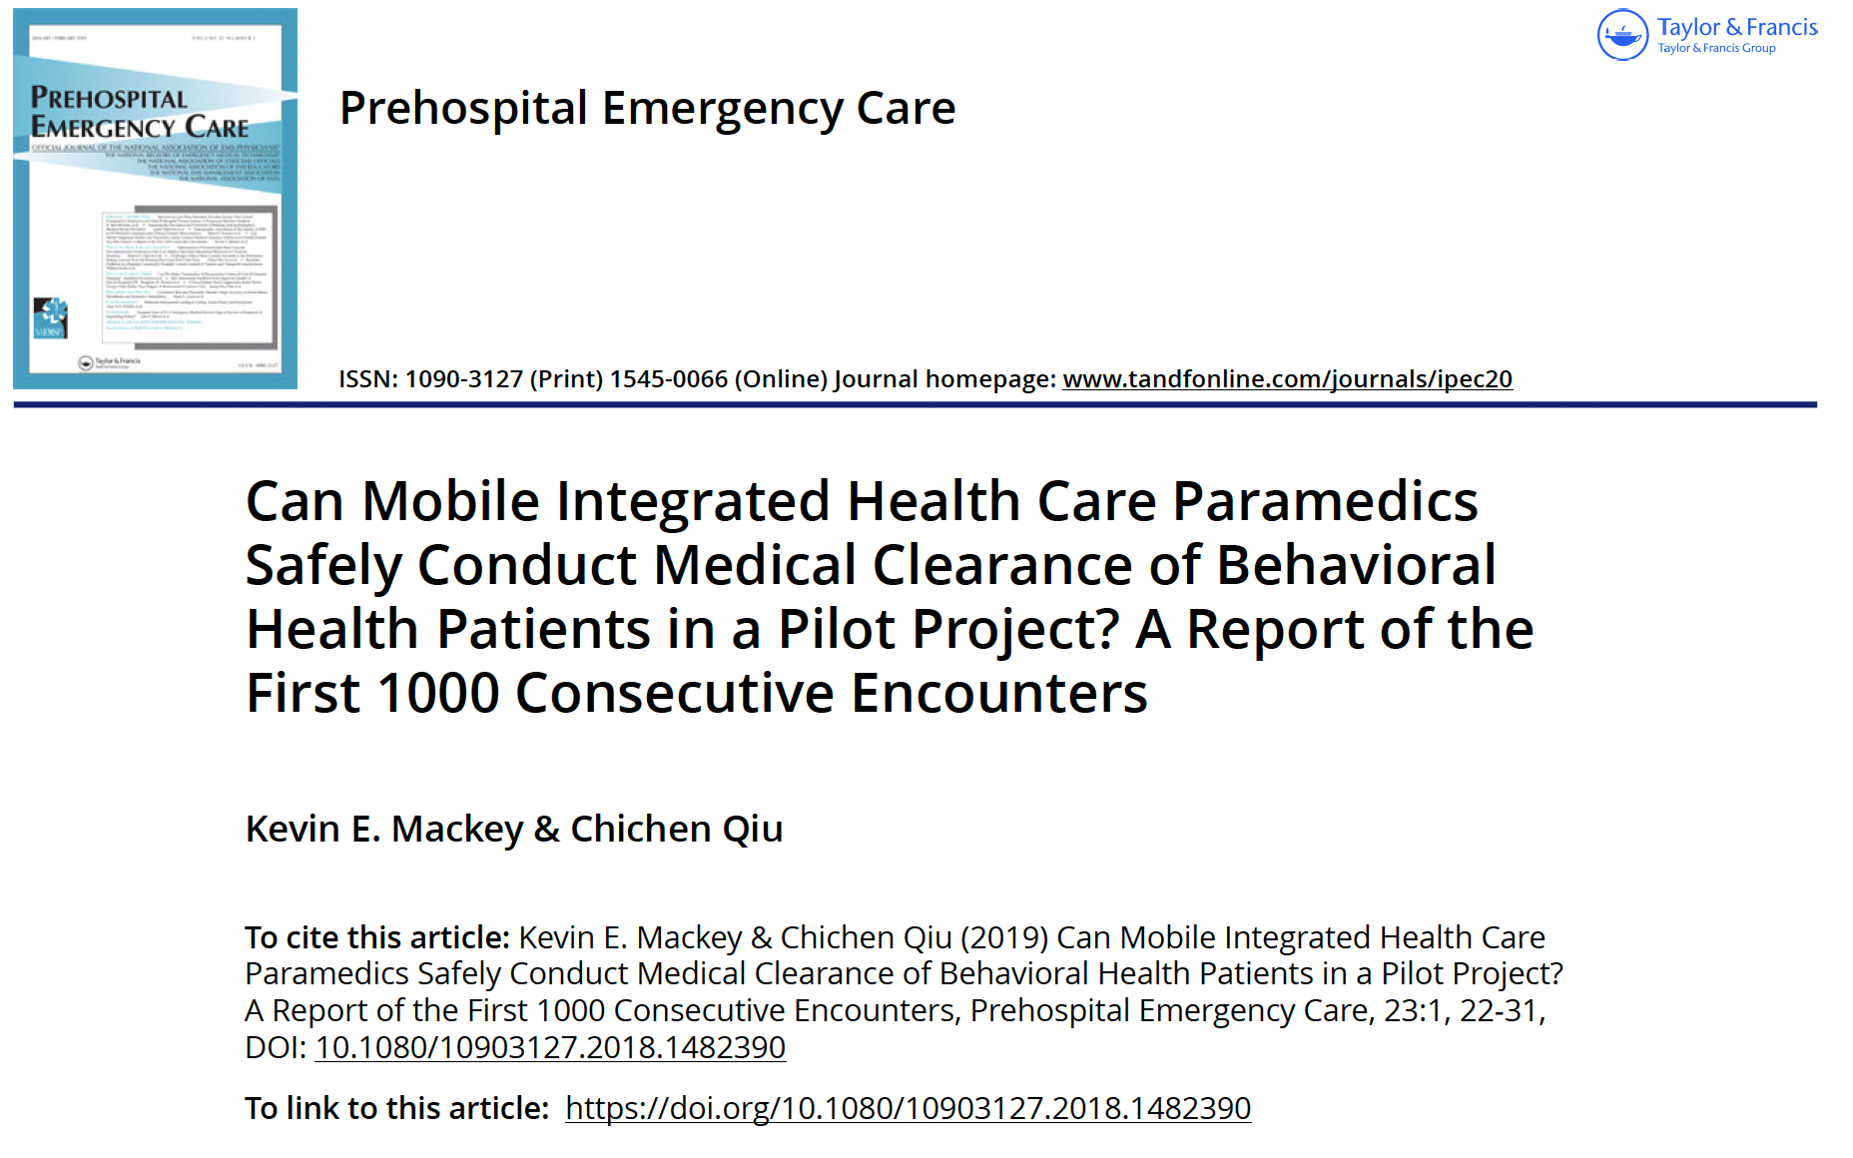

Slide 24
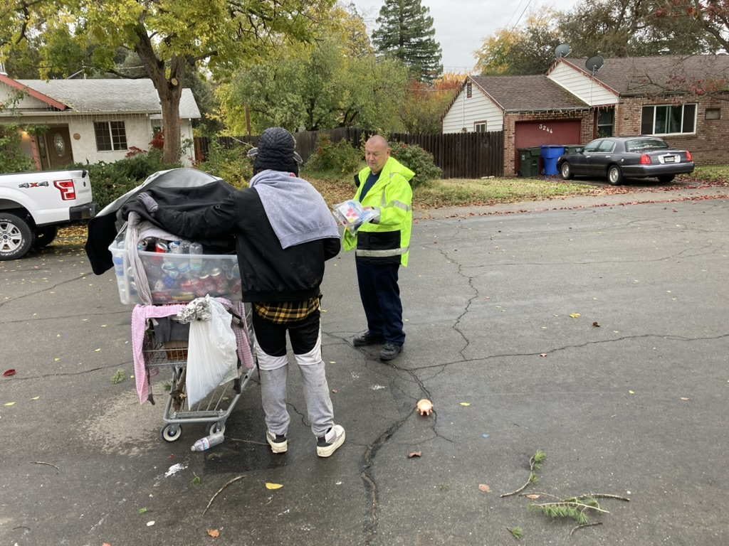
STREET OVERDOSE
RESPONSE TEAM

Slide 25

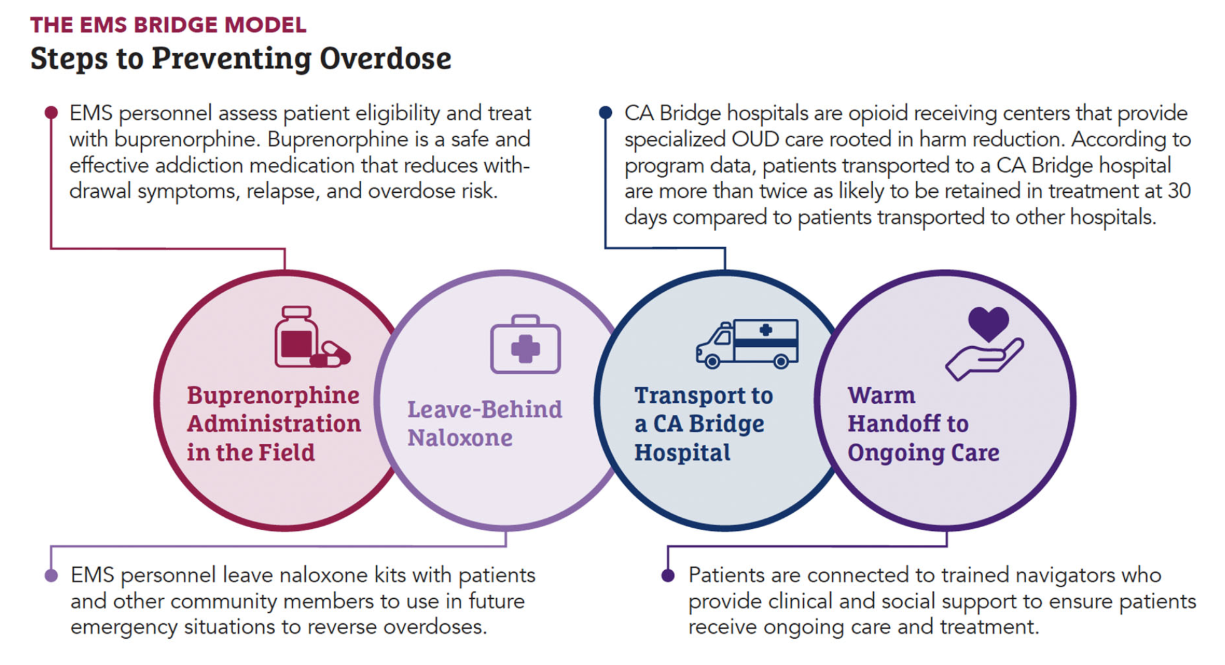
https://bridgetotreatment.org/addiction-treatment/ca-bridge/

Slide 26
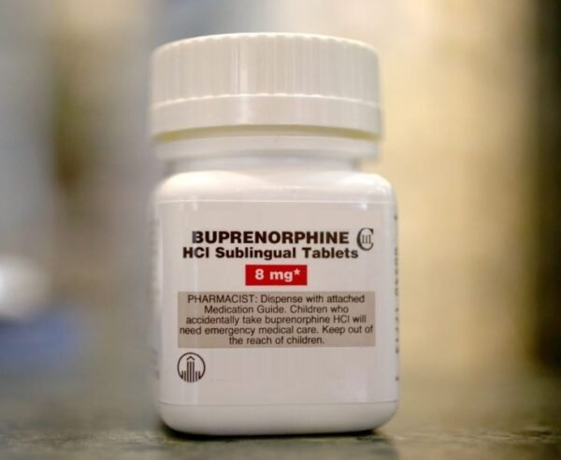

Slide 27
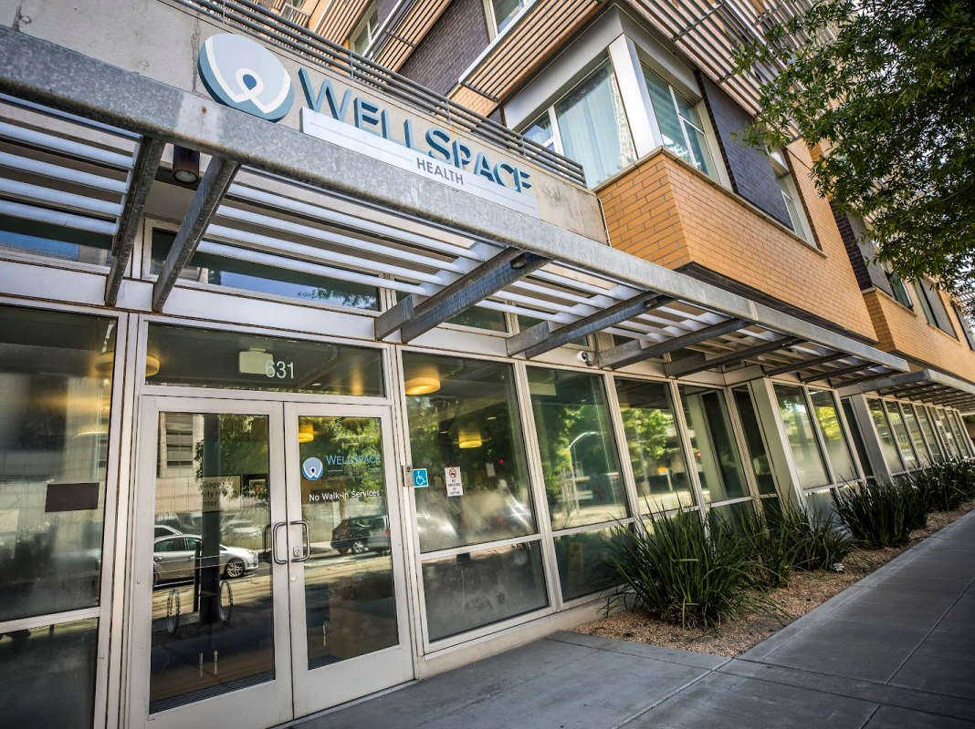

Slide 28
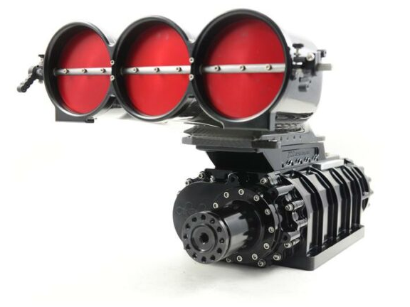
Adding a Supercharger

Slide 29
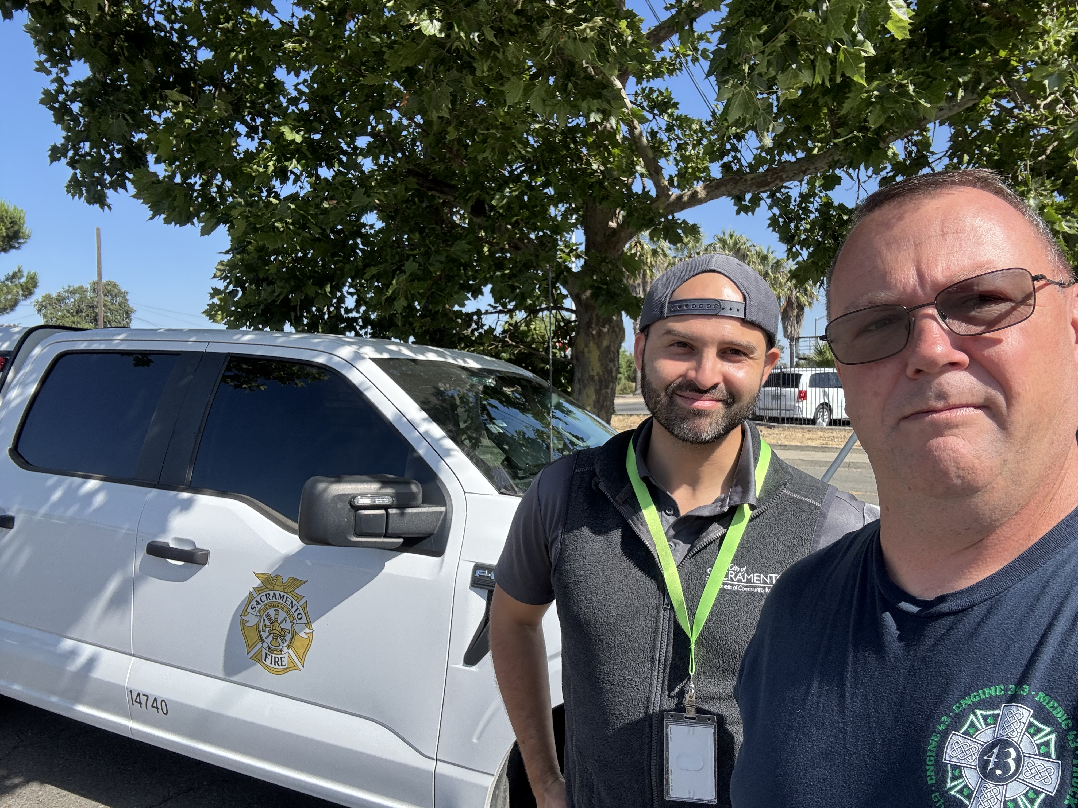
SORT Team: June 12, 2025

Slide 30


Slide 31
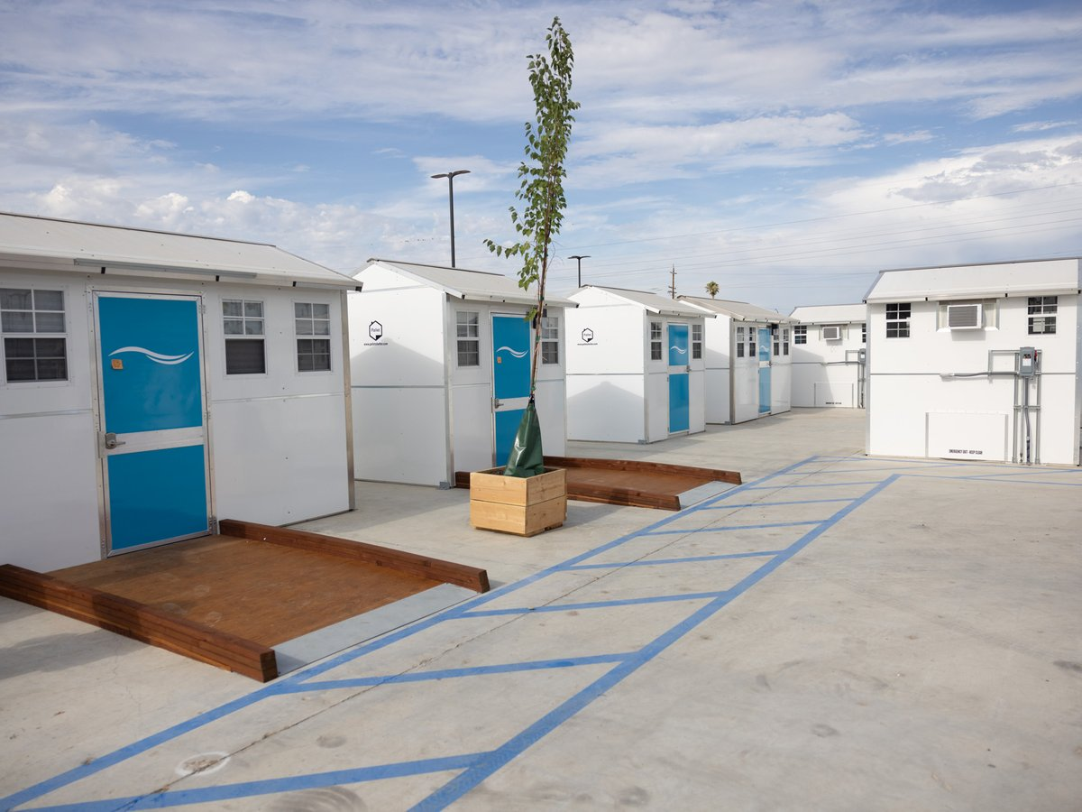

Slide 32
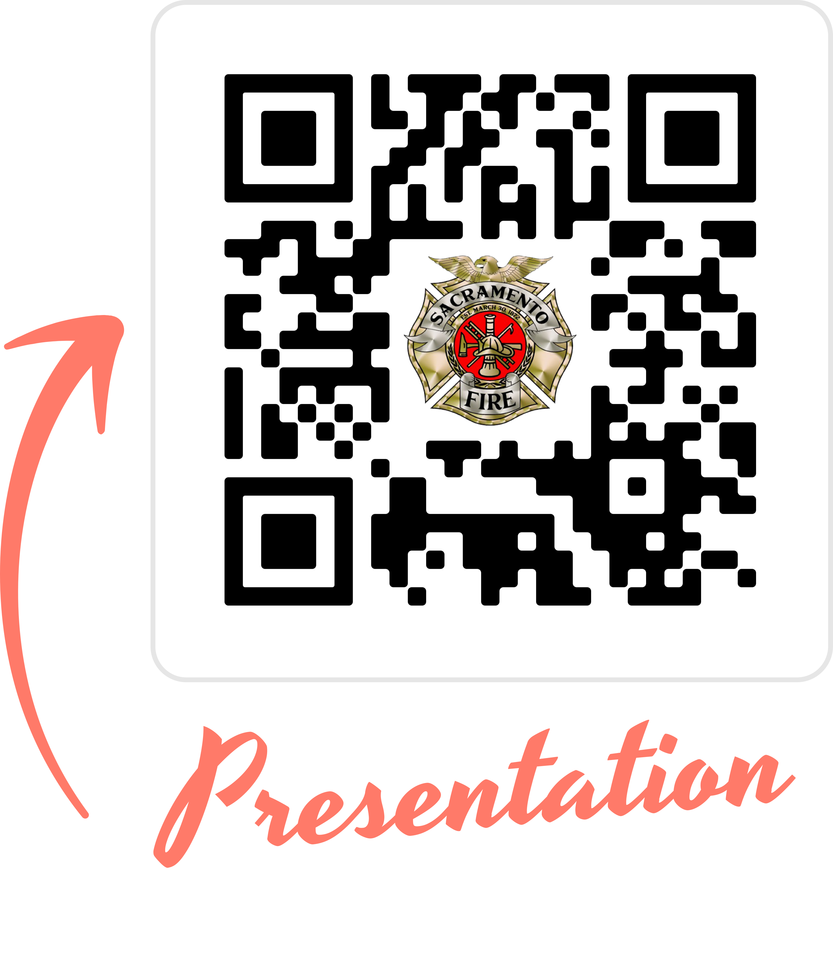
Drug
Addiction?
Buprenorphine
Leave Behind Naloxone
Alcohol
Addiction?
Offer Wellspace
Mental Health Crisis?
SMART Clear
Direct to MHTC
Offer Wellspace
Unsheltered?
Shelter Navigation

Slide 33

BLS CVA Response
Timothy Satty, MD

Slide 34
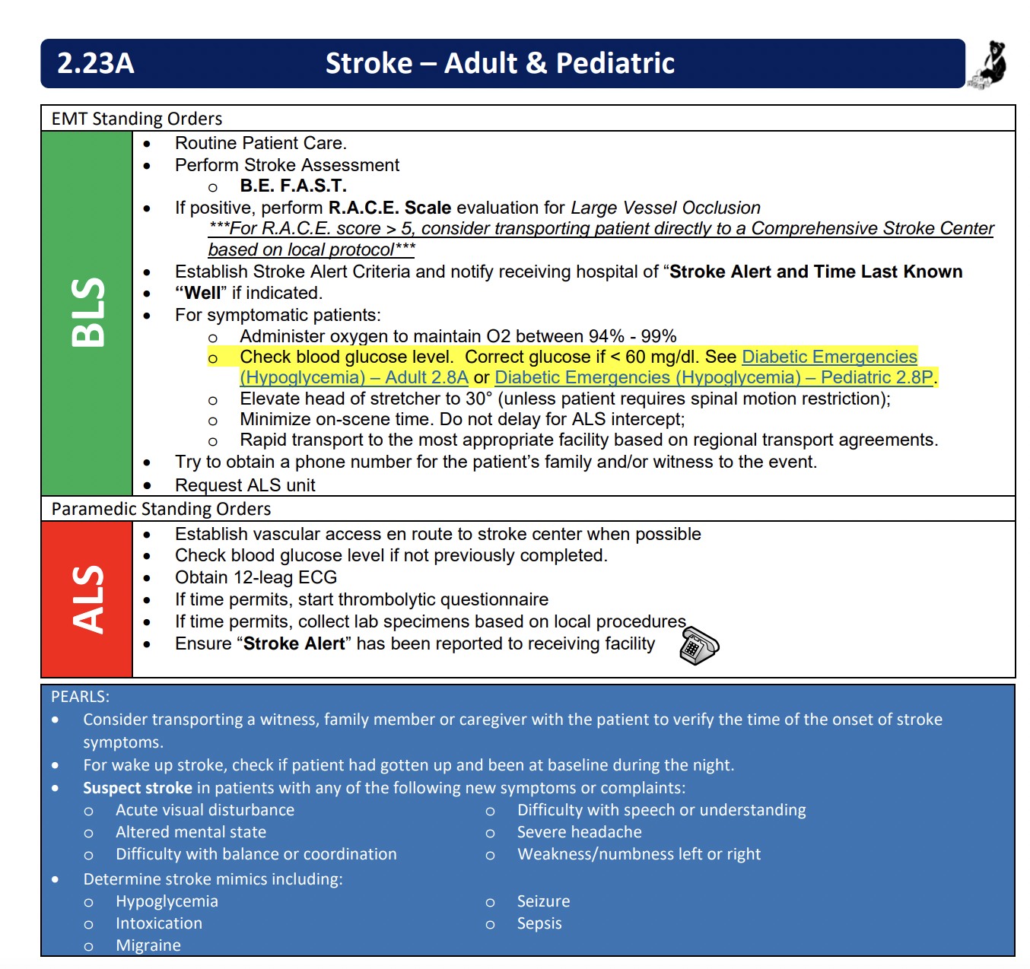

Slide 35

Anyone Have a Spare Paramedic
10-15 BLS units
4 ALS units at full staffing
  Routinely down to 2

Slide 36
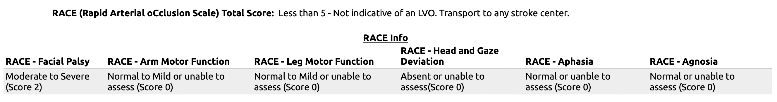

Slide 37
Race Scale
Notes:
Includes all patients who were assigned RACE scores from 8/2021 to 6/2022

Slide 38
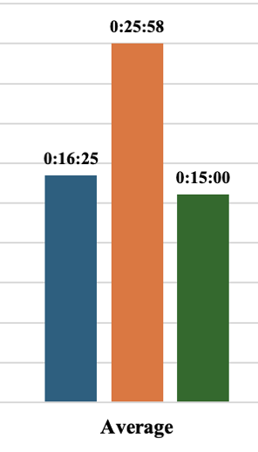
Stroke Patient Scene Times
Average
Single Unit: 16:25
Dual Unit: 25:58
<15 minutes
Single unit: 39.28%
Dual unit: 8.11%

Slide 39
Should we change the response to BLS only?
Appears to be similar levels of accuracy in applying LVO prediction score
Faster on scene time
Protects limited ALS resources

Slide 40



Lights Out Responses
Mecklenburg EMS System, North Carolina
Doug Swanson, MD, FAEMS, FAMPA, FACEP
Medical Director
OUR PATIENTS
OUR PEOPLE
OUR STEWARDSHIP

Slide 41
Why
Better align responses with patient needs
  Protect response to the most critical patients
Better align resources with patient needs
  ALS, BLS, First Responder
Improve provider safety
  Improve public safety
Enhance flexibility for system dispatcher
Decrease overall first responder volume
Caveat: no adverse impact to patient outcomes

Slide 42
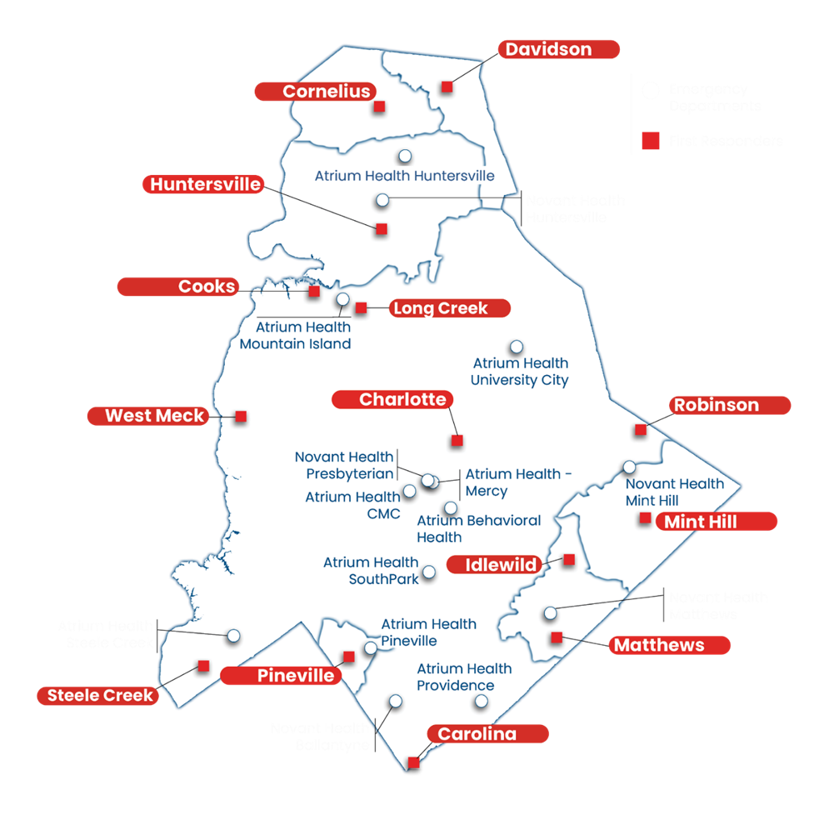
System Overview
1.1 million residents
546 square miles
160,000 responses
114,000 transports
14 First Responder Agencies
15 Emergency Departments
System Status Management BLS & ALS ambulances

Slide 43

Response Matrix
Delta/Echo (10:59)
  Immediate dispatch
  L&S – Medic & Fire
Charlie (15:00)
  Immediate dispatch
  L&S discretion of crew chief per CAD notes
  Medic only / Meidc & Fire
Bravo (30:00)
  Immediate to delayed dispatch
  Non-L&S
  Medic only / Medic & Fire
  Simultaneous dispatch
Alpha (60:00)
  Immediate to delayed dispatch
  Non-L&S
  Medic only
Each MPDS Sub-determinant base on % P1 transport and % of PLSI

Slide 44

Charlie
Crew Upgrades
3 – 10% crew-initiated upgrades since launch
Upgrade outcomes
  P1 (12%)
  P2 (19%)
  P3 (50%)
  Refusal (16%)
  DOA/Pronounced 2%
  Care transfer (1%)

Slide 45
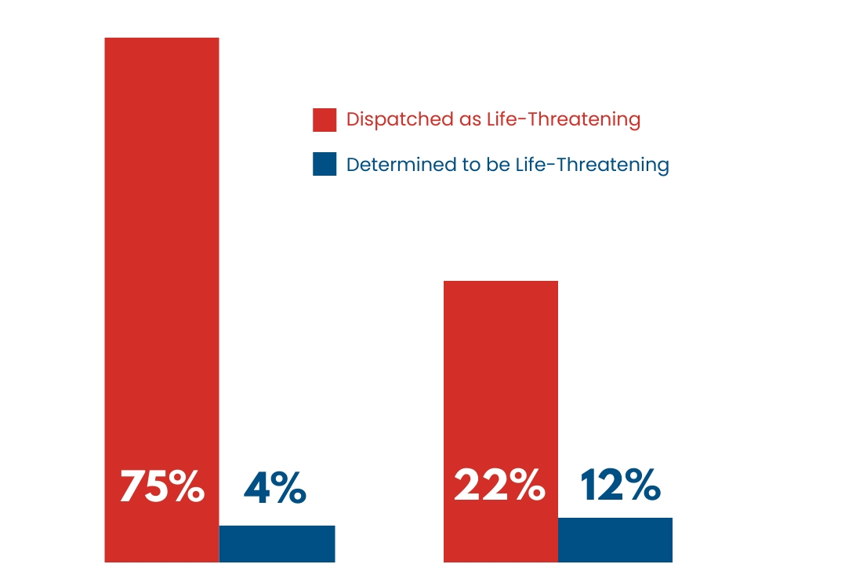
Lights & Siren
Responses vs. Transports
Pre-response configuration, Medic responded to 9,506
911 calls with lights & sirens on average per month vs 3,483 per month post-response configuration; a reduction of 64%
Pre
Post
Data compares Pre-Response Configuration April 2022-March 2023 vs. January 2024 – December 2024

Slide 46
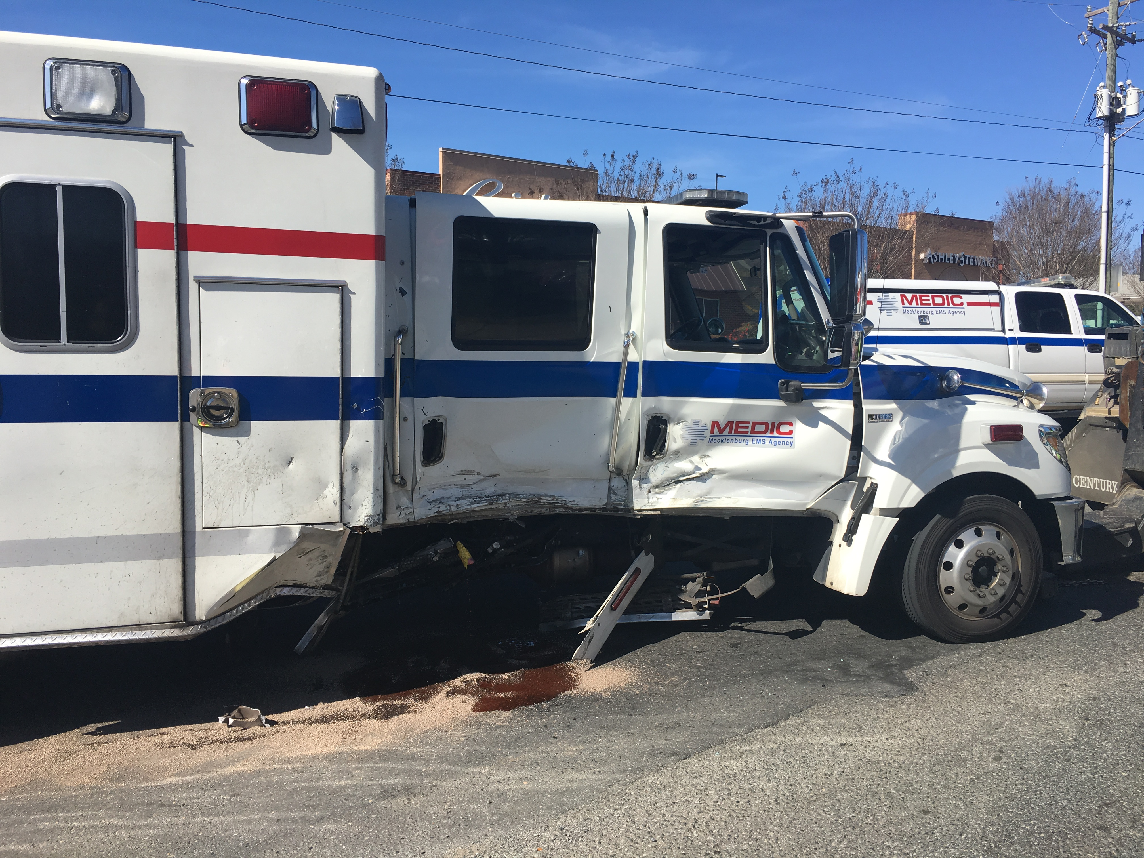
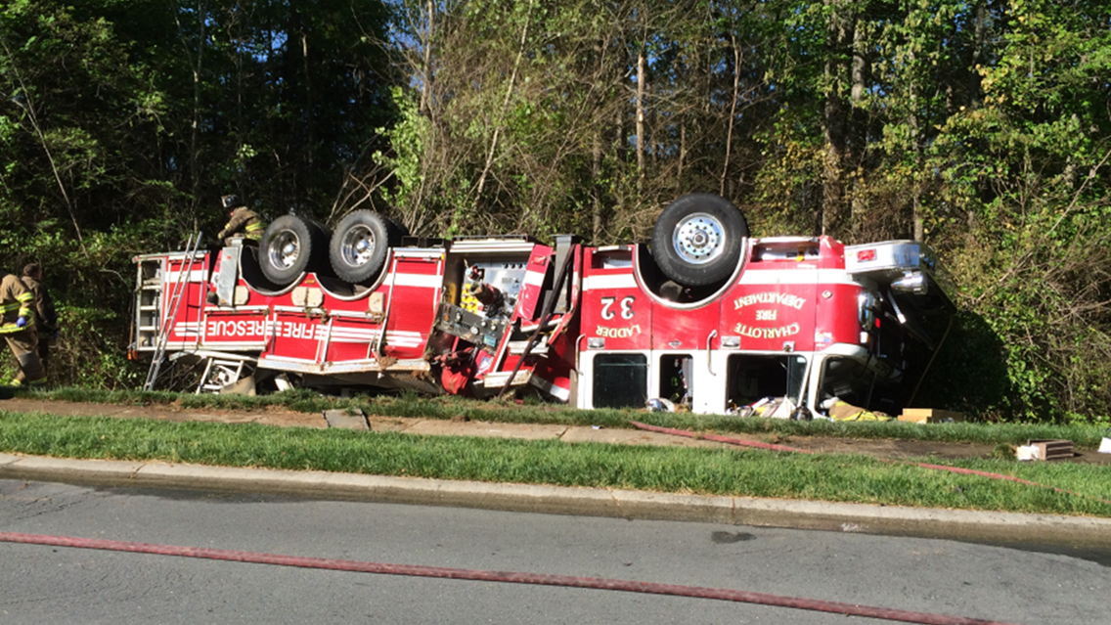
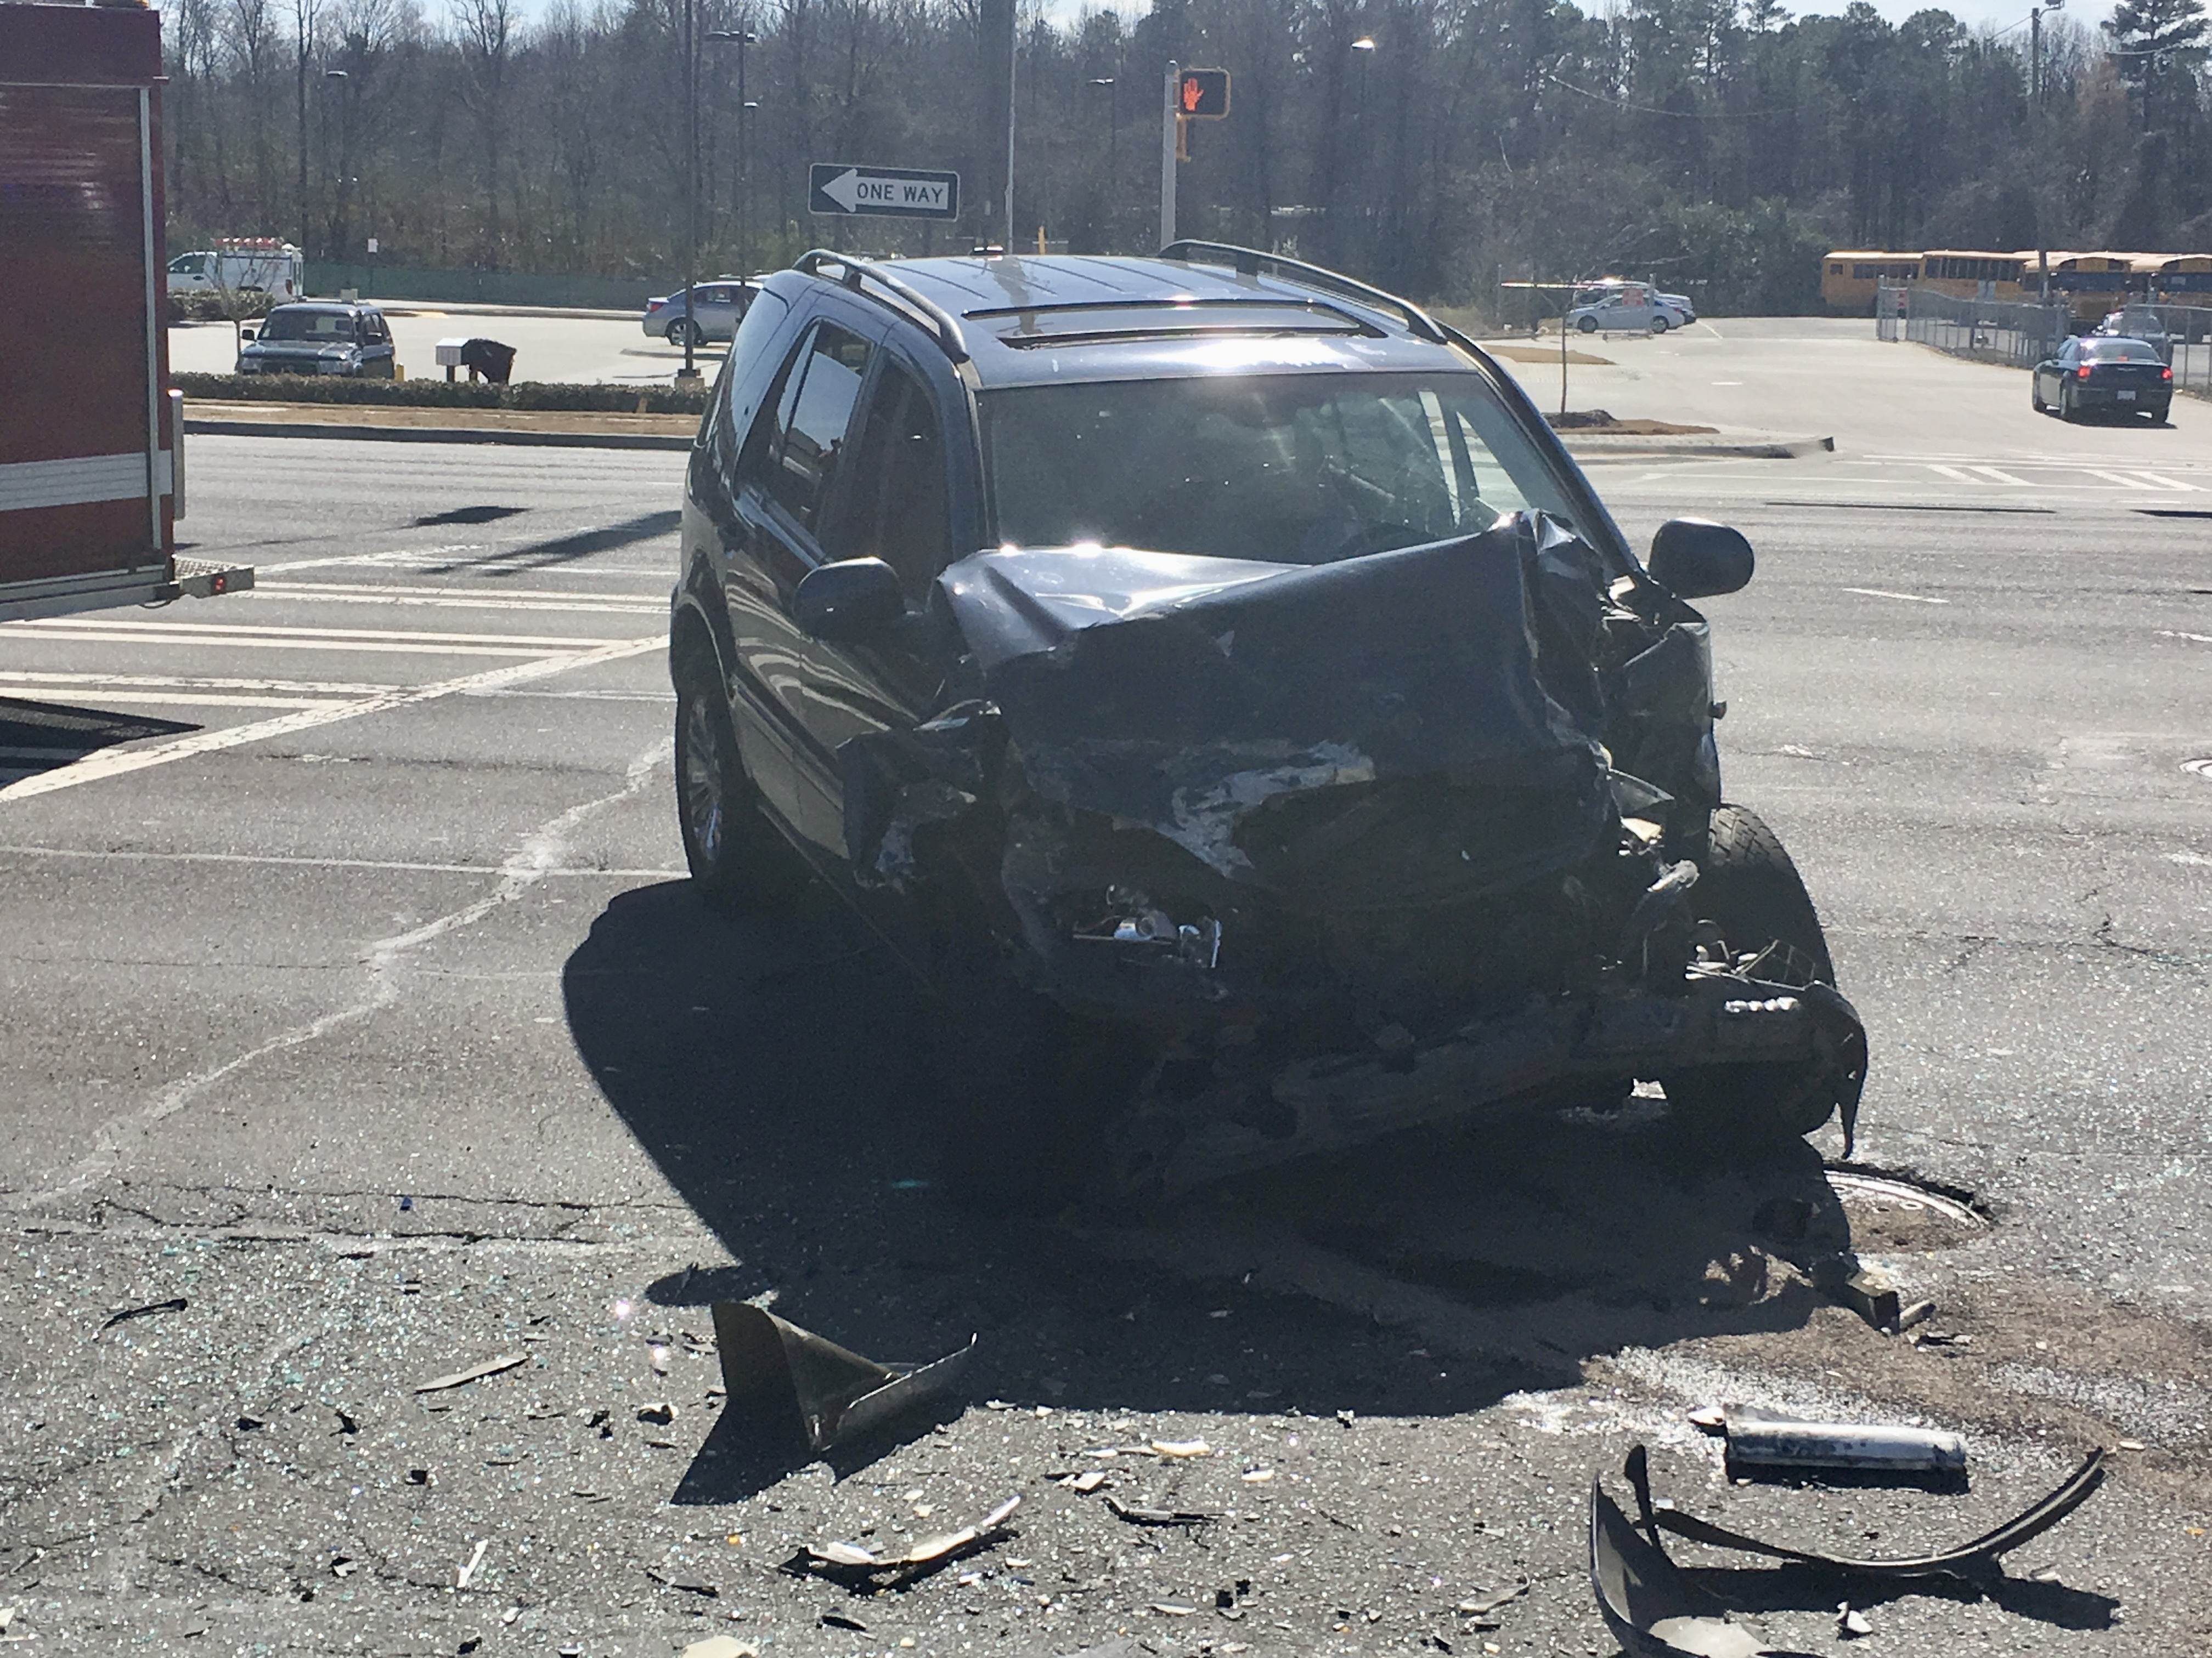
IMPACT: Medic involved traffic accidents
15%
15% reduction in Medic-involved traffic accidents responding with lights and sirens (2.25 average per month pre-response configuration vs. 1.92 per month post-response configuration)
Medic does not have access to first responder data regarding lights & sirens responses or traffic accidents
Data compares Pre-Response Configuration April 2022-March 2023 vs. May 2023-June 2024

Slide 47
IMPACT: First Responder Volume
16%
00:00:24
County fire departments experienced a 16% decrease in the number of EMS 911 calls post response configuration
24 second increase to the amount of time county fire departments were on scene for EMS 911 calls, based on all EMS calls where a fire unit arrived on scene and includes all units on each scene
Data includes April 2022 to March 2023 vs. July 2023 to June 2024
Data includes county first responders only; Medic does not have access to Charlotte Fire Department data

Slide 48
Response Times
Target | Average Response Time |  | Difference
Call Type | May to December 2023 | Calendar Year 2024
P1 (10:59) | 9:19 | 8:44 | - 35 seconds
P2 (15:00) | 14:15 | 14:21 | + 6 seconds
P3 (30:00) | 19:00 | 18:38 | - 22 seconds
Further reduced in 2025 YTD

Slide 49
IMPACT: Cardiac Arrest Survival
CARES 2024 Utstein | Total Cases | Survival to Hospital D/C
 | 109 | 51%
2023 = 43%
CARES 2024 Overall | Total Cases | Survival to Hospital D/C
 | 909 | 16%
2023 = 16%

Slide 50
Low Acuity Responses Resulting in a High Priority Transport
911 calls categorized as non-life threatening that resulted in a high priority response happened 1% of the time after Response Configuration launch
100% physician review – NO ADVERSE PATIENT IMPACT related to response time
POST-RESPONSE CONFIGURATION
Total Transported P1 | 587
Total Low Acuity Calls | 57,616
% Low Acuity That Go P1 | 1%
0.7% if exclude calls w/ RT < 11:00

Slide 51
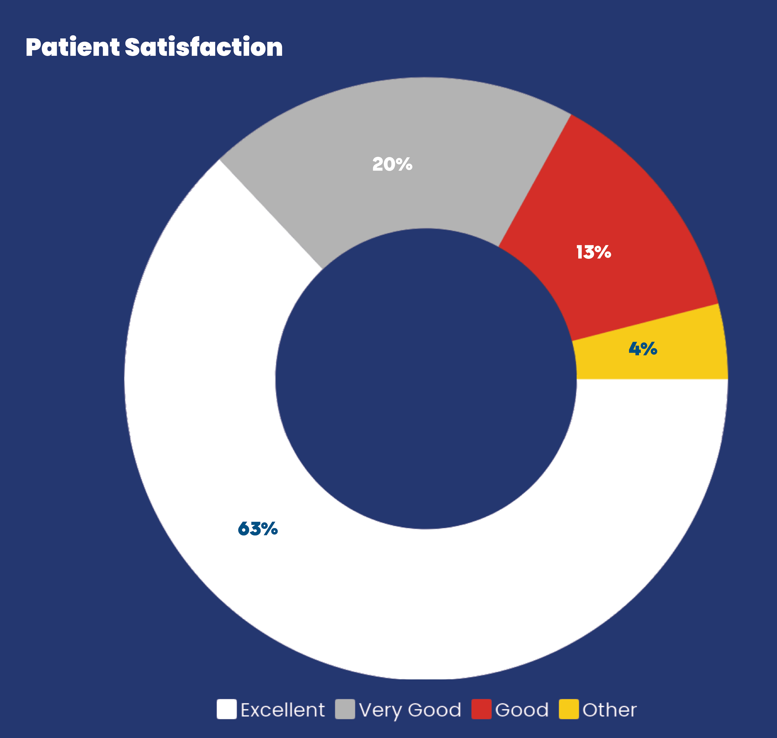
Patient Satisfaction
96% of patients surveyed rated their experience with Medic as excellent, very good or good in FY '24
200 patients surveyed per month by a third-party source

Slide 52
Concerns Voiced
Callers: Response Time
  Mitigated via Response Matrix for controller
First Responders: FROR
  Time on scene
    “Triage Tool” protocol option (“available” on scene)
  Additional 33% of FROR now receiving simultaneous ambulance dispatch

Slide 53
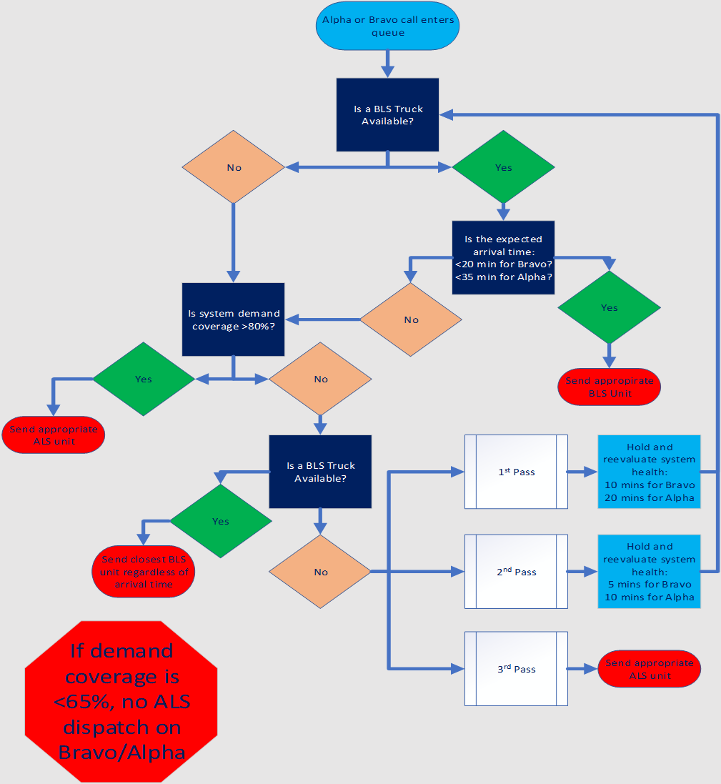
Resource Matrix
Will a BLS truck make it on time?
Is the system status enough for ALS to handle?
  If not, send BLS at any point
When do we reconsider sending ALS to BLS call?

Slide 54
Reduces Lights & Siren Punchline
Safe
No adverse patient impact
Protects responses to sickest patients
Accepted by responders
Improved P1 response performance
Decreased concerns from callers with callback on low acuity calls

Slide 55
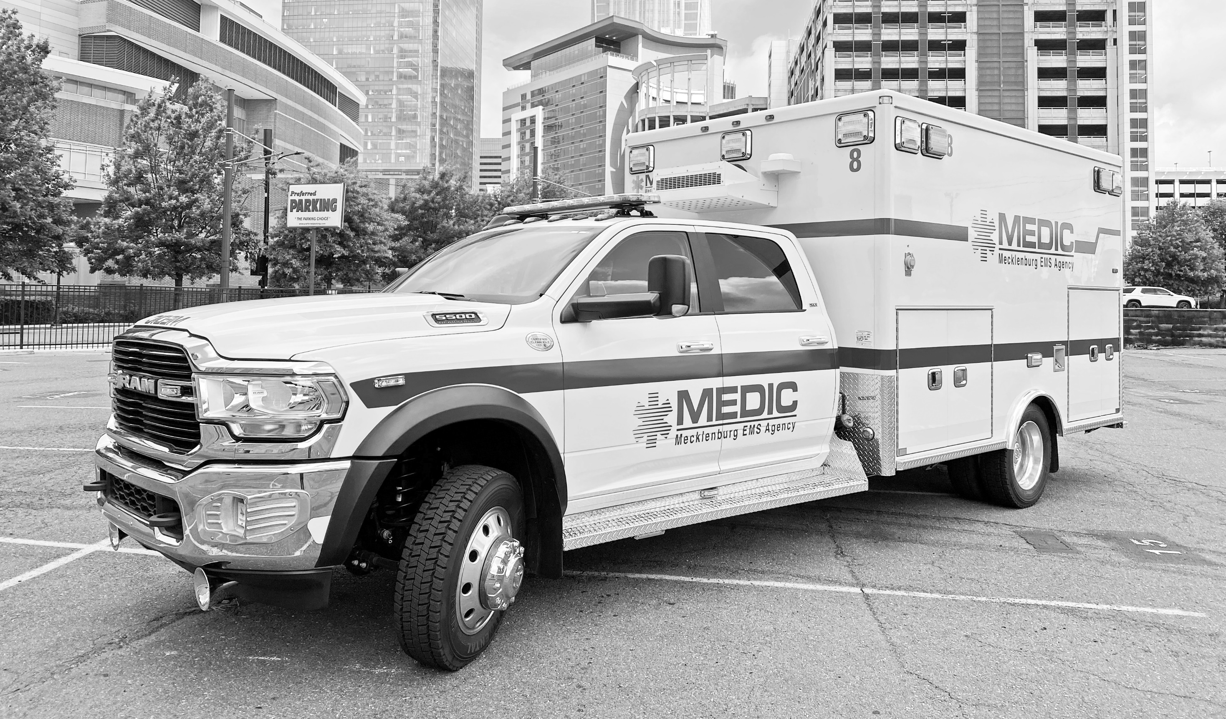
Thank You

Slide 56
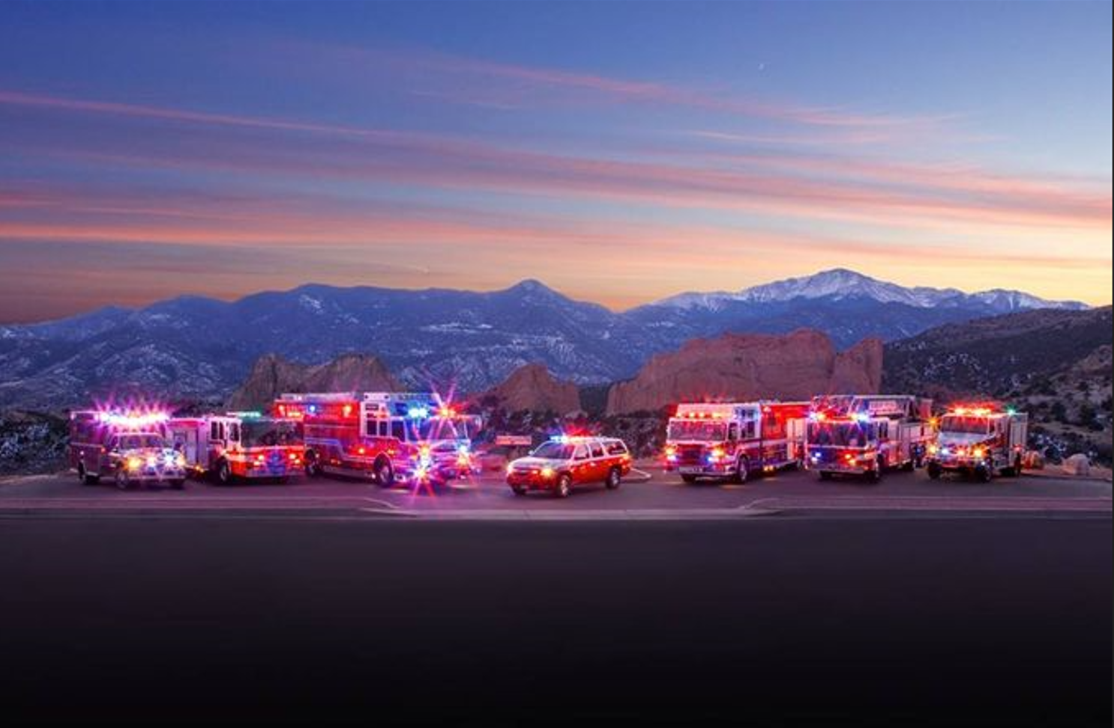

Colorado Springs
Tiered Timing Response
Stein Bronsky, MD
June 12, 2025
Gathering of the Eagles

Slide 57


System
Overview
2024
Population: 510,000
Square Miles: 195.8 mi
Medical Alarms only: 85,000
Notes:
Colorado springs population 2022 506,646 Count higher
Colorado Springs approx. 196 square miles

Slide 58

TIERED RESPONSE APPROACH (Tactics)
Fire and ambulance response
Notes:
Super Utilizer Program (2015/2016)
Originally known as "CARES", this program provided the template for all of our navigation programs. The Super Utilizer Program endeavors to assists frequent users of the 9-1-1 system and the emergency departments (six visits to the ED or six 9-1-1 calls within a 6-month period) in Colorado Springs with their physical, medical and behavioral health needs through outreach, assessment, connection to community resources and care navigation. Referred patients are offered the opportunity to participate in a voluntary intervention designed to find resources and address barriers to healthcare access; this intervention can last for up to 12 months. Commonly identified barriers include lack of adequate housing, food, transportation options, primary care physicians (PCPs), medical specialists, insurance, and behavioral health treatment. The CARES team consists of intake providers, medical navigators, and behavioral health clinicians. The navigation teams are designed to provide integrated intensive interventions to members who consent to treatment. This allows community resource providers to keep vulnerable populations healthy rather than only providing reactive emergency services.
Homeless Outreach Program (HOP) 2020
In August 2019, CPH launched a limited pilot of the Homeless Outreach Program (HOP), which provides targeted, intensive outreach to high needs utilizers in downtown Colorado Springs. HOP operates in collaboration with CARES, the Colorado Springs Police Department's (CSPD) Homeless Outreach Team (HOT) and Downtown Area Response Team (DART), the City of Colorado Springs Homelessness Prevention & Response Coordinator, Homeward Pikes Peak, The Place, and Coordinated Entry through Pikes Peak Community Health Partnership.
HOP conducts intensive outreach work with individuals experiencing homelessness who are vulnerable and exhibit high-acuity behaviors in the downtown Colorado Springs area. Through rapport building, needs identification, and medical and behavioral health navigation, with the addition of housing assessment solicitation/completion and behavior modification, HOP is designed to increase access to healthcare and improve quality of life for targeted individuals. Although initially a pilot, HOP was expanded to full program status in 2020.
Since inception, the program has proactively adapted to the changing needs of the community. During the height of the pandemic, HOP provided case management at the homeless isolation shelter, provided Covid testing for the homeless throughout the community, provided vaccines on the trails and in the camps and is now assisting City Hope with its high acuity, vulnerable clients. In 2022, HOP partnered with Municipal Court to establish a consistent, three day a week presence outside the courtroom to provide resources to the homeless community. More recently, HOP began a small pilot project with the public defenders office to assist those who will benefit from the intensive navigation offered through the Homeless Outreach Program. During the week you will find this team walking the downtown corridor and engaging with the homeless population in the parks, shelters, trails, and homeless camps offering resources and navigation wherever they go.
Aging in Place Program (APP)
In January 2019, we began a small pilot to provide support to elders struggling to age in place in their homes. By July of that year, the Next50 Initiative partnered with us through a grant to support and expand this program. The genius of the Aging in Place Program is that it maximizes the first responder's role, as they are often first to recognize when a senior citizen is struggling to age in place. For instance, CSFD often receives 9-1-1 calls for "lift assist," indicating that someone has fallen in their home and cannot get up. While in the home assisting the elder, first responders may observe home and living conditions that indicate the elder is in need of home care, nursing care, or other community-based support and services. The Aging in Place Program (APP) offers a way for CSFD to immediately begin to connect elders and their families with resources and support. Through CSFD referrals to APP, CPH plays an important role in leveraging first responder and co-responder roles to quickly identify elders in need, assist them in connecting to resources, teach them the necessary skills to continue appropriate self-care, and observe their success. Elders are then graduated back into independence to age gracefully and successfully or assisted in finding proper placement if they are unable to age safely in their home.
Transition Assistance Program (TAP) 2020
The Transition Assistance Program (TAP) provides intensive community navigation services for inmates of the El Paso County Criminal Justice Center (CJC) identified as high risk/high need. This category of vulnerable individuals includes inmates reporting chemical dependence, mental illness, those in need of chronic medical care, those who are transient/homeless or are high utilizers of jail services.
This program is comprised of two teams, each staffed with a Behavioral Health Clinical Navigator and a Recovery Navigator, who assist community re-entry by creating and managing individualized member treatment plans. Throughout program enrollment, there are ongoing assessments to determine appropriate care, build connection to community providers and resources while simultaneously delivering vital case navigation. This enables vulnerable inmates to receive the resources they need to stay healthy, connect to the community, and decrease recidivism. Through intensive navigation, the TAP program enables members to make lasting connections to needed services, empowers a better quality of life and makes our community a safer, healthier place.
Mobile Response Programs
Community Response Team (CRT) 2014
The CRT program was developed to assist patients suffering from acute behavioral health crisis by employing cross-agency collaboration to integrate behavioral health services into the broader healthcare spectrum. Using the flexibility of emergency services, but with a mindset of healthcare integration, teams identify behavioral health needs and work to connect patients to a larger collaborative healthcare team. CRT engages patients that have extensive and often complicated diagnoses, who encounter significant medical, social, and behavioral health barriers posing potential risk to themselves or others and provides a progressive alternative to a strictly law enforcement response. Designed to respond to behavioral health crisis calls from 9-1-1 and the state crisis line, the CRT team decreases the time between a patient's call for help and their receipt of definitive services. This eliminates prolonged and often detrimental emergency room stays where little to no behavioral health intervention or treatment is performed.
Alternate Response Team (ART) 2022
The ART team is expanding the scope of collaborative response in our community by responding to low acuity 9-1-1 calls while the CRT units are responding to higher levels of mental health crisis.
The Alternate Response Team (ART) consisting of a Crisis Navigator and an EMT is responding to appropriate low acuity call types such as: medical check the welfare, mental health check the welfare and unwanted person calls. The ART team assists and navigates the individual of concern into the correct resources and/or disposition of care.
Both ART and CRT units are able to make referrals to existing CSFD Community and Public Health navigation programs as appropriate. For individuals who are homeless, the ART team can consult with our Homeless Outreach Program who can in turn reach out to the CSPD HOT or DART teams as necessary. Thus, the addition of the ART teams expands the coordination and collaboration occurring across our city with community service providers, CSPD and CSFD.
Through the recent addition of the two Alternate Response Teams, members of our community experiencing a crisis receive appropriate access to the right care in an expedient fashion. At the same time, CSPD Patrol officers are able to respond to call types that are more appropriate for their mission and their training. As a result of this addition of ART to a continuum of crisis response in our city, our citizens in need receive definitive care in a timely manner while our CSPD patrol officers are more readily available to respond to the law enforcement concerns for which they are trained. The end result is that all citizens across our community benefit from increased 9-1-1 response availability, a healthier social environment and a healthier citizen population.
CMED 2022
The Community Medicine Response (CMED) teams were created to bridge the gap between those alarms that are considered time sensitive life threats and non-time sensitive threats. CMED alarm types were carved out for those alarm types that two personnel could handle and responses could hold in a pending status for a period. These responses range from Omega to Delta level responses.
Ambulance only response types
Lower acuity alarm types where BLS responses are appropriate for the majority of the alarm types.

Slide 59
TIERED RESPONSE APPROACH (Tactics)
Ambulance only responses
Fire and ambulance response
Notes:
Super Utilizer Program (2015/2016)
Originally known as "CARES", this program provided the template for all of our navigation programs. The Super Utilizer Program endeavors to assists frequent users of the 9-1-1 system and the emergency departments (six visits to the ED or six 9-1-1 calls within a 6-month period) in Colorado Springs with their physical, medical and behavioral health needs through outreach, assessment, connection to community resources and care navigation. Referred patients are offered the opportunity to participate in a voluntary intervention designed to find resources and address barriers to healthcare access; this intervention can last for up to 12 months. Commonly identified barriers include lack of adequate housing, food, transportation options, primary care physicians (PCPs), medical specialists, insurance, and behavioral health treatment. The CARES team consists of intake providers, medical navigators, and behavioral health clinicians. The navigation teams are designed to provide integrated intensive interventions to members who consent to treatment. This allows community resource providers to keep vulnerable populations healthy rather than only providing reactive emergency services.
Homeless Outreach Program (HOP) 2020
In August 2019, CPH launched a limited pilot of the Homeless Outreach Program (HOP), which provides targeted, intensive outreach to high needs utilizers in downtown Colorado Springs. HOP operates in collaboration with CARES, the Colorado Springs Police Department's (CSPD) Homeless Outreach Team (HOT) and Downtown Area Response Team (DART), the City of Colorado Springs Homelessness Prevention & Response Coordinator, Homeward Pikes Peak, The Place, and Coordinated Entry through Pikes Peak Community Health Partnership.
HOP conducts intensive outreach work with individuals experiencing homelessness who are vulnerable and exhibit high-acuity behaviors in the downtown Colorado Springs area. Through rapport building, needs identification, and medical and behavioral health navigation, with the addition of housing assessment solicitation/completion and behavior modification, HOP is designed to increase access to healthcare and improve quality of life for targeted individuals. Although initially a pilot, HOP was expanded to full program status in 2020.
Since inception, the program has proactively adapted to the changing needs of the community. During the height of the pandemic, HOP provided case management at the homeless isolation shelter, provided Covid testing for the homeless throughout the community, provided vaccines on the trails and in the camps and is now assisting City Hope with its high acuity, vulnerable clients. In 2022, HOP partnered with Municipal Court to establish a consistent, three day a week presence outside the courtroom to provide resources to the homeless community. More recently, HOP began a small pilot project with the public defenders office to assist those who will benefit from the intensive navigation offered through the Homeless Outreach Program. During the week you will find this team walking the downtown corridor and engaging with the homeless population in the parks, shelters, trails, and homeless camps offering resources and navigation wherever they go.
Aging in Place Program (APP)
In January 2019, we began a small pilot to provide support to elders struggling to age in place in their homes. By July of that year, the Next50 Initiative partnered with us through a grant to support and expand this program. The genius of the Aging in Place Program is that it maximizes the first responder's role, as they are often first to recognize when a senior citizen is struggling to age in place. For instance, CSFD often receives 9-1-1 calls for "lift assist," indicating that someone has fallen in their home and cannot get up. While in the home assisting the elder, first responders may observe home and living conditions that indicate the elder is in need of home care, nursing care, or other community-based support and services. The Aging in Place Program (APP) offers a way for CSFD to immediately begin to connect elders and their families with resources and support. Through CSFD referrals to APP, CPH plays an important role in leveraging first responder and co-responder roles to quickly identify elders in need, assist them in connecting to resources, teach them the necessary skills to continue appropriate self-care, and observe their success. Elders are then graduated back into independence to age gracefully and successfully or assisted in finding proper placement if they are unable to age safely in their home.
Transition Assistance Program (TAP) 2020
The Transition Assistance Program (TAP) provides intensive community navigation services for inmates of the El Paso County Criminal Justice Center (CJC) identified as high risk/high need. This category of vulnerable individuals includes inmates reporting chemical dependence, mental illness, those in need of chronic medical care, those who are transient/homeless or are high utilizers of jail services.
This program is comprised of two teams, each staffed with a Behavioral Health Clinical Navigator and a Recovery Navigator, who assist community re-entry by creating and managing individualized member treatment plans. Throughout program enrollment, there are ongoing assessments to determine appropriate care, build connection to community providers and resources while simultaneously delivering vital case navigation. This enables vulnerable inmates to receive the resources they need to stay healthy, connect to the community, and decrease recidivism. Through intensive navigation, the TAP program enables members to make lasting connections to needed services, empowers a better quality of life and makes our community a safer, healthier place.
Mobile Response Programs
Community Response Team (CRT) 2014
The CRT program was developed to assist patients suffering from acute behavioral health crisis by employing cross-agency collaboration to integrate behavioral health services into the broader healthcare spectrum. Using the flexibility of emergency services, but with a mindset of healthcare integration, teams identify behavioral health needs and work to connect patients to a larger collaborative healthcare team. CRT engages patients that have extensive and often complicated diagnoses, who encounter significant medical, social, and behavioral health barriers posing potential risk to themselves or others and provides a progressive alternative to a strictly law enforcement response. Designed to respond to behavioral health crisis calls from 9-1-1 and the state crisis line, the CRT team decreases the time between a patient's call for help and their receipt of definitive services. This eliminates prolonged and often detrimental emergency room stays where little to no behavioral health intervention or treatment is performed.
Alternate Response Team (ART) 2022
The ART team is expanding the scope of collaborative response in our community by responding to low acuity 9-1-1 calls while the CRT units are responding to higher levels of mental health crisis.
The Alternate Response Team (ART) consisting of a Crisis Navigator and an EMT is responding to appropriate low acuity call types such as: medical check the welfare, mental health check the welfare and unwanted person calls. The ART team assists and navigates the individual of concern into the correct resources and/or disposition of care.
Both ART and CRT units are able to make referrals to existing CSFD Community and Public Health navigation programs as appropriate. For individuals who are homeless, the ART team can consult with our Homeless Outreach Program who can in turn reach out to the CSPD HOT or DART teams as necessary. Thus, the addition of the ART teams expands the coordination and collaboration occurring across our city with community service providers, CSPD and CSFD.
Through the recent addition of the two Alternate Response Teams, members of our community experiencing a crisis receive appropriate access to the right care in an expedient fashion. At the same time, CSPD Patrol officers are able to respond to call types that are more appropriate for their mission and their training. As a result of this addition of ART to a continuum of crisis response in our city, our citizens in need receive definitive care in a timely manner while our CSPD patrol officers are more readily available to respond to the law enforcement concerns for which they are trained. The end result is that all citizens across our community benefit from increased 9-1-1 response availability, a healthier social environment and a healthier citizen population.
CMED 2022
The Community Medicine Response (CMED) teams were created to bridge the gap between those alarms that are considered time sensitive life threats and non-time sensitive threats. CMED alarm types were carved out for those alarm types that two personnel could handle and responses could hold in a pending status for a period. These responses range from Omega to Delta level responses.
Ambulance only response types
Lower acuity alarm types where BLS responses are appropriate for the majority of the alarm types.

Slide 60
TIERED RESPONSE APPROACH (Tactics)
Super utilizer program
Ambulance only responses
Fire and ambulance response
Tiered Response
Operations
Community
Public Health
Division
Notes:
Super Utilizer Program (2015/2016)
Originally known as "CARES", this program provided the template for all of our navigation programs. The Super Utilizer Program endeavors to assists frequent users of the 9-1-1 system and the emergency departments (six visits to the ED or six 9-1-1 calls within a 6-month period) in Colorado Springs with their physical, medical and behavioral health needs through outreach, assessment, connection to community resources and care navigation. Referred patients are offered the opportunity to participate in a voluntary intervention designed to find resources and address barriers to healthcare access; this intervention can last for up to 12 months. Commonly identified barriers include lack of adequate housing, food, transportation options, primary care physicians (PCPs), medical specialists, insurance, and behavioral health treatment. The CARES team consists of intake providers, medical navigators, and behavioral health clinicians. The navigation teams are designed to provide integrated intensive interventions to members who consent to treatment. This allows community resource providers to keep vulnerable populations healthy rather than only providing reactive emergency services.
Homeless Outreach Program (HOP) 2020
In August 2019, CPH launched a limited pilot of the Homeless Outreach Program (HOP), which provides targeted, intensive outreach to high needs utilizers in downtown Colorado Springs. HOP operates in collaboration with CARES, the Colorado Springs Police Department's (CSPD) Homeless Outreach Team (HOT) and Downtown Area Response Team (DART), the City of Colorado Springs Homelessness Prevention & Response Coordinator, Homeward Pikes Peak, The Place, and Coordinated Entry through Pikes Peak Community Health Partnership.
HOP conducts intensive outreach work with individuals experiencing homelessness who are vulnerable and exhibit high-acuity behaviors in the downtown Colorado Springs area. Through rapport building, needs identification, and medical and behavioral health navigation, with the addition of housing assessment solicitation/completion and behavior modification, HOP is designed to increase access to healthcare and improve quality of life for targeted individuals. Although initially a pilot, HOP was expanded to full program status in 2020.
Since inception, the program has proactively adapted to the changing needs of the community. During the height of the pandemic, HOP provided case management at the homeless isolation shelter, provided Covid testing for the homeless throughout the community, provided vaccines on the trails and in the camps and is now assisting City Hope with its high acuity, vulnerable clients. In 2022, HOP partnered with Municipal Court to establish a consistent, three day a week presence outside the courtroom to provide resources to the homeless community. More recently, HOP began a small pilot project with the public defenders office to assist those who will benefit from the intensive navigation offered through the Homeless Outreach Program. During the week you will find this team walking the downtown corridor and engaging with the homeless population in the parks, shelters, trails, and homeless camps offering resources and navigation wherever they go.
Aging in Place Program (APP)
In January 2019, we began a small pilot to provide support to elders struggling to age in place in their homes. By July of that year, the Next50 Initiative partnered with us through a grant to support and expand this program. The genius of the Aging in Place Program is that it maximizes the first responder's role, as they are often first to recognize when a senior citizen is struggling to age in place. For instance, CSFD often receives 9-1-1 calls for "lift assist," indicating that someone has fallen in their home and cannot get up. While in the home assisting the elder, first responders may observe home and living conditions that indicate the elder is in need of home care, nursing care, or other community-based support and services. The Aging in Place Program (APP) offers a way for CSFD to immediately begin to connect elders and their families with resources and support. Through CSFD referrals to APP, CPH plays an important role in leveraging first responder and co-responder roles to quickly identify elders in need, assist them in connecting to resources, teach them the necessary skills to continue appropriate self-care, and observe their success. Elders are then graduated back into independence to age gracefully and successfully or assisted in finding proper placement if they are unable to age safely in their home.
Transition Assistance Program (TAP) 2020
The Transition Assistance Program (TAP) provides intensive community navigation services for inmates of the El Paso County Criminal Justice Center (CJC) identified as high risk/high need. This category of vulnerable individuals includes inmates reporting chemical dependence, mental illness, those in need of chronic medical care, those who are transient/homeless or are high utilizers of jail services.
This program is comprised of two teams, each staffed with a Behavioral Health Clinical Navigator and a Recovery Navigator, who assist community re-entry by creating and managing individualized member treatment plans. Throughout program enrollment, there are ongoing assessments to determine appropriate care, build connection to community providers and resources while simultaneously delivering vital case navigation. This enables vulnerable inmates to receive the resources they need to stay healthy, connect to the community, and decrease recidivism. Through intensive navigation, the TAP program enables members to make lasting connections to needed services, empowers a better quality of life and makes our community a safer, healthier place.
Mobile Response Programs
Community Response Team (CRT) 2014
The CRT program was developed to assist patients suffering from acute behavioral health crisis by employing cross-agency collaboration to integrate behavioral health services into the broader healthcare spectrum. Using the flexibility of emergency services, but with a mindset of healthcare integration, teams identify behavioral health needs and work to connect patients to a larger collaborative healthcare team. CRT engages patients that have extensive and often complicated diagnoses, who encounter significant medical, social, and behavioral health barriers posing potential risk to themselves or others and provides a progressive alternative to a strictly law enforcement response. Designed to respond to behavioral health crisis calls from 9-1-1 and the state crisis line, the CRT team decreases the time between a patient's call for help and their receipt of definitive services. This eliminates prolonged and often detrimental emergency room stays where little to no behavioral health intervention or treatment is performed.
Alternate Response Team (ART) 2022
The ART team is expanding the scope of collaborative response in our community by responding to low acuity 9-1-1 calls while the CRT units are responding to higher levels of mental health crisis.
The Alternate Response Team (ART) consisting of a Crisis Navigator and an EMT is responding to appropriate low acuity call types such as: medical check the welfare, mental health check the welfare and unwanted person calls. The ART team assists and navigates the individual of concern into the correct resources and/or disposition of care.
Both ART and CRT units are able to make referrals to existing CSFD Community and Public Health navigation programs as appropriate. For individuals who are homeless, the ART team can consult with our Homeless Outreach Program who can in turn reach out to the CSPD HOT or DART teams as necessary. Thus, the addition of the ART teams expands the coordination and collaboration occurring across our city with community service providers, CSPD and CSFD.
Through the recent addition of the two Alternate Response Teams, members of our community experiencing a crisis receive appropriate access to the right care in an expedient fashion. At the same time, CSPD Patrol officers are able to respond to call types that are more appropriate for their mission and their training. As a result of this addition of ART to a continuum of crisis response in our city, our citizens in need receive definitive care in a timely manner while our CSPD patrol officers are more readily available to respond to the law enforcement concerns for which they are trained. The end result is that all citizens across our community benefit from increased 9-1-1 response availability, a healthier social environment and a healthier citizen population.
CMED 2022
The Community Medicine Response (CMED) teams were created to bridge the gap between those alarms that are considered time sensitive life threats and non-time sensitive threats. CMED alarm types were carved out for those alarm types that two personnel could handle and responses could hold in a pending status for a period. These responses range from Omega to Delta level responses.
Ambulance only response types
Lower acuity alarm types where BLS responses are appropriate for the majority of the alarm types.

Slide 61
TIERED RESPONSE APPROACH (Tactics)
Tiered Response
Super utilizer program
(TRIAL)
Community medicine (CMED)
Community response team (CRT)
Ambulance only responses
Fire and ambulance response
Operations
Community
Public Health
Division
Notes:
Super Utilizer Program (2015/2016)
Originally known as "CARES", this program provided the template for all of our navigation programs. The Super Utilizer Program endeavors to assists frequent users of the 9-1-1 system and the emergency departments (six visits to the ED or six 9-1-1 calls within a 6-month period) in Colorado Springs with their physical, medical and behavioral health needs through outreach, assessment, connection to community resources and care navigation. Referred patients are offered the opportunity to participate in a voluntary intervention designed to find resources and address barriers to healthcare access; this intervention can last for up to 12 months. Commonly identified barriers include lack of adequate housing, food, transportation options, primary care physicians (PCPs), medical specialists, insurance, and behavioral health treatment. The CARES team consists of intake providers, medical navigators, and behavioral health clinicians. The navigation teams are designed to provide integrated intensive interventions to members who consent to treatment. This allows community resource providers to keep vulnerable populations healthy rather than only providing reactive emergency services.
Homeless Outreach Program (HOP) 2020
In August 2019, CPH launched a limited pilot of the Homeless Outreach Program (HOP), which provides targeted, intensive outreach to high needs utilizers in downtown Colorado Springs. HOP operates in collaboration with CARES, the Colorado Springs Police Department's (CSPD) Homeless Outreach Team (HOT) and Downtown Area Response Team (DART), the City of Colorado Springs Homelessness Prevention & Response Coordinator, Homeward Pikes Peak, The Place, and Coordinated Entry through Pikes Peak Community Health Partnership.
HOP conducts intensive outreach work with individuals experiencing homelessness who are vulnerable and exhibit high-acuity behaviors in the downtown Colorado Springs area. Through rapport building, needs identification, and medical and behavioral health navigation, with the addition of housing assessment solicitation/completion and behavior modification, HOP is designed to increase access to healthcare and improve quality of life for targeted individuals. Although initially a pilot, HOP was expanded to full program status in 2020.
Since inception, the program has proactively adapted to the changing needs of the community. During the height of the pandemic, HOP provided case management at the homeless isolation shelter, provided Covid testing for the homeless throughout the community, provided vaccines on the trails and in the camps and is now assisting City Hope with its high acuity, vulnerable clients. In 2022, HOP partnered with Municipal Court to establish a consistent, three day a week presence outside the courtroom to provide resources to the homeless community. More recently, HOP began a small pilot project with the public defenders office to assist those who will benefit from the intensive navigation offered through the Homeless Outreach Program. During the week you will find this team walking the downtown corridor and engaging with the homeless population in the parks, shelters, trails, and homeless camps offering resources and navigation wherever they go.
Aging in Place Program (APP)
In January 2019, we began a small pilot to provide support to elders struggling to age in place in their homes. By July of that year, the Next50 Initiative partnered with us through a grant to support and expand this program. The genius of the Aging in Place Program is that it maximizes the first responder's role, as they are often first to recognize when a senior citizen is struggling to age in place. For instance, CSFD often receives 9-1-1 calls for "lift assist," indicating that someone has fallen in their home and cannot get up. While in the home assisting the elder, first responders may observe home and living conditions that indicate the elder is in need of home care, nursing care, or other community-based support and services. The Aging in Place Program (APP) offers a way for CSFD to immediately begin to connect elders and their families with resources and support. Through CSFD referrals to APP, CPH plays an important role in leveraging first responder and co-responder roles to quickly identify elders in need, assist them in connecting to resources, teach them the necessary skills to continue appropriate self-care, and observe their success. Elders are then graduated back into independence to age gracefully and successfully or assisted in finding proper placement if they are unable to age safely in their home.
Transition Assistance Program (TAP) 2020
The Transition Assistance Program (TAP) provides intensive community navigation services for inmates of the El Paso County Criminal Justice Center (CJC) identified as high risk/high need. This category of vulnerable individuals includes inmates reporting chemical dependence, mental illness, those in need of chronic medical care, those who are transient/homeless or are high utilizers of jail services.
This program is comprised of two teams, each staffed with a Behavioral Health Clinical Navigator and a Recovery Navigator, who assist community re-entry by creating and managing individualized member treatment plans. Throughout program enrollment, there are ongoing assessments to determine appropriate care, build connection to community providers and resources while simultaneously delivering vital case navigation. This enables vulnerable inmates to receive the resources they need to stay healthy, connect to the community, and decrease recidivism. Through intensive navigation, the TAP program enables members to make lasting connections to needed services, empowers a better quality of life and makes our community a safer, healthier place.
Mobile Response Programs
Community Response Team (CRT) 2014
The CRT program was developed to assist patients suffering from acute behavioral health crisis by employing cross-agency collaboration to integrate behavioral health services into the broader healthcare spectrum. Using the flexibility of emergency services, but with a mindset of healthcare integration, teams identify behavioral health needs and work to connect patients to a larger collaborative healthcare team. CRT engages patients that have extensive and often complicated diagnoses, who encounter significant medical, social, and behavioral health barriers posing potential risk to themselves or others and provides a progressive alternative to a strictly law enforcement response. Designed to respond to behavioral health crisis calls from 9-1-1 and the state crisis line, the CRT team decreases the time between a patient's call for help and their receipt of definitive services. This eliminates prolonged and often detrimental emergency room stays where little to no behavioral health intervention or treatment is performed.
Alternate Response Team (ART) 2022
The ART team is expanding the scope of collaborative response in our community by responding to low acuity 9-1-1 calls while the CRT units are responding to higher levels of mental health crisis.
The Alternate Response Team (ART) consisting of a Crisis Navigator and an EMT is responding to appropriate low acuity call types such as: medical check the welfare, mental health check the welfare and unwanted person calls. The ART team assists and navigates the individual of concern into the correct resources and/or disposition of care.
Both ART and CRT units are able to make referrals to existing CSFD Community and Public Health navigation programs as appropriate. For individuals who are homeless, the ART team can consult with our Homeless Outreach Program who can in turn reach out to the CSPD HOT or DART teams as necessary. Thus, the addition of the ART teams expands the coordination and collaboration occurring across our city with community service providers, CSPD and CSFD.
Through the recent addition of the two Alternate Response Teams, members of our community experiencing a crisis receive appropriate access to the right care in an expedient fashion. At the same time, CSPD Patrol officers are able to respond to call types that are more appropriate for their mission and their training. As a result of this addition of ART to a continuum of crisis response in our city, our citizens in need receive definitive care in a timely manner while our CSPD patrol officers are more readily available to respond to the law enforcement concerns for which they are trained. The end result is that all citizens across our community benefit from increased 9-1-1 response availability, a healthier social environment and a healthier citizen population.
CMED 2022
The Community Medicine Response (CMED) teams were created to bridge the gap between those alarms that are considered time sensitive life threats and non-time sensitive threats. CMED alarm types were carved out for those alarm types that two personnel could handle and responses could hold in a pending status for a period. These responses range from Omega to Delta level responses.
Ambulance only response types
Lower acuity alarm types where BLS responses are appropriate for the majority of the alarm types.

Slide 62
TIERED RESPONSE APPROACH (Tactics)
Tiered Response
Super utilizer program
Homeless outreach program (HOT)
Aging in place program(APP)
Community response team (CRT)
Ambulance only responses
Fire and ambulance response
Operations
Community
Public Health
Division
Notes:
Super Utilizer Program (2015/2016)
Originally known as "CARES", this program provided the template for all of our navigation programs. The Super Utilizer Program endeavors to assists frequent users of the 9-1-1 system and the emergency departments (six visits to the ED or six 9-1-1 calls within a 6-month period) in Colorado Springs with their physical, medical and behavioral health needs through outreach, assessment, connection to community resources and care navigation. Referred patients are offered the opportunity to participate in a voluntary intervention designed to find resources and address barriers to healthcare access; this intervention can last for up to 12 months. Commonly identified barriers include lack of adequate housing, food, transportation options, primary care physicians (PCPs), medical specialists, insurance, and behavioral health treatment. The CARES team consists of intake providers, medical navigators, and behavioral health clinicians. The navigation teams are designed to provide integrated intensive interventions to members who consent to treatment. This allows community resource providers to keep vulnerable populations healthy rather than only providing reactive emergency services.
Homeless Outreach Program (HOP) 2020
In August 2019, CPH launched a limited pilot of the Homeless Outreach Program (HOP), which provides targeted, intensive outreach to high needs utilizers in downtown Colorado Springs. HOP operates in collaboration with CARES, the Colorado Springs Police Department's (CSPD) Homeless Outreach Team (HOT) and Downtown Area Response Team (DART), the City of Colorado Springs Homelessness Prevention & Response Coordinator, Homeward Pikes Peak, The Place, and Coordinated Entry through Pikes Peak Community Health Partnership.
HOP conducts intensive outreach work with individuals experiencing homelessness who are vulnerable and exhibit high-acuity behaviors in the downtown Colorado Springs area. Through rapport building, needs identification, and medical and behavioral health navigation, with the addition of housing assessment solicitation/completion and behavior modification, HOP is designed to increase access to healthcare and improve quality of life for targeted individuals. Although initially a pilot, HOP was expanded to full program status in 2020.
Since inception, the program has proactively adapted to the changing needs of the community. During the height of the pandemic, HOP provided case management at the homeless isolation shelter, provided Covid testing for the homeless throughout the community, provided vaccines on the trails and in the camps and is now assisting City Hope with its high acuity, vulnerable clients. In 2022, HOP partnered with Municipal Court to establish a consistent, three day a week presence outside the courtroom to provide resources to the homeless community. More recently, HOP began a small pilot project with the public defenders office to assist those who will benefit from the intensive navigation offered through the Homeless Outreach Program. During the week you will find this team walking the downtown corridor and engaging with the homeless population in the parks, shelters, trails, and homeless camps offering resources and navigation wherever they go.
Aging in Place Program (APP)
In January 2019, we began a small pilot to provide support to elders struggling to age in place in their homes. By July of that year, the Next50 Initiative partnered with us through a grant to support and expand this program. The genius of the Aging in Place Program is that it maximizes the first responder's role, as they are often first to recognize when a senior citizen is struggling to age in place. For instance, CSFD often receives 9-1-1 calls for "lift assist," indicating that someone has fallen in their home and cannot get up. While in the home assisting the elder, first responders may observe home and living conditions that indicate the elder is in need of home care, nursing care, or other community-based support and services. The Aging in Place Program (APP) offers a way for CSFD to immediately begin to connect elders and their families with resources and support. Through CSFD referrals to APP, CPH plays an important role in leveraging first responder and co-responder roles to quickly identify elders in need, assist them in connecting to resources, teach them the necessary skills to continue appropriate self-care, and observe their success. Elders are then graduated back into independence to age gracefully and successfully or assisted in finding proper placement if they are unable to age safely in their home.
Transition Assistance Program (TAP) 2020
The Transition Assistance Program (TAP) provides intensive community navigation services for inmates of the El Paso County Criminal Justice Center (CJC) identified as high risk/high need. This category of vulnerable individuals includes inmates reporting chemical dependence, mental illness, those in need of chronic medical care, those who are transient/homeless or are high utilizers of jail services.
This program is comprised of two teams, each staffed with a Behavioral Health Clinical Navigator and a Recovery Navigator, who assist community re-entry by creating and managing individualized member treatment plans. Throughout program enrollment, there are ongoing assessments to determine appropriate care, build connection to community providers and resources while simultaneously delivering vital case navigation. This enables vulnerable inmates to receive the resources they need to stay healthy, connect to the community, and decrease recidivism. Through intensive navigation, the TAP program enables members to make lasting connections to needed services, empowers a better quality of life and makes our community a safer, healthier place.
Mobile Response Programs
Community Response Team (CRT) 2014
The CRT program was developed to assist patients suffering from acute behavioral health crisis by employing cross-agency collaboration to integrate behavioral health services into the broader healthcare spectrum. Using the flexibility of emergency services, but with a mindset of healthcare integration, teams identify behavioral health needs and work to connect patients to a larger collaborative healthcare team. CRT engages patients that have extensive and often complicated diagnoses, who encounter significant medical, social, and behavioral health barriers posing potential risk to themselves or others and provides a progressive alternative to a strictly law enforcement response. Designed to respond to behavioral health crisis calls from 9-1-1 and the state crisis line, the CRT team decreases the time between a patient's call for help and their receipt of definitive services. This eliminates prolonged and often detrimental emergency room stays where little to no behavioral health intervention or treatment is performed.
Alternate Response Team (ART) 2022
The ART team is expanding the scope of collaborative response in our community by responding to low acuity 9-1-1 calls while the CRT units are responding to higher levels of mental health crisis.
The Alternate Response Team (ART) consisting of a Crisis Navigator and an EMT is responding to appropriate low acuity call types such as: medical check the welfare, mental health check the welfare and unwanted person calls. The ART team assists and navigates the individual of concern into the correct resources and/or disposition of care.
Both ART and CRT units are able to make referrals to existing CSFD Community and Public Health navigation programs as appropriate. For individuals who are homeless, the ART team can consult with our Homeless Outreach Program who can in turn reach out to the CSPD HOT or DART teams as necessary. Thus, the addition of the ART teams expands the coordination and collaboration occurring across our city with community service providers, CSPD and CSFD.
Through the recent addition of the two Alternate Response Teams, members of our community experiencing a crisis receive appropriate access to the right care in an expedient fashion. At the same time, CSPD Patrol officers are able to respond to call types that are more appropriate for their mission and their training. As a result of this addition of ART to a continuum of crisis response in our city, our citizens in need receive definitive care in a timely manner while our CSPD patrol officers are more readily available to respond to the law enforcement concerns for which they are trained. The end result is that all citizens across our community benefit from increased 9-1-1 response availability, a healthier social environment and a healthier citizen population.
CMED 2022
The Community Medicine Response (CMED) teams were created to bridge the gap between those alarms that are considered time sensitive life threats and non-time sensitive threats. CMED alarm types were carved out for those alarm types that two personnel could handle and responses could hold in a pending status for a period. These responses range from Omega to Delta level responses.
Ambulance only response types
Lower acuity alarm types where BLS responses are appropriate for the majority of the alarm types.

Slide 63
TIERED RESPONSE APPROACH (Tactics)
Tiered Response
Super utilizer program
Homeless outreach program (HOT)
Aging in place program(APP)
Transitional assistance program (TAP)
Community medicine (CMED)
Community response team (CRT)
Alternate response team (ART)
Ambulance only responses
Fire and ambulance response
Operations
Community
Public Health
Division
Notes:
Super Utilizer Program (2015/2016)
Originally known as "CARES", this program provided the template for all of our navigation programs. The Super Utilizer Program endeavors to assists frequent users of the 9-1-1 system and the emergency departments (six visits to the ED or six 9-1-1 calls within a 6-month period) in Colorado Springs with their physical, medical and behavioral health needs through outreach, assessment, connection to community resources and care navigation. Referred patients are offered the opportunity to participate in a voluntary intervention designed to find resources and address barriers to healthcare access; this intervention can last for up to 12 months. Commonly identified barriers include lack of adequate housing, food, transportation options, primary care physicians (PCPs), medical specialists, insurance, and behavioral health treatment. The CARES team consists of intake providers, medical navigators, and behavioral health clinicians. The navigation teams are designed to provide integrated intensive interventions to members who consent to treatment. This allows community resource providers to keep vulnerable populations healthy rather than only providing reactive emergency services.
Homeless Outreach Program (HOP) 2020
In August 2019, CPH launched a limited pilot of the Homeless Outreach Program (HOP), which provides targeted, intensive outreach to high needs utilizers in downtown Colorado Springs. HOP operates in collaboration with CARES, the Colorado Springs Police Department's (CSPD) Homeless Outreach Team (HOT) and Downtown Area Response Team (DART), the City of Colorado Springs Homelessness Prevention & Response Coordinator, Homeward Pikes Peak, The Place, and Coordinated Entry through Pikes Peak Community Health Partnership.
HOP conducts intensive outreach work with individuals experiencing homelessness who are vulnerable and exhibit high-acuity behaviors in the downtown Colorado Springs area. Through rapport building, needs identification, and medical and behavioral health navigation, with the addition of housing assessment solicitation/completion and behavior modification, HOP is designed to increase access to healthcare and improve quality of life for targeted individuals. Although initially a pilot, HOP was expanded to full program status in 2020.
Since inception, the program has proactively adapted to the changing needs of the community. During the height of the pandemic, HOP provided case management at the homeless isolation shelter, provided Covid testing for the homeless throughout the community, provided vaccines on the trails and in the camps and is now assisting City Hope with its high acuity, vulnerable clients. In 2022, HOP partnered with Municipal Court to establish a consistent, three day a week presence outside the courtroom to provide resources to the homeless community. More recently, HOP began a small pilot project with the public defenders office to assist those who will benefit from the intensive navigation offered through the Homeless Outreach Program. During the week you will find this team walking the downtown corridor and engaging with the homeless population in the parks, shelters, trails, and homeless camps offering resources and navigation wherever they go.
Aging in Place Program (APP)
In January 2019, we began a small pilot to provide support to elders struggling to age in place in their homes. By July of that year, the Next50 Initiative partnered with us through a grant to support and expand this program. The genius of the Aging in Place Program is that it maximizes the first responder's role, as they are often first to recognize when a senior citizen is struggling to age in place. For instance, CSFD often receives 9-1-1 calls for "lift assist," indicating that someone has fallen in their home and cannot get up. While in the home assisting the elder, first responders may observe home and living conditions that indicate the elder is in need of home care, nursing care, or other community-based support and services. The Aging in Place Program (APP) offers a way for CSFD to immediately begin to connect elders and their families with resources and support. Through CSFD referrals to APP, CPH plays an important role in leveraging first responder and co-responder roles to quickly identify elders in need, assist them in connecting to resources, teach them the necessary skills to continue appropriate self-care, and observe their success. Elders are then graduated back into independence to age gracefully and successfully or assisted in finding proper placement if they are unable to age safely in their home.
Transition Assistance Program (TAP) 2020
The Transition Assistance Program (TAP) provides intensive community navigation services for inmates of the El Paso County Criminal Justice Center (CJC) identified as high risk/high need. This category of vulnerable individuals includes inmates reporting chemical dependence, mental illness, those in need of chronic medical care, those who are transient/homeless or are high utilizers of jail services.
This program is comprised of two teams, each staffed with a Behavioral Health Clinical Navigator and a Recovery Navigator, who assist community re-entry by creating and managing individualized member treatment plans. Throughout program enrollment, there are ongoing assessments to determine appropriate care, build connection to community providers and resources while simultaneously delivering vital case navigation. This enables vulnerable inmates to receive the resources they need to stay healthy, connect to the community, and decrease recidivism. Through intensive navigation, the TAP program enables members to make lasting connections to needed services, empowers a better quality of life and makes our community a safer, healthier place.
Mobile Response Programs
Community Response Team (CRT) 2014
The CRT program was developed to assist patients suffering from acute behavioral health crisis by employing cross-agency collaboration to integrate behavioral health services into the broader healthcare spectrum. Using the flexibility of emergency services, but with a mindset of healthcare integration, teams identify behavioral health needs and work to connect patients to a larger collaborative healthcare team. CRT engages patients that have extensive and often complicated diagnoses, who encounter significant medical, social, and behavioral health barriers posing potential risk to themselves or others and provides a progressive alternative to a strictly law enforcement response. Designed to respond to behavioral health crisis calls from 9-1-1 and the state crisis line, the CRT team decreases the time between a patient's call for help and their receipt of definitive services. This eliminates prolonged and often detrimental emergency room stays where little to no behavioral health intervention or treatment is performed.
Alternate Response Team (ART) 2022
The ART team is expanding the scope of collaborative response in our community by responding to low acuity 9-1-1 calls while the CRT units are responding to higher levels of mental health crisis.
The Alternate Response Team (ART) consisting of a Crisis Navigator and an EMT is responding to appropriate low acuity call types such as: medical check the welfare, mental health check the welfare and unwanted person calls. The ART team assists and navigates the individual of concern into the correct resources and/or disposition of care.
Both ART and CRT units are able to make referrals to existing CSFD Community and Public Health navigation programs as appropriate. For individuals who are homeless, the ART team can consult with our Homeless Outreach Program who can in turn reach out to the CSPD HOT or DART teams as necessary. Thus, the addition of the ART teams expands the coordination and collaboration occurring across our city with community service providers, CSPD and CSFD.
Through the recent addition of the two Alternate Response Teams, members of our community experiencing a crisis receive appropriate access to the right care in an expedient fashion. At the same time, CSPD Patrol officers are able to respond to call types that are more appropriate for their mission and their training. As a result of this addition of ART to a continuum of crisis response in our city, our citizens in need receive definitive care in a timely manner while our CSPD patrol officers are more readily available to respond to the law enforcement concerns for which they are trained. The end result is that all citizens across our community benefit from increased 9-1-1 response availability, a healthier social environment and a healthier citizen population.
CMED 2022
The Community Medicine Response (CMED) teams were created to bridge the gap between those alarms that are considered time sensitive life threats and non-time sensitive threats. CMED alarm types were carved out for those alarm types that two personnel could handle and responses could hold in a pending status for a period. These responses range from Omega to Delta level responses.
Ambulance only response types
Lower acuity alarm types where BLS responses are appropriate for the majority of the alarm types.

Slide 64

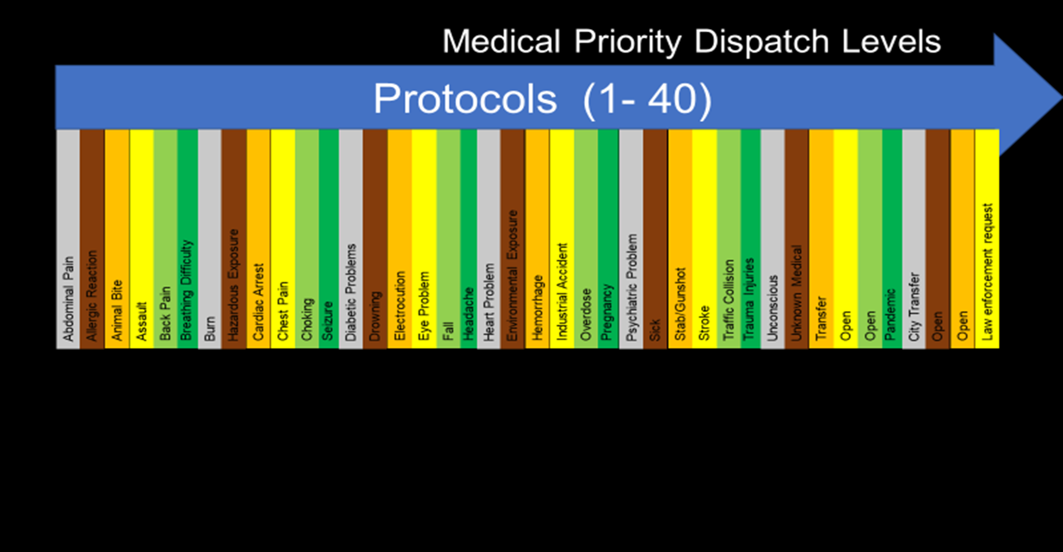
MPDS Protocols
DEFINE
Notes:
Our dispatch system works off a medical priority dispatch system designed to prioritize medical complaints at various levels of severity. These levels range from the lowest severity, Omega, with little to no life threats, to Echo level, where the severity is grave. The City is not a stranger to tiering out responses. It has piloted different studies, implemented other programs, and allowed the ambulance service to respond to lower acuity incidents. Today, Omega and Alpha responses are handled primarily by ambulance provider. The CMED program is designed to take the next layer of Bravo level and some Charlie level determinates. A fire apparatus will still respond on Delta and Echo level emergencies and lower determinates if equipment or safety dictates a fire apparatus response.

Slide 65
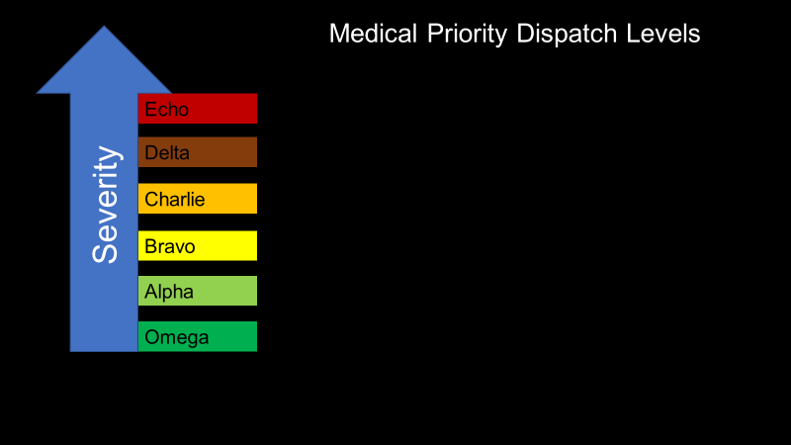
Tiered Response
Time sensitive
Fire apparatus with ambulance
DEFINE
CMED or fire apparatus with ambulance
Primarily ambulance only
Notes:
Our dispatch system works off a medical priority dispatch system designed to prioritize medical complaints at various levels of severity. These levels range from the lowest severity, Omega, with little to no life threats, to Echo level, where the severity is grave. The City is not a stranger to tiering out responses. It has piloted different studies, implemented other programs, and allowed the ambulance service to respond to lower acuity incidents. Today, Omega and Alpha responses are handled primarily by ambulance provider. The CMED program is designed to take the next layer of Bravo level and some Charlie level determinates. A fire apparatus will still respond on Delta and Echo level emergencies and lower determinates if equipment or safety dictates a fire apparatus response.

Slide 66


How does this change what we are doing?
Time Sensitive Critical Illness
Define
Measure
Analysis
Improve
Control
Unstable Vital Signs
DEFINE
ALS Criteria

Slide 67

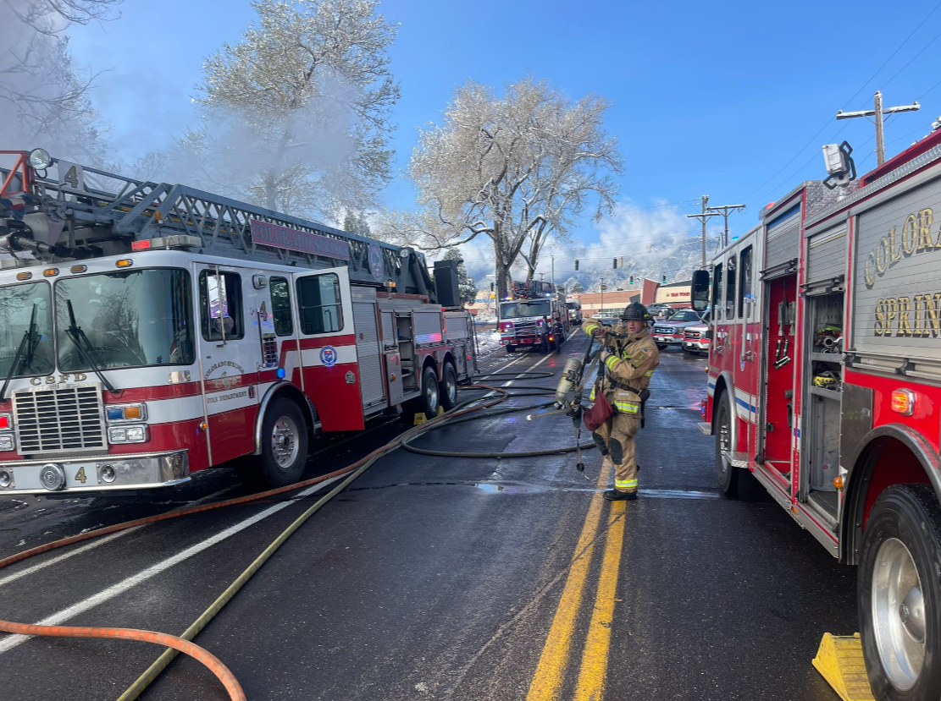
Assisted ventilations
Electrical therapy
CPR
Intraosseous access
Orogastric tube insertion
Vagal maneuver
Cardiac or Respiratory arrest (Except obvious death)
ALS Medications
Measure
Statement: ALS procedures were performed on this alarm. True or False
If yes then True
What percent of
True vs False
Did any of the above occur
ALS
ALS

Slide 68
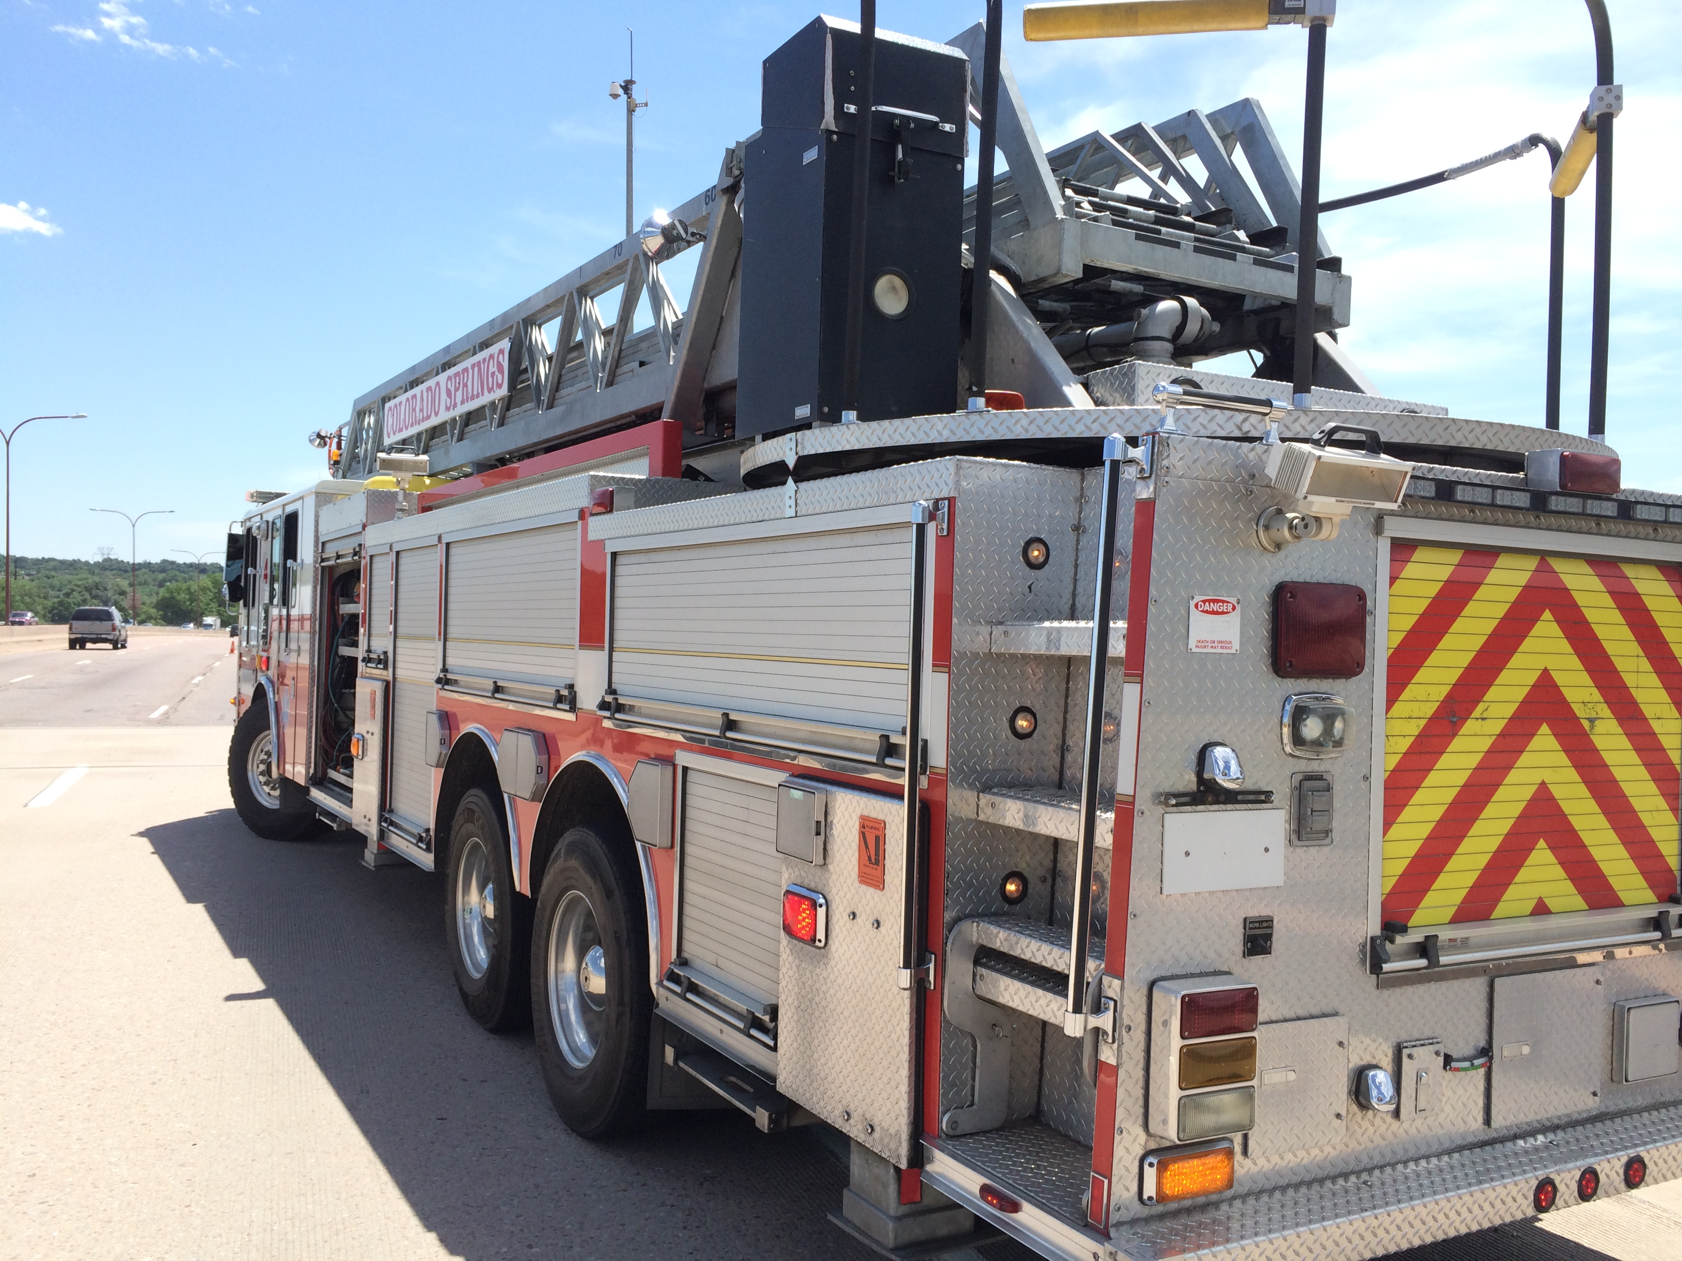
Time Sensitive Critical Illness
Assisted ventilations or airway management
Statement: There was a time sensitive critical incident on the alarm? True or False
If yes then True
What percent of
True vs False
Did any of the above occur
Measure
ALS
ALS
ALS

Slide 69

SAMPLE
ALS
19A2
met ALS in Time Sensitive
ALS
19A2
met BLS in Vital Signs
What would it look like combined
19A2
met BLS in ALS Criteria
ALS
ALS
19A2 = Heart Problems – Chest Pain - age < 35 without other priority systems
ALS in any one of the three triggers an ALS

Slide 70
How the MPDS determinates were decided for CMED
MPDS
Medical Director and CSFD
reviewed each Bravo and Charlie MPDS using data
DEFINE
Two personnel can handle the alarm
Can the response wait in pending screen
Will the CMED apparatus have the needed equipment
Operational
Data Elements
Was BLS or ALS treatment provided
Was the patient transported to the hospital
Reviewing situation found vs situation dispatched
Notes:
The MPDS determinates were reviewed by the Colorado Springs Medical Directors, CSFD executive team, and other stakeholders. The scope was to evaluate Bravo and Charlie level determinates given the following data elements to consider.
Can two people handle the alarm
Can the response be held in a pending screen up to 20 min
Will the CMED apparatus have the needed equipment
Was the care provided BLS or ALS?
Was the patient transported to the hospital?
Reviewing situation found vs. the MPDS determinate
Although a great deal of work has taken place to review these determinates, we will find that these need to be adjusted.

Slide 71
Intent
Time sensitive
Basic
Interventions
(BLS)
Advanced
Interventions
(ALS)
Not Time sensitive
Notes:
Our dispatch system works off a medical priority dispatch system designed to prioritize medical complaints at various levels of severity. These levels range from the lowest severity, Omega, with little to no life threats, to Echo level, where the severity is grave. The City is not a stranger to tiering out responses. It has piloted different studies, implemented other programs, and allowed the ambulance service to respond to lower acuity incidents. Today, Omega and Alpha responses are handled primarily by ambulance provider. The CMED program is designed to take the next layer of Bravo level and some Charlie level determinates. A fire apparatus will still respond on Delta and Echo level emergencies and lower determinates if equipment or safety dictates a fire apparatus response.

Slide 72
Intent
Time sensitive
Basic
Interventions
(BLS)
Advanced
Interventions
(ALS)
5 Min
17A1G
Fall – not dangerous- ground
with deformity
Not Time sensitive
Notes:
Our dispatch system works off a medical priority dispatch system designed to prioritize medical complaints at various levels of severity. These levels range from the lowest severity, Omega, with little to no life threats, to Echo level, where the severity is grave. The City is not a stranger to tiering out responses. It has piloted different studies, implemented other programs, and allowed the ambulance service to respond to lower acuity incidents. Today, Omega and Alpha responses are handled primarily by ambulance provider. The CMED program is designed to take the next layer of Bravo level and some Charlie level determinates. A fire apparatus will still respond on Delta and Echo level emergencies and lower determinates if equipment or safety dictates a fire apparatus response.
Colorado Springs agreed that a 17A1G (Fall – not dangerous on the ground with deformity ) could stay in a pending screen up to 5 min before it was released to a Engine or a Truck to respond. Although the data show the determinate is less time sensitive, pain medication was used therefore, the recommendation was an ALS response.

Slide 73
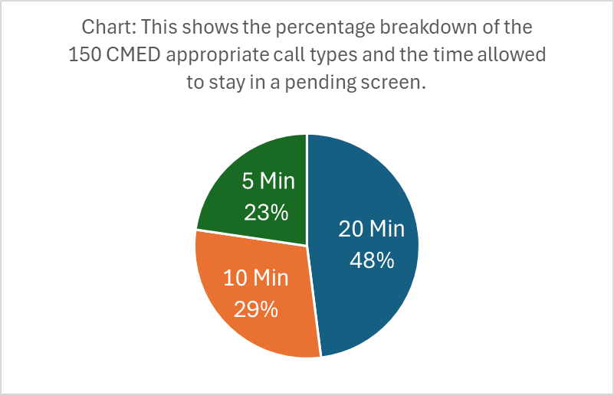
Intent
Time sensitive
Basic
Interventions
(BLS)
Advanced
Interventions
(ALS)
32B2
Unknown problem – Medical Alarm
2A3
Allergies reactions – Asymptomatic
32D1
Unknown Problem Life status questionable
20 Min
Not Time sensitive
Notes:
Our dispatch system works off a medical priority dispatch system designed to prioritize medical complaints at various levels of severity. These levels range from the lowest severity, Omega, with little to no life threats, to Echo level, where the severity is grave. The City is not a stranger to tiering out responses. It has piloted different studies, implemented other programs, and allowed the ambulance service to respond to lower acuity incidents. Today, Omega and Alpha responses are handled primarily by ambulance provider. The CMED program is designed to take the next layer of Bravo level and some Charlie level determinates. A fire apparatus will still respond on Delta and Echo level emergencies and lower determinates if equipment or safety dictates a fire apparatus response.
The 2A3 – data reveals more BLS responses. Whereas the City decided that although the 32 B and D showed more BLS interventions they wanted to error with an ALS response.

Slide 74
33% of the time CMED kept a fire company available for a higher acuity alarm
CMED Impact
Improved fire and ambulance reliability on critical alarms
Availability of resource
Fire companies not responding in other districts
Decreased run order deviations
Analyze
Alignment of right resource to right alarm
30% of the time CMED kept a fire company from responding into another station district
Decreased usage of ambulance resources and decreased emergency responses
Increase availability of ENG/T
Level of resource and response modes
Notes:
Available Resource
The data supports that 33% of the time, when a CMED company responded, a fire company was available to respond to a higher acuity alarm within 30 minutes of the previous alarm.
Decreasing run order deviations
During the same period, 30% of the time, a responding CMED company kept a fire company from responding to another station district, thereby maintaining available resources in their own response area.

Slide 75
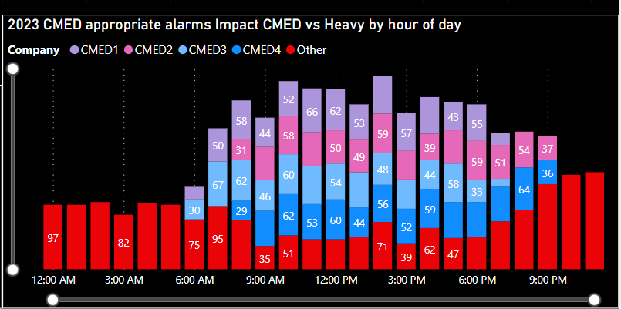
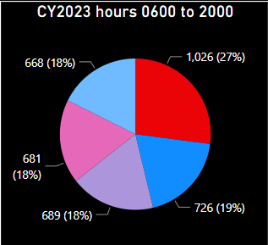
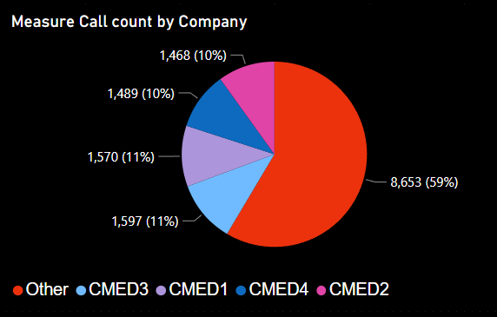
CMED Impact
CMED appropriate alarms in Battalions 1 and 2
Analyze
Increase availability of ENG/T
Notes:
In this slide, you’re looking at the number of CMED-appropriate alarms that occurred within an hour of the day and the type of resource sent. In this sample, CMED only was scheduled during the peak periods 0630 to 2130 hours. The red bars illustrate an Engine or Truck response where the different CMED companies make up the other colors. If CMED was not responding to these alarms, an Engine or a Truck response would occur, removing them. The distribution on the right illustrates the entire 24-hour period, and the distribution on the left is the operational period for the CMED companies. These two pie charts help demonstrate that there is room for growth.

Slide 76
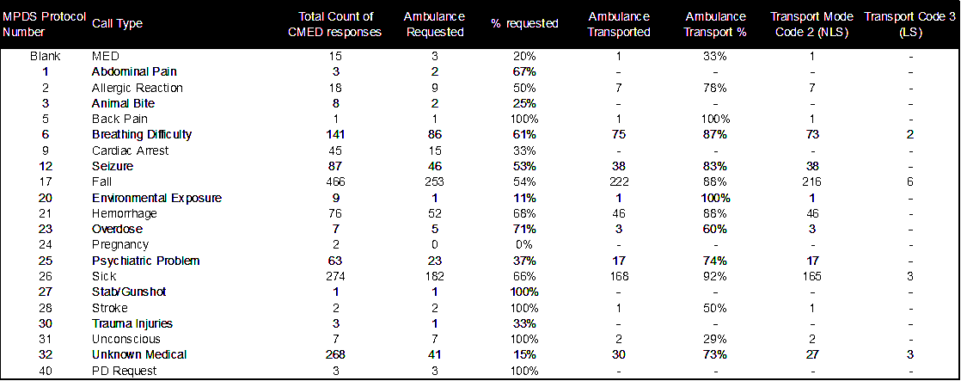
CMED Impact
Table: Sample data 5 month period
Analyze
Notes:
This table illustrates the CMED-appropriate call types individually. The total number of CMED responses by call type in the sample was evaluated based on the number of times an ambulance was requested. Then, the number of times the ambulance transported the patient was compared. Before CMED implementation, all these alarms would have required an ambulance response.

Slide 77
Analysis
MPDS protocol 32
02/11/2024

Slide 78
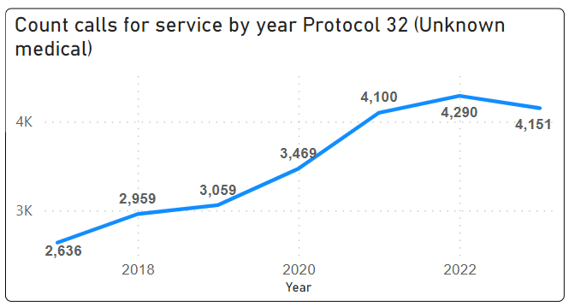
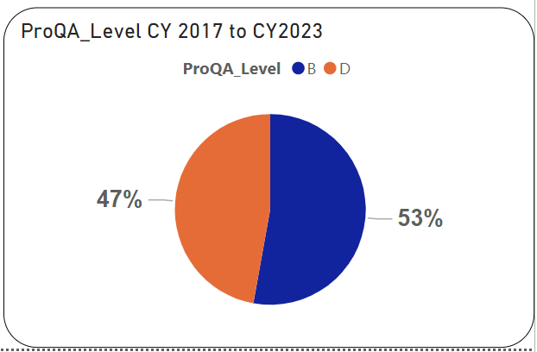





Protocol 32 – Unknown Medical
Males between ages 50 and 60
Upward trend of unknown medical call types
47% of protocol 32 are Delta level
Delta Level is seasonal
When CMED responded they requested an ambulance 13% of the time
Out of 8,441 alarms 31 (0.4%) were transported with lights and siren

Slide 79







Protocol 32 – Unknown Medical Bravo
CMED requested an ambulance 233/1,565 (15% ) of the time
97% of the alarms were within the BLS scope

Slide 80







Protocol 32 – Unknown Medical Delta level
CMED requested an ambulance 158/1,392 (11%) of the time
Out of 4,357 alarms 14 (0.3%) were transported with lights and siren

Slide 81
STAKEHOLDER GROUP
Communications
Determinate review monthly
    Why didn’t the call type match the situation found
    Have we addressed internal communications
    Are changes needed
    Are the timeouts appropriate
Ambulance Service
Community public health
Medical Directors
CSFD Executives
Improve
Control
Firefighters
Notes:
Having a quality improvement process where each segment is evaluated and the information is distributed for additional changes if needed.

Slide 82
Lessons Learned
    Hold to determinate
    Stakeholder involvement important
        Embracing the vision
    Change Management
        Creating the buy-in early (Communications and field)
        Communicate the why and the data
    It takes time to change
    Defining is as equally critical as measuring
    Tactics change
        Embrace change
    Written processes and procedures
Notes:
During the pilot studies of the CMED program, it was determined that waiting until the call determination is finalized before dispatching companies is a must for this program to work effectively. Embracing the program's vision from the stakeholders' executives is essential to trickle down to the staff level. Communicating the why supported with the data at all levels is important. The area where we did not expect to see the initial pushback was the dispatchers, who were accustomed to resources being sent immediately. With this program, they saw medical alarms held in a pending screen. This was addressed by speaking directly with the dispatcher and providing ongoing data analysis of the call types of what the findings were.

Slide 83
What We Found Out
    No patient harm!
    Better availability for faster response to critical calls.
    Huge change in call volume for the Line
      Initially happy
      Then complaining
    Overall employee satisfaction
Notes:
During the pilot studies of the CMED program, it was determined that waiting until the call determination is finalized before dispatching companies is a must for this program to work effectively. Embracing the program's vision from the stakeholders' executives is essential to trickle down to the staff level. Communicating the why supported with the data at all levels is important. The area where we did not expect to see the initial pushback was the dispatchers, who were accustomed to resources being sent immediately. With this program, they saw medical alarms held in a pending screen. This was addressed by speaking directly with the dispatcher and providing ongoing data analysis of the call types of what the findings were.

Slide 84
Thank You
E. Stein Bronsky, MD
Eric.bronsky@coloradosprings.gov
Cell: 719-362-6159

Slide 85
Thank You
E. Stein Bronsky, MD
Eric.bronsky@coloradosprings.gov
Cell: 719-362-6159

