Slide 1
All BLS Ambulances,…in an Urban Center?
…there’s a question?!
David Persse MD FACEP FAEMS
EAGLES Conference
June 2025
KJS 2/5/2019

Slide 2
What is the Goal?
Save Lives
  Immediately Life-Threatening calls are Infrequent (?<5%)
  What do these calls need?
    Rapid Bleeding Control
    Rapid Defibrillation
    Rapid Airway Management
  Complex Medical Calls
Good Customer Service
  Competent, compassionate care.

Slide 3
Paramedics are Needed for:
Rapid Bleeding Control
  …actually, this is a BLS level intervention
Early Defibrillation
  …actually, this is a BLS level intervention
Rapid Airway Management
  …actually, this is a BLS level intervention
  Except for when it isn’t!

Slide 4
Paramedics are Needed for:
Complex Medical Calls
What is needed for Complex Medical Calls?
  Higher Level Training
  Critical Thinking SKILLS
  Experience
    using critical thinking skills

Slide 5
Can A System Maximize Critical Care Skills?
ESO Survey of 2015 data: 71% of EMS encounters resulted in transport
Some large urban centers report 45-55%
  2-20% require ALS
Recent NAEMT Survey of EMS Systems:
49% reported that they have lengthened response time goals
28% reported moving from all ALS to tiered (mix of ALS and BLS) deployment models
23% reported transitioning from dual paramedic to single paramedic deployment.

Slide 6
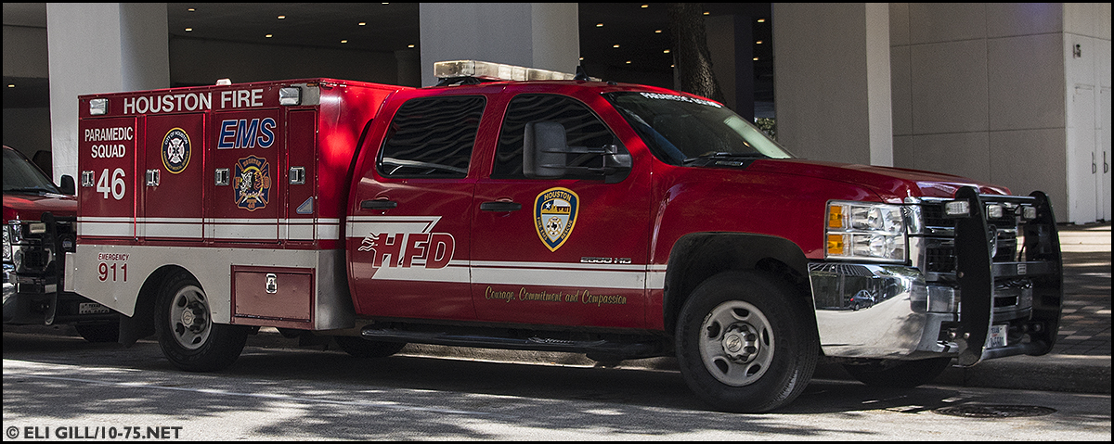
Paramedic Squads in Houston
(PROS)
19.1% reduction in response time to all calls
3-minute reduction in response time to CPR cases
30% increase in patients found in VF
Reduced Paramedic Attrition Rate.

Slide 7
Paramedic Squads in Houston
(CONS)
Need More EMTs to Staff BLS Units
Need to Purchase Squad Vehicles.

Slide 8
Paramedic Squads w All BLS Transport System in Houston
DISCLAIMER:
  HFD had never had a fully implemented squad program!
    Fire Chief #1
    Fire Chief #2
    Fire Chief #3
    Fire Chief #4
  2024: 332,000 EMS incidents (910/d avg.)
  87 Engines
  37 Ladders/Towers
  56 BLS Ambulances
  36 ALS Ambulances
  12 Paramedic Squads.

Slide 12
Thank You!

